Slide 1
Tumors of the Larynx
Benign | Epithelial | Papilloma
 | Connective tissue | Angioma
 |  | Fibroma Chondroma
Malignant | Epithelial | Squamous cell carcinoma
 | Connective tissue | Sarcoma
 |  | Lymphoma

Slide 2
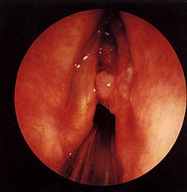
Carcinoma of the Larynx
The larynx is the most common site for carcinoma in the upper aero digestive tract occurring most often in men between 50-70 years of age.
Histology:
Microscopically 85-95% of laryngeal
tumors are squamous cell
carcinoma

Slide 3
Etiology
Heavy smoking and alcoholism.
Cigarette smoke contains hydrocarbons which are carcinogenic.
Combination of alcohol and smoking increases the risk 15 folds compared to each factor alone (2-3 folds).
Radiation exposure.
Asbestos, mustard gas exposure.
GERD.
Human papilloma virus.

Slide 4
Classification

Slide 5
Supraglottis:
It includes the epiglottis, aryepiglottic folds, arytenoids, false cords and the ventricles.
The supraglottis has a rich lymphatic drainage and a high proportion of these tumors spread to upper and middle jugular lymph nodes.
Hoarseness of voice is a late symptom, therefore these tumors often diagnosed late and carries a bad prognosis.

Slide 6
Glottis:
Vocal cords and the anterior and posterior commissures. The vocal cords have no lymphatic drainage and hoarseness of voice is an early symptom, therefore these tumors have an excellent prognosis.

Slide 7
Subglottis:
Up to lower border of cricoid cartilage. It is the rarest region to be affected. Lymphatic mertastasis go to prelaryngeal, paratracheal and lower jugular lymph nodes.
Hoarseness of voice is a late symptom and the patient may initially presents with stridor.
The prognosis is poorer than carcinoma of the glottis and supraglottis.

Slide 8
TNM classification and staging
Laryngeal carcinoma is classified according to the TNM staging system:
T1: Tumuor is limited to one region.
T2: Tumuor affecting two adjacent regions.
T3: Fixation of the vocal cord.
T4: Tumour outside the larynx.

Slide 9
Staging- Nodes
N0 | No cervical lymph nodes positive
N1 | Single ipsilateral lymph node ≤ 3cm
N2a | Single ipsilateral node > 3cm and ≤6cm
N2b | Multiple ipsilateral lymph nodes, each ≤ 6cm
N2c | Bilateral or contralateral lymph nodes, each ≤6cm
N3 | Single or multiple lymph nodes > 6cm

Slide 10
Staging- Metastasis
M0 | No distant metastases
M1 | Distant metastases present
TNM classification and staging helps to determine:
The extent, the treatment modality and the prognosis.

Slide 11
Clinical Picture
Hoarseness of voice: Any patient with hoarseness of voice for more than 3 weeks without improvement, laryngoscopy is indicated.
Dyspnea and stridor.
Referred otalgia: Is a late symptom seen in mainly in supraglottic lesions.
Dysphagia: Late symptom, indicating invasion of the pharynx and commonly seen in supraglottic lesions.
Swelling of the neck: It may reflect direct penetration of the tumor outside the larynx or secondary lymphatic metastases.

Slide 12
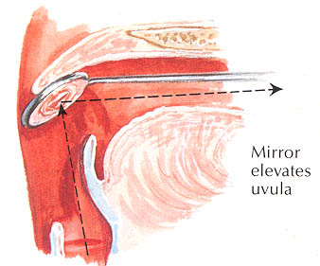
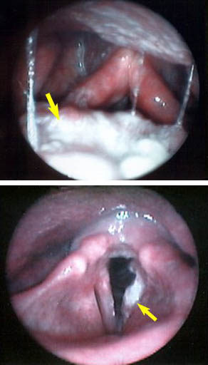
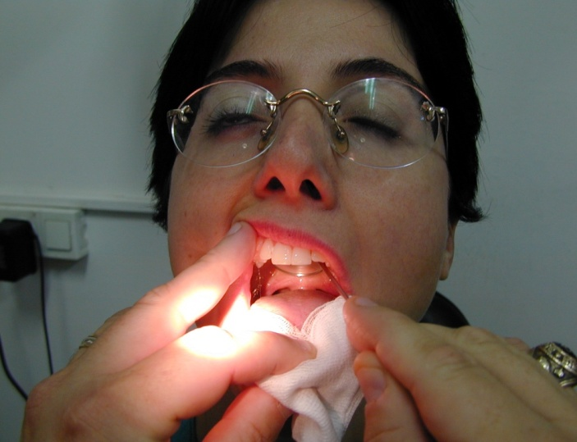
Examination
Indirect laryngoscopy for the shape, color and mobility of vocal cords.
Fiberoptic endoscopy.
Examination of the neck for the shape of the larynx and lymph nodes.

Slide 13
Any patient with hoarseness of two weeks duration or longer must undergo visualization of the vocal cords.

Slide 14
Investigations
Radiography
1 -Chest X-ray for pulmonary metastasis or mediastinal lymphnodes.
2 -CT scan and MRI assist in delineating the lesion.
Direct laryngoscopy and biopsy to prove the diagnosis

Slide 15
Spread of Laryngeal carcinoma
Direct spread from one region to another and spread outside the larynx.
Lymphatic spread: common in supraglottic lesions and rare in glottic tumors.
Metastasis takes place to level (II-IV) lymph nodes or to paratracheal lymph nodes in subglottic tumors.
Distant metastases: mostly to the lung.

Slide 16
Treatment
Carcinoma in situ: Transoral CO2 LASER.
- Early cancers T1 and T2 lesions are usually treated with either primary radiation or surgical excision. Both offer the 85-95% cure rate.
Radiotherapy has the advantage of preserving voice and it is indicated for small tumors with no cervical lymph nodes. Evidence of poor response to DXT or recurrence is an indication for suregry.
Surgery by LASER or partial laryngectomy.
Surgery has a shorter treatment period, saves radiation for recurrence, but may have worse voice outcomes.

Slide 17
Advanced laryngeal cancers (T3-T4) are often handled by multimodality therapy. Surgery with postoperative radiation.
Surgery is usually: total laryngectomy±Neck dissection if nodes are palpable.
Organ preservation therapy by induction Chemotherapy followed by radiotherapy.

Slide 19
Voice rehabilitation after total laryngectomy
Oesophageal speech.
Artificial larynx.
Tracheoesophageal valve.

Slide 20
Electrolarynx

Slide 21
Tracheo-oesophageal speech

Slide 22
Prognosis
5 year survival
Stage I | >95%
Stage II | 85-90%
Stage III | 70-80%
Stage IV | 50-60%

Slide 23
Tracheostomy
Surgical anatomy of the trachea
The trachea is a fibromuscular tube supported by 20 hyaline cartilages which are opened posteriorly.
The soft tissue posterior wall is in contact with the oesophagus.
About 7-8 cartilaginous rings constitute the cervical portion.
Neck extension draws more rings to the cervical portion

Slide 24
The trachea begins at the 6th cervical vertebra.
The trachea is more superficial at its upper end, it became deeper as it passes downward and backward so that at the manuberum it is one inch from surface.
In adults it is 12-16 cm long and 13-16 mm wide in women and 16-20 mm wide in men.
It is slightly to the right of the midline and divides at the carina into the right and left bronchi.
The carina lies under the junction of the sternum at the level of the 4th thoracic vertebra

Slide 25
MANAGEMENT OF THE OBSTRUCTED AIRWAY
I. Laryngotomy (Cricothyroidotomy)
An opening through the cricothyroid membrane.
Indications
Sudden laryngeal obstruction when intubation is impossible and facilities for tracheostomy are not available.
Technique
It is performed without anaesthesia by transverse incision to open the cricothyroid membrane.
An elective tracheostomy is performed within a few hours if the obstruction is still present.
Complications
Haemorrhage.
Surgical emphysema.
Laryngeal stenosis

Slide 27
Tracheostomy
The creation of surgical opening into the trachea and converting it into a stoma on the skin surface.
Types
1- Emergency tracheostomy: Its usually done under local anaesthesia in conditions such as acute respiratory failure, or large laryngeal tumor presenting with stridor.
2- Elective temporary tracheostomy: This is performed as planned procedure, usually under GA.
3- Permanent tracheostomy: The trachea is brought to the surface as a permanent mouth to the respiratory tract as following total laryngectomy.

Slide 28
Indications
I. Emergency
Relief of upper airway obstruction.
Congenital, Inflammatory lesions, Laryngeal tumors, Impacted F.B., Trauma, and Bilateral abductor paralysis.
Signs of upper airway obstruction
Accessory Muscle use, Pallor, diaphoresis, restlessness, Tachycardia, Cyanosis and altered conscious state, Intercostal recession, Nasal Flaring, Exhaustion
Bradycardia – most dangerous sign
2. Respiratory insufficiency: severe head and chest injuries, drug intoxication.
Tracheostomy aids respiration by:
a-Reduction of the dead space.
b-Reducing resistance to airflow.
c. The ability to use mechanical ventilator.
3. Respiratory difficulty due to secretions (bronchial toilet): coma, CVA and neurological lesions.
II. Elective: in cases of major head and neck surgery to maintain the airway and to protect it against hemorrhage.

Slide 29
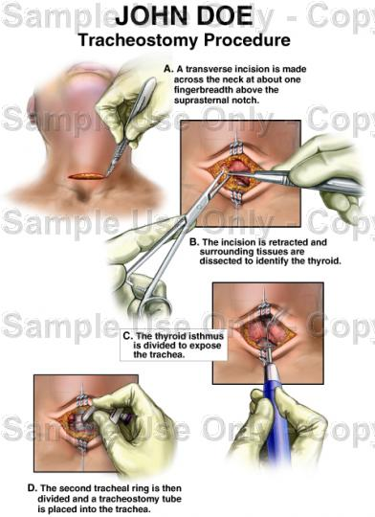

Slide 30
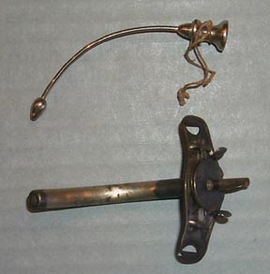
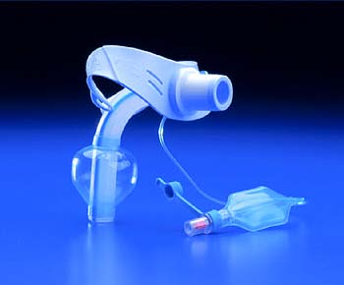

Slide 31
Postoperative Management
Nursing: constant attention is essential for the first 24 hours. The patient should have a paper to write and a bell to get assistance.
Care of the tube:
Frequent tube suctioning and humidification of inspired air to prevent blockage.
The safest way is to stitch it to the skin with a silk to prevent tube slippage.
If cuffed tube is used, it should be periodically deflated to prevent pressure necrosis of the trachea.
The first tube change can be done 3-4 days after surgery when the tract is fully formed.

Slide 32
Complications
1- Haemorrhage.
2- Aprea: a result from sudden discharge of CO2 and the obstruction has been bypassed. It is managed by allowing the patient to breath a mixture of 95% O₂ and 5% CO₂.
3. Displacement of the tracheostomy tube caused by: Thick neck. Short tracheostomy tube. Postoperative oedema and haemorrhage causing broadening of the distance between the skin surface and the anterior tracheal wall.
4. Obstruction of the tracheostomy tube: this occurs if there is lack of humidification or poor toilet. It is treated by changing the tube.
5. Surgical emphysema: Too tight suturing of the wound. Small tracheostomy tube. Patient on positive pressure ventilation.
6. Pneumothorax: Due to injury to apical pleura. It is common in children and in low tracheostomy procedures.
7. Infection: wound, Chest
8. Subglottic stenois: especially if the cricoid cartilage is injured.

Slide 33
PARALYSIS OF THE LARYNX
I. Organic
Central lesions: since the larynx is presented on both sides of the cortex, it requires bilateral symmetrical lesions to produce laryngeal paralysis. e.g. C.V.A., intracranial tumors and bulbar palsy.
Peripheral lesions
Congenital: Second most common cause of stridor in infants.
Tumours: carcinoma of the lung, oesophagus, larynx, hypopharynx and mediastinal metastasis.
Trauma: surgical trauma of thyroidectomy and chest surgery. The left R.L.N. being more affected by tumours and trauma than the right owing to its longer course.
Neurological lesions: C.V.A, multiple sclerosis and head injury.
Inflammatory lesions: Pulmonary or mediastinal T.B. and diphtheria toxins.
Idiopathic: no cause could be found although infectious mononucleosis and influenza viruses have been suggested as aetiological agents.
II. Functional:
Occurs in emotionally unstable individuals, particularly in young women.

Slide 34
Investigations
History.
Examination: mirror or rigid laryngoscopy, fiberoptic exam is important to visualize larynx in normal anatomic state.
Examination also includes postnasal space, neck and chest.
Imaging studies:
1. Chest X-ray.
2. CT scan of skull base, neck and thorax down to aortic arch.
3. MRI of brain.
Sputum analysis for cytology.
Fasting glucose, ESR and viral titres.
Panendoscopy including oesophagoscopy and bronchoscopy.

Slide 35
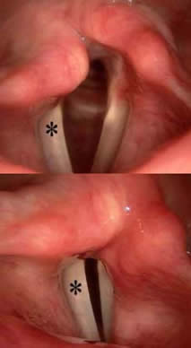
Management
Main strategies:
Treat the cause.
Observation for 6-12 months after injury.
Speech &/or swallow therapy
Early surgical intervention
Temporary – augmentation with filler.
Permanent – medialization surgery.
Abductor paralysis: unilateral or bilateral.
Adductor paralysis: unilateral or bilateral.

Slide 36
Unilateral Abductor Paralysis
Position: The paralyzed cord lies near the midline (paramedian position).
Aetiology: The most common cause is damage to the R.L.N. by:
Left bronchogenic carcinoma, aortic aneurysm and cardiac surgery.
Surgical trauma of thyroidectomy.
Clinically: the voice and respiration remain near normal and the condition may be unsuspected.
Treatment
Treat the cause: if it is occurred after thyroidectomy, then the neck should be urgently explored and any ligature involving the R.L.N. should be removed.
Speech therapy: the voice problem is minimal and the other cord usually compensates by speech therapy.

Slide 37
Unilateral Adductor Paralysis
Position: the paralyzed cord lies in lateral position.
Aetiology: It is the result of damage to the vagus or both the superior and R.L.N.
1. Thyroid surgery is the most common cause.
2. Rarely, lesions of medulla, posterior cranial fossa and jugular foramen can cause it.
Clinically: the patient will be aphonic at the onset, but later the opposite cord will cross the midline and the voice will begin to return. Respiration is normal but aspiration of food and saliva can occur.
Treatment: 1. Treat the cause.
2. Speech therapy.
3. If there is no compensation after 6-12 months teflon paste injection in the paralyzed cord.

Slide 38
Bilateral Abductor Paralysis
Position: Both cords lie near the midline (paramedian).
Aetiology: It is most often caused by
Damage to both R.L.N. at thyroidectomy, for this all thyroid surgery should be preceded by laryngoscopy.
It is also seen as a complication of postcricoid cancer and carcinoma of the cervical oesophagus.
Clinically: the quality of voice is good but sooner or later every patient will have stridor.
Treatment
Sudden onset → Intubation or tracheostomy and urgent exploration of the neck is indicated in thyroidectomy.
less urgent cases: Observation.
The final decision for treatment is taken after 6-12 months because compensation is possible at this period. If no improvement:
Permanent tracheostomy with a speaking valve.
Arytenoidectomy and/or cordectomy

Slide 39
Bilateral Adductor Paralysis
Position: Both cords lie in lateral position.
Aetiology: It is commonly functional and most frequently encountered in hysterical females.
Clinically: the voice is weak and the patient uses a whisper. The most important single diagnostic feature is when the patient is asked to cough, there is good adduction of the cords.
Treatment: Psychotherapy and speech therapy.

