Slide 1
Principles of teeth extraction

Slide 2
Methods of tooth Extraction:
There are 2 basic methods of tooth removal:
Simple tooth extraction and surgical extraction
The simple extraction is suitable for the majority of erupted teeth, using forceps and elevators. It relies on the ability to gain sufficient grip on the root of the tooth by forcing the blade of the instrument into the periodontal space between the root & the alveolar bone

Slide 3
Using the simple method, the approach to the root is solely from inside the tooth socket within the alveolar bone ‘intra-alveolar extraction’

Slide 4
The surgical extraction indicated for those roots that cannot be approached & gripped using the forceps technique or when the roots defy all efforts to deliver from the bone despite application of the forceps.
In these cases, bone must be removed from around the roots by dissection through the alveolus after the overlying soft tissues have been reflected as a mucoperiosteal flap .
This approach is therefore ‘transalveolar’, but is more commonly called ‘the surgical method’

Slide 5
Extraction with dental forceps
The patient is seated comfortably in the chair with the head-rest adjusted to fit the back of the neck and support the head.
After adjusting the chair to the proper height ,fitting an apron around the patients neck , and inspecting the tooth to be extracted, the instrument required for the extraction are selected, and placed in a sterile dish at the side of the patient ,but out of his line of vision.

Slide 6
General arrengment
A good extraction technique entails two fundamental requirements :
1- adequate access to the tooth.
2- use of controlled force to luxate and deliver the tooth.

Slide 7
Adequate access
Adequate access to the tooth is facilitated by the proper positioning of the clinician and the patient.
1-For the greatest mechanical advantage , it is best if the clinician is standing for all extractions.
2- The non dominant hand ( the hand which not hold the extraction instrument) should be used to retract the lips and tongue , with fingers on either side of the alveolus , and to support the jaw.

Slide 8
Adequate access 1- light
Good illumination of the operative field is an absolute essential for the successful teeth extraction . Inadequate light is the main reason for the failure of a number of attempts at extraction.

Slide 9
Adequate access :2- Position of the dentist
Stand behind the patient (10-11 o'clock ) for extractions in the right lower posterior teeth, and in front of the patient (7-8 o'clock ) for all other extractions.

Slide 10
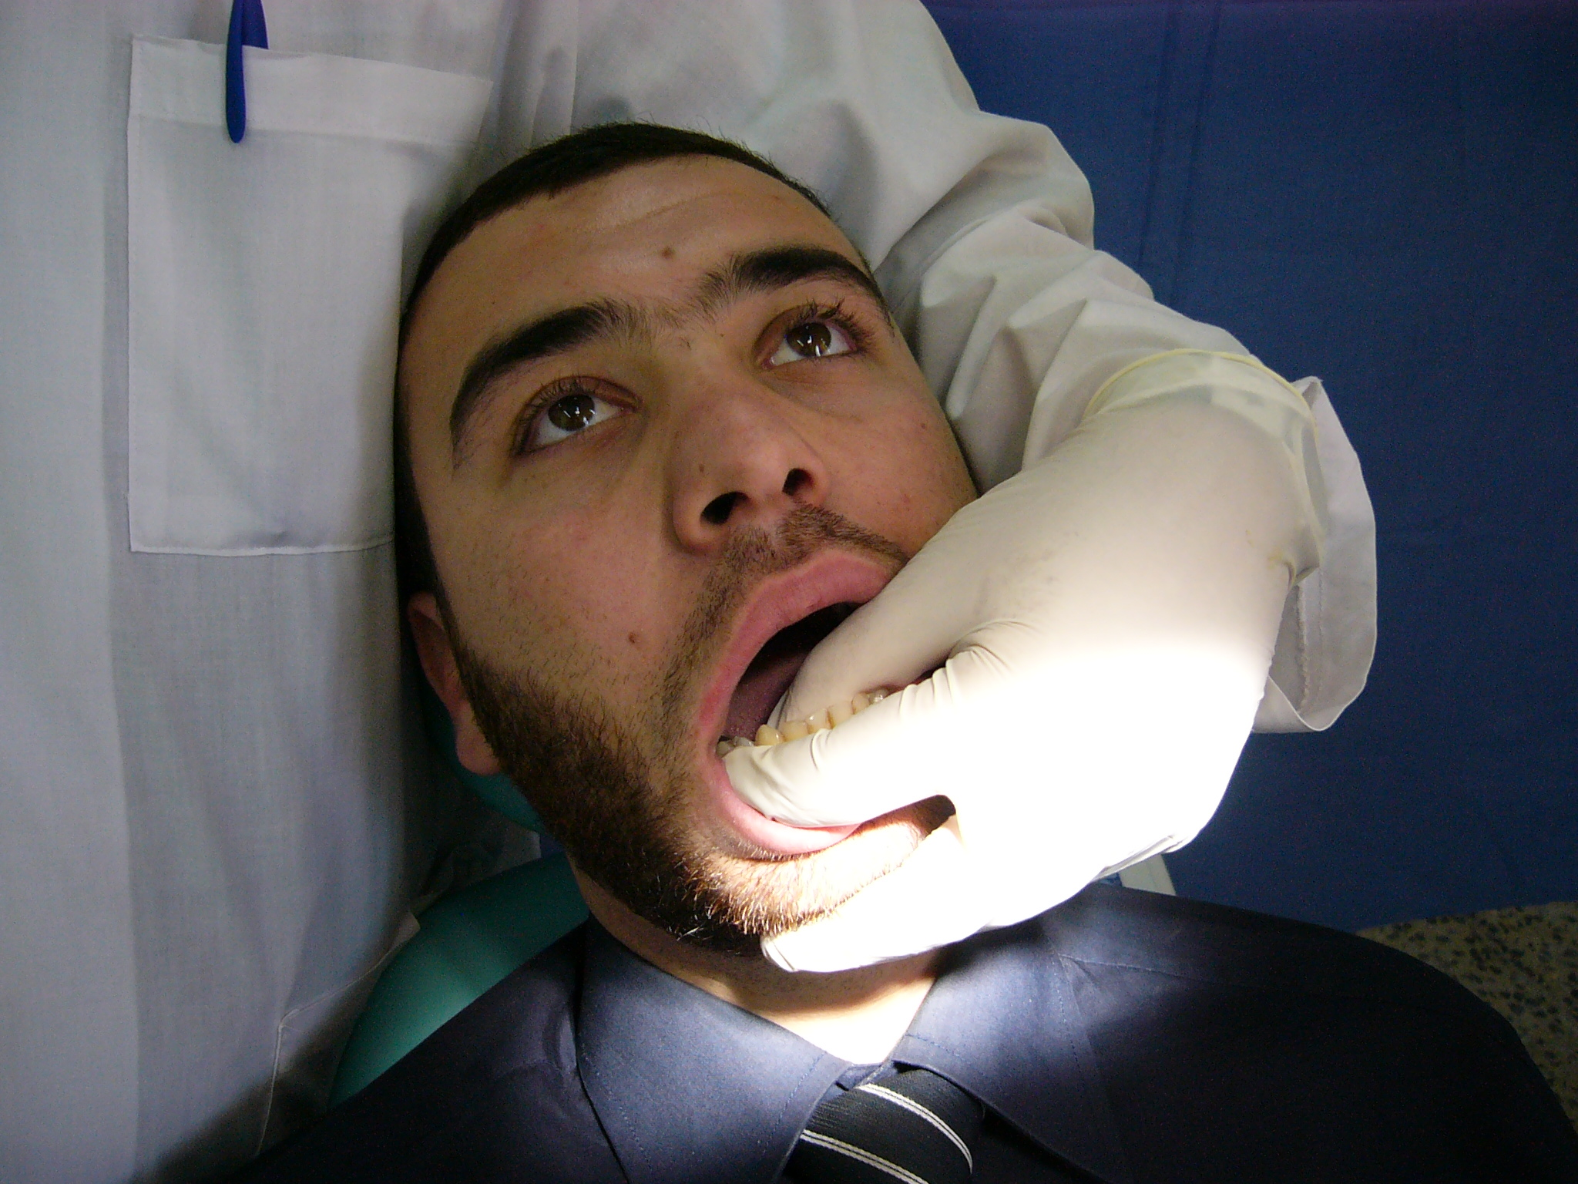

Slide 11
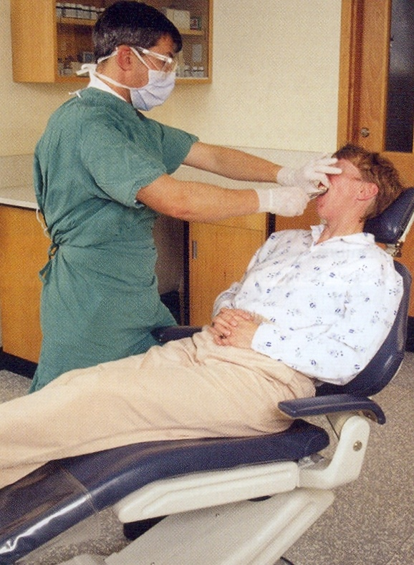

Slide 12
Adequate access 3- HEIGHT OF THE DENTAL CHAIR
If the site of the extraction is either too height or too low in relation to the operator, he works at a mechanically tiring and uncomfortable position.
When a maxillary tooth is being extracted, the chair should be adjusted so that the site of the extraction is between the shoulder level of the operator and his elbow.

Slide 13
During the extraction of a mandibular tooth the chair height should be adjusted so that the tooth to be extracted is slightly below the level of the operator elbow.
The lower occlusal plane should be parallel to the floor.

Slide 14
Using the non dominant hand
Jaw support by the non dominant hand is essential for all extractions.

Slide 15
1- Support of the mandible during tooth extraction
- Lessen the discomfort of the patient .
- Facilitate the extraction
- Prevent dislocation of the TMJ.

Slide 16
During extraction of upper teeth
use the finger to retract the lips and cheeks when extracting maxillary teeth.

Slide 17
use fingers to support the lower border of the mandible while the thumb retracts and protects the tongue when extracting teeth in the mandibular right quadrant

Slide 18
Use the thumb to support the chin when extracting teeth in mandibular left quadrant.

Slide 19
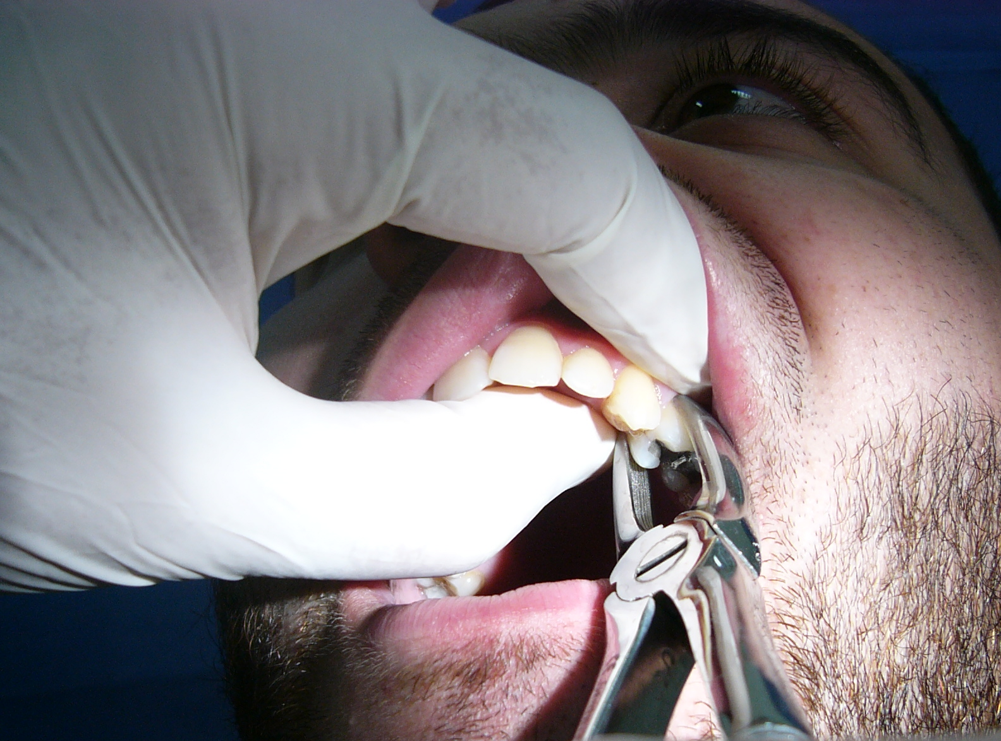

Slide 20
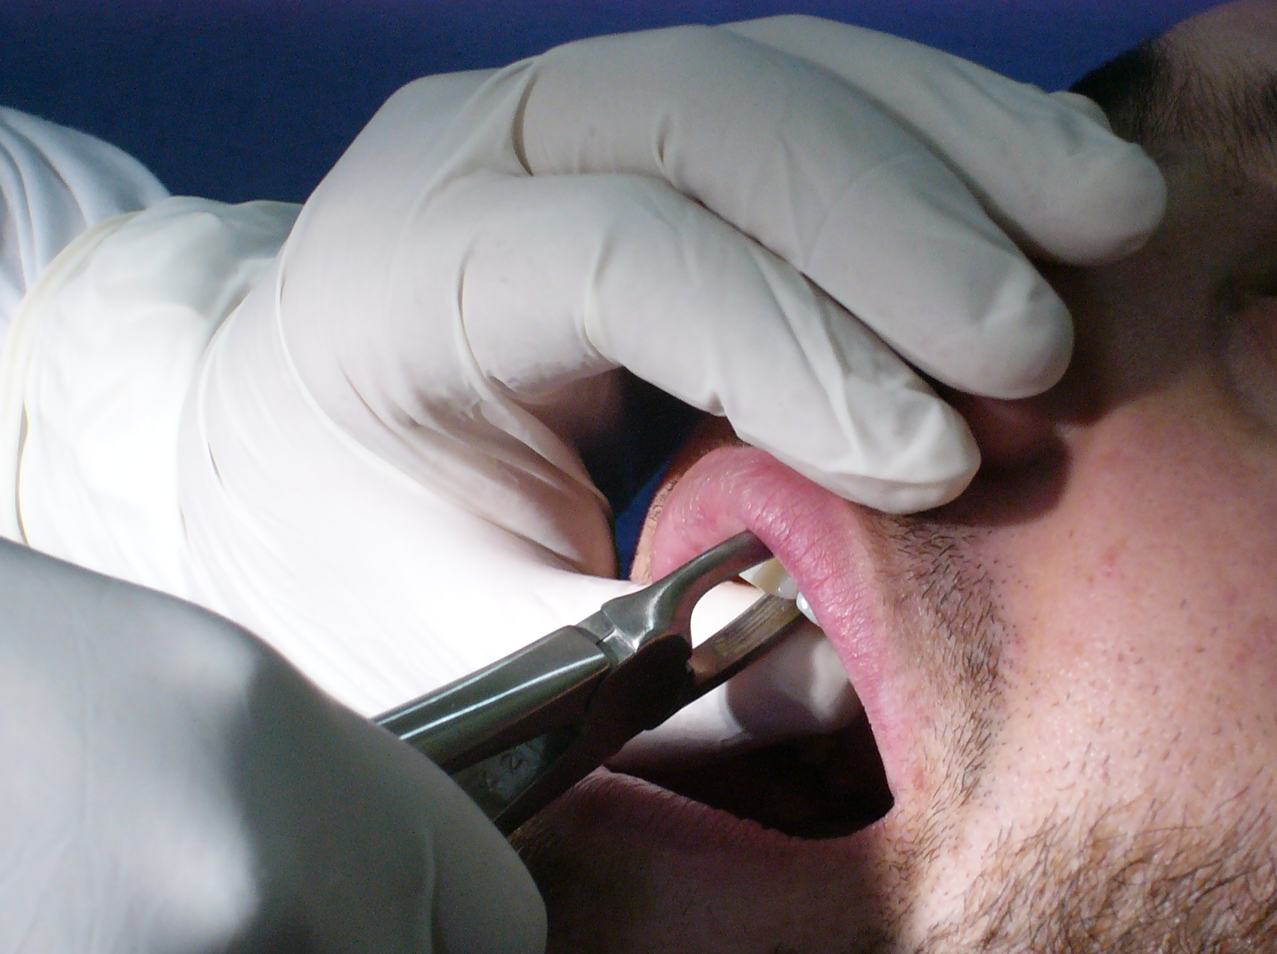
X

Slide 21
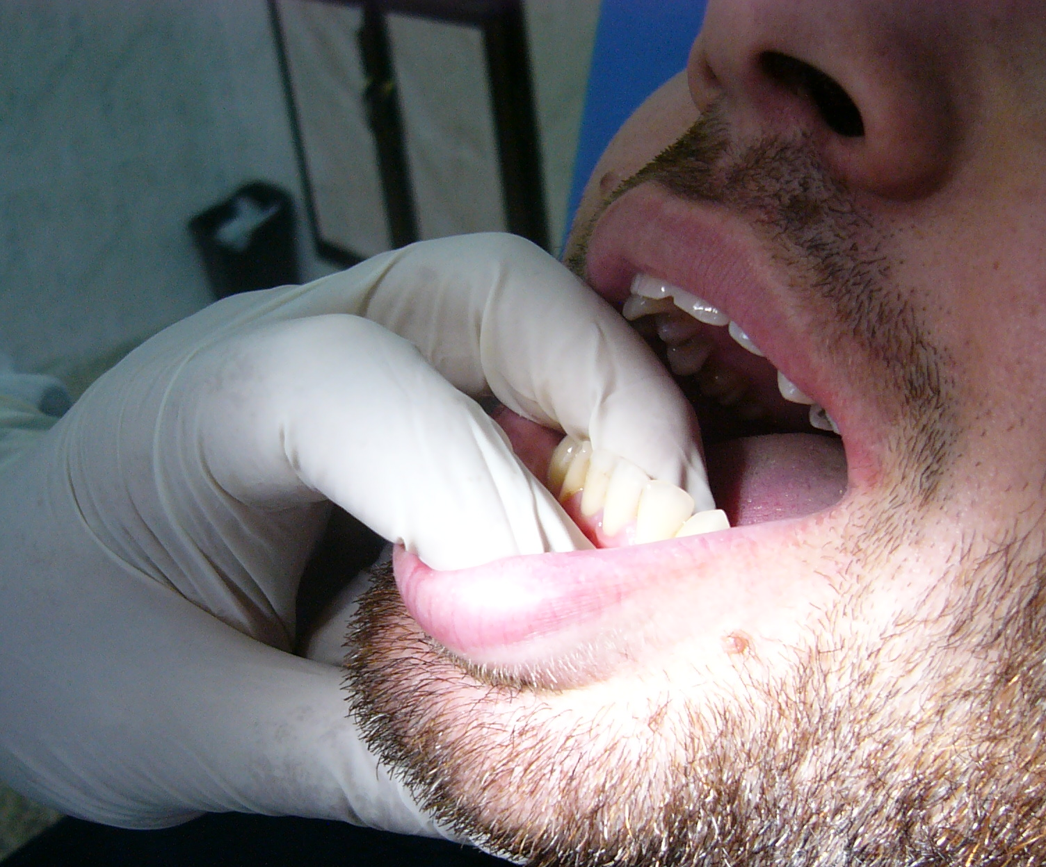

Slide 22
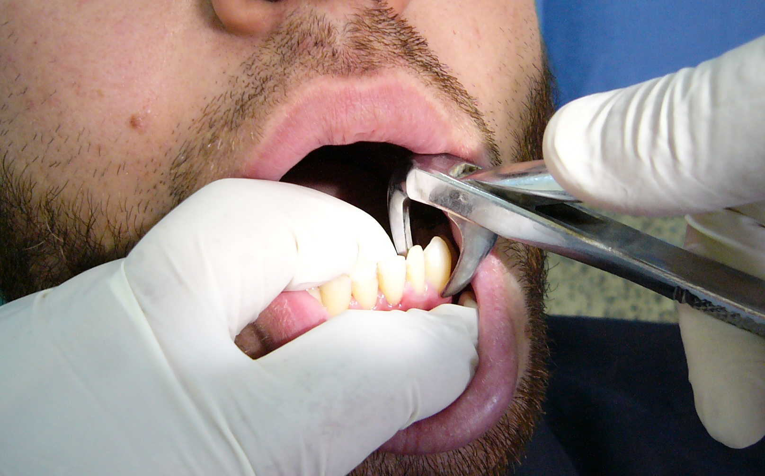

Slide 24
Sequencing extractions
1- When both maxillary and mandibular teeth are to be removed at the same appointment, the maxillary teeth are removed first . This aids in avoiding blood and debris from contaminating the mandibular surgical site.
2- When extracting teeth in the same quadrant, it is more efficient to extract the most posterior tooth first.

Slide 25
Used of controlled force
The successful removal of teeth with forceps relies largely on the proper use of controlled force. Excessive force can lead to fracture of the crown and hence increase the operating time and surgical morbidity for the patient.

Slide 27
Use of the controlled force
The pressure should be firm , smoothed ,and controlled .
Wrist movements play an essential but lesser part during forceps extraction.

Slide 28
Hurry is the enemy of dentistry.
The dental surgeon should attempt to acquire a quite, efficient, unhurried, and methodical approach in his work.

Slide 29
The correct grasping of the forceps
The position of the thumb just below the joint of the forceps, and position of the forceps handle in the palm of the hand, give the operator a firm grip on , and fine control over the forceps.
The little finger is placed inside the handle and used to control the opening of the forceps blades during their application to the root mass. When the tooth is gripped the little finger is placed out side the handle.

Slide 31
During tooth extraction it is a good practice to apply the forceps blade to the less accessible side of the tooth first under direct vision and then apply the other blade.
If either the buccal or lingual surface of the tooth is destroyed by cervical caries the appropriate blade should be applied to the carious side first , and the first movement towards the caries.

Slide 33
BASIC STEPS OF FORCEPS EXTRACTION
Simple forceps extractions involve the following four basic steps:
1-grasping of the tooth: use the beaks of the forceps to grasp the root trunk 1-2 mm beyond the cementoenamel junction.
2- expansion of the bony socket.
3-mobilization of the tooth.
4-delivery of the complete and intact tooth.

Slide 34
The following basic forces are used to expand the socket and mobilize the tooth.
1.Apical force to break the periodontal ligament.
2.Buccal force to expand the buccal plate of bone.
3.Lingual force to expand the lingual crest of bone.
4. Rotational force, resulting in overall expansion of the tooth socket.
5. Traction force to deliver the tooth.
Always commence with apical pressure and end with traction force to deliver the tooth.

Slide 35
Post extraction care
1-When the tooth has been extracted the socket should be inspected and any loose fragments of bone removed.
2- The socket should be squeezed in order to reduce any distortion of the supporting tissues and minute fracture in the cortical bone.
3- The patient instructed to bite firmly upon a gauze pack until a firm blood clot is present in the socket.

Slide 36
A suitable analgesic should be prescribed for use as required .
The patient should be instructed to avoid vigorous mouth washes for the rest of the day to minimize the risk of post-extraction hemorrhage.
Healing may be aided by the use of hot saline mouth wash frequently during the following 2-3 days.

Slide 37
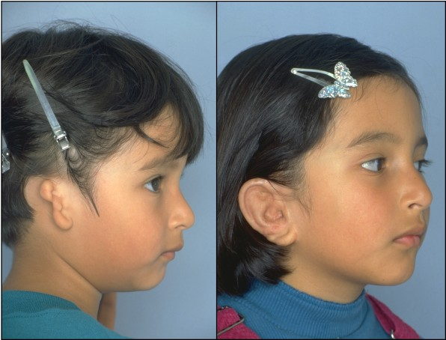

Slide 38
