Slide 1
AUDITORY FUNCTION

Slide 2
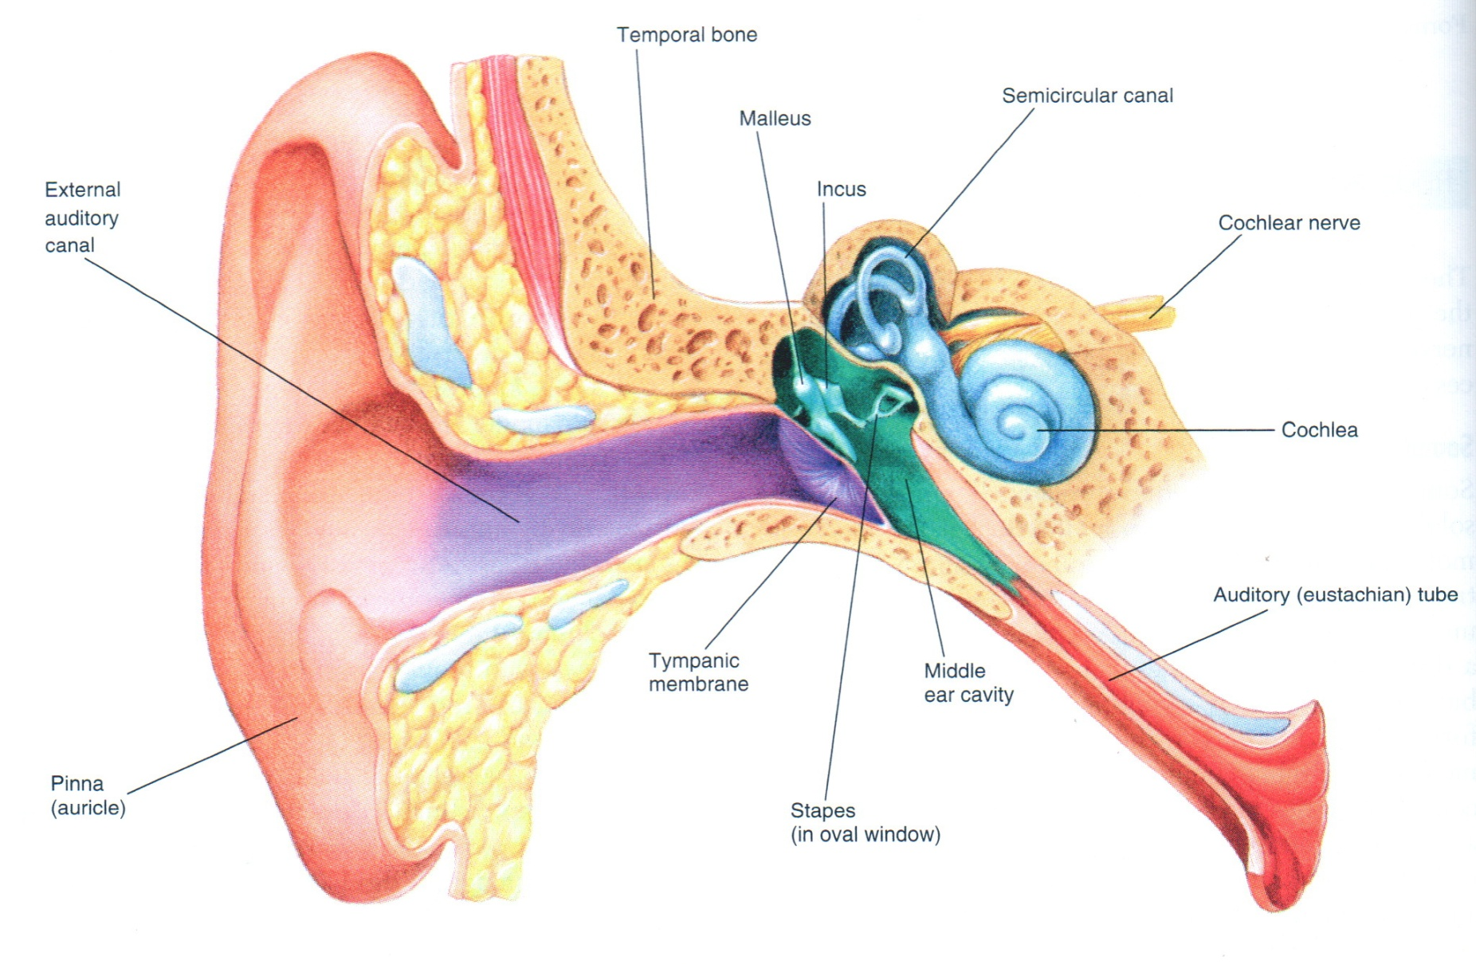

Slide 3
Audition results from sound conduction by either air or bones of the skull or both. Sound waves are converted (mechanically in the middle ear), into movement of the endolymph of the inner ear. This movement causes vibration of the basilar membrane that in turn stimulates the hair cells (hearing receptors).

Slide 4
Deafness :impairment of hearing is two type:
1.Conductive deafness: impairment of the physical structures that conduct the sound itself into cochlea is destroyed (ext.aud.meatus ,tem.memb., middle ear cavity , ossicles ).
2.Sensorineural deafness: impairment of cochlea or the auditory nerve.
if either the cochlea or the auditory nerve is completely destroyed, the person is permanently deaf.

Slide 5
Objectives
To examine and compare air and bone conduction of the subject .

Slide 6
Subject and instruments
1-Vibrating tuning fork ( 256 and 512 Hz).
2-Volunteers from students .

Slide 7
Procedures :
1-Rinne’s test
2-Weber’s test
3- Schwabach’s test

Slide 8
1-Rinne’s test : Base of vibrating tuning fork placed on mastoid process until subject no longer hears it then held in air next ear .
Normally : The subject hears vibrating of the tuning fork in air after bone conduction is over(air conduction > bone conduction) .
In conductive deafness : (one ear) : patient does not hear vibration in air after bone conduction is over .
In nerve deafness : (one ear), patient hears vibration in air after bone conduction is over .
After doing the Rinne test on one ear of the volunteer, repeat the test on the other ear and compare your results .

Slide 9
2-Weber’s test :
The base of vibrating tuning fork is placed on vertex of skull .
Normally : Subject hears equally on both sides
In conductive deafness : (one ear) : The sound of the vibrating tuning fork is louder in diseased ear because masking effect of environmental noise is absent on diseased side .

Slide 10
In nerve deafness : (one ear), sound louder in normal ear
The Weber’s test is said to be positive when the sound appears louder
in one ear than in the other when both ears are unblocked

Slide 11
3- Schwabach’s test : In this test we compare bone conduction of the
patient with that of a normal subject
In conductive deafness: bone conduction is better than in normal subject .
In nerve deafness: bone conduction is less than normal

Slide 12
AUDIOMETRY
This is an instrument used to determine the hearing threshold and hearing disabilities .
The subject uses earphone connected to an electronic oscillator capable of emitting pure tones ranging from low frequencies to high frequencies .

Slide 13
The instrument is calibrated so that the zero intensity level of sound at each frequency is the loudness that can barely be heard by the normal person.
However a calibrated volume control can increase or decrease the loudness of each tone above or below the zero level.
When the loudness of the tone need to be increased to 30 decibel (dB) above normal before it can be heard the person is said to have a hearing loss of 30 dB..

Slide 14
In performing a hearing test using an audiometer , we can test approximately 8-10 frequencies . Then the so called audiogram is plotted The audiometer in addition to be equipped with ear phone for testing air conduction, is also equipped with an electronic vibrator for testing bone conduction from the mastoid process into the cochlea.

Slide 15
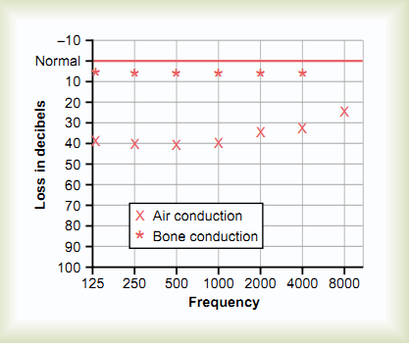
Audiogram of air conduction deafness resulting from middle ear sclerosis.

Slide 16
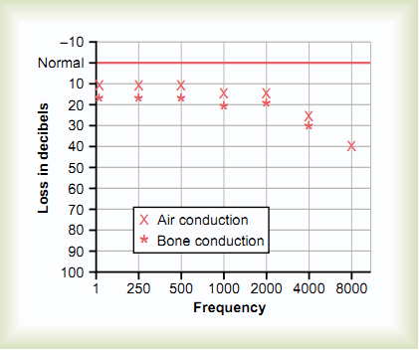
Audiogram of the old-age type of nerve deafness.

Slide 17
Thanks

