Slide 1
بسم الله الرحمن الرحيم

Slide 2
Minor Connectors

Slide 3
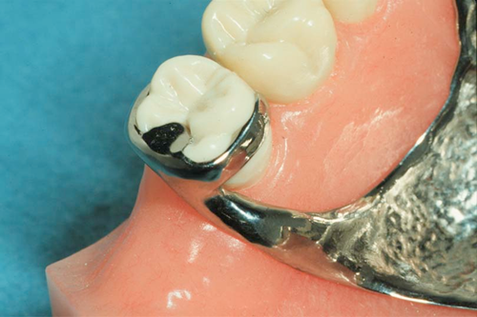
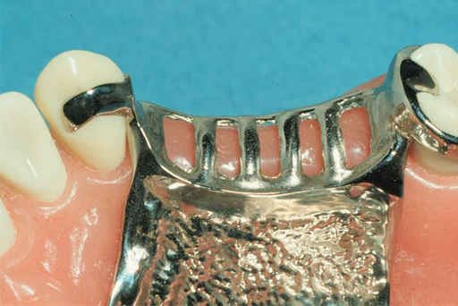
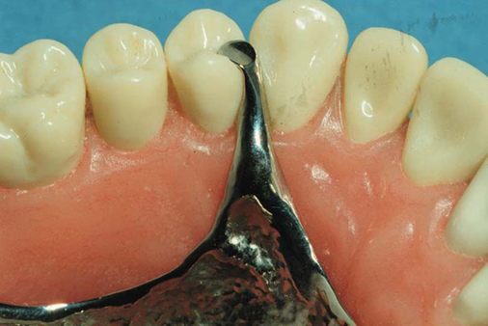
Minor Connectors
Connects components to the major connector
Direct retainer
Indirect retainer
Rest

Slide 4
Requirements of minor connector:
1.sufficient rigidity . Like the major connector, the minor connector must have sufficient bulk to be rigid to transmit forces between the linked components.

Slide 5
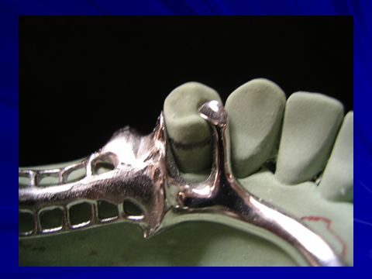
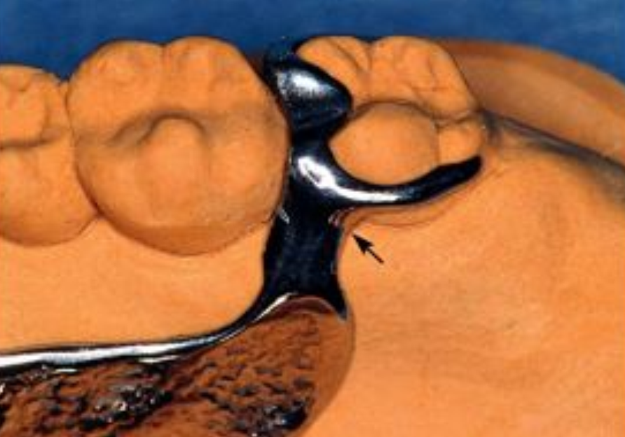
2. must not impinge on marginal gingival tissues.
Slight relief is required when crossing the gingival margin especially in tooth-mucosa borne dentures.

Slide 6
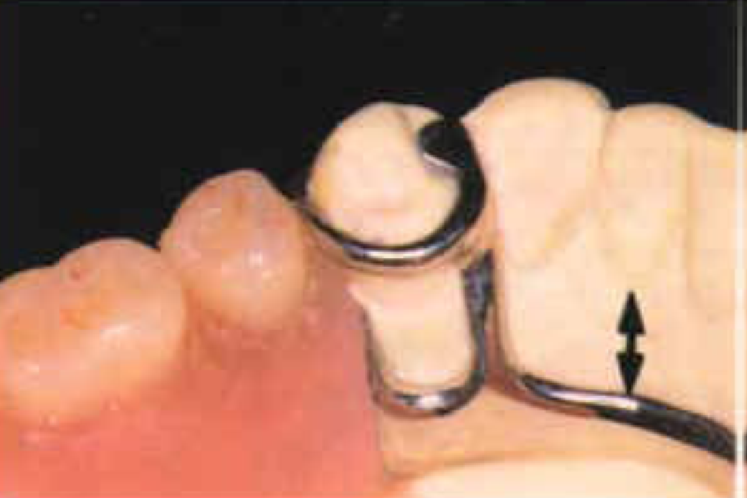
3.Minor connectors should be located at least 5mm from other vertical components.

Slide 7
Functions of Minor Connectors
1. Unification and rigidity
2. Stress distribution
3. Bracing through contact with guiding planes
4. Maintain a path of insertion

Slide 8
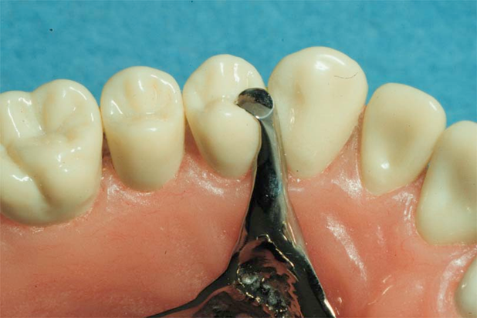
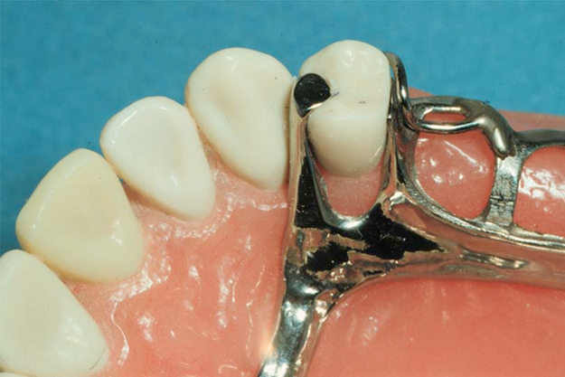
Types of Minor Connectors
Embrasure Minor Connectors
Between two adjacent teeth

Slide 9
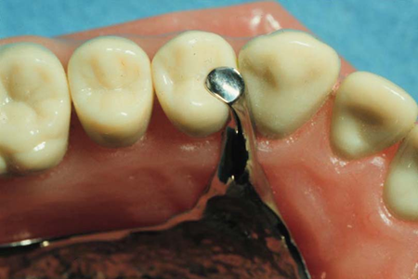
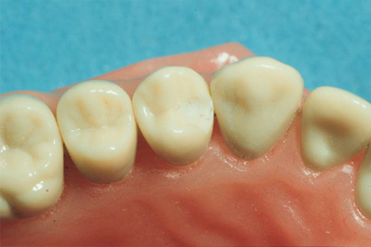

Embrasure Minor Connectors
Triangular shaped in cross section
Joins major connector at right angles
Relief placed so connector not directly on soft tissue

Slide 10
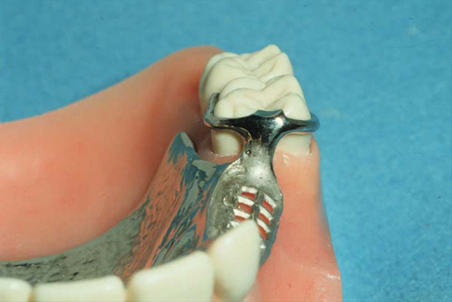
Proximal minor connector:
Those that join the clasp assembly to the major connector.
If the minor connector is located on a proximal surface of a tooth adjacent to edentulous areas, it should be broad buccolingually to provide strength but thin mesiodistally to minimize encroachment on the saddle area.

Slide 11
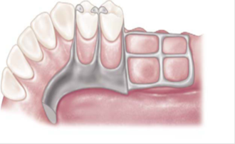
mesial and distal minor connectors and proximal plates adjacent to the edentulous areas should swing back to join the major connector in a rounded acute angle in order to increase gingival exposure.

Slide 12
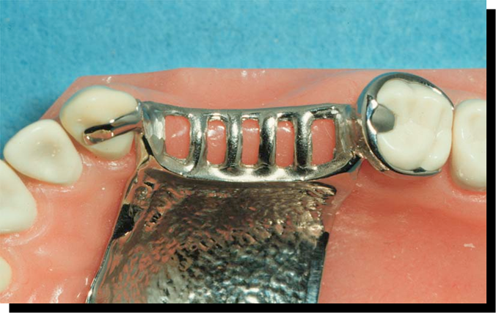
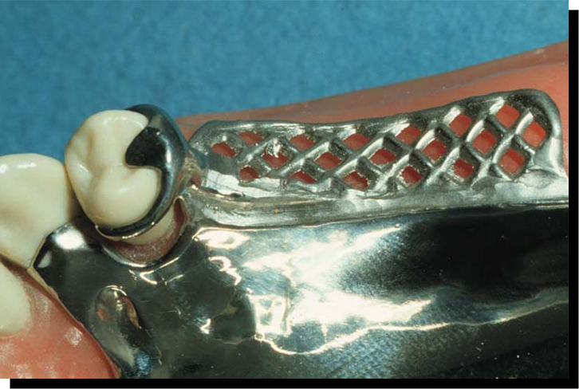
Gridwork minor connectors that connect the denture base and teeth to the major connector.
Latticework construction,
Mesh construction,
Bead, wire, or nail-head minor connectors .

Slide 13
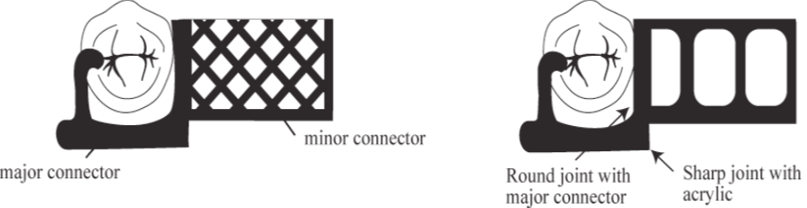
Gridwork Minor Connectors
Open lattice work
mesh types

Slide 14
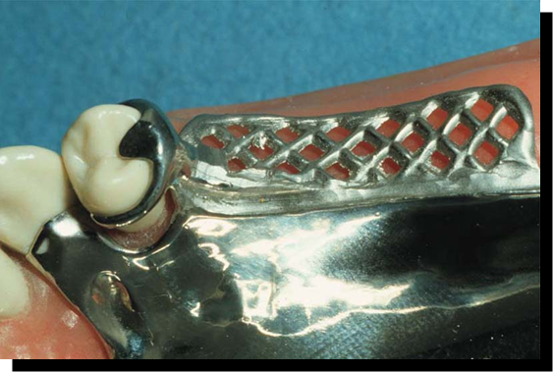
Mesh type
Flatter
Potentially more rigid
Less retention for acrylic
if openings are small

Slide 15
Lattice Type
Potentially superior retention
Interferes with setting of teeth, if struts are too thick
This type can be relined easily after ridge resorption.

Slide 16
Bead, wire, or nail-head minor connectors
no relief is provided for this type of minor connector.
It cannot be relined if ridge resorption takes place. It should be used on tooth-supported ridges.

Slide 17
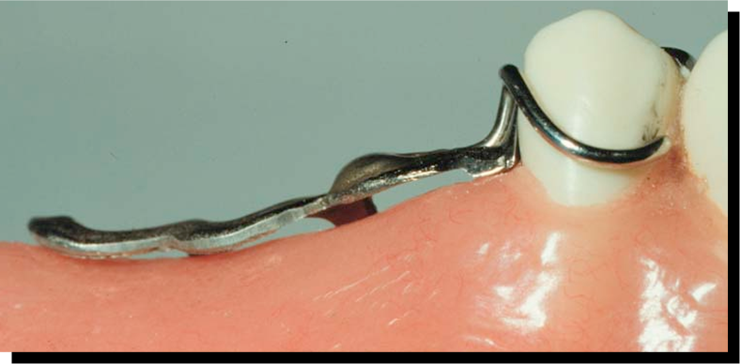
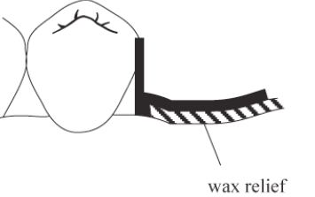
Gridwork Relief
Usually one thickness of baseplate wax is about
1 mm of relief sufficient
the space provided by the relief wax is available for the mechanical retention of the acrylic resin

Slide 18
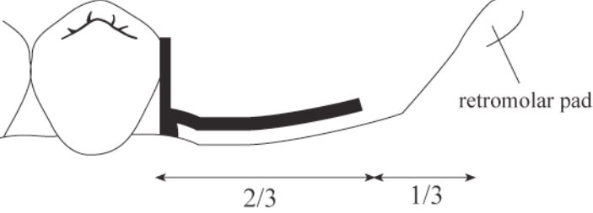
The minor connector for the mandibular distal extension base should extend posteriorly about two-thirds the length of the edentulous ridge and should have elements on both lingual and buccal surfaces.

Slide 19
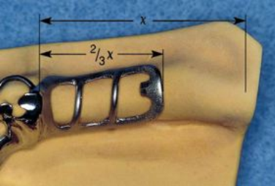
Mandibular Gridwork Design

Slide 20
Minor connectors for maxillary distal extension denture bases should extend the entire length of the residual ridge and should be of a ladderlike and loop design.

Slide 21
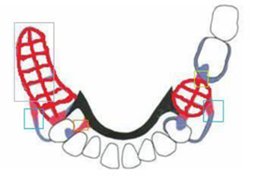
Those that serve as an approach arm for a vertical projection or bar-type clasp.

Slide 22
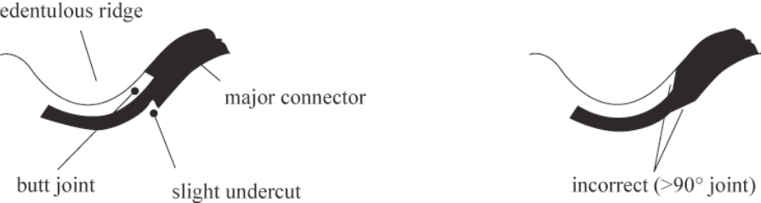
Finishing Lines
The junction of gridworks to the major connector should be in the form of a butt joint with a slight undercut in the metal. The angle formed by the metal at this juncture must not be greater than 90 degrees.

Slide 23
If these butt joints occur on the outer aspect of the major connector they are called external finish lines; if they are on the internal or tissue side of the major connector ,they are internal finish lines .

Slide 24
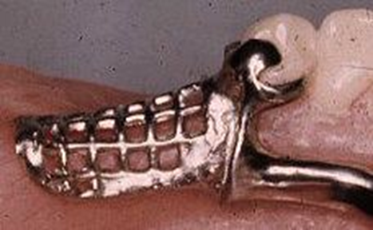
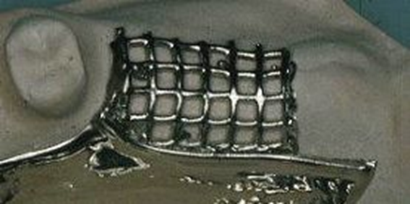
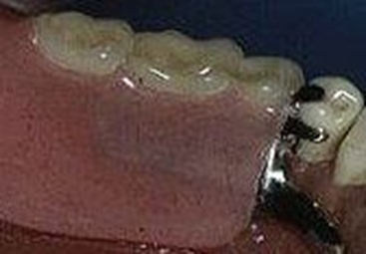
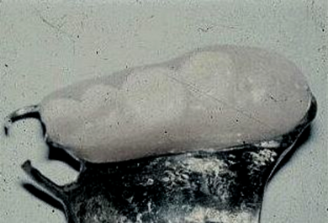
Angle the finish line forms with major connector – less than 90 degree.

Slide 25
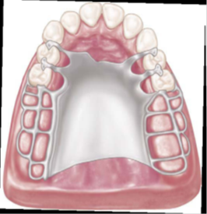
Finish line located too far medially– natural contour of palate altered by thickness of acrylic Too far buccally– difficult to create a natural contour of acrylic resin on lingual surface of artificial teeth

Slide 26
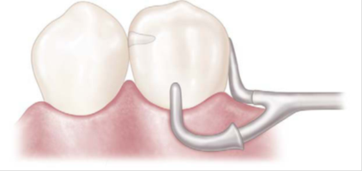
90-degree butt-type joints

Slide 27
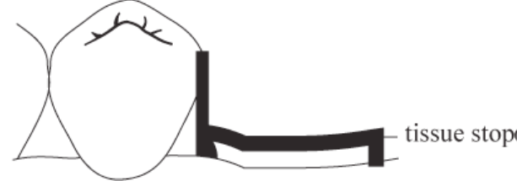
Tissue stop : a small projection of metal at the distal end of an extension base frame that contacts the cast and prevents downward movement of the plastic retention area during packing with resin

Slide 28
Closure of the flask under hydraulic pressure can causes distortion of the framework, pushing it tissue ward.

Slide 31
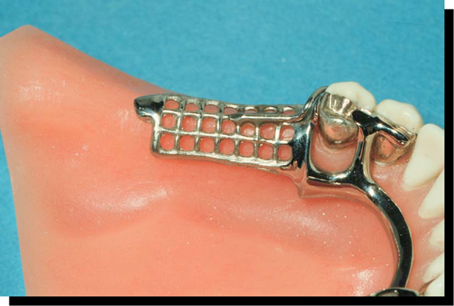

Slide 32

THANK YOU

