Slide 1
NEOPLASIA

Slide 2
Nomenclature

Slide 3
Neoplasia
.new growth
Tumor
.swelling
Oncology
.study of neoplasms
Cancer
.common term for malignant neoplasm

Slide 4
Neoplasm
.abnormal mass of tissue, growth of
which exceeds & is uncoordinated
with that of normal tissues & persists
in the same excessive manner after
cessation of stimuli which evoked the
change

Slide 5
.neoplasms have 2 components -parenchyma (neoplastic cells) -stroma (supportive connective tissue) desmoplasia .is a term applied when a stroma is densely collagenous

Slide 6
Types of Neoplasms Based on Behavior .nomenclature of tumors & their biologic behavior are based on parenchymal component -benign -malignant

Slide 7
Benign Neoplasms .have innocent microscopic & gross features .remain localized .amenable to local surgical removal .patient generally survives .in mesenchymal neoplasms, oma is attached to cell of origin (fibroma, chondroma, osteoma, leiomyoma, rhabdomyoma)

Slide 8
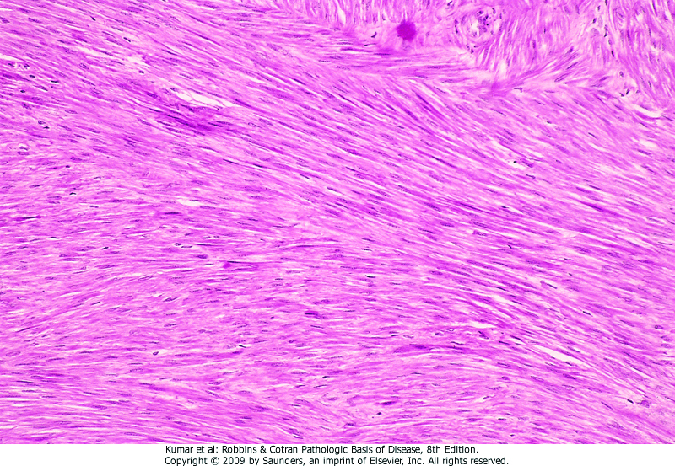
Leiomyoma

Slide 9
.in epithelial neoplasms nomenclature
depends on
-cell of origin, (adenoma)
-microscopic pattern &/or macroscopic
architecture (adenoma, papilloma,
cystadenoma, papillary cystadenoma)

Slide 10
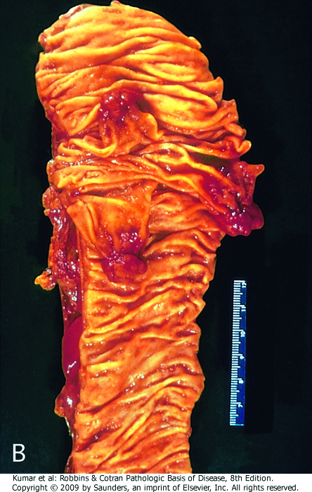
Colon, adenoma

Slide 11
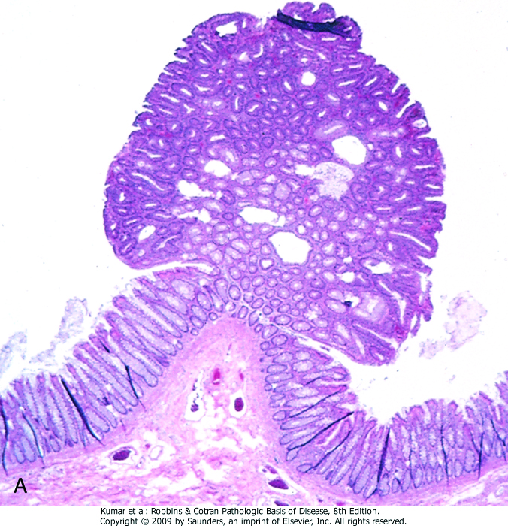
Colon, adenoma

Slide 12
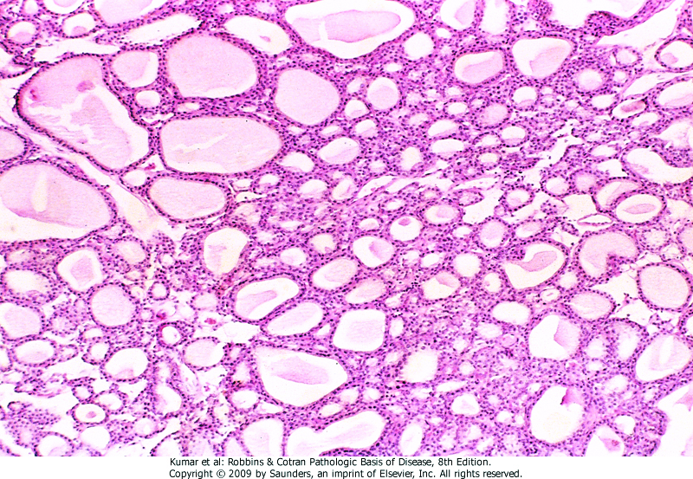
Thyroid, adenoma

Slide 13
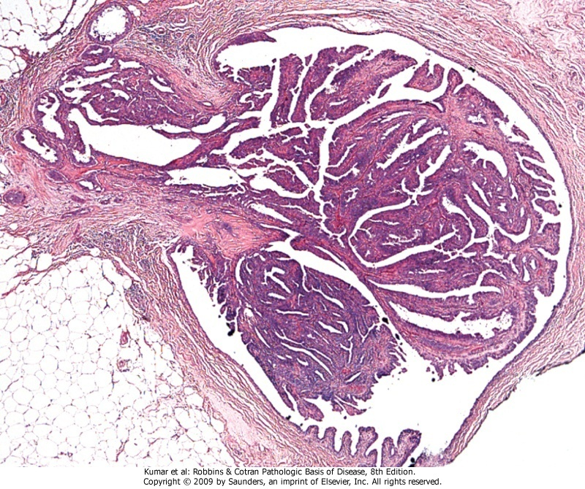
Breast, papilloma

Slide 14
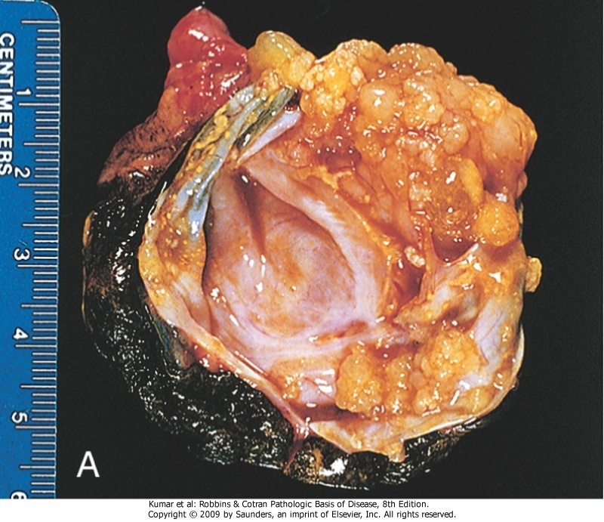
Ovary, cystadenoma

Slide 15
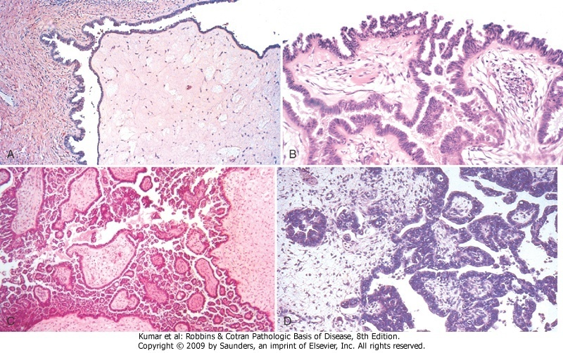
Ovary, papillary cyst adenoma

Slide 16
Malignant Neoplasms .can invade & destroy adjacent tissues .can spread to distant sites (metastasize) .cause death of patient .malignant neoplasms of mesenchyme are called sarcomas -fibrosarcoma (connective tissue) -liposarcoma (adipose tissue) -leiomyosarcoma (smooth muscle) -rhabdomyosarcoma (skeletal muscle)

Slide 17
.malignant neoplasms of epithelium are called carcinomas
-adenocarcinoma (glandular pattern)
-squamous cell carcinoma (squamous differentiation)
.malignant tumors with undifferentiated cells of unknown tissue origin are called undifferentiated malignant tumors
(anaplastic)

Slide 18
Polyp .benign or malignant neoplasm with macroscopically visible projection above a mucosal surface projecting into gastric or colonic lumen

Slide 19
Colon, polyp (adenoma)

Slide 20
Colon, polyp (adenoma)

Slide 21
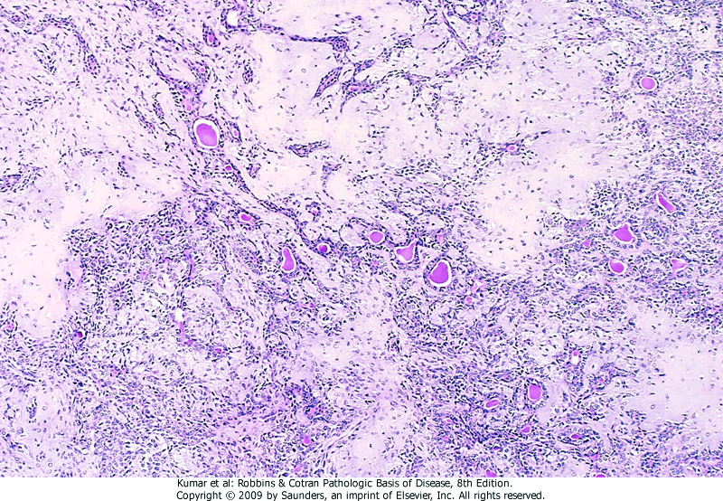
Mixed Neoplasm
.divergent differentiation of a single neoplastic clone along two lineages
Salivary gland, mixed tumor

Slide 22
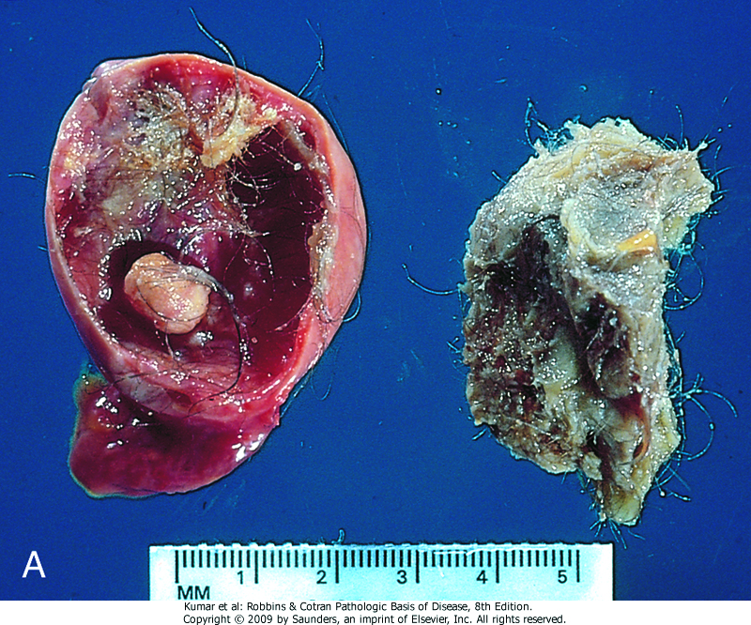
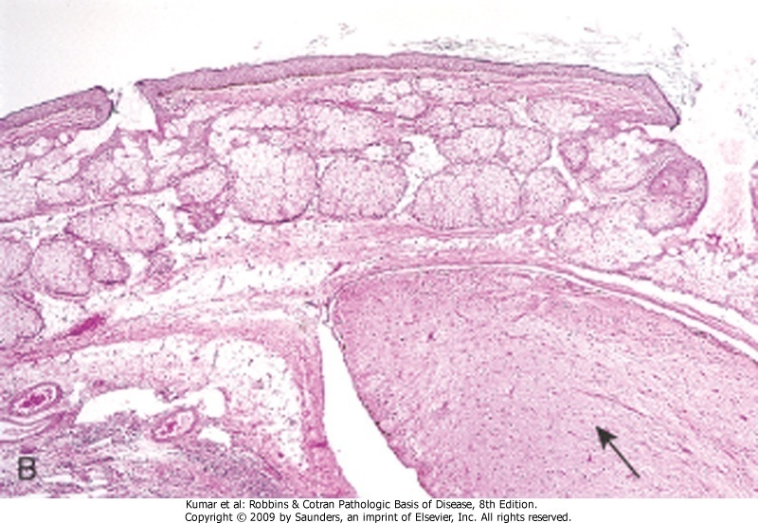
Teratoma .neoplasm arising from more than one germ layer (totipotent cell) Ovary, teratoma

Slide 23
Choristoma .ectopic rest of normal tissue Hamartoma .mass of disorganized mature cells or tissue indigenous to particular site

Slide 24
