Slide 1
EPIDEMIOLOGY

Slide 2
Cancer Incidence .most common cancers in men (prostate lung, colorectum) .most common cancers in women (breast, lung, colorectum)

Slide 3
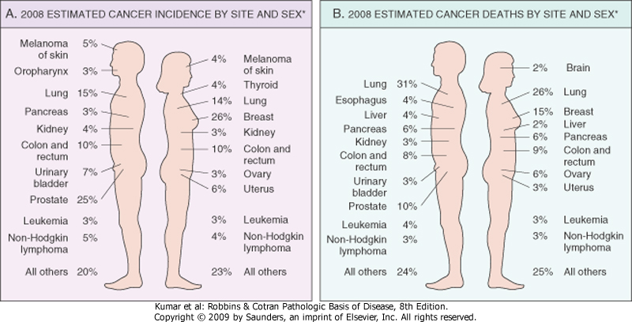
Cancer incidence & mortality by site & sex

Slide 4
.cancer incidence & mortality has decreased in the past 2 decades -decrease use of tobacco products (lung cancer) -improved detection & treatment (colorectal, female breast, & prostate cancers) -earlier diagnosis by the Papanicolaou (Pap) smear (uterine cervix cancer) -better food preservation or changes in dietary habits (cancers of stomach & colorectum)

Slide 5
.increase of lung cancer death rates in women (tobacco products) .increase in liver & intrahepatic bile duct cancer death rates in men {hepatitis C infection (HCV)}

Slide 6
Etiologic Factors Related to Cancer .environmental .age-related .genetics .non-inherited

Slide 7
Geographic And Environmental Factors
.are significant contributors in sporadic cancers
-air (ultraviolet-UV- rays, smog)
-medication (methotrexate)
-at work (asbestos, vinyl chloride)
-food (fat)
-personal habits (alcohol, smoking, sex)

Slide 8
Age
.most cancers occur in later years of life (older than 55 years)
.cancer is the main cause of death among women aged 40-79 years & among men aged 60-79 years
.possible causes of rising incidence with age
-accumulation of somatic mutations -decline in immune competence

Slide 9
Genetic Predisposition To Cancer -autosomal dominant inherited cancer syndromes .point mutations involving tumor suppressor genes .examples -retinoblastoma (RB gene) -familial adenomatous polyposis coli (APC gene) -Li Fraumeni syndrome (p53 gene) -MEN 1 & MEN 2 -HNPCC

Slide 10
.characteristic features of autosomal dominant cancers -involvement of specific tissues -arising in benign lesions (adenomatous colonic polyps) -have incomplete penetrance & variable expression

Slide 11
-autosomal recessive inherited cancer syndromes-defective DNA repair .examples
-xeroderma pigmentosum
-ataxia telangiectasia
-Fanconi anemia
-Bloom syndrome

Slide 12
-familial cancers
.site or type (colon, breast, ovary, brain
melanoma)
.characteristic features
-onset at early age
-arising in 2 or more close relatives of index case
-sometimes are bilateral or multiple

Slide 13
Nonhereditary Predisposing Conditions certain proliferative conditions are fertile soil for cancers, because cell replication is involved in neoplastic transformation .regeneration, (cirrhosis) .hyperplasia, (endometrium) .dysplasia, (cervix, larynx) .metaplasia, (bronchus, esophagus)

Slide 14
.chronic inflammatory conditions
-examples
.inflammatory bowel disease
.H. pylori gastritis
.viral hepatitis
.chronic pancreatitis
-mechanism of cancer development
.bioactive substances from activated immune cells promote cell survival, cell proliferation, remodeling of tissue, angiogenesis, & mutations

Slide 15
.precancerous conditions
-examples
.chronic atrophic gastritis (autoimmune)
.solar keratosis of skin
.chronic inflammatory bowel disease
.leukoplakia (oral cavity, vulva, penis)
.villous adenoma of colon

