Slide 1
THE PANCREAS
It is a retroperitoneal organ, it’s weight about 80 gm.
It secretes digestive enzymes in an alkaline bicarbonate rich fluid.

Slide 2
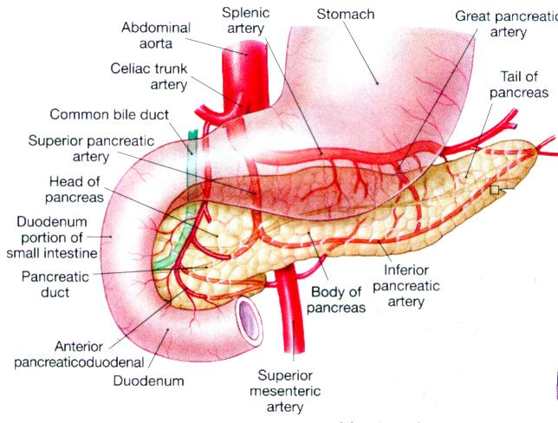

Slide 3
Surgical physiology
Endocrine function .
A cells which secrete glucagon.
B cells which secrete insulin.
C cells which secrete somatostatin.
Exocrine function.
lipase, amylase, as well as proteolytic enzymes as trypsinogen and chemotrypsinogen.

Slide 4
Congenital Anomalies
1. Agenesis = incompatible with life
2. Pancreas Divisum = persistence as dorsal and ventral pancreas
Predisposes to Chronic Pancreatitis
3. Annular pancreas = pancreatic head encircles the duodenum
Risk of Intestinal obstruction
4. Aberrant (or Ectopic) pancreas = located in the stomach, SI, Meckel’s Diverticulum, submucosal, yellow-gray nests
5. cystic fibrosis:
6. cystic disease of the pancreas

Slide 5
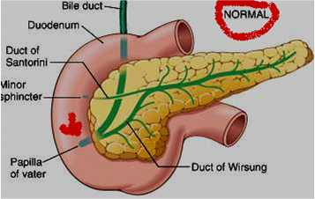
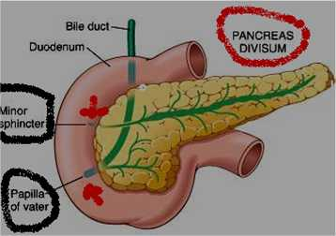
Pancreas - Pancreas Divisum

Slide 6
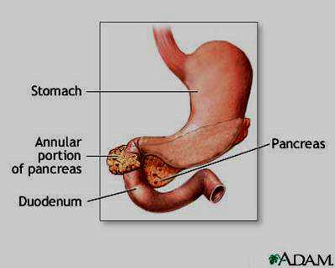
Pancreas - Annular pancreas

Slide 7
PANCREATITIS
Acute pancreatitis: A single episode of pancreatitis in a previously normal gland. characterized by abdominal pain and raised pancreatic enzymes.
Pathogenesis: autodigestion of the pancreas following premature activation of its proteolytic enzymes. And it returns to normal when the primary cause is removed.

Slide 8
AETIOLOGY
Biliary tract disease(50-70%):
If the cause is gall stones, cholecystectomy is indicated in the same admission.
Alcohol abuse: 25%
Post ERCP:
Abdominal trauma:
Following surgery: biliary, upper gastrointestinal and cardiothoracic.

Slide 9
Ampullary tumor
Rare causes : as hypercalcemia, hyperparathyroidism, autoimmune pancreatitis, hereditary pancreatitis, malnutrition.
Viral infection (mumps)
scorpion bite
Idiopathic:
Drugs: corticosteroids, thiazides, estrogen.

Slide 10
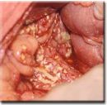
Pathology
The peritoneal cavity :
blood stained exudates
fat necrosis in greater omentum and peritoneum.
Pancreas :
edematous.
hemorrhagic.
necrotizing pancreatitis.

Slide 11
Acute Pancreatitis
hemorrhage in the head of the pancreas
fat necrosis

Slide 12
COMPLICATION systemic
Cardiovascular: shock, arrhythmias
Pulmonary: ARDS
Renal failure
Hematological: DIC
Metabolic: hypocalcemia, hyperglycemia, hyperlipidemia.
Gastrointestinal: ileus
Neurological: confusion, irritability

Slide 13
local complication
Acute fluid collection
pancreatic necrosis
Pancreatic abscess
Pseudocyst
Pleural effusion
Portal/ systemic vein thrombosis
Pseudo-aneurysm

Slide 14
Clinical Picture
occur at any age, with a peak in young men and older women.
Symptoms
Pain: severe reaching its maximum intensity within minutes, and persist for hours or days. It is constant in nature and intensity and refractory to analgesia. epigastric radiated to the back, may relieve on leaning forward.
Nausea, Vomiting, retching, and hiccough.
Peripheral vascular collapse and shock
Death occurs from shock, ARDS, and renal failure

Slide 15
Signs
General: The patient may be well or severely ill, with profound shock, toxicity and confusion.
Tachypnoea, tachycardia, and hypotension may be present.
Body temperature may be normal or subnormal.
Mild icters may develop caused by biliary obstruction.

Slide 16
Abdominal:
Mild epigastric tenderness and rigidity.
Distention due to ileus, or ascites.
Bluish ecchymosis discoloration of the skin may be visible after 2-3 days in the flanks (Grey Turner sign ), or around the umbilicus (Cullen’s sign).
Tender, palpable mass in the epigastric region.

Slide 17
Pancreatitis with retroperitoneal hemorrhage
Grey Turner’s sign
Cullen’s sign

Slide 18
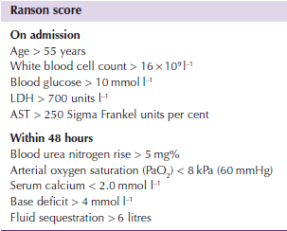
Ranson score

Slide 19
Investigation
Serum amylase :three to four times above normal is indicative of the disease, increase within24 hours.
Serum lipase: increase specially in alcoholic pancreatitis
Urine amylase: increase and is of diagnostic value.
Serum calcium: may fall
Plain X-ray: abdomen may show sentinel loop, (local ileus).
Colon cut off sign
Calcified gall stones or pancreatic calcification.

Slide 20
Sentinel loop
Colon cut off sign

Slide 21
A chest radiograph may show a pleural effusion, and a diffuse alveolar interstitial shadowing may suggest ARDS.
Ultrasonography can confirm the diagnosis of the pancreatic enlargement and edema, and the presence of gall stones.
In doubt CT scan must be performed.
Cross-sectional MRI
EUS and MRCP: assess pancreatic parenchyma
ERCP: allows identification and removal of stones in the common bile ducts.

Slide 22
Differential diagnosis
Perforated peptic ulcer .
Acute cholecystitis.
High intestinal obstruction.
Acute mesenteric vascular occlusion.
Acute myocardial infarction.

Slide 23
TREATMENT conservative treatment
Admission to the ICU
Analgesia
Aggressive fluid administration
Oxygenation
Monitoring of vital signs, CVP, urine output and blood gases.
Frequent monitoring of hematological and biochemical parameters.

Slide 24
Nasogastric drainage
Antibiotic prophylaxis
CT if clinical deterioration or signs of sepsis develops.
ERCP within 72 hours for severe gallstone pancreatitis, or signs of cholangitis.
Supportive therapy for organ failure
If nutritional support is required, consider entral feeding.

Slide 25
Surgical treatment
Laparotomy when diagnosis is uncertain, shows white spots of fat necrosis, ascites, retroperitoneal hemorrhage, or pancreatic necrosis.
The necrotic tissue is excised, a drain is left.
Treatment of local complication, a Pseudocyst, or abscess.

Slide 26
Pancreatic Pseudocyst
Is a collection of amylase rich fluid enclosed in a wall of fibrous or granulation tissue. The fluid aspirate should be sent for CEA, amylase and cytology.
Etiology:
Acute pancreatitis
Pancreatic trauma

Slide 27
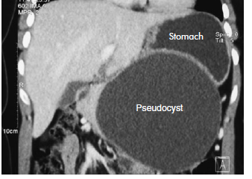
Pseudocyst

Slide 28
Complications

Slide 29
Clinical Picture:
History of trauma or pancreatitis.
Epigastric mass and pain
Persistent amylase elevation
20-40% of these cases are resolved spontaneously within six weeks.
Differential diagnosis
Epigastric Abdominal masses
Abscess or acute fluid collection
Cystic tumor of the pancreas.

Slide 30
Investigation:
Barium meal
U/S, CT, MRI to monitor alteration in the size of the cyst.
Fluid aspirate and send for CEA, amylase, and cytology.
ERCP and MRCP

Slide 31
TREATMENT
Most cysts resolve spontaneously and need follow up only.
Thick wall cysts
size over 6 cm
persistent more than 12 weeks are less likely to resolve.
Liable for complication
The wall is mature for internal drainage. Transgastric cysto-gastrostomy.

Slide 32
Surgical treatment
cystgastrostomy
Internal drainage
Cystgastrostomy
Cystjejunostomy
External drainage
May cause pancreatic fistula
Excision
Small, tail location

