Slide 1
General and Local Anesthesia

Slide 2
General Anesthesia

Slide 3
Terminology:
-Surgery
-Operation
-Operating room (theater)
-Anesthesia/ Anesthetist

Slide 4
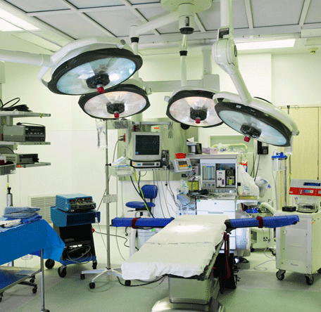
(Operating Room/ Theater)

Slide 5
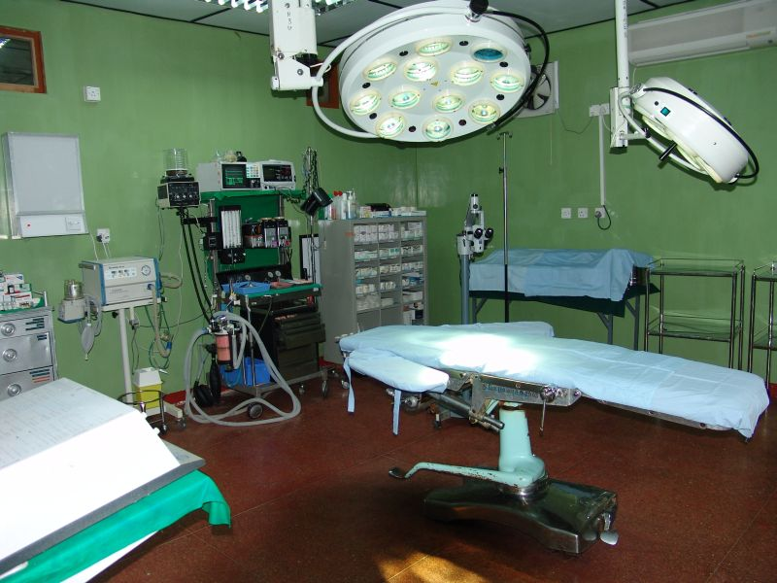
(Operating Room/ Theater)

Slide 6
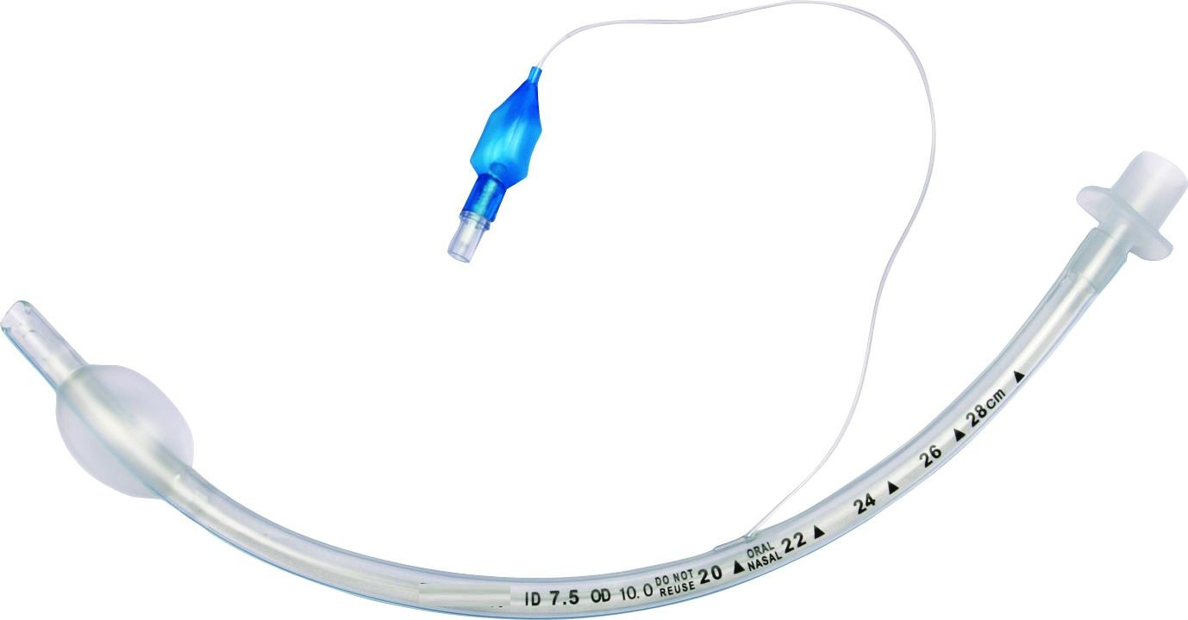
(Endotracheal tube/Endotracheal intubation)

Slide 7
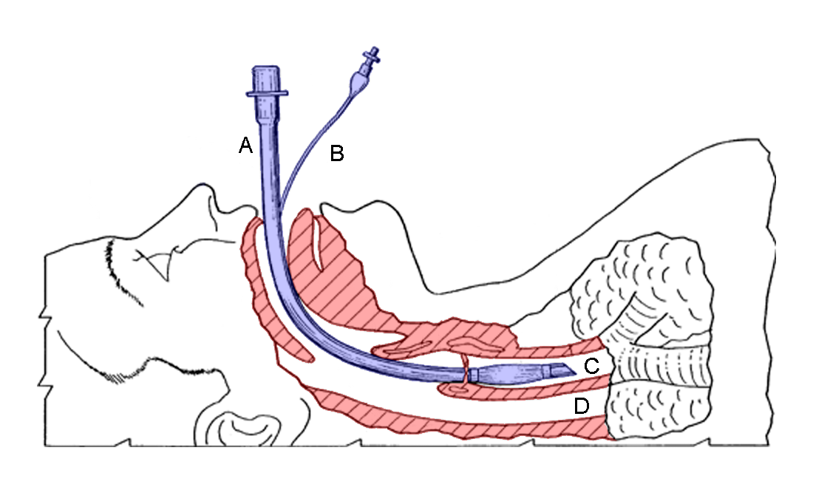
(Endotracheal tube/Endotracheal intubation)

Slide 8
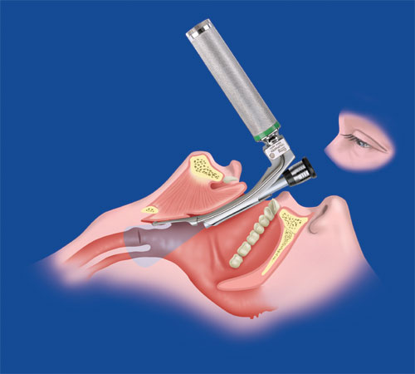
(Endotracheal tube/Endotracheal intubation)

Slide 9
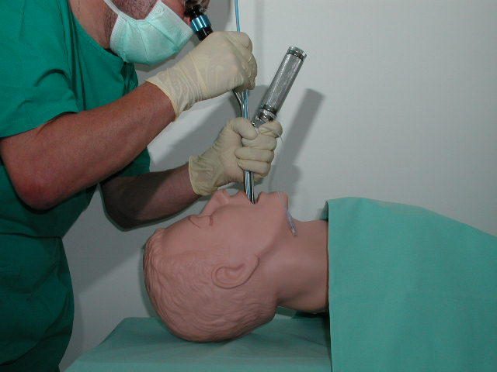
(Endotracheal tube/Endotracheal intubation)

Slide 10
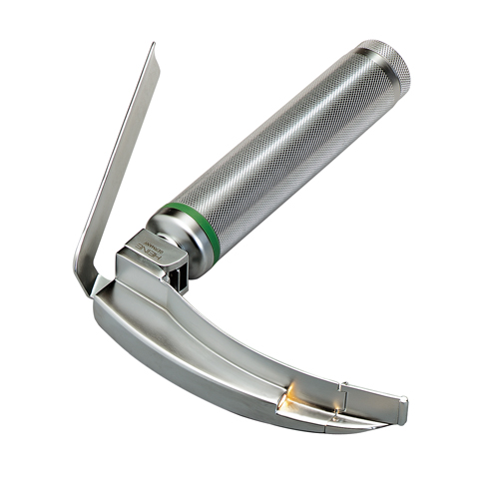
(Laryngoscope)

Slide 11
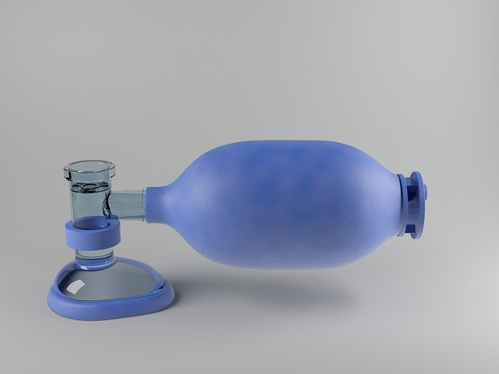
(Ambo Bag)

Slide 12
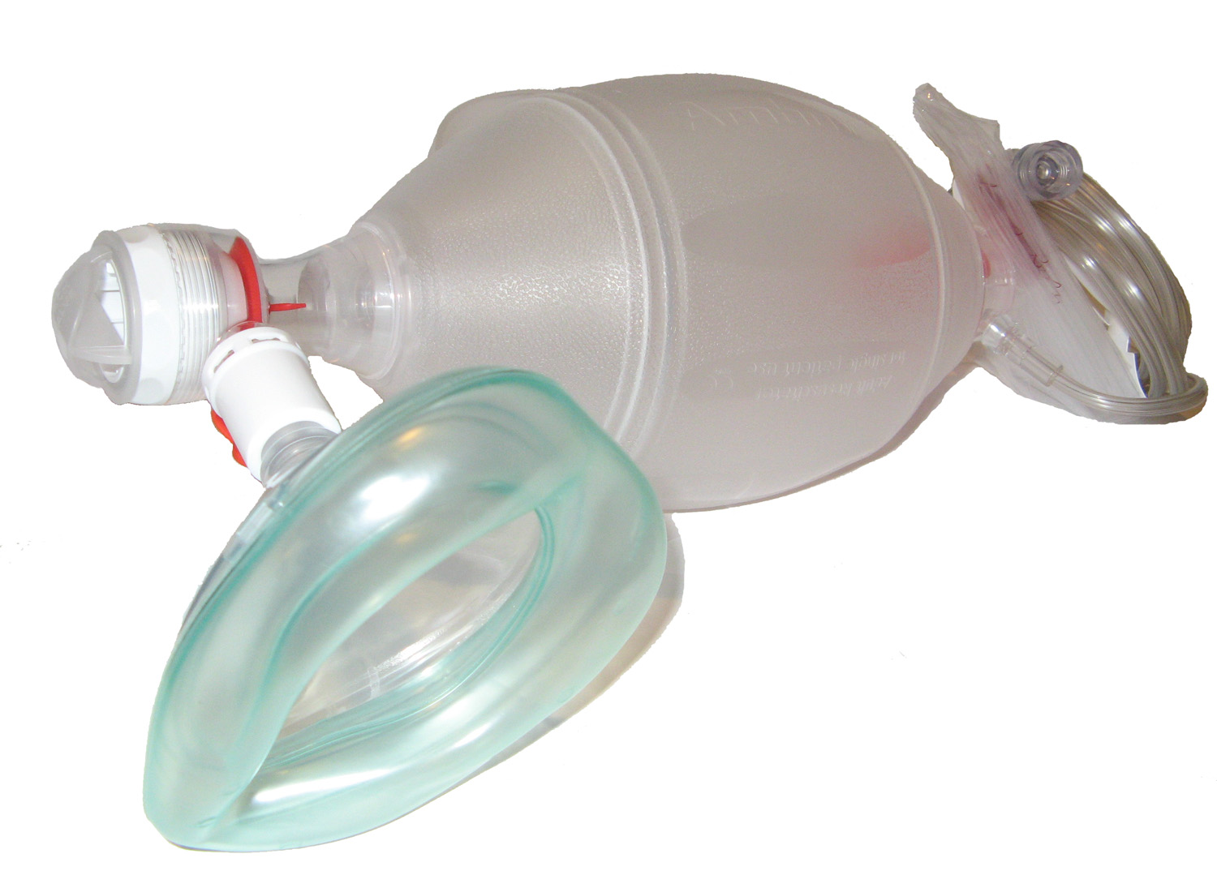
(Ambo Bag)

Slide 13
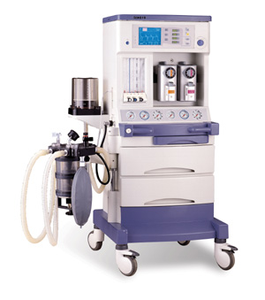
(Ventilator)

Slide 14
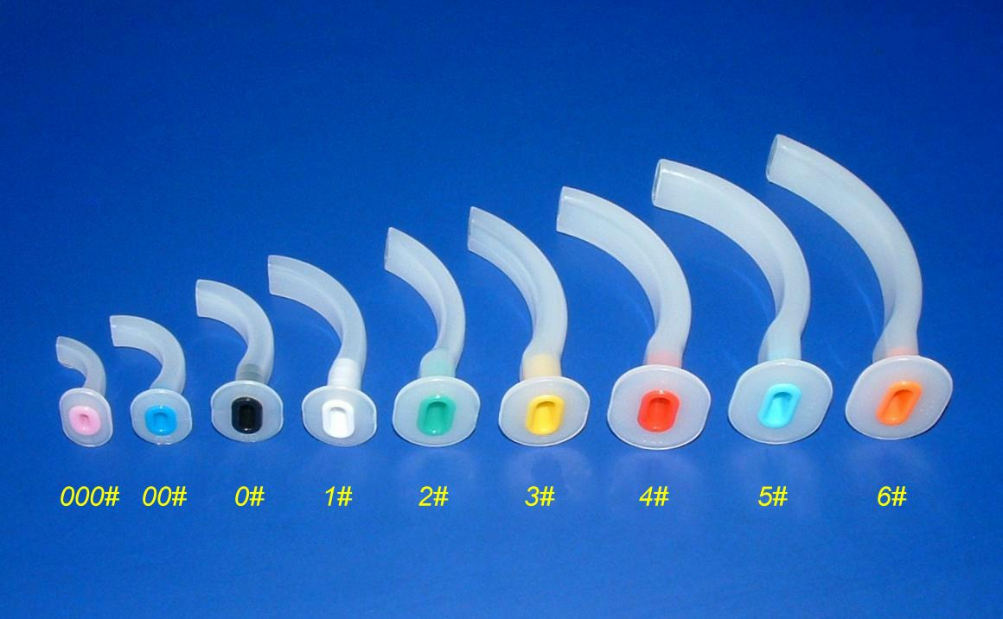
(Airway tube)

Slide 15
General Anesthesia:= Inducing
-Quick
-Safe
-Easily reversible
Unconsciousness for any desired period of time.

Slide 16
Drugs in Anesthesia are given:
1- Before surgery
2-During surgery:
-Unconsciousness
-Analgesia
-Muscle relaxation
3-After surgery:
-Reversal of neuromuscular block
-Relief of pain
other

Slide 17
Stages of General anesthesia:
Stage One: Analgesia
Stage two: Delirium
*Stage Three: Surgical anesthesia 4 plans
Stage Four: Medullary paralysis, death
*Ether to non Pre-medicated patient

Slide 18
1-Before surgery: (Premedication)
A- Anxiolysis and Amnesia.
Patient is apprehensive clear explanation of what to expect
-Reassurance.
Very anxious patient can be helped by benzodiazepines

Slide 19
B-Analgesia for patient in pain.
Or to:
Prevent post operative pain
-Parenteral opiates morphine
C-Drying of bronchial secretions.
Anti muscarinic drugs
Rarely used
Glycopyrronium is used one hour before surgery

Slide 20
Gastric content can lead to pulmonary aspiration:
-Single dose of anti acid
-Ranitidine
-Metoclopramide
*Fasting for at least 6 hours before anesthesia

Slide 21
2-During surgery:
The Aim is to induce:
-Analgesia
-Unconsciousness
-Muscle relaxation (Intra abdominal surgery)

Slide 22
General anesthesia will include two steps:
A- Induction of anesthesia.
B- Maintenance.
A-Induction: Usually IV (Pre-Oxygenated patient)
-Small doses of opiates
-Fentanyl
-Followed by Thiopental (Ultra short acting Barbiturate)
or: Propofol

Slide 23
----Airway patency is maintained
(Oral airway + face mask)
Or
(Endotracheal tube)
Endotracheal tube insertion require paralysis
with Neuromuscular Block
Inhalation induction Sevoflurane
*(less common)

Slide 24
B-Maintenance: (Inhalation)
-Nitrous oxide (N2O) and Oxygen
-Volatile agents +Oxygen + Air.
-Isoflurane
-Sevoflurane
-Halothane
Or
Continuous iv infusion of Propofol (IV)
*(Less Common)

Slide 25
3-After surgery:
-Patient is not left alone until consciousness regained:
-Effect of neuromuscular blockade either wane off or reverted by Antidote.
-Relief of pain

Slide 26
Dissociative Anesthesia:
-Profound Analgesia
-Antegrade Amnesia
-Minimal Hypnosis

Slide 27
Mode of action:
On brain primarily on midbrain reticular formation system.
Lipid solubility is important as the more lipid soluble is the drug the more its effect on the brain.
GABA receptor activation is also another proposed mechanism

Slide 28
Individual Anesthetics:
1-Gases and Volatile Agents:
(Inhalation anesthesia)
Effect correlate with the partial pressure of anesthetic agent.
*Agents with law solubility in blood provide rapid effect
-N2O (Nitrous Oxide)
-Sevoflurane

Slide 29
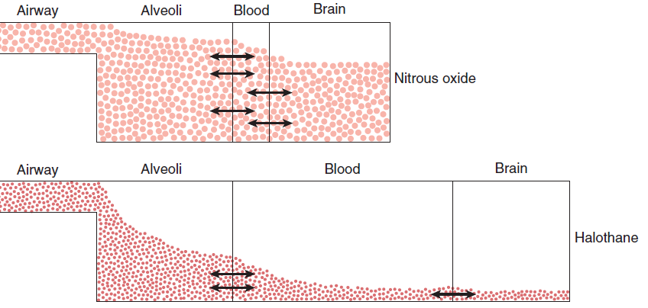

Slide 30
When discontinued it moves from the tissue to the blood to the alveoli.
10 % of the expired volume and can lead to hypoxia.
Treated by oxygen (Diffusion hypoxia)
*Fast Induction
*Fast Elimination

Slide 31
Nitrous Oxide (N2O):
Gas used since 1844
-Not inflammable
-Not explosive
-Light anesthesia

Slide 32
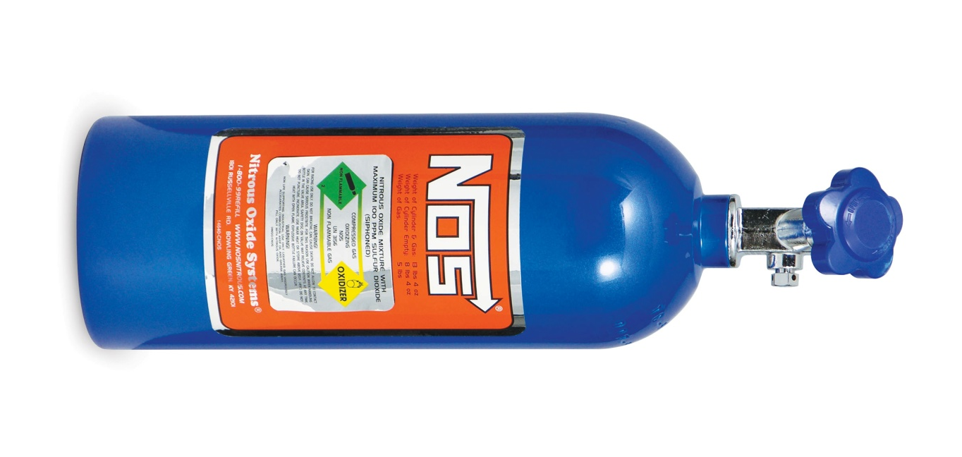
(Nitrous Oxide)

Slide 33
Advantages of Nitrous Oxide: (N2O)
-Strong Analgesic action
50 % N2O in Oxygen provide profound analgesia.
-Recovery is very fast
-Around 4 minutes

Slide 34
Disadvantages of Nitrous Oxide : (N2O)
-Expensive
-Must be used with more potent drug to produce surgical anesthesia.
***Post operative nausea and vomiting
Uses:
Use d to maintain surgical anesthesia with other agents e.g. Isoflurane

Slide 35
Dosage of Nitrous Oxide (N2O):
-Maintain anesthesia mixed with at least 30 % O2
-Analgesia: 50 % N2O + 50% O2
Contra indications of Nitrous Oxide (N2O):
-Any closed distended air filled space will expand
-Intra ocular surgery
-Middle ear
-lung

Slide 36
Precaution of Nitrous Oxide (N2O):
Adverse reactions:
-Nausea and vomiting
*When used for more than 4 hours
-Megaloblastic changes in blood.
-Teratogenicity to staff?

Slide 37
Halogenated anesthetics:
(Volatile Agents)
-Halothane
-Isoflurane
-Sevoflurane

Slide 38
Isoflurane:
-Volatile colorless liquid
-Not flammable under normal conditions
-Pungent odor
-Can cause bronchial irritation
-Minimally metabolized (o.2 %)

Slide 39
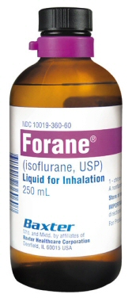

Slide 40
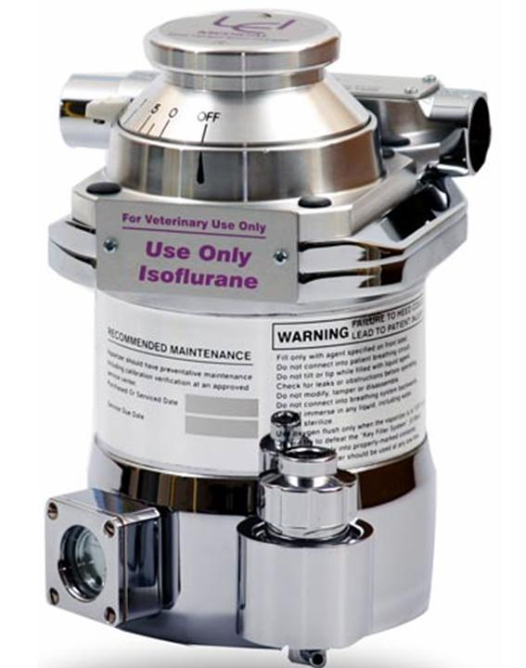
(Vaporizer)

Slide 41
Effects of Isoflurane:
-Respiratory depression
-Increased respiratory rate and tidal volume
CVS:
-Slight depression in CVS
-And cardiac output
-Reduce Blood Pressure and peripheral vasodilatation.

Slide 42
Sevoflurane:
Chemical analogue to Isoflurane
Enflurane causes more respiratory depression
Desflurane

Slide 43
Halothane (Fluothane):
-Slow recovery
-Decrease cardiac output
-Sensitize heart to catecholamine (Arrhythmia)
-20% metabolized and induce liver enzymes
-Fever, anorexia, nausea, vomiting
***Hepatic damage (rare but serious)
Hepatitis is reported adverse reaction in 1:50000
Immune reaction

Slide 44
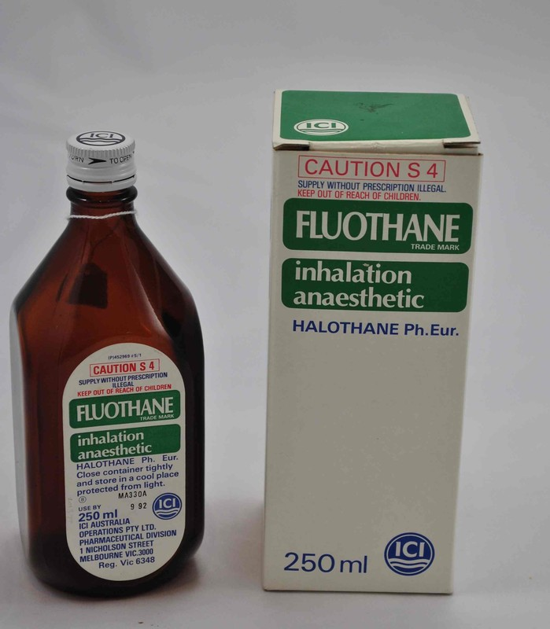

Slide 45
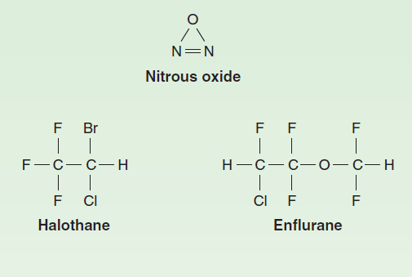

Slide 46
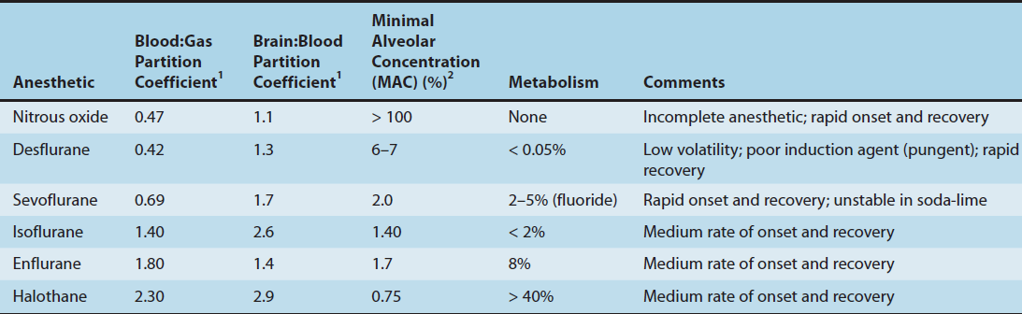

Slide 47
Oxygen in anesthesia:
-Supplementary O2 is always useful
-With inhalation agents to prevent hypoxia
O2 concentration is 30%.... not exceed 80 %
Atmospheric pollution in operating theater:
-Fetal malformation
-Miscarriages increased
-Hepatitis

Slide 48
Intravenous anesthesia:
Extremely rapid induction
*It is common practice to use iv induction and inhalation agents for maintenance.
When volatile anesthesia is stopped it is eliminated quickly through the lungs.

Slide 49
Propofol:
-Inductions within 30 sec
-Recovery is rapid
-Nausea and vomiting are extremely rare

Slide 50
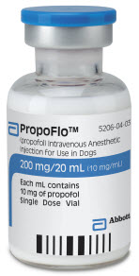
(Propofol Emulsion)

Slide 51
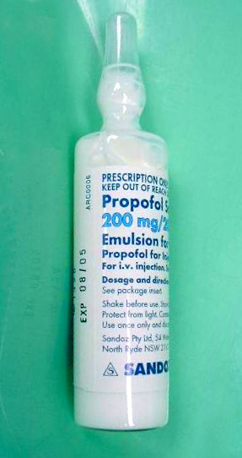
(Propofol Emulsion)

Slide 52
Thiopental (Pentothal) :
-Very short acting barbiturate
-Induces anesthesia smoothly
Dose is 3-5 mg /kg
-Half life = 4 min allows swift recovery after a single dosage (Patient is awake after 10-15 min)
-Terminal half = life is 11 hours very prolonged recovery after repeated dosage or infusion

Slide 53
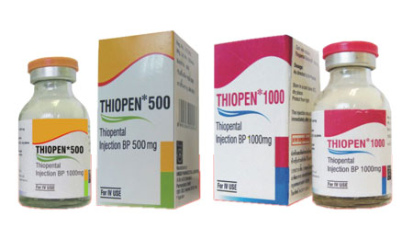
(Thiopental)

Slide 54
Metabolized in the liver
Ph = 11 Can damage tissue if exrtravasated
CNS:
-No analgesia
-Decrease intracranial pressure
CVS:
-Hypotension
-Tachycardia
-Decrease respiratory rate

Slide 55
Ketamine (Ketalar):
-Hallucinogen
-Trance like state
-Dissociative anesthesia
-Sedation amnesia dissociation
-Analgesia
15 min after a single IV injection
Can be given IM

Slide 56
Used for Minor surgical interventions
Tachycardia
*Increased blood pressure
Cardiac output
Has an advantage in Shocked patients
Bronchodilatation.

Slide 57
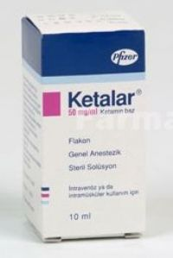
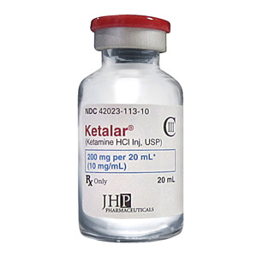
(Ketamine)

Slide 58
Disadvantages of Ketamine:
-No muscle relaxation
*Increase intracranial and intra ocular pressure
-Hallucination during recovery
***Decrease by diazepam
Usage:
Induction as a soul agent in minimal surgery
1-2 mg/kg over 60 sec
5-10 mg/kg IM

Slide 59
Contra indication of Ketamine:
-Hypertension
-Congestive cardiac failure
-Cerebral trauma
-Increased intracranial pressure
-Pregnancy (Contra indication in pregnancy)

Slide 60
Muscle relaxants in Anesthesia:
***Abdominal surgery requires muscle relaxation
(Deep general anesthesia can cause relaxation)
Neuromuscular blocking agents
*Deep general anesthesia is not advised
Light general anesthesia + selective neuromuscular block
Tracheal intubation + Quick recovery

Slide 61
***Mechanical ventilation is always used
-Technical skill is required
***Neuromuscular block should only be given after induction of anesthesia
Curare was an arrow poison
Complete paralysis of all voluntary muscles
Movement is impossible

Slide 62
Mechanisms of muscle relaxants:
Acetylcholine is released after nerve impulse
Leads to activation of receptors on motor end plate
Natural substances that prevent release of ach at nerve ending:
Botulinum toxin

Slide 63
1- Competitive relaxants:
Atracurium, Mivacurium
Pancuronium, Vecuronium
-Competitive antagonists to ach.
-Flaccid paralysis
Reversal of anticholinesterases drugs is by
Neostigmine
Prevent destruction of ach
Pancuronium bromide =(trademarked as Pavulon)

Slide 64
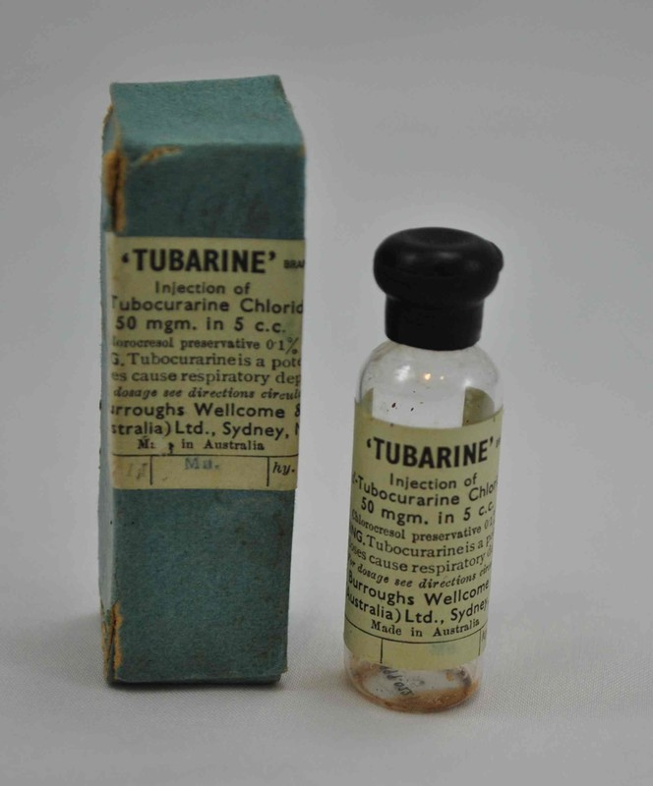
Tubocurarine:
*Can cause Hypotension
*Not used in many countries

Slide 65
Atracurium (Atracurium besylate):
-Altered in the body spontaneously in the body to inactive form
-T ½ = 30 min
-By passive chemical process
(Hofmann elimination)
Duration of action = 15-30 min
Hepatic and renal disease
Vecuronium
Full blockade after 3 min
20-30 min duration

Slide 66
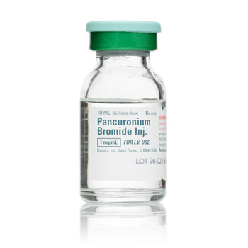
(Pancuronium/Pavulon )

Slide 67
2- By Depolarization:
Suxamethonium = Succinylcholine = Scoline
Contraction +relaxation
Shortest duration of action
Tracheal intubation in less than 60 sec
Total paralysis for 4 minutes
If intubation is impossible recovery is rapid

Slide 68
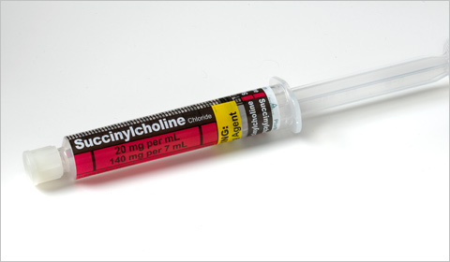
(succinylcholine = scoline)

Slide 69
Suxamethonium (succinylcholine)
=scoline
-Destroyed by pseudocholinesterase
-Hereditary deficiency
-Scoline apnea
-Muscle fasciculation then paralysis
-Muscle pain 1-3 days
***Most rapid onset

Slide 70
Antagonism of Neuromuscular Blocking agents:
-Anti cholinesterase drugs
Neostigmine IV + Glycopyrronium = (or Atropine)
Glycopyrronium bromide = Glycopyrrolate
Glycopyrronium bromide is a medication of the muscarinic anticholinergic group. It does not cross the blood–brain barrier and consequently has no to few central effects
*To prevent bradycardia due to parasympathetic action
-Act within 4 minutes-Effect lasts 30 min
-Neostigmine can itself cause paralysis in overdose = depolarization

Slide 71
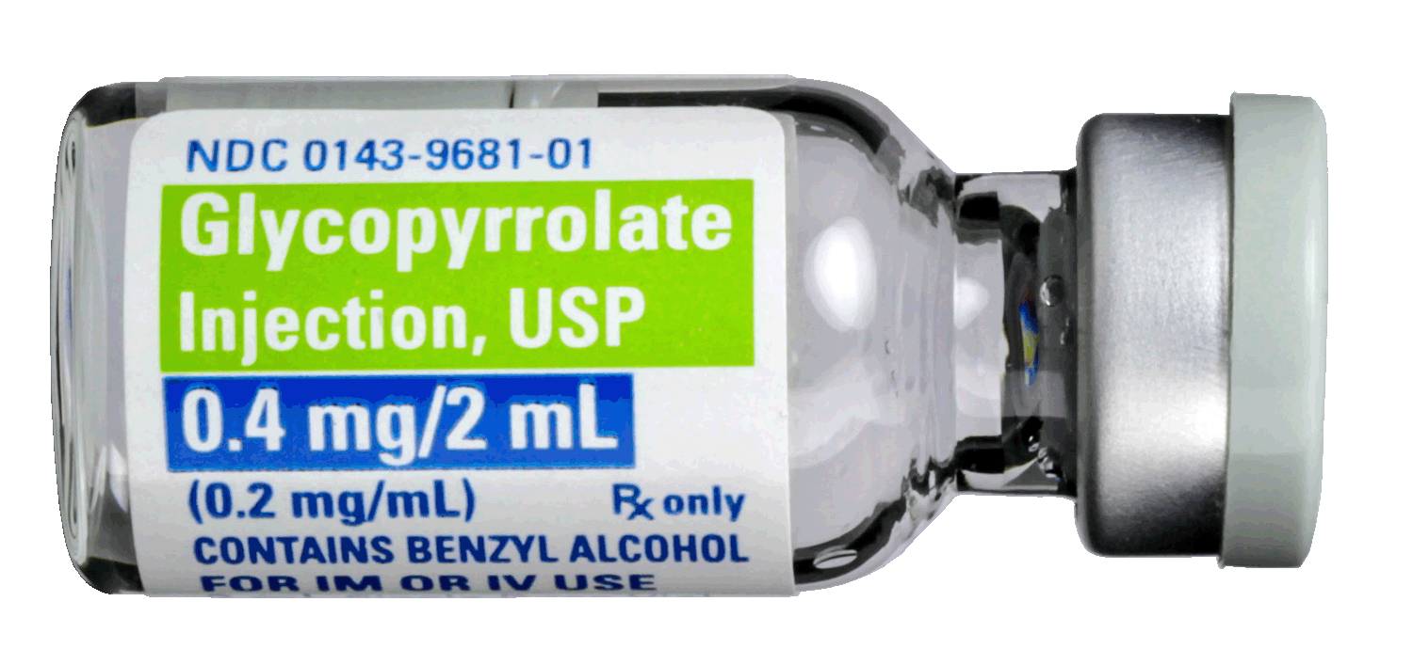
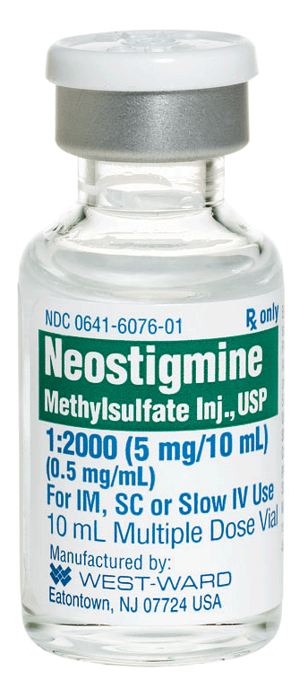
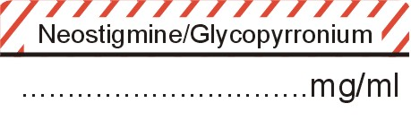

Slide 72
Local Anesthesia

Slide 73
Local Anesthesia:
Cocaine 1884 Carl Koller;
-Water soluble
-Rapid onset
-Sterilizable by heat

Slide 74
Mode of action of local anesthesia:
Prevent the initiation and propagation of the action potential (nerve impulse)
Reducing the passage of sodium through voltage gated sodium channel
They rise the threshold for excitability and block conduction

Slide 75
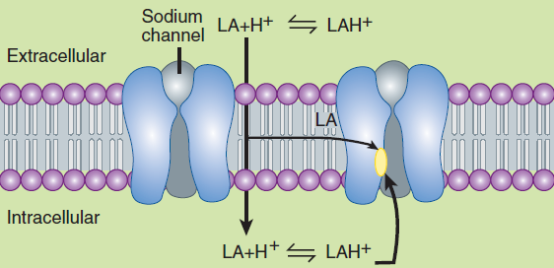
(Mechanism of action of local anesthesia)

Slide 76
The distribution of a single dose la is determined by diffusion into the tissue
Plasma half life is few mints
By infiltration local anesthesia act within 5 min
And have a useful duration of effect for 1-1.5 hors
Can be doubled by vasoconstriction
Local anesthesia is used as an acid salt = HCL

Slide 77
Dissociate in Basic Media
Liberating the active compound HCL
Free base
In abnormally acidic media (abscess)
This dissociation can be delayed
***Also risk of spreading infection

Slide 78
Absorption of topical anesthesia on mucus membrane can be extremely rapid and give plasma concentration comparable to injection
*This is important specially in urethra

Slide 79
Chemical classification of local anesthetics:
1-Esters:
Cocaine, Procaine, tetracaine, Benzocaine
2-Amides:
Lignocaine (Xylocaine) Lidocaine
Prilocaine, Pupivacaine

Slide 80
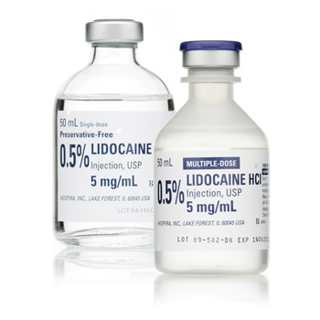
(Xylocaine = Lidocaine)

Slide 81
Effect is terminated by removing the local anesthetic from the circulation.
Delaying this will increase the duration of action of la and decrease systemic absorption.
Most la cause dilatation with the exception of cocaine
Addition of epinephrine (Adrenaline) increase the duration of lidocaine

Slide 82
Never use adrenaline in
Extremities = fingertips
Nose , toes, ..etc
Can lead to Gangrene!

Slide 83
Uses of local anesthesia:
1- Surface anesthesia: solution jelly cream
2- Infiltration anesthesia
3- Regional anesthesia
-Nerve block
-Intravenous regional anesthesia
-Epidural anesthesia
-Intrathecal ( Spinal anesthesia)

Slide 84
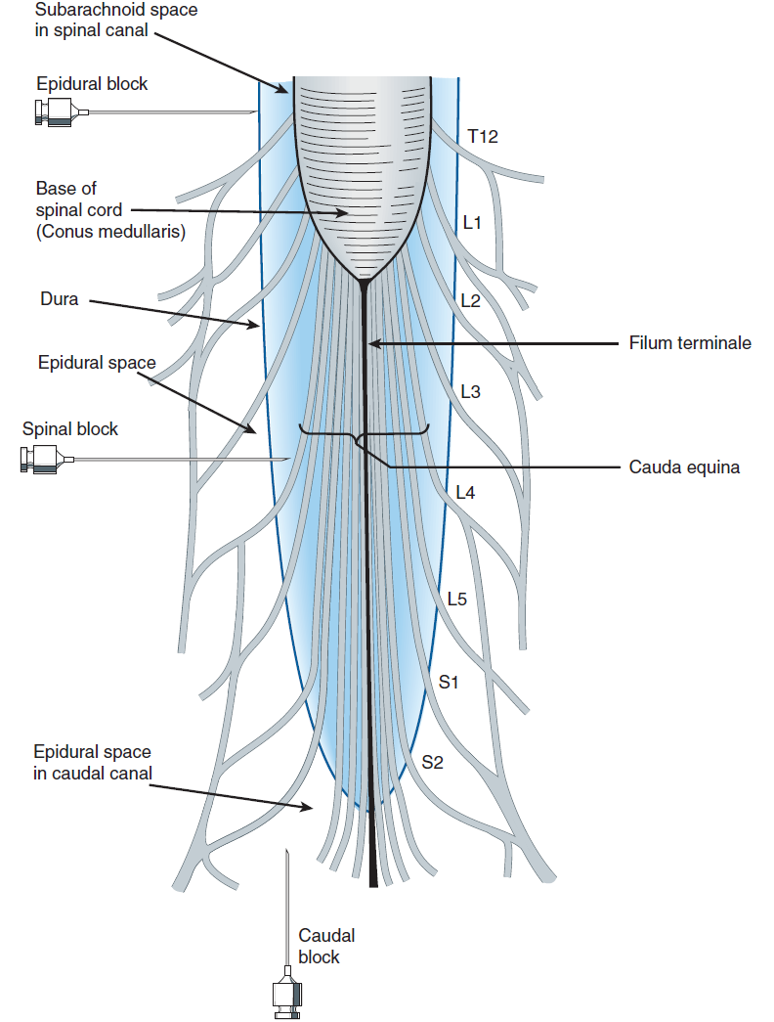
(Sites of Anesthesia)

