Slide 1
Acute upper gastrointestinal bleeding(AUGIB)

Slide 2
Upper gastrointestinal (UGI) bleeding is a common medical condition and an important gastroenterological emergency that results in high patient morbidity and medical care costs and can be fatal.

Slide 3
Mode of presentation
(vomiting of blood) 1. Hematemesis :
Red blood
or
Coffee-ground emesis
Frankly bloody emesis suggests moderate to severe bleeding that may be ongoing.
Coffee-ground emesis suggests more limited bleeding.

Slide 4
2- Melena: (black, tarry, offensive stool)
Melena may be seen with variable degrees of blood loss, being seen with as little as 50 mL of blood.
3. Hematochezia ( is usually due to lower GI bleeding) can occur with massive upper GI bleeding , which is typically associated with orthostatic hypotension

Slide 5
Atypical presentation
Orthostatic dizziness
Confusion
Angina
Severe palpitations
These symptoms suggest severe bleeding

Slide 6
Major causes of upper gastrointestinal bleeding
Common
Duodenal ulcer
Gastric ulcer
Esophageal varices
Mallory-Weiss tear

Slide 7
Less Common
Gastric erosions
Esophagitis
Dieulafoy lesion
Telangiectasias
Portal hypertensive gastropathy
Gastric varices
Neoplasms

Slide 8
Initial evaluation
The goal of the evaluation is:
1. To assess the severity of the bleed.
2. Identify the underlying cause.
3. Determine if there are conditions present that may affect subsequent management (comorbidities)

Slide 9
History
1. Peptic ulcer-like symptoms.
2. Prior history of chronic liver disease.
3. Prior episodes of upper GI bleeding.
4. Drug history: aspirin and other nonsteroidal antiinflammatory drugs (NSAIDs), antiplatelet (clopidogrel) and anticoagulants.
5. Past medical history should be reviewed to identify important comorbid conditions that may influence the patient’s subsequent management.

Slide 10
Physical examination

Slide 11
1. Signs indicative of hypovolemia
1. Resting tachycardia: Mild to moderate hypovolemia
2. Orthostatic hypotension (a decrease in the systolic blood pressure of more than 20 mmHg and/or an increase in heart rate of 20 beats per minute when moving from recumbency to standing) :
Blood volume loss of at least 15 percent.
3. Supine hypotension: Blood volume loss of at least 40 percent.

Slide 12
2. Physical signs indicative of possible cause
- Stigmata of liver cirrhosis
- Lymph node enlargement
- Mucocutaneous telangiectasia
- Epigastric mass.
- Abdominal signs of portal hypertension (ascites, splenomegaly)

Slide 13
3.Signs of significant co-morbid disease
1. Heartnfailure
2. Signs of chronic renal failure (CRF)
3. Signs of COPD

Slide 14
Laboratory data
1. A complete blood count
2. Serum chemistries(urea, creatinine, electrolytes)
3. liver tests
4. Coagulation studies.
5. Serial electrocardiograms and cardiac enzymes may be indicated in patients who are at risk for a myocardial infarction, such as the elderly, patients with a history of coronary artery disease, or patients with symptoms such as chest pain or dyspnea.

Slide 15
Hemoglobin
1. The initial hemoglobin in patients will often be at the patient’s baseline and can be normal because the patient is losing whole blood.
2. With time (typically after 24 hours or more) the hemoglobin will decline as the blood is diluted by the influx of extravascular fluid into the vascular space and by fluid administered during resuscitation.
3.The hemoglobin level is monitored every two to eight hours, depending upon the severity of the bleed.

Slide 16
Patients with acute bleeding should have normocytic red blood cells.
Microcytic red blood cells or iron deficiency anemia suggest chronic bleeding

Slide 17
Urea-to-creatinine
Patients with acute upper GI bleeding typically have an elevated blood urea nitrogen (BUN)
Urea-to-creatinine ratio is high.
The higher the ratio, the more likely the bleeding is from an upper GI source

Slide 18
Nasogastric lavage
Advantages:
1. It confirms an upper GI source of bleeding.
2. Indicate ongoing bleeding and the need for urgent endoscopy.
3.. It can be used to remove food residue, fresh blood, and clots from the stomach to facilitate endoscopy
Lavage may not be positive if bleeding has ceased or arises beyond a closed pylorus

Slide 19
Treatment

Slide 20
1.General support
nothing per oral)) 1. NPO
2. Adequate vascular access: 2, 16 gauge or larger
caliber peripheral intravenous catheters or a central venous line should be inserted
4. Elective endotracheal intubation in patients with :
Ongoing hematemesis
Altered respiratory or mental status
To facilitate endoscopy and decrease the risk of aspiration.

Slide 21
2.Fluid resuscitation
Adequate resuscitation and stabilization is essential prior to endoscopy to minimize treatment-associated complications
Patients with active bleeding should receive intravenous fluids (eg, 500 mL of normal saline over 30 minutes) while being typed and cross-matched for blood transfusion
If the blood pressure fails to respond to initial resuscitation efforts, the rate of fluid administration should be increased

Slide 22
ICU admission
Indications
1. Hemodynamic instability (shock, orthostatic hypotension)
2. Active bleeding (manifested by vomiting of bright red blood , or hematochezia)
For :
1. Resuscitation
2. Close observation of:
Blood pressure
Electrocardiogram
Pulse oximetry.

Slide 23
3.Blood transfusions 3.
The decision should be individualized:
1. Low risk patient(young adults without comorbid illnesses ): restrictive transfusion strategy (blood is given if HB below 7 g/dL)
2. High-risk patients (eg, older adults or those who have severe comorbid illnesses such as coronary disease or heart failure) should receive packed red blood cell transfusions to maintain a hemoglobin level of at least 10 g/dL.
3. Patients with active bleeding and hypovolemia may require blood transfusion despite apparently normal hemoglobin.

Slide 24
Care should be taken not to over-transfuse patients with suspected variceal bleeding, as doing so can precipitate worsening of the bleeding .
In such patients, we suggest a goal hemoglobin level of no greater than 10 g/dL

Slide 25
4. Pharmacotherapy
:1. Proton pump inhibitors (PPI)
Should be started at presentation and continued until confirmation of the cause of bleeding.
2. Vasoactive drugs (terlipressin or octerotide ):
Should be initiated as soon as variceal bleeding is suspected

Slide 26
Beneficial effects of PPI
PPI therapy also decrease the length of hospital stay, rebleeding rate, and need for blood transfusion in patients with high-risk ulcers treated with endoscopic therapy
PPIs may also promote hemostasis in patients with lesions other than ulcers.

Slide 27
Value of acid suppression
Acid has been shown to inhibit platelet aggregation and even favors platelet disaggregation.
Acid is also known to facilitate clot lysis through the activation of pepsin, which occurs at pH levels below 2
The pH target required to avert these deleterious effects and favor hemostasis is thought to approximate 6.0 to 6.5

Slide 28
DIAGNOSTIC STUDIES
Upper endoscopy :
Early endoscopy (within 24 hours)
1. Diagnostic
2. Therapeutic

Slide 29
Bleeding peptic ulcer
The endoscopic appearance helps determine which lesions require endoscopic therapy
- Spurting hemorrhage
- Visible vessel
- Adherent clot
The absence of all of these stigmata identifies a subgroup of patients who can be discharged early from the hospital.

Slide 30
Forrest classification of bleeding peptic ulcers
Grade Ulcer appearance
Ia Spurting haemorrhage
Ib Oozing haemorrhage
IIa Non-bleeding visible vessel
IIb Adherent clot
IIc Flat pigmented spot
III Clean ulcer base
Forrest JA, et al. Lancet 1974;17:394–7
Notes:
Forrest classification of bleeding peptic ulcers
Based on the endoscopic findings, bleeding peptic ulcers can be categorized according to the Forrest classification.¹
1. Forrest JA, et al. Lancet 1974:17:394–7.

Slide 31
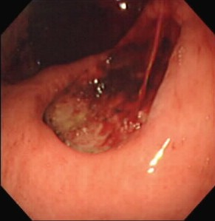
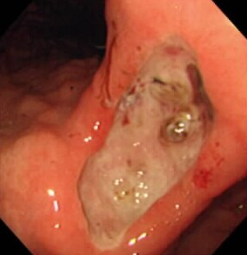
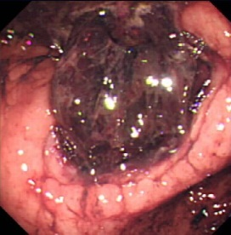
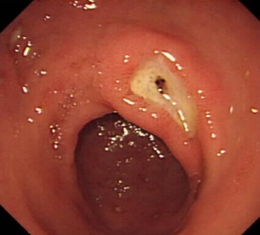
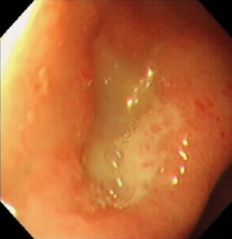
Risk of re-bleeding by Forrest grade
Patients with endoscopic or clinical re-bleeding (%)
100
80
Forrest I*
Forrest IIa
Forrest IIb
Forrest IIc
Forrest III
60
55
40
43
20
22
10
5
0
Laine L & Peterson WL. N Engl J Med 1994;331:717–27
*Patients did not receive endoscopic therapy
Notes:
Risk of re-bleeding by Forrest grade
The prevalence of ulcer re-bleeding is highest in patients with Forrest grade I (55% among those not receiving endoscopic therapy), compared with 43% with grade IIa, 22% with grade IIb, 10% with grade IIc and 5% with grade III. Thus, the Forrest grading of a bleeding peptic ulcer is predictive of the risk of re-bleeding.¹ Furthermore, despite having received endoscopic haemostasis, 19.6% of those with Forrest grade l in the study by Lau et al. (shown on the previous slide) also experienced re-bleeding within 72 hours.²
There is therefore a large unmet medical need in this area, as there is no approved drug to treat these patients and prevent re-bleeding.
1. Laine L & Peterson WL. N Engl J Med 1994;331:717–27
2. Lau JY, et al. Endoscopy 1998;30:513–18.

Slide 32
5.Endotherapy
1. Bleeding PU: A variety of endoscopic methods have been described to control active bleeding from peptic ulcers. The most commonly used modalities are: a. Injection therapy(diluted adrenaline)
b.Thermal techniques (heat probes)

Slide 33
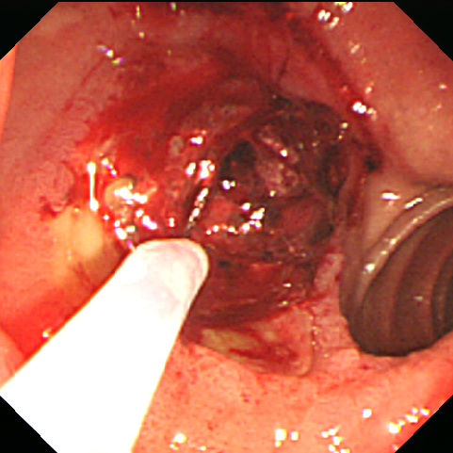
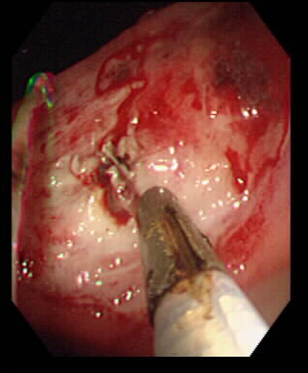
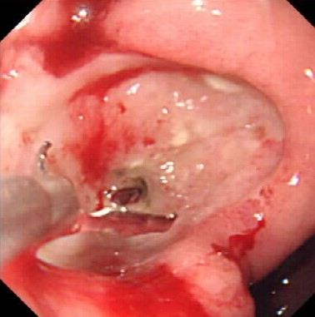
Endoscopic haemostasis
Epinephrine injection
Heater probe
Haemoclip
Monotherapy with either epinephrine injection or thermal treatment (e.g. with a heater probe)
or
A combination of epinephrine injection plus thermal treatment and/or haemoclips
Notes:
Endoscopic haemostasis
Since the late 1980s, endoscopic haemostasis has been widely accepted as the first-line therapy for upper GI bleeding. Contemporary endoscopic treatments include injection therapy (e.g. saline, vasoconstrictors, sclerosing agents, tissue adhesives), thermal therapy (with the use of contact methods, such as multipolar electrocoagulation and heater probe, or non-contact methods, such as argon plasma coagulation) and mechanical therapy (principally endoscopic clips). In practice it usually consists of an epinephrine injection, which has a vasoconstrictive effect and has been shown to help to stop the bleeding, combined with either heater-probe coagulation or the use of mechanical devices such as haemoclips.¹
While endoscopic therapy is effective in achieving initial haemostasis in more than 90% of cases,² the focus then has to turn to preventing re-bleeding, which is experienced by up to 20% of patients and is associated with a high risk of mortality.³
Sung J. Nat Clin Pract Gastroenterol Hepatol 2006;3:24–32.
2. Netzer P, et al. Am J Gastroenterol 1999;94:351–7.
3. Lau J, et al. N Engl J Med 2000;343:310–16.

Slide 34
6.Surgery
Indications:
Failure of endoscopic therapy
Hemodynamic instability despite vigorous resuscitation (more than a three units transfusion)
Recurrent hemorrhage after initial stabilization (with up to two attempts at obtaining endoscopic hemostasis)
Continued slow bleeding with a transfusion requirement exceeding three units per day

Slide 35
Esophageal varices

Slide 36
1. Pharmacological therapy
Using vasoactive drugs should be initiated as soon as :variceal hemorrhage is suspected
Terlipressin should be the first choice
Octerotide infusion is an alternative option

Slide 37
2. Endotherapy
Endotherapy should be done as soon as possible under resuscitation, preferably within 6 h of admission
a. Endoscopic variceal ligation (EVL )with multiband ligator is the treatment of choice for acute esophageal variceal bleeding
b. Injection sclerotherapy (EST) is indicated EVL is not available or is not technically feasible
.

Slide 38
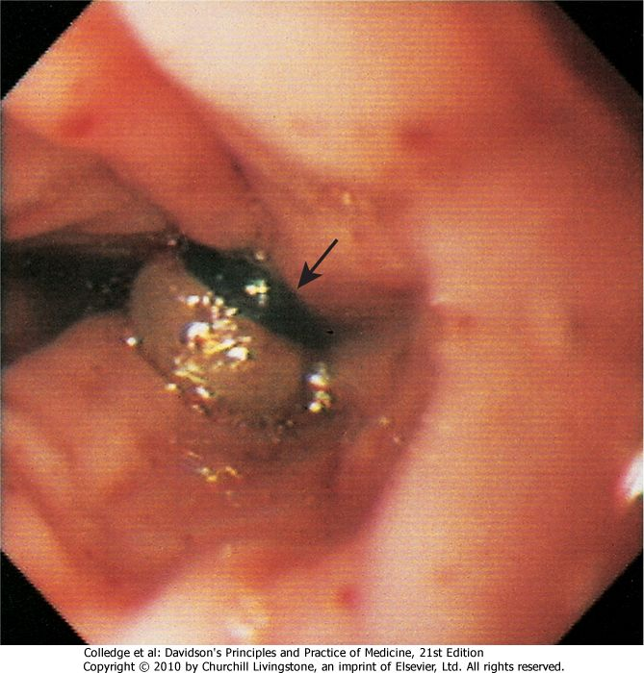

Slide 39
3. Sengestaken tube
Balloon tamponade (Sengestaken tube) should only be used in uncontrolled bleeding as a temporary ‘‘bridge’’until definitive treatment can be instituted for a maximum of 12 hrs.
This technique employs a Sengstaken-Blakemore tube possessing two balloons which exert pressure in the fundus of the stomach and in the lower oesophagus respectively

Slide 40
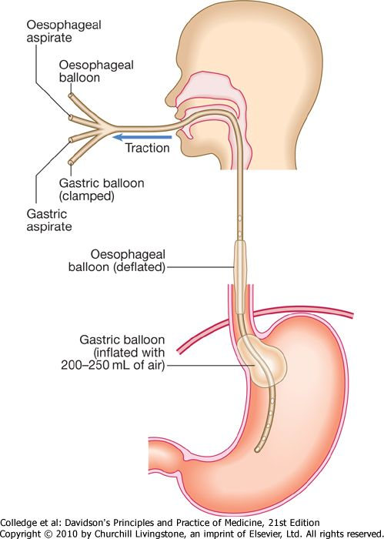

Slide 41
3. Transjugular intrahepatic portovenous shunt (TIPS)
This technique uses a stent placed between the portal vein and the hepatic vein within the liver to provide a portosystemic shunt and therefore reduce portal pressure
Indications:
1. Persistent variceal bleeding
2. Rebleeding
Despite combined pharmacological and endoscopic therapy

Slide 42
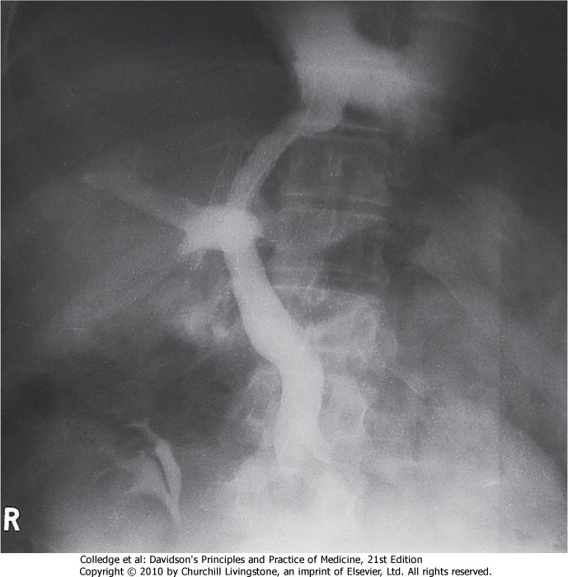

Slide 43
4. Portosystemic shunt surgery
Surgery prevents recurrent bleeding, but carries a high mortality and often leads to encephalopathy

Slide 44
5. Antibiotics
Bacterial infections are present in up to 20 percent of patients with cirrhosis who are hospitalized with gastrointestinal bleeding and up to an additional 50% develop an infection while hospitalized.
Such patients have increased mortality.

Slide 45
Emergency management of bleeding varices
Management | Reason
i.v fluids (1-2 L) | Extracellular volume replacement
Vasopressor (terlipressin) | Reduces portal pressure, acute bleeding and risk of early rebleeding
Prophylactic antibiotics (cephalosporin i.v.) | Reduces incidence of SBP
Emergency endoscopy | Confirm variceal rather than ulcer bleed
Variceal band ligation | To stop bleeding
Proton pump inhibitor | To prevent peptic ulcers
Phosphate enema and/or lactulose | To prevent hepatic encephalopathy

Slide 46
Prevention of recurrent P.U bleeding
Depend on the eitiology of ulcer:
1. H. pylori is eradicated and after cure is documented anti-ulcer therapy is generally not given.
2. Nonsteroidal anti-inflammatory drugs (NSAIDs)
are stopped; if they must be resumed low-dose COX-2-selective NSAID plus PPI is used.
3. Patients with established cardiovascular disease who require aspirin should start PPI and generally re-institute aspirin soon after bleeding
ceases (within 7 days and ideally 1 – 3 days).
4. Patients with idiopathic ulcers receive long-term anti-ulcer therapy

