Slide 1
Diuretic Drugs

Slide 2
Lecture 1
1-Overview
2-Classification
3-Indiviual drugs

Slide 3
Lecture 2
1-Indications of Diuretics.
2-Adverse effects.
3-Mannitol and Carbonic Anhydrase inhibitors.

Slide 4
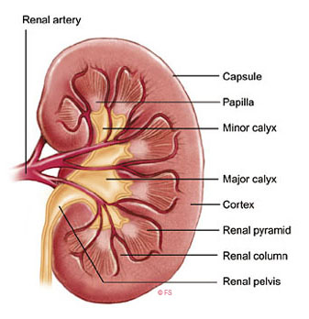
Overview
The kidneys
Comprise 0.5% of body weight
But
They receive 25% the cardiac output

Slide 5
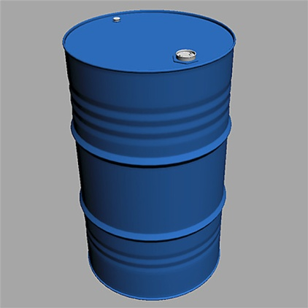
Overview
Each day the body produce 180 liter of glomerular filtrate
1.5 liters of urine

Slide 6
Overview
If only 1 % of re-absorption is affected ?
Vast increase in urine output
“Doubled”

Slide 7
Definition:
A diuretic:
Is any drug which causes increase in water and solute excretion in the urine.
Sodium is the most important solute.

Slide 8
Classification
According to the Site of action.
(understanding)
According to the Efficacy.
(clinical use)

Slide 9
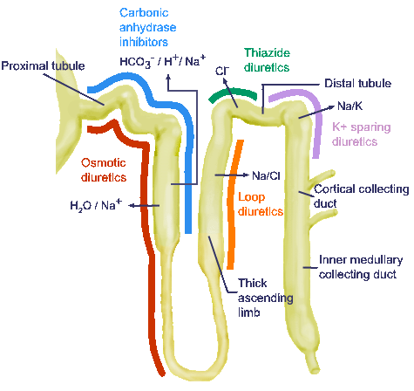
Classification according to the site of action
The kidney contains
1,000,000 unite
(Nephron)
(Basic unite)

Slide 10
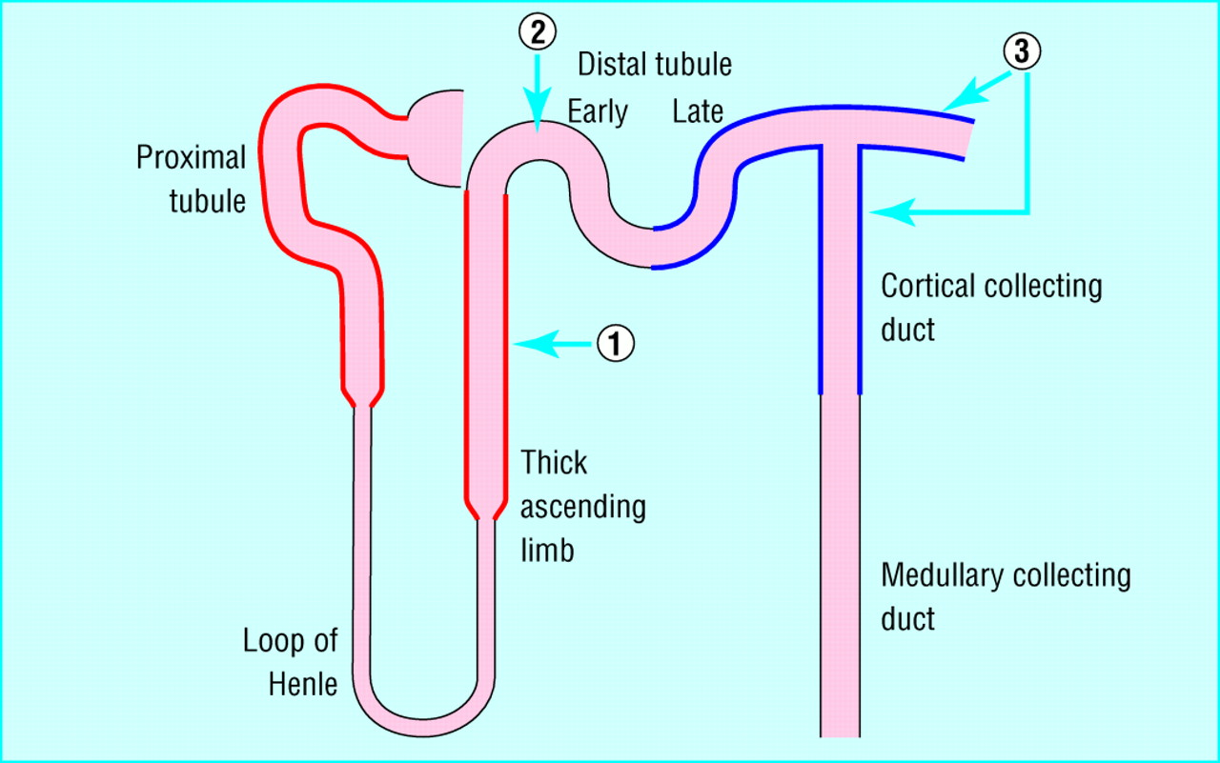

Slide 11
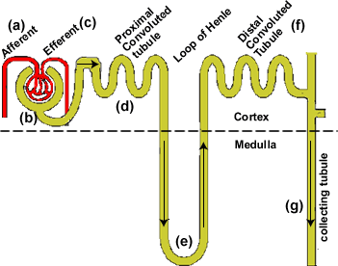

Slide 12
1-Proximal convoluted tubule(PCT)
65 % of filtered sodium is reabsorbed in:
PCT
Na-K ATPase
Cl also re-absorbed

Slide 13
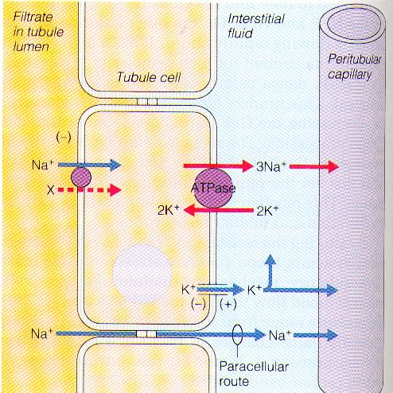

Slide 14
Proximal convoluted tubule(PCT)
1-Osmotic diuretic.
2- Carbonic Anhydrase Inhibitors.

Slide 15
2-Loop of Henle
25 % of filtered sodium is re-absorbed
Ascending (Thick )
Na and Cl
“Interstitial concentration”
Hypertonic Medullary Concentration

Slide 16
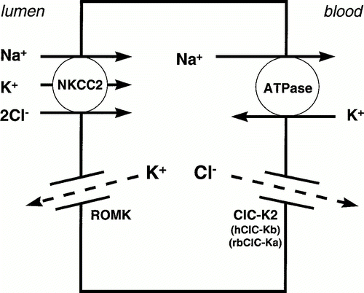

Slide 17
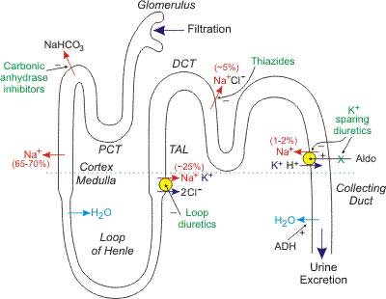

Slide 18
Loop of Henle
Descending loop is permeable to water
Loop of Henle is the site of action of
“Loop diuretics”

Slide 19
3-Distal convoluted tubule(DCT)
Is the site of Thiazide diuretics

Slide 20
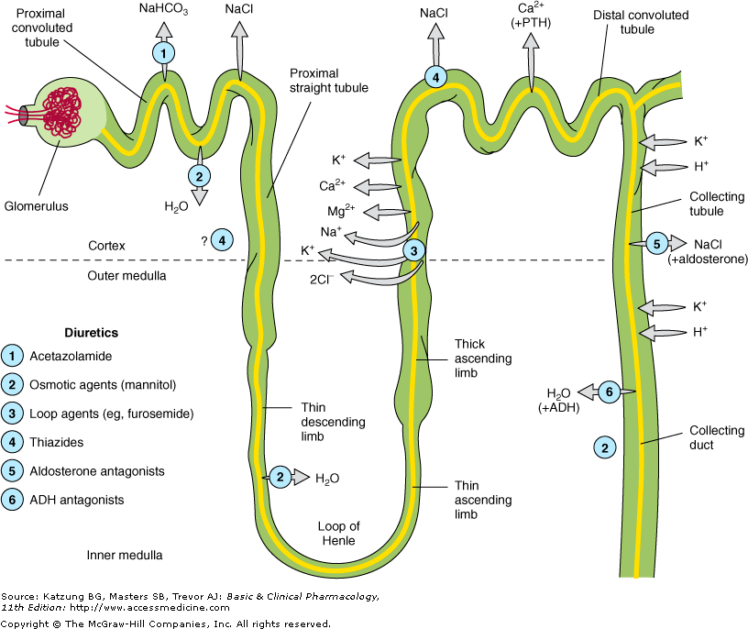

Slide 21
4-Collecting duct
Na
Is exchanged for
K and H
Mineralocorticosteroid
“Aldosterone”

Slide 22
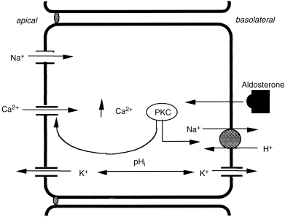

Slide 23
Collecting duct
Final concentration step is under ADH control
Ethanol decrease ADH hormone

Slide 24
Collecting ducts
Is the site of action of Aldosterone antagonists
Spironolactone
“K-sparing Diuretics”

Slide 25
Classification acoording to the efficacy
1- High efficacy
2-Intermediat efficacy
3-Low efficacy

Slide 26
1-High efficacy diuretics
Furosemide
Frusemide
Decrease the urine concentration mechanism at loop of Henle
Affecting the medullary concentration mechanism
25% of filtered sodium excreted

Slide 27
High efficacy diuretics
Furosemide
Frusemide
Increasing the dose will increase the effect
“No Ceiling”

Slide 28
High efficacy diuretics
Furosemide
Frusemide
Overtreatment can induce dehydration
It is active even if the GFR is < 10 ml/min
Normal GFR = 120 ml/ min

Slide 29
2-Moderate efficacy
Thiazide family drugs
Bendrofluazide
Chlorthalidone
Indapamide

Slide 30
Moderate efficacy
Thiazide family drugs
Increasing the dose will NOT increase the effect
“Low ceiling”
Ineffective when GFR < 20 ml/ min

Slide 31
3-Law efficacy
Potassium sparing diuretics
Osmotic diuretic
Spironolactone (Aldosterone antagonist)
Amiloride
Triamterene

Slide 32
Law efficacy
Potassium sparing diuretics
2-3 % of filtered sodium is excreted by k sparing diuretics

Slide 33
3-Individual Drugs
Furosemide (Lasix)
Thiazides
Amiloride

Slide 34
Furosemide (Lasix)
Acts on the thick portion of loop of Henle (ascending)
K loss and hypokalemia
Mg and calcium loss also occur

Slide 35
Pharmacokinetics of Furosemide
Well absorbed
Half Life = 2 hours
10 hours in renal failure
20- 120 mg / day
20 mg amp

Slide 36
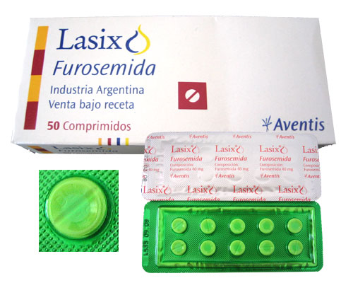

Slide 37
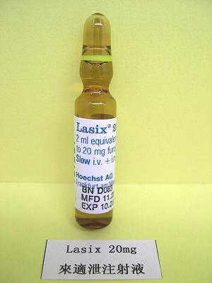

Slide 38
Furosemide (Lasix)
Adverse effects
Uncommon
electrolyte disturbance
Hypotension, nausea rarely deafness which is transient

Slide 39
Furosemide (Lasix)
Other Loop Diuretics:
Bumetanide 0.5-2 mg/day
Ethacrynic acid 50 mg/day

Slide 40
Thiazides
DCT increasing k exertion
Reduce the blood pressure
1- reduction of intravascular volume.
2-reduction in peripheral vascular resistance.
Direct effect on vascular smooth muscle.

Slide 41
Thiazides
Used in:
1-Cardiac failure in combination with other drugs.
2-Hypertension.

Slide 42
Thiazides
Well absorbed acting within an hour of administration.
Half life less than 4 hours.

Slide 43
Thiazides
Adverse Effects
Rashes and photosensitivity.
Thrombocytopenia.
Increase total plasma cholesterol

Slide 44
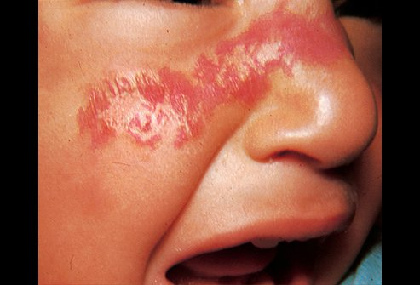
Photosensitivity

Slide 45
Thiazides
Bendroflumethiazide 5- 10 mg orally at the morning.
1.25-2.25 mg as anti hypertensive.
Hydrochlorthazide 25-100 mg/day

Slide 46
Spironolactone
(Aldactone)
Structurally related to Aldosterone
“Competitive inhibitor of Aldosterone”

Slide 47
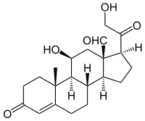
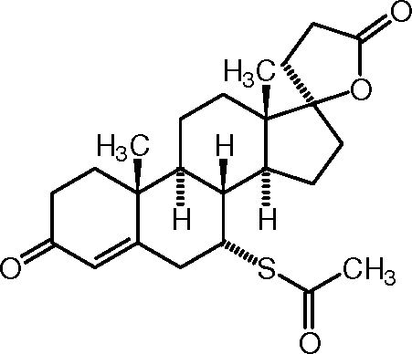
Aldosterone
Spironolactone

Slide 48
Low efficacy diuretics
Spironolactone (Aldactone)
1-Hepatic cirrhosis and Nehrotic Syndrome.
2-Congestive heart failure.

Slide 49
Spironolactone (Aldactone)
Short half life = 1.6 hours
Ineffective alone but more effective when given with other drugs

Slide 50
Spironolactone can be used with loop diuretics
Impaired renal function may increase the potassium
Contra indicated

Slide 51
Spironolactone dose is 100- 200 mg
Per day.

Slide 52
Spironolactone
Adverse reactions
1-Estrogenic effect which is dose dependent.
Breast tenderness and enlargement.
10 % of male patients breast discomfort.
Menstrual irregularity.
2-Carcinogenic in rodents.

Slide 53
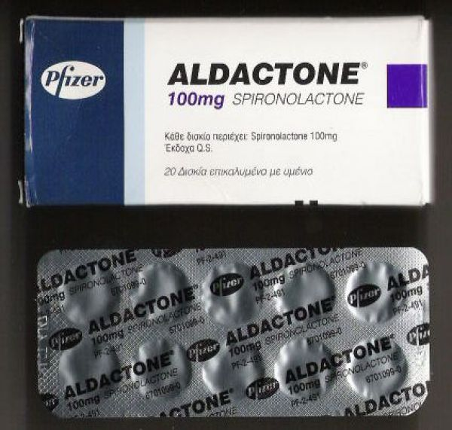

Slide 54
Amiloride
Mechanism of action:
Directly blocking the epithelial sodium channel (ENaC) in the DCT.
Inhibiting sodium re-absorption in the distal convoluted tubule.

Slide 55
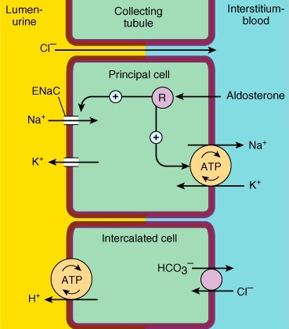

Slide 56
Amiloride
Dosage: 5- 10 mg/ day

Slide 57
Combination Formulae
Amiloride + Hydrochlorothiazide
2.5-5 mg Amiloride
25-50 mg Hydrochlorothiazide
(Moduretic)
Hypertension and edema

Slide 58
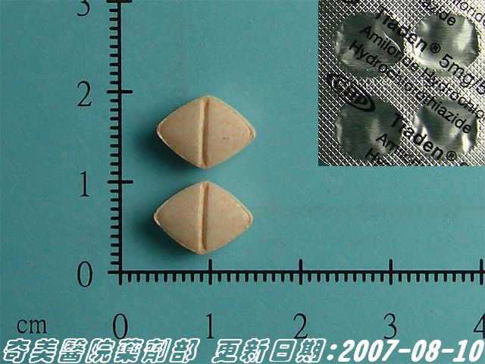

Slide 59
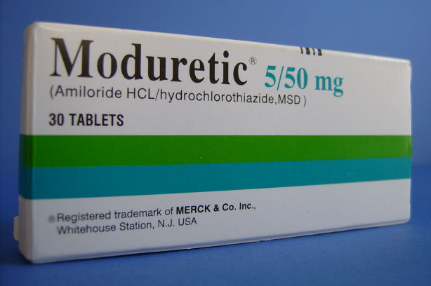

Slide 60
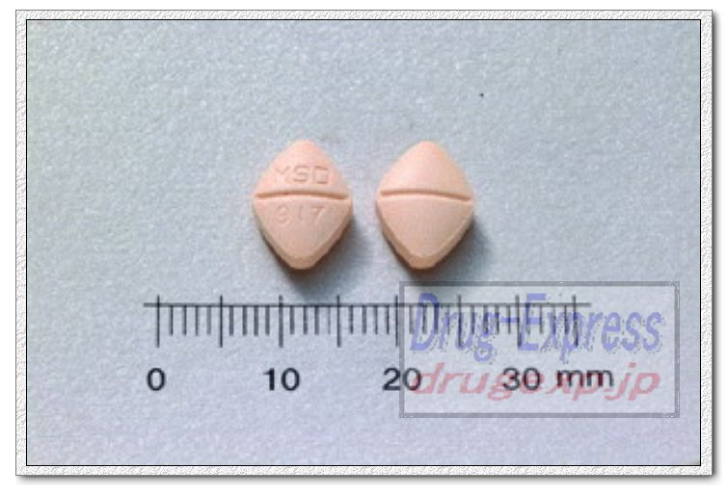

Slide 61
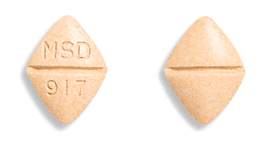

Slide 62
MCQs
High efficacy diuretics acts on:
A-Proximal con. Tubule
B-Loop of Henle.
C-Distal Con. Tubule.
D-Collecting Ducts.

Slide 63
MCQs
All the following drugs are potassium sparing diuretics except:
A-Amiloride.
B-Spironolactone.
C-Triamterene.
D-Furosemide.

Slide 64
MCQs
Which one of the following diuretics has estrogenic effect?
A-Amiloride.
B-Spironolactone.
C-Frusemide.
D-Hydrochlorothiazide.

Slide 65
MCQs
The main solute excreted by diuretics is;
A-Potassium.
B-Sodium.
C-Chloride.
D-Calcium.

Slide 66
MCQs
Dehydration due to overtreatment is most common with:
A-Spironolactone.
B-Amiloride
C-Furosemide.
D-Hydrochlorothiazide.

Slide 67
MCQs
It is best to take Furosemide:
A-At the morning.
B-At the afternoon.
C-Before dinner.
D-At Bedtime.

Slide 68
MCQs
All the following diuretic combinations are wrong except:
A- Furosemide + Ethacrynic acid.
B-Hydrochlorothiazide + Amiloride.
C-Amiloride + Spironolactone.
D-Chlorthalidone + Indapamide.

Slide 69
MCQs
Which one of the following diuretics has a significant effect on plasma cholesterol?
A-Furosemide.
B-Thiazides
C- Ethacrynic acid.
D-Spironolactone.

Slide 70
MCQs
Which diuretic is structurally similar to Aldosterone?
A-Furosemide.
B-Thiazides
C-Spironolactone.
D-Amiloride.

Slide 71
MCQs
Combination in diuretics are used to:
A-Increase efficacy.
B- Minimize the adverse reactions.
C-Improve the patient compliance.
D- All of the above.

