Slide 1
و ما أوتيتم من العلم الا قليلا
د.برع سلطان
مدرس جراحة الفم والوجه والفكين
BDS , MSc , FICMS
R

Slide 2
Oral surgery is that branch of dentistry which deals with the diagnosis , prevention and\ or treatment of disease of the oral cavity.
The branch of oral surgery now has moved from simple extractions to complex surgeries . the oral surgeon is now referred to as a maxillofacial surgeon. There are no sharp lines separating the maxillofacial surgeon from an ENT or a plastic surgeon and therefore many of us are referred to as ”craniofacial surgeons”

Slide 3
Oral and maxillofacial surgery involves the diagnosis and management of diseases , injuries, and defects of the human mouth and jaws and associated structures.
In most countries , the speciality of oral and maxillofacial surgery has earned the respect of and acceptance of both the medical and dental professions.

Slide 4
Oral and maxillofacial surgery is an exciting and rapidly growing specialty that has undergone tremendous changes in both the training requirements and scope of practice.

Slide 6
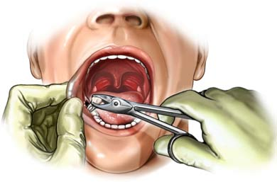
Dental Extraction:
Dental Extraction is defined as :
“The removal of a tooth from oral cavity by means of elevators and forceps”.
Also referred as “Exodontia”.

Slide 7
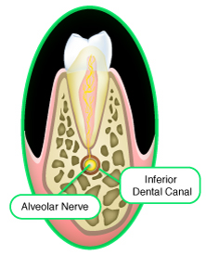
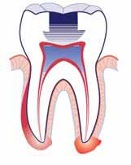
EXODONTIA

Slide 8
Tooth extraction :the ideal tooth extraction is the painless removal of the whole tooth or roots from its socket with minimal trauma to the investing tissues , so that the wound heals normally with no post operative prosthetic problem .

Slide 9
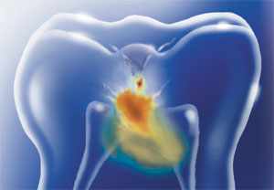
Indications Of Extraction:
Indications advocated for dental extraction:
1-Unrestorable carious tooth.
2 -Pulp necrosis and irreversible pulpitis;untreatable by endodontic therapy,due to calcified root canal,or patient refusal.

Slide 12
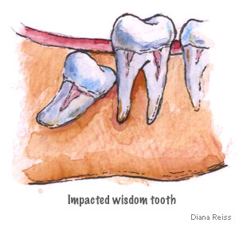
Indications Of Extraction:
3 -Severe periodontal disease; Bone loss,grade 3 mobility,furaction involvement.
4- -Impacted teeth ,resorption of roots of adjacent teeth.

Slide 14
Indications Of Extraction:
5 -Orthodontic treatment ; Crowding,Space creation.Maxillary and Mandibular 1st Pre-molar.
6 -Mal-alligned teeth ; Tissue trauma,mal-positioning,esthetics.

Slide 15
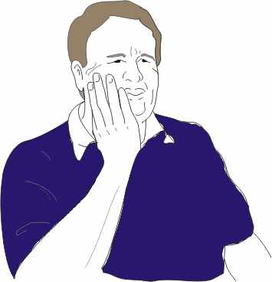
Indications Of Extraction:
7 -Esthetics ; Stained teeth, excessively protruded teeth,mal-alligned.
8 -Cracked and fractured tooth ;Tooth in fracture line,pain,Dialceration,, infection.

Slide 16
Indications Of Extraction:
9 -Pre-prosthetic extraction ; Unsuitable abutments,interference with appliance
10 -Supre-numerary teeth ; Impacted,resorption, displacement,failure for eruption.

Slide 17
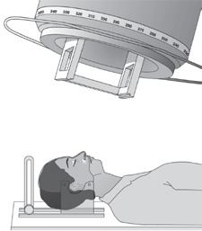
Indications Of Extraction:
11-Pre-radiation therapy ; to prevent Osteoradionecrosis.
12 -Economical reason ; Unaffording patient.
13 -Lack of time ; Unavailability of time for other
options. 14- peri apical lesion or other pathology.

Slide 18
Periapical lesion associated with endodotically treated canals

Slide 19
Regression of the lesion 6 months after retreatment of the tooth

Slide 20
Contraindications Of Extraction:
Contraindications for Dental Extraction
Systemic Local

Slide 21
Local contraindications
1- Irradiated jaw which may lead to osteoradionerosis due to endarteritis obliterans
2-Tooth located within the area of tumor.
Cause: metastasis.
3-Acute pericoronitis around a partially erupted lower third molar
Cause: trismus preoperatively & dry socket post operatively.
4-Acute cellulites
5- Acute alveolar abcess
6- Acute infectious stomatitis

Slide 22
Systemic contraindications
Uncontrolled diabetes mellitus
Reason: infection & delayed healing
End stage renal disease &uremia

Slide 23
Uncontrolled bleeding problems like hemophilia and thrombocytopenia.
Uncontrolled hyper tensive patient.
Uncontrolled cardiac disease .No surgery is performed within 1st 6 months due to high incidence of cardiac instability & arrhythmias
Addison’s disease
Fever of unexplained origin
Suspected bacterial endocarditis
Pregnancy: 1st and 3rd trimesters . Relative contra indication.

Slide 25
9- uncontrolled thyroid disease.
Uncontrolled liver disease (bleeding)
Patient taking specific drugs : corticosteroids ,immunosuppressive ,
chemotherapeutic agents).
Senility: poor physiological response to injury.
Psychosis & neurosis , epileptic patients.

Slide 26
Uncontrolled pulmonary disease e.g. Asthma .
15 – uncontrolled epileptic patient

Slide 27
As a rule; any uncontrolled systemic
disease is considered as a contraindication for surgery (tooth extraction)

Slide 28
Instruments used
in tooth extraction

Slide 29
A basic examination set, including dental mirror, dental probe, tweezers and gauze.
Strong light and adequate suction.
Local anesthetic , needle , dental syringe , and local anesthetic carpule.
Dental extraction instrument like dental forceps and dental elevators.

Slide 30
Diagnostic instruments
Dental mirror
Tissue reflection
Indirect vision of inaccessible areas
Light reflection.
Checking of local anesthesia.

Slide 32
Dental probe
Detection of carious lesion or cavitations especially mesialy or distally
Percussion to detect tenderness ( percussion of teeth mean use the handle of dental mirror or probe to tap teeth to elicit pain, indicative of apical periodontitis, usually in non vital teeth.
Checking of anesthesia

Slide 33
Tweezers:
For carrying cotton and gauze to & from oral cavity
Periodontal ligament separation and checking of anesthesia before extraction
During suture removal
Removal of any tooth fragment from site of the surgery

Slide 35
DEFINITIONS
Dental forceps : A surgical instrument used in the extraction of teeth. Handle (shank) + beaks (blades)
Joined by a hinge joint .
Elevator (exolever) : is a single bladed instrument used to luxate or extract teeth or roots.

Slide 38
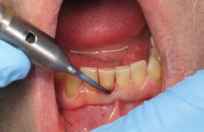
Periotome
What is periotome?

Slide 39
One way to reduce trauma to adjacent bone during tooth extraction is via use of the periotome. Periotomes are extraction instruments that employ the mechanisms of “wedging” and “severing” to facilitate tooth removal. Periotomes are composed of very thin metallic blades that are gently wedged down the periodontal ligament (PDL) space in a repetitive circumferential fashion. In addition to minimally invasive luxation, the periotome blade severs Sharpey’s fibers that secure the tooth within the socket.

Slide 40
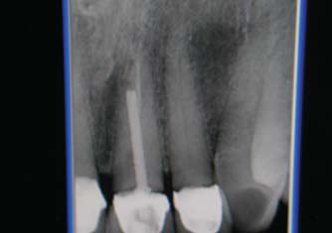
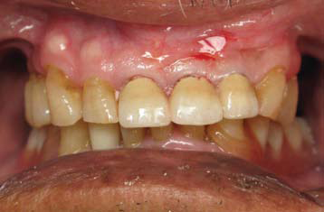
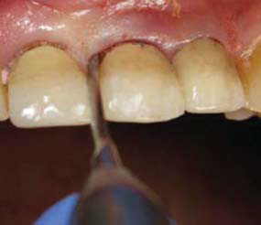
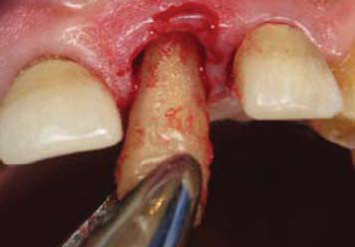
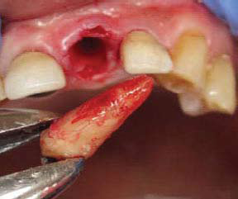

Slide 41
Thank You:

