Slide 1
Lecture two

Slide 2
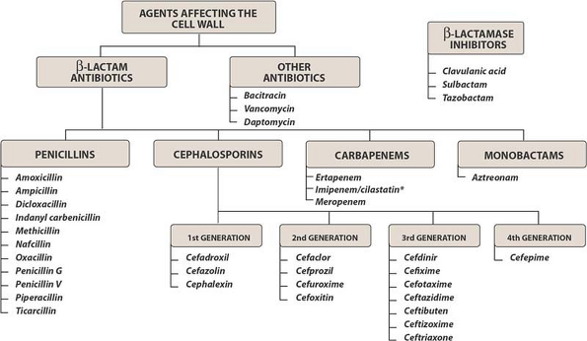

Slide 3
1. Inhibitors of bacterial cell wall synthesis
β-lactams( penicillins, cephalosporins ).
Vancomycin

Slide 4
Antibiotic selectively interfere with the synthesis of bacterial cell wall (a structure that mammalian cell do not possess ) the cell wall is a polymer called peptidoglycan that consist of glycan unit joint to each other by peptide cross –links and the designation of peptidoglycan cell wall to be maximally effective .
These agents require actively proliferating M.O , they have little or no effect on bacteria that are not growing and dividing . Eg B-lactam ring which essential to their activity .

Slide 5
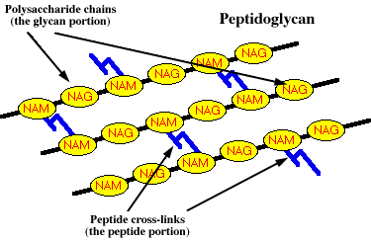

Slide 6
Penicillins
Mechanism of action
It interfere with last step of cell synthesis by inactivation of some penicillin binding protein which a bacterial enzymes involve d in –bacterial cell wall synthesis.
or penicillin Inhibit transpeptidase (enzyme responsible for cross –linkage between peptidoglycan chain ).
or by activation of autolysins.
All resulting in exposure of the osmotically less stable membrane and cell lysis occur so it Bactericidal and only effective against rapidly growing organism that synthesis peptidoglycan cell wall .

Slide 7
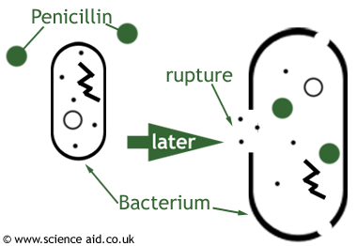

Slide 8
Antibacterial spectrum
Good gram ve+, fair gram ve –
Structure :
all penicillin contain the nucleus 6-aminopenicillinic acid (for biological activity ) penicillins consist of Thiazolidine ring , connected to B-lactam ring to which attached a side chin (R).
the addition of organic group at R position create the various penicillins. The penicillin can be inactivated by any reaction that remove R group or in case of penicillinase break the B-lactam
ring

Slide 9
Penicillins
β
T

Slide 10
Penicillin class | Drug | Antimicrobial spectrum
Natural Penicillins | Penicillin G Penicillin V | gram+ cocci and bacilli,some gram– cocci (Neisseria)
Penicillinase resistant penicillin | Nafcillin,methacillin Cloxacillin Dicloxacillin Oxacillin | Staphylococcus aureus
extended-spectrum (Aminopenicillins) | Ampicillins Amoxicillin Bacampicillin | Extended spectrumSame as Pen G plus some gram(–) organisms
antipseudomonas | Ticarcillin Piperacillin Carbenicillin Mezlocillin | gram(–)coverage, including Pseudomonas
Penicillin/β - Lactamase inhibitor combination | amoxicillin clavulanate (Augmentin) ampicillin/sulbactam (Unasyn) piperacillin/tazobactam (Zosyn) ticarcillin/clavulanate (Timentin) | Extended spectrumSame as Pen G plus some gram(–) organisms and Staphylococcus aureus

Slide 11
Types of Penicillins according to the spectrum
1- A. Penicillin G:
its prototype of Penicillin
available as sodium , potassium , procaine or benzathin salts
The potassium salts given IV produce the most rapid and highest blood level whereas benzathin salts IM produce much less level
The potassium and procaine salts given IM produce intermedite blood level .
procaine and , benzathin is suspension given I M only, benzathin penicillin use once monthly in patient with history of rhumatic heart disease, syphilis

Slide 12
Uses
a.Dental infection
Periodental abscess,periapical abscess,pericoronitis,oralcellulitis.
B.Medical use
pharyngitis,tonsillitis,pneumonia,gonorrhea, syphilis,diphtheria,
and meningitis
c. Prophylactic, benzathin penicillin use once monthly in patient with history of rheumatics heart disease

Slide 13
Penicillin V
Is pectrum similar to penicillin G , it given orally and it produce higher blood level
its used in the treatment and prevention of non serious dental infection.
usual dose is 500 mg twice daily for 5-7 days usually in form of salt with potassium because its more soluble.
half life for PG and PV about 0. 5 hr , 2.5-5 hr
Probenecid interfere with P secretion and prolong action .

Slide 14
2- penicillinase resistant penicillins
( Methicillin , Nafcillin , Oxacillin , cloxacillin , Dicloxacillin
These drugs should be used only against penicillinase producing Staphylococci ,such bact resistance through elaboration of B-lactamase enz.(penicillinase) that inactivate the pencillin by clevage of 6 aminopenicillanic acid and nucleus to penicilloic acid .the production of pencillinace is encoded in plasmid and may be transferred to other bact.

Slide 15
penicillinase resistant penicillins
its less effective against PG sensitive microorganisms and they are produce more side effect
. GIT discomfort , bone marrow depression.
Cloxacillin , Dicloxacillin are better absorbed they are group of choice .

Slide 16
Penicillinase resistant penicillin
Nafcillin
Cloxacillin
Dicloxacillin
Oxacillin
methicillin
Antimicrobial spectrum
gram+ cocci and bacilli,some gram– cocci (Neisseria)
Staphylococcus aureus

Slide 17
Extent spectrum pencillin
3- Aminopenicillins (Broad Spectrum) Developed to increase activity against gram-negative aerobes
Ampicillins and amoxicillin Has wide spectrum than PG and effect against pseudomonas aerrginosa and some strain of proteus and it given parentally .

Slide 18
Amoxicillin is preferable than Ampicillin because it:
a. produce higher blood level
b. better absorption
c. require less frequency dosing 250-500mg-1g (Tid) .
d. it absorbed not affected by food
e. its drug of choice for prophylaxis of RH disease prior to dental procedure .

Slide 19
Uses of ampicillin
1.dental infections
2.respiratory tract infections(bronchitis,sinusitis)
Dose:
Oral:250-500mg four times dialy.
Inj.500mg-1g(vial)

Slide 20
4.Antipseudomonal penicillins: Carbenicillin,ticarcillin and piperacillin are called antipseudomonal penicillins because of their activity against P. aeruginosa
Piperacillin is the most potent of these antibiotics. They are effective against many gram-negative bacilli, but not against klebsiella, because of its constitutive penicillinase..

Slide 21
uses of antipseudomonal penicillins
Serious infection caused by pseudomonas or proteus like
Burns,urinary tract infection,septicaemia.

Slide 22
5-extended spectrum penicillin with B-lactamase inhibitors(BLI).
BLI bind to active site of B-lactamases where are then converted to an inactive product.
A. (Amoxicillin + Clavulanic acid)-------- Augmentin
β-lactamase inhibitors
those are certain molecules that can inactivate β-lactamases enzyme in bacteria
β-lactamases cause hydrolysis of antibiotic either by enzyme cleavage or by acid destruction which lead to drug inactivation.
.

Slide 23
Indication of coamoxiclave
1.skin and soft tissue infection
2.UTI
3.RTI
4.Dental infection caused by B-lactamase bac.
5.Gonorrrhea

Slide 24
Dose
Augmentin=250 amoxicilin+125 mg clavulanic acid tablet 1-2tab TiD orally(325)
500+125=625 twice daily
injection in sever infection.
The combination widens the antimicrobial spectrum
B. Sulbactam and Ampicillin ( Unasyn)
C. Tazobactam and Piperacillin (Tazocin)

Slide 25
Kinetics:
- absorption vary with the preparation depending on their acid stability and protein binding
- absorption of most oral penicillins
(except amoxicillin) impaired by food and drugs should be given 1-2 hours before or after meal.

Slide 26
- Excreted primarily by the kidneys (90% tubular secretion, 10% glomerular filtration) small amount through bile and feces, sputum and milk; renal excretion inhibited by probenecid.

Slide 27
Resistance
. Natural resistance to the penicillins occurs in organisms that either lack a peptidoglycan cell wall (for example, mycoplasma) or have cell walls that are impermeable to the drugs.
Acquired resistance to the penicillins by plasmid transfer has become a significant clinical problem, because an organism may become resistant to several antibiotics

Slide 28
Therapeutic uses of penicillin groups in dentistry
1.Infection of dental origin(penicillin V,ampicillin,amoxicillin).
2.sever infection in(malabsorption,vomiting)
use penicillin G.
3.prophylactic (bacterial endocarditis)
4.periodontal infection caused by
gm+ve and gm-ve , aerobic and anaerobic need combination of
(amoxicillin+metronidazole)
5.- pericarditis , osteomytitis
6. -Oral infections are caused by β-lactamase producing microoorganism
should be treated by Penicillinase – resistant penicillin , erythromycin, clindamycin

Slide 29
Adverse reaction
allergy to one Penicillin increase the risk of reaction if another Penicillin is given and allergy Can occur at any age
allergy can be mild ,moderate , severe (lead to death)
1- Allergy reaction :this is represent a danger with therapy and include all type of hypersensitivity type, which include :
A- Acute (< 30 min) anaphylactic reaction : urtecaria , bronchospasm, angiodema ,capillary dilatation ( shock), sudden hypotension and death .
B- delayed serum sickness(> 72 hrs) : fever , skin rashes , lymphadenopathy , splenomegaly ( take 6 days to develop )

Slide 30
Adverse reaction
2- Diarrhea: disturbance of normal balance of intestine M.O (ampicillin)
3- Nephritis : cause acute interstitial nephritis(methicillin)
4- Neurotoxicity: it irritant to neuronal tissue cause seizure if injected intrathecally.
5- Cation toxicity : P. administered as sodium or potassium salt , toxicity may caused by large quantity of sodium or potassium
6- P. change the composition of microflora which can be reestablished shortly after therapy is stopped , sometime super infection results

Slide 31
Contraindication
1.positive history of penicillin.
2.patient taking coumarin (untoward bleeding may occur) but rare.

Slide 32
Drug interaction
(penicillin V,G,amoxicillin).may antagonized by bacteriostatic antibiotic.
NSAI drugs and probencid may increase the half life of penicillin by decreasing their renal excretion.
Hydrocortison inactivate ampicillin if mixed in the i.v solution
Failure of oral contraception.?HOW

