Slide 1
D I a p h r a g m

Slide 2
Diaphragm
Separates the thoracic and abdominal cavities.
Number of openings to allow passage of structures between thoracic and abdominal cavities.
  Largest openings for esophagus, aorta and inferior vena cava
Only muscle that must contract for quiet, relaxed inspiration.
Usually under both conscious and unconscious control.
Innervations is phrenic nerve composed of spinal nerves
C3, 4, 5.
  “C3, 4, 5 keeps the diaphragm alive!”
Clinically a Hiatal hernia is when part of the stomach herniated through the diaphragm into the thoracic cavity.

Slide 3
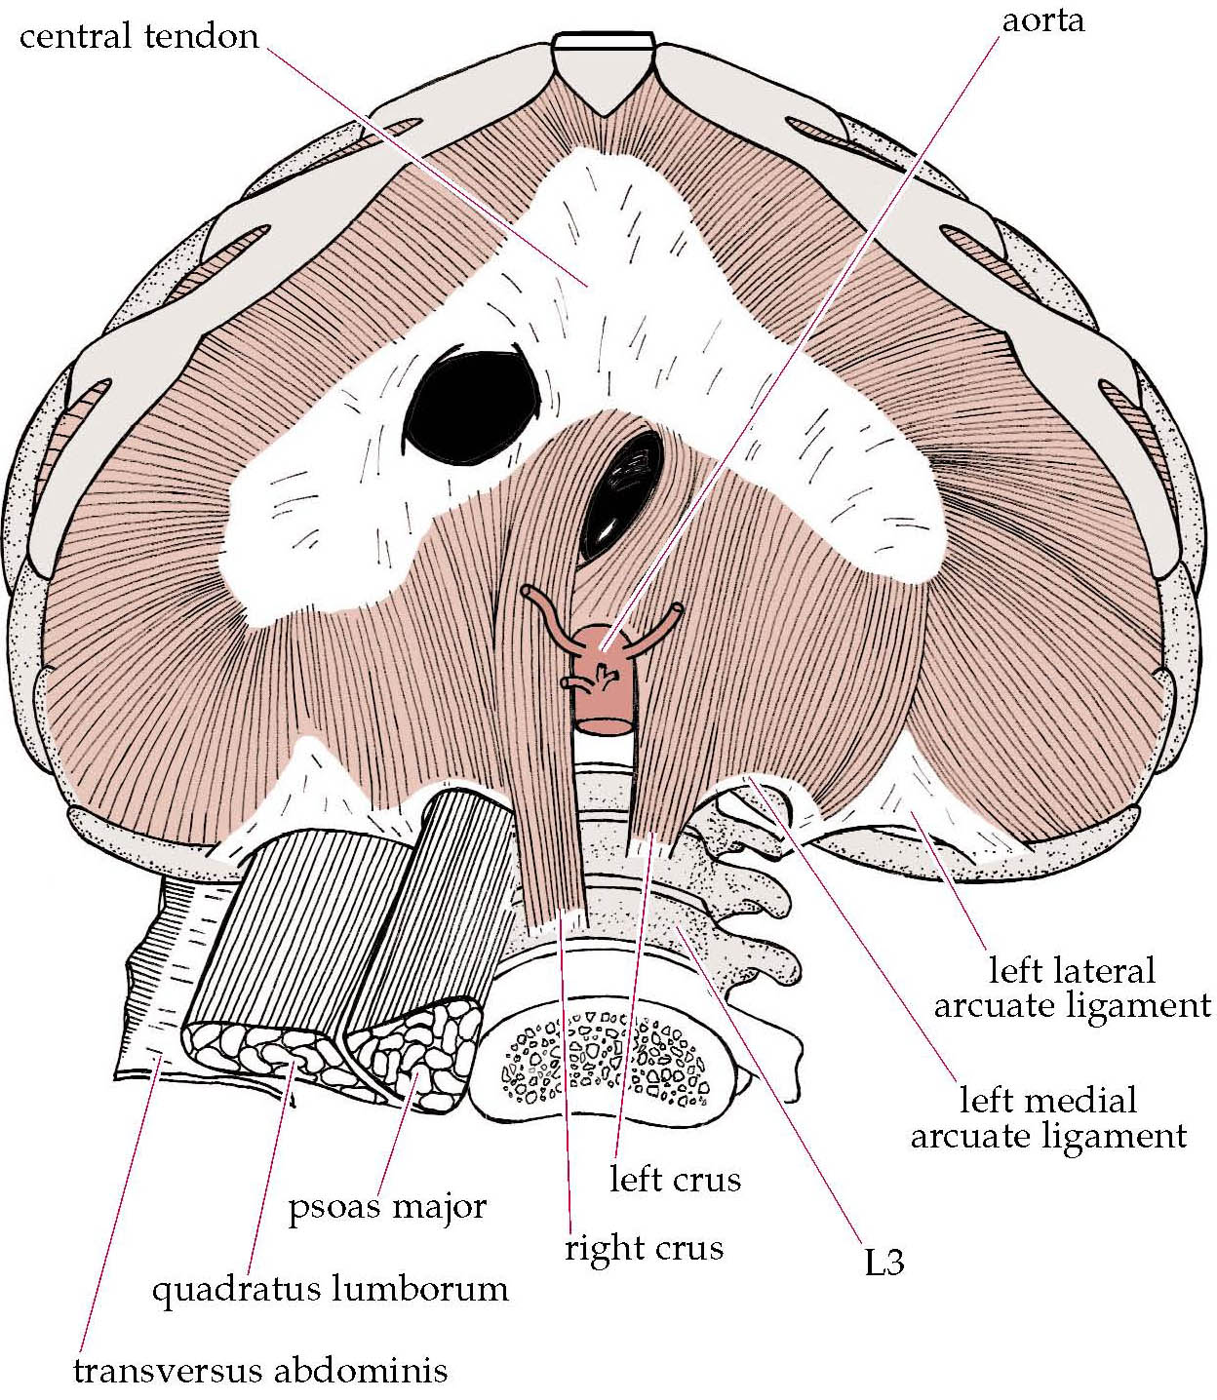
Diaphragm
Origen: Internal surfaces of ribcage, sternum and spine
Insertion: Central tendon of diaphragm
Action: Increases volume of thoracic cavity during inspiration
Nerve supply: Phrenic nerve

Slide 4
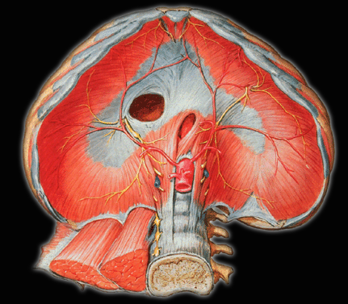
Central tendon
Sternal origin
Costal origin
Lumbar origin

Slide 5
Sternocostal triangle
Lumbocostal triangle

Slide 6
3 Hiatus
Vena cava foramen: inferior vena cava ( vertebrae VIII & IX)
Esophageal hiatus: esophagus, vagus nerve (vertebrae X )
Aortic hiatus: aorta, thoracic duct, azygos vein, hemiazygos vein (vertebrae XII )

Slide 7
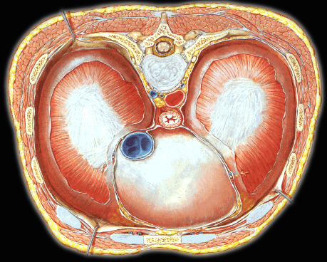
aorta
esophagus
Inferior vena cava

Slide 8
Vena caval foramen
Esophageal
hiatus
thoracic aorta

Slide 9
Blood Vessels
Superior Surface:
Pericardiophrenic artery
Musculophrenic artery
Superior Phrenic artery
Inferior Surface:
Inferior phrenic arteries
Veins
Correspond to the arteries
Internal thoracic artery
Thoracic aorta
Abdominal aorta
Superior & inferior vena cava

Slide 10
Lymphatic Drainage
Phrenic lymph nodes
Parasternal & posterior mediastinal lymph nodes
Innervation
Phrenic nerves
Cervical plexus ( C3-C5 )

Slide 17
