Slide 1
Diabetes Mellitus in Pregnancy
Dr.
Ahmed Jasim
Ass.Prof
MBChB.-DOG-FIBMS
Consultant of gyn.&obst.

Slide 2
definition
Gestational Diabetes (GDM) is defined, as glucose intolerance of variable degree with onset or first recognition during the present pregnancy. Gestational diabetes may merely represent type 2 diabetes that has been unmasked by pregnancy.

Slide 3
Gestational Diabetes (GDM)
Definition:
Insulin resistance/ glucose intolerance first diagnosed during pregnancy
Prevalence: 1-14% of all pregnancies
Indicates predisposition to later development of Type 2 Diabetes
Chance of recurrence in future pregnancies:
30-84%
Notes:
Within 10-20 years after delivery, approximately 50% of women who had gestational diabetes will develop type 2 diabetes
Varies by ethnicity – in the Hispanic population, up to 50% develop type 2 diabetes within 5 years of diagnosis of gestational diabetes
Prevalence is wide-ranging and variable depending on ethnic makeup of the population.
Also, patients’ first presentation may be during pregnancy

Slide 4
Incidence
1:350 pregnancies.

Slide 5
Classification
White classification (1965) is approved by The American College of Obstetricians and Gynaecologists (1986) as follow:

Slide 6
Pregestational Diabetes
Class | Age at Onset |  | Duration (Yr) | Vascular Disease | Therapy
A | Any |  | Any | None | A-1, diet only
B | Over 20 |  | < 10 | None | Insulin
C | 10--19 | or | 10-- 19 | None | Insulin
D | < 10 | or | > 20 | Benign retinopathy | Insulin
F | Any |  | Any | Nephropathy | Insulin
R | Any |  | Any | Proliferative retinopathy | Insulin
H | Any |  | Any | Heart disease | Insulin
T | Any |  | Any | After renal transplantation | Insulin

Slide 7
Gestational Diabetes
Class | Fasting Plasma Glucose |  | Postprandial Plasma Glucose
A-1 | <105 mg/dl | and | <120mg/dl
A-2 | >105 mg/dl | and/or | >120mg/dl

Slide 8
Gestational diabetes is appearance of diabetes for the first time during pregnancy and disappears postpartum. In the original white classification, class A diabetes is asymptomatic diabetes with abnormal glucose tolerance test i.e. chemical diabetes.

Slide 9
Phases of Diabetes Mellitus
Potential diabetes: There is high risk of developing diabetes e.g. if one or both parents is diabetic.
Prediabetes: The period preceding the development of diabetes. It is a retrospective diagnosis.
Latent diabetes: Diabetes appears only under stress conditions as pregnancy (gestational diabetes) or with cortisone administration.
Chemical diabetes: An abnormal glucose tolerance test without symptoms.
Clinical diabetes: An abnormal glucose tolerance test with symptoms of diabetes.

Slide 10
Carbohydrate metabolism during pregnancy:
Pregnancy is a diabetogenic state manifested by insulin resistance and hyperinsulinemia. This is because of the placental secretion of diabetogenic hormones including growth hormone, corticotropin-releasing hormone, placental lactogen, and progesterone.

Slide 11
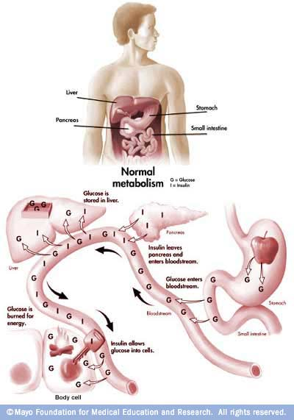
Normal glucose metabolism
Glucose enters bloodstream from food source
Insulin aids in storage of glucose as fuel for cells
Insulin resistance is defined as insensitivity of cells to insulin, therefore resulting in increased levels of insulin and glucose in the bloodstream
Notes:
Let’s talk about the changes in metabolism that occur during pregnancy, specifically carbohydrate metabolism. First of all, normal glucose metabolism is depicted here.
Glucose is absorbed from the stomach and small intestine and enters the bloodstream, then is transported to various organs. Insulin, secreted by the pancreas is required to permit entry of the glucose into the cell to be used.

Slide 12
Effect of Pregnancy on Diabetes
Pregnancy is diabetogenic due to increased production of insulin antagonists as human placental lactogen, placental insulinase, cortisol, oestrogens and progesterone.
Insulin requirements: increases during pregnancy due to increased production of insulin antagonists while it decreases postpartum.
Reliance on urine for control of diabetes may lead to insulin overdosage due to lowered renal threshold for glucose.

Slide 13
Effect of Diabetes on Pregnancy
Maternal:
Pregnancy induced hypertension (30%).
Infections: as monilial vulvo-vaginitis, urinary tract infections, puerperal sepsis and breast infection.
Obstructed labour due to large sized baby.
Deficient lactation: is more common.

Slide 14
Foetal:
Abortions.
Polyhydramnios (30%): due to large placenta and foetal size.
Congenital anomalies (6%): This is about 4 times the normal incidence (1.5%). Sacral dysgenesis is a specific anomaly related to diabetes.
Macrosomia: i.e. foetal weight > 4 kg at term may cause obstructed or traumatic delivery.
Preterm labour: with its complications mainly due to polyhydramnios.

Slide 15
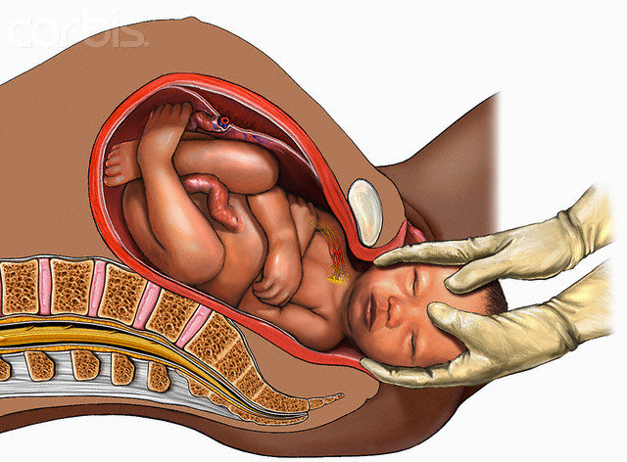
Diabetes in Pregnancy: Clinical implications
Shoulder dystocia
Fetal macrosomia

Slide 16
Intrauterine foetal death (5%): especially in the last 4 weeks due to;
ketosis,
hypoglycaemia,
pre-eclampsia,
congenital anomalies,
placental insufficiency.

Slide 17
Neonatal mortality and morbidity (5%): due to ;
hypoglycaemia,
respiratory distress syndrome,
congenital anomalies,
birth trauma,
hyperbilirubinaemia due to immaturity of the foetal liver,
hyperviscosity,
hypocalcaemia and hypomagnesaemia which may result from decreased parathyroid hormone.

Slide 18
Methods of Screening
Selective screening – it is not cost-effective to screen women who are less than 25 years of age, have a normal body weight, no family history of diabetes, and are not at risk on the basis of race or ethnicity.
Screening based solely on risk factors will only identify approximately 50% of women with GDM.

Slide 19
Initially a 50-g oral glucose challenge is given and venous serum or plasma glucose is measured one hour later; a value > or =140 mg/d L (7.8 m mol/L) is considered abnormal, and is associated with a 25 to 30 percent risk of a macrosomic infant if no treatment is offered.

Slide 20
Such test can be performed at any time of the day and with disregard to previous meal ingestion. Women with an abnormal value are then given a 75-g, two-hour oral glucose tolerance test (GTT). The test is performed in the fasting state.

Slide 21
SCREENING TECHNIQUE AND DIAGNOSTIC CRITERIA – Screening is optimally performed at 24 to 28 weeks of gestation. However, it can be done as early as the first prenatal visit if there is a high degree of suspicion that the pregnant woman has undiagnosed type 2 diabetes.

Slide 22
Diagnosis
History
History of diabetes or symptoms suggesting it as loss of weight, polydepsia (thirst), polyuria and polyphagia.
History of frequent severe pruritis (recurrent monilial infection).
History of repeated abortions, intrauterine foetal deaths or delivery of oversized babies.

Slide 23
Investigations
Positive urine test: during routine antenatal care.
Fasting and 2 hours postprandial venous plasma sugar.

Slide 24
Fasting | 2h postprandial | Result
<100 mg/dl | < 145mg/ dl. | Not diabetic
>145 mg/ dl | >200 mg/ dl. | Diabetic
100-145 mg/dl | 145-200 mg/dl. | Border line indicates glucose tolerance test.
N.B. The whole blood glucose values are 15% lower.

Slide 25
Glucose tolerance test (GTT):
Prerequisites:
Normal diet for 3 days before the test.
No diuretics 10 days before.
At least 10 hours fast.
Test is done in the morning at rest.
Oral glucose tolerance test:
Giving 75 gm (100 gm by other authors) glucose in 250 ml water orally.
Intravenous glucose tolerance test:
Giving 25 gm rapid IV, has little practical value due to bypassing the gut so there is no stimulus to gut hormone production particularly glucagon.

Slide 26
Criteria for glucose tolerance test:
The maximum blood glucose values during pregnancy:
fasting 90 mg/ dl,
one hour 165 mg/dl,
2 hours 145 mg/dl,
3 hours 125 mg/dl.
If any 2 or more of these values are elevated, the patient is considered to have an impaired glucose tolerance test.

Slide 27
Indications of performing glucose tolerance test:
Positive urine test.
First degree family history of diabetes.
Gross obesity.
Previous macrosomic babies.
Previous unexplained intrauterine or neonatal deaths.
Previous 2 or more unexplained abortions.
Current or previous congenital anomalies.
Current or previous polyhydramnios.

Slide 28
Glycosylated haemoglobin (Hb A1):
It is normally accounts for 5-6% of the total haemoglobin mass. A value over 10% indicates poor diabetes control in the previous 4-8 weeks. If this is detected early in pregnancy, there is a high risk of congenital anomalies and in late pregnancy it indicates increased incidence of macrosomia and neonatal morbidity and mortality.

Slide 29
Differential Diagnosis of Glycosuria
Lactosuria:may be present during pregnancy, labour or puerperium. Lactose is differentiated by:
Osazone test,
it does not ferment yeast, and
glucose oxidase test is negative.

Slide 30
Alimentary glycosuria:
Usually occurs early in pregnancy due to rapid absorption of glucose from the gut.
No symptoms of diabetes.
GTT is normal.

Slide 31
Renal glycosuria:
usually occurs in midpregnancy due to lowered renal threshold.
No symptoms of diabetes.
GTT is normal.
Reducing agents: as vitamin C, salicylates and morphine.
Diabetes mellitus.

Slide 32
Management
Antenatal care
Frequent antenatal visits: for maternal and foetal follow up.
Control of diabetes:
Diet: is arranged to supply 1800 calories/ day with restriction of carbohydrates to 200 gm/ day, less fat and more proteins and vitamines.

Slide 33
Insulin therapy:
Oral hypoglycaemics are contraindicated during pregnancy, labour and early puerperium as they are not adequate for controlling diabetes, have teratogenic effects and may result in neonatal hypoglycaemia.
Doses of insulin tend to increase in the first half of pregnancy, then stabilise and finally rise in the last quarter, to be decreased again postpartum.

Slide 34
Twice daily (before breakfast and before dinner) injections of a combination of short and intermediate acting insulins are usually sufficient to control most patients otherwise a subcutaneous insulin pump is used.
Monocomponent insulins which do not provoke production of antibodies are preferable e.g. " Actrapid" (short acting) and " Monotard" (intermediate acting).

Slide 35
The total first dose of insulin is calculated by;
Starting with a low dose of 20 units combined insulin then increase it according to the blood sugar level or,

Slide 36
according to the patient’s weight as follow:
In the first trimester ............patient’s weight x 0.7
In the second trimester.........patient’s weight x 0.8
In the third trimester............patient’s weight x 0.9
If the total dose of insulin is less than 50 units/ day, it is given in a single morning dose with the ratio:
Short acting (regular or Actrapid)/Intermediate (NPH or Monotard) = 0.5
In higher doses, 2/3 the dose is given in the morning with the same ratio and 1/3 the dose is given in the evening in a ratio 1:1.

Slide 37
Blood sugar analysis is carried out 4 times daily to regulate the doses as follow:
Time of analysis | The dose to be regulated
Postprandial - breakfast | Evening - intermediate
Postprandial - lunch | Morning - short
Postprandial- dinner | Morning - intermediate
Fasting - midnight | Evening - short

Slide 38
The aim is to achieve normoglycaemic values as in GTT.
Hospitalisation: if diabetics are not controlled as outpatients or complications develop.
Evaluation of foetal well - being by:-
ultrasound weekly,
cardiotocography weekly,
serial oestriol estimation 3 times/ weekly,
amniocentesis before delivery for detection of phosphatidyl glycerol that indicates lung maturity. L/S ratio is less reliable in diabetics.

Slide 39
Delivery
Timing: pregnancy is terminated at 37 completed weeks to avoid intrauterine foetal death.
Mode of delivery: vaginal delivery is induced in normal presentation, favourable cervix, average sized baby and no foetal distress. Otherwise, caesarean section is indicated.

Slide 40
Insulin therapy:
Day prior to delivery:
Normal diet, - normal morning insulin,
reduce evening insulin by 25% or omit intermediate acting insulin.
Day of delivery:
5% glucose infusion in a rate of 125 ml/hour + short acting insulin 1-2 units/hour.
Postpartum:
Continue 5% glucose + insulin till oral feeding is established. When oral feeding is allowed the pre-pregnancy dose of insulin is given.

Slide 41
Neonatal care:
The neonate is managed as a premature baby as it is more liable for RDS.
5% glucose may given IV at a rate of 0.24 gm / kg/ hour to guard against possible neonatal hypoglycaemia. Pulsed IM glucose is not preferred as they may sustain the output of insulin from the foetal pancreas.

Slide 42
Contraception
Mechanical and chemical methods or sterilization are allowed but hormonal methods are diabetogenic and IUDS may cause PID. Progestogen only contraception may be used if the patient will accept the high possibility of menstrual irregularity.

Slide 43
THANK YOU

