Slide 1
Etiology of Mental disorders
Elham Aljammas
18/9/2013

Slide 2
Objectives:
1.to understand the relationship between different etiological factors
2.To analyze the possible &treatable causes.
3.To define the responsibility of the family & or the community .
4.To tackle the exact area in the treatment.

Slide 3
No single paradigm suffice =multifactorial
Some important etiological issues in psychiatry :
1.complexity of causes
2.classification of causes
3. concept of stress
4. concept of psychological reaction

Slide 5
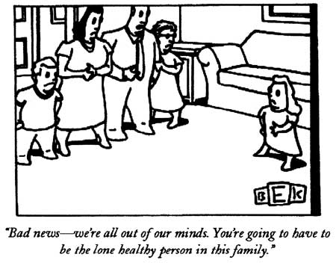

Slide 6
In psychiatry the study of causation is complicated by 3 problems
1.lack of temporal association (childhood experience ,adult emotional disorder )
2.cause & effect
Parental deprivation in childhood & later antisocial behavior
3. indirect mechanism(genetic predisposition) may be mediated in part through psychological factors .

Slide 7
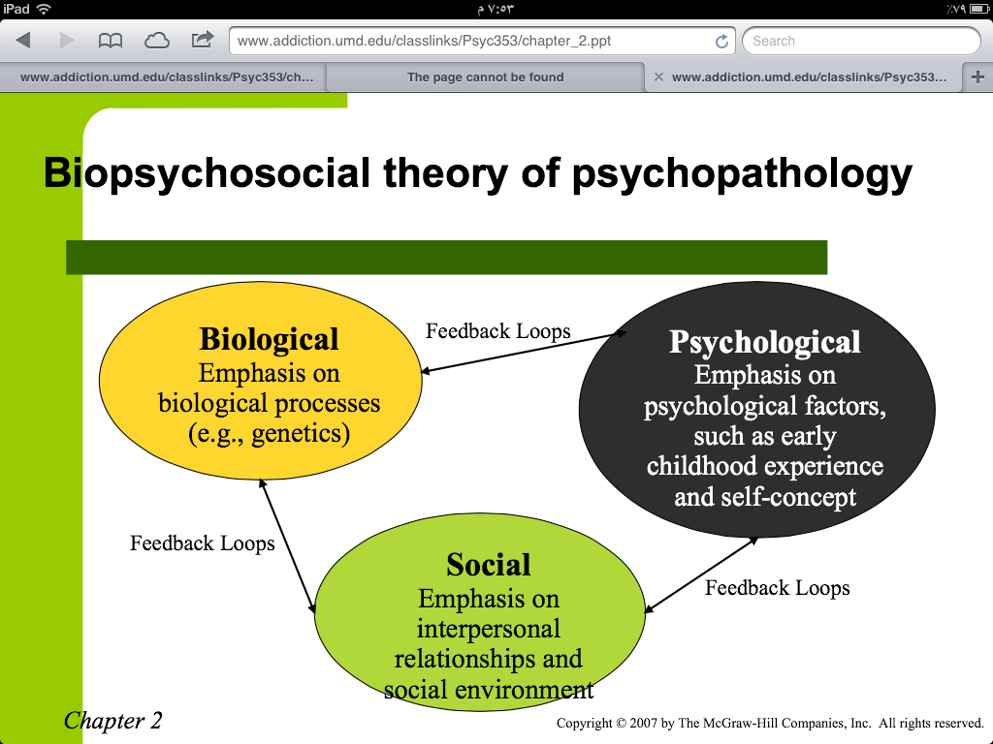
Models of aetiogical factors
1-Biological Model
2-Social Model
3-Psychological ModeL

Slide 8
Aetiological factors could be divided into :
1.Predisposing factors
Family history
Disturbed childhood
2.Precipitating factors:
Loss of jobs
Physical illness
Loss of loved one
3.Perpetuating factors

Slide 10
Biological Models
1 .Mental process are derived from operations of the brain ,resulting in behavioral disturbances.
2.Gene through their protein product ,have important effect on brain function & therefore exert a significant control over behavior.
3. social &behavioral effect exert their impact on the brain in part through changes in gene expression
Changes in gene expression & the consequent pattern of synaptic connectivity underlie the ability of experiences such as learning &psychotherapy to change behavior.

Slide 13
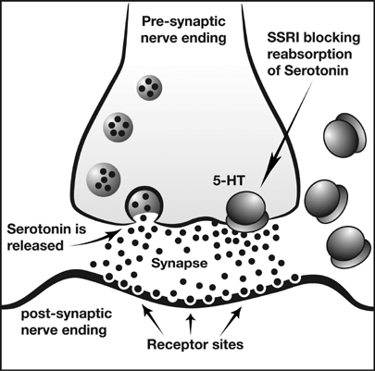
a.Monamine theories

Slide 17
f.Genetic:
Heritability estimates for for selected psychiatric disorders are :
Schizophrenia 80%
Major dep. 40%
Bipolar disorder 80%
Generalized A D 30%
Panic disorders 40%
Phobia 35%
Alcohol problems 60%

Slide 18
1-Family studies:.
60% of schizophrenic have no family history of the illness.
If one parent is schizophrenic 15% of offspring develop the illness .
If both parents are schizophrenic, 46% of them suffer
2-Twin studies
Mz twins have 42% concordance rate
Dz twins have 10% concordance
3.Adoption studies

Slide 20
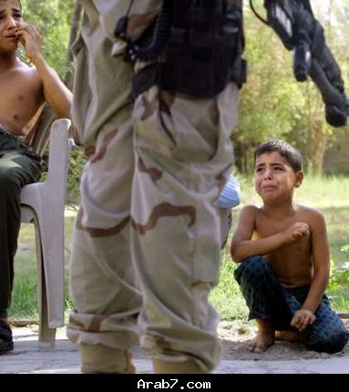
Pychological model

