Slide 1
DISINFECTANTS

Slide 2
Our Environment is Full of:
“Microorganisms”

Slide 3
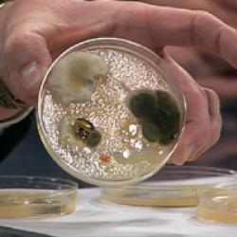
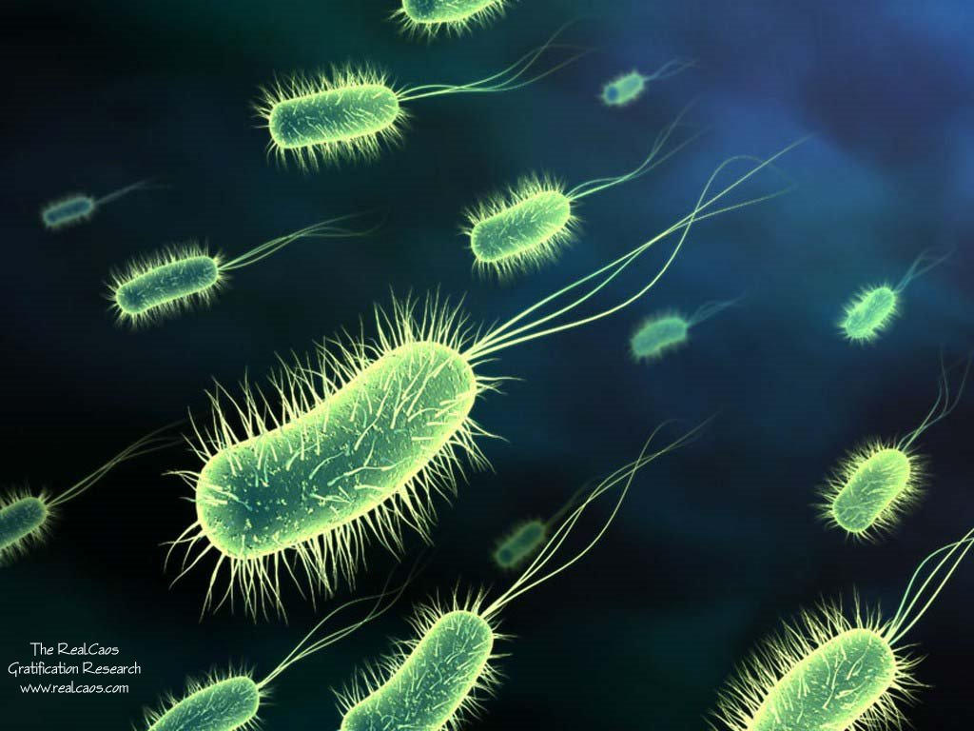
Bacteria

Slide 4
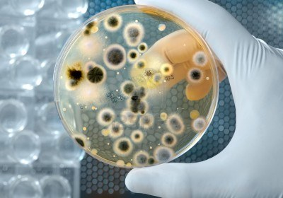
Bacteria

Slide 5
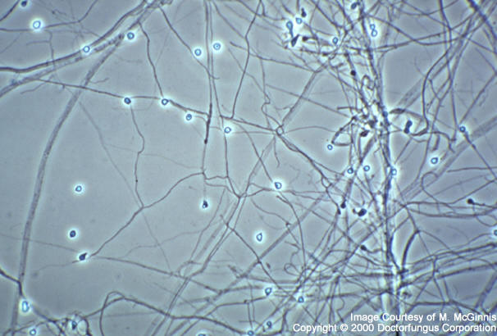
Fungi

Slide 6
Disinfectants:
They are Chemical Agents that inhibit or kill microorganisms .
They prevent infection by:
-Killing,
-Removing,
-Diluting microorganisms.

Slide 7
Disinfection can be accomplished also by application of Physical Agents:
e.g. Super heated steam 120-160 degree centigrade (Autoclave).

Slide 8
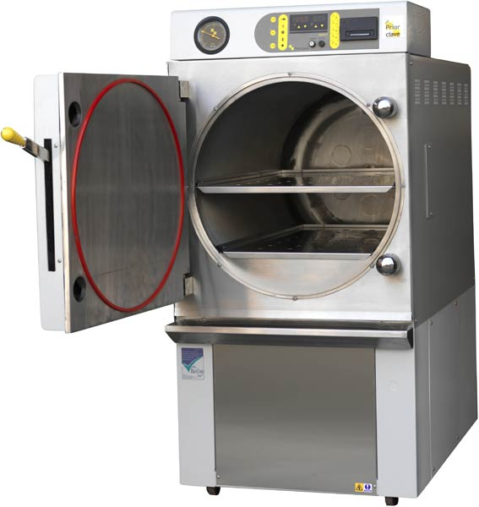
Autoclave

Slide 9
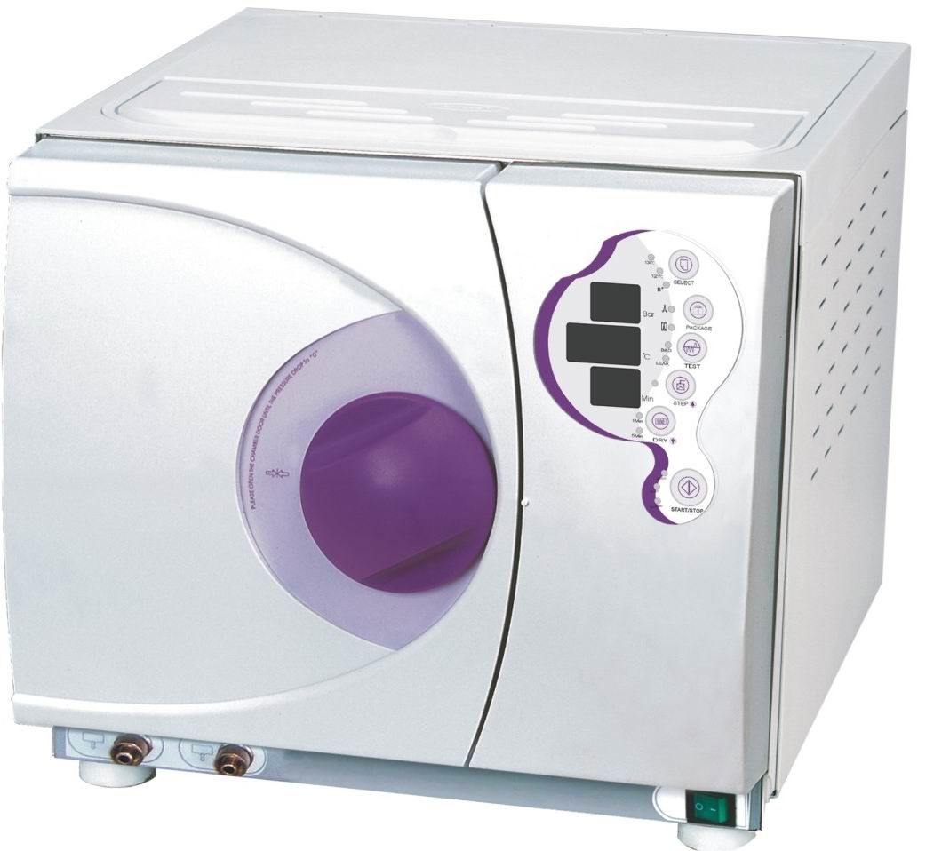
Autoclave

Slide 10
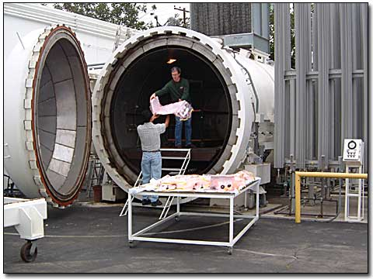
Autoclave

Slide 11
Antisepsis: (Antiseptic)
Application of an agent to “Living Tissue” for the purpose of preventing infection .
Sterilization:
A process intended to kill or remove “All Types” of microorganism including spores and uncoated viruses.

Slide 12
Sterilization
Can we sterilize living tissue?

Slide 13
NO !
Sterilization involves application of physical or chemical agents too harsh
to be applied to a living tissue.

Slide 14
Factors that affect the effectiveness of disinfectants are:
-Intrinsic resistance of the microorganism.
-Number of the microorganisms present.
-Availability of mixed population.
-Amount of the organic material present.
-Concentration & stability of disinfectants.
-Time & temperature of the exposure.
-PH, hydration & binding of the agent to surfaces.

Slide 15
Three Types of Disinfection:
1-Tissue Disinfection (Antiseptic).
2-Instrument Disinfection.
3-Enviromental Disinfection (Hospital setting).

Slide 16
Chemical classes of Disinfectants
1- Alcohols.
2- Biguanides.
3- Halogens.
4- Phenols.
5- Aldehyds.
6- Quaternary ammonium compounds.
7- Superoxides.

Slide 17
1-Alcohols:
*Antiseptic
The two alcohols most frequently used are:
-Ethanol.
-Isopropanol.
They are rapidly active (30 sec.) ,killing vegetative bacteria ,mycobacterium tuberculosis, many fungi & lipophilic viruses.

Slide 18
The optimum bactericidal concentration is:
70-90 % by vol. in water
-They act by denaturation of proteins.
-Their skin drying effect can be partially alleviated by addition of some emollients to the formulation.
-Alcohols are flammable & must be stored in cool ,well ventilated areas.

Slide 19
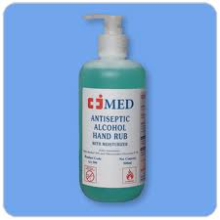

Slide 20
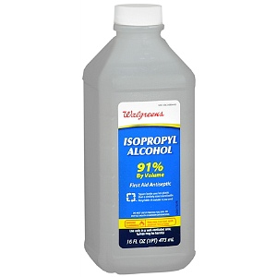

Slide 21
2-Chlorhexidine:
*Antiseptic
Is a Cationic Biguanide with very low water solubility ,it is active against vegetative bacteria & mycobacterium &has moderate activity against fungi & viruses.
strongly adsorbs to bacterial membranes causing leakage of small molecules & hence precipitation of cytoplasmic proteins.
they act at PH=5.5-7.0

Slide 22
Chlorhexidine digluconate resist inhibition by blood & organic materials especially the formulation of 4% solution.
0.2% -0.4 % are used as mouth washes

Slide 23
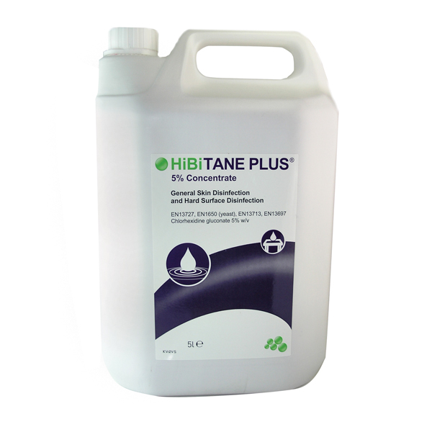
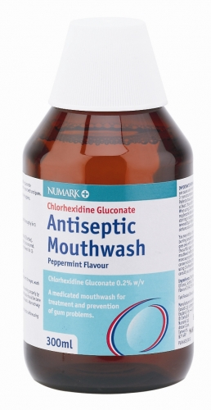

Slide 24
3-Halogens:
*Antiseptic
A.Iodine:
Iodine in a 1:20.000 sol. Is a bactericidal in 2-3 minutes & kills spores in 15 min.
It is the most active antiseptic for intact skin but have staining property with serious hypersensitivity reaction so not commonly used.

Slide 25
B.Iodophores :
Are complex of iodine with surface active agent such as povidone –iodine .
They kill vegetative bacteria ,mycobacterium ,fungi & lipophilic viruses &could be sporicidal upon prolonged exposure
They are less irritant &less likely to produce hypersensitivity than iodine.

Slide 26
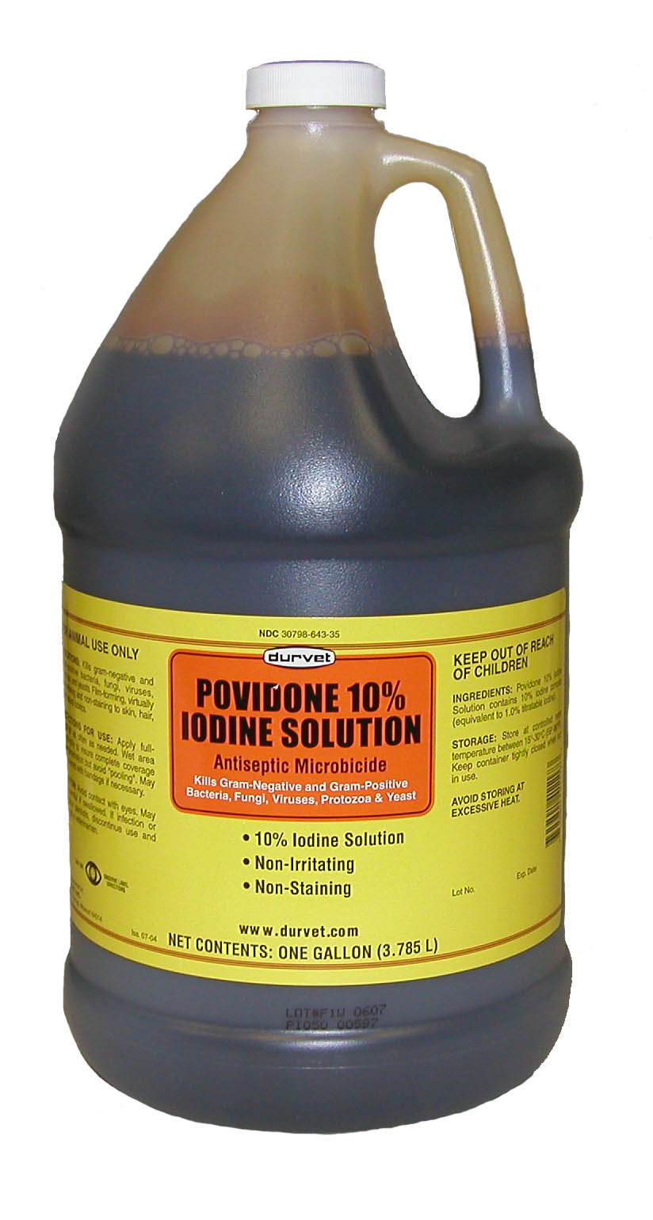
Povidone Iodine

Slide 27
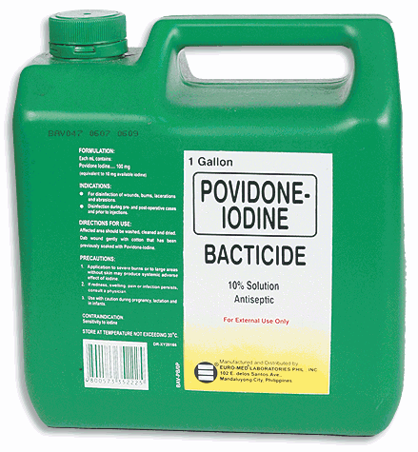
Povidone Iodine

Slide 28
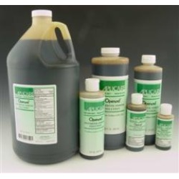
Povidone Iodine

Slide 29
C.Chlorine
*Environmental Disinfectant
Is a strong oxidizing agent & universal disinfectant that is most commonly provided as 5.25% sodium hypochlorite solution.
(typical formulation for household bleach)

Slide 30
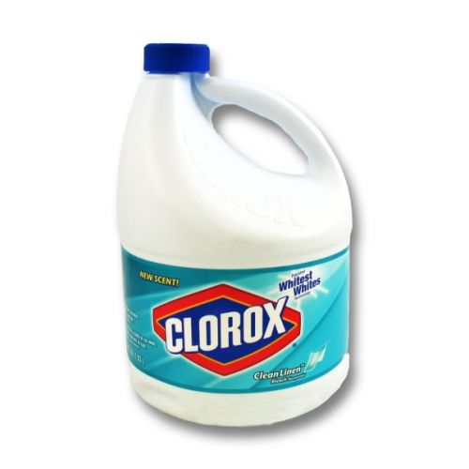
Household bleach
6%

Slide 31
Because formulation may vary ,the exact concentration Should be verified on the label.
A 1:10 dilution of household bleach provide 5000 ppm of chlorine which is sufficient to kill spores.
where as less than 5ppm enough for bacterial disinfection.
200-500ppm for lipophilic & hydrophilic viruses.

Slide 32
4-Phenol:
*Environmental Disinfectant
The oldest of the surgical antiseptics, it is no longer used because of its corrosive effect on the tissues.
*its toxicity when absorbed
*its carcinogenic effects

Slide 33
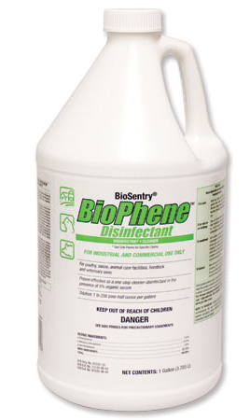
Phenols
*Environmental Disinfectant

Slide 34
Phenolic compounds disrupt cell walls & membranes ,so precipitate proteins and inactivate enzymes.
They are bactericidal including mycobacterium bacilli & fungicidal, also capable of inactivating lipophilic viruses but not sporicidal.
Phenolic compounds mainly used for hard surfaces decontamination in hospitals & laboratories and hospital beds.

Slide 35
5-Aldehyds:
*Instrumental Disinfection
Formaldehyde & glutaraldehyde are used for disinfection & sterilization of instruments such as fiberoptic endoscopes & respiratory therapy equipments that can not withstand exposure to high temperature of steam sterilization.

Slide 36
These agents have abroad spectrum of activity against microorganisms & viruses.
They act by alkylation of proteins & nucleic acids.
An 8% formaldehyde solution in water has abroad spectrum activity against bacteria, viruses & fungi.
A 4% form used for fixation of tissues.

Slide 37
Formaldehyde is highly irritant to respiratory mucous membranes & eye at high concentration.
same thing for glutaraldehyde, so protection is important.

Slide 38
6-Quaternary ammonium compounds :
*Environmental Disinfectant
Their bactericidal action has been attributed to:
-Inactivation of energy producing enzymes.
-Denaturation of proteins.
-Disruption of the cell membrane.
Used as disinfectant for floor ,bench……etc.

Slide 39
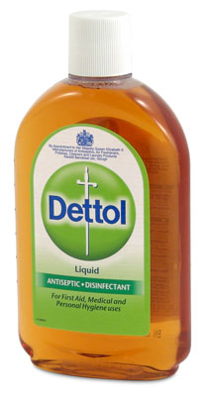
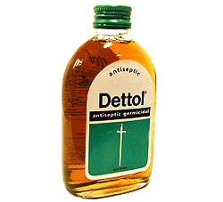
Benzalkonium chloride is the active ingredient of Dettol
*Environmental Disinfectant

Slide 40
7-Peroxygen compounds:
e.g. Hydrogen peroxide(H2O2), these agents have the advantage that their decomposition product are not toxic & do not injure the environment.
Used as tissue disinfectant as well as for certain instruments(respirators).

Slide 41
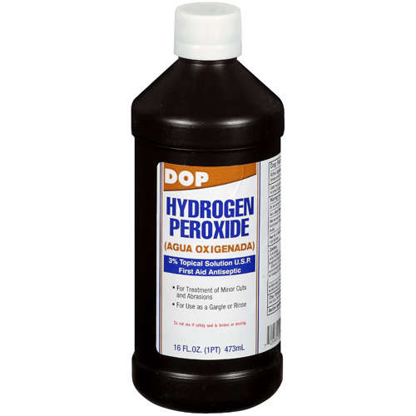

Slide 42
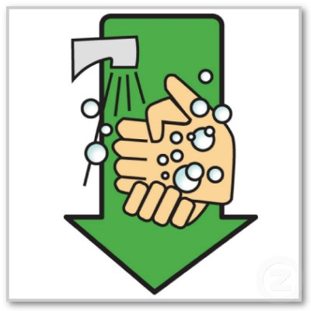
Soap and water
Washing hands with soap and water remains one of the most important ways of disinfection and prevention of contamination!
Soup reduces the number of vegetative bacteria to a very large extent.

Slide 43
HBV and HIV
(Hepatitis B virus and Human immunodeficiency virus).
Cloths, furniture…etc can be disinfected with:
1-1:10 dilution of household bleach for 10 minutes.
or
2-High iodine content iodophor 70% in 70% isopropanol for 10 minutes.

Slide 44
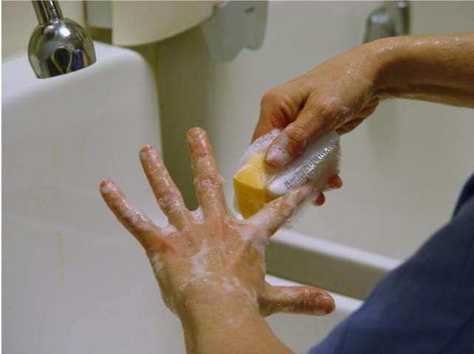
Example of Disinfection
Surgical Scrubbing

Slide 45
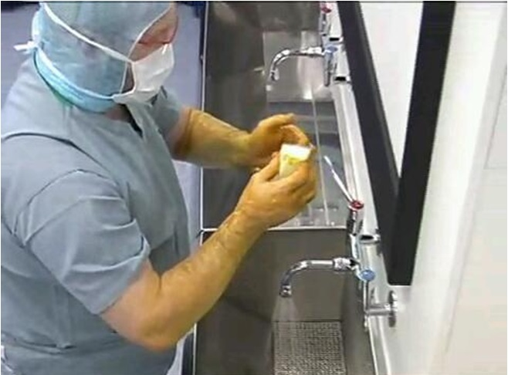
Surgical Scrubbing

