Slide 1
Benign disorder of cervix
Dr. Ahmed jasim
Ass.Prof.
MBChB-DOG-FICMS
COSULTANT OF GYN. & OBST.

Slide 2
anatomy
The cervix is fibromuscular inferior part of the uterus protruding into the vagina. It measures 2.5-3 cm in diameter and 3-5 cm in length. The normal anatomic position of the cervix is angulated slightly downward and backward.

Slide 4
The external os is usually small and round in nulliparous women but can be seen as a transverse slit in those who have had cervical dilation during labor. The anterior and posterior fornices limit the portio (exocervix). The cervical canal measures approximately 8 mm wide and contains longitudinal ridges. The opening of the cervical canal into the uterus is called the internal cervical os. The area between the endocervical and endometrial cavity is called the isthmus or lower uterine segment.

Slide 5
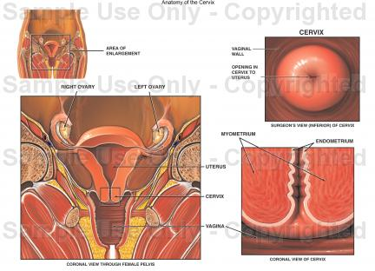

Slide 6
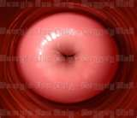
Ectocervix is covered by a pink stratified squamous epithelium, consisting of multiple layers of cells. It is smooth, pearly, opaque appearance.

Slide 7
Endocervix is lined by a reddish columnar epithelium consisting of a single layer of cells. it appears reddish in colour because the thin single cell layer allows the coloration of the underlying vasculature in the stroma to be seen more easily. It covers a variable extent of the ectocervix, depending upon the woman’s age, reproductive, hormonal and menopausal status.

Slide 8
The columnar epithelium is normally visible with the speculum during
Ovulatory phase of the menstrual cycle
Pregnancy
women taking the combined oral contraceptive pill
where estrogen levels are elevated.

Slide 9
The point where these two epithelia meet is called the squamo-columnar junction.

Slide 10
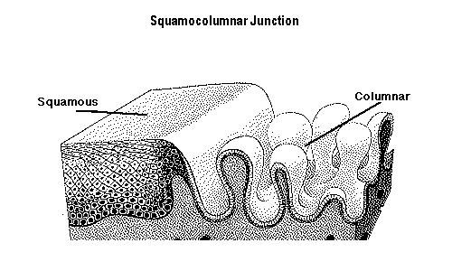

Slide 11
Squamous metaplasia is physiological replacement of the everted columnar epithelium by a newly formed squamous epithelium. It is an irreversible process; the transformed epithelium (now squamous in character) cannot revert to columnar epithelium.

Slide 12
The region of the cervix where squamous metaplasia occurs is referred to as the transformation zone. Identifying the transformation zone is of great importance in colposcopy, as almost all manifestations of cervical carcinogenesis occur in this zone .

Slide 13
The point where these two epithelia meet is called the squamo-columnar junction.
The location of squamocolumnar junction in relation to the external os varies depending upon age, menstrual status, and other factors such as pregnancy and oral contraceptive use. The epithelium of the transformation zone is identified by the variegation of the color between the two native epithelia.

Slide 14
The anatomical site of the squamo-columnar junction fluctuates under hormonal influence through out the reproductive life.
During childhood and perimenarche, the original squamocolumnar junction is located at, or very close to, the external os

Slide 15
After puberty and during the reproductive period, the female genital organs grow under the influence of estrogen. Thus, the cervix swells and enlarges and the endocervical canal elongates. This leads to the eversion of the columnar epithelium of the lower part of the endocervical canal on to the ectocervix (This condition is called ectropion).

Slide 17
At menarche (With acidification of a vagina), the ectocervix undergoes an accelerated rate of squamus metaplasia which produces the transformation zone.
The metaplastic process mostly starts at the original squamocolumnar junction and proceeds towards the external os through the reproductive period to perimenopause. Thus, a new squamocolumnar junction is formed between the newly formed metaplastic squamous epithelium and the columnar epithelium remaining everted onto the ectocervix.

Slide 18
The buffer action of the mucus covering the columnar cells is interfered with when the everted columnar epithelium in ectropion is exposed to the acidic vaginal environment. This leads to the destruction and eventual replacement of the columnar epithelium by the newly formed metaplastic squamous epithelium. Metaplasia refers to the change or replacement of one type of epithelium by another. The metaplastic process mostly starts at the original squamocolumnar junction and proceeds centripetally towards the external os through the reproductive period to perimenopause. Thus, a new squamocolumnar junction is formed between the newly formed metaplastic squamous epithelium and thecolumnar epithelium remaining everted onto the ectocervix.

Slide 20
As the woman passes from the reproductive to the perimenopausal age group, the location of the new squamocolumnar junction progressively moves on the ectocervix towards the external os.

Slide 21
From the perimenopausal period and after the onset of menopause, the cervix shrinks due the lack of estrogen, and consequently, the movement of the new squamocolumnar junction towards the external os and into the endocervical canal is accelerated.

Slide 23
In postmenopausal women, the new squamocolumnar junction is often invisible on visual examination .

Slide 25
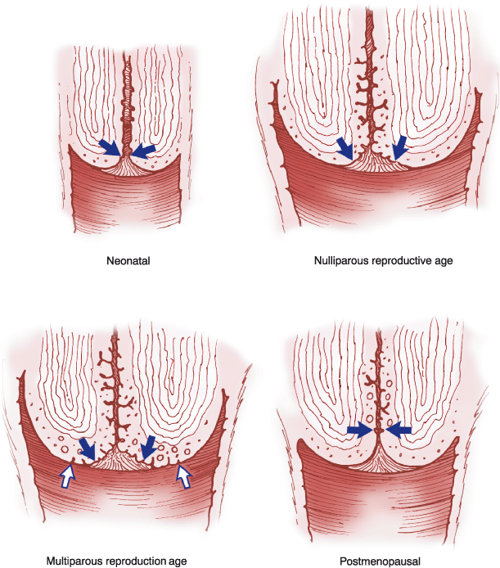

Slide 26
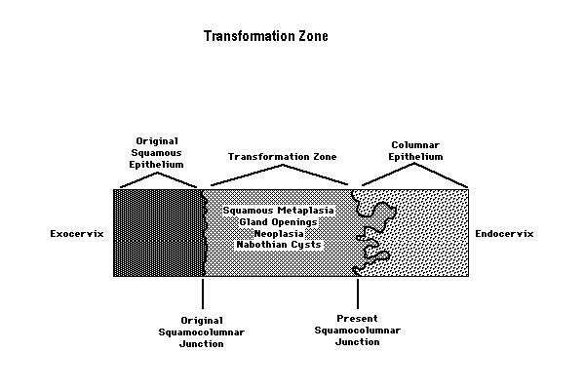

Slide 27
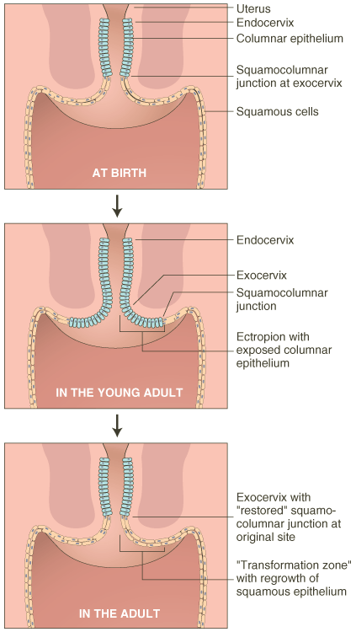

Slide 28
The transformation zone
The transformation zone is a dynamic area, usually located on the ectocervix. At times, the distal edge of the transformation zone extends into the upper vagina. The transformation zone, by definition, is the area between the original squamocolumnar junction and the current squamocolumnar junction. The transformation zone is that portion of the cervix that originally was columnar epithelium and through a process of squamous metaplasia is now squamous epithelium. Squamous metaplasia occurs continuously; however, this process is most active during fetal development, around the time of menarche, and during pregnancy. Local hormonal changes, as reflected by vaginal pH, influence this process.

Slide 29
It consists of endocervical stroma and glands covered by squamous epithelium.
The position of the transformation zone varies according to age. In women during the childbearing age, the transformation zone is fully located on the ectocervix.
In post-menopausal women the transformation zone is often located within the endocervical canal as the cervix shrinks with the decreasing levels of estrogen and Consequently, the transformation zone may move into the cervical canal.

Slide 30
Identifying the transformation zone is of great importance in colposcopy, as almost all manifestations of cervical carcinogenesis occur in this zone due to the high cell turnover of this tissue which is important in the pathogenesis of cervical carcinoma

Slide 31
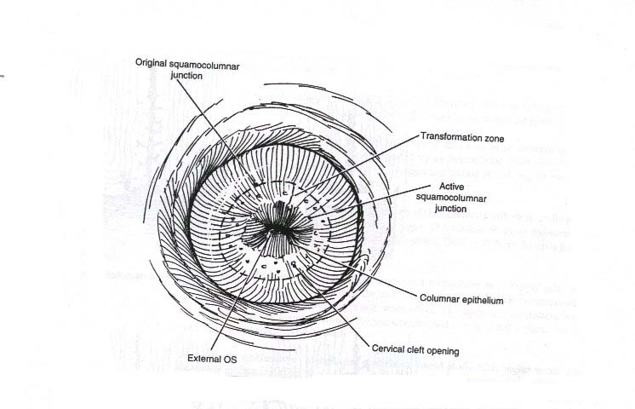

Slide 32
Cervical ectropion
Is the presence of everted endocervical columnar epithelium on the ectocervix.
it is in reality an area of columnar epithelium that has not yet undergone squamous metaplasia. it occurs when the cervix grows rapidly and enlarges under the influence of estrogen, after menarche and during pregnancy. And also seen in women under the influence of estrogen (combined oral contraceptive pills COCP, pregnancy).

Slide 33
it is a normal, physiological occurrence in a woman’s life.
it is previously called Cervical erosion which is very inappropriate name and best to be avoid as it conveys quite the wrong impression of what is really a normal phenomenon.

Slide 34
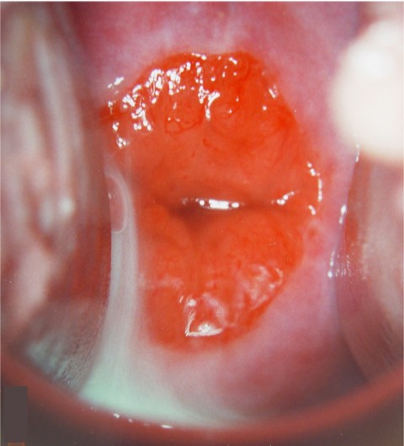

Slide 35
Clinical feature:
Most patients have no complaint.(seen during speculum examination), or it can be associated with:
1.excessive Mucoid vaginal discharge.
2.Brown intermenstrual discharge.
3. Slight postcoital bleeding.(should investigated)
4.During pregnancy slight bleeding (could be a cause of early pregnancy bleeding or Anti-Partum Haemorrhage APH).
Pain is never caused by an ectropion nor is it a cause of backache or dysparunia.

Slide 36
Sign
Speculum examination:
*Bright red area is seen around the external os continuous with the endocervix with clearly defined outer edge. The eversion of the columnar epithelium is more pronounced on the anterior and posterior lips of the ectocervix and less on the lateral lips.
*It is not tender.
*It bleeds from multiple pinpoint areas when touched.

Slide 37
Differential diagnosis:
Carcinoma.
Tuberculosis.
Syphlytic ulcer
Other ulcer.

Slide 38
Treatment:
Cervical smear must be taken in all cases.
A. No treatment
Ectropion found on routine examination should not be treated unless they are causing troublesome discharge.
Ectropion are not treated during pregnancy, most of them resolve after delivery.
Change the oral contraceptive contraception if patient complain of discharge to other contraceptive method.

Slide 39
Treatment:
B. Treatment needed
When a patient has a trouble some discharge, the Ectropion is treated by :
Thermal cauterization.
Cryosyrgery (freezing)
Laser.
The resulting raw area takes 6-8 weeks to become covered with squamous epithelium

Slide 40
Nabothian cysts (follicles):
Nabothian follicles (cysts) are retention cysts that develop as a result of the occlusion of an endocervical crypt opening or outlet by the overlying metaplastic squamous epithelium and it is located in the transfusion zone. The underlying (buried) columnar cells continuo to secret mucus, and a mucous retention cyst is created on the ectocervix.
It is so common that they are considered a normal variant and it is of no pathological significance.

Slide 41
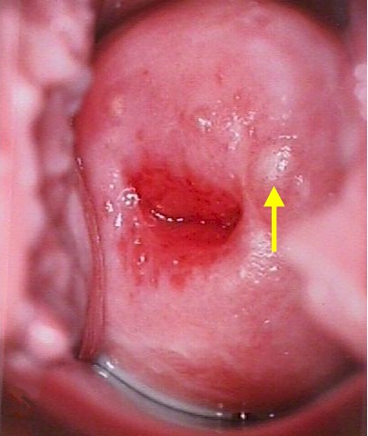

Slide 42
Nabothian cysts
Nabothian cysts are opaque, ivory-white to yellowish on visual examination.
They vary generally in size from 2mm -3 cm.
It needs no treatment.

Slide 43
Cervical polyp
Ectocervical and endocervical polyps are the most common benign neoplastic growths of the cervix.
It may be isolated or multiple and vary in diameter from a few millimeters to several centimeters.

Slide 44
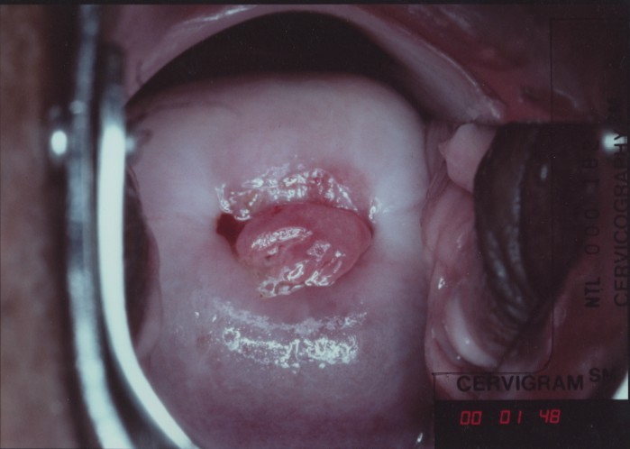


Slide 45
Symptoms:
A. Asymptomatic
B. symptomatic
they most commonly cause :
1. post coital bleeding.
2. menorrhagia & irregular vaginal Bleeding .
3. pregnancy slight bleeding (could be a cause of early pregnancy bleeding or
APH (antipartum haemorrhage).

Slide 46
Treatment:
Removal of polyp.
All specimens must be sent for pathologic examination, because squamous cell carcinoma and adenocarcinoma can be present as polyps.

Slide 47
Pyometra and Haematometra
Haematometra: It is a collection of blood in the uterine cavity, caused by obstruction in the genital tract at or below the level of cervix.
Pyometra: It is a collection of pus in the uterine cavity, caused by obstruction in the genital tract at or below the level of cervix.

Slide 48
Causes
Congenital
vaginal atrasia or absent causing haematocolpos which rarly associated with haematometra.
functioning rudimentary horn.
one half of double uterus not communicate with vagina.

Slide 49
stenosis of cervix caused by operation :
a Amputation of cervix.
Cone biobsy.
Cervical cauterization
Vigorous curettage.
carcinoma
  of cervix
  lower part of body of uterus.

Slide 50
Symptom and signs according to cause.
Suggestive feature in the history are amenorrhoea associated with severe cyclical dysmenorrhoea-like pain, with a previous history of cervical surgery in reproductive years.
In post menopausal women it may give rise to pyometra where accumulated secretions become a focus of infection.

Slide 51
Treatment
Evacuation of uterus & treatment of the cause .

Slide 52
THANK YOU

