Slide 1
Thoracic Surgery
Introduction to

Slide 2
Embryology:

Slide 3
Anatomy:

Slide 4
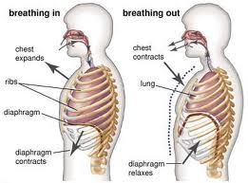
Mechanism of breathing

Slide 5
Pulmonary function test (PFT)
Spirometry
ppo FEV1
DLCO
VO2 max
V/P scan

Slide 6
Bronchoscopy:
Indications:
Diagnostic:
Hemoptysis
Chronic cough
Localized wheeze
Pulmonary mass on chest X-ray
Recurrent or unresolved pneumonia
Preoperative resectability assessment
Suspicion of malignancy;

Slide 7
Indications (cont.):
Therapeutic:
Foreign body inhalation
Difficult intubation
Atelectasis
Stricture dilatation
Lung abscess drainage
Laser therapy
Cryotherapy
Brachytherapy

Slide 8
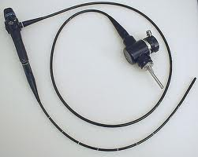
Flexible Bronchoscopes:
Advantages:
Better patient tolerance
Topical anesthesia
Wider field of view
Flexibility
Ambulatory setting
Useful in patients with cervical spine disorders.
Allows assessing movement of vocal cords.

Slide 9
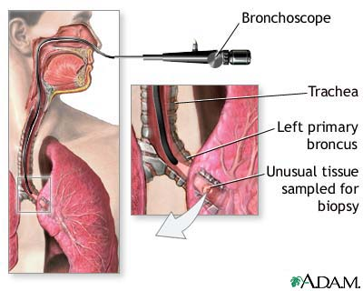
Disadvantages:
Small instrument channel size
Difficulties in sterilization and maintenance
Impinges on the airway
Needs patient cooperation

Slide 10
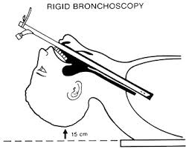
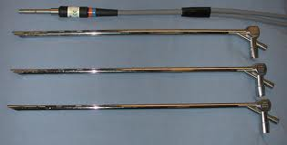
Rigid Bronchocopes:
Advantages:
Durability
Large instrument channels
Control of airway

Slide 11
Disadvantages:
Needs general anesthesia
Limited distal visualization
Higher cost
Higher risk of trauma
Contraindications:
Thoracic aortic aneurysm
Cervical spine disorders

Slide 12
Complication of bronchoscopy
Laryngospasm and / or bronchospasm
Hypoxemia
Tracheal or bronchial obstruction
Tracheal or bronchial perforation
Bleeding
Arrhythmias and cardiac arrest
Pneumonia
Air embolism
Pneumothorax

Slide 13
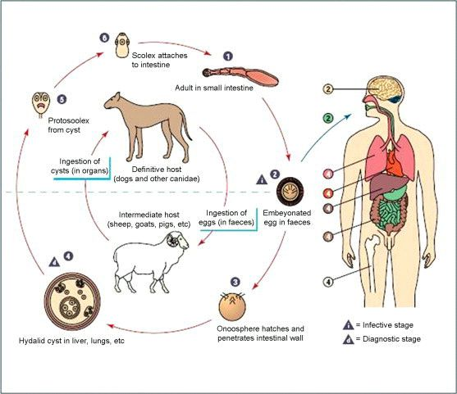
Pulmonary Hydatid Disease:
Cyst full of water
Echinococcus granulosus

Slide 14
Pathology:
Adventicia
(host tissue)
Ectocyst
(Laminated membrane)
Endocyst
(germinal layer)
Broad capsule

Slide 15
Clinical presentation:
Asymptomatic
Rupture →cough, hemoptysis, watery sputum
Coughing up "grape skin"
2ry infection →fever, rigor, purulent sputum
Hydropneumothorax or pyopneumothorax
Anaphylaxis

Slide 16
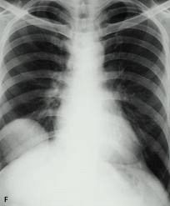
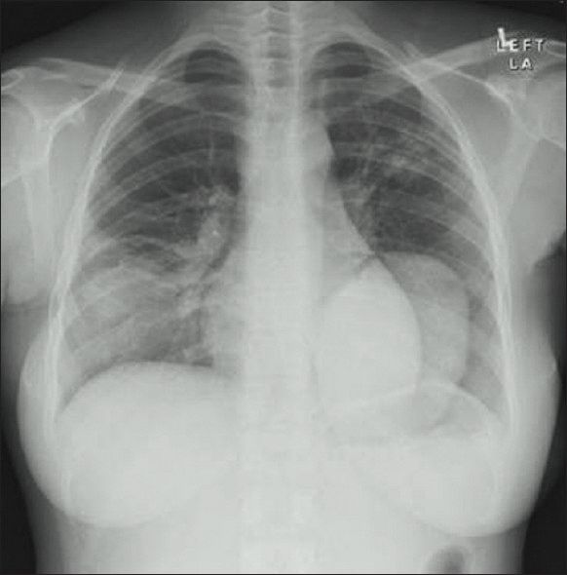
Investigations:
1. CXR 2. CT scan
1) well defined circular or oval homogenous opacity

Slide 17
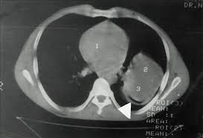
2) perivesicular pneumocyst or signet ring sign

Slide 18
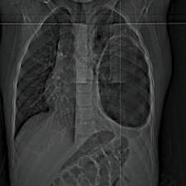
3) An empty cavity

Slide 19
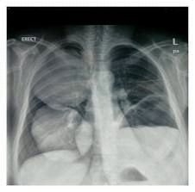
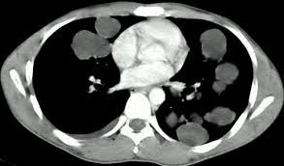
4) Bilateral and multiple cysts

Slide 20
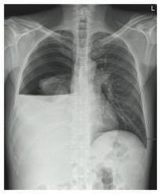
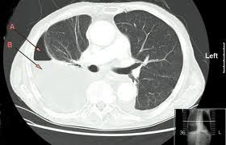
5) Hydro- or pyo-pneumothorax

Slide 21
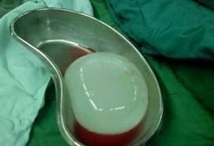
Treatment:
Surgical treatment:
Removal of the cyst
Aspiration / evacuation technique
Enucleation technique
Excision
Anatomical resection:
Segmentectomy
Lobectomy
Pneumonectomy
Medical treatment:
not effective

Slide 22
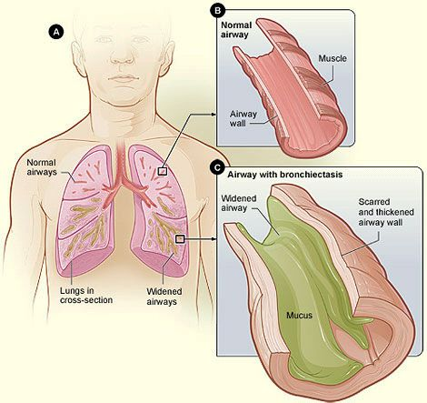
Bronchiectasis:
Causes:
Congenital
Acquired

Slide 23
Clinical presentaion:
A persistent productive cough of purulent sputum, with fetor oris.
Hemoptysis
Recurrent pneumonitis
On examination:
Cyanosis,
Clubbing
Coarse crepitations.

Slide 24
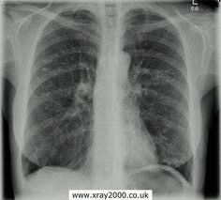
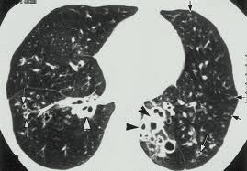
Investigations:
CXR
CT scan
Bronchography

Slide 25
Treatment:
Medical treatment:
Prevent infection
Physiotherapy and postural drainage
Surgical treatment indicated in:
Localized bronchiectasis
Massive hemoptysis
Recurrent suppurition
Anatomical resection

Slide 26
Lung Abscess:
Causes:
Primary necrotizing pneumonia
Aspiration pneumonia
Bronchial obstruction
Systemic sepsis
Pulmonary trauma
Direct extension

Slide 27
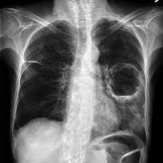
Diagnosis:
Fever, poor appetite, malaise, dyspnea, copious purulent sputum, hemoptysis
CXR
CT scan
Sputum culture
Bronchoscope

Slide 28
Treatment:
Medical treatment:
Prolonged antimicrobial therapy
Drainage
Surgical treatment:
No response
Suspicion of malignancy
Significant hemoptysis
Complications of lung abscess

Slide 29
Thank You

