Slide 1
Pericardium
The heart lies enclosed within pericardial membranes
Fibrous pericardium (pericardial sac) – outer layer of dense CT that protects & anchors
Serous pericardium – double layered membrane with “pericardial fluid” between
Parietal pericardium – lines the pericardial sac
Visceral pericardium – covers the heart; also known as the “epicardium”

Slide 4
Pericardium
Double walled sac around heart composed of:
Superficial fibrous pericardium
Deep two-layer serous pericardium
Parietal layer lines internal surface of fibrous pericardium
Visceral layer (AKA epicardium) lines surface of heart
Parietal and visceral layers separted by fluid filled pericardial cavity

Slide 5
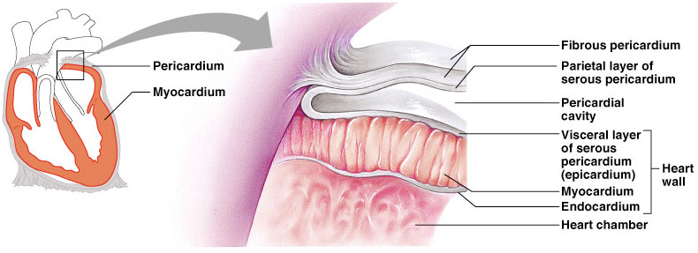
Pericardium
Protects and anchors heart
Prevents overfilling
Provides friction free environment for heart

Slide 6
Constituents of Heart Wall
Epicardium: the visceral layer of serous pericardium
Myocardium: muscle layer
Fibrous skeleton: interlacing, criss-crossing layer of connective tissue
Endocardium: endothelial layer of inner myocardial surface

Slide 10
Cardiovascular System The Heart Anatomy

Slide 11
The Cardiovascular system is comprised of the heart, blood vessels, & blood
The heart acts as a “pump”, creating pressure which causes blood to move through the blood vessels of the body, allowing O2 & nutrients to be distributed to, & wastes removed from, body tissues

Slide 12
Cardiac Anatomy

Slide 13
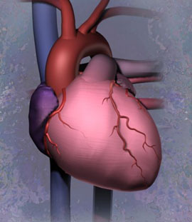

Slide 14
Atria
Receiving chambers of heart
Each has an auricle
Pectinate muscles

Slide 15
Ventricles
Discharging chambers of heart
Characterized by papillary muscles and trabeculae carneae muscles

Slide 16
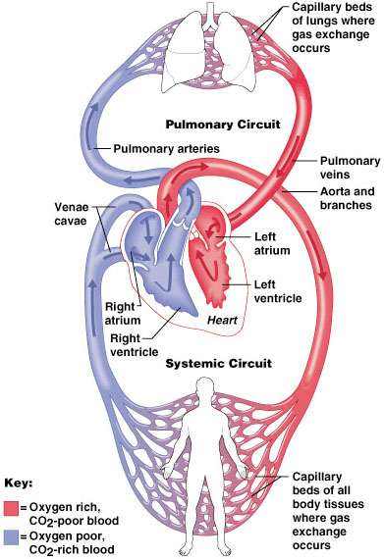
Overview of Blood Flow
Right Atrium
Tricuspid Valve
Right Ventricle
Pulmonary Valve
Pulmonary Artery
Lungs
Pulmonary Veins
Left Atrium
Mitral Valve
Left Ventricle
Aortic Valve
Aorta
Systemic Circulation

Slide 17
Anatomical Features of the Heart
The heart lies within the mediastinum of the thoracic cavity
Hollow muscular organ with four internal chambers
(2) atria (lt. atrium & rt. atrium)- receive blood from veins
(2) ventricles (lt. ventricle & rt. ventricle)- pump blood into arteries
Superior aspect of heart is the “base” (3rd intercostal space/sternal angle), where the blood vessels attach; Inferior is the “apex” (5th intercostal space), which rests on the relaxed diaphragm

Slide 18
External Features
Auricles
Coronary sulcus – contains the coronary sinus
Anterior interventricular sulcus – contains coronary vessels
Posterior interventricular sulcus – contains coronary vessels

Slide 19
Layers of Heart Wall
Epicardium (visceral pericardium)
Myocardium
Endocardium

Slide 20
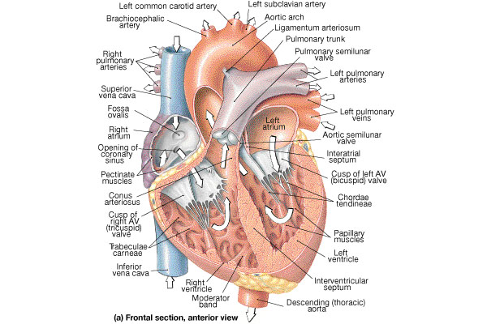
Internal Anatomy of the Heart
Chambers of the heart
Right & left atrium
Separated by the interatrial septum
Right & left ventricle
Separated by the interventricular septum

Slide 21
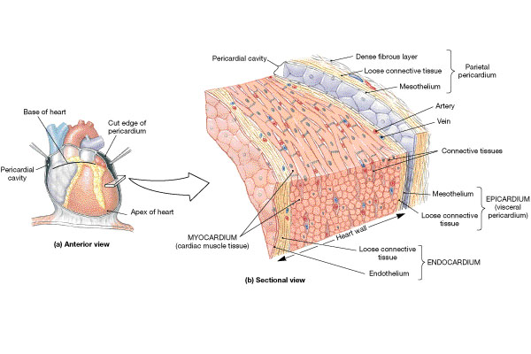
Structure of the Heart Wall
Epicardium = “upon the heart” = visceral pericardium
Dense fibrous connective tissue
Myocardium is the middle layer
Cardiac muscle
Endocardium = “inside the heart”
Simple squamous epithelium

Slide 22
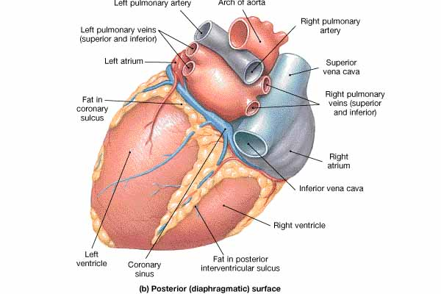
The Great Vessels
Superior & inferior vena cava
Return blood from body to right atrium
Coronary Sinus
Returns blood from heart wall to right atrium

Slide 23
The Great Vessels
Pulmonary veins
Return blood (oxygenated) from lungs to left atrium
Aorta
Takes blood from left ventricle to body
Pulmonary artery
Takes blood (deoxygenated) from right ventricle to lungs

Slide 27
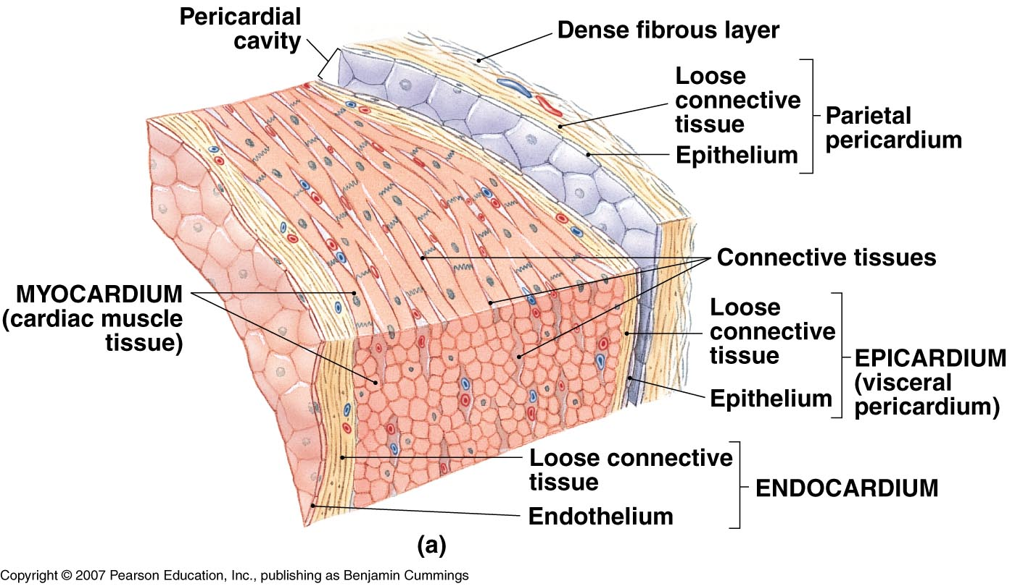

Slide 28
Cardiac muscle tissue

Slide 29
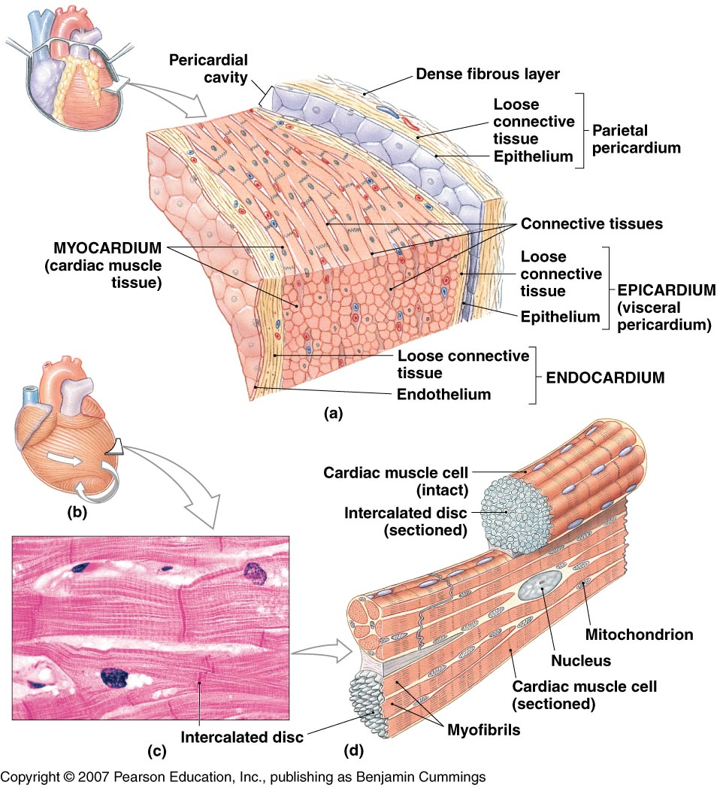

Slide 33
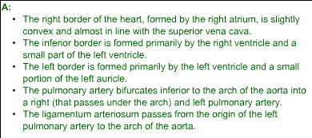

Slide 36
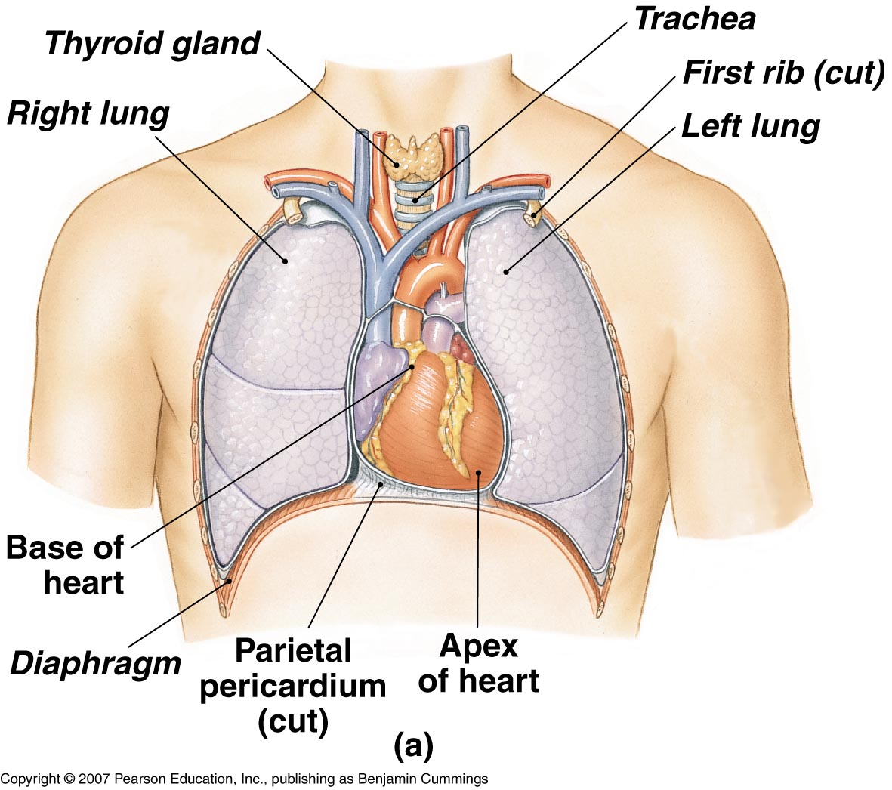

Slide 37
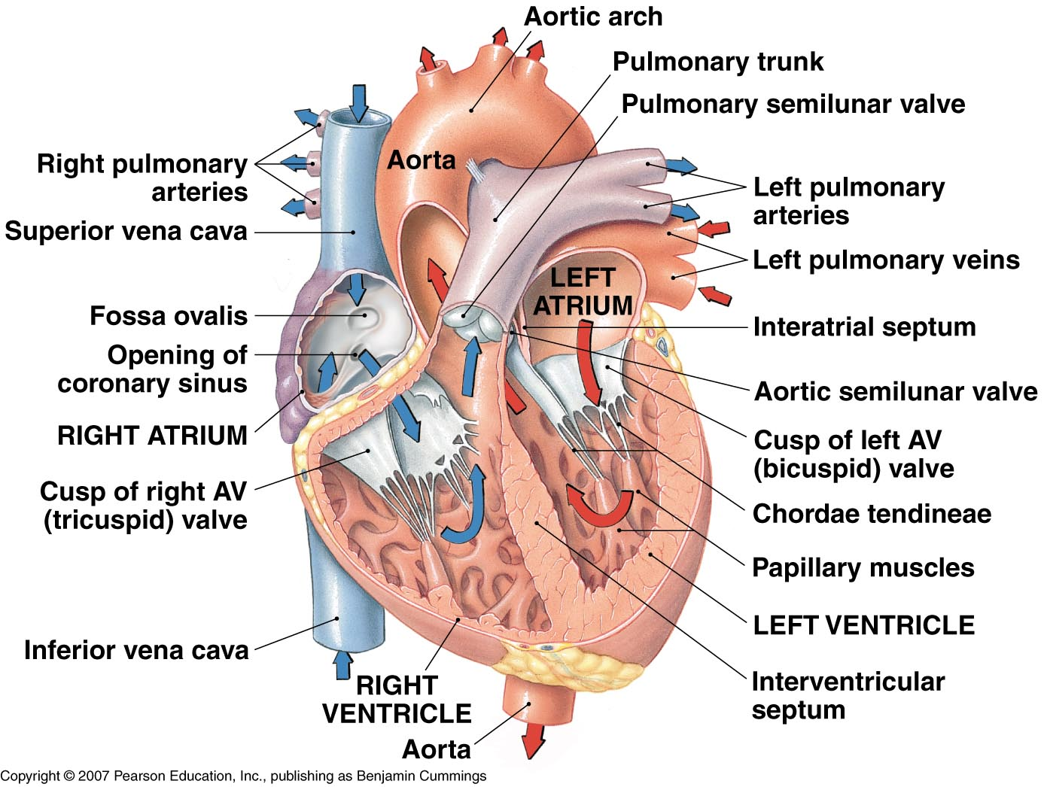

Slide 38
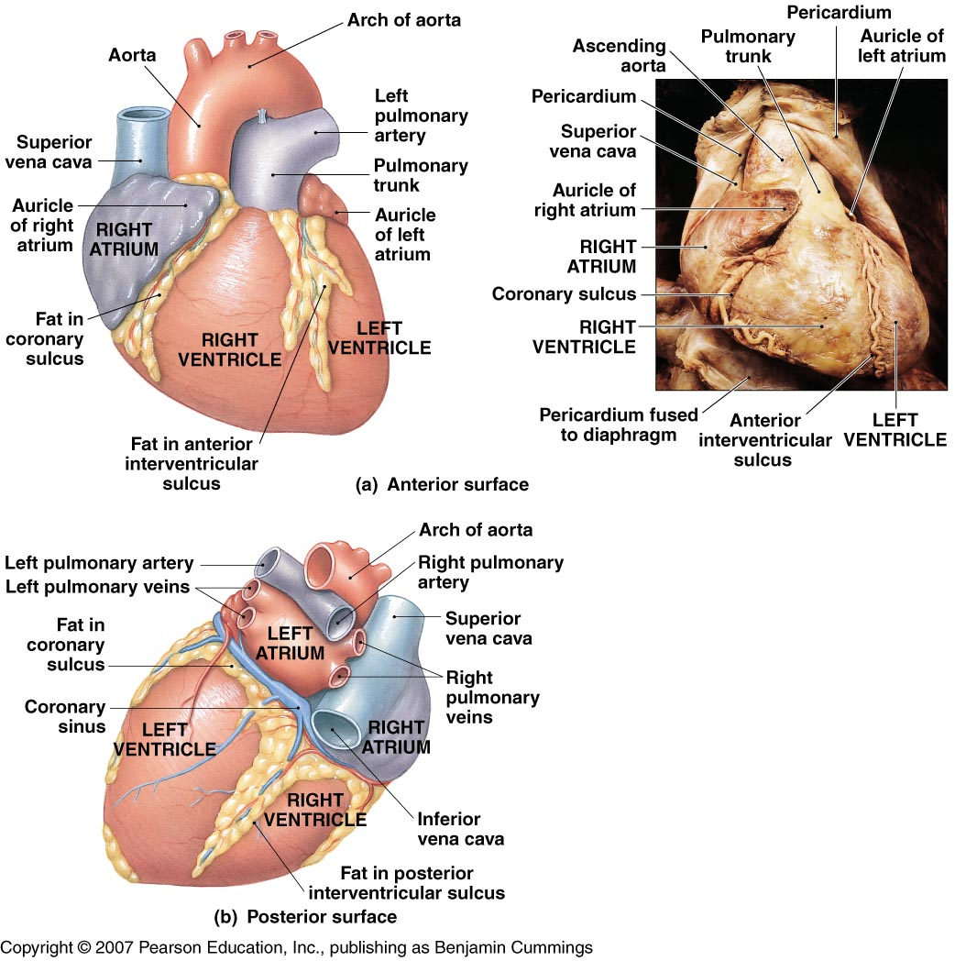

Slide 39
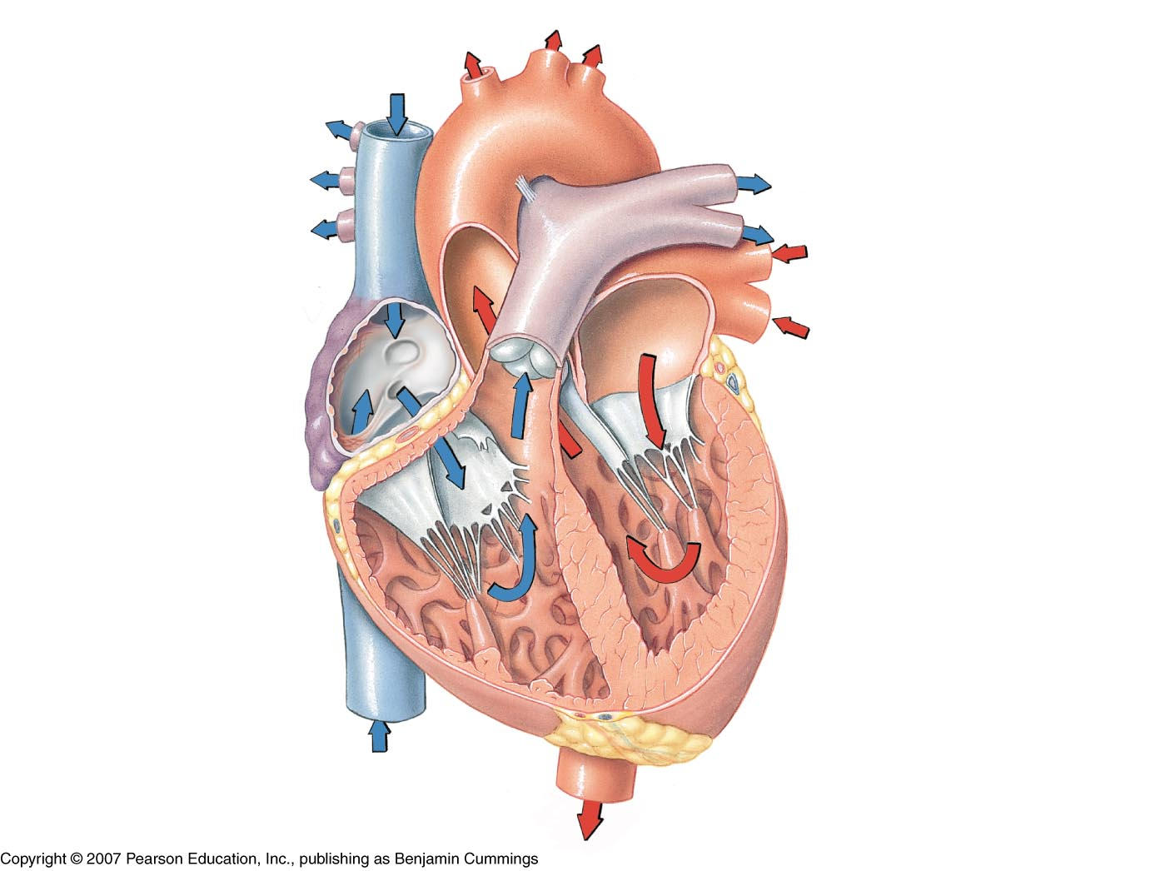
SVC
Interatrial septum
Pulmonary veins
Fossa ovalis
Lt Atrium
Rt Atrium
Pectinate muscles
Bicuspid (mitral) valve
Coronary sinus (opening)
Chordae tendoneae
Tricuspid valve
Chordae tendoneae
Papillary muscle
Papillary muscle
IVC
Oxygenated blood
Deoxygenated blood

Slide 41
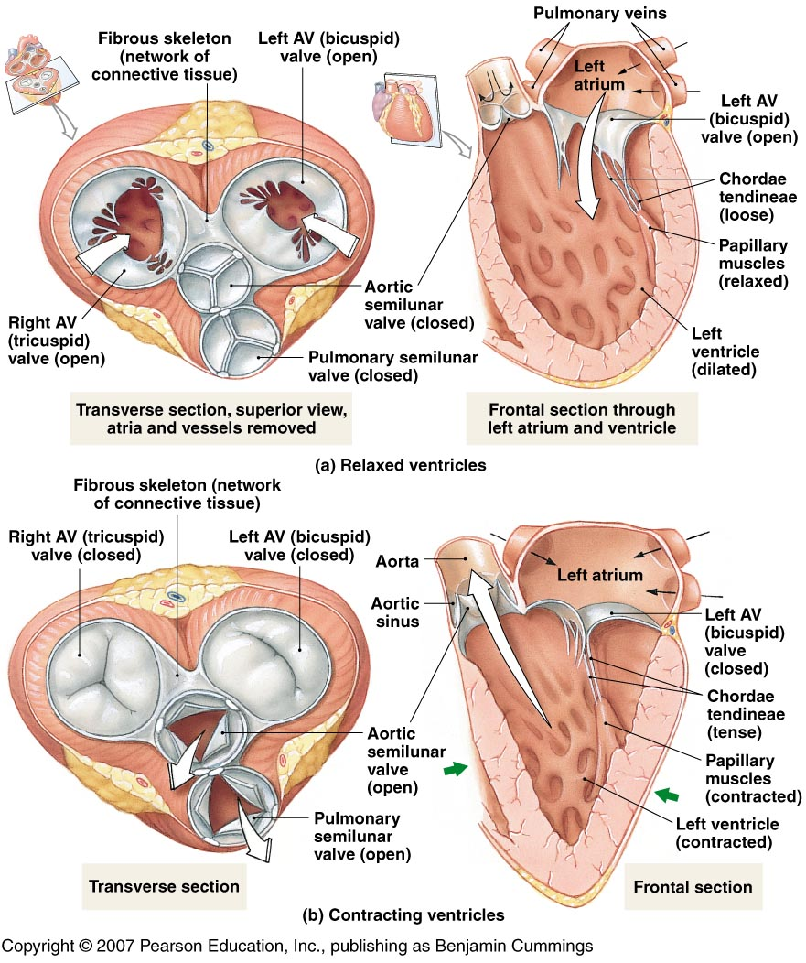
Atrioventricular (AV) valves
Tricuspid
Bicuspid

Slide 42
Left common carotid artery
Left subclavian artery
Brachiocephalic trunk
Ligamentum arteriosum
Aorta
Pulmonary artery
Pulmonary trunk
Pulmonary semilunar valve
Aortic semilunar valve
Trabeculae carneae
Lt ventricle
Rt ventricle
Interventricular septum

Slide 43
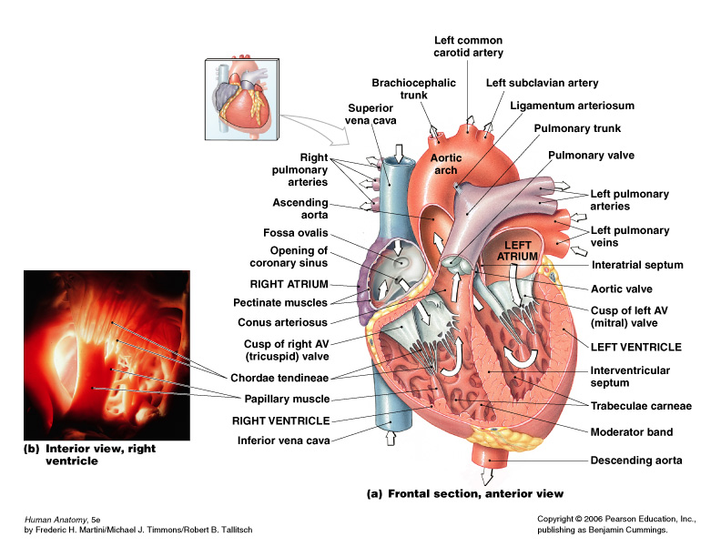

Slide 44
Internal Anatomy of the Heart
Chambers of the heart
Right & left atrium
Separated by the interatrial septum
Right & left ventricle
Separated by the interventricular septum

Slide 45
Structure of the Heart Wall
Epicardium = “upon the heart” = visceral pericardium
Dense fibrous connective tissue
Myocardium is the middle layer
Cardiac muscle
Endocardium = “inside the heart”
Simple squamous epithelium

Slide 46
The Great Vessels
Superior & inferior vena cava
Return blood from body to right atrium
Coronary Sinus
Returns blood from heart wall to right atrium

Slide 47
The Great Vessels
Pulmonary veins
Return blood (oxygenated) from lungs to left atrium
Aorta
Takes blood from left ventricle to body
Pulmonary artery
Takes blood (deoxygenated) from right ventricle to lungs

Slide 74
The End
The End

