Slide 1
APPROACH TO PATIENT WITH RESPIRATORY DISEASE AND PHYSICAL EXAMINATION
Dr Dhaher Jameel Salih Al-habbo
FRCP London UK
Assistant Professor Department of Medicine

Slide 2
Examination of the patient with suspected pulmonary disease includes inspection, palpation, percussion, and auscultation of the chest.
An efficient approach begins with observing the pattern of breathing, auscultation of the chest, and inspection for extrapulmonary signs of pulmonary disease. More detailed examination follows from initial findings

Slide 3
Extrapulmonary signs of intrinsic pulmonary disease
Include digital clubbing, cyanosis, elevation of central venous pressures, and lower extremity edema.
Digital clubbing refers to structural changes at the base of the nails that include softening of the nail bed and loss of the normal 150-degree angle between the nail and the cuticle.
The distal phalanx is convex and enlarged: its thickness is equal to or greater than the thickness of the distal interphalangeal joint.

Slide 4
Extrapulmonary signs of intrinsic pulmonary disease
Hypertrophic pulmonary osteoarthropathy is a syndrome of digital clubbing, chronic proliferative periostitis of the long bones, and synovitis.
It is seen in the same conditions as digital clubbing but is particularly common in bronchogenic carcinoma.
The cause of clubbing and hypertrophic osteoarthropathy may reflect platelet clumping and local release of platelet-derived growth factor at the nail bed.

Slide 5
Extrapulmonary signs of intrinsic pulmonary disease
Cyanosis is a blue or bluish-gray discoloration of the skin and mucous membranes caused by increased amounts (> 5 g/dL) of unsaturated hemoglobin in capillary blood.
Cyanosis is therefore not a reliable indicator of hypoxemia but should prompt direct measurement of arterial PO2 or of hemoglobin saturation

Slide 6
Extrapulmonary signs of intrinsic pulmonary disease

Slide 7
Extrapulmonary signs of intrinsic pulmonary disease
Estimation of central venous pressure (CVP) and assessment of lower extremity edema are indirect measures of pulmonary hypertension, the major cardiovascular complication of chronic lung disease.
Elevated CVP is a pathologic finding associated with impaired ventricular function, pericardial effusion or restriction, valvular heart disease, and chronic obstructive or restrictive lung disease.
Peripheral edema is a nonspecific finding that, in the setting of chronic lung disease, suggests right ventricular failure

Slide 8
Extrapulmonary signs of intrinsic pulmonary disease
Look for any obvious chest or spine deformities.
These may arise as a result of chronic lung disease (e.g. emphysema), occur congenitally, or be otherwise acquired.
Pectus excavatum: Congenital posterior displacement of lower aspect of sternum. This gives the chest a somewhat "hollowed-out" appearance. The x-ray shows a subtle concave appearance of the lower sternum.

Slide 9
Pectus excavatum

Slide 10
Barrel chest: Associated with emphysema and lung hyperinflation. Accompanying xray also demonstrates increased anterior-posterior diameter as well as diaphragmatic flattening.

Slide 11
Extrapulmonary signs of intrinsic pulmonary disease
The pattern of breathing refers to the respiratory rate and rhythm, the depth of breathing or tidal volume, and the relative amount of time spent in inspiration and expiration.
Normal values are a rate of 12–14 breaths per minute, tidal volumes of 5 mL/kg, and a ratio of inspiratory to expiratory time of 2:3.

Slide 12
Extrapulmonary signs of intrinsic pulmonary disease
Tachypnea is an increased rate of breathing and is commonly associated with a decrease in tidal volume.
Respiratory rhythm is normally regular, with a sigh (1.5–2 times normal tidal volume) every 90 breaths or so to prevent collapse of alveoli and atelectasis.
Alterations in the rhythm of breathing include rapid, shallow breathing, seen in restrictive lung disease and as a precursor to respiratory failure

Slide 13
Extrapulmonary signs of intrinsic pulmonary disease
Kussmaul :breathing, rapid large volume breathing indicating intense stimulation of the respiratory center, seen in metabolic acidosis.
Cheyne-Stokes respiration, a rhythmic waxing and waning of both rate and tidal volumes that includes regular periods of apnea. This last pattern is seen in patients with end-stage left ventricular failure or neurologic disease and in many normal persons at high altitude, especially during sleep.

Slide 14
Extrapulmonary signs of intrinsic pulmonary disease
During normal quiet breathing, the primary muscle of respiration is the diaphragm. Movement of the chest wall is minimal.
The use of accessory muscles of respiration, the intercostal and sternocleidomastoid muscles, indicates high work of breathing.
At rest, the use of accessory muscles is a sign of significant pulmonary impairment.

Slide 15
Extrapulmonary signs of intrinsic pulmonary disease
As the diaphragm contracts, it pushes the abdominal contents down.
Hence, the chest and abdominal wall normally expand simultaneously.
Expansion of the chest but collapse of the abdomen on inspiration indicates weakness of the diaphragm.

Slide 16
Chest examination
The chest normally expands symmetrically. Asymmetric expansion suggests unilateral volume loss, as in atelectasis or pleural effusion, unilateral airway obstruction, asymmetric pulmonary or pleural fibrosis, or splinting from chest pain.

Slide 17
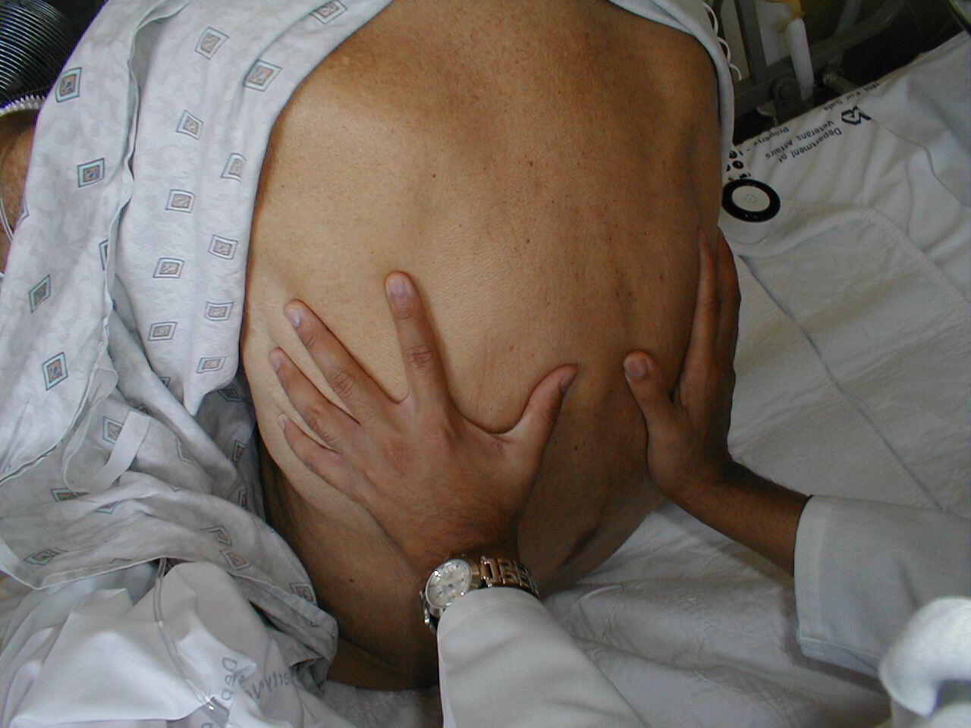

Slide 18
Chest examination
The palpation as follows:
The trachea at the suprasternal notch, to detect shifts in the mediastinum; on the posterior chest wall, to gauge fremitus and the transmission through the lungs of vibrations of spoken words; and on the anterior chest wall to assess the cardiac impulse.
All these maneuvers are characterized by low interobserver agreement

Slide 19
Chest examination
Chest percussion identifies dull areas that correspond to lung consolidation or pleural effusion .
Hyperresonant areas suggesting emphysema or pneumothorax.

Slide 20
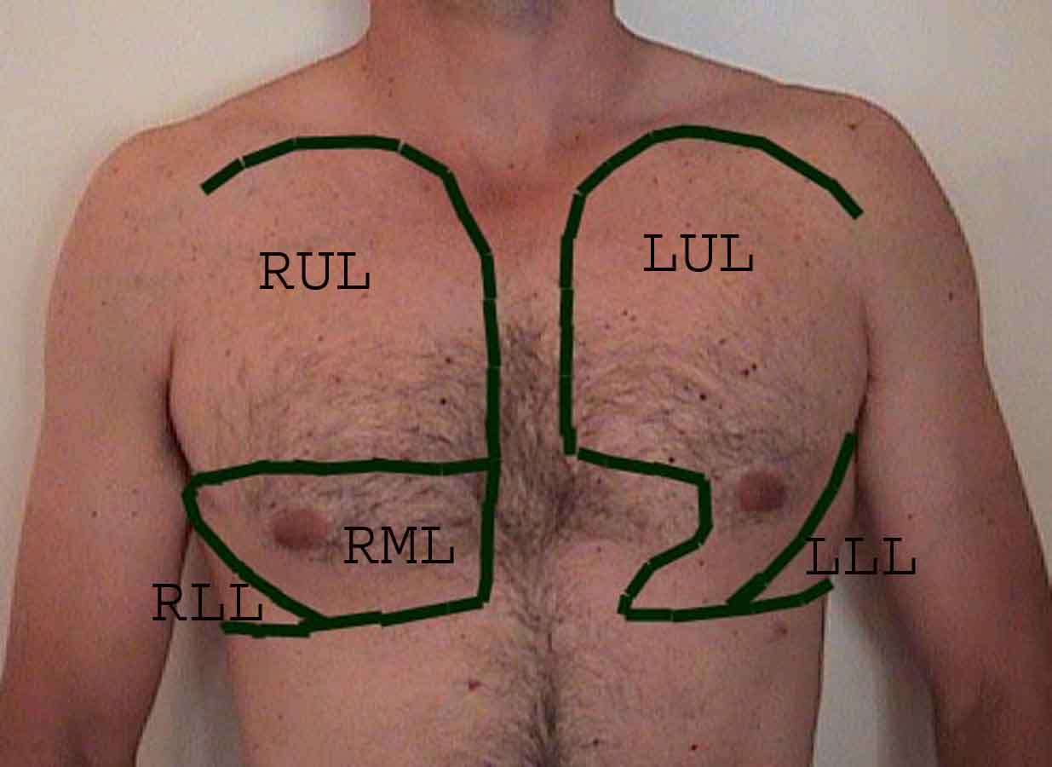
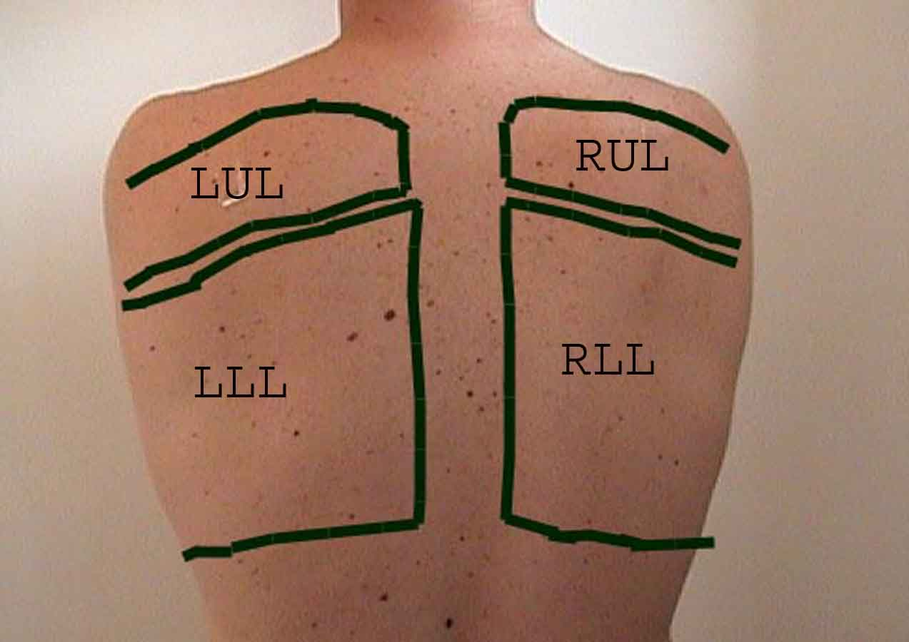
Chest examination

Slide 21
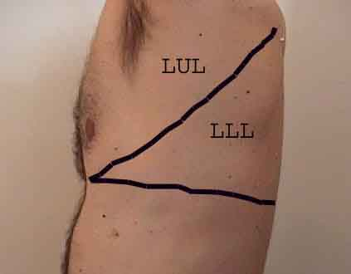
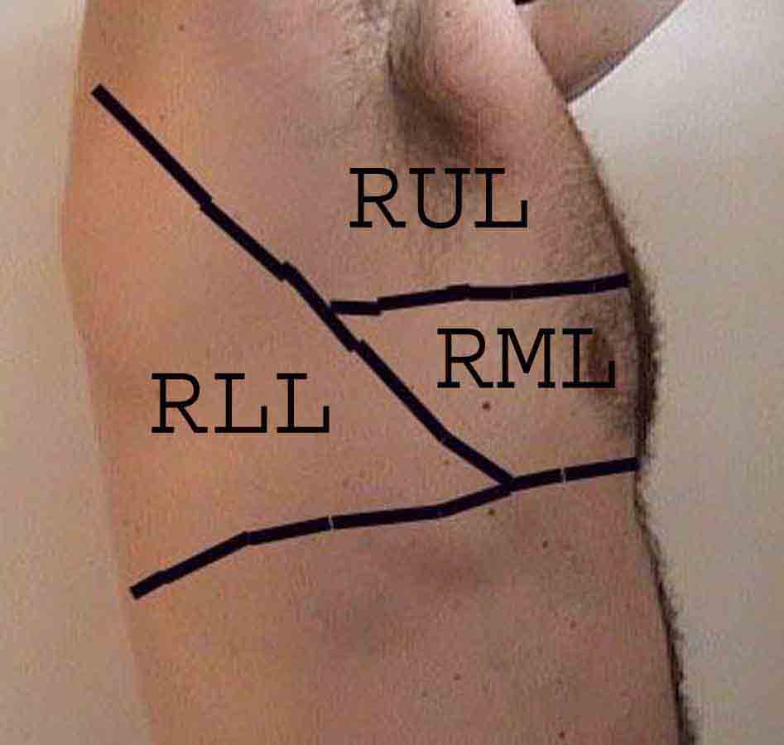
Chest examination

Slide 22
Chest examination

Slide 23
Auscultation of the chest
Normal lung sounds heard over the periphery of the lung are called vesicular.
They have a gentle, rustling quality heard throughout inspiration that fades during expiration.
Normal sounds heard over the suprasternal notch are called tracheal or bronchial lung sounds. They are louder, higher-pitched, and have a hollow quality that tends to be louder on expiration.

Slide 24
Auscultation of the chest
Bronchial lung sounds heard over the periphery of the lung are abnormal and imply consolidation.
Globally diminished lung sounds are an important finding predictive of significant airflow obstruction.

Slide 25
Auscultation of the chest
Abnormal lung sounds (“adventitious” breath sounds) may be continuous (> 80 ms in duration) or discontinuous (< 20 ms).
Continuous lung sounds are divided into (a)wheezes, which are high-pitched, musical, and have a distinct whistling quality.
Wheezes occur in the setting of bronchospasm, mucosal edema, or excessive secretions.

Slide 26
Auscultation of the chest
(b) Rhonchi, which are lower-pitched, sonorous, and may have a gurgling quality. Rhonchi originate in the larger airways when excessive secretions and abnormal airway collapsibility cause repetitive rupture of fluid films.
Rhonchi frequently clear after cough.
In each case(wheezes or Rhonchi),the airway is narrowed to the point where adjacent airway walls flutter as airflow is limited.

Slide 27
Auscultation of the chest
Discontinuous lung sounds are called crackles— brief, discrete, nonmusical sounds with a popping quality.
Fine crackles are soft, high-pitched, and crisp (< 10 ms in duration).
They are formed by the explosive opening of small airways previously held closed by surface forces and are heard in interstitial diseases or early pulmonary edema.

Slide 28
Auscultation of the chest
Coarse crackles are louder, lower-pitched, and slightly longer in duration (< 20 ms) and probably result from gas bubbling through fluid.
Coarse crackles are heard in pneumonia, obstructive lung disease, and late pulmonary edema.
The timing and character of crackles can reliably distinguish different pulmonary disorders.
Fine, late inspiratory crackles suggest pulmonary fibrosis, while early coarse crackles suggest pneumonia or heart failure.

