Slide 1
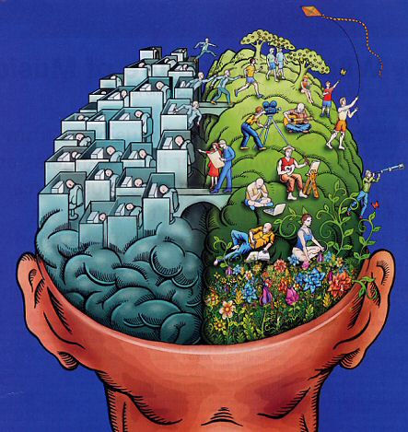
Intelligence
Prof. Dr. Elham AlJammas
22/9/2013

Slide 2
Objectives:
1.What is IQ?
2.Is IQ unitary (one general ability) or multi-faceted (many
different abilities)?
3.To what extent do genetics and environmental influences affect IQ?
4.Is IQ important in predicting academic success and real-life

Slide 3
Definition
IQ (Intelligence quotient) is an index of how people perform on a standardized intelligence test relative to others of the same age.
The ability to assimilate factual knowledge to recall either recent or remote events, reason logically, to manipulate concepts, to translate the abstract to the literal to the abstract, to analyze and synthesize forms , and to deal meaningfully and accurately with problems and priorities in particular setting some ability to adapt & learn from life every day experiences.

Slide 4
The Intelligent quotient: The intelligent ( IQ ) is the ratio of (MA) to CA (Chronological age multiplied by 100) IQ=MA/C*100
An IQ of 100 or average result when chronological and mental age are equal.
Mental age(MA) : is an individual level of mental development & intellectual level of particular age, relative to others.
MA was firstly introduced by a French psychologist called AlferdBinet
Binet test L A scale consisted of 30 items ranging from the ability to touch ones nose or ear whem asked to the ability to draw signs from memory & define abstract concepts the age of children were 3-11 years

Slide 5
Mental retardation : is inadequate intellectual functioning in which the individual IQ usually below 70, has difficulty adapting to every day life & has onset of these characteristics during the developmental period i.e by the age of 18
Mild : 55-70 about 89% of mental retardation Moderate: 40-54 6% sever M.R : 25-30 3-5% profound: below 25 1%
Giftedness: gifted have above average intelligence (I.Q 120 or higher)
Creativity: is the ability to think about something in usual ways & came up with unique solution to problems thus intelligence & creativity are not the same thing

Slide 6
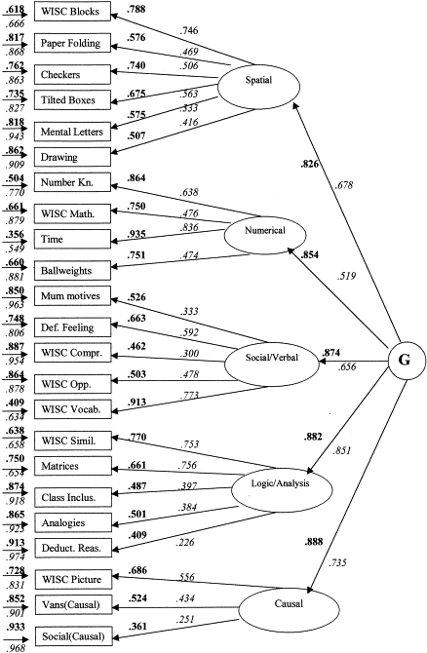
Theories of intelligence
1.Factor analytic theory

Slide 7
Verbal meaning
2.Thurman’s seven primary skills of intelligence
Perceptual speed
Reasoning
Number
Rote memory
Word fluency
Spatial
visualization

Slide 8
3.Triarchic Theory of Intelligence(Sternberg’s)
Adapt, select, and shape to needs
Ability to tailor one’s behavior to demands of context
Encode, combine, compare information
Exposure and practice
IQ
Information-processing skills
Experience with a given task/situation

Slide 9
4/Gardner’s Theory of Multiple Intelligences
Intrapersonal
Musical
naturalist
Linguistic
Logical-
mathematical
Bodily-
kinesthetic
Spatial
Interpersonal

Slide 10
5.The Stanford-Binet Test
Originated in early 1900s by Binet and Simon as a means of placing children in appropriate tracks in school--basically a project of finding questions that discriminated among children and successfully predicted school performance (grades, teachers' opinions). They didn't have a theory.
The point was to find items that discriminated among children as follows:
The items of the test were retained only if they were useful in sorting children by age. E.g., an item would be retained if it was passed by 40% of 5-year olds, 60% of 6-year-olds, and 80% of 7-year-olds.
Mental age is an index of child's performance level compared to the average for children of the same age.

Slide 11
Some important facts about intelligence:
* many factors could contribute to the individual differences level but culture & ethnicity & IQ test bias due to linguistic, economical & educational differences. * Mental ability tends to increase up to the age of 26, level off for the next 10 years , and then decline after age 49 but recent research proved that IQ is increasing all over the world due to positive environmental influences through stimulation & communication. * The most useful intelligence test must measure a variety of skills and abilities including verbal – performance timed untimed culture free culture bound early learned late learned,. * Test measure present functioning ability not necessarily of future potential

Slide 12
The Traditional Approach: The Wechsler Scales
The Wechsler Scales: Separate verbal and performance scores
Verbal: General information, arithmetic, similarities between words, digit span
Performance: Picture completion, Picture arrangement, Reproducing Block designs, assemble jigsaw puzzle

Slide 13
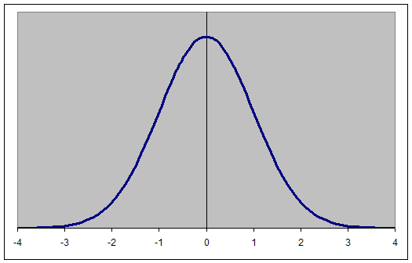
The Traditional Approach: The Wechsler Scales
Wechsler introduced the deviation IQ. in which IQ is measured in terms of standard deviations from the mean of children the same age.
This results in the familiar Bell Curve. Average IQ is 100. An IQ of 115 is 1 Standard Deviation above the mean, 130 is 2 standard deviations above the mean.

Slide 14
WISC-IV
Arithmetic
Similarities
Letter-number sequencing
Vocabulary
Picture completion
Information
Comprehension
Cancellation
Word Reasoning
Block Design
Picture concepts
Digit span
Matrix reasoning

Slide 15
Why Do People Differ In Measured Intelligence?: Genetics and Intelligence
Responsible estimates of 40% to 80% of the variation in IQ is because people have different genes
The degree of genetic influence (=heritability) increases as children get older.
All agree that environmental differences have an effect; environmental differences may be social (family, peers, school) or non-social (nutrition, pollutants, diseases).
The fact that a trait is caused by genes does not mean that it can't be influenced by the environment. Example: Blindness, deafness, Pheylketonuria (PKU).

Slide 16
Heritability
Estimates of heritability apply to the entire population studied;
Estimates of heritability are averages, and they do not apply to particular people. Can't say: He has a heritability of .6 for IQ. .
This would be compatible with some children's IQ being strongly influenced by the environment and other children's IQ not being influenced by the environment.
The heritability estimate is an average of all the influences for the entire sample

Slide 18
Environmental variation has most effect in poor environments, especially abusive environments
ABUSIVE VERSUS NORMAL ENVIRONMENTS IQ
__________|___________________|_____ ABUSIVE NORMAL ENRICHED
Gain from
Better Normal
E
Bad E’s have
Accelerating
Negative eff
ectsOn IQ

Slide 19
Environmental variation has most effect in poor environments, especially abusive environments
ABUSIVE VERSUS NORMAL ENVIRONMENTS
Environmental influences are highest on the left hand side of this graph.
If you had a sample of children who came from normal environments, the degree of genetic influence would be relatively high, but if you had a sample from abusive environments or even perhaps the low end of normal environments, there would be more evidence for environmental influence.
The low end of normal environments in the US would be working class people who send their kids to school but are not well educated and are not much interested or able to provide a lot of intellectual stimulation to their children.
The high end of normal would be, well educated parents who desperately try to get their kids into the best schools, hire tutors, and take them on trips the local art museum.)

Slide 20
Why Do People Differ In Measured Intelligence?
Environmental factors affecting IQ
Pregnancy and birth problems:
Prenatal malnutrition, maternal disease (e.g., AIDS);
These characteristics are considered congenital--that is, they are acquired either in utero or shortly after birth;
they are not inherited.

Slide 21
Why Do People Differ In Measured Intelligence?
Environmental factors affecting IQ
The family: IQ correlated with family environments that are "emotionally and verbally responsive to their children, provide appropriate play and reading materials, encourage children in school, etc.
THESE FINDINGS COULD BE DUE TO PASSIVE GENOTYPE-ENVIRONMENT CORRELATIONS.
Parent
Genes Env.
Child

Slide 22
Why Do People Differ In Measured Intelligence?
Environmental factors affecting IQ
Schools and Peer Groups:
Lack of formal education or "dropping out" of school associated with DECLINES in IQ.
IQ declines during summer vacation
Children whose birthdays barely qualify them for school entry have higher IQs.

Slide 23
Asian American
80
European American
Chinese
Japanese
60
Percentage of students
40
20
Figure 10-2
0
Studying hard
A good teacher

Slide 24
Box 10-1: Asian students higher on math scores; Figures 10-6 and 10-7 Differences:
Chinese and Japanese mothers see academics as most important thing a child does.
They are more likely to help children with homework. Strictly monitor children's homework and play time. intelligence is innate but attribute the success o
They do not think that f their children to studying hard. This is an incremental theory of intelligence as a body of skills that can be increased with effort.
They think their children are average, while American mothers think their children are smarter than they really are.

Slide 25
Characteristics of successful intervention programs
Timing: Must begin by age 2 and continue until kindergarten;
Suggests Critical or Sensitive Period
Intensity: Success influenced by how much time is spent in the program.
continued intervention had beneficial effects, but not as much as the early intervention.
Direct provision of learning experiences to children (as opposed to working only with parents).
Must be academically oriented, not just play.
Environmental maintenance of development
."

Slide 26
Beyond The Norms: Giftedness And Mental Retardation
Intellectual giftedness: IQ over 130
Mental retardation: IQ below 70
Learning disabilities: speech, language, or reading impairments;
These are not deficits in general intelligence.
They are deficits in specific abilities
.

Slide 27
Wechsler intelligence test:
Constructed by David Wechsler at New york university in 1939 the original test gone through several revisions the latest revision is lll
WAIS lll : is designed for person 16-89
WISC lll : ( Wechsler intelligence scale years for children) designed for age 5-15
WPPSI-R: (Wechsler preschool and primary scale of intelligence – Revised) for children of 4-6
Construction of the test: WAIS comprises ll sub tests made up to
6-verbal
5 performance

Slide 28
Verbal skills:
1. Information: this sub tests covers general information 2. Comprehension: this sub test measures subjects knowledge of social conventions and common sense 3. Arithmetic : the ability to do arithmetic and other simple calculations is reflected on this sub test which is adversely influenced by anxiety and poor attention and concentration. 4. Similarity: This sub test is a sensitive indicator of intelligence it covers the ability to abstract by asking subjects to explain the similarity between two things 5. Digit span: immediate retention is measured in this sub test subject are asked to learn a series of two to nine digits, which are immediately recalled both forward and backward, anxiety, poor attention span , and brain dysfunction interfere with recall. 6. Vocabulary: subjects are asked to define 35 vocabulary words of increasing difficulty , intelligence has a high correlation with vocabulary, which is related to level of education.

Slide 29
Performance:
1. Picture completion: consists of completing a picture in which a part is missing visuo-perceptive 2. Block design: this sub tests requires subjects to match colored blocks and visual designs brain dysfunction 3. Picture arrangement: subjects are require to arrange a series of pictures in a sequence that tells a story 4. Object assembly: subjects must assemble objects. 5. Digit symbols: in this final subtest of the WAIS subjects receive a code that pair symbols with digit.

Slide 31
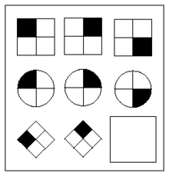
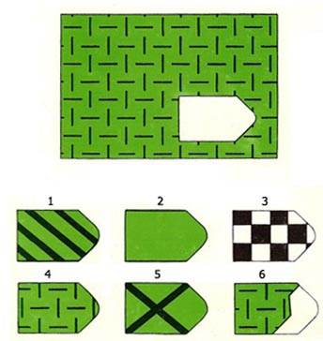
RAVEN Progressive Matrices IQ Test
Consist of 5 groups A,B,C,D,E each group consist 12 design of matrices in progressive difficulties. Each matrix contains a series of picture with a missing piece and the candidate has to select the right answer from a number of correct answers and age

Slide 32
Other Tests performance test
* Koh's block
The subject has to construct designs with the block according to given pattern of increasing difficulty the result is usually expressed as mental age (MA) or IQ
* Domino Test * Maze test * Picture completion tests

Slide 33
Advantage of performance tests 1. Can be used on illiterate , foreigners, deaf mute and those with speech difficulties. 2. Less determines by education than verbal tests
Disadvantages 1. Usually take a long time to do 2. The norms are different according to cultures.
Verbal tests: Mostly consisting of series of short questions arranged in a progressive difficulties according to mental ages there is a battery of question *Binet test * spearman approach * Kent test

Slide 34
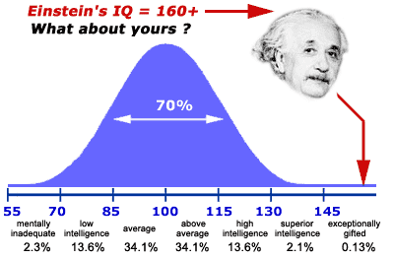
The extreme of intelligence are represented by: mentally subnormal at one end of the scale, and the intellectually gifted at the other.
IQ Classification % >129 very superior 1% 120-129 superior 11% 110-119 High average 18% 90-109 average 46% 80-89 low average 15% 70-79 borderline 6% <70 mentally sub. 3%
(

Slide 35
Practical uses of intelligence tests
1. Educational * Selection of pupils for special groups : like schools classes or institutes 2. Researches e.g. relationship between IQ and personality and behavior 3. Military service 4. Committees * medical : ( fitness for job or study) * Courts and police ( criminal responsibility)

Slide 36
Thank you for being gifted and creative students

