Slide 1
Wounds, Tissue repair and Scars
د. موفق مزعل طلفاح
General Surgeon
MBChB, MSC, MRCS/Eng

Slide 2
Definition
Wound: It is a break in the continuity of the skin, mucous membrane or any other tissue caused by physical, chemical or biological insult.

Slide 3
Wounds
Tissue Repair = Wound healing
Scar
Liver and epithelium

Slide 4
Is it important ?
Surgeons induce tissue injuries as part of their access ,
It is a common casualty complaint.

Slide 5
Wound healing:
an orchestrated biological process initiated by tissue injury and results in restoration of tissue integrity. The end result of repair process is fibrosis and scar formation.
This process is defined theoretically into three phases.

Slide 6
Phases of wound healing
Inflammatory phase (Early): 0 – 3 days.
Proliferative phase (Intermediate): 3rd day – 3rd week.
Remodelling Phase (Late): up to 1 year

Slide 7
Inflammatory phase (Early):
Hemostasis:
Vasoconstriction,
Platelets aggregation,
Activation of coagulation system.
Inflammation:
Neutrophils act to sterilize the wound.
Monocyte will continue phagocytosis and secrete several growth factors.

Slide 8
Proliferative phase (Intermediate):
Fibroplasia:
Deposition of collagen fibers to form the extra-cellular matrix.
Angiogenesis:
New capillary networks which comes from endothelial cell division and migration.
"Granulation tissues" consist of new blood vessels, macrophages, fibroblasts embedded in a loose matrix of collagen.

Slide 9
Contraction:
wound is pulled circumferentially toward the center by specialized Myofibroblast to decrease the size of the wound.
Epithelilisation:
epidermis migrate over the wound defect thus forming a barrier to further contamination.

Slide 10
Remodelling Phase (Late):
The collagen fibers align with the skin tension lines to increase the tensile strength of the skin.
However, at best it only reach approximately 80% of the normal skin.

Slide 11
Factors affect wound healing :
Local factors :
Site of the wound, structures involved and mechanism of wounding e.g. incision, crush and avulsion.
Ischemia.
Infection.
Foreign bodies and necrotic tissues.
Chronic venous insufficiency and tissue oedema.
Ionizing radiation.

Slide 12
Systemic Factors
Systemic diseases:
Malnutrition: Vit C deficiency results in inadequate collagen production.
Drugs: steroid and chemotherapeutic agents for cancer therapy.

Slide 13
Types of wound healing :
Primary Healing: wound edges opposed, normal healing and minimal scar.
Secondary Healing: The wound left open to heal by granulation, contraction and epithelialisation. There will be increased inflammation and proliferation with poor scar.
Tertiary Healing: wounds initially left open and the edges opposed later when healing conditions favourable.

Slide 14
Classification of wounds

Slide 15
Acute wounds
Tidy:
Sharp instrument e.g. surgical incisions or wound by glass or knife,
it contains no devitalized tissue
little contamination and seldom has tissue loss.
These wounds are usually single with clear cut.
closed immediately with expected good healing and minimal scar.

Slide 16
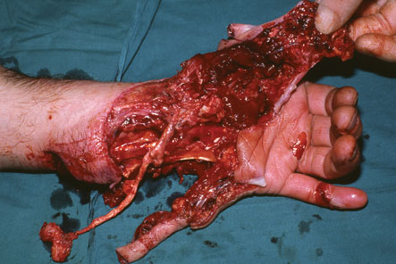
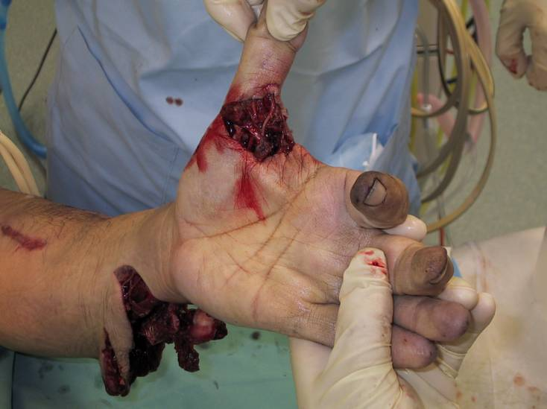
Acute wounds
Untidy:
blunt injuries e.g. crushing, tearing, avulsion.
It has a dead tissue
significant contamination and often has tissue loss.
They are often multiple and irregular.
If closed immediately, healing is unlikely and associated with wound complications.

Slide 17
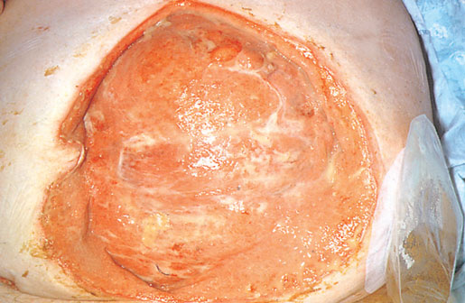
Granulation Tissue

Slide 18
Management: 1. Assessment
History:
Examination:
Generally:
Locally:
Supportive measures:

Slide 19
Local wound care
Wound excision:
The process of removal of the dead tissue from the wound.
Wound closure:

Slide 20
Wound closure:
Primary closure: the edges of the wound are approximated. The wound will heal by primary intention with minimal scaring e.g. Tidy wounds
Healing by secondary intention: In untidy wounds, it require serial wound excision and cannot be closed. These wounds are left open for care and dressing until healing achieved by granulation with significant scaring.
Delayed Primary Closure: Sometimes Untidy wounds can be converted to tidy wounds which can be closed directly.
Tissue Transfer: when there tissue loss, appropriate tissue need to be transferred into the defective area e.g. Skin graft.

Slide 21
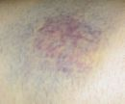
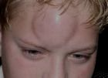
Some specific wounds
Contusion, Bruises:
closed wounds
blunt trauma
bleeding into the tissues with visible discoloration.
hematoma which can resolve spontaneously or it may need drainage or repeated aspiration.

Slide 22
Some specific wounds
Bites:
Animal/ human bites.
Aerobic and anaerobic organism prophylaxis required as bites wound typically have high virulent bacterial counts and proper wound excision.

Slide 23
Puncture wounds:
open wounds
penetrating injuries e.g. standing on a nail or sharp objects, or needle stick injuries.
foreign bodies and microorganism are likely to be carried deeply into the tissues.
The danger is, it might give rise to deep abscess.

Slide 24
Degloving:
skin and the S.C. fat are stripped by avulsion from its underlying fascia,
It could be open injury e.g. ring avulsion or closed injury e.g. roll-over injury typically caused by motor vehicle over a limb.

Slide 25
Scars:
Is the inevitable consequences of wound repair.
"Remodelling“: immature collagen fibers replaced by acellular, avascular tissue composed of mature collagen fibers.
red, raised, firm area to pale, flat, soft and symptomless mature scar.

Slide 26
The appearance of the scar from red, raised, firm area to pale, flat, soft and symptomless mature scar.
Factors:
age of patient,
site of the wound,
time the wound took to heal and
direction of the scar and the tension across it.

Slide 27
Complication of Scar
Hypertrophied scar:
more cellular and vascular with increased collagen production than mature scar.
Clinically it is red, raised, itchy and tender but confined to the wound site.
It tends to occur in wounds whose healing has delayed because of infection or dehiscence.
spontaneous resolution .
Keloid scar:
extensive growth of the scar beyond the wound site.
It is biologically identical to hypertrophied scar.
They often occur in wounds which healed without complications.
It rarely subside with time and require active treatment.

