Slide 1
HYPOKALEMIA
3.5-5.2 mmol/L) )Potassium
Only 2% is found outside the cells and of this only 0.4% of your K+ is found in the plasma.
Thus as you can see serum K+ measurements have limitations in
reflecting TOTAL body K+ stores.
A 1 mEq/L drop in K+ reflects between 200-400 mEq total body K+ deficit

Slide 2
3.5-5.2 mmol/L) )Pottasium
*Major intracellular cation
*ICF conc. = 150- 160 mEq/ L
*Resting membrane potential
*Regulates fluid, ion balance inside cell
*Contribute to pH balance
Pathophysiology of Hypokalemia
Decrease in K+ causes decreased excitability of cells, therefore cells are less responsive to normal stimuli

Slide 3
Hypokalemia can only occur for four reasons:
Decreased intake
Shift into cells
Extra-renal losses..GIT
Renal losses
*Spurious - i.e. K+ is falsely low..cases of Hyperleukocytosis

Slide 4
Decreased intake normal intake 40-120 daily.
Shift into cells:
1. Alkalosis
2.Insulin
3. Beta adrenergic drugs or epinephrine
*Ketoacidosis – mechanism of Hypokalemia : because of hypoinsulinemia there will be shift of K⁺ to ECC, H⁺ replaces K⁺, which is lost in urine(polyuria)

Slide 5
Examples of
increased potassium entry into cells
Hypokalemic periodic paralysis:
typically oriental men with thyrotoxicosis; ? abnormal Ca++ channel; ? Increased Na/K atp ase activity.
Increased RBC uptake:
e.g. after treatment with B12, folate.

Slide 6
Gastrointestinal losses of potassium
Gastric juice contains 5 – 10 mEq K+/L.
Intestinal fluids contain 20 – 50 mEq/L

Slide 7
Hypokalemia from loss of gastric fluid.
*Loss of hydrogen ion increases plasma bicarbonate(Alkalosis).
*Coexisting volume depletion increases aldosterone secretion.
* In the setting of increased aldosterone levels, sodium is retained and potassium excreted.
Potassium loss is most prominent early.
Actual losses in gastric juice are relatively small.

Slide 8
Diarrheal losses are usually accompanied by metabolic acidosis
1.Villous adenoma
.Laxative abuse2

Slide 9
The kidney and potassium
Renal K+ Loss Urine K+ >20 mEq/24 hours
or spot urine K+ of > 30
*Nearly all potassium filtered at the glomerulus is reabsorbed in the proximal nephron.
*Urinary potassium is the result of distal potassium secretion.
* To excrete potassium, the kidney requires an adequate number of nephrons, aldosterone, and a circulation adequate to provide adequate distal delivery of sodium for sodium/potassium exchange.(Na-K-ATPase)

Slide 10
Causes of Renal loss of potassium
Primary hyperaldosteronism ( Conns syndrome),
Cushing syndrome and increased steroids.
Diuretic therapy :Thiazides, loop diuretics and *Diuretics- activate the renin-angiotensin-aldosterone cascade.
Cabonic anhydrase inhibitor
DKA
Renal tubular acidosis (RTA)
Proximal RTA type 1 and 2 ,Some distal types
((Type IV RTA patients are typically hyperkalemic

Slide 11
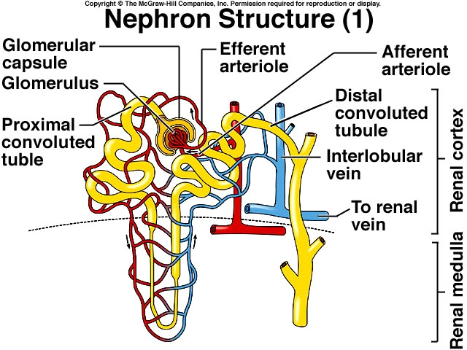

Slide 12
Clinical manifestations of Hypokalemia
Neuromuscular disorders
Muscle Weakness, flaccid paralysis, respiratory arrest,
GIT :nuasia , constipation paralytic ileus
Acquired Nephrogenic DI( Polyuria,polydypsia)
Heart : Arrhythmias, Postural hypotension
ECG Changes: Flat T-wave appearance of U wave
Cardiac arrest

Slide 13
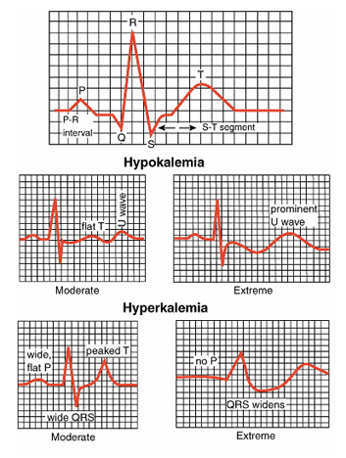

Slide 14
Management
*treat underlying cause
*correction of alkalosis
*Oral…KCL Tabs
*Parenteral…….beware……infusion of KCL should be slowly….DO NOT exceed 10mmol per hour

