Slide 1
Exodontia
حسان ثامر محمد فاضل الملاح
Group –B-
Indications for surgical extraction
Surgical procedures

Slide 2
Methods of tooth extraction
1- forceps extraction(intra alveolar extraction) consist of removing of the tooth or root using forceps ,elevator or both.
2- surgical extraction (Transalveolar extraction) achieved by reflecting a muco periosteal flap, removal of some of the bone investing the root which is then delivered by the use of an elevator and\or forceps

Slide 3
Indications for trans alveolar extraction
1:failed attempted forceps extraction
2:retained roots which can not be grasped with forceps or delivered with an elevators
3:history of complicated extraction
4:heavily restored tooth specially when root canal filled
5:hypercementosed or ankylosed tooth

Slide 4
6: geminated or dilacerated tooth
7 : impacted teeth.

Slide 5
Surgical steps of trans alveolar extraction
                1: muco periosteal flap design , incision and reflection.
2: bone removal
3: tooth division
4: tooth removal
5: socket toilet
6: wound closure or suturing

Slide 6
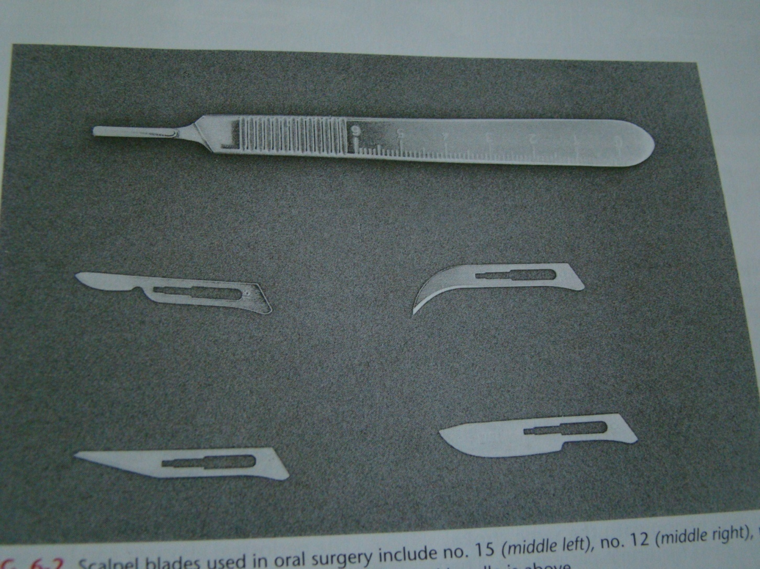
15
12
10
11

Slide 7
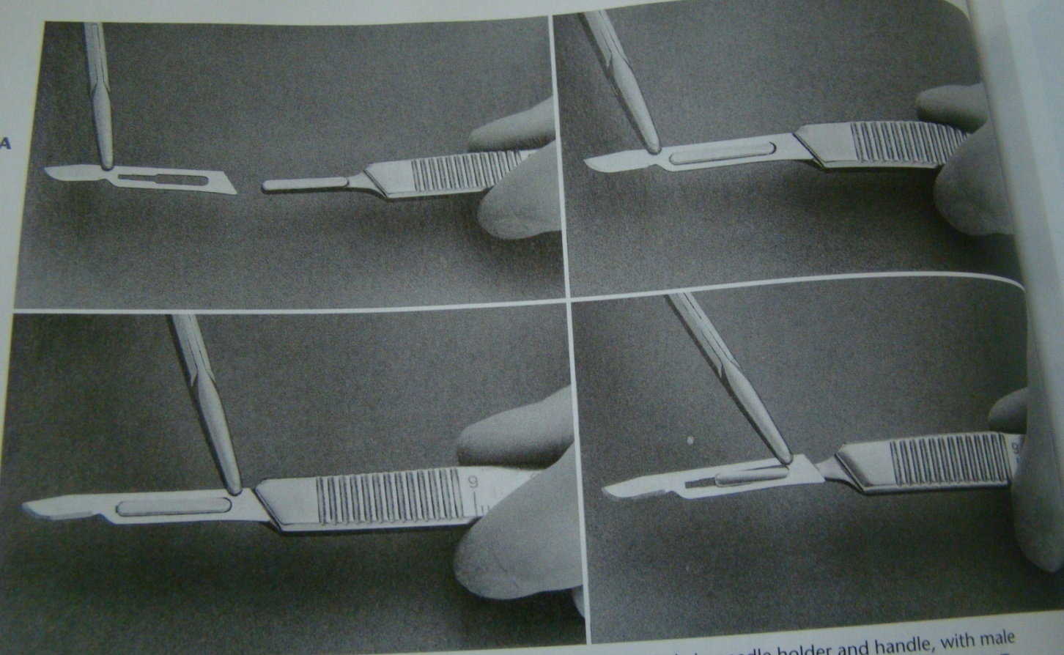

Slide 8
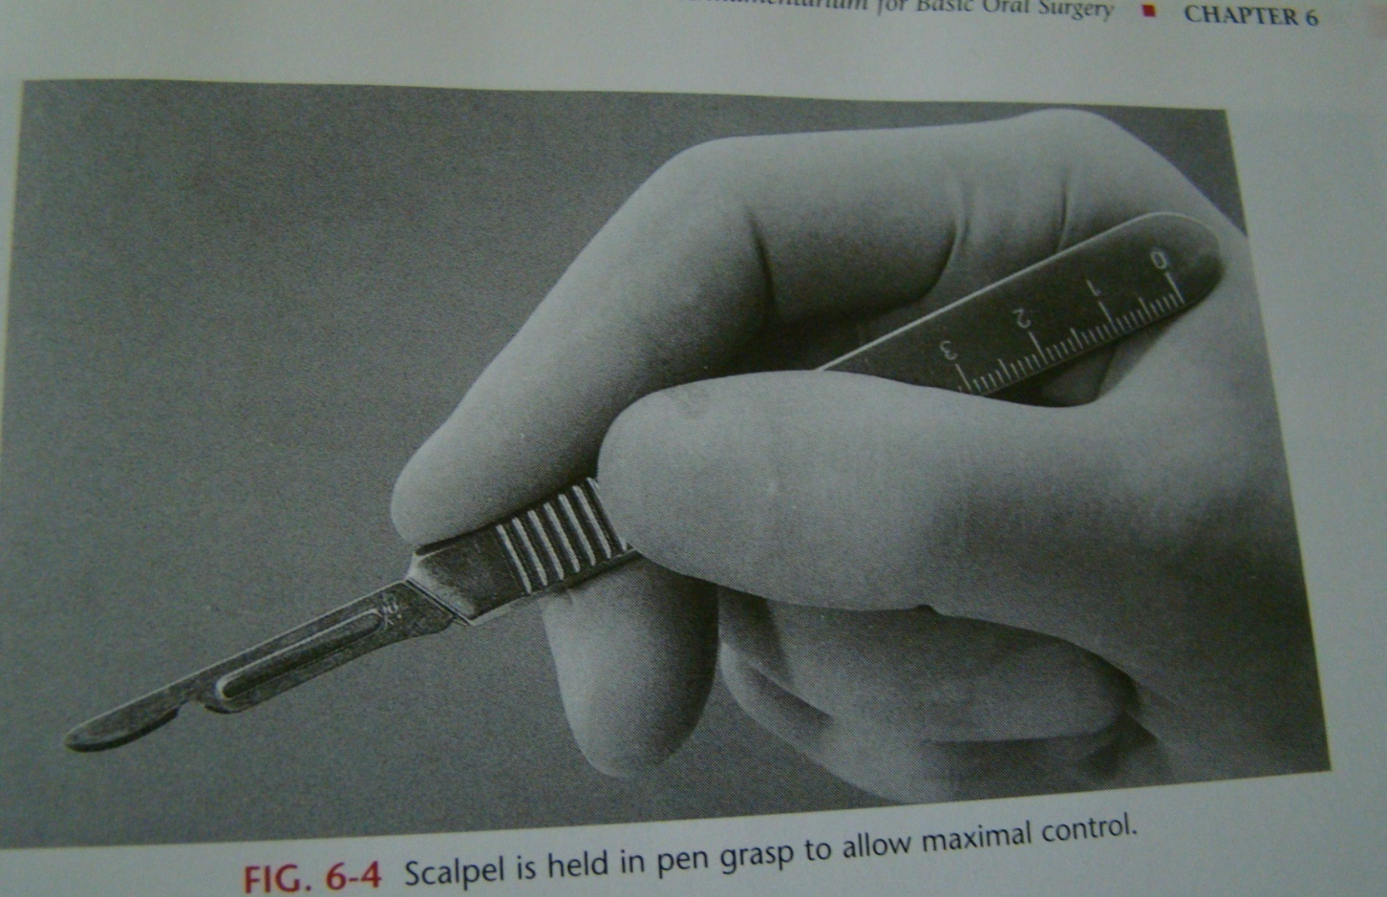

Slide 9
Principles of mucoperiosteal flap design
These are raised to render the operative site clearly visible
1 : the base of the flap should be wider than it's apex
2: at suturing the wound margin should be supported by intact bone.
3: full thickness (mucoperiosteum)

Slide 10
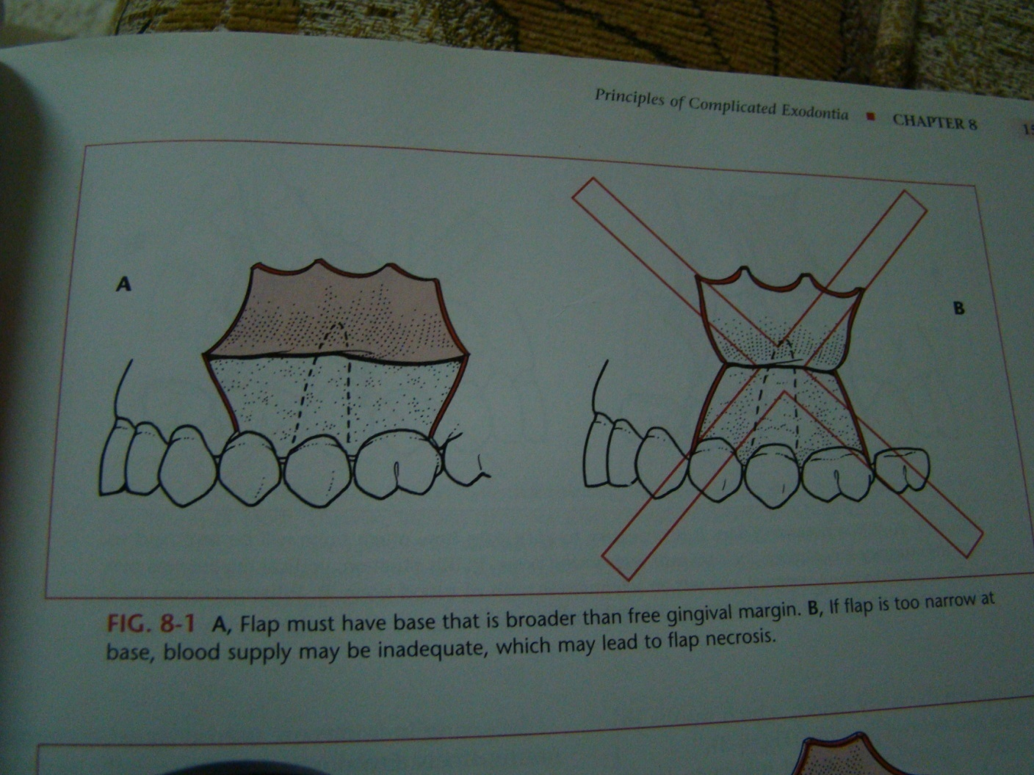

Slide 11
4- the inter dental papilla should be kept not traumatized , so that , it is either included or excluded at flap incision or design.
5- anatomical structure should be avoided . Like the canine eminence and the mental foramen.
In surgery at lower premolar the incision should be either mesial to the first premolar or distal to the second premolar.

Slide 12
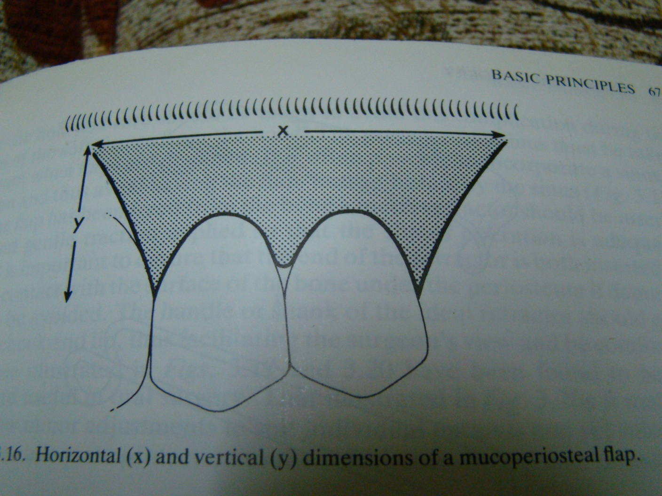

Slide 13
Types of flaps used in transalveolar extraction.
Different type of flaps can be used in dento alveolar surgery like :
1- two sided flap .
2- three sided flap.
3- semilunar flap .
4- sub marginal flap .

Slide 14
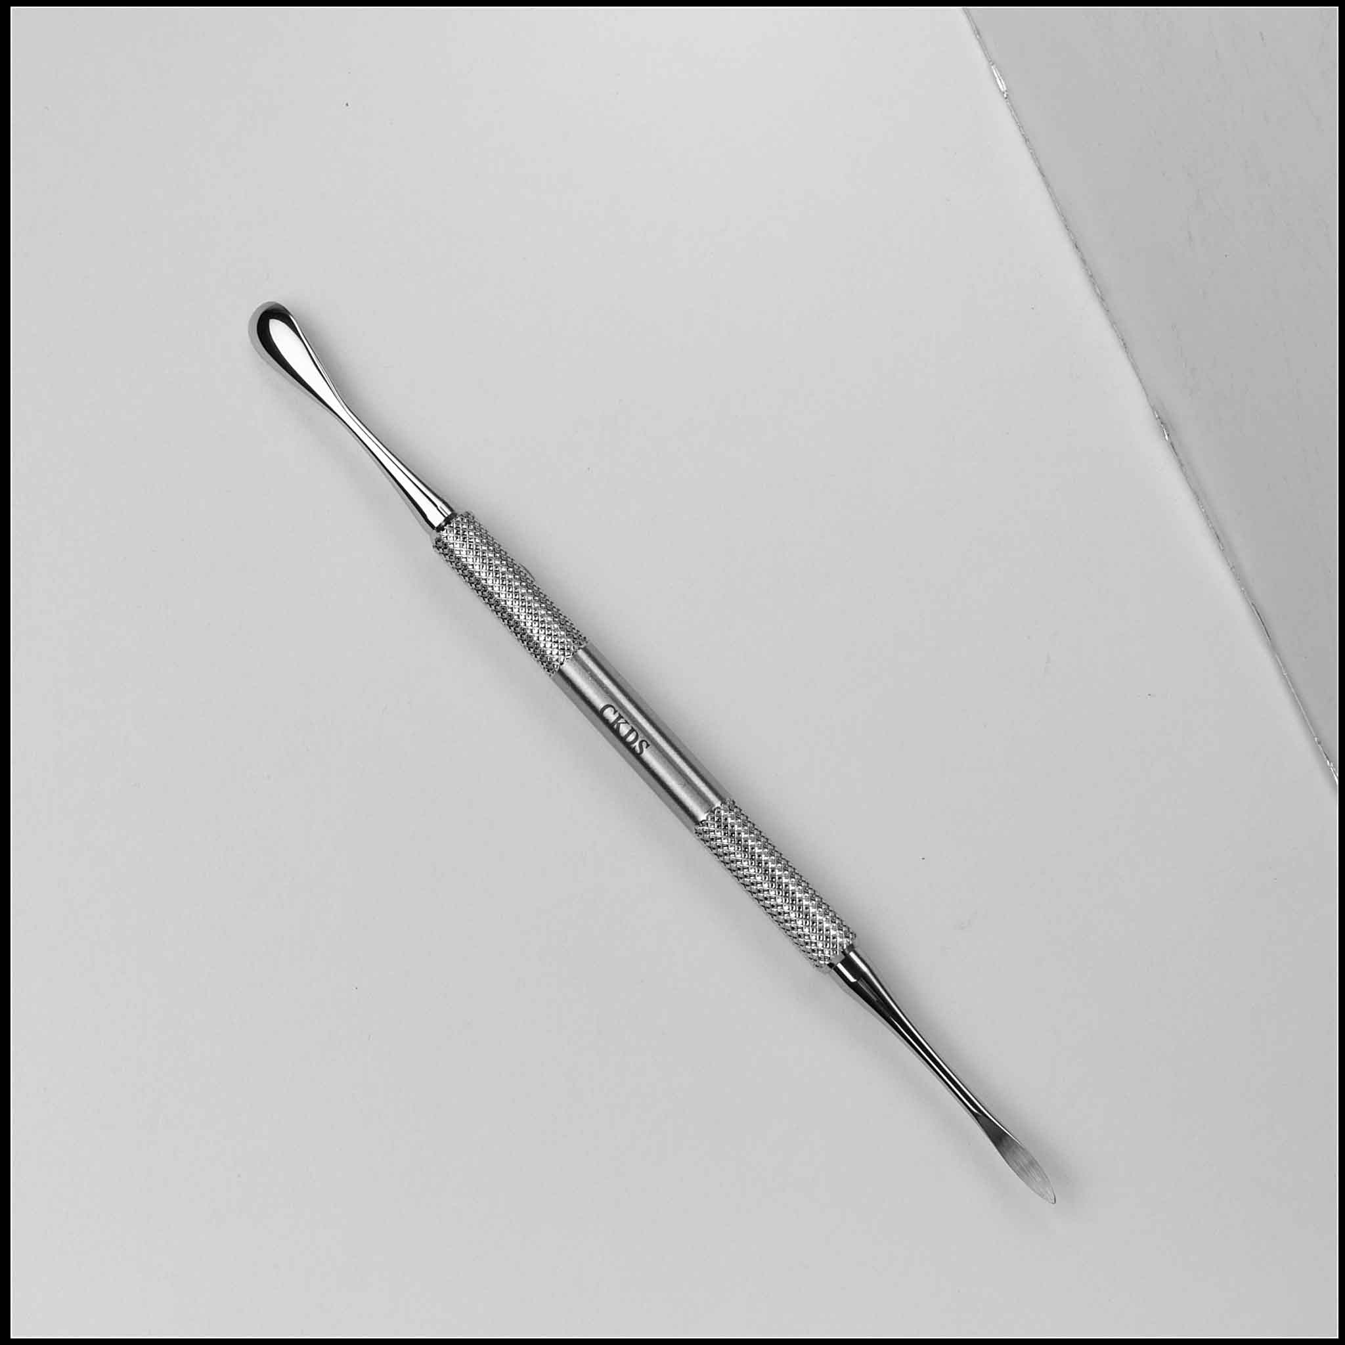
Flap reflection
The flap are raised subperiosteally. This is done by blunt dissection with a periosteal elevator , making use of the well defined plane between the soft tissues and hard tissues

Slide 15
Bone removal
Bone should only be removed to expose the root or tooth to provide a point of application for an elevator or forceps. After the tooth or root has been extracted all sharp bony edges and boney projection should be removed ( using bone file).

Slide 16
Methods of bone removal
1: surgical bur either guttering or postage stamp method
2:chisel and mallet pressure
3: rounger forceps is a valuable instrument for trimming bone edges after extraction of the tooth or root
4-bone file for reaming of the sharp bony margin

Slide 17
A constant stream of water irrigation must accompany the drilling to avoid overheating the bone as well as improving visibility by removing the cut bone and tooth debris .

Slide 18
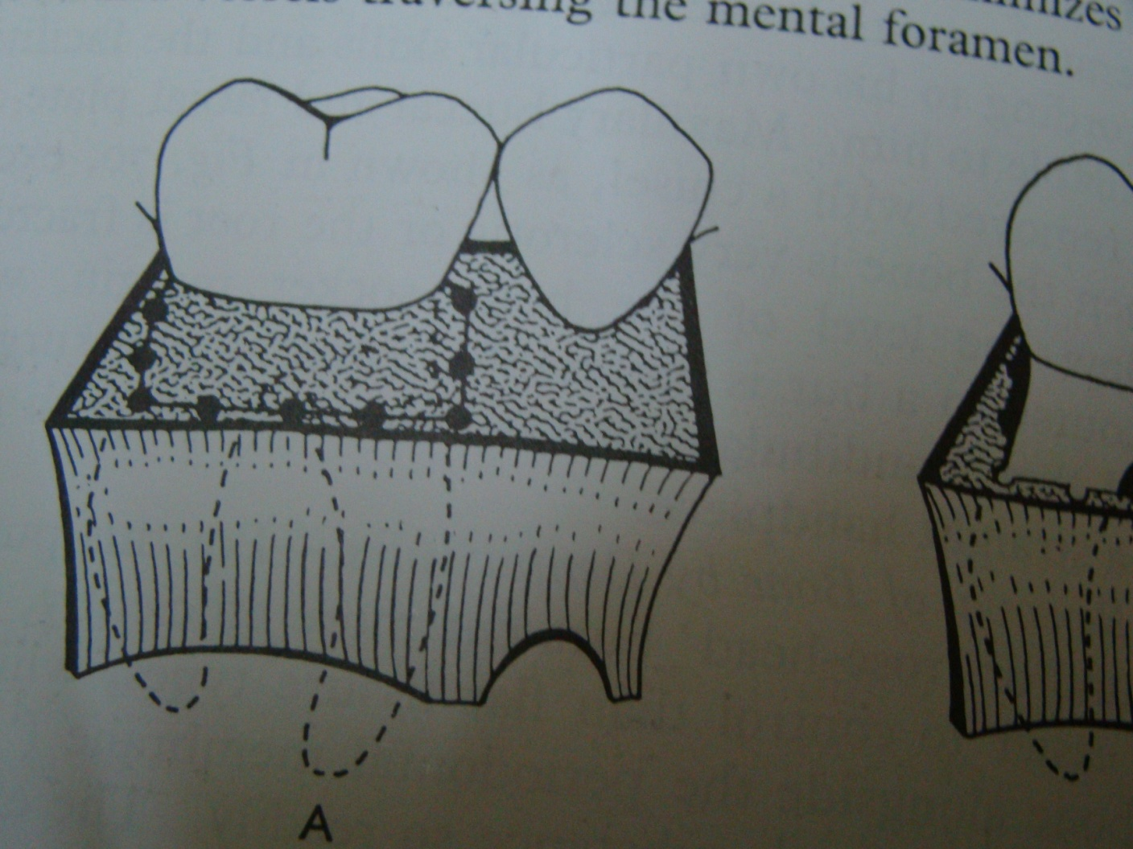

Slide 19
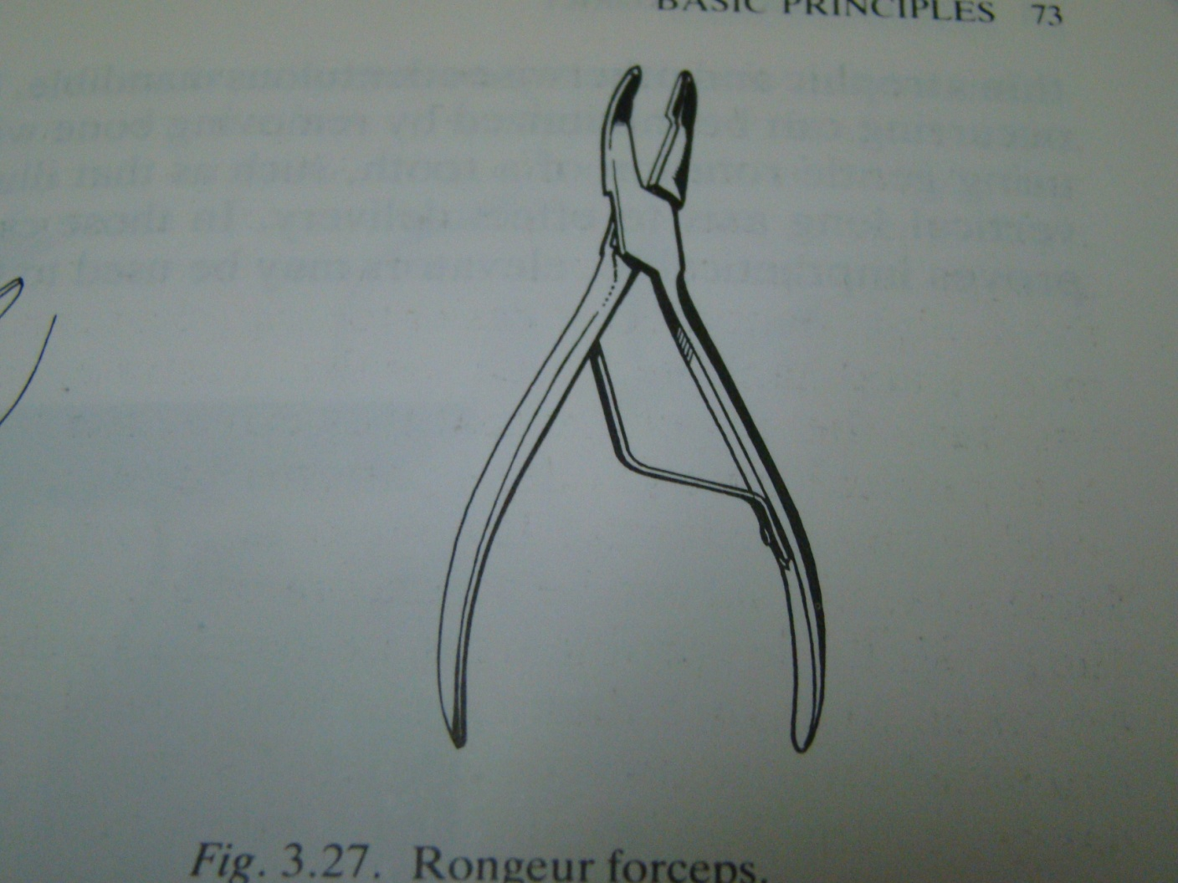

Slide 20
5- peizo electric surgery. Is a new technique of bone removal .

Slide 21
Piezoelectric bone surgery known simply as piezosurgery is a new technique of bone removal ( osteomy ) which require the use of micro vibrations by ultrasonic frequency scalpel . the vibration is amplified and transferred into a drill which when rapidly applied with slight pressure up on the bony tissues , results in cavitations phenomena , with a mechanical cutting effect exclusively on mineralized tissue .

Slide 22
the advantage of using this technology is that piezoelectric surgery dose not cut soft tissues , so damage to the soft tissue is less likely to occur .

Slide 23
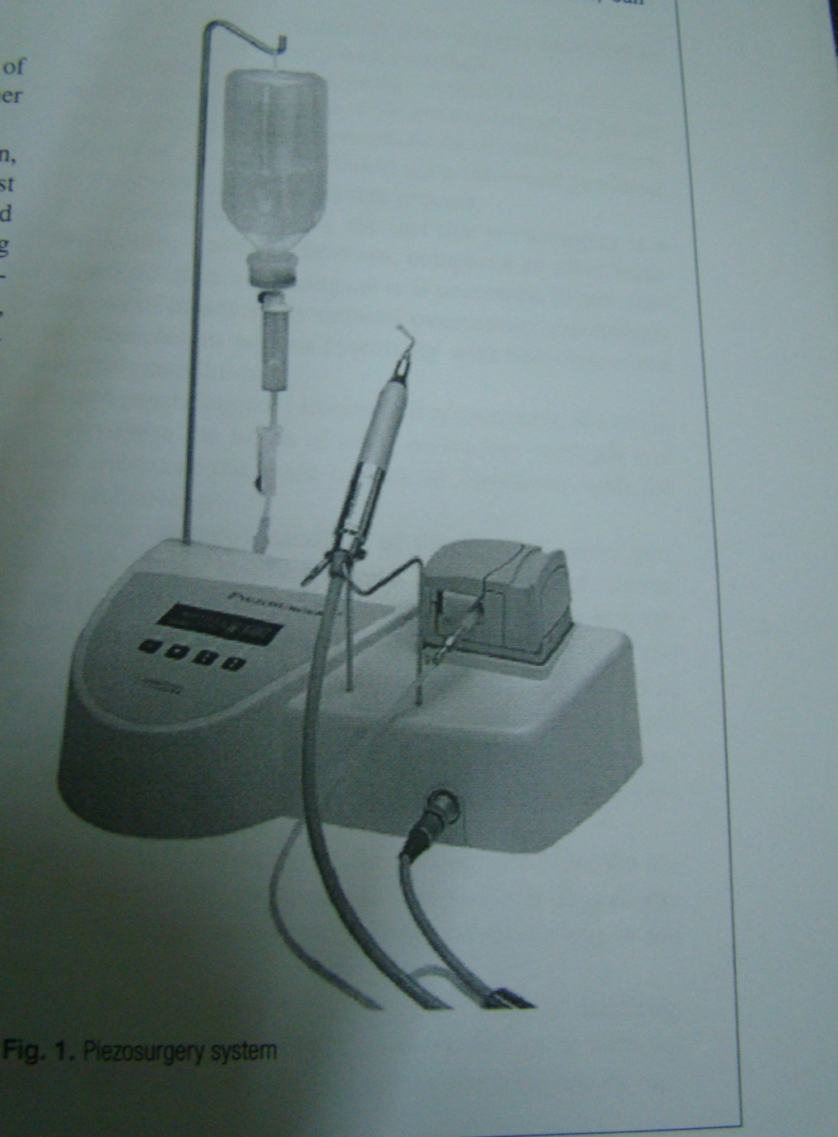

Slide 24
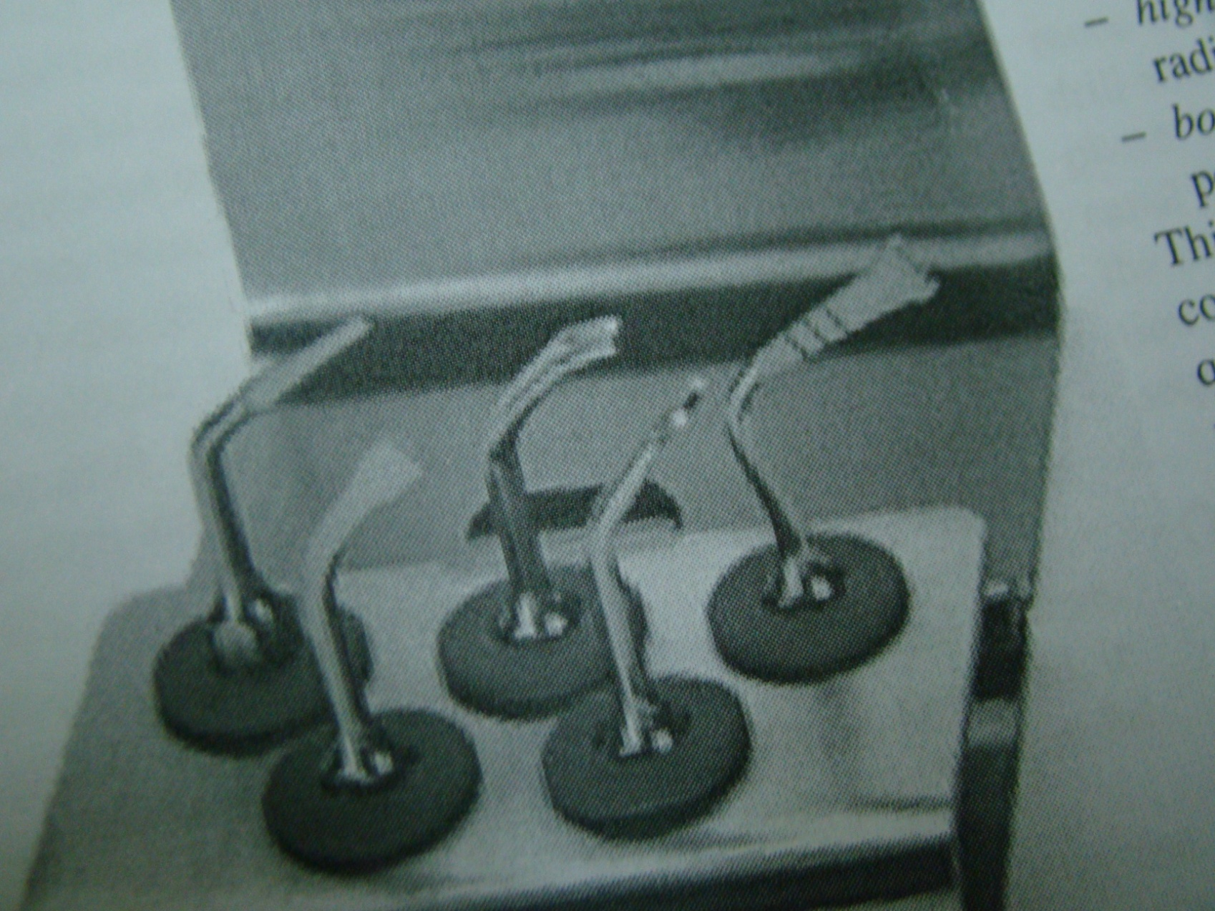

Slide 25
Tooth division
If the roots have different path of removal or the root trunk can not be grasped with forceps , the root mass must be divided and the separated roots removed along their individual path of withdrawal.

Slide 26
Methods of tooth division
1 :surgical bur
2:osteotome or chisel

Slide 27
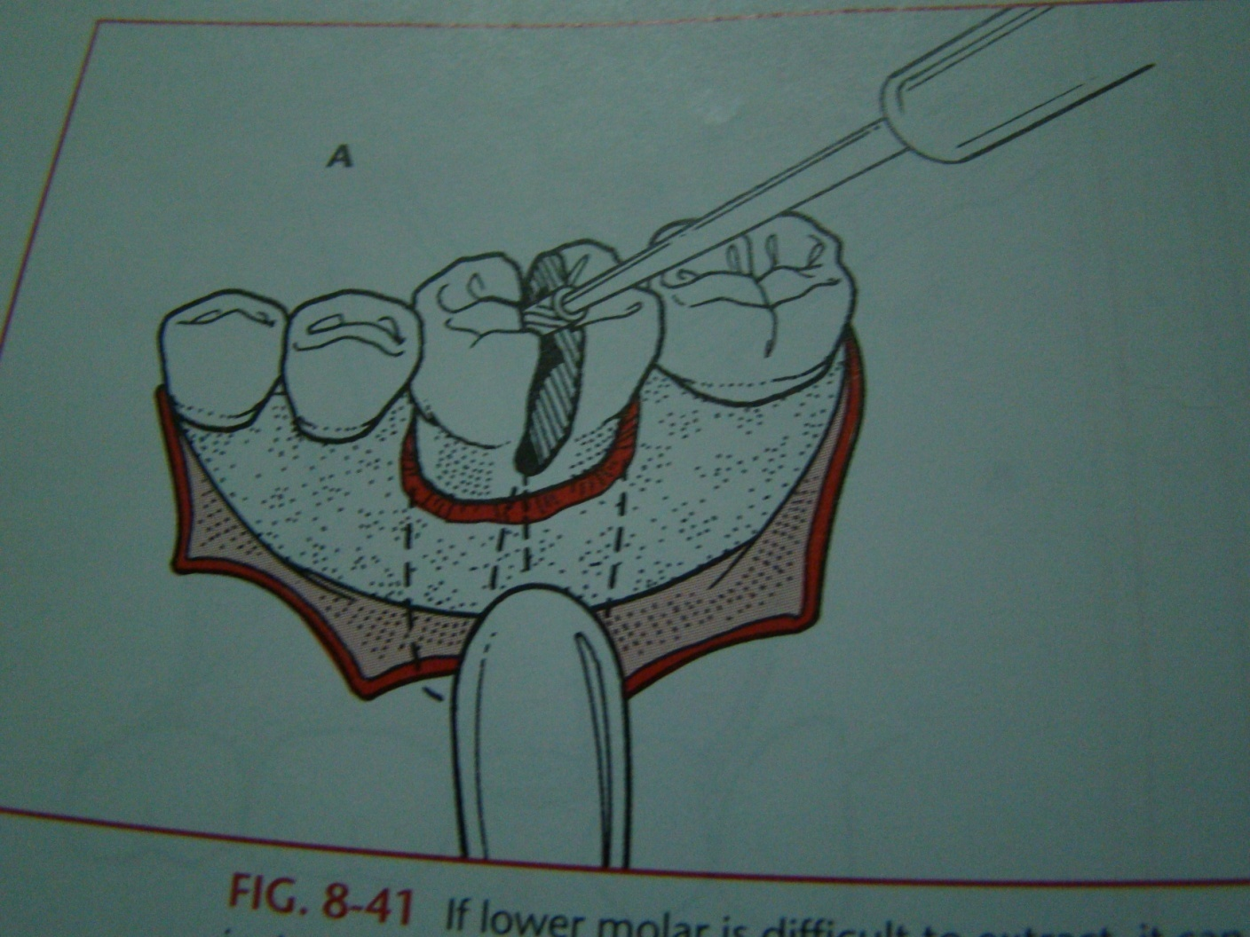

Slide 28
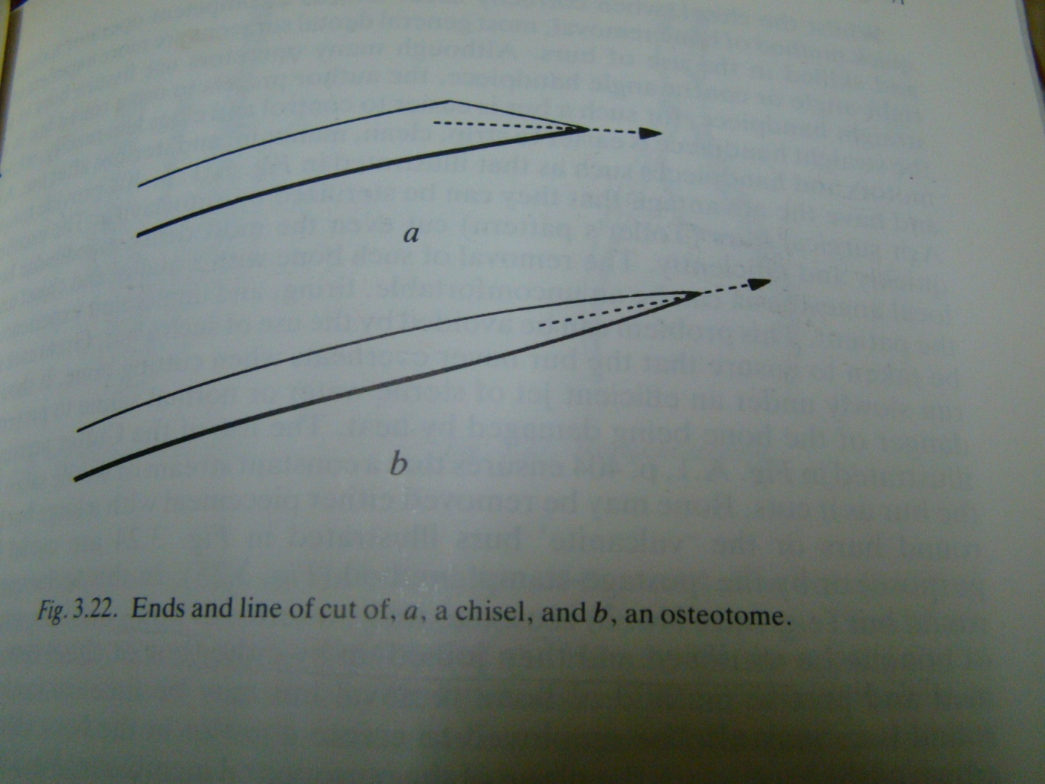

Slide 29
After that then
Tooth removal using elevator or forceps

Slide 30
Toilet of the socket
1- un wanted boney prominence should be removed
2- the socket should be irrigated with normal saline
3- the mucoperiosteal flap should then be replaced and a decision is made as to weather suturing is needed

Slide 31
Suturing
The purpose of suturing are :
1 – to hold the wound margins together to promote wound healing by first intention if possible
2- to approximate the wound margin to minimize wound contamination with food debris
3 – to arrest hemorrhage

Slide 32
Usually use sterile black silk gauged 000 is the material of choice and either simple interrupted suture or horizontal matrices suture is used .the needle of cutting type is widely used in dentistry

Slide 33
Principles of suturing
1- The needle is grasped with a needle holder at its 2\3 of its curvature .it never held by the eye or the point
2- the area to be sutured is dried with either a sucker or cotton guaze so that the cut edge are clearly visible .
3- suturing from the movable to the fixed wound margin
4- toothed dissecting tweezers are used to grip the flap and fix it .

Slide 34
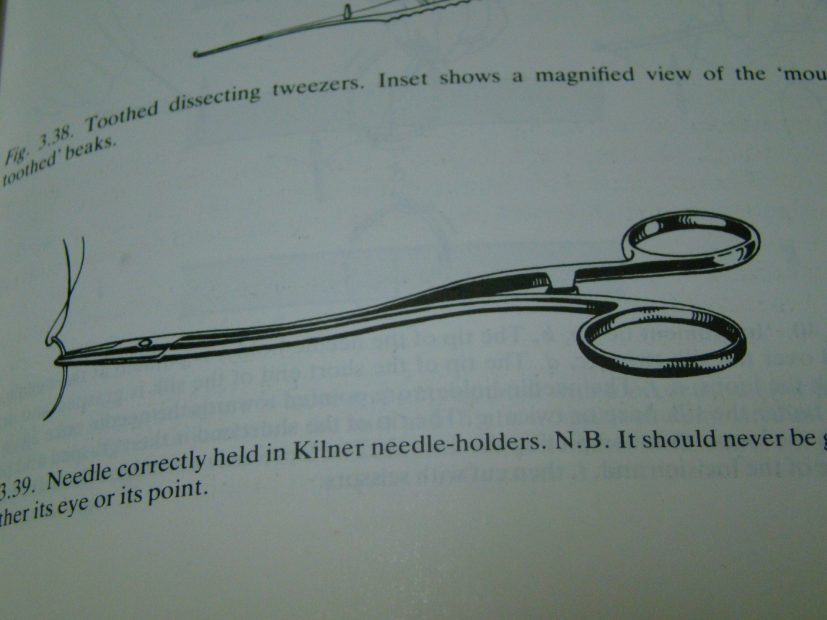

Slide 35
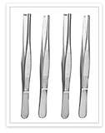
Toothed tissue forceps

Slide 36
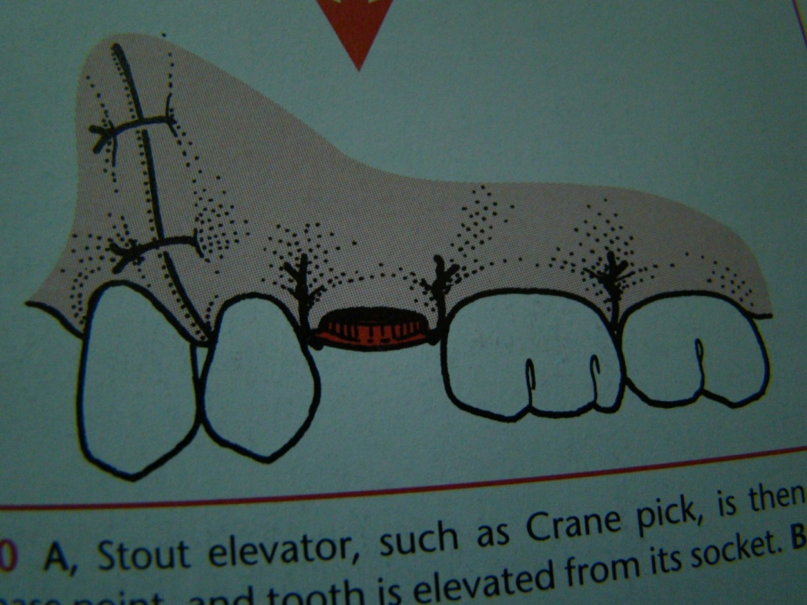
5- the needle should pass at least 3 mm from the wound margin
6- the knots should be lied at one side of the wound margin.
7- the knots should be not too tight and not too loose .

Slide 37
The removal of suture
The suture should be remain in situ for up to 7 days
They loosen in the tissues and should be removed by grasping of the knots and cutting the suture where it enter the tissues
If the suture is cut at a distance from point of entry into the tissues, contaminated suture material may be dragged through the healing wound thus infecting it .

Slide 38
