Slide 1
General examination
New version (25-12-2014)

Slide 2
Examination of the Face

Slide 3
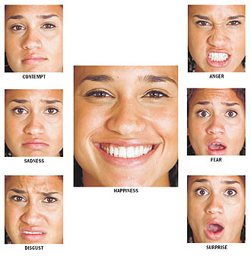
Facial expression
Sad
Depressed
Anxious
Angry
….

Slide 4
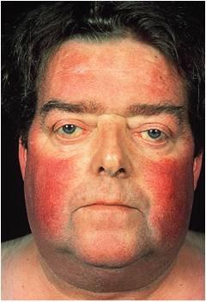
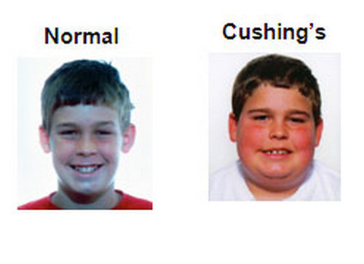
Special faces
1-Cushing syndrome

Slide 5
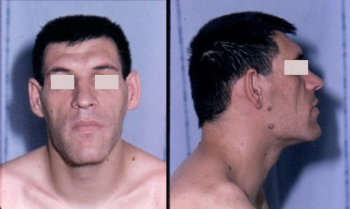
Special faces
2- Acromegaly

Slide 6
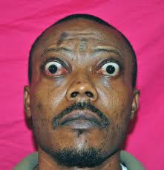
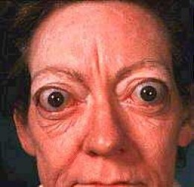
Special faces
3- thyrotoxicosis

Slide 7
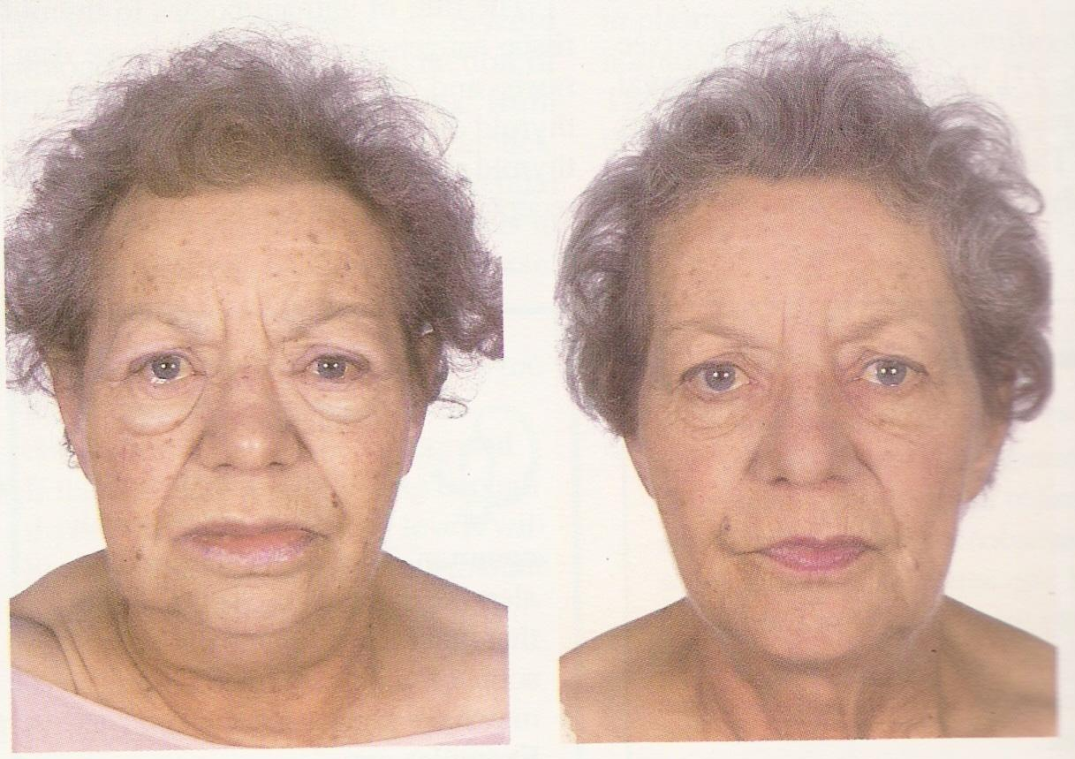
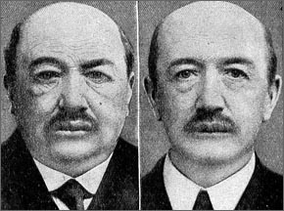
Special faces
4- Myxoedema

Slide 8
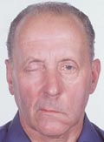
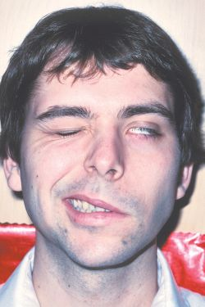
Special faces
5- facial nerve palsy

Slide 9
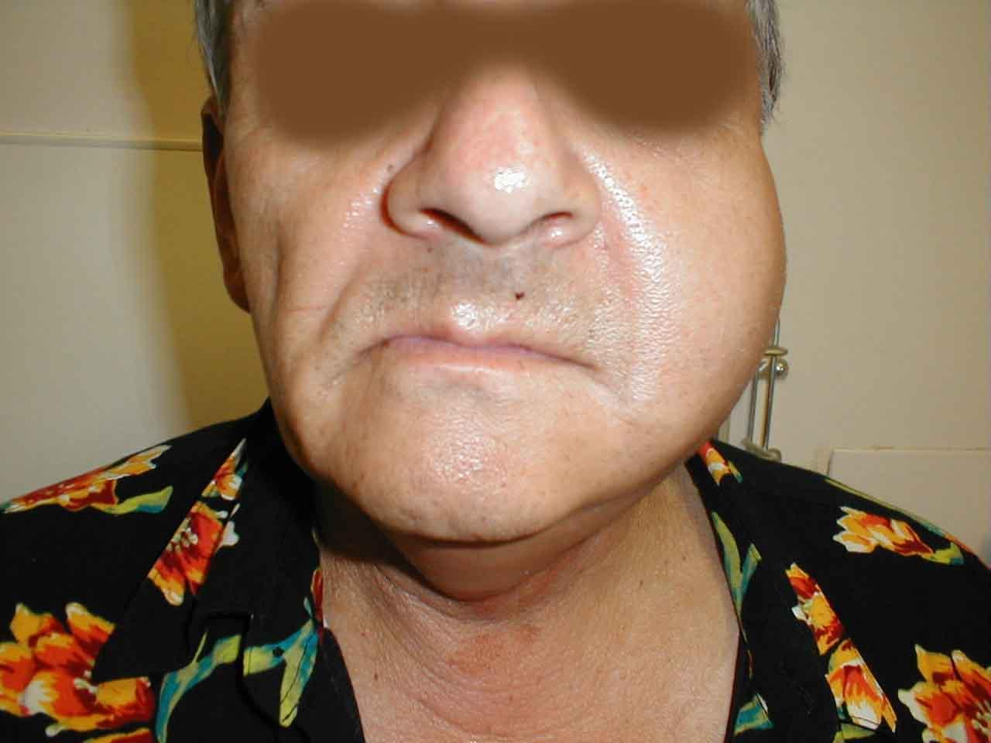
Special faces
6- parotid swelling ( mumps )

Slide 10
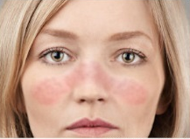
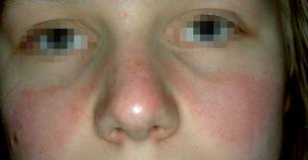
Special faces
7- SLE

Slide 11
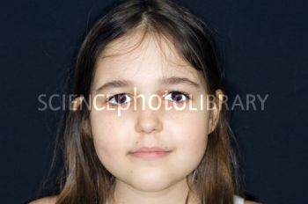
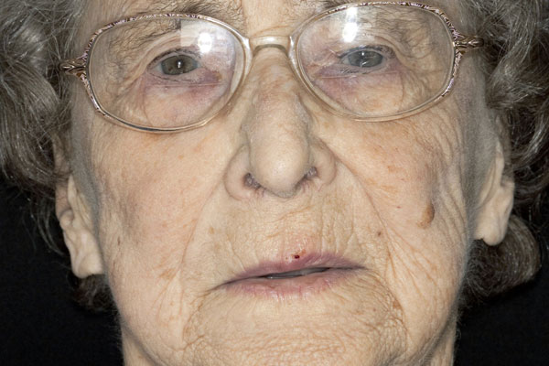
Facial Skin color
1- pallor

Slide 12
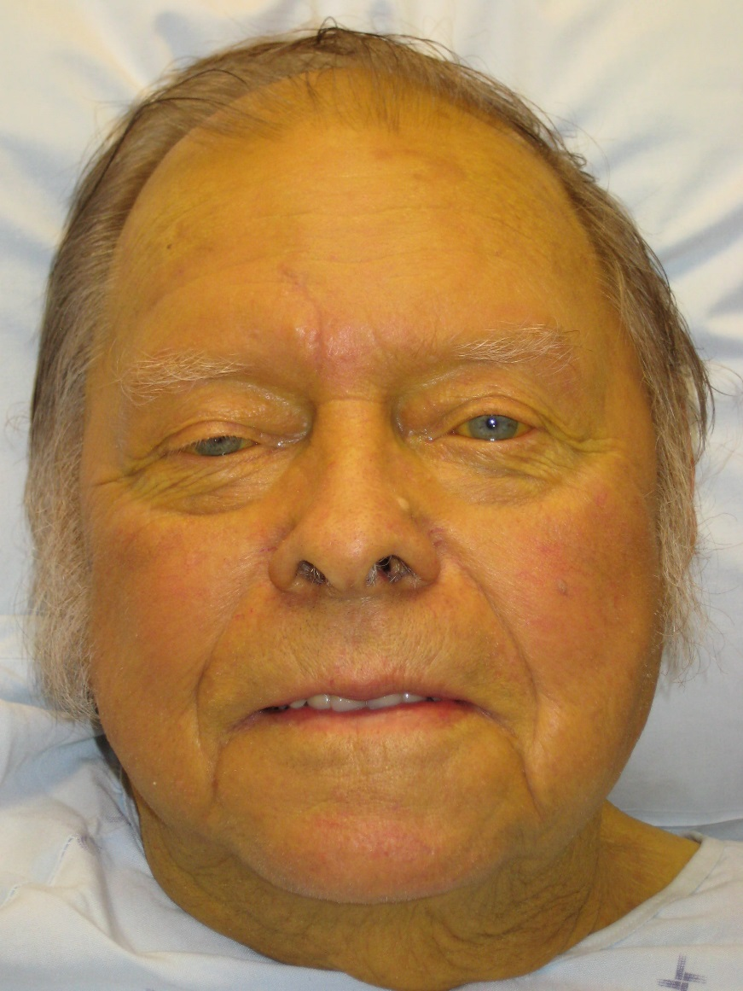
Facial Skin color
2- jaundice

Slide 13
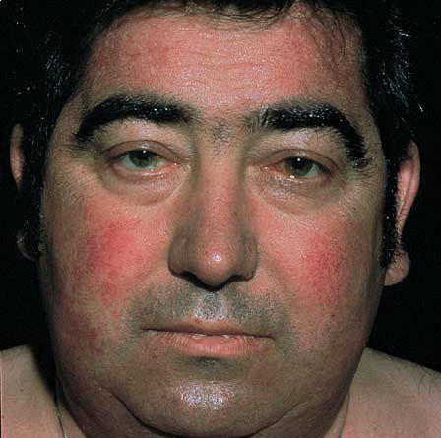
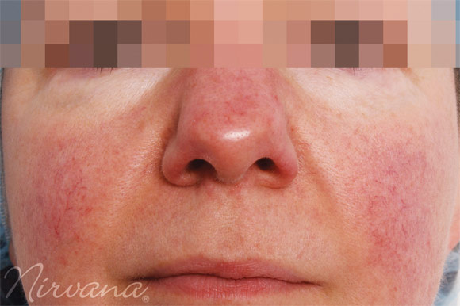
Facial Skin color
3- plethoric face

Slide 14
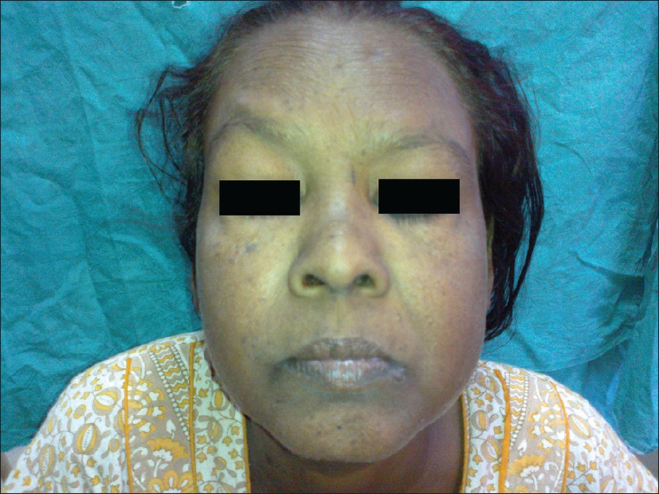
Facial Skin color
4- Earthy pale complexion

Slide 15
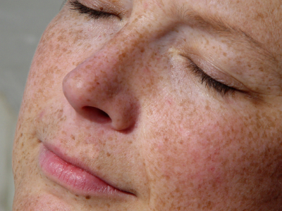
Facial Skin color
5- pigmentations

Slide 16
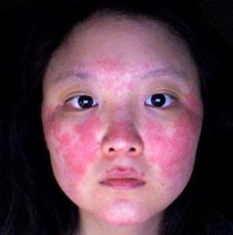
Facial Skin color
6- malar flush

Slide 17
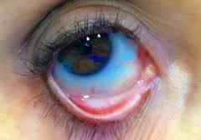
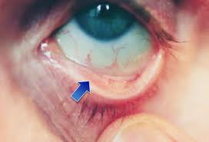
Eye examination
1- Anemia

Slide 18
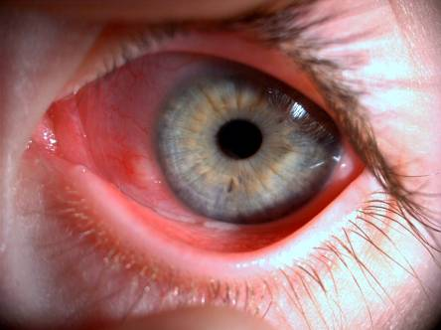
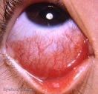
Eye examination
2- polycythemia

Slide 19
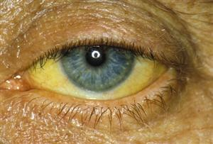
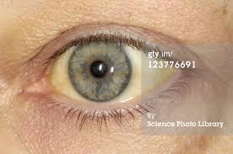
Eye examination
3- jaundice

Slide 20
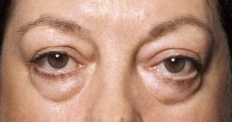
Eye examination
4- Puffiness

Slide 21
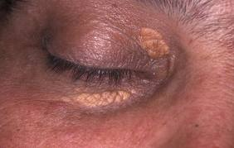
Eye examination
5- Xanthelasma

Slide 22
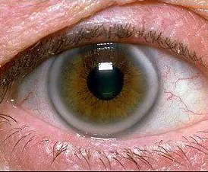
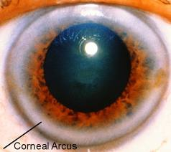
Eye examination
6- Corneal arcus

Slide 23
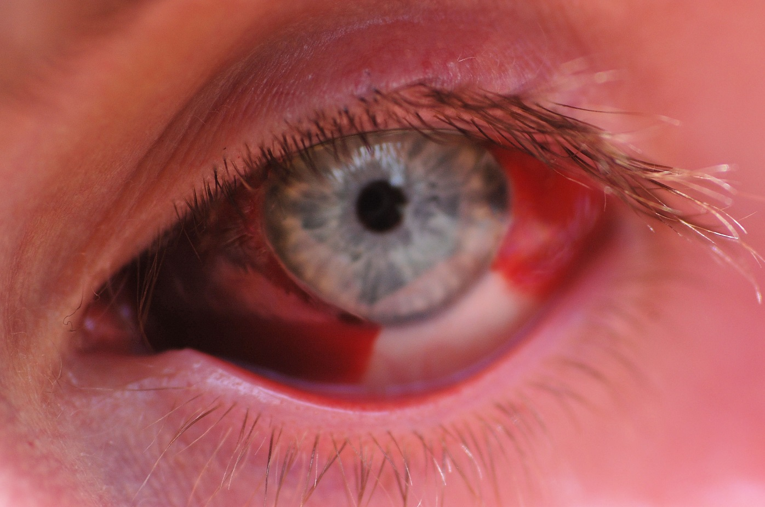
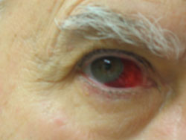
Eye examination
7- subconjuctival hemorrhage

Slide 24
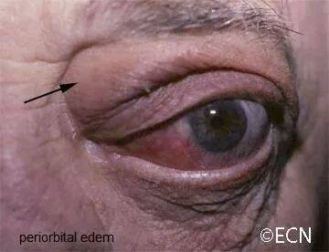
Eye examination
8- periorbital edema

Slide 25
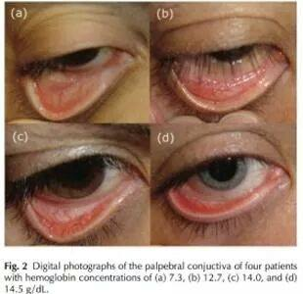
Eye examination
9- Digital photographs of the conjunctiva

Slide 26
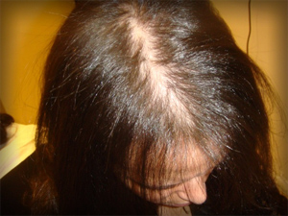
Hair examination
1- Coarse dry lusterless ( in hypothyroidism )

Slide 27
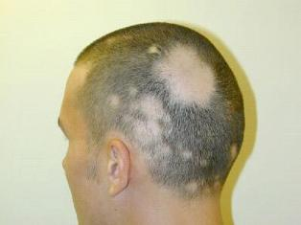
Hair examination
2- alopecia

Slide 28
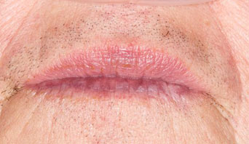
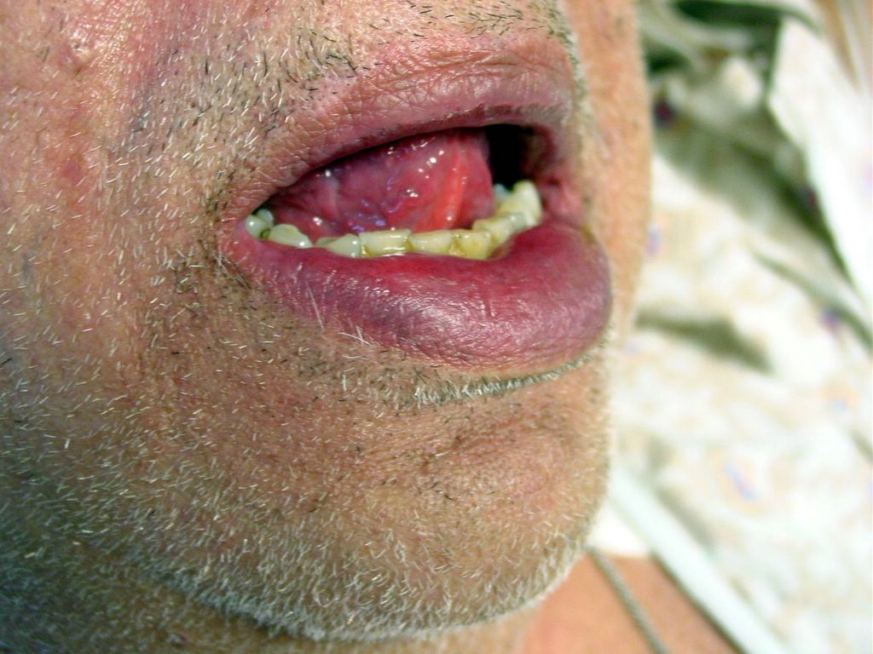
lips examination
1- cyanotic lip

Slide 29
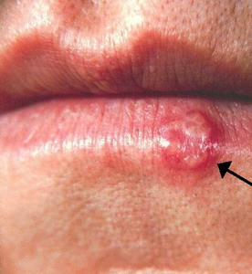
lips examination
2- herpes labialis

Slide 30
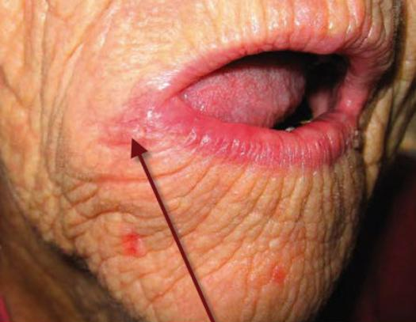
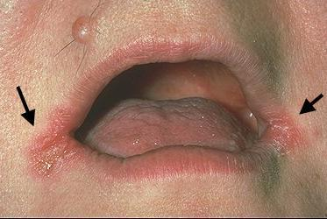
lips examination
3- angular stomatitis

Slide 31
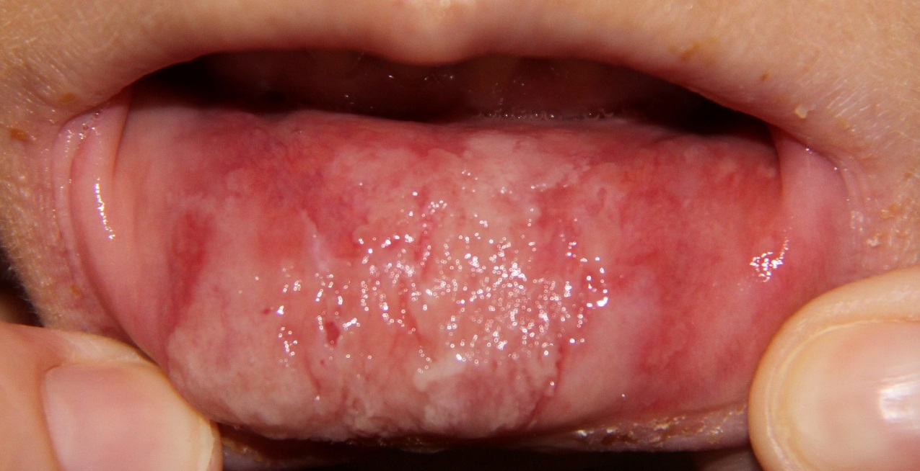
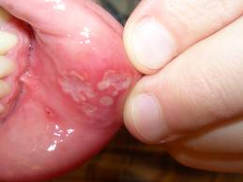
lips examination
4- ulcer

Slide 32
lips examination
5- tattooing

Slide 33
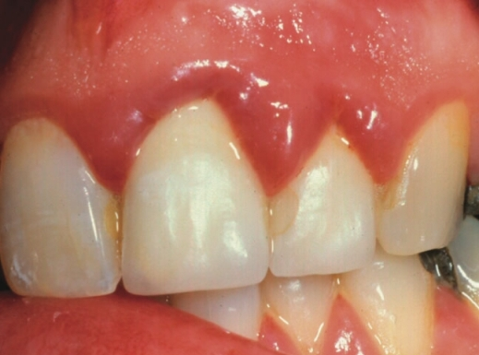
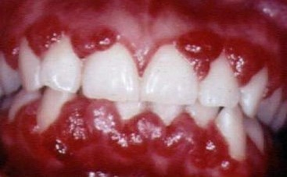
Gums examination
1- Gingivitis

Slide 34
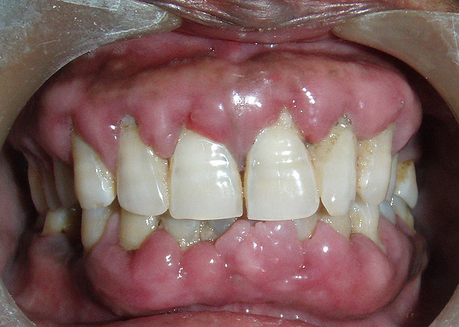
Gums examination
2- Gingival hypertrophy

Slide 35
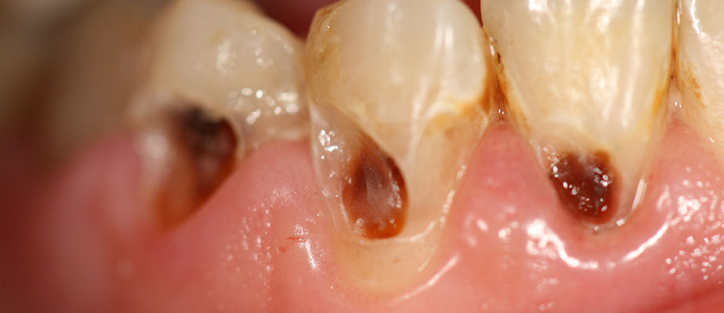
Teeth examination
1- Dental caries

Slide 36
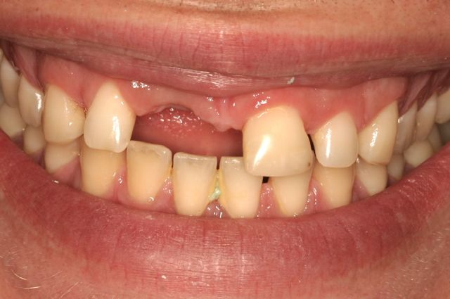
Teeth examination
2- teeth loss

Slide 37
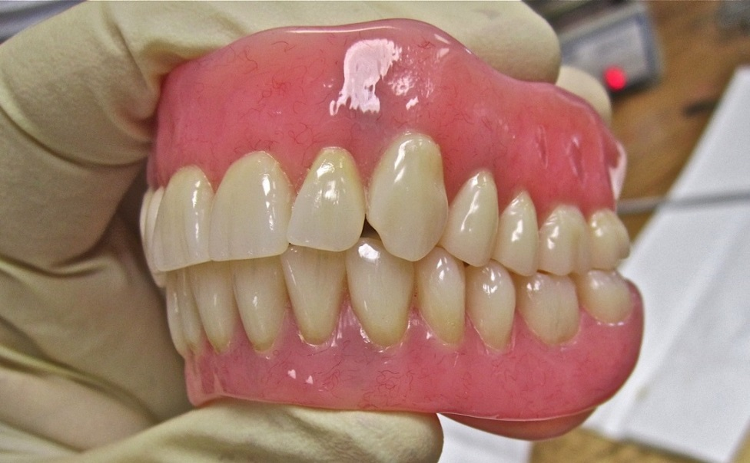
Teeth examination
3- dentures

Slide 38
Tongue examination
1- Glossitis

Slide 39
Tongue examination
2- pale ( in anemia )

Slide 40
Tongue examination
3- yellow ( in jaundice )

Slide 41
Tongue examination
4- central cyanosis

Slide 42
Tongue examination
5- dry tongue

Slide 43
Tongue examination
6- Furred tongue

Slide 44
Tongue examination
7- smooth tongue

Slide 45
Tongue examination
8- Geographical tongue

Slide 46
Tongue examination
9- Tumor Nodule

Slide 47
Buccal mucosa examination
1- Thrush

Slide 48
Buccal mucosa examination
2- aphthus ulcer

Slide 49
Buccal mucosa examination
3- Petechial hemorrhage

Slide 50
Buccal mucosa examination
4- pigmentations

Slide 51
Buccal mucosa examination
5- Pallor

Slide 52
Tonsil and pharynx examination
1- Tonsillitis

Slide 53
Tonsil and pharynx examination
2- enlargement of tonsils

Slide 54
Tonsil and pharynx examination
3- post nasal discharge

Slide 55
Tonsil and pharynx examination
4- pharyngitis

Slide 56
Examination of the Neck

Slide 57
L.N examination

Slide 58
L.N examination

Slide 59
Thyroid examination ( Goiter )

Slide 60
Examination of the Hand

Slide 61
Joints examination
1- deformity

Slide 62
Joints examination
2- swelling

Slide 63
Muscle examination
1- atrophy

Slide 64
Muscle examination
2- carpal tunnel syndrome

Slide 65
Muscle examination
3- claw hands

Slide 66
Color examination
1- cyanosis

Slide 67
Color examination
2- anemia

Slide 68
Skin lesions
1- petechiae

Slide 69
Skin lesions
2- purpura

Slide 70
Skin lesions
3- Ecchymosis

Slide 71
Skin lesions
4- hematoma

Slide 72
Skin lesions
5- spider nevi

Slide 73
Skin lesions
6- Palmer erythema

Slide 74
Skin turgor
Causes:
Decreased fluid intake
Dehydration
Diarrhea
Diabetes
Extreme weight loss
Heat stroke
Vomiting

Slide 75
Nails examination
1- Clubbing of fingers

Slide 76
Nails examination
2- leukonychia

Slide 77
Nails examination
3- Koilonychias

Slide 78
Nails examination
4- Onycholysis

Slide 79
Tremor examination
Rest tremor
Intention tremor
Flapping tremor
Tremor of outstretched hand

Slide 80
Examination of the Leg

Slide 81
Deformities and amputation

Slide 82
Edema examination

Slide 83
Ischemia examination
Pallor
Cyanosis
Ulcerations
Gangrene
Loss of pulses
Hairless shiny skin

Slide 84
Diabetic foot

Slide 85
Blood spots of the foot

Slide 86
Vital Signs

Slide 87
1-Temperature
oral temperature → 33.2-38.2 C
rectal temperature → 34.4-37.8 C
Tympanic temperature → 35.4- 37.8 C
Axillary temperature → 35.5-37.0 C

Slide 88
2-Pulse
A normal resting heart rate for adults ranges from 60 to 100 beats a minute.
When you feel the pulse, count the number of beats in 15 seconds. Multiply this number by 4 to calculate the pulse ( beats per minute ).

Slide 89
3- Blood Pressure
Blood Pressure Category | Systolic mm Hg (upper #) |  | Diastolic mm Hg (lower #)
Normal | less than 120 | and | less than 80
Prehypertension | 120 – 139 | or | 80 – 89
High Blood Pressure (Hypertension) Stage 1 | 140 – 159 | or | 90 – 99
High Blood Pressure (Hypertension) Stage 2 | 160 or higher | or | 100 or higher
Hypertensive Crisis (Emergency care needed) | Higher than 180 | or | Higher than 110

Slide 90
4- Respiratory rate
Recorded as breaths per minute. They should be counted for 30 seconds multiplied by 2 or 15 seconds multiplied by 4
Normal is between 12 and 20 breaths per minute.

Slide 91
Done…..
By : Mosul medical college students

