Slide 1
Epidemiological measureas

Slide 2
How do we determine disease frequency for a population?

Slide 3
Measures of
Disease Frequency
The most basic measure of disease frequency is a simple count of affected individuals.
However, counting is not enough!

Slide 4
Why is a simple count not enough?
3 cases of cancer per year from a city of 1,000 people is very different than 3 cases per year from a city of 100,000 people

Slide 5
  So, in epidemiology we must know:
  the size of the population from which the affected individuals come, and
  the time period the information was collected.

Slide 6
Tools of Measurement
• Counts
• Proportions
• Ratios
• Rates
6

Slide 7
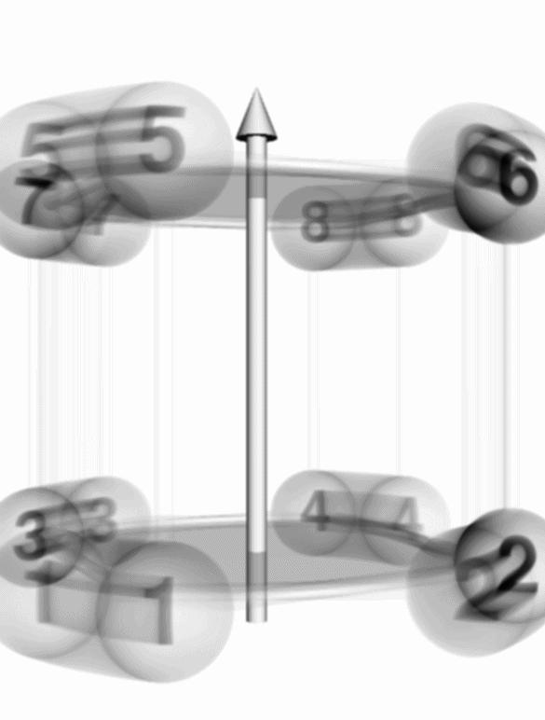
Case Counts
Measuring disease or health or health care frequency starts with counting cases
Simplest and most frequently gathered measure in epidemiology
7

Slide 8
Counts
• Refers to the number of cases of a disease or
other health phenomenon being studied
i.e. Number of cases of influenza in Astana in January 2012
• Can be useful for allocation of health resources
• Limited usefulness for epidemiologic purposes without knowing size of the source population
8

Slide 9
Proportions
Persons included in the numerator are always included in the denominator:
A
Proportion: --------
A + B
Indicates the magnitude of a part, related to the total. In epidemiology, tells us the fraction of the population that is affected.
9

Slide 10
Proportions - Example
A | B | Total (A + B)
# persons with hypertension | # persons without hypertension | Total study population
1,400 | 9,650 | 11,050
P = A / (A + B) = (1,400 / 11,050) = 0.127
10

Slide 11
Ratios
Like a proportion, is a fraction, BUT without a specified relationship between the numerator and denominator
Example: Occurrence of Major Depression
Female cases = 240 240
------------------------ = ---- 2:1 female to male
Male cases = 120 120
11

Slide 12
Rates
A ratio in which TIME forms part of the denominator
Epidemiologic rates contain the following elements:
• health issue frequency (in the numerator)
• unit size of population
• time period during which an event occurs
12

Slide 13
Rate: a measure of the occurrence of a health event in a population group at a specified time period
Number of events
in time period
numerator
:
denominator
Number at risk
for the event in period
13
Notes:
In epidemiology, the calculation of a rate generally involves some measure of the frequency of disease in the numerator and the population at risk in the denominator.

Slide 14
Rates are the basic tool of epidemiologic practice
Why are rates important?
because they provide more complete information to describe or assess the impact of a health issue in a community or population
14
Notes:
Rates are the fundamental tool of epidemiology because they give more complete information about the importance of disease in a community.

Slide 15
Rates allow comparisons between two or more populations of different sizes or of a population over time

Slide 16
Compute Disease Rate
Number of persons at risk = 5,595,211
Number of persons with disease = 17,382
Rate = 17,382 persons with heart disease 5,595,211 persons
= .003107 heart disease / resident / year

Slide 17
Prevalence vs. Incidence
Prevalence is the number of existing cases of disease in the population during a defined period.
Incidence is the number of new cases of disease that develop in the population during a defined period.

Slide 18
Incidence
Incidence rate is a measure of the probability of the event among persons at risk.

Slide 19
Incidence Rates
Population denominator:
I = number of new events during a period of time
number of persons at risk during this time period

Slide 20
Example (Incidence Rate)
During a six-month time period, a total of 53 nosocomial infections were recorded by an infection control nurse at a community hospital. During this time, there were 832 patients with a total of 1,290 patient days. What is the rate of nosocomial infections per 100 patient days?

Slide 21
Prevalence
Prevalence: The number of existing cases in the population during a given time period.
PR = # existing cases during time period
population at same point in time
Prevalence rates are often expressed as a percentage.

Slide 22
Measures
Morbidity: Refers to the presence of disease in a population
Mortality: Refers to the occurrence of death in a population

Slide 23
Mortality Rates: Examples
Maternal mortality: Ratio of death from childbearing for a given time period per number of live births during same time period

Slide 24
Mortality Rates: Examples
Infant mortality: Rate of death for children less than 1 year per number of live births
Neonatal mortality: Rate of death for children less than 28 days of age per number of live births

