Slide 1
Asthma:
Chronic airway inflammation and increased airway hyper-responsiveness.
These leads to airflow obstruction which is variable with time either spontaneously or in response to treatment.
- The common symptoms are wheeze, cough, chest tightness and dyspnea.

Slide 2
Epidemiology:
1- Prevalence increase both in developed and developing countries.
2- In childhood it is more common in boys, but following puberty females are more frequently affected.
3- The impact of socioeconomic state on asthma is enormous.

Slide 3
Aetiology:
1- Both environmental and genetic factors are implicated.
2- The hygiene hypothesis proposes that decreased infection in early life bias the immune system towards an allergic phenotype.
However infection with respiratory syncytial virus, appear to increase the risk of asthma.

Slide 4
3- Sensitisation and exposure to allergens is an important risk factor (House dust mite, pets).
4- Dietary intake may be important (Milk, fat, and antioxidant such as vitamin E and selenium may protect against the development of asthma in children.
5- Obesity may also linked to asthma.

Slide 5
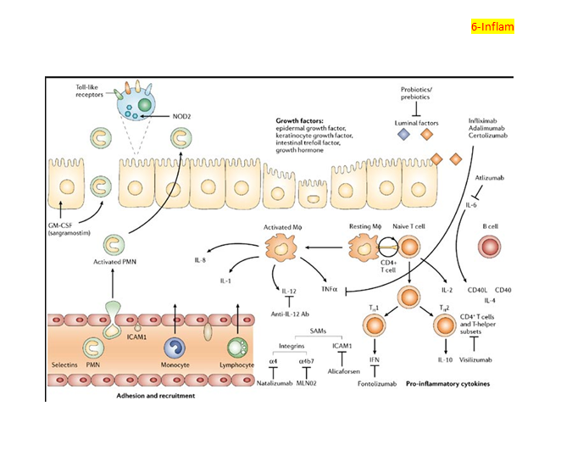
Pathophysiology:

Slide 6
The inhalation of an allergen in a sensitized atopic asthmatic patient results in a two-phase bronchoconstrictor response.
1- Early reaction (type I): the inhaled allergen rapidly interacts with mucosal mast cells via an IgE – dependent mechanism, leading to release of pre-formed mediators such as histamine and the cysteinyl leukotrienes with resulting bronchoconstriction.

Slide 7
2-Late reaction (type II): characterize by complex inflammatory response (numerous inflammatory cells, transformation and participation of airway structural cells, and the secretion of an array of cytokines, chemokines and growth factors).
3-Other factors that may influence airway – hyper reactivity such as neurogenic mechanism, smooth muscle behavior.

Slide 8
4- With increasing severity and chronicity of the disease remodeling of the airway occurs leading to fibrosis, fixed narrowing and reduced response to bronchodilator medication.
So the cardinal pathophysiological features of asthma:
1- Airflow limitation.
B- Airway hyper-reactivity.
C- Airway inflammation.
"Eosinophils, Lymphocytes, mast cells, neutrophils lead to odema, Smooth m. hypertrophy and hyperplasia, thickening of basement membrane, mucous plugging and epithelial damage".

Slide 9
Clinical features:
1- Recurrent episodes of wheezing, chest tightness, breathlessness and cough.
2- Common precipitant include exercise, airborne allergens or pollutants, and viral upper respiratory tract infections.
3- Patient may be asymptomatic between exacerbation while in chronic (persistant asthma) the pattern is chronic wheeze and breathlessness.

Slide 10
4- Asthma characterize by a diurnal pattern, with symptoms worse in the early morning.
5- Cough may be the dominant symptoms in some patients and the lack of wheeze or breathlessness may lead to a delay in reaching the diagnosis of so called "cough variant asthma.

Slide 11
6-Bronchospasim induced by medications. Beta-blocker even when administered topically as eye drops may induce bronchospasm. Aspirin and NSAID are associated with asthma in about 10% of patients.
7-Occupational asthma: about 5% of all adult-onset asthma.

Slide 12
Investigation:
The diagnosis of asthma is made on the basis of a compatible clinical history combined with the demonstration of variable airflow obstruction.
FEV1 ≥ 15% (and 200 ml) increase following administration of a bronchodilator OR trial of corticosteroids.
- > 20% diurnal variation on ≥ 3 days in a week for 2 weeks on PEF diary.
- FEV1 ≥ 15% decrease after 6 minutes of exercise.

Slide 13
1- Pulmonary function tests: peak flow meters, a trial of corticosteroids e.g: 30 mg/d for 2 weeks may be useful in documenting the improvement in PEF.
"diurnal variation in PEF > 20% of the morning". While the measurement of FEV1 and VC done by spirometry.
2-Radiological exam unhelpful in establishing the diagnosis of asthma but may exclude alternative diagnosis.
Acute asthma is accompanied by hyperinflation, and lober collapse. Filling infiltrates acompanied by lober collapse suggest asthma complicated by allergic bronchopulmonary aspergillosis.

Slide 14
3- Measurement of allergic status: An elevated sputum or peripheral blood eosinophil count may be observed and the serum total IgE is typically elevated in atopic asthma.
Skin prick tests are simple and provide a rapid assessment of atopy.
4- Assessment of airway inflammation: induced sputum and exhaled breath allow assessment of airway inflammation.

Slide 15
Management:
1- Patient education.
2-Avoidance of aggravating factors: occupational, household antigens (pets, house dust mites).
3-A stepwise approach to the management of asthma.
Step 1: occasional use of inhaled short-acting B2 – adrenocepter agonist bronchodilator: (< once/ week for 3month and < 2 nocturnal episodes/ month).

Slide 16
Step 2: introduction of regular preventer therapy:
Regular anti-inflammatory therapy (preferably inhaled corticosteroid) in addition to inhaled B2- agonists taken on as required basis in any patient who:

Slide 17
- Has experienced an exacerbation of asthma in the last 2 years.
- Uses inhaled B2- agonist ≥ 3 times a week.
- Reports symptoms ≥ 3 times a week.
Is awakened by asthma one night per week.
A reasonable starting dose is 400 Mg beclometasone dipropionate or equivalent such as budesonide.

Slide 18
Step 3: add – on therapy:
- A further increase in the dose of inhaled CS may benefit some patients but in general, add – on therapy should be considered beyond an inhaled CS dose of 800 Mg/day BDP (or equivalent).
- Long-acting B2- agonist, such as salmeterol and formoterol.
(fixed combination inhalers of ICS and LABAs have been developed).
- Leukotriene receptor antagonists (e.g. Montelukast 10 mg daily)
- Theophylines may useful.

Slide 19
Step 4: addition of a fourth drug: in addition to ICS to 2000 Mg BDP/ BUD daily. (nasal CS, oral leukotriene receptor antagonists, theophylines or slow release B2-agonists).
Monoclonal nobodies directed against IgE(Itraconazole).

Slide 20
Step 5: addition of continuous or frequent oral steroids (sually administered as a single daily dose in the morning).
(Risk of side effect increase in patients on long-term CS tablets (> 3 months) or receiving more than 3-4 courses per year).
Steroid sparing therapies such as methotrexate, ciclosporin or oral gold may be considered.

Slide 21
Step- down therapy: once asthma control is established, the dose of inhaled (or oral) CS should be titrated to the lowest dose at which effective control of asthma is maintained.
Management of mild –moderate exacerbations:
(Short courses of oral CS (prednisolon 30-60 mg daily) are required to regain control of symptoms).
(Tapering of the dose to withdraw treatment is not necessary unless given for more than 3 weeks).

Slide 22
Indication for short courses include:
1- Progressive worsening of symptoms and PEF day by day.
2- Fall of PEF below 60% of the patient personal best recording.
3- Onset or worsening of sleep disturbance by asthma.
4- Persistence of morning symptoms until midday.
5- Progressively diminishing response to an inhaled bronchodilator.
6- Symptoms sever enough to require treatment with nebulised or injected bronchodilator.

Slide 23
Management of acute severe asthma:
1- Initial assessment:-
a - Acute severe asthma:
- PEF 33-50% predicted (< 2001/min).
- R.R ≥ 25/min.
- H.R ≥ 110/min.
- Inability to complete sentence in one breath.

Slide 24
b- Life – threatening features:
- PEF 33-50% predicted (< 100 1/min).
- SpO₂ < 92% or PaO₂ < 8 kpa (60 mm Hg).
- Normal P_{a}Co₂.
- chest.

Slide 25
- Cyanosis.
- Feeble respiratory effort.
- Bradycardia.
- Hypotension.
- Exhaustion.
- Confusion.
- coma.

Slide 26
c - Near-fatal asthma:
(raised P_{a}Co₂ and/ or requiring mechanical Ventilation with raised inflation pressures).
- O₂: High conc. to maintain O₂ saturation above 92% .Increase P_{a}Co₂ is not indicator to reduce O₂ conc. but is a warning sign of a severe or life threatening attack.
- High doses of inhaled bronchodilator.
- Systemic CS.: oral pred. 30-60 mg or I.V hydrocortisone 200 mg.
- I.V fluid.

Slide 27
2 - Subsequent management: if patients fail to improve,add I.V magnesium, I.V aminophyline, I.V leukotriene receptor antagonists.
3- Monitoring of treatment:
- PEF recorded every 15-30 minutes then every 4-6 h.
- Pulse oximetry should ensure that SaO₂ remains > 92%.
Repeat arterial blood gases are necessary if:

Slide 28
1- Initial P_{a}Co₂ measurements were normal or raised.
2- The P_{a}O₂ was < 8 Kpa (60 mmHg), or
3- The patient deteriorates.
* Indications for assisted ventilation in acute severe asthma:
- Coma.
- Respiratory arrest.
- Deterioration of arterial blood gas tension despite optimal therapy {P_{a}O₂ <8 Kpa (60 mmHg) and falling}
{P_{a}O₂ > 6 Kpa (45 mmHg) and rising}
- Exhaustion, confusion, drowsiness.

