Slide 1
Growth and development
Mazin Al-Jadiry
5 October 2015

Slide 2
Human Development

Slide 3
Lecture 2
Mazin Al-Jadiry
6 October 2015

Slide 4
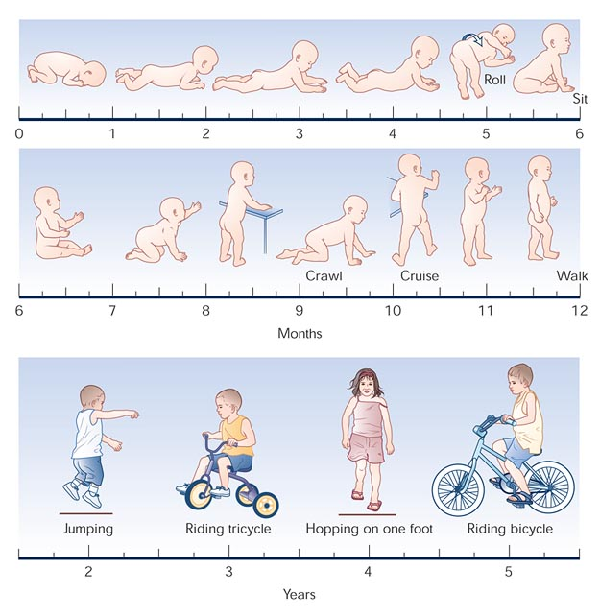
Progression of gross motor milestones from birth to age 5 years
Notes:
Figure 4-1. Progression of gross motor milestones from birth to age 5 years. Motor control proceeds in a cephalocaudal progression in a predictable sequence. (Adapted from Johnson and Blasco []; with permission.)

Slide 5
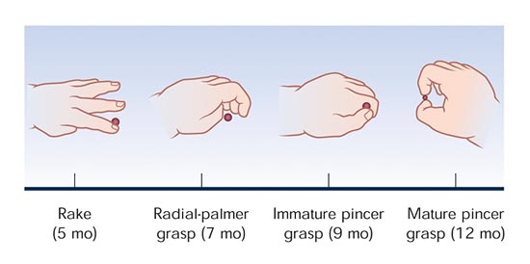
Progression of fine motor milestones from birth to 12 months
Notes:
Figure 4-2. Progression of fine motor milestones from birth to 12 months. In the newborn period, the child's hands remain mostly closed. After the primitive grasp disappears, progression of fine motor skills proceeds in a proximal to distal fashion. The movements progress from swiping at an object to a voluntary grasp. At approximately 4 to 5 months of age, the infant starts to use her or his hands as a rake to manipulate objects. Over the subsequent months the infant uses the fingers independently from the hand in a progressively more mature pincer grasp. (Adapted from Erhardt []; with permission.)

Slide 6
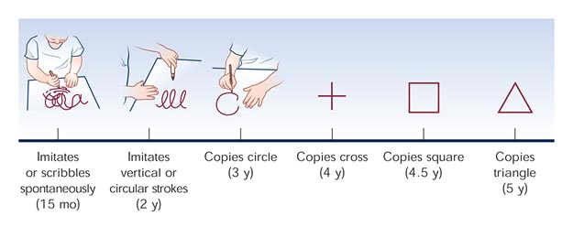
Progression of fine motor milestones from 12 months to 5 years
Notes:
Figure 4-3. Progression of fine motor milestones from 12 months to 5 years in tasks involving crayon or pencil grasping and copying. (Adapted from Erhardt []; with permission.)

Slide 7
Developmental Milestones
4 fields with a sequence of development
Gross Motor - the development of locomotion
Vision and fine manipulation - the development of eye-hand control
Hearing & speech - the development of language
Personal & social - integration of acquired abilities to reflect understanding of environment.

Slide 8
At 2 months;
  Social smiles
  Hold head erects in mid-position.
  Fixes & follows

Slide 9
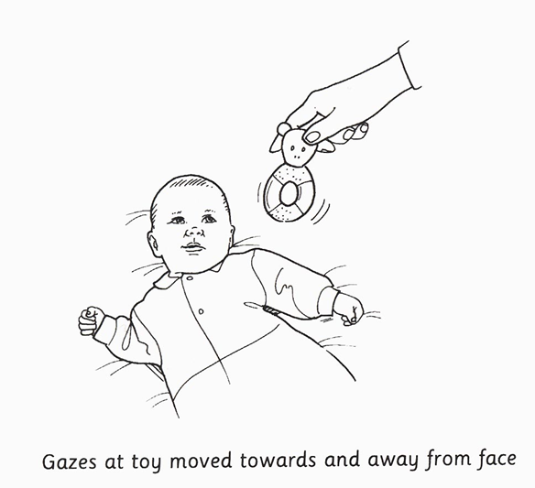
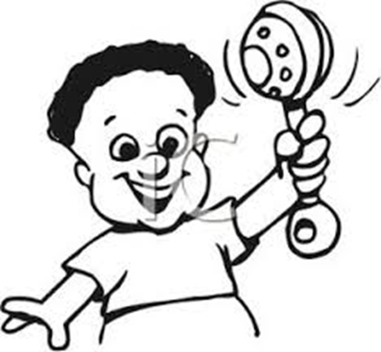
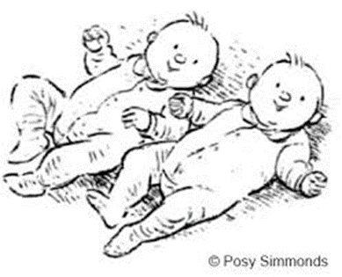
At 3 months;
Holds head up,
Good eye contact
Holds rattle (subject) in hand
turns to sound ear level

Slide 10
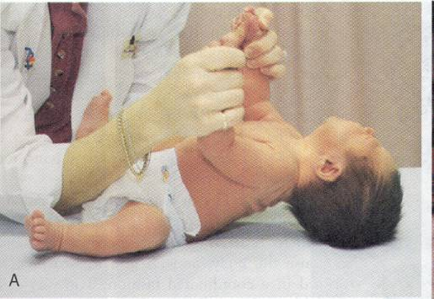
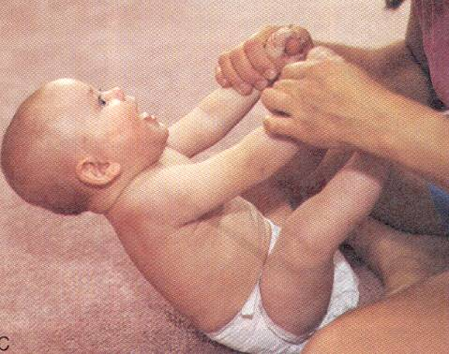
Head Control
Newborn
Age 6 months
Notes:
Newborn

Slide 11
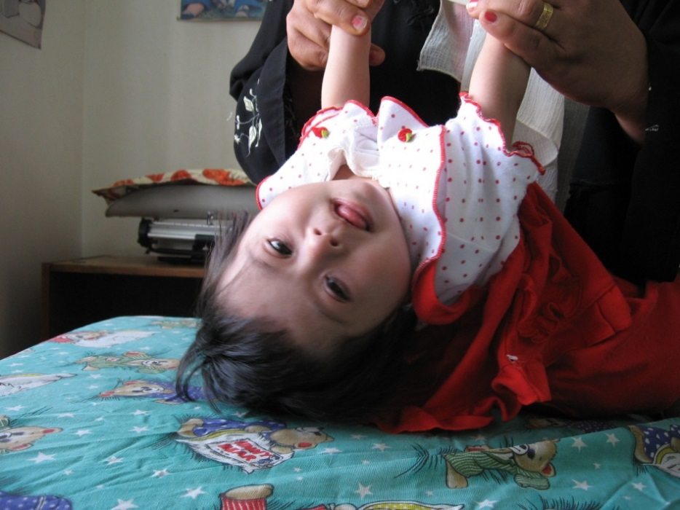
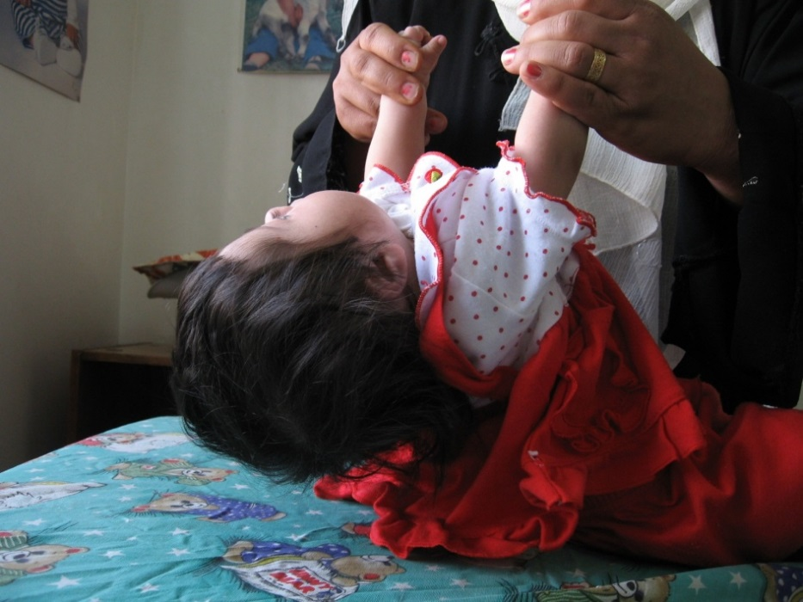
Head lag in a 5-month girl with Down syndrome

Slide 12
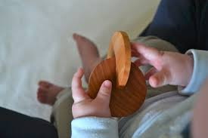
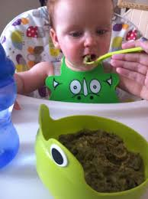
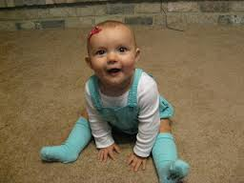
At 6 months;
Transfers hand to hand
Chews, babbles
Sits supported (hands forward) (
Lifts head from supine
Recognize strangers
Hold own bottle
6ma 6mb

Slide 13
At 7-8 months;
Sit alone
Drink from cup with assistance
Imitate simple acts of others
Uses a raking grasp to pull objects closer

Slide 14
At 9-10 months;
Rise to sitting position alone
Crawl (i.e., pull body while in prone position)
Hold one bottle with good hand-mouth coordination
Walk holding on furniture (cruises)

Slide 15
At 11-12 months;
Walks alone
Uses mature pincer grasp
Uses few words other than “dada/mama”
Imitates actions
Comes when called
Cooperates with dressing

Slide 16
Important milestones
18 months:
  Runs stiffly. Picks up toy without falling over.
  Gets up/down stairs holding onto rail.
  Begins to jump with both feet.
  Build a tower of 4 cubes and throw a ball.
  Imitates vertical stroke.
  Has vocabulary of 10 words.
  Drinks from a cup with both hands.
  Feeds self with a spoon.

Slide 17
Important milestones
2 years:
  runs well.
  Climb stairs.
  Makes tower of 6 cubes.
  Imitates horizontal stroke
  Puts 3 words in sentences.
  Develops control of sphincters (dry by day).
3 years:
  Goes upstairs with alternate steps
  Ride tricycle
  Speak sentences of 6 syllables
  Builds tower of 9 cubes
  Copies circle
  Undresses with assistance

Slide 18
Important milestones
4 years:
  Copies cross and square.
  Dresses and undresses with assistance
  Attends to own toilet needs
5 years:
  Copies triangle
  Fluent speech with few infantile substitutions in speech
  Knows 4 colours
  Dresses and undresses alone

Slide 19
Overall Motor Milestones

Slide 20
Speech Milestones
1-2 months: coos
2-6 months: laughs and squeals
8-9 months babbles: mama/dada as sounds
10-12 months: “mama/dada specific
18-20 months: 20 to 30 words – 50% understood by strangers
30-36 months: almost all speech understood by strangers

Slide 21
Red Flags in infant development
Unable to sit alone by age 9 months
Unable to transfer objects from hand to hand by age 1 year
Abnormal pincer grip or grasp by age 15 months
Unable to walk alone by 18 months
Failure to speak recognizable words by 2 years.

Slide 22
Developmental Warning Signs - at any age
Family History of developmental problems; eg. deafness, cataracts
Maternal concern
Persistent primitive reflexes
Persistent squint
Discordance in developmental abilities in different areas
Regression of previously acquired skills

Slide 23
Red flags in Development
(abnormal signs or observations)
Age | Warning sign
10 wks | Not smiling
3 mo | Not responding to noise or voice, not focusing on face, not vocalizing
5 mo | Poor head control
6 mo | Not interested in people, noises, toys. Does not laugh or smile. Primitive reflexes still present. Absent babbling may indicate hearing deficit. Absent smile may indicate visual loss

Slide 24
Red flags in Development
(abnormal signs or observations)
Age | Warning sign
9-12 mo | Not sitting, Not saying baba mama
18 mo | Not walking, no words, no eye contact
3 yrs | Unaware of surroundings, not imitating adult activities, little or no speech
4 yrs | Unintelligible speech
At any age | Parental concern, regression of acquired skills

Slide 25
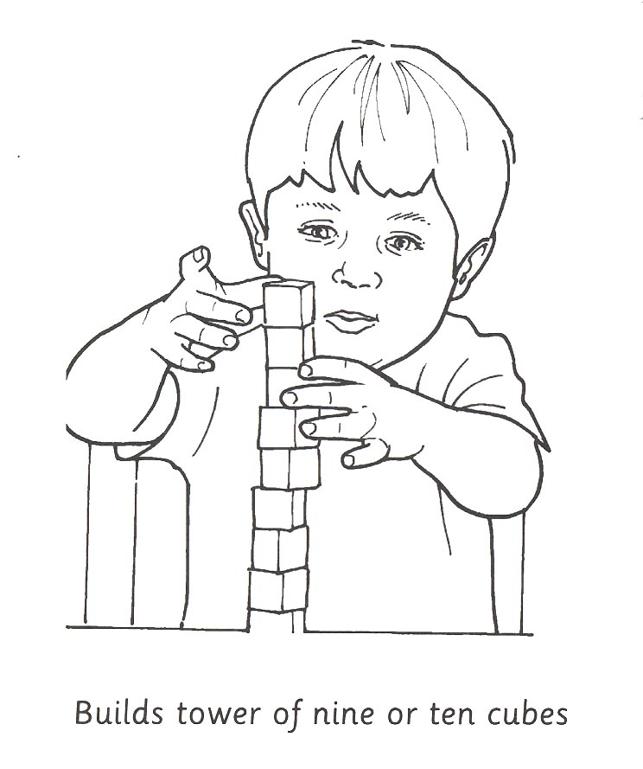

Slide 26
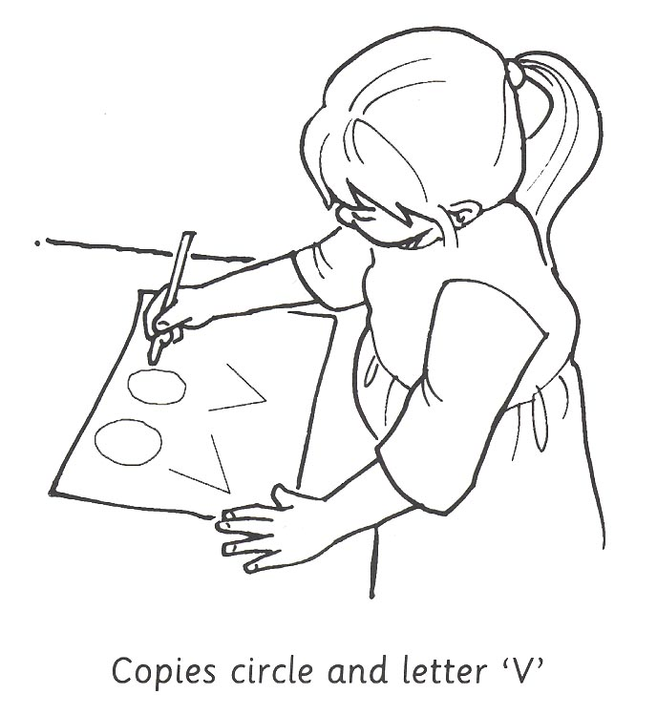

Slide 27
Thanks

