Slide 1
Connective Tissue Diseases
SYSTEMIC LUPUS ERYTHEMATOSUS

Slide 2
Epidemiology and natural history
It is widely agreed that lupus is approximately 10–20 times more common in women than men.F:M is 9:1
There is also little dispute that the overwhelming majority of lupus patients will develop their disease between the ages of 15 and 40.
Although, in the early part of the century, lupus was considered a serious and frequently fatal disease, perceptions of it have changed considerably.
There is now widely available tests for measuring antinuclear antibodies have eased identification of milder cases.

Slide 3
The introduction of corticosteroids and immunosuppressive drugs, dialysis, and renal transplantation has improved the chances of survival in the more serious cases.
However, as will be discussed, lupus continues to cause considerable morbidity and 10–20 per cent of patients succumb from either the disease, a side-effect of its treatment, or both within 15 years of follow-up

Slide 4
SLE
Pathophysiology

Slide 5
SLE-Pathophysiology
The cause of SLE is incompletely understood but genetic factors play an important role.
There is a higher concordance in monozygotic twins and associations with multiple polymorphisms in the HLA locus on chromosome 6 have been identified.
In a few instances, SLE is associated with inherited mutations in complement components C1q, C2, and C4; in the immunoglobulin receptor or in the DNA exonuclease .

Slide 6
Recent studies have identified common polymorphisms that predispose to SLE, including a gene which encodes an integrin; agenes which are involved in interferon signalling; and a gene which is involved in B-cell signalling.
From an immunological standpoint, the characteristic feature of SLE is the production of autoantibodies.

Slide 7
SLE-Pathophysiology
These have specificity for a wide range of targets but many are directed against antigens present within the cell or within the nucleus. This has led to the suggestion that patients with SLE have defects in apoptosis or in the clearance of apoptotic cells, which causes inappropriate exposure of intracellular antigens on the cell surface, leading to polyclonal B- and T-cell activation and autoantibody production.

Slide 8
This is supported by the fact that environmental factors that cause flares of lupus, such as ultraviolet (UV) light, pregnancy and infections, increase oxidative stress and/or stimulate apoptosis .
Whatever the underlying cause, immune complex formation is thought to be an important mechanism of tissue damage in active SLE, leading to widespread vasculitis and organ damage.

Slide 9
SLE
Clinical Features

Slide 10
Non-specific features
lymphadenopathy, especially in the axillae, which persists long after patients have gone into remission.
Patients with active lupus may experience weight loss and, on occasion, nausea.
Most of these general features will improve when treatment is commenced.

Slide 11
Musculoskeletal involvement
Arthralgia occurs in about 90 per cent of patients with SLE. The joint pain is polyarticular and frequently symmetrical, .
It is accompanied in about half the patients by early morning stiffness. Very often, the patient's symptoms outweigh the objective signs and major synovial effusions are rare.
Furthermore, unlike patients with rheumatoid arthritis, the deformities are usually related to an intense tenosynovitis and less frequently to synovial hypertrophy, with or without bone erosion. These deformities in the hands are known as Jaccoud's arthropathy which is generally a reversible subluxation.

Slide 12
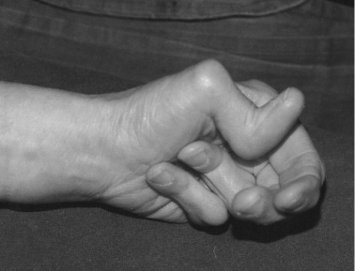

Slide 13
Musculoskeletal involvement
Myalgia, muscle weakness, and tenderness have been reported in upto 60 per cent of lupus patients, although a true myositis is confined to about 5 per cent of these patients
Treatment with corticosteroids and chloroquine may cause a myopathy, but in the main the myalgia experienced by lupus patients seems to be a complication of adjacent joint involvement

Slide 14
Dermatological involvement
Common (20–50% approximately)
Butterfly rash | Chronic discoid lesion
Photosensitivity | Non-scarring alopecia
Non-specific maculopapular lesions | Purpura/petechiae
Less common (5–20% approximately)
Mucous membrane lesions | Leg ulcer
Urticaria | Subcutaneous nodules
Diffuse hyperpigmentation
Occasional (<5%)
Periorbital oedema | Bullae
Jaundice | Panniculitis
Severe scarring alopecia | Psoriaform lesions
Pruritis

Slide 15
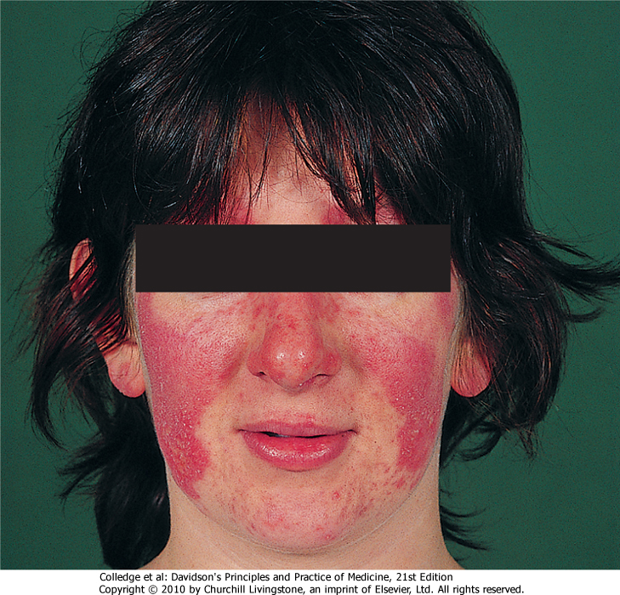

Slide 16
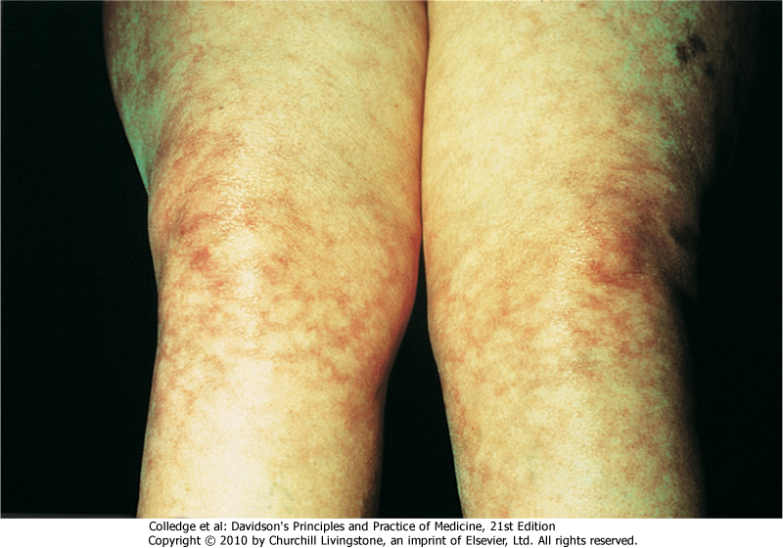

Slide 17
Cardiovascular involvement
Pericardial disease
Pericardial disease is the most common component of heart involvement in lupus. A pericardial rub is, however, also more common than significant accumulations of pericardial fluid.
Myocardial disease
True myocardial involvement is less frequent than pericardial disease. The results of investigations and necropsy studies suggest that involvement is more common than is suspected clinically. Clinical myocarditis, usually defined by combinations of unexplained tachycardia, congestive heart failure, arrythmias, prolongation of the PR interval on electrocardiogram, or cardiomegaly without pericardial effusion or valvular disease, occurs in up to 15 per cent of lupus patients. Echocardiographic studies have suggested that myocardial function can reversibly deteriorate in parallel with flares of generalized lupus activity.

Slide 18
Cardiovascular involvement
Valves
Conduction defects and rhythm disturbances are recognized as occasional features of lupus, but have rarely been found in more than 10 per cent of patients.
Systolic murmurs have been recorded in upto a third of lupus patients
The classic endocarditis, although identified in up to 50 per cent of autopsied cases, rarely causes clinically significant lesions. Histologically small (1–4 cm) vegetations (verrucae) comprising proliferating and degenerating valve tissue with fibrin and thrombi are seen. A prevalence of valvular lesions of 22.7 per cent this is known as Lipman-Sack endocarditis .
Bacterial endocarditis has been reported on a number of occasions in lupus patients.
Accelerated atherosclerosis

Slide 19
Major pulmonary manifestations in lupus
1. Pleuritic pain/pleuritis
2. Pleural effusions .These are usually small volume, straw coloured, white cell count 3–5000/mm ³ mostly mononuclear cells and lymphocytes, glucose levels approximate to those in the blood (unlike RA in which the levels are lower), ANA may be detected, protein content varies from 2.75 to 6.4 g%
3. CXR and lung function tests (and autopsy findings!) invariably indicate a greater degree of pulmonary involvement than is evident clinically
4. Interstitial fibrosis, pulmonary vasculitis, and interstitial pneumonitis are found in upto one-fifth of the patients
5. Pulmonary hypertension is unusual and has been linked to the presence of antiphospholipid antibodies

Slide 20
Renal involvement-WHO classification of SLE glomerulonephritis
I Normal glomeruli
(a) Nil (by all techniques)
II Pure mesangial alterations (mesangiopathy)
(a) Mesangial widening and/or mild hypercellularity (+)
III Focal segmental glomerulonephritis (associated with mild or moderate mesangial alterations )
(a) 'Active' necrotizing lesions
(b) Normal by light microscopy, but deposits by electron or immunofluorescence microscopy
(b) Moderate hypercellularity (++)
(b) 'Active' and sclerosing lesions
(c) Sclerosing lesions

Slide 21
Renal involvement-WHO classification of SLE glomerulonephritis
IV Diffuse glomerulonephritis (severe mesangial, endocapillary, or mesangiocapillary proliferation, and/or extensive sub-endothelial deposits)
(a) Without segmental lesions
V Diffuse membranous glomerulonephritis
(a) Pure membranous glomerulonephritis
VI Advanced sclerosing glomerulonephritis
(b) With 'active' necrotizing lesions
(c) With 'active' and sclerosing lesions
(d) With light microscopy, but deposits by electron or immunofluorescence microscopy
(b) Associated with lesions of Category II (a or b)
(c) Associated with lesions of Category III (a–c)
(d) Associated with lesions of Category III (a–d)

Slide 22
Neuropsychiatric syndromes observed in SLE
Neuropsychiatric syndromes observed in SLE
Central nervous system
Aseptic meningitis
Peripheral nervous system
Cerebrovascular disease
Demyelinating syndrome
Headache (including migraine and benign intracranial hypertension)
Movement disorder (chorea)
Myelopathy
Seizure disorders
Acute confusional state
Anxiety disorder
Cognitive dysfunction
Mood disorder
Psychosis
Acute inflammatory demyelinating polyradiculoneuropathy (Guillain–Barré syndrome)
Autonomic disorder
Mononeuropathy, single/multiplex
Myasthenia gravis
Neuropathy, cranial
Plexopathy
Polyneuropathy

Slide 23
Haematopoietic involvement
normochromic, normocytic anaemia, the 'anaemia of chronic disease', is present in upto 70 per cent of lupus patients
Coombs' positive haemolytic anaemia. Much less frequently, a microangiopathic haemolytic anaemia with disseminated intravascular coagulation has been described.
Leucopaenia (<4 × 10 ⁹ /l) and lymphopaenia (<1.5 × 10 ⁹ /l) are the most frequent abnormalities of the white blood cell count in lupus patients.
leukocytosis is rare in lupus in the absence of infection or major corticosteroid therapy.

Slide 24
Gastrointestinal disease
Gastrointestinal diseases include mouth ulcers, dysphagia, anorexia, nausea, vomiting, haemorrhage, and abdominal pain
Hepatomegaly, which can be detected in upto one-fourth of patients with lupus, is usually a minor degree of enlargement only and rarely accompanied by major abnormalities in liver function tests. Splenomegaly is found in approximately 10 per cent of the patients, though again the spleen is rarely greatly enlarged

Slide 25
Revised American Rheumatism Association criteria for systemic lupus erythematosus
Features | Characteristics
Malar rash | Fixed erythema, flat or raised, sparing the nasolabial folds
Discoid rash | Erythematous raised patches with adherent keratotic scarring and follicular plugging
Photosensitivity | Rash due to unusual reaction to sunlight
Oral ulcers | Oral or nasopharyngeal ulceration, which may be painless
Arthritis | Non-erosive, involving two or more peripheral joints
Serositis | Pleuritis (history of pleuritic pain or rub, or pleural effusion) or pericarditis (rub, ECG evidence or effusion)

Slide 26
Revised American Rheumatism Association criteria for systemic lupus erythematosus
Features | Characteristics
Renal disorder | Persistent proteinuria > 0.5 g/day or cellular casts (red cell, granular or tubular)
Neurological disorder | Seizures or psychosis, in the absence of provoking drugs or metabolic derangement
Haematological disorder | Haemolytic anaemia or leucopenia² (< 4 × 10⁹/L), or lymphopenia² (< 1 × 10⁹/L), or thrombocytopenia² (< 100 × 10⁹/L) in the absence of offending drugs
Immunological disorder | Anti-DNA antibodies in abnormal titre or presence of antibody to Sm antigen or positive antiphospholipid antibodies
Antinuclear antibody (ANA) disorder | Abnormal titre of ANA by immunofluorescence

