Slide 1
Cementum

Slide 2
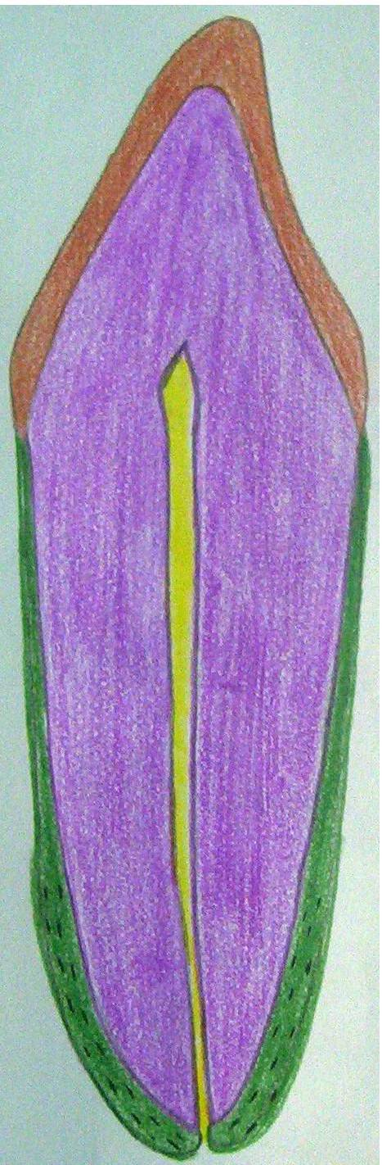

Physical Characteristics
1-Color
Light yellow
Lighter in color than dentin
2- Thickness
Acellular cementum (20-50 m)
Cellular cementum (150-200 m)
3- Permeability
Permeable from dentin and PDL sides.
Cellular C is more permeable than acellular C.

Slide 3
Chemical Composition
45-50 % Inorganic substances
50-55% Organic substances
Collagen
Hydroxyapatite crystals
protein
Polysaccharides
Trace elements
Cementum contains the greatest amount of fluoride in all mineralized tissues

Slide 4
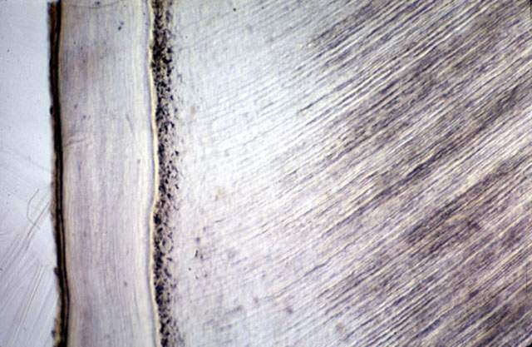
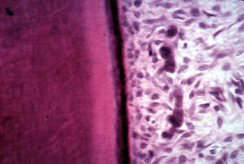
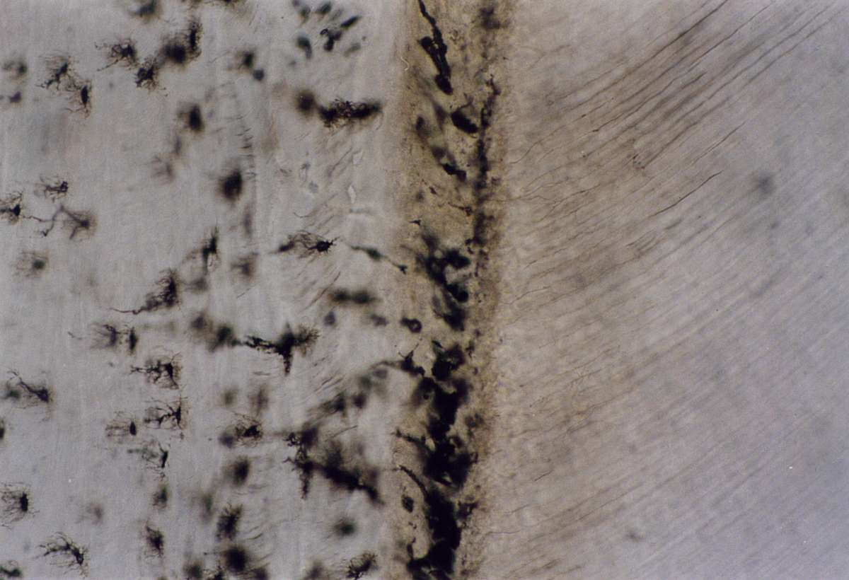
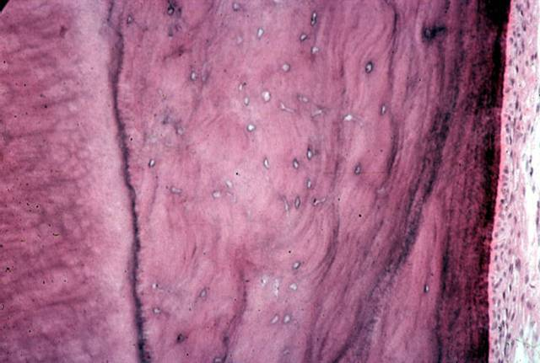
Cementum Structure
Cementocytes
Malassez
Cementoid layer
Acellular cementum
Cellular cementum

Slide 5
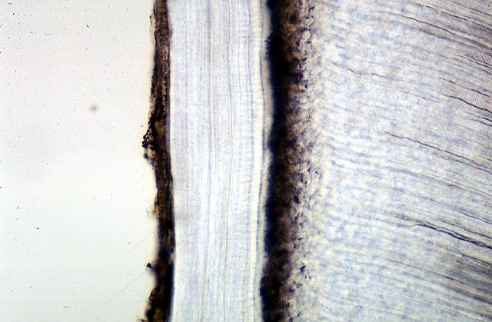
Acellular Cementum
Thickness is 20-50 µ.
It is clear and structureless
Covers the coronal half of the root.
Incremental lines of Salter are parallel to the surface.
Sharpey’s fibers space can be seen in it .
Alternating layers of
a cellular and cellular cementum could be seen.

Slide 6
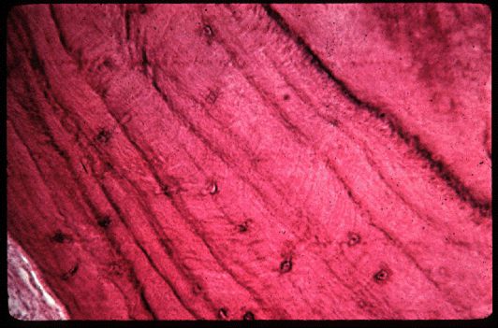
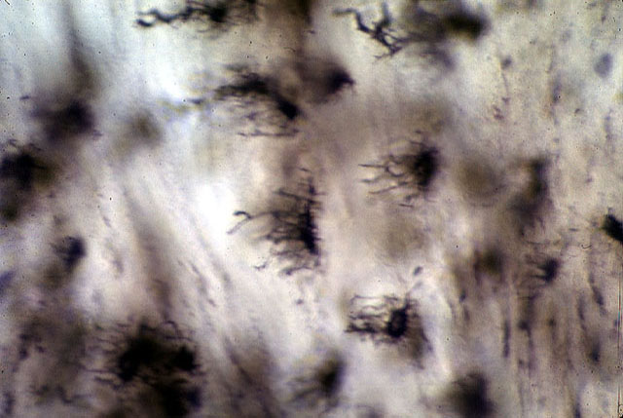
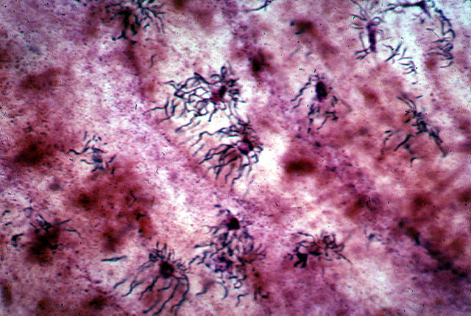
Cellular Cementum
Lacunae of cementocytes
Incremental lines of Salter
Cementocytes
PDL side
Dentin side
Cementocytes

Slide 7
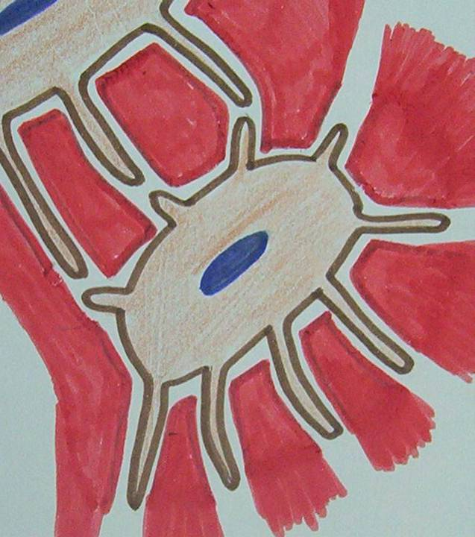
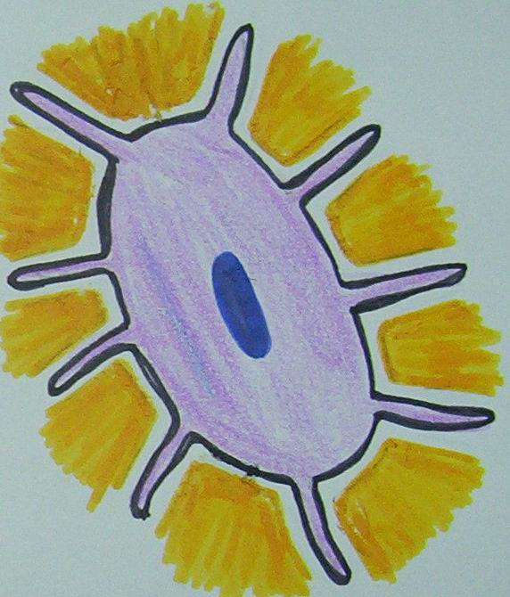
Cementocyte And Osteocyte
Dentin side
Osteocyte
Lacuna
Canaliculi
PDL side

Slide 8
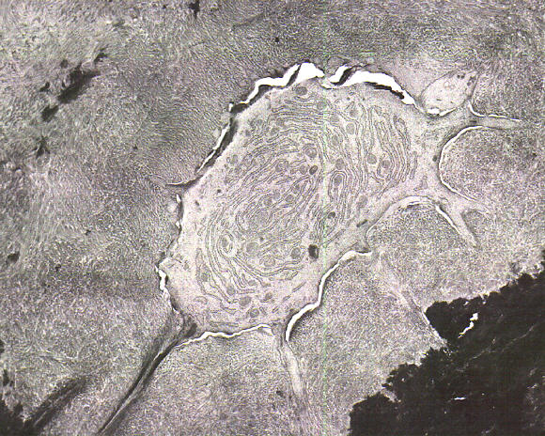
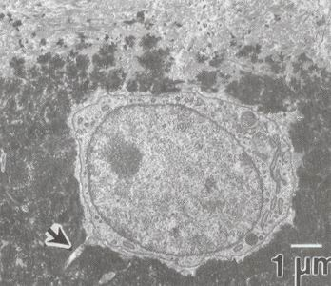
Cementocyte And Osteocyte
Dentin side
Osteocyte
Lacuna
Canaliculi
Periodontal ligament side

Slide 9
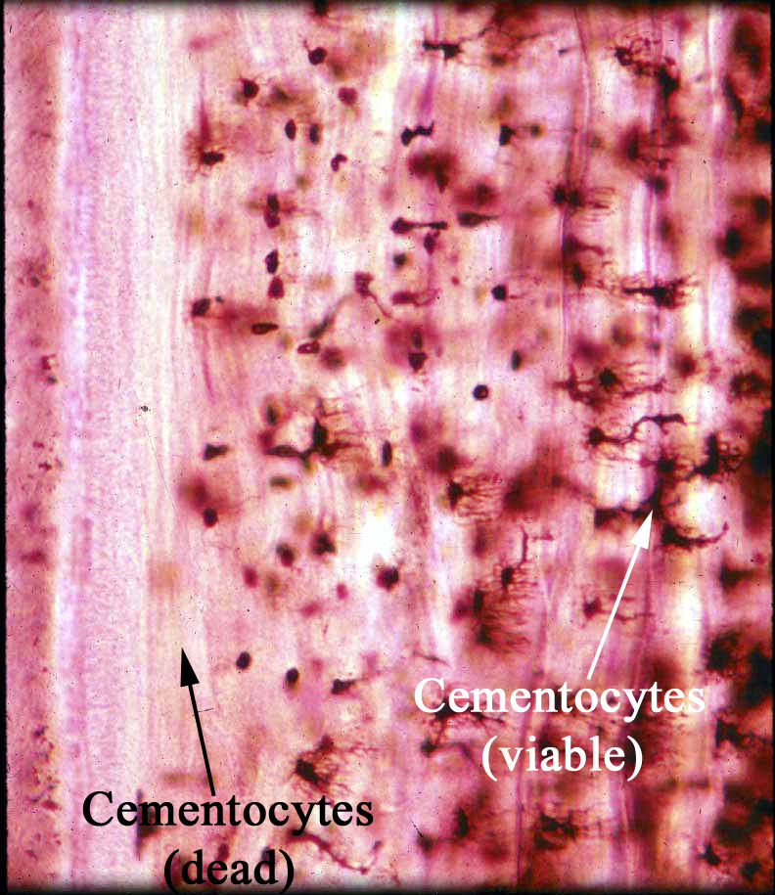
Cellular Cementum
Viable superficial cementocytes
Dentin side
Degenerated deep layer’s cementocytes
PDL side

Slide 10
Cementoid
The uncalcified matrix of cementum is called cementoid.
It is lined by cementoblast.
Connective tissue fibers from the PDL are embedded in the cementum and serve to attach tooth to surrounding bone (Bone bundle)
These embedded fibers are known as Sharpey`s fibers.

Slide 11
Acellular- Cellular
Acellular
Cementoblast are absent
Covers the root from CEJ to the apex
Predominates in the coronal half of the root
Sometimes found on the surface of cellular cementum
Cellular
Cementoblasts are seen
Seen in apical 3rd of root
Predominates in the apical half of root
Frequently seen on the surface of acellular cementum

Slide 12
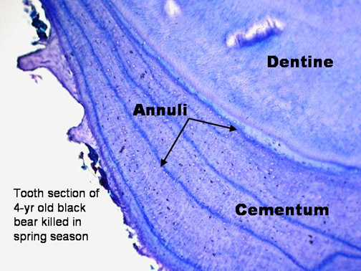
Incremental Lines Of Salter
In acellular C
In cellular C
They are hypermineralized area with less collagen fibers and more ground substance

Slide 13
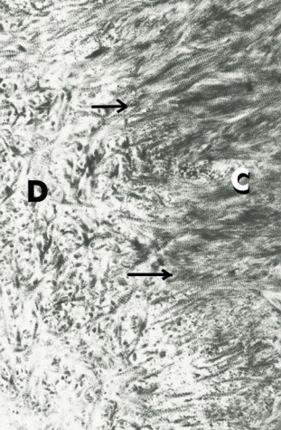
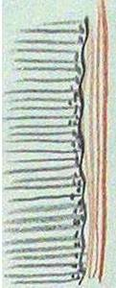
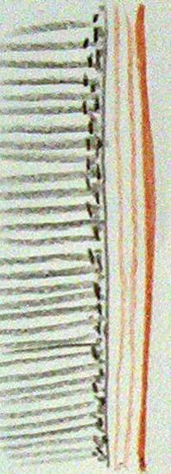
Cemento Dentinal Junction
C
D
Smooth in permanent teeth
Scalloped in deciduous teeth

Slide 14
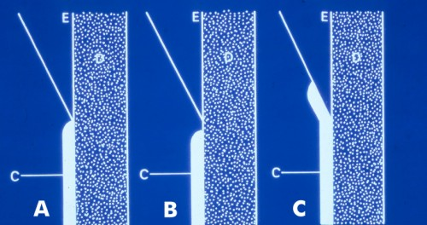
Cemento Enamel Junction
Touching:
30% cementum meets the enamel in a sharp line
Gapping:10% cementum and enamel doesn’t meet because of delayed separation of epith root sheath of Hertwig (area of dentin not covered by C).
Overlapping:60% cementum overlaps E (afibrillar cementum)

Slide 15
3-Intermediate cementum
Sometimes dentin is separated from the cementum by a zone known as intermediate cementum.
This layer is seen mostly in apical 2/3rd of Molars and Premolars.
This layer represents areas where cells of Hertwig`s epithelial root sheat become trapped in a rapidly deposited dentin or cementum matrix.
It is rarely seen in primary and anterior teeth.

Slide 16
4-Afibrillar cementum (No fibril)
Cementoblasts contact enamel surface produce afibrillar cementum
Afibrillar cementum contacts connective tissue cells and forms fibrillar cementum.

Slide 17


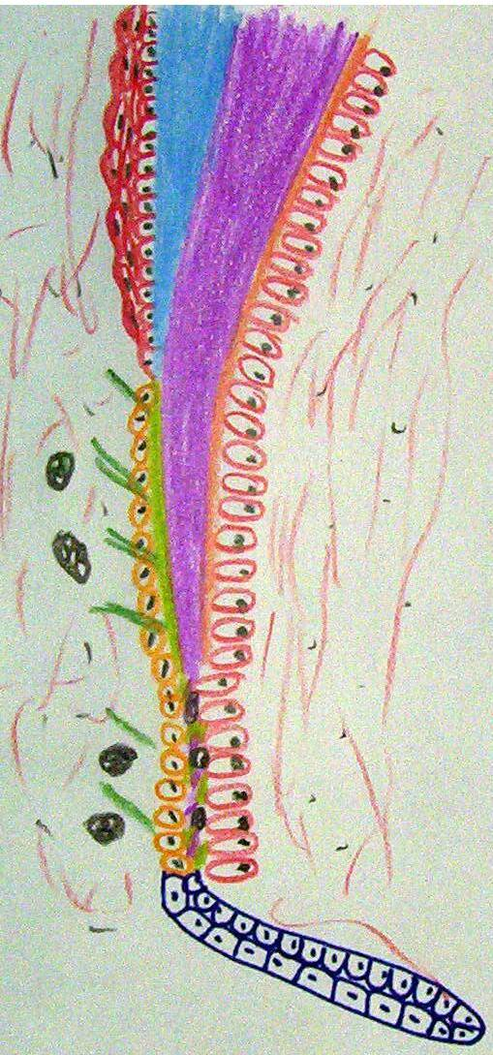
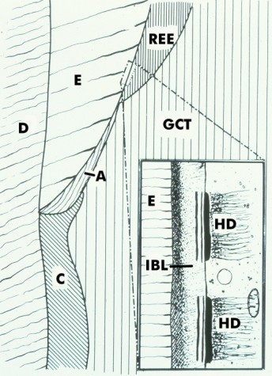
Types Of Cementum
1- Acellular cementum
2- Cellular cementum
3- Intermediate cementum
4- Afibirllar cementum

Slide 18
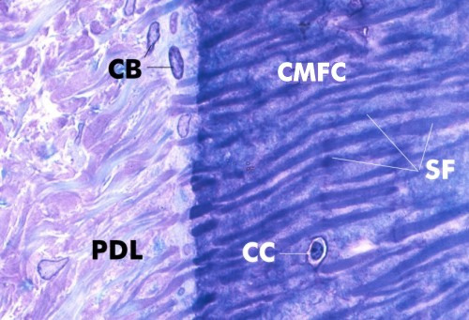
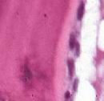
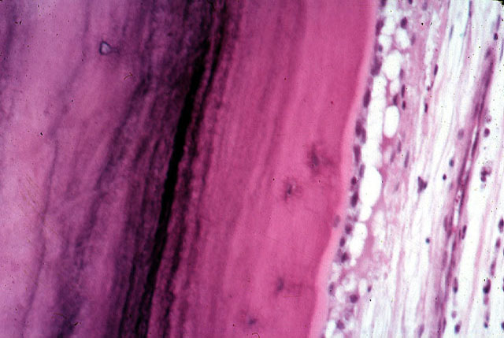
Functions Of Cementum
1- Acts as a medium for attachment of collagen fibers of PDL (Sharpey’s fibers) that bind tooth to alveolar bone.
2- The continuous formation of cementum keeps the attachment apparatus intact (undamaged).
Cementoid T
Cementoblast

Slide 19
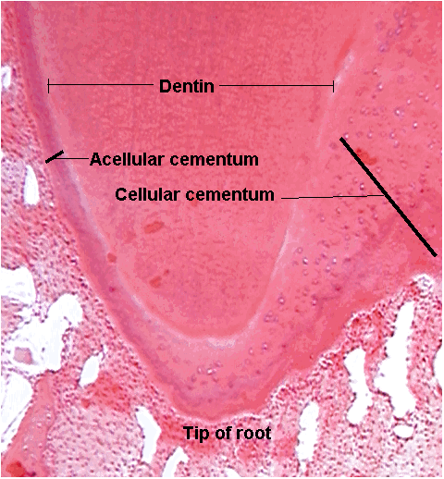
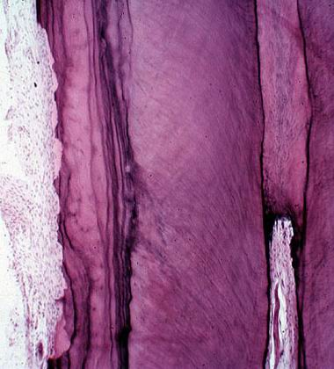
3- Cementum deposition apically compensate (balance) for the attrition.
4- It is a major reparative tissue and protect dentin.
( as in case of fracture or resorption of root)

Slide 20
Cementogenesis
1- Matrix formation
2- Maturation
Collagen fiber type I
Ground substance
Hydroxy apatite crystals

Slide 21
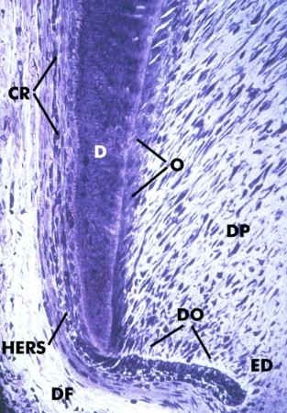
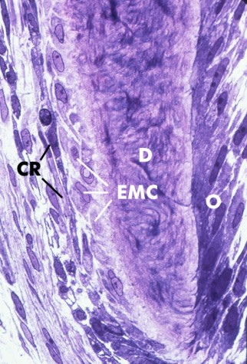
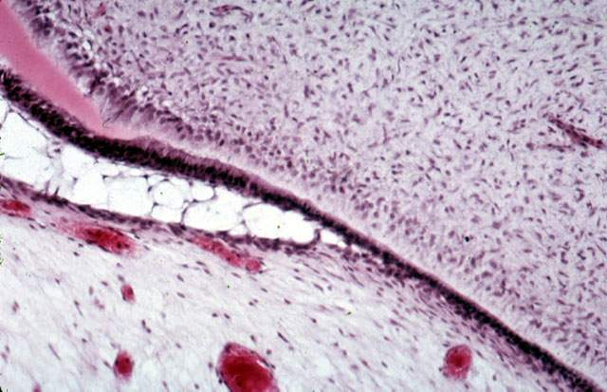
1- Matrix formation
Cementum is formed during root formation
Cementoblasts
D
H E R
Future C E J
Epith. Diaph.

Slide 22
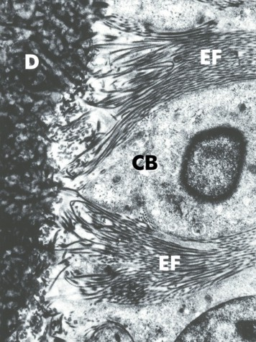
Cementoblast is a protein forming and secreting cell.
Collagen fibers + ground substance.
D
Large open face nucleus
R E R
Cementoblast
Golgi apparatus
Mitochondria
Secretory granules
Alkaline phosphatase

Slide 23
Cementum
Cementoblasts
Cementoid layer

Slide 24
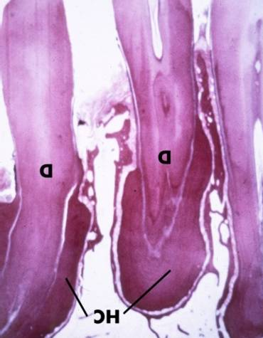
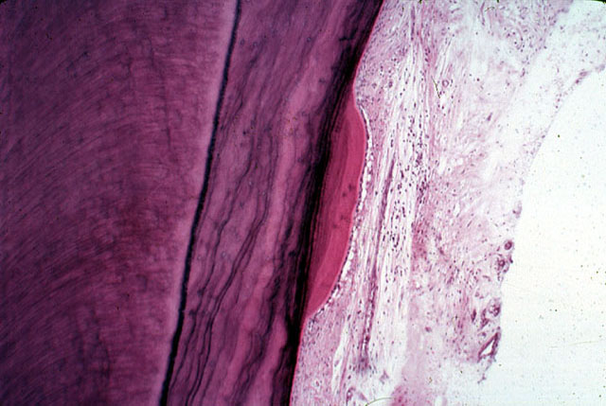
Age Changes Of The Cementum
1- Hypercementosis.
Localised
D
D
Is abnormal thickening of cementum. May affect one tooth or all teeth
Hypercementosis

Slide 25
Types Of Hypercementosis
Hypercementosis hypertrophy
Hypercementosis hyperplasia
Increase number of Sharpey’s fibers
Decrease number of Sharpey’s fibers

Slide 26
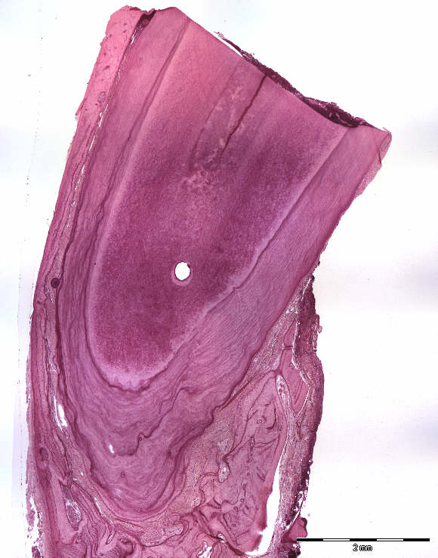
Types Of Hypercementosis

Slide 27
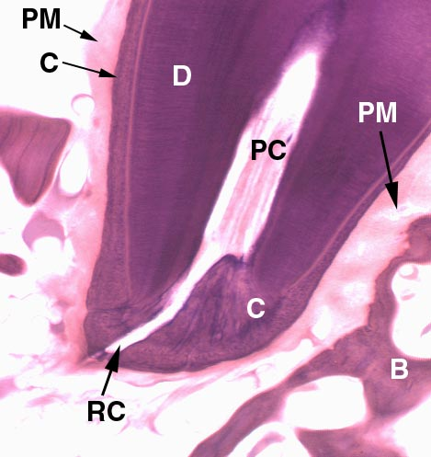
2- Permeability
From periodontal side, but remain at the superficial recently formed layers
From dentin side remains at apical area ONLY

Slide 28
Clinical considerations
Cementum is more resistant to resorption than bone because cementum is avascular; bone is vascular.
Cemental resorption is repaired by formation of cellular or acellular cementum or by both.This is called anatomic repair.
Thin layer of cementum is deposited on the surface of a deep resorption.in such areas, the periodental space is restored to its normal width by formation of a bony protection.This is called functional repair.

