Slide 1
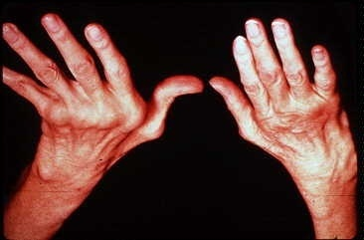
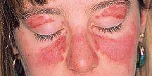
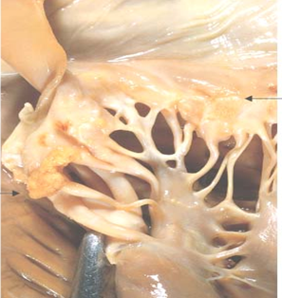
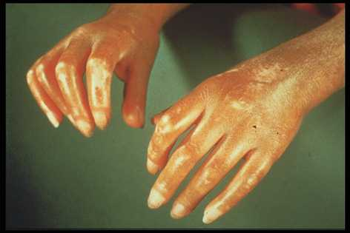
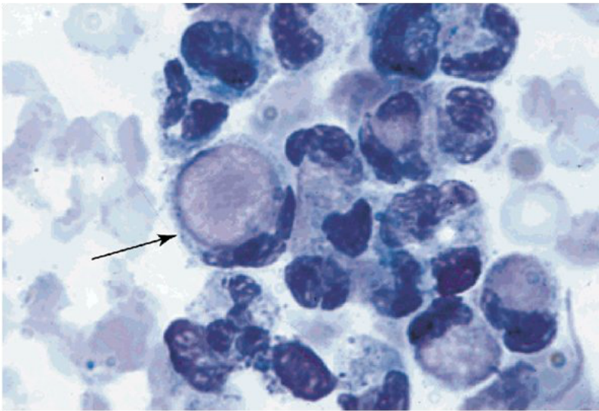
Autoimmune diseases
Ch. 4
p (99 – 159)
March 7 /2016
March.6.2016

Slide 2
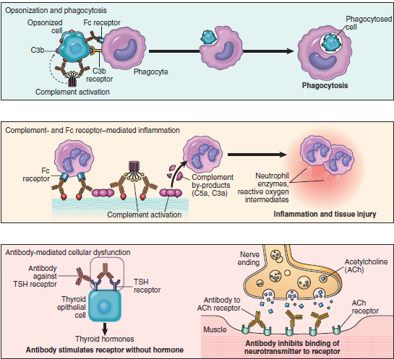
Diseases of the Immune System
Ch. 4
p (99 – 159)
Feb. 28 /2016
March 6 /2016

Slide 3
Autoimmune Diseases
Local
Systemic
Ab mediated
Cell mediated
CT Diseases or Collagen Vascular diseases

Slide 5
Mechanism of tolerance induction
apoptosis, negative selection or deletion
Clonal deletion:
auto-reactive T-cells are eliminated in the thymus following interaction with self antigen during their differentiation (negative selection).
AIRE (autoimmune regulator).

Slide 6
Mechanism of tolerance induction
Clonal deletion:
differentiating early B cells become tolerant when they encounter cell-associated or soluble self antigen.
Clonal deletion also occur in the periphery.

Slide 7
Mechanism of tolerance induction
Receptor editing:
B cells which encounter large amounts of soluble antigen, as they do in the body, and bind to this antigen with very low affinity undergo DNA recombination and change their antigen specificity.

Slide 8
Cells slippage
Central tolerance, is not perfect.
T cells bearing receptors for autoantigens escape into the periphery “ T cells slippage”
There is similar “slippage” in the B-cell system.
Cells slippage ______ Autoimmune Dis, or (+ve Auto Abs in the circulation)

Slide 9
Peripheral Tolerance
Negative selection
Anergy
Suppression by regulatory T cells
Deletion by activation-induced cell death

Slide 10
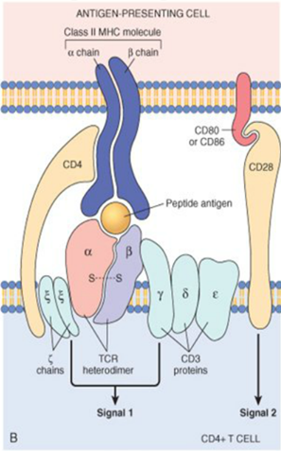
Mechanism of tolerance induction
Clonal anergy:
Auto-reactive T cells, when exposed to antigenic peptides which do not possess co-stimulatory molecules (B7), become anergic to the antigen.

Slide 11
Mechanism of tolerance induction
Clonal anergy:
Also, B cells when exposed to large amounts of soluble antigen down regulate their surface IgM and become anergic.
These cells also up-regulate the Fas molecules on their surface. An interaction of these B cells with Fas-ligand-bearing cells results in their death via apoptosis.
B cell anergy:
No Th cooperation.

Slide 12
Suppression by regulatory T cells
Regulatory T cells; CD4+ T lymphocytes that express (CD25) .
Regulatory T cells may be generated by self antigen recognition in the thymus or in the periphery.
Induce immunosuppression by secreting TGF-b and IL-10
Foxp3 transcription factor pr. Imp for generation & survival of CD25

Slide 13
Peripheral Tolerance
Deletion by activation-induced cell death:
CD4+ T cells, & B-cells that recognize self-Ags may receive signals, promote their death by apoptosis, (by the mitochondrial pathway) .
Or by The Fas-Fas ligand system, (Fas-mediated apoptosis).
mutations in the FAS gene; Cause autoimmune lymphoproliferative syndrome.

Slide 14
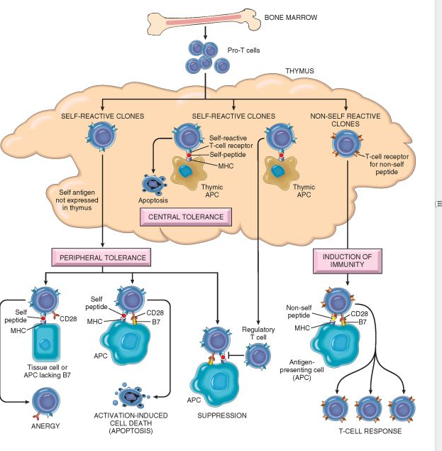
Mechanisms of central and peripheral immunological tolerance to self-antigens, shown for CD4+ T cells.
Notes:
Mechanisms of immunological tolerance. Schematic illustration of the mechanisms of central and peripheral tolerance to self-antigens, shown for CD4+ T cells. APC, antigen-presenting cell

Slide 15
Pathogenesis of autoimmune diseases.
Genetic
Infection
Hormonal
OTHER AUTOIMMUNE DISEASES

Slide 16
Genetic predisposition;
Families
Twins
HLA-Dr, DQ
Odd ratio , Relative risk
Rhumatoid arthritis; HLA-DR4 (3-4)
Ank. Spondylitis; HLA-B27 (100)

Slide 17
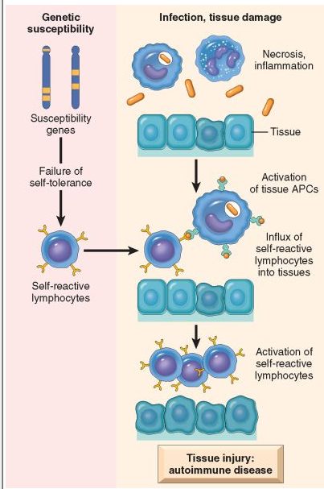
Infection:
Cross reaction
(Molecular Mimicry)
Rhumatic Heart Dis.
Upregulation of Costimulatory molec. on APC
(T cell activation)
Altered tiss Ag.
Exposure of Nuc. Ag
SLE.

Slide 18
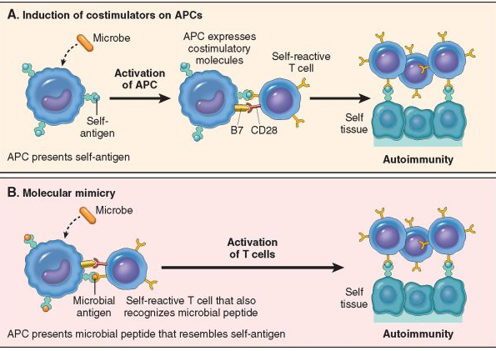
Role of infections in autoimmunity. Infections induces expression of costimulators (A),
or microbial Ags may mimic self-antigens and cause cross-reaction (B).

Slide 19
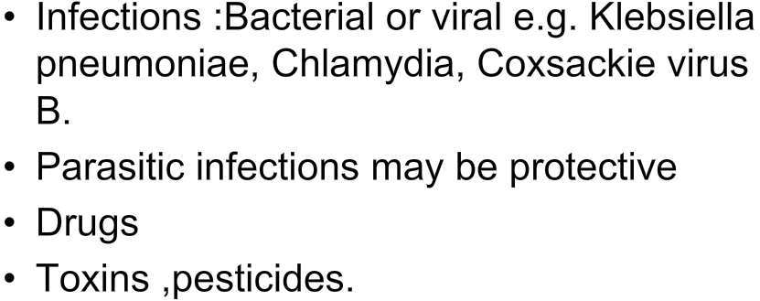

Slide 21
DISEASES MEDIATED BY T CELLS
Organ-specific autoimmune diseases
Type 1 diabetes mellitus
Multiple sclerosis
Systemic autoimmune diseases
Rheumatoid arthritis[*]
Systemic sclerosis[*]
Sjogren syndrome[*]
Inflammatory bowel disease
Inflammatory myopathies

Slide 22
DISEASES MEDIATED BY ANTIBODIES AND IMMUNE COMPLEXES
Organ-specific autoimmune diseases
Autoimmune hemolytic anemia
Autoimmune thrombocytopenia
Myasthenia gravis
Graves disease
Goodpasture syndrome
Systemic autoimmune diseases
Systemic lupus erythematosus (SLE)
Polyarteritis nodosa

Slide 23
N.B.
The list of diseases proven to be “autoimmune” grows by leaps and bounds every year!!!
Notes:
Would it be fair to say EVERY disease is autoimmune? Probably NOT!
Would it be fair to say almost every disease can result as a failure of some immune process? Probably!

