Slide 1

DISEASE OF THE VEINS
Assistant prof.
Abdulameer M. Hussein

Slide 2
Venous disease refers to all conditions related to or caused by veins that become diseased or abnormal.
Venous disease is quite common.
Mild venous disease is usually not a problem for patients, but as venous disease worsens, it can become crippling chronic venous insufficiency.

Slide 3
VEINS
Deep System
  Named for by associated arteries
  Found running along the arteries
  Predictable anatomy
  Causes most of the Morbidity
    DVT
    PE
    Severe Leg Swelling
    Ulcerations
  Little Surgical interventions (IVC Filter)
  Medical Management
    Anticoagulation
    Thrombolytic therapy
      Systemic vs. Catheter directed
    Elevation and Compression

Slide 4
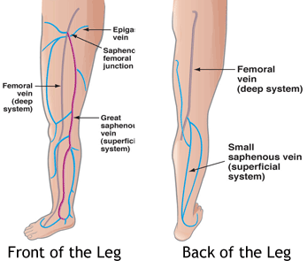
Superficial Venous System
These are the veins we see
Two main named branches
  Greater saphenous
  Small saphenous
Perforators connect superficial and deep systems
Highly variable anatomy
Many unnamed branches and Tributaries

Slide 5
Venous Disease
Superficial System
Varicose Veins
Spider Veins
Venous Malformation
Venous Reflux
Leg Swelling
Venous Ulceration
phlebitis

Slide 6
Risk factors for venous disease include:
Family history
Obesity
Pregnancy
Prolonged standing
Prior history of blood clot formation in the veins
Trauma
Surgery
Medications
Lifestyle

Slide 7
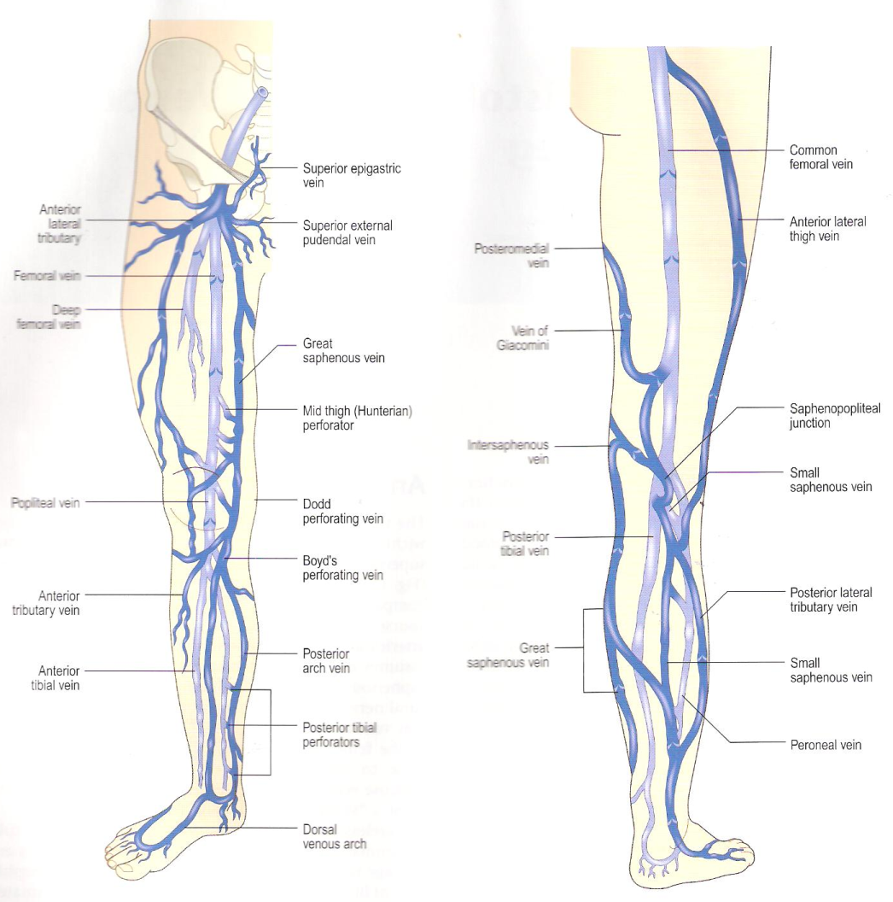
Superficial Anatomy
Deep System = Light blue
Superficial System = Dark blue
Complex and variable anatomy

Slide 8
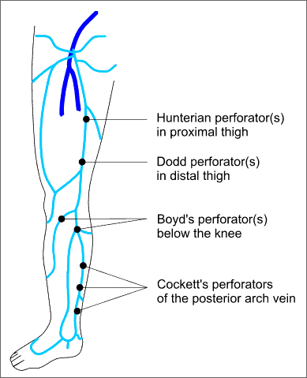
Named perforators along the greater saphenous distribution

Slide 9
Physiology
Arteries deliver blood to tissue
Veins return blood to the heart
Heart is the arterial pump
What pumps the venous blood back to the heart?
    Venous pressure is about 25mmHg at the foot
    Pressure needed 80mmHg to return blood
  Two unique features of veins accomplish this
    Most important is one-way Venous Valves
    Easily compressible by surrounding muscle (calf pump)

Slide 10
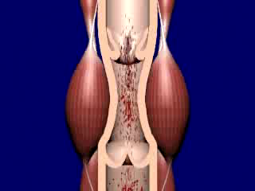
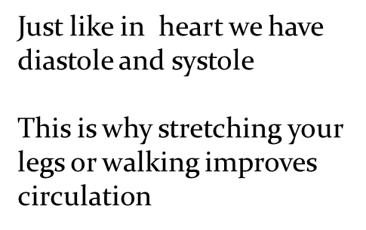
Calf Muscle Pump

Slide 11
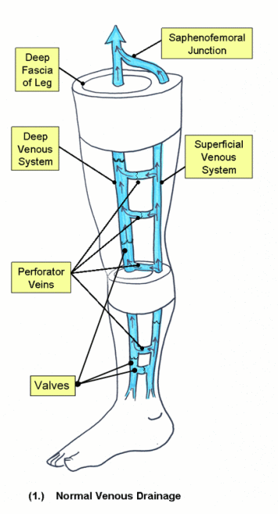
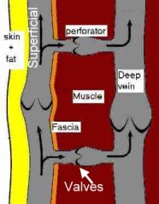
Normal venous flow in the Leg
Normal Flow
  Superficial veins drain into the deep veins
  From the foot up to the heart
Superficial vein disease always starts with abnormal valves and interruption to normal flow called venous reflux

Slide 12
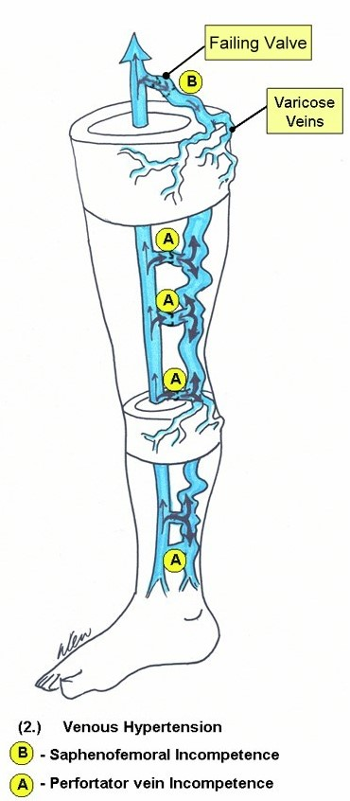
Abnormal flow = Venous Reflux
Damaged Valves
  Blood flows to the skin
  Blood is pushed distally and proximally
  Close loop recirculation
  Blood is retained in the leg
    Increased volume of blood (heaviness Fatigue)
    Increased venous pressure
    Veins Dilate (varicose veins)

Slide 13
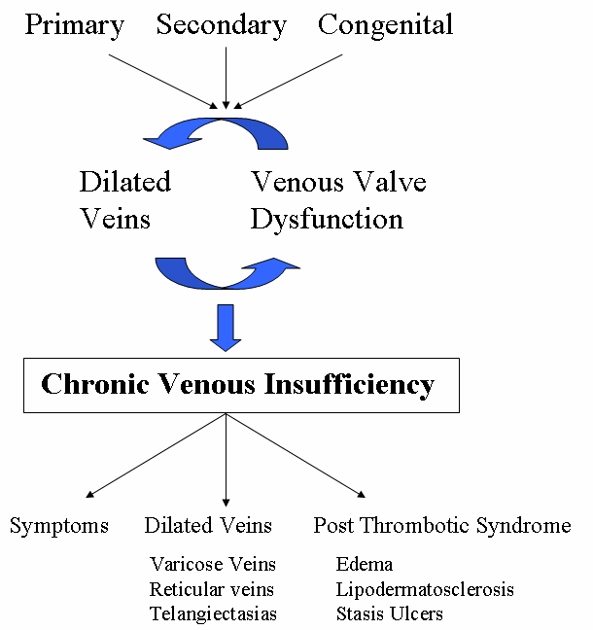
Causes of Venous Reflux

Slide 14
Symptoms of venous reflux
Leg Fatigue
Leg Heaviness
Itching and pain along veins
Varicose Veins
Spider veins (not always 2nd to reflux)
Leg swelling( think DVT 1st)
Skin Discoloration (lipo dermatosclerosis)
Venous ulceration

Slide 15
Varicose Veins
Definition: Visible tortious bulging blue veins found in the lower extremities
Located in the Subcutaneous(between skin and fascia)
  Remember this is only a manifestation of the underlying disease
  Mild Disease is cosmetic issue
  Advanced Disease significant medical problem
    Pain
    Swelling
    Ulcerations

Slide 16
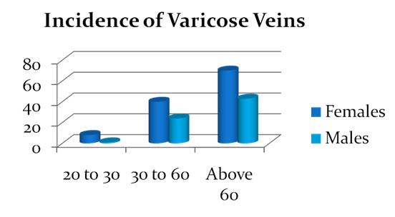
Varicose Veins
Incidence Increases with age
Females to male 3 to 1
50% of the population will affected in their life time

Slide 17
Spider Veins (Telangiectasia)
These are non raised dilated veins located in the Dermis (deep layer of the skin)
Single layer endothelium, minimal muscle
Do not cause major medical complications
Appears earlier than varicose veins (4% of teenagers , and 13 % in 18 to 20 year olds
More common in females
50 percent of adult females are affected with spider veins.
Reticular Veins are lager feeding veins

Slide 18
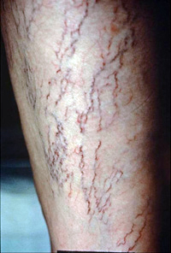

Slide 19
Spider Veins
Etiology: Multifactorial
  Venous Hypertension associated with varicose veins
  Congenital: vascular nevi, neonatal hemangiomatosis, others..
  Collagen Vascular Disease: lupus,
  Hormonal factors: pregnancy, estrogen therapy, topical steroids
  Trauma: contusion, incisions
  Infections

Slide 20
Venous Stasis Ulcers
Differential Diagnosis
    Venous ulcerations 50% on non healing ulcers
    Arterial ulcers in about 10%
    Malignancy : basal and squamous cell, lymphoma
    Infections: HIV, fungal
    Collagen vascular disorders: Lupus.
    Lymphatic obstruction

Slide 21
Venous Stasis Ulcers
Etiology
  Venous Hypertension
    Venous reflux
    DVT
    Varicose veins
  Edema
  Biological factors
    Leakage of proteins impedes diffusion O₂
    Aggregation of white cells
      Block capillary flow
      Release on inflammatory proteins

Slide 22
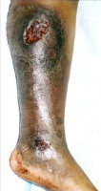
Venous stasis ulcer

Slide 23
Diagnosis of venous disease
Physical exam
    Appearance
    Trendelenburg test
    Palpation
    Hand Doppler
Duplex Examination
    DVT
    Size of veins
    Map out superficial veins
    Locate the site of reflux
    Find refluxing perforators

Slide 24
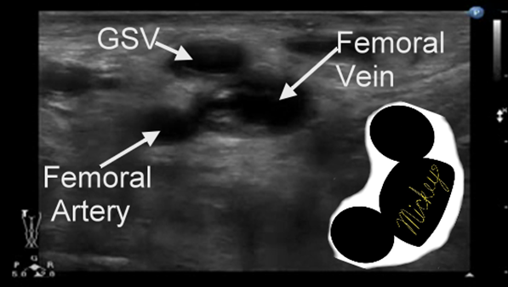
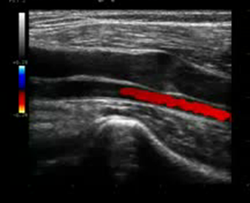
Duplex Anatomy
Locate GSV Junction(FSJ)
Look for Mickey's
Normal venous flow Look at valve
Venous flow is opposite the artery

Slide 25
  Magnetic Resonance Venography (MRV)
Most sensitive & most specific test to find causes of anatomic obstruction.
This is expensive test used only as adjuvant when doubt still exists.

Slide 26
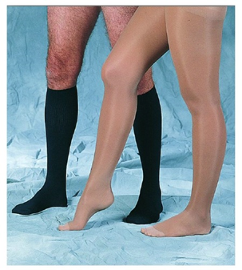
Treatment of Varicose Veins
  Conservative management
    Exercise
    Leg elevation
    Compression stocking
  Surgical treatment
    Standard Ligation and stripping
    Phlebectomies
  Minimally invasive procedures (Currently accepted standard)
    Laser Ablation
    Radio Frequency ablation
    Sclerotherapy

Slide 27
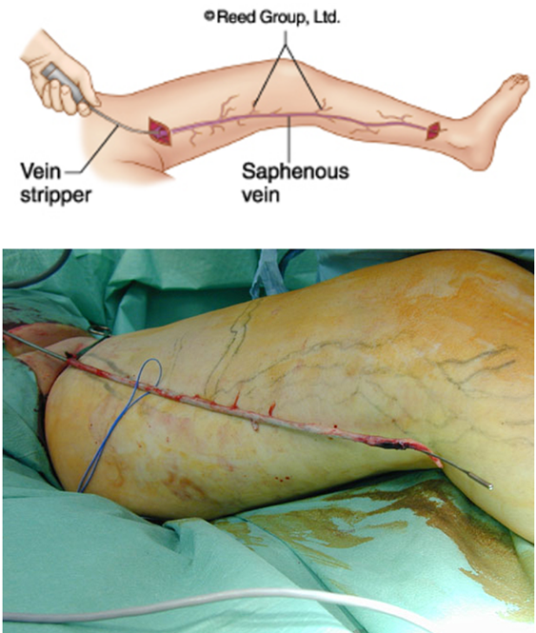
Surgical ligation and Stripping
Standard treatment for a century
General anesthesia
Pain
Long recovery
Some complications
Good cosmetic results

Slide 28
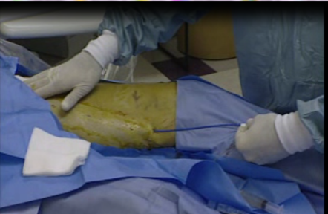
Vein Ablation
Laser Ablation (EVLA or EVLT)
    Uses light to heat the vein
Radio Frequency
    Uses radio frequency to heat the vein
  Office based procedure
  Done under local anesthesia
  One needle puncture at the level of the knee
  Takes about 1 hour
  Patient resumes normal activity same day

Slide 29
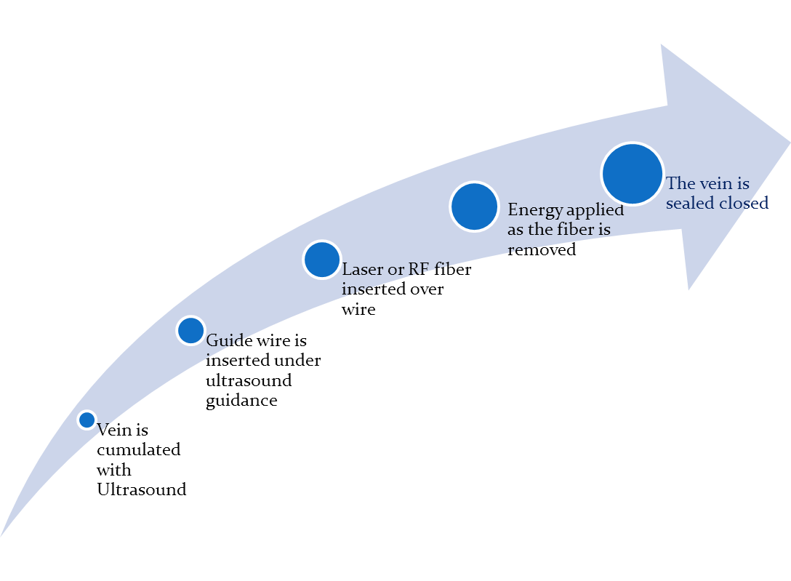
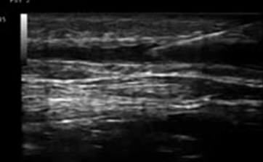

Slide 30
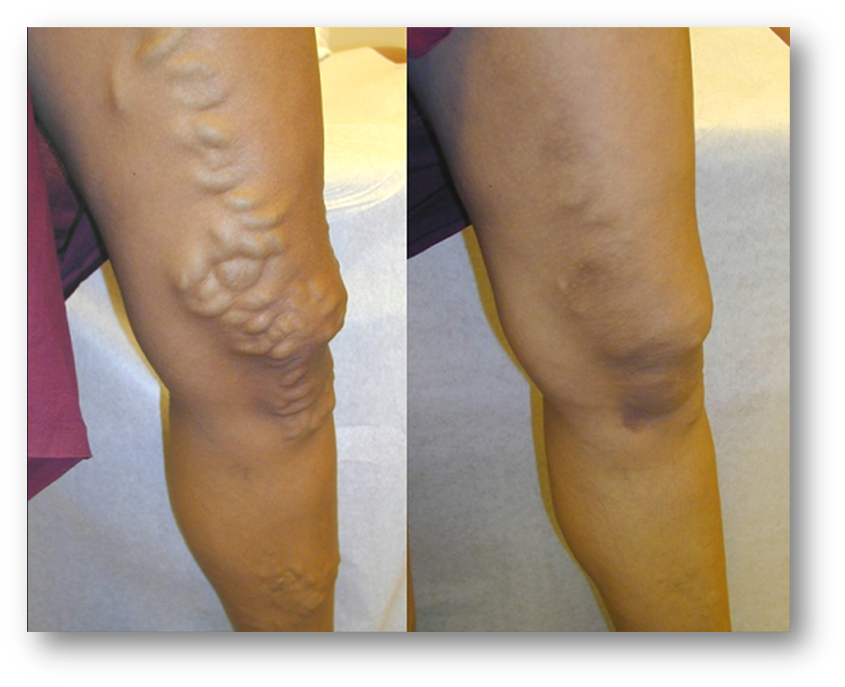
EVLA Results

Slide 31
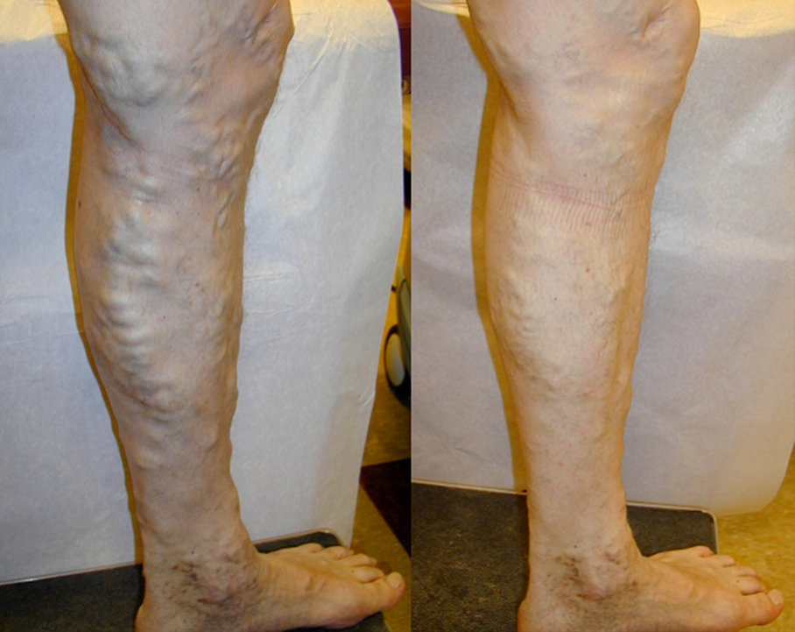
EVLA Results

Slide 32
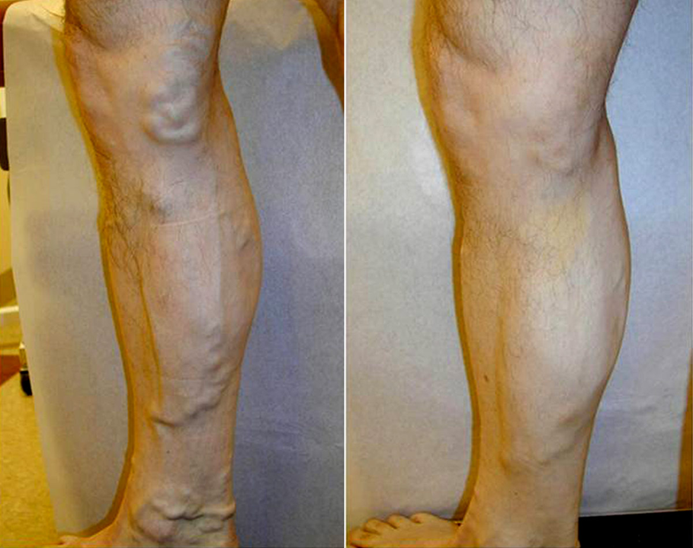
EVLA Results

Slide 33
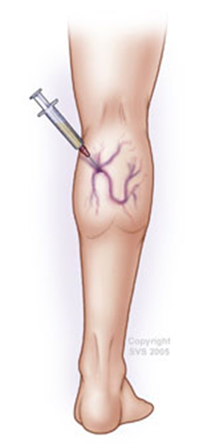
Sclerotherapy
Cumulate vein with needle
Inject Sclerosing Solution
  Hyper tonic Saline
Intravenous injection causes intima inflammation and thrombus formation

Slide 34
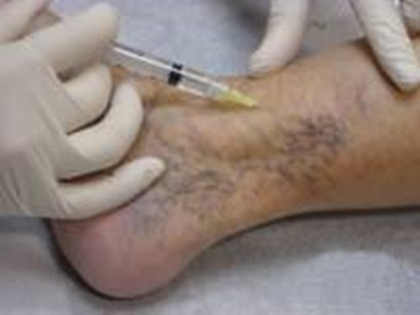
Sclerotherapy
Use in
Perforators
Spider veins
Reticular veins
GSV: can closure the, but has high recurrence rate

Slide 35
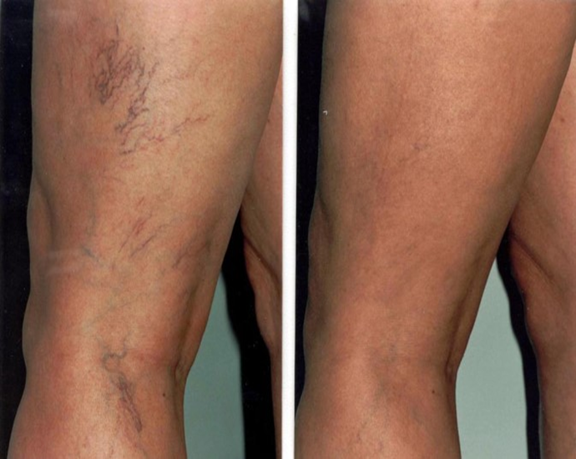
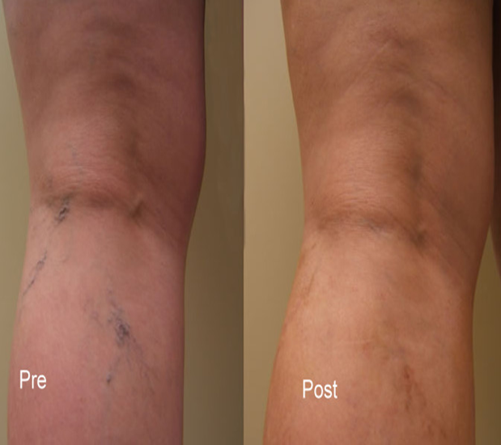
Sclerotherapy results

Slide 36
Thank you for attention!

