Slide 1
BLADDER OUTLET OBSTRUCTION
(B.O.O.)
BLADDER OUT FLOW OBSTRUTION
(B.O.F.O.)
2016

Slide 2
BLADDER OUTLET OBSTRUCTION
It’s urodynamic concept of low flow rates and high intravesical pressures.
The complex of symptoms referred to as lower urinary tract symptoms (LUTS) is not specific for BPH.
Causes:
Benign prostatic hyperplasia (B.P.H.)
Carcinoma of the prostate (CAP)
Prostatitis
Bladder neck stenosis or contracture.
urethral stricture.
Urethral stones
Bladder tumors (if presents at the bladder neck)
Neuropathic bladder.

Slide 3
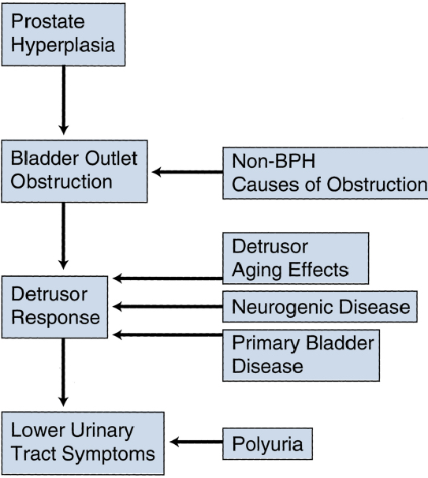

Slide 4
Symptomatology (LUTS)
Voiding or Obstructive:
Weak stream.
Straining to void.
Hesitancy.
Intermittency.
Post voiding dribbling.
Retention of urine.
Incomplete bladder emptying.
Storage or Irritative:
Frequency.
Urgency
Urge incontinence.
Nocturia & nocturnal incontinence (enuresis).

Slide 5
Pathophysiology
BOO over time will result in increase in the intravesical pressure, bladder muscle hypertrophy (trabeculation, sacculation and diverticulum formation).
High pressure may transmit to the upper tract causing hydroureter, hydronephrosis and renal insufficiency.
BOO results in incomplete bladder evacuation (residual urine) which predisposes to UTI and stone formation.

Slide 6
Benign Prostatic Hyperplasia (BPH)
Definition: BPH describes a proliferative process of the stromal and epithelial (stromoglandular) elements of the prostate.

Slide 7
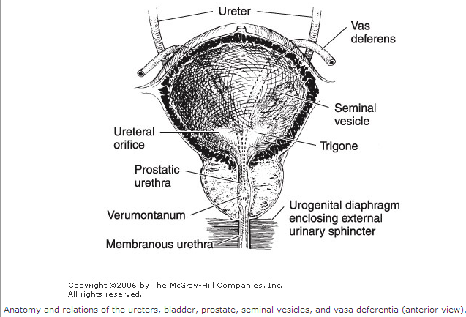
Anatomy
The prostate
fibromuscular &
glandular organ
The bladder neck & prostatic bed is abundantly supplied by
1a sympathetic receptors
weighs : 20 gm
Anterior view

Slide 8
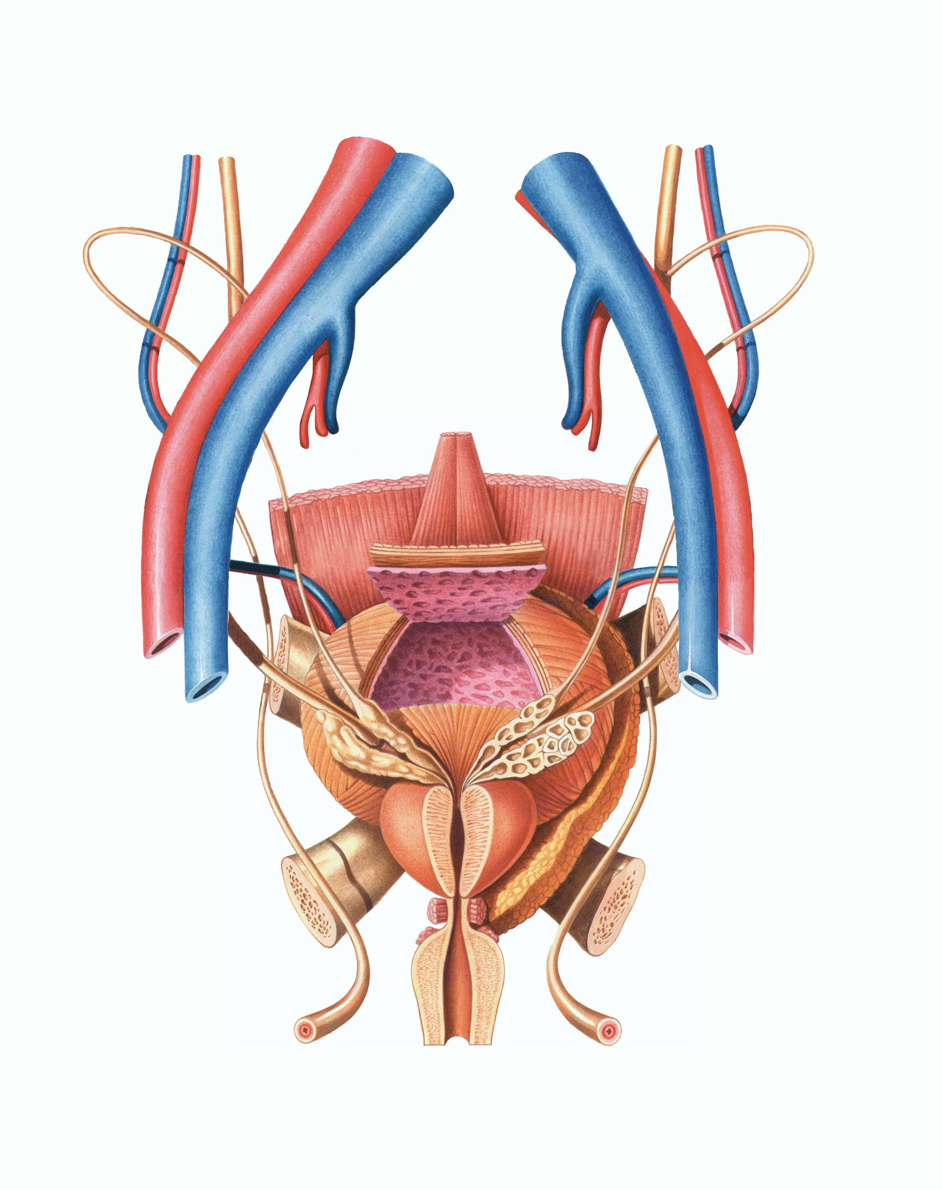
Posterior view

Slide 9
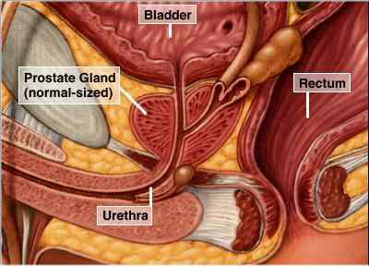

Slide 10
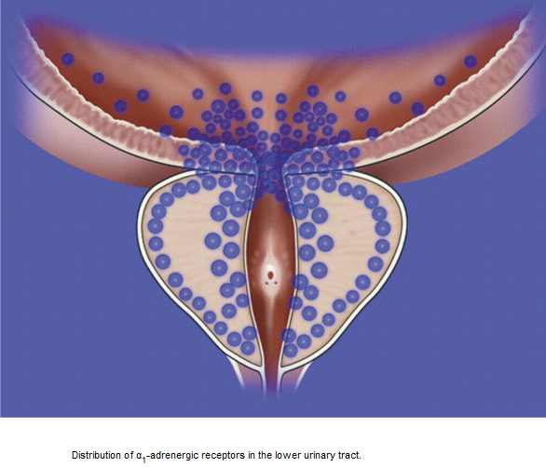

Slide 11
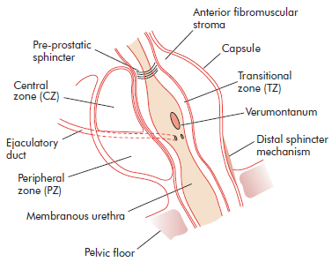
SURGICAL ANATOMY
McNeal classification of the prostate into zones:
The central zone
The peripheral zone
The transitional zone
BPH Typically affects submucosal glands at transitional zone

Slide 12
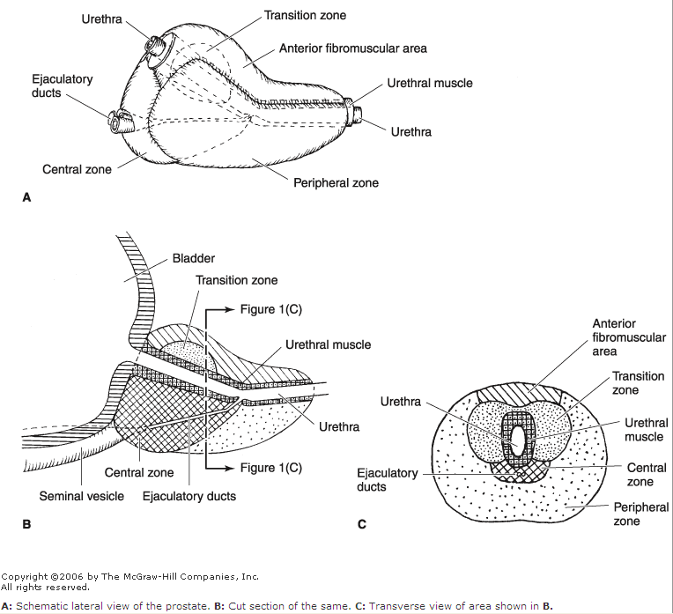

Slide 13
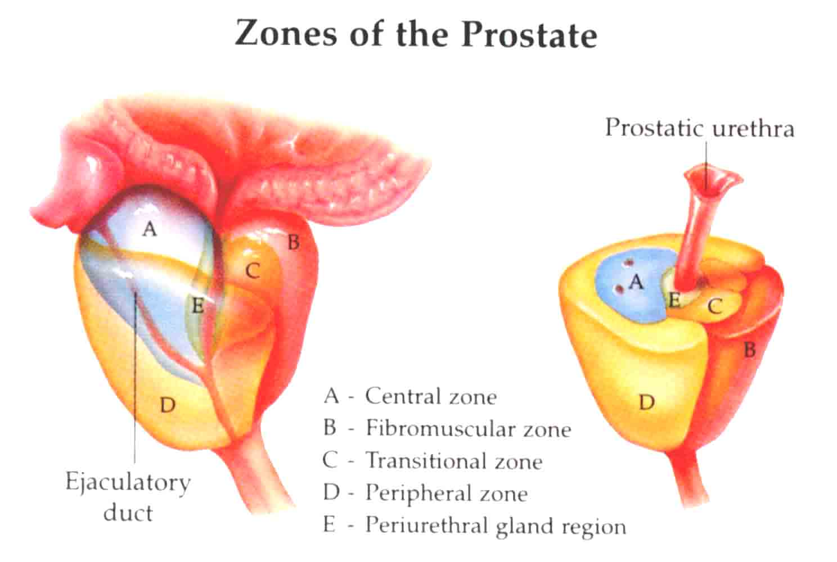

Slide 14
BENIGN PROSTATIC HYPERPLASIA
Etiology:
Multifactorial and endocrine controlled (Hormonal imbalance)
Serum testosterone levels decrease with advancing age.
Oestrogenic steroids do not decrease equally.
( the prostate enlarges because of increased oestrogenic effects.)

Slide 15
Risk factors
Genetic and Familial Factors:
BPH has an inheritable genetic component (autosomal dominant trait).
The first-degree relatives of surgically treated BPH carry an increased risk of developing BPH approximately 4-fold compared with controls.
Racial differences
Abdominal obesity may increase the frequency and severity of obstructive symptoms and may increase the likelihood to undergo prostatectomy.

Slide 16
Incidence & Epidemiology
-BPH is the most common benign tumor in men.
-Its incidence is age-related (increases with age).
-The prevalence of Histologic BPH in autopsies: -20% in men aged 41–50 YEARS. -50% in men aged 51–60 YEARS. -Over 90% in men older than 80 Years.
Clinical evidence BPH occurs less commonly:
-25% at age 55 years
-50% at age 75 years

Slide 17
Pathology
BPH affects both glandular epithelium and connective tissue stroma to variable degrees causing:
- Glandular hyperplasia
- Fibromuscular hyperplasia

Slide 18
PATHOPHYSIOLOGY
The symptoms of BPH can be related to either:
1) The obstructive component of the prostate which is divided into: -The mechanical obstruction.
-The dynamic obstruction.
2) The secondary response of the bladder to the outlet resistance (detrusor instability & low bladder compliance, trabeculation & diverticulae formation in the wall of the bladder & ultimately causes bladder decompensation).

Slide 19
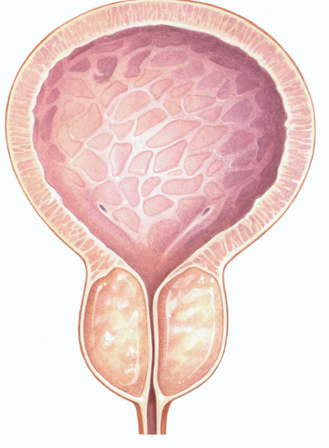
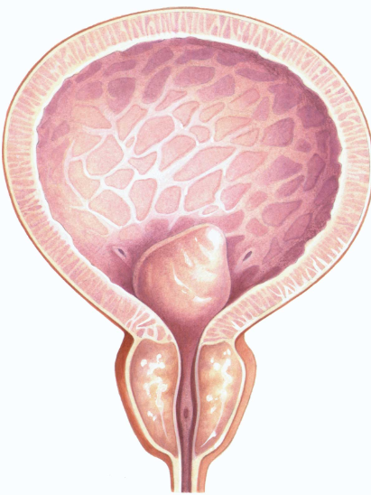
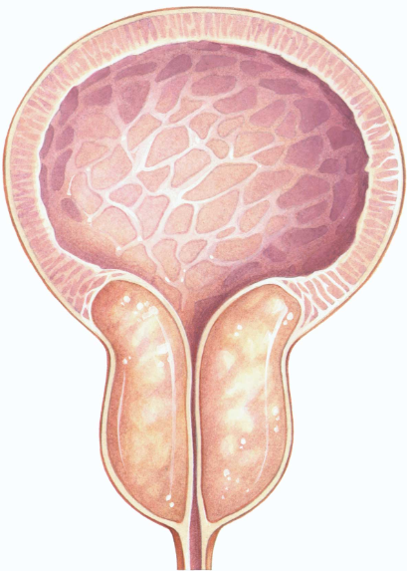
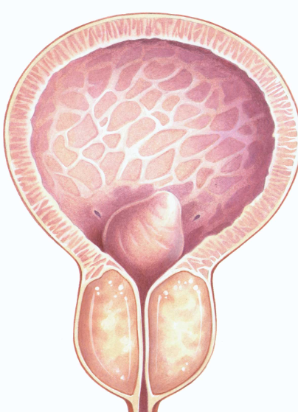

Slide 20
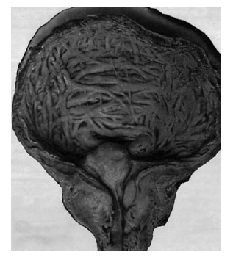
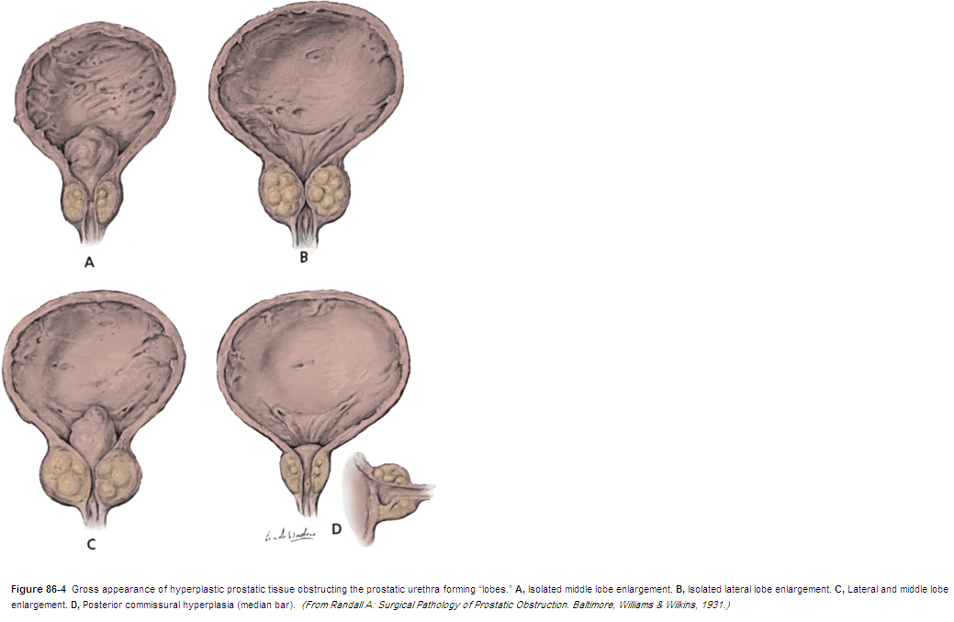
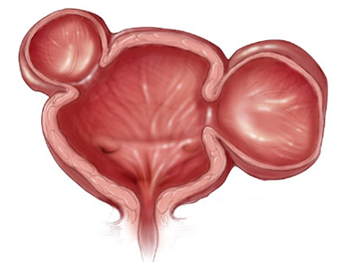

Slide 21
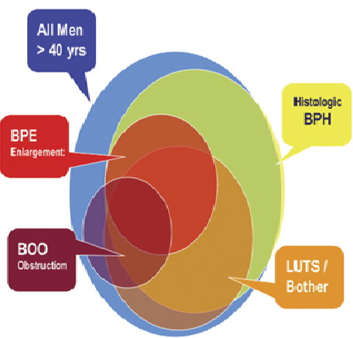
BPH: Is a histologic diagnosis & doesn’t necessarily implies prostatic enlargement (BPE)or presence of symptoms.
BPE
Bladder outlet obstruction(BOOorBOFO)
Lower urinary tract symptoms( LUTS) indicate all lower urinary tract symptoms that results from either outlet obstruction or bladder dysfunction & response of the bladder to a pathology in the prostate or urethra.

Slide 22
Symptomatology
Slowly progressive over years,
worsening at winter time.
LUTS: irritative and obstructive.
Urinary retention: inability to pass urine in spite of full bladder (Acute & chronic)
Recurrent UTI
Renal failure due to back pressure effect on the kidneys.
Hematuria.
Pain is not a symptom of BOO: its presence should prompt the exclusion of acute retention, urinary infection, stones.
N.B.: The size of the prostate has no relation to the severity of the symptom but the degree of urethral compression.

Slide 23
Causes of frequency in BPH
Bladder irritation by enlarged prostate.
Residual urine.
Vesical stone.
Cystitis.
Vesical diverticulum.
Chronic retention and overflow incontinence.

Slide 24
Precipitating causes for acute retention
Constipation.
Anticholinergics, antihistaminics & diuretic medication (sudden bladder over distention).
Ignoring first desire for urination.
Cold exposure.
Severe pain: MI, joint pain, pelvic or perineal pain.
Psychological upset.

Slide 25
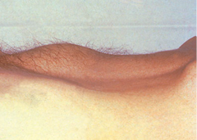
Clinical Exam.
Usually normal.
Distended bladder.
A digital rectal examination (DRE) and a focused neurologic examination should usually be performed
Digital rectal examination (DRE): enlarged prostate, painless, smooth surface, regular, firm consistency, maintained median sulcus, and mobile rectal mucosa over the prostate.

Slide 26
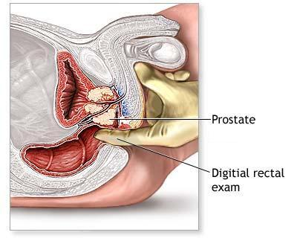

Slide 27
Investigations:
Laboratory
GUE: to rule out UTI and hematuria
RFT: Urea, Creatinine measurement
Serum PSA: (prostate specific Ag) normal value up to 4.0 ng/mL

Slide 28
Radiological
U/S: abdominal (conventional) & transrectal(TRUS): Prostatic enlargement, vesical stone, post void residual urine and hydronephrosis.
IVU: elevation of bladder base, irregular bladder out line, bladder diverticulum, fish hook lower ureter, vesical stones and residual urine.
Cystoscopy: enlarged prostate, vesical trabeculation & stones.
Urodynamic studies: uroflowmetry
cystometry

Slide 29
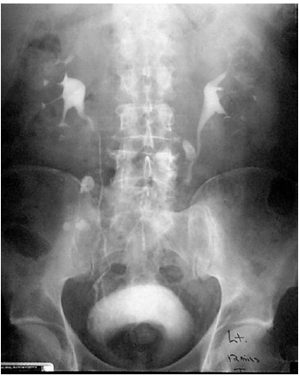

Slide 30
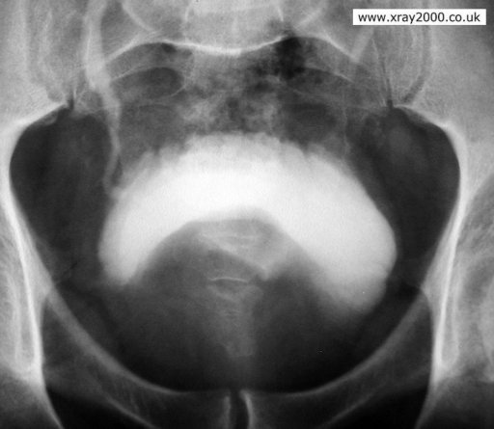
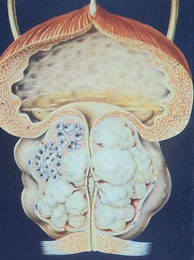
Benign prostatic hyperplasia

Slide 31
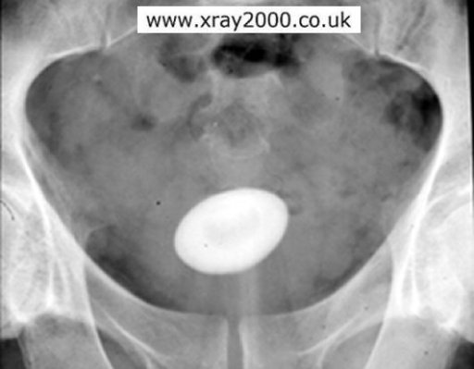
Vesical stone
Vesical Stone

Slide 32
Complications of BPH
Recurrent urinary tract infections.
Bladder stones.
Recurrent hematuria.
Hydroureteronephrosis & renal impairment.
Refractory urine retention (failing at least one attempt at catheter removal).

Slide 33
Treatment:
Watchful Waiting (conservative)
Medical therapy
Surgical Therapy

Slide 34
Conservative:
Indications: mild symptom, reasonable flow rates, and good bladder emptying
Waiting for a period of 6 months
Avoid precipitating factors:
Treat pains.
Treat UTI.
Avoid constipation
Avoid rapid overfilling of the bladder (diuretics)
Avoid anticholinergics & antihistamines.
Do not postpone micturition
Avoid cold exposure

Slide 35
Medical therapy
α-Adrenergic blocking agents: work quickly eg.: prazocin, terrazocin, doxazocin , alfuzocin, tamsulosin
S/E : hypotension, retrograde ejaculation,1st dose syncope.
5 α- reductase inhibitors: inhibit the conversion of testosterone to DHT (the most active form of androgen). eg.: Fenasteride, Dutasteride
Need to be taken for at least 6 months, and their effect is greatest in patients with large (> 40 g) glands.
S/E: Impotence.
Phytotherapy: eg. Pumpkin seeds

Slide 36
Surgical (Operative) treatment
Absolute indications for surgical intervention:
Refractory urinary retention.
Recurrent UTIs.
Renal insufficiency.
Bladder calculi &\or large bladder diverticula.
Recurrent gross hematuria.

Slide 37
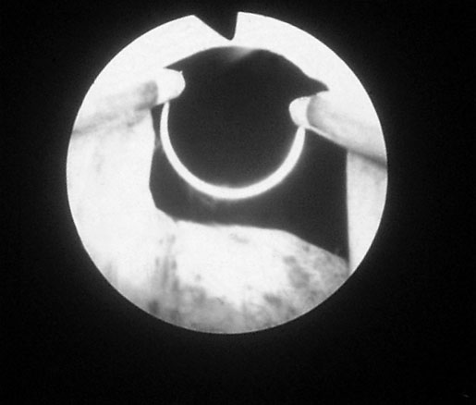
Surgical treatment includes:
Endoscopic: -TURP (Transurethral Resection of the Prostate ), constitutes 95% of simple prostatectomies
-TUIP (Transurethral Incision of the Prostate)
Open simple prostatectomy:
- Transvesical prostatectomy. - Rertopubic prostatectomy.
- Perineal prostatectomy.

Slide 38
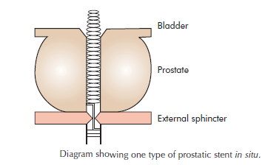
Minimally Invasive Therapy
TULIP: Transurethral laser-induced prostatectomy
Transurethral Electrovaporization of the Prostate
TUNA: Transurethral Needle Ablation of the Prostate through Interstitial radiofrequency needles
TUMT: trans urethral microwave thermotherapy delivered with a transurethral catheter
HIFU ( high intensity focused u/s)
Urethral stents
Transurethral balloon dilatation of the prostate

Slide 39
Post operative Complications
Early:
Late:
Bleeding and clot retention.
TURP syndrome (water intoxication). Dilutional hyponatremia.
Infection: wound infection. Cystitis, prostatic bed, pyelonephritis, Sepsis
Urethral stricture & bladder neck contracture.
Retrograde ejaculation.
Urinary incontinence.
Impotence.
Recurrence of BPH in 15% after 5-10 years.

Slide 40
TURP syndrome
Etiology: absorption of water into the circulation at the time of TURP
Causing: congestive cardiac failure, hyponatraemia and haemolysis, confusion, convulsion, sudden death.
Treatment: diuretics & normal saline.

