Slide 1
Principles of Tooth Preparation
Dr. Huda Yaser

Slide 2
PURPOSE OF TOOTH PREPARATION
Preventing and Treating Caries
Replacing Restorations
Treatment of Malformed, Fractured and Traumatized Teeth
Aesthetic Improvement
For Restoration of Loss of Tooth Material

Slide 3
TERMINOLOGY OF TOOTH PREPARATION
Definition
Tooth preparation is the mechanical alteration of a defective, injured, or diseased tooth to receive a restorative material that reestablishes a healthy state for the tooth, including esthetic corrections where indicated and normal form and function.
Notes:
It is a mechanical alteration of a defective, injured or diseased tooth in order to best receive a restorative material which will reestablish the healthy state of the tooth including aesthetics correction when indicated along with normal form and function

Slide 4
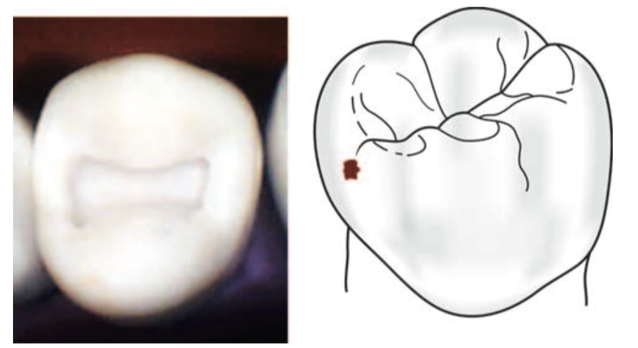
Simple, Compound and Complex Tooth Preparation
Simple Tooth Preparation
A tooth preparation involving only one tooth surface is termed simple preparation

Slide 5
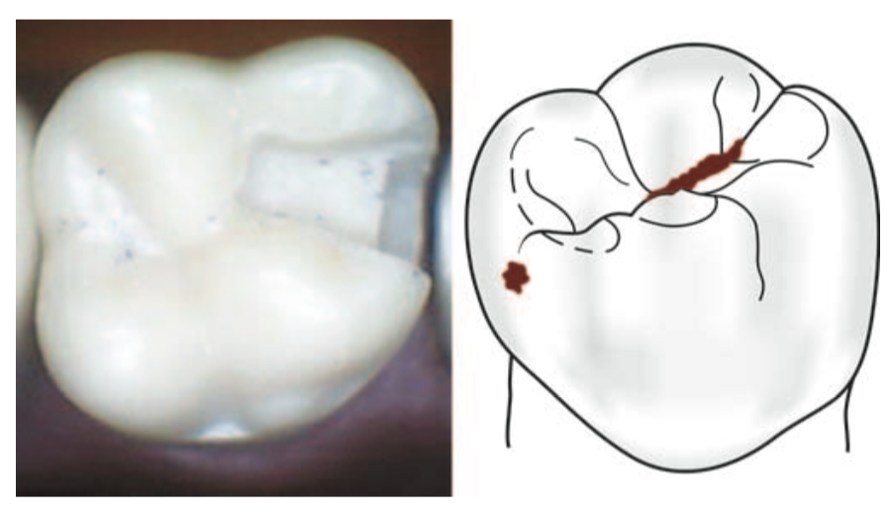
Compound Tooth Preparation
A tooth preparation involving two surfaces is termed compound tooth preparation

Slide 6
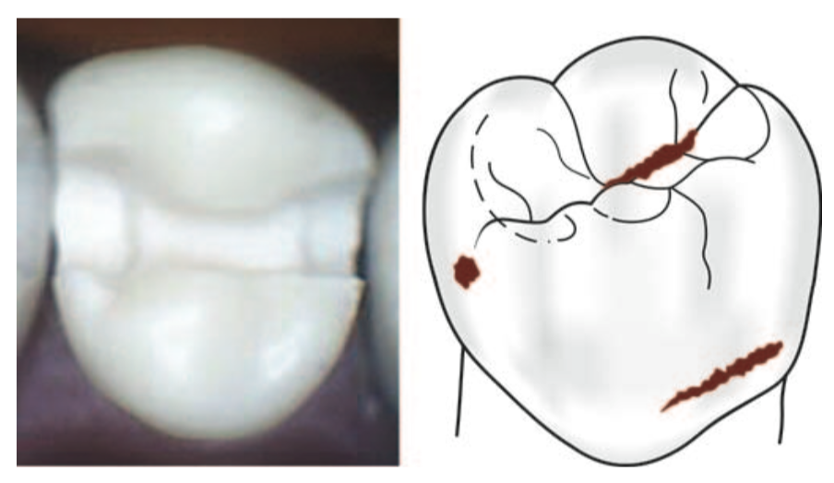
^{Complex Tooth Preparation}
A tooth preparation involving more than two surfaces is called as complex tooth preparation

Slide 7
Tooth Preparation Walls
Internal Wall
External Wall
Pulpal Wall
Axial wall
Floor

Slide 8
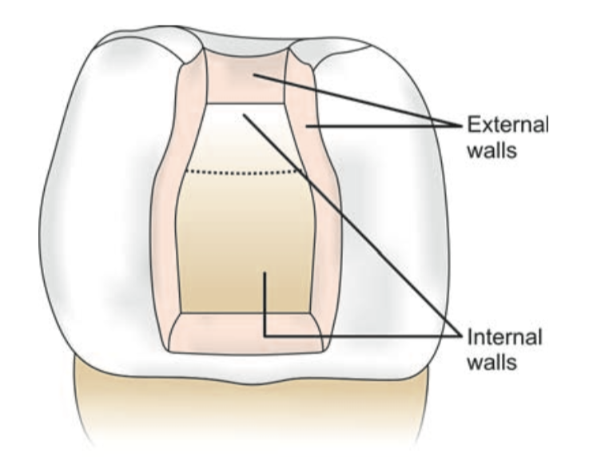
Internal Wall
It is a wall in the preparation, which is not extended to the external tooth surface

Slide 9
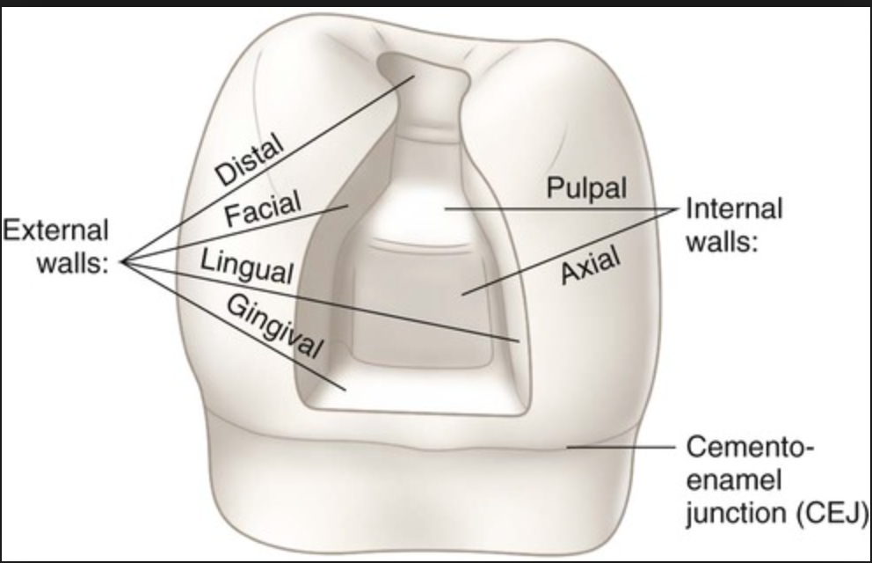
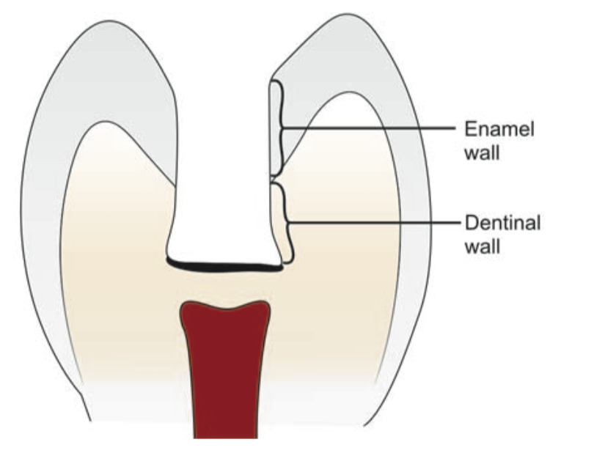
An external wall
Is a wall in the prepared tooth surface that extends to the external tooth surface. External wall takes the name of the tooth surface towards which it is situated.
eg; Buccal, lingual, mesial, distal

Slide 10
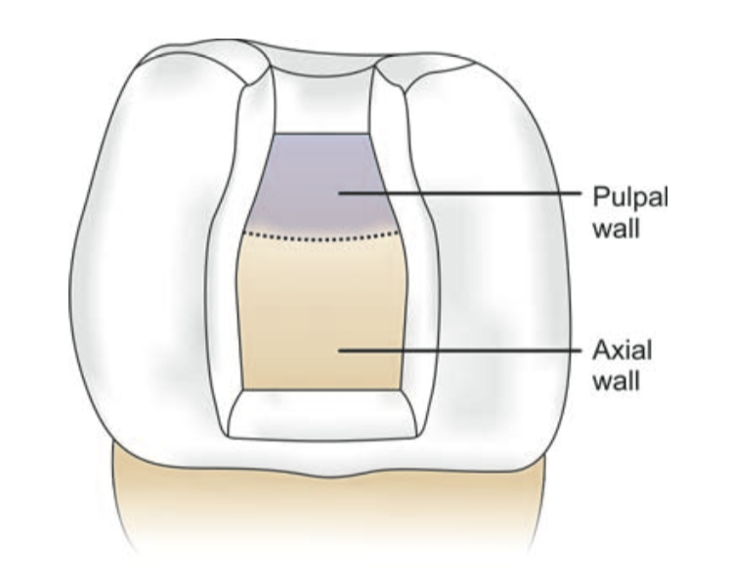
Pulpal Wall
A pulpal wall is an internal wall that is towards the pulp and covering the pulp. It may be both vertical and perpendicular to the long axis of tooth.

Slide 11
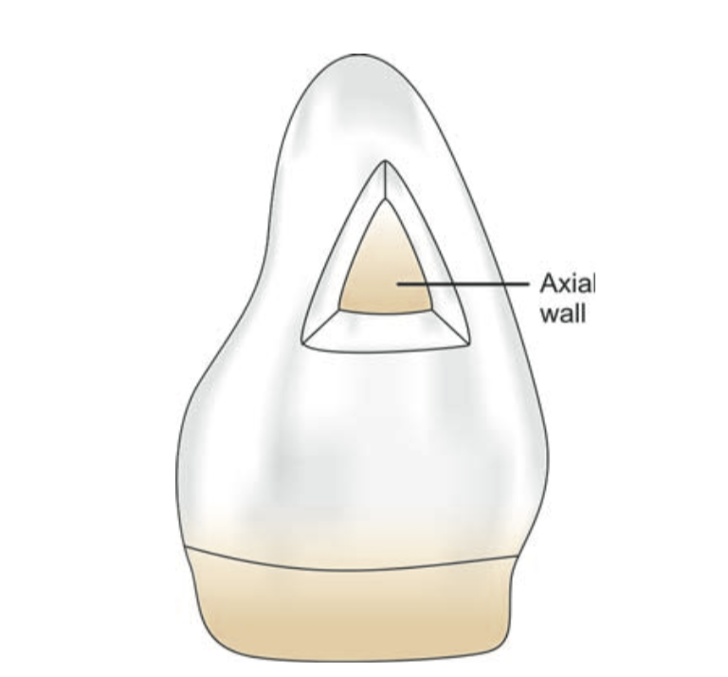
Axial Wall
It is an internal wall which is parallel to the long axis of the tooth

Slide 12
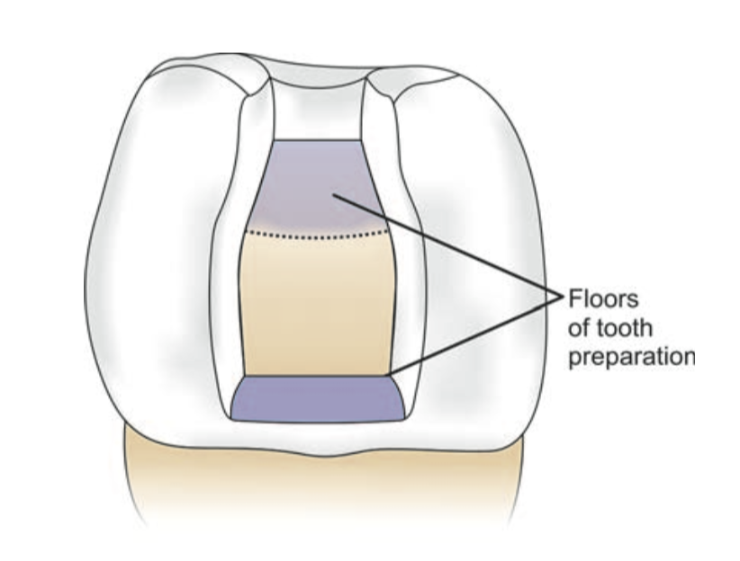
Floor
Floor is a prepared wall which is usually flat and perpendicular to the occlusal forces directed occluso-gingivally, for example, pulpal and gingival walls

Slide 13
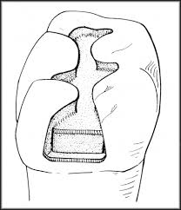
Distal
Lingual
Buccal

Slide 14
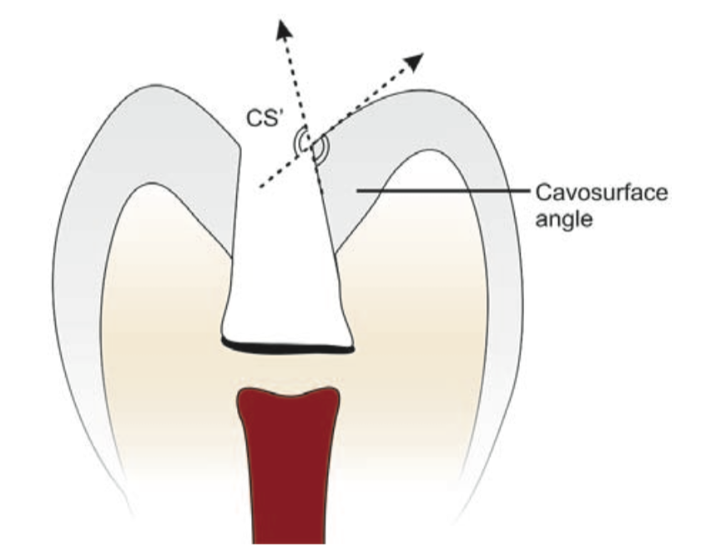
Cavosurface Angle Margin/Tooth Preparation Margin
Cavosurface angle is formed by the junction of a prepared tooth surface wall and external surface of the tooth

Slide 15
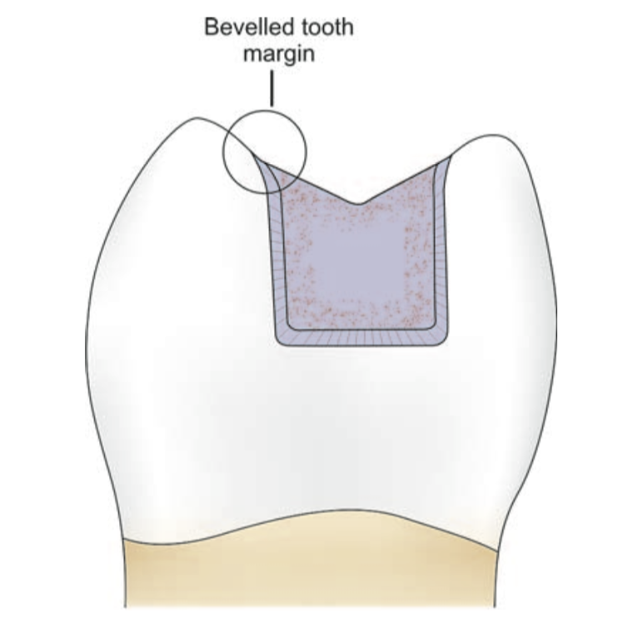
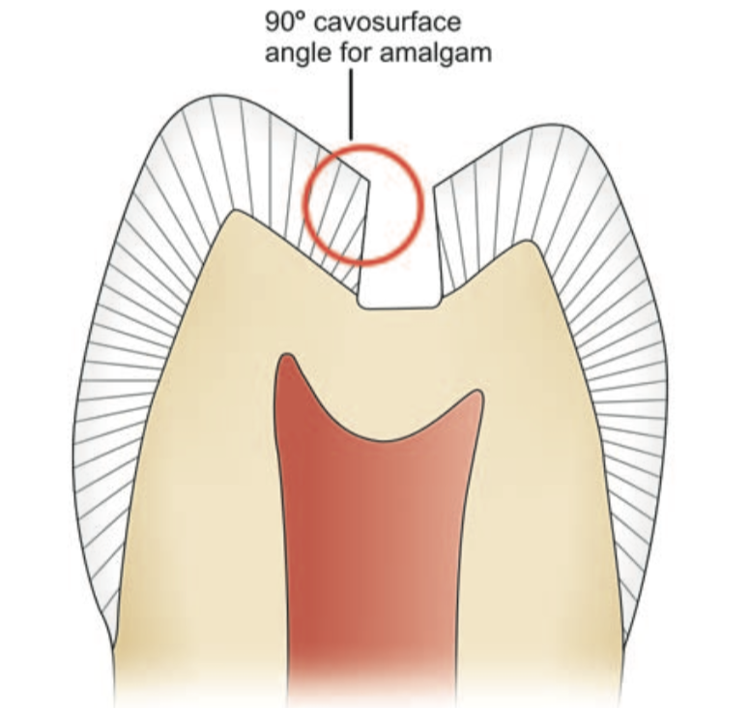
The acute junction is referred to as preparation margin or cavosurface margin. The cavosurface angle may differ with the location of tooth and enamel rod direction of the prepared walls and also differ according to the type of restorative material to be used

Slide 16
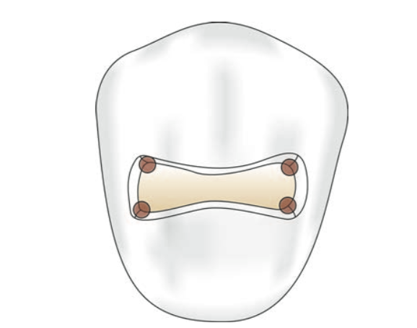
Line Angle
It is a junction of two surfaces of different orientations along the line and its name is derived from the involved surfaces.
1
2

Slide 17
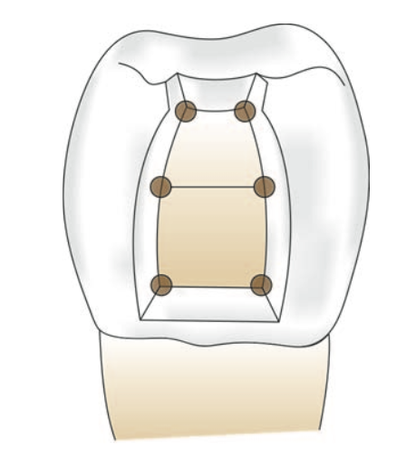
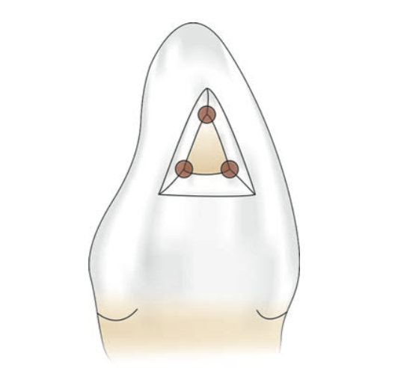
Point Angle
It is a junction of three plane surfaces or three line angles of different orientation and its name is derived from its involved surfaces or line angles.
1
3
2

Slide 19
Distal
Lingual
Buccal

Slide 20
TOOTH PREPARATION
Black gave following guidelines for tooth preparation:
Providing definite mechanical retention in the preparation.
Extension of preparation in adjacent pits and fissures for prevention of recurrent caries.
Removal of infected and affected dentin from all surfaces.
Removal of even healthy tooth structure to gain access and good visibility

Slide 21
When Black gave classification, following conditions and considerations were prevalent at that time:
Poor oral hygiene habits
Poor properties of the existing restorative materials
The expected longer life of the restoration
Hard and fibrous food
More liking towards gold and silver fillings in teeth

Slide 22
Nowadays because of change in following conditions, design of the tooth preparation has become most conservative
Use of preventive measures like fluoridation of water supply, fluoride toothpaste, topical fluoride applications, proper brushing and flossing, etc.
Understanding of the fact that the remineralization of enamel and affected dentin can take place
Advances in tooth colored, adhesive, fluoride releasing restorative materials
Newer advancements in restorative materials.
Improvements in diagnostic aids.
Better oral hygiene maintenance.
Mechanical retention forms further improve the retention.
Notes:
Use of preventive measures like fluoridation of water
supply, fluoride toothpaste, topical fluoride
applications, proper brushing and flossing, etc.
Understandingofthefactthattheremineralizationof
enamel and affected dentin can take place
Advancesintoothcolored,adhesive,fluoridereleasing
restorative materials
Neweradvancementsinrestorativematerials.
Improvementsindiagnosticaids.
Betteroralhygienemaintenance.
Mechanical retention forms further improve the
retention.

Slide 23
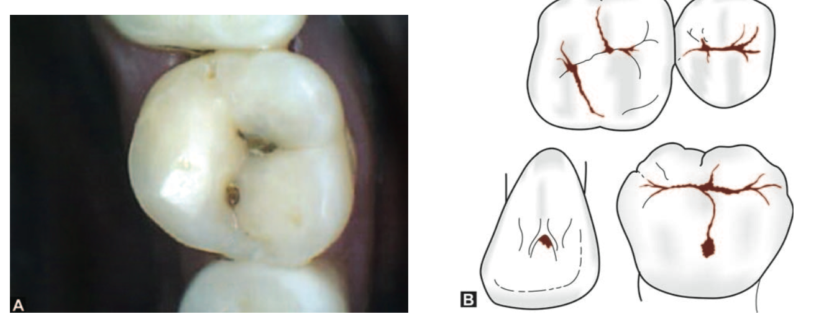
Classification of Tooth Preparations
Class I–Pit and fissure preparations
occur on the occlusal surfaces of premolars and molars, the occlusal two-third of buccal and lingual surface of molars, lingual surface of incisors and any other abnormal position

Slide 24
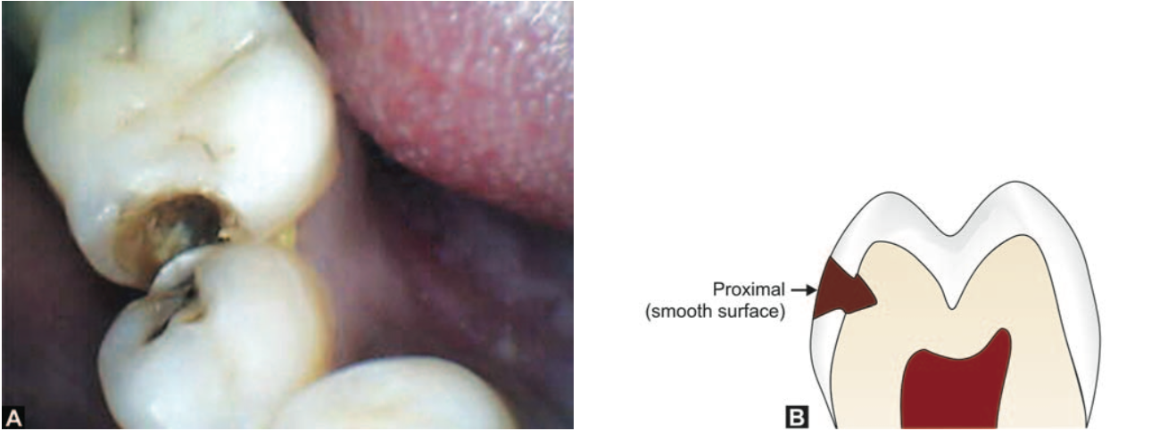
Class II
Preparations on the proximal surface of premolars and molars are class II

Slide 25
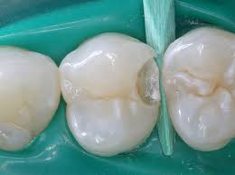
Modification of Black’s classification was made to provide more specific localization of preparations.

Slide 26
MOD
Class II–Preparations on the single or both proximal surface of premolar and molar teeth. When there is involvement of both proximal surfaces, it is called mesio- occluso-distal (MOD) preparation

Slide 27
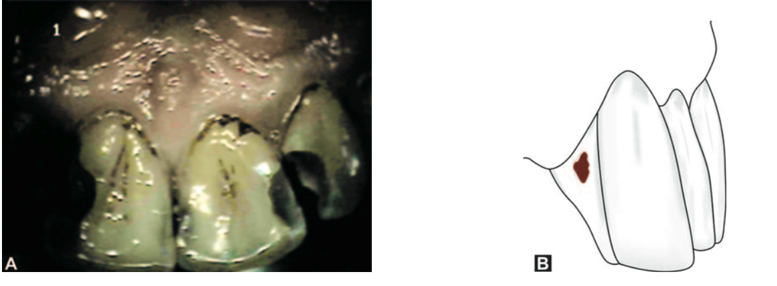
Class III
Preparations on the proximal surface of anterior teeth and not involving the incisal angles are class III

Slide 28
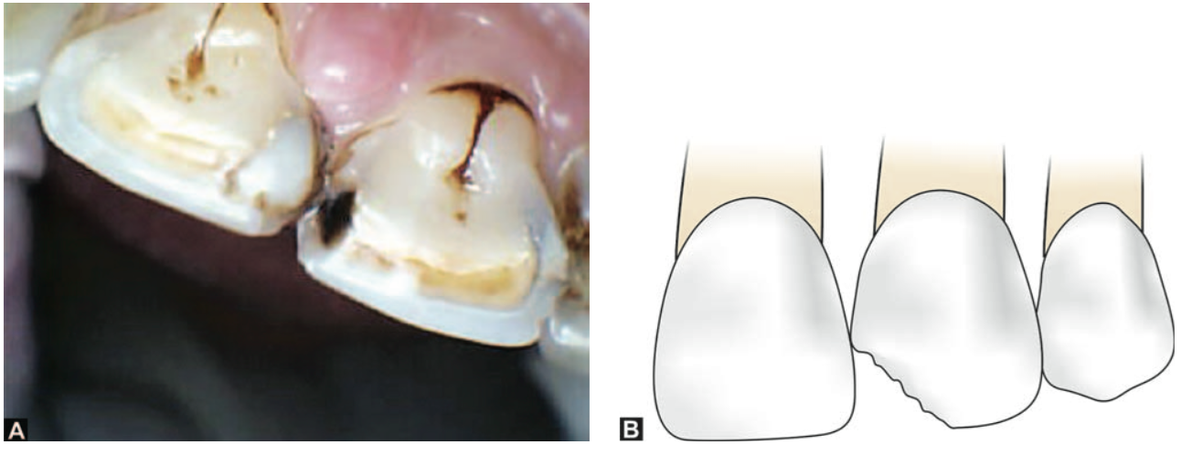
Class IV
Preparations on the proximal surface of anterior teeth also involving the incisal angle come under class IV

Slide 29
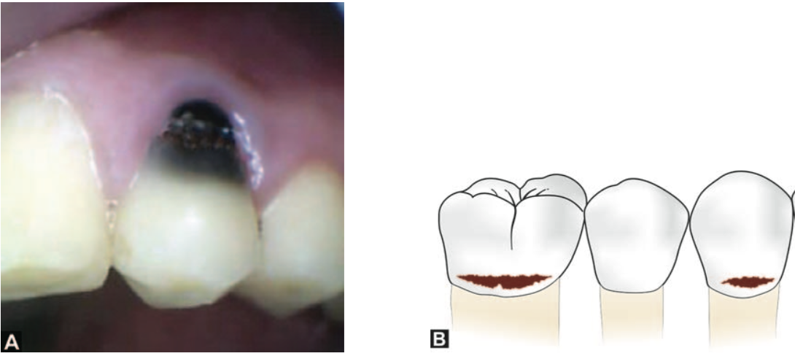
Class V
Preparations on gingival third of facial and lingual or palatal surfaces of all teeth came under Class V

Slide 30
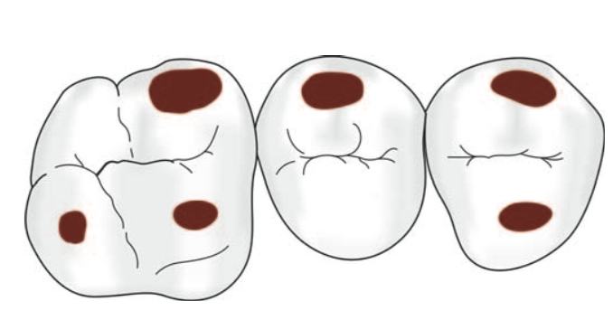
Class VI
Preparations on incisal edges of anterior and cusp tips of posterior teeth without involving any other surface

Slide 31
STEPS IN TOOTH PREPARATION
Tooth preparation is divided into two stages, each consisting of many steps. Though each step should be done to perfection, but sometimes modifications can be made in steps.

Slide 32
Stage I
Initial tooth preparation steps
Outline form and initial depth.
Primary resistance form.
Primary retention form.
Convenience form.
B. Stage II Final tooth preparation steps
Removal of any remaining enamel pit or fissure, infected dentin and/or old restorative material, if indicated.
Pulp protection, if indicated.
Secondary resistance and retention form.
Procedures for finishing the external walls of the tooth preparation.
Final procedures: cleaning, inspecting and sealing.
Under special conditions these sequences are changed.

Slide 33
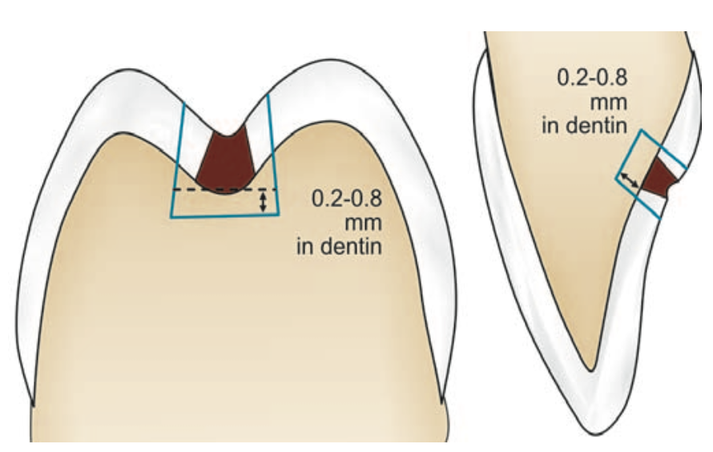
Initial Tooth Preparation
Outline Form and Initial Depth
Outline form defines the external boundaries of the preparations.
Maintaining the initial depth of 0.2 to 0.8mm in to the dentin.

Slide 35
Black’s Extension For Prevention Principles
Extension for prevention means the placing the margins of preparations at areas that would be cleaned by the excursions of food during chewing.
It is done with the objective of preventing the recurrence of caries at the margins of fillings where the recurrence of decay is most commonly seen.
His concept also included extending preparations through enamel fissures to allow cavosurface margins to be placed on nonfissured enamel.

Slide 37
2.Primary Resistance Form
Is that shape and placement of preparation walls to best enables both the tooth and restoration to withstand, without fracture the stresses of masticatory forces delivered principally along long axis of the tooth

Slide 39
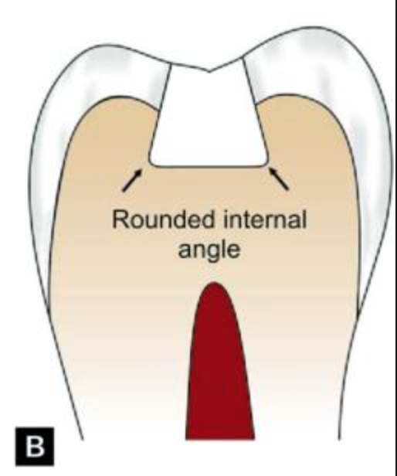
Rounding of internal line angle to reduce the stress concentration points in tooth preparation

Slide 40
3.Primary retention form.
is that form, shape and configuration of the tooth preparation that resists the displacement or removal of restoration from the preparation under lifting and tipping masticatory forces.

Slide 41
The retention form is affected by the type of the restorative material used.

Slide 42
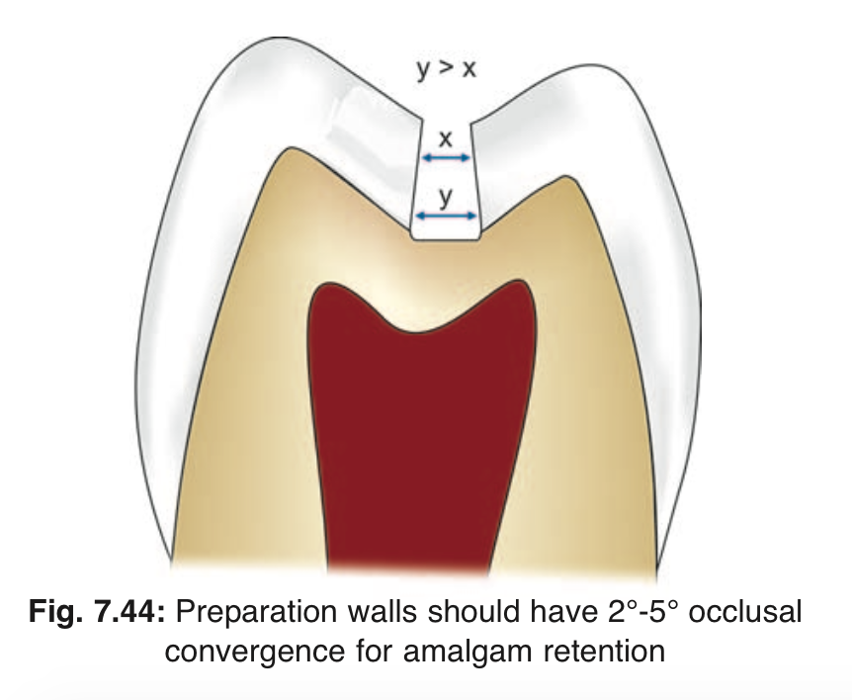
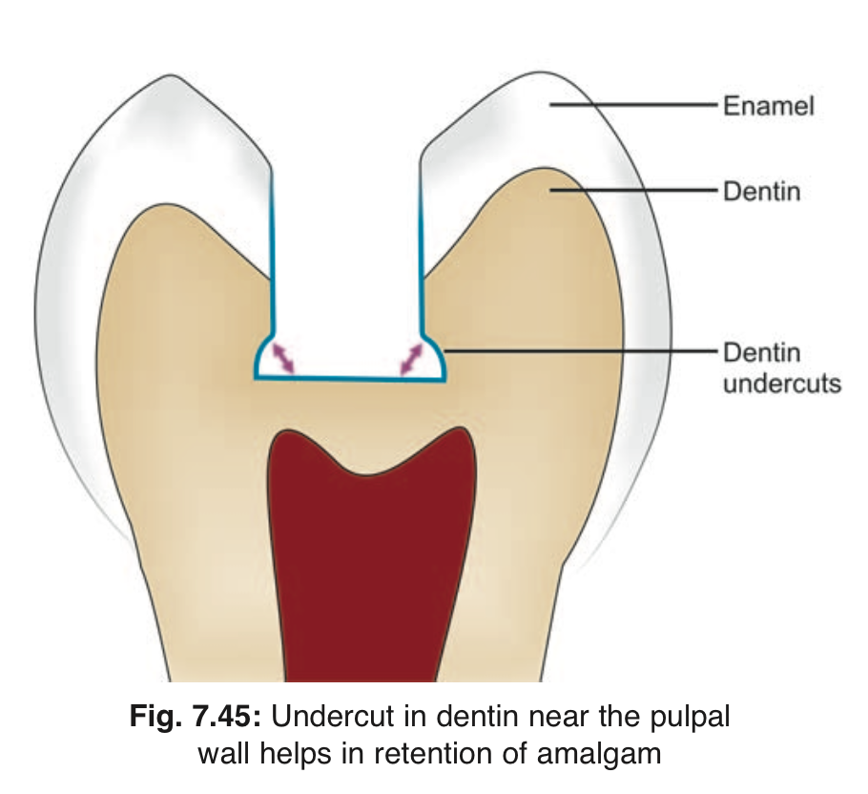
Amalgam:
Retention is increased by the following:
Providing occlusal convergence (about 2 to 5%)the dentinal walls towards the tooth surface .
Giving slight undercut in dentin near the pulpal wall

Slide 43
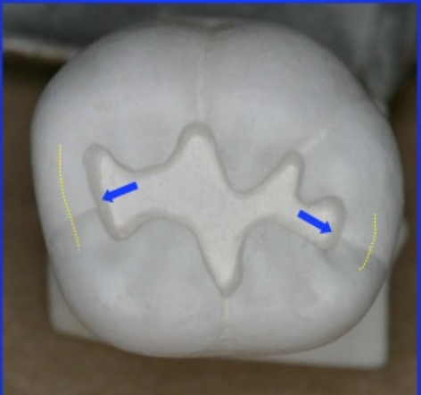
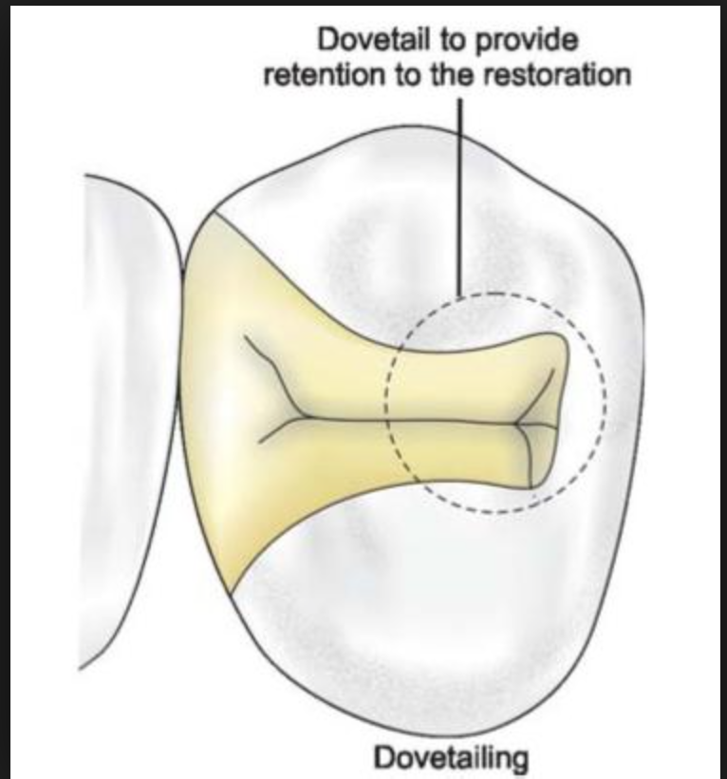
Conserving the marginal ridges.
Providing occlusal dovetail

Slide 44
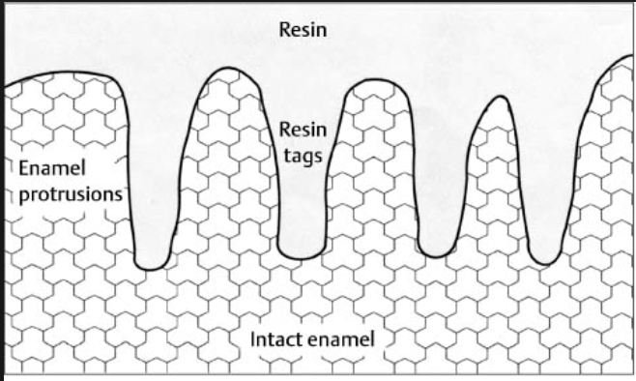
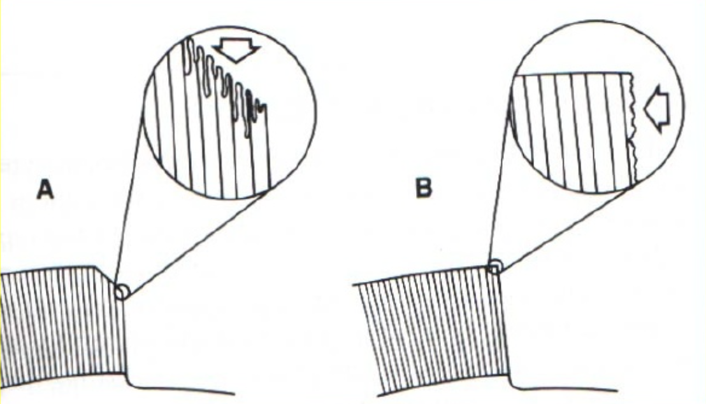
Composites:
Retention is increased by:
Micromechanical bonding between the etched and primed prepared tooth structure and the composite resin.
Providing enamel bevels

Slide 45
4.Convenience form.
The convenience form is that form which facilitates and provides adequate visibility, accessibility and ease of operation during preparation and restoration of the tooth.

Slide 49
B. Stage II Final tooth preparation steps
Removal of any remaining enamel pit or fissure, infected dentin and/or old restorative material, if indicated.
Pulp protection, if indicated.
Secondary resistance and retention form.
Procedures for finishing the external walls of the tooth preparation.
Final procedures: cleaning, inspecting and sealing.
Under special conditions these sequences are changed.

Slide 50
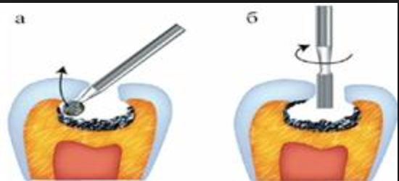
Remove any undermined enamel, all enamel should be supported by dentin

Slide 51
Any Questions??
Thank You….

