Slide 1
Leprosy
Dr ghazi F.Haji
Cardiologist

Slide 2
Agenda
Introduction
Epidemiology
Immunology
Classification of leprosy
Signs &symptoms
Laboratory Studies
Treatment
Prognosis

Slide 3
Introduction
Leprosy is a chronic infection caused by the acid-fast, rod-shaped bacillus Mycobacterium leprae.
Leprosy can be primarily affect superficial tissues, especially the skin and peripheral nerves.
A mycobacterial infection causes a wide array of cellular immune responses.
The social and psychological effects of leprosy, as well as its highly visible debilities and sequelae have resulted in a historical stigma associated with leprosy
Exposure: The incubation period of leprosy is long, ranging from a few months to 20-50 years.

Slide 4
Epidemiology
Leprosy is rarely fatal, no racial predilection is known. Leprosy is generally more common in males than in females, Leprosy can occur at any age
Worldwide, leprosy is considered the most common cause of crippling of the hand, foot
Nerve involvement results in loss of sensory and motor function(peripheral neuropathy ), which may lead to frequent trauma and amputation.
Travel: Leprosy should be considered in anyone who has lived in the tropics or who has traveled for prolonged periods to endemic areas

Slide 5
clawing, contracture

Slide 6
Immunology Leprosy can manifest in different forms, depending on the host response to the Individuals
1-who have a vigorous cellular immune response to M leprae have the tuberculoid form of the disease that usually involves the skin and peripheral nerves.
The number of skin lesions is limited, and they tend to be dry and hypoesthetic. Nerve involvement is usually asymmetric. as paucibacillary leprosy because of the low number of bacteria in the skin lesions (ie, < 5 skin lesions, with absence of organisms on smear). Results of skin tests with antigen from killed organisms are positive in these individuals.
2-Individuals with minimal cellular immune response have the lepromatous form of the disease, which is characterized by extensive skin involvement. Skin lesions are often described as infiltrated nodules and plaques, and nerve involvement tends to be symmetric in distribution. The organism grows best at 27-30°C; therefore, skin lesions tend to develop in the cooler areas of the body, with sparing of the groin, axilla, and scalp. as multibacillary leprosy because of the large number of bacteria found in the lesions (ie, >6 lesions, with possible visualization of bacilli on smear). Results of skin tests with antigen from killed organisms are nonreactive.
3-Patients may also present with features of both categories; however, over time, they usually evolve to one or the other (indeterminate or borderline leprosy).

Slide 7
Classification of leprosy
2 classification schemas:.
1-Ridley-Jopling: Depending on the host response to the organism, leprosy can manifest clinically along a spectrum bounded by the tuberculoid and lepromatous forms of the disease. Most patients fall into the intermediate classifications, which include borderline tuberculoid leprosy, and borderline lepromatous leprosy..
2-WHO system:according to the number of lesions and the presence of bacilli on a skin smear. This method is useful in countries where biopsy analysis in unavailable.
Paucibacillary leprosy is characterized by 5 or fewer lesions with absence of organisms on smear. Paucibacillary leprosy generally includes the tuberculoid and borderline lepromatous categories from the Ridley-Jopling system.
Multibacillary leprosy is marked by 6 or more lesions with possible visualization of bacilli on smear.
Lepromatous leprosy, borderline lepromatous leprosy, and midborderline leprosy on the Ridley-Jopling scale are included in the multibacillary leprosy category.

Slide 8
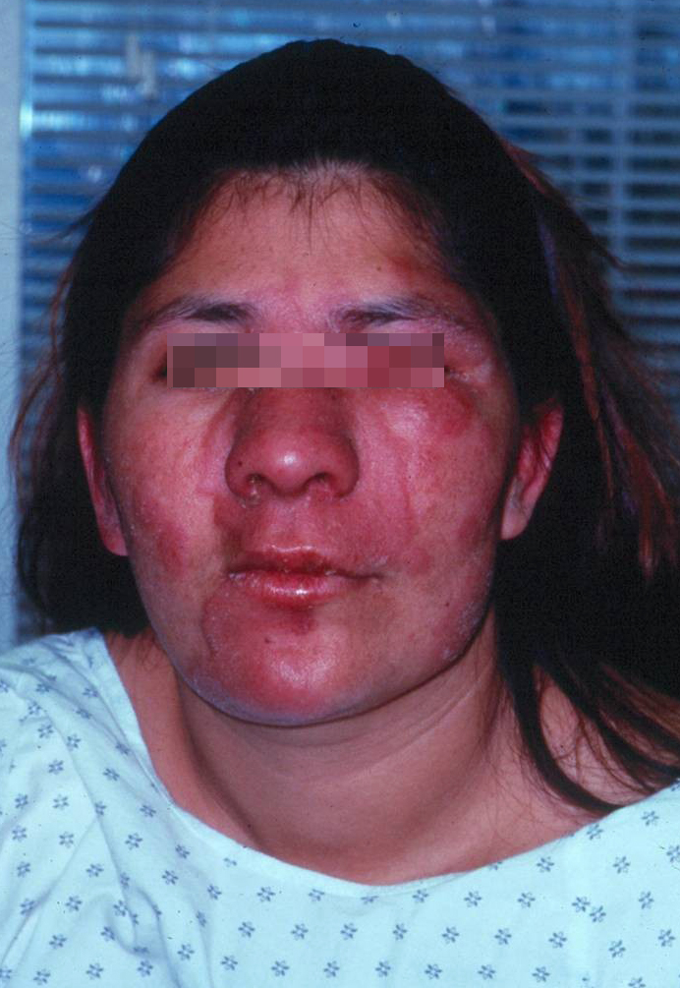
SYMPTOMS
Painless skin patch accompanied by loss of sensation but not itchiness (Loss of sensation is a feature of tuberculoid leprosy, unlike lepromatous leprosy, in which sensation is preserved.)
Wasting and muscle weakness.
Foot drop or clawed hands
; Ulcerations on hands or feet
iridocyclitis, corneal ulceration,
and/or secondary cataract
:Symptoms in reactions
Type 1 (reversal) - Sudden onset of
skin redness and new lesions
Type 2 (erythema nodosum leprosum
.

Slide 9
Patient with facial nerve palsy and contractures of the hand

Slide 10
Chronic insensate patch due to leprosy infection

Slide 11
Characteristic clawed hand deformity caused by ulnar involvement in leprosy

Slide 12
Chronic nonhealing ulcer at the metatarsal head resulting from loss of sensation in the feet

Slide 13
Multiple flat hypopigmented lesions on shoulder and neck, suggestive of multibacillary leprosy. Note ulceration of hypothenar area of hand, indicative of ulnar neuropathy

Slide 14
Man with advanced deformities caused by unmanaged leprosy. Keratitis, loss of eyebrow, thickened skin, and typical hand impairments

Slide 15
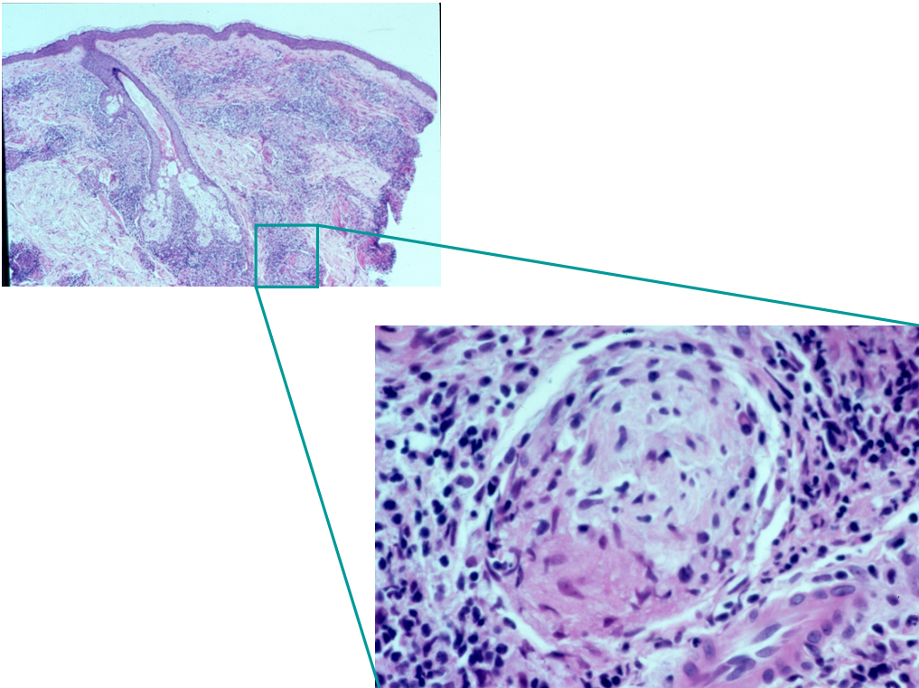
Laboratory Studies
1-Skin smear positive for acid-fast bacilli
2-Laboratory studies include the following:
A-Skin biopsy, nasal smears, or both are used to assess for acid-fast bacilli
B-Serologic assays.
3-Laboratory tests related to drug treatment follow-up include the following:
a-CBC count
b-Creatinine level
c-Liver function tests
#Large numbers of acid-fast bacilli (in clusters) in histiocytes and within nerves. Fite-Faraco stain

Slide 16
Treatment
Type of Leprosy | Daily, Self-Administered | Monthly Supervised | Months of Treatment
Paucibacillary | Dapsone 100 mg | Rifampicin 600 mg | 6-12
Multibacillary | Dapsone 100 mg, Clofazimine 50 mg | Rifampicin 600 mg, Clofazimine 300 mg | 24
Pediatric | Dapsone 2 mg/kg, Clofazimine 1 mg/kg | Rifampicin 10 mg/kg, Clofazimine 6 mg/kg #Corticosteroids have been used to treat nerve damage associated with leprosy, | Same as in adults

Slide 17
Increased pigmentation on the face due to clofazimine therapy

Slide 18
Patient with erythema nodosum leprosum type 2 reaction several weeks after initiation of drug therapy

Slide 19
Prognosis
Recovery from neurologic impairment is limited, but skin lesions generally clear within the first year of therapy. Discoloration and skin damage typically persist.
Physical therapy, reconstructive surgery, nerve and tendon transplants, and surgical release of contractures have all contributed to increasing the functional ability in patients with leprosy.
A common residual deformity is insensitive feet, as seen in persons with diabetes.

Slide 20
THANK YOU FOR ATTENTION

