Slide 1
أطفال \ خامس اسنان
د. حكم م(1)
26\ 4\ 2017
557
Local Anesthesia in Pediatric
Dentistry

Slide 2
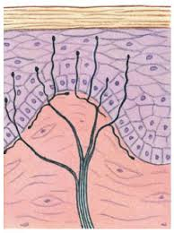
Local Anesthesia:
Transient loss of sensation in a circumscribed area of the body caused by a depression of excitation in nerve endings or an inhibition of the conduction process in peripheral nerves.

Slide 3
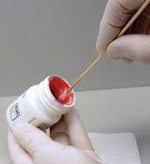
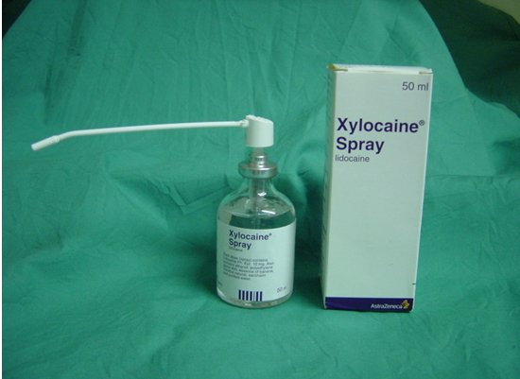
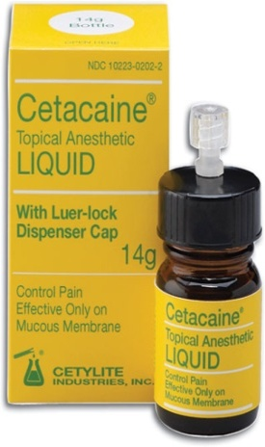
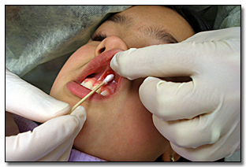
Topical Anesthesia
Available in different forms:
Gel ( most effective type).
Liquid
Spray.
Technique:
The mucosa at the site of the intended needle insertion is dried with gauze.
A small amount of the topical anesthetic agent is applied to the tissue with a cotton swab.
The dentist should prepare the child for the injection ( tell the patient : the tooth is going to sleep so that the treatment can proceed without discomfort).
Give it enough time.

Slide 4
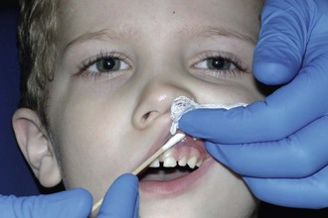
Effective to a depth of 2-3 mm when used properly .
Effective in reducing the discomfort of the initial penetration of the needle into the mucosa.
It’s disadvantages are the taste may be disagreeable to patient and the length of application time may increase apprehension in the pediatric patient.
Not known to produce systemic toxicity in adults but can produce local allergic reactions.
Necessity in topical anesthesia
1- Good tasting
2- low toxicity.
3- Rapid onset.
4- Available in an easy form to control (gel)

Slide 5
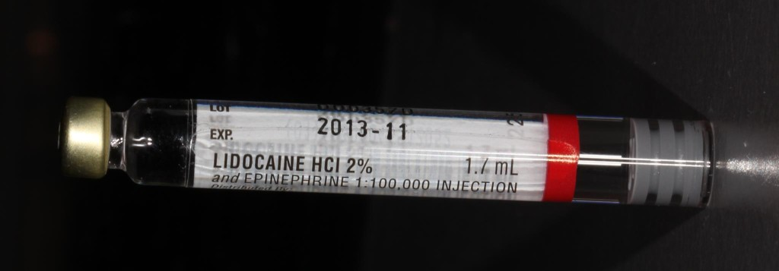
Content of L.A. Solution:
Local anesthetic agent.
Vasoconstrictors.
Reducing agents.
Preservatives.
Fungicide.
Vehicle.

Slide 6
Reducing Agent
Sodium metabisulphite.
Preservative
Methylparaben.
It increases the shelf life of the anesthetic solution.
Acts as a bacteriostatic agent.
Fungicide
Thymol.
Vehicle
Distilled Water to give volume.

Slide 7
Local anesthetic agent
Esters
  Esters of Benzoic Acid
  Cocaine, Butacaine
  Esters of Para Aminobenzoic Acid
  Procaine, Chloroprocaine, propoxycaine
Amides
  lidocaine, articaine, prilocaine

Slide 8
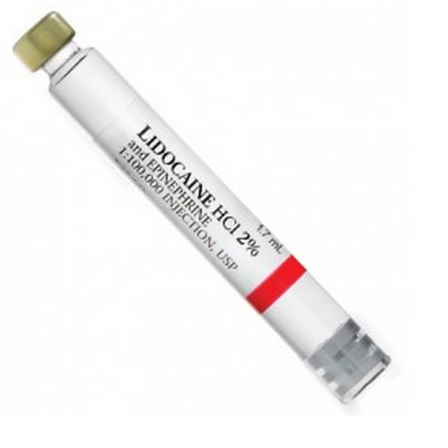
Lidocaine hydrochloride (Xylocain) 2 % is most commonly used local anesthetic agent.
2% mean…….
20mg in 1 ml

Slide 9
Vasoconstrictors
Adrenaline in the concentration of 1:50000 to 1:200000 is commonly used.
1:200000 means….
1 gm in 200000 ml
Function of Vasoconstrictors:
Delays absorption of LA from the site.
Provides blood less field.
Prolongs the action .
Reduces the systemic toxicity.
Contraindication: haypertension

Slide 10
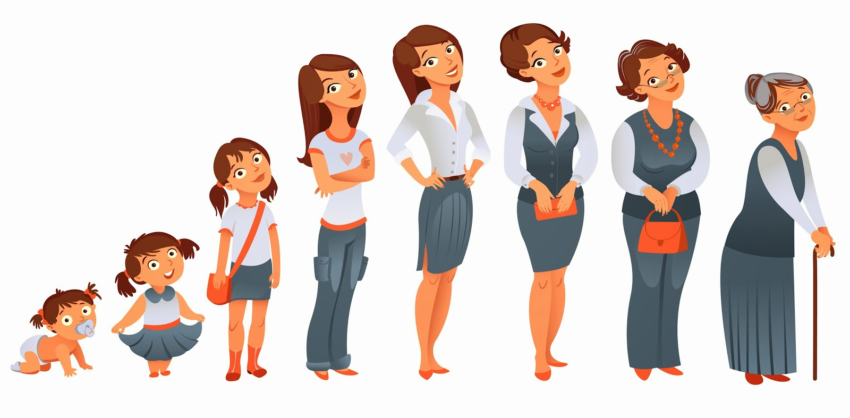
Points to be Kept in Mined Regarding the Difference between Child and Adult Patient:
1.Density and calcification of maxillary and mandibular bone
in general bone is less calcified and less dense in child
2.Anatomic structures.
4.Depth of needle penetration.
5.Emotional aspect.

Slide 11
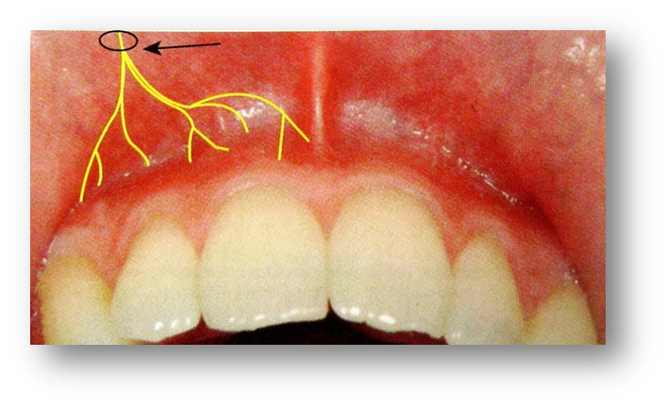
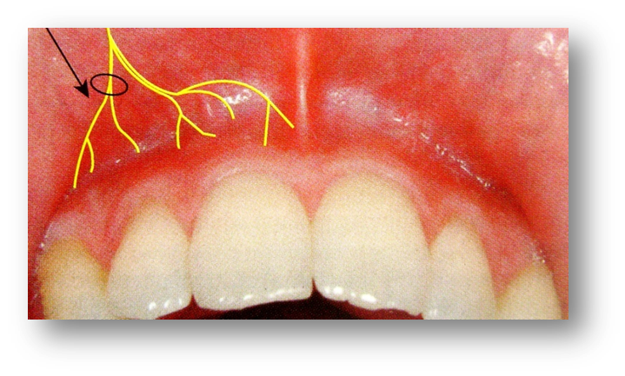
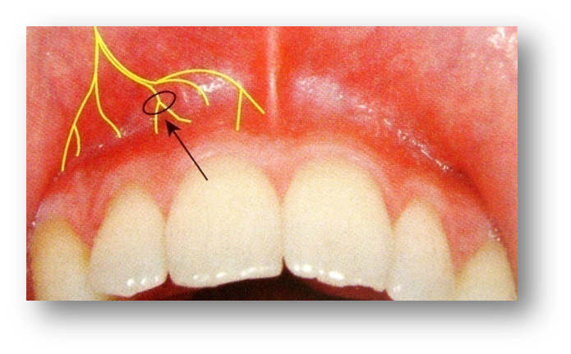
Types of Injection Procedures:
1.Nerve block: depositing the LA solution within close proximity to a main nerve trunk.
2.Field block: depositing in proximity to the larger nerve branches.
3.Local infiltration: small terminal nerve endings are anaesthetized.

Slide 12
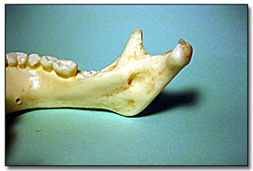
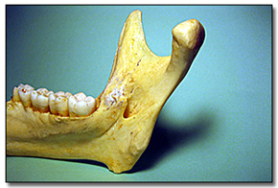
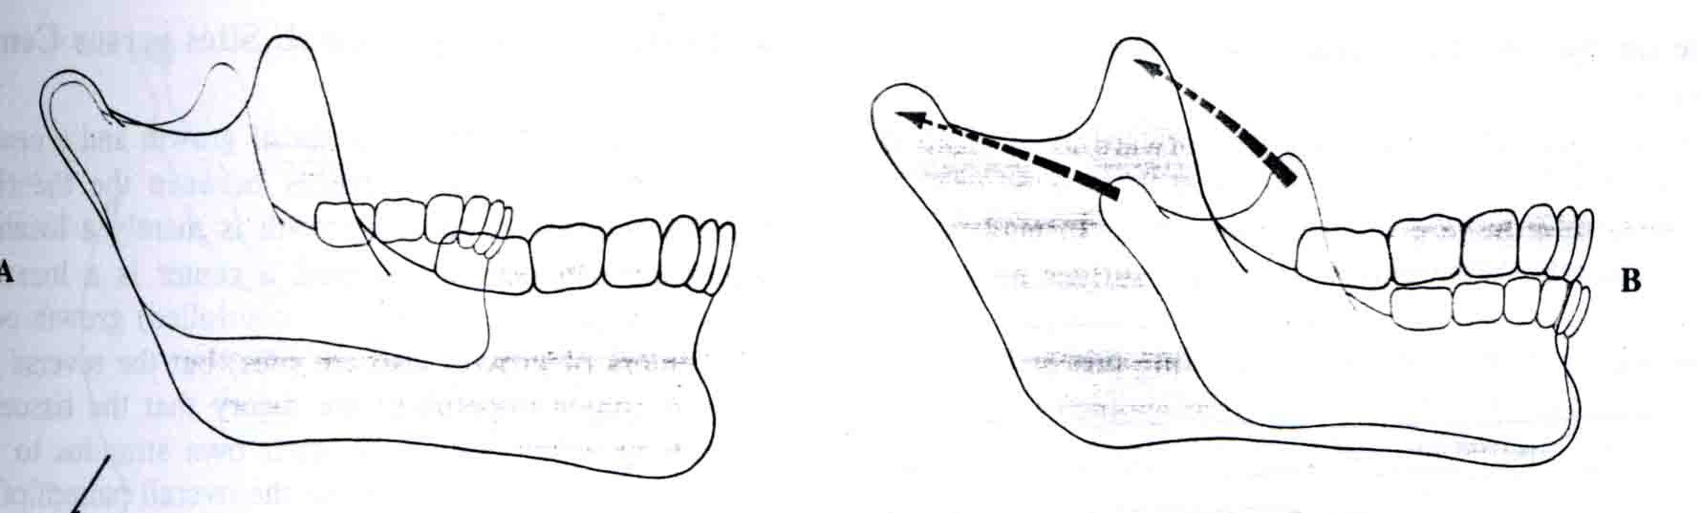
Anesthesia of Mandibular Teeth and Soft Tissue:
Inferior Alveolar Nerve Block + Lingual Nerve Block:
Anatomical Differences
  Ramus is shorter vertically and narrower anteroposteriorly .
  Mandibular foramen is lower than in adult

Slide 13
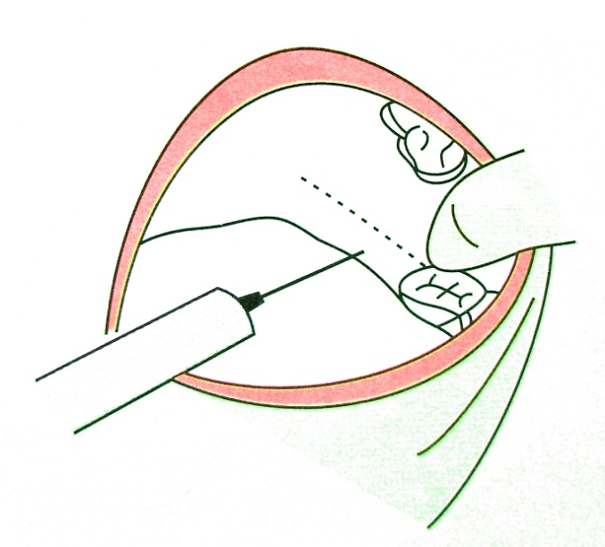
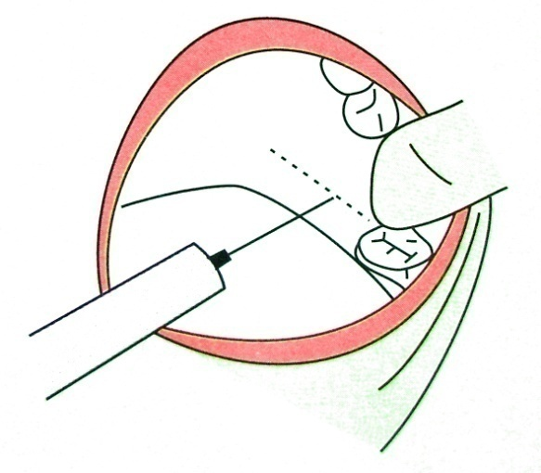
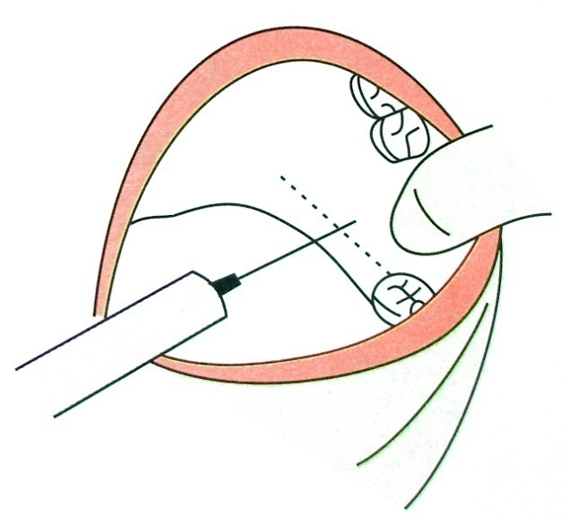
Inferior Alveolar Nerve Block + Lingual Nerve Block:
The mandibular foramen is situated at a level lower than the occlusal plane of the primary teeth of the pediatric patient.
The injection must be made slightly lower and more posteriorly than for an adult patient.
Do not need to penetrate tissue as far as in adult.
BELOW 6 YEARS
6 – 12 YEARS
ABOVE 12 YEARS

Slide 14
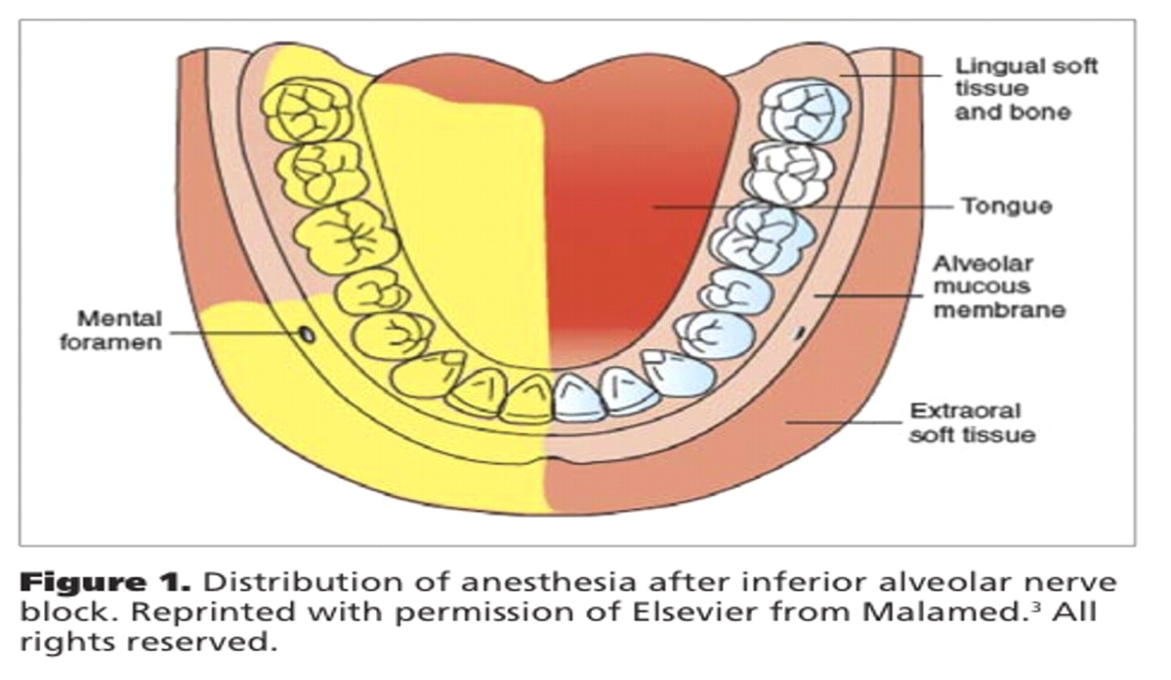
Area anesthetized
Mandibular teeth of the injected side.
Body of the mandible, inferior portion of the ramus.
Buccal mucoperiosteum, mucous membrane anterior to the mandibular 1st molar.
Anterior 2/3rd of tongue and floor of the mouth.
Lingual soft tissue and periosteum.

Slide 15
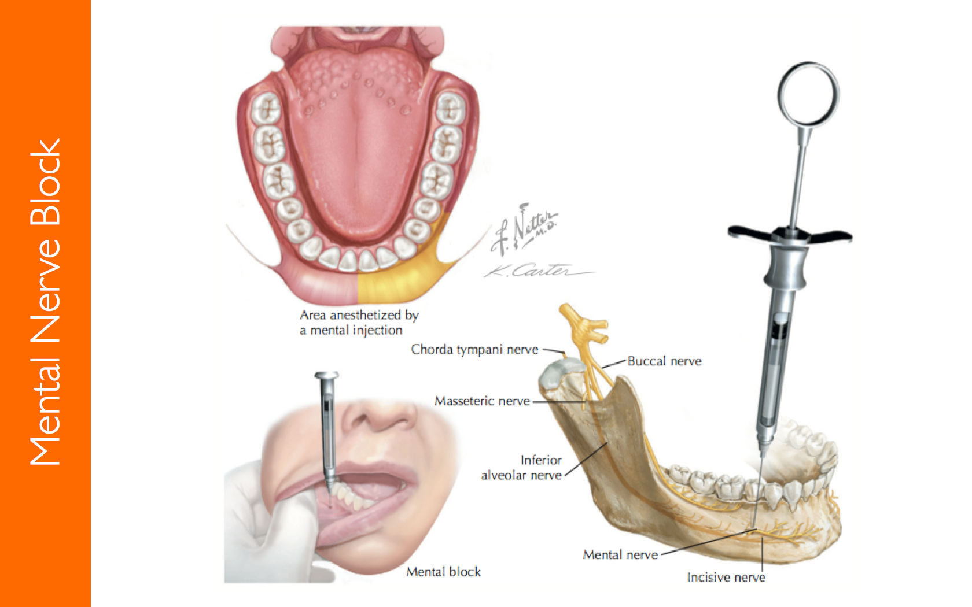
2) Mental Nerve Block ( Lower E & D filling)

Slide 16
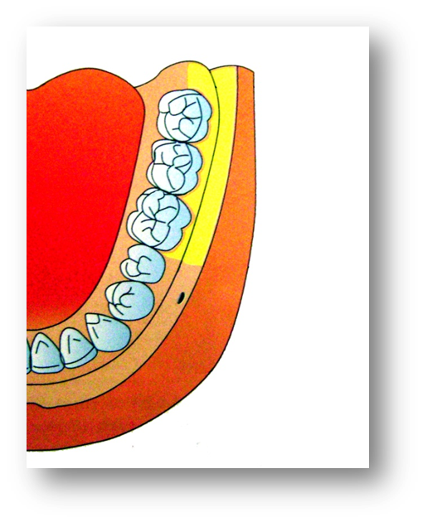
3) Long Buccal Nerve Block
Site of injection
Mucous membrane distal and buccal to the most distal molar tooth in the arch.
Area Anesthetized
Soft tissue and periosteum buccal to the mandibular molar teeth.

Slide 17
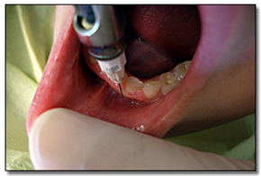
4) Infiltration For Mandibular Incisors:
The labial bone overlying the mandibular incisors is usually thin enough for supraperiosteal anesthesia techniques to be effective.

Slide 18
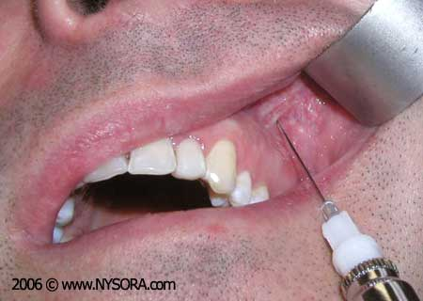
Anesthesia of Maxillary Teeth and Soft Tissue:
Supraperiostial Technique (Local Infiltration)
Most frequently used for obtaining pulpal anesthesia in maxillary teeth.
Indicated whenever dental procedures are confined to only one or two teeth.
Apices of primary anterior teeth are at depth of
Mucobuccal fold
Pulling tissue taut makes
the procedure less painful
Landmark: insertion 45 to
Long acsses of the tooth

Slide 19
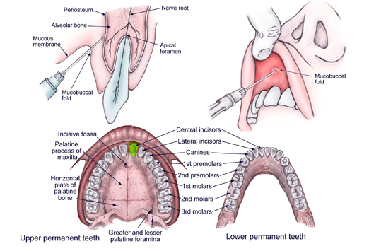
Areas Anesthetized
    Pulp and root area of the tooth.
    Buccal periosteum.
    Connective tissue.
    Mucous membrane.

Slide 20
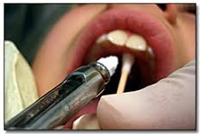
4) Palatal Anesthesia:
a) Nasoplatine Nerve Block:
Blocking the nasopalatine nerve anesthetizes the palatal tissues
of the six anterior teeth.
This technique is painful. ( apply pressure to decrease pain).

Slide 21
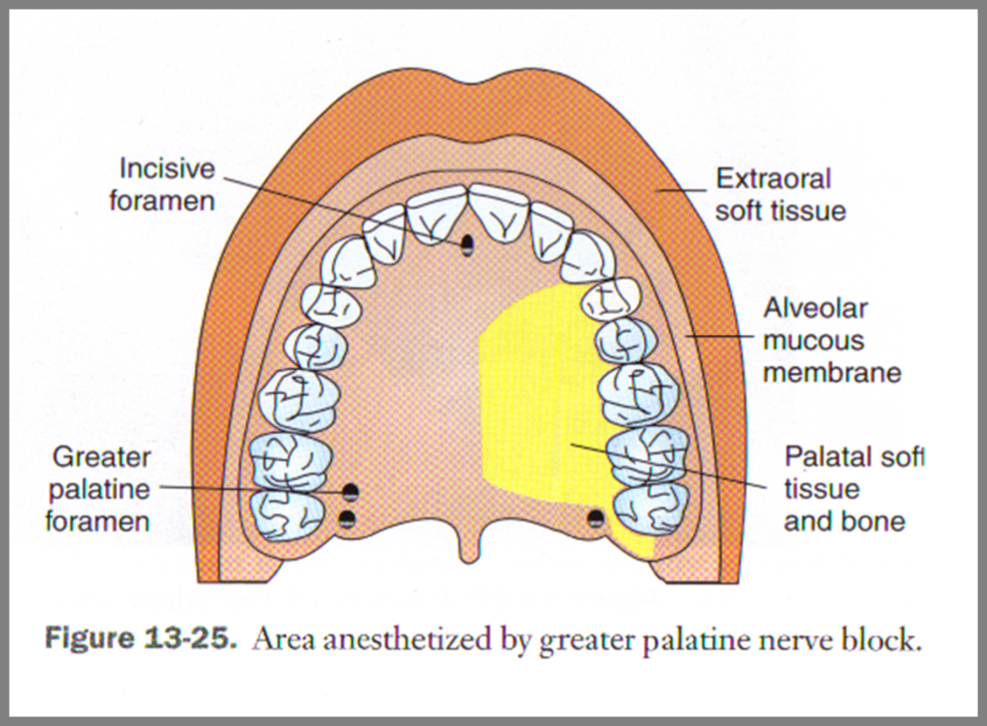
b) Greater Palatine Nerve Block:
Anesthetizes the mucoperiosteum of the palate from the tuberosity to the canine region and from the median line to the gingival crest on the injected side.

Slide 22
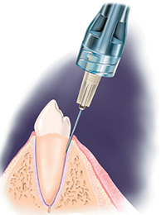
Supplemental Injection Technique:
1) Periodontal Ligament Injection
The needle is placed in the gingival sulcus, and advanced along the root surface until resistance.
Then approximately 0.2 mL of anesthetic is deposited into the periodontal ligament.
Pressure is necessary ( by the injection) to express the anesthetic solution.

Slide 23
Advantages of Periodontal Ligament Anesthesia:
1. It provides reliable pain control rapidly and easily.
2. It provides pulpal anesthesia for 30 to 45 minutes.
3. It is no more uncomfortable than other local anesthesia techniques.
4. It requires very small quantities of anesthetic solution.
5. It does not require aspiration before injection.
6. It may be performed without removal of the rubber dam.
7. It may be useful in patients with bleeding disorders that contraindicate use of other injections like haemophilia.
8. It may be useful in young or disabled patients in whom the possibility of postoperative trauma to the lips or tongue is a concern.

Slide 24
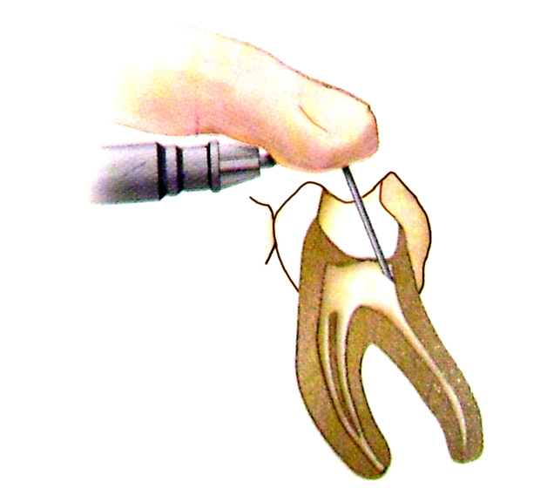
2)Intrapulpal Injection: ( not used for deciduous teeth)
Local anesthetic solution is delivered directly to the pulp using a bent needle.
Advantages:
    Requires minimum volumes of LA solution
    Immediate onset of action
    Very few post operative complications

Slide 25
Maximum Recommended Doses (Safety):
4.4 mg/kg body weight.
Dose Calculation:
2% lidocaine = 20 mg/ ml with 1:100,000 Epinephren
1 carpule = 1.8ml
Amount of LA in 1 carpule = 20X 1.8 = 36mg/carpule.
Example:
20 Kg child can tolerate a maximum dose of 2% lidocaine with vasoconstrictor of LA ----------
4.4 X 20= 88 mg = 88/36 = 2.4carpules.

Slide 26
How to calculate
maximum dose
Child weight Х Maximum dose of L A
Amount of L A per carpule
Example child weight 10 Kg , what is the maximum safe dose of local anesthesia that we can give

Slide 27
Complications OF LA:
Systemic Complications
Toxicity.
Syncope.
Allergic Reaction.
Vasoconstrictors effects.

Slide 28
Manifestation Of Toxicity
Cardiac Depression
Coma
Convulsions
Unconsciousness
Muscular twitching
Visual and auditory disturbances
They can be avoided by closely monitoring during the injection, injecting slowly and withdrawing the needle at first signs of an adverse response
Concentration of LA in Plasma
Notes:
CAUSES OF TOXICITY
Use of excessive dose of LA
Inadvertent intravascular injection
Slow detoxification or biotransformation
Slow elimination or redistribution
Majority of the toxic reactions to LA are immediate, mild and transient
They can be avoided by closely monitoring during the injection, injecting slowly and withdrawing the needle at the first signs of an adverse response

Slide 29
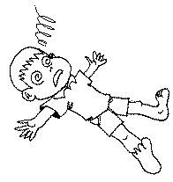
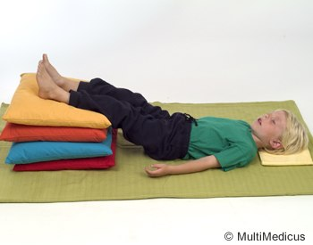
Syncope:
Most common cause : Vasovagal attach
Signs and Symptoms:
Child become pale and cold .
Pulse is rapid.
The pupils are dilated or constricted.
Drop of blood pressure.

Slide 30
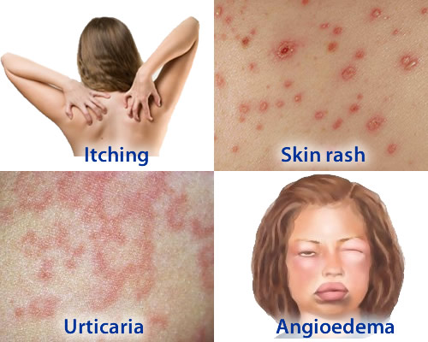
Allergic Reaction:
Uncommon.
Manifestations: edema, eczema .skin rash .itching ……
Anaphylactic shock : more sever form of allergy >> Med. Emergency.
Tx: .1-.5 ml of 1:1000 epinephrine injection >> the base of the tongue.

Slide 31
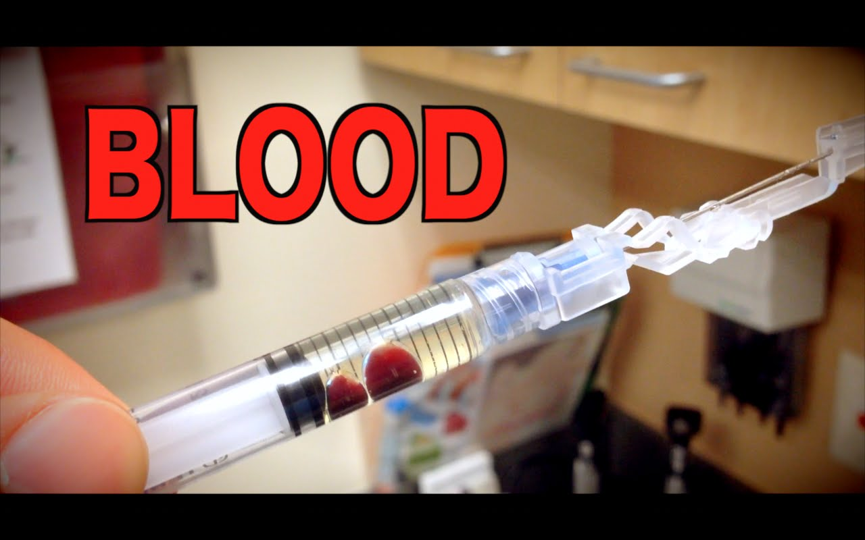
Vasoconstrictors Effects:
Patients with ischemic heart diseases and hypertension are at high risk of toxicity if LA administrated intravascularly.
Don’t forget aspiration
Before injection

Slide 32
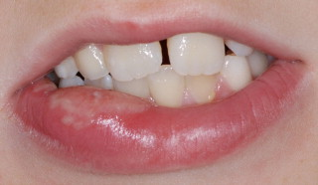
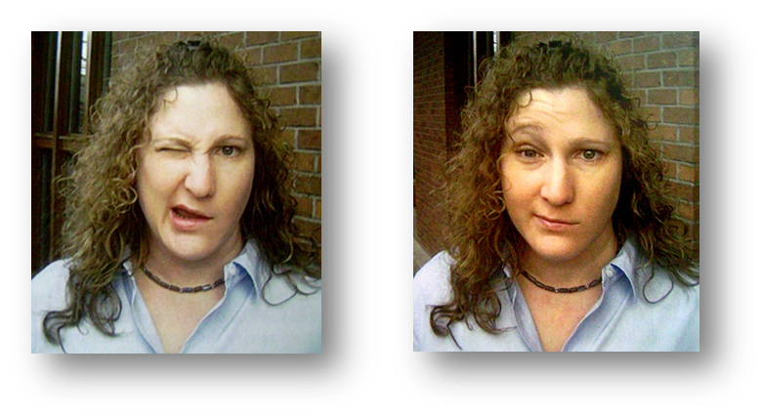
2) Local Complications:
Broken needle.(due to sudden movement during administration)
Hematoma and scar formation (due to repeat insertion in the same area).
Facial nerve gets temporarily paralyzed.
Trauma of the nerve causing Paresthesia.
Blanching due to Vasoconstrictor.
Soft tissue injury or trauma to soft tissue .

Slide 33
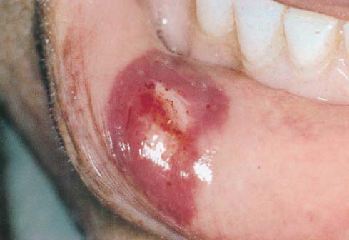
3) Post Anesthesia Trauma:
Remind both parent and child that area will remain numb after the appointment.
Caution that child should not to chew or bite at area.
Sometimes placing a cotton roll between the teeth will help remind patient not to chew.

Slide 34
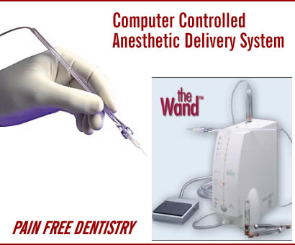
Computer Controlled Anesthesia Delivery System (WAND) :
Administers local anesthetic at two specific rates of delivery.
The slow rate is 0.5ml/min
and
fast rate is 1.8ml/min .

Slide 35
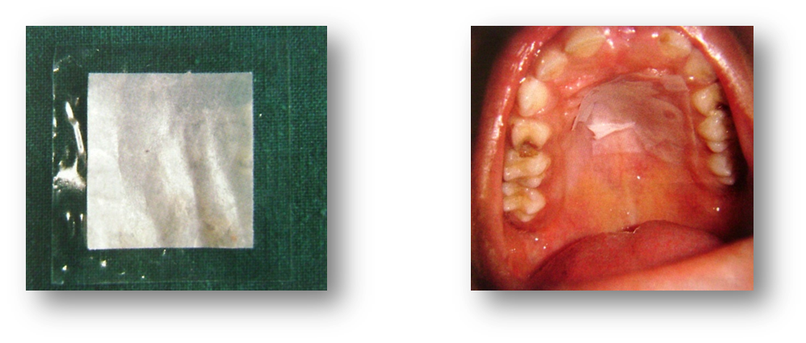
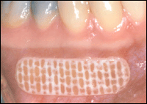
Intraoral lidocaine patch (Topical Anesthesia)
Contains 10% or 20% lidocaine.
Placed for 15 minutes on the buccal mucosa of the maxillary or mandibular premolar area, 2 mm apical to the mucogingival junction.

Slide 36
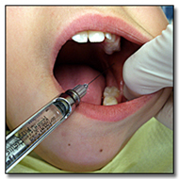
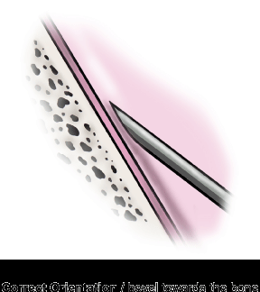
Principles of Atraumatic Injection:
Lock confident and smile.
Don’t let the parents take charge.
Use Anesthetic cartilage and siring at
temperature close to room temperature.
Proper positioning for the patient and doctor.
Apply topical anesthesia.
Always communicate with the patient.
Keep syringe out of patient site.
Don’t inject subperiosteally.
Always aspirate.
Slowly deposit LA solution.
Bevel of the needle facing the bone.
Never leave patient unattended assistant
should be ready at all times to restrain patient’s hands.
Assistance can help bloch view and keep patient distracted.

Slide 37
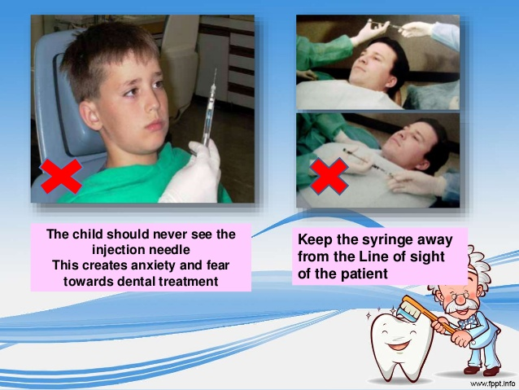
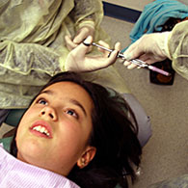

Slide 38
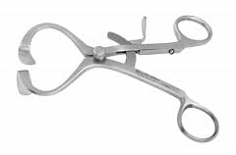
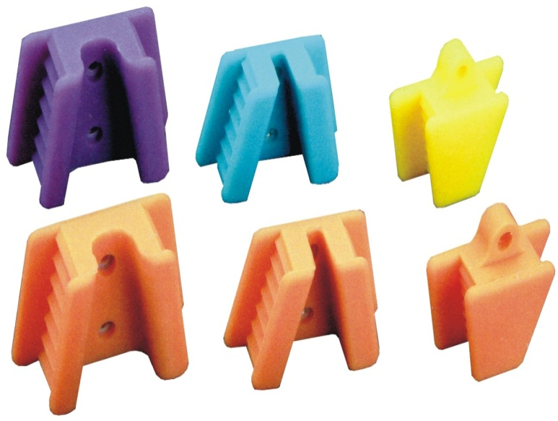
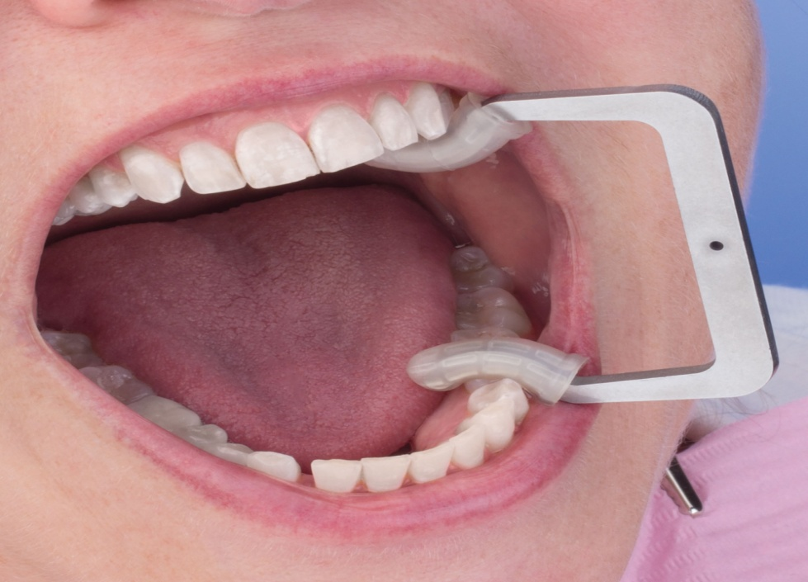
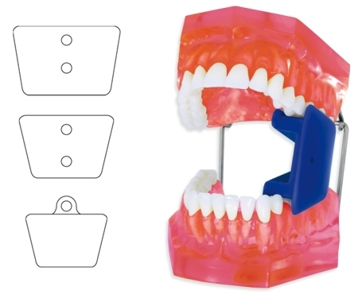
Mouth props
Help child keep his mouth
Sufficiently open.
Placed on the posterior teeth .

Slide 39
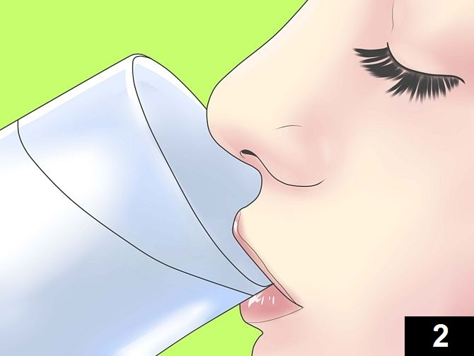
Immediate post injection instruction
The child should be instructed to rinse his mouth immediatally
Patient can’t cry.
Minimize the bitter taste.

