Slide 1
Physiology of Cerebral Cortex
Lec: 11 Dr. Farah Nabil Abbas

Slide 2
The cerebral cortex is made of 3 types of cells:
Granular Cells: which are intercortical neuron and they have short axons. They are either excitatory and contain glutamate as a neurotransmitter or inhibitory and contain GABA as a neurotransmitter.
Pyramidal Cells: They have long axons and they make connections to the spinal cord and thalamus.
Fusiform Cells: They have long axons.
The cerebral cortex is made also of 6 layers:
Layers 1,2,3 are for intercortical association functions.
Layer 4 is a relay for the incoming signals.
Layers 5 & 6 are for the output.

Slide 3
Cortical Areas
Primary Areas:
Motor: For discrete muscle movement.
Sensory: To detect specific sensations such as primary visual, primary auditory and primary somatic.
Secondary Areas: Make senses out of the functions of the primary areas such as the secondary auditory, secondary visual, secondary somatic and supplemental and premotor area.
Association Areas: These also receive and analyze signals from motor and sensory cortex and subcortical structures. These are the following:

Slide 4
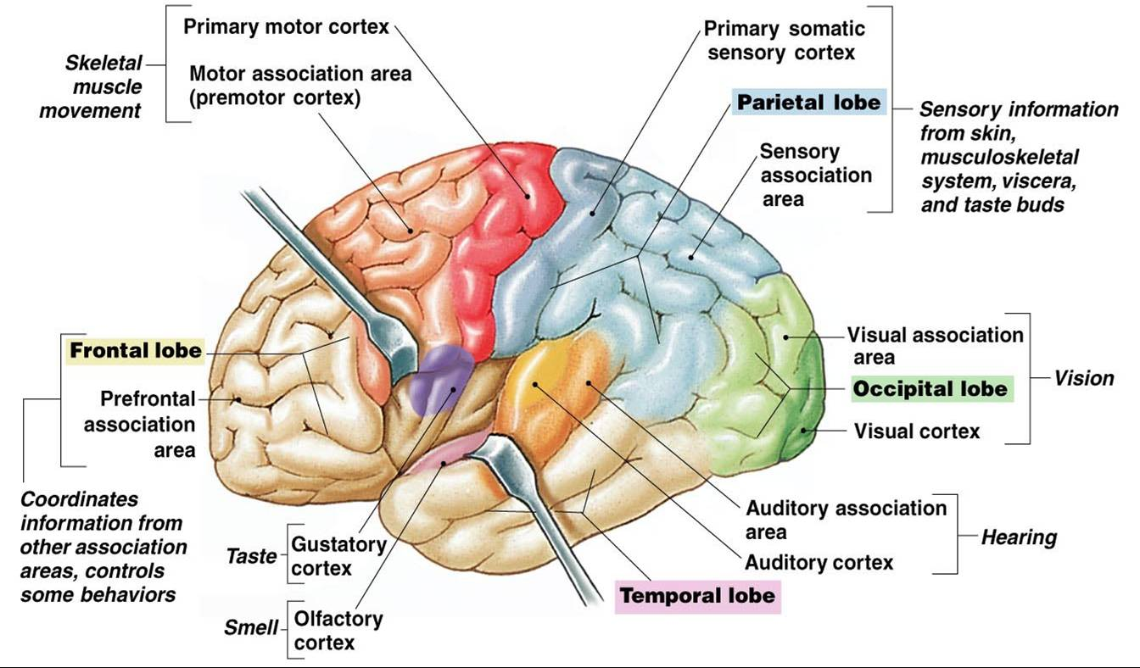

Slide 5
A- Parieto-Occipito-Temporal (P.O.T) Association Area:
-This area gives the meaning of the signals from all the surrounding sensory areas which are the visual, auditory and somatosensory.
-It also analyzes the spatial coordination of the body such as the visual information and the somatic information from the anterior parietal cortex.
The Wernicke’s Area (area for language comprehension): lies at the posterosuperior portion of temporal lobe, It is the most important area for higher intellectual functions, It is well developed in the dominant hemisphere.
Damage to this area give rise to Wernicke Aphasia in which there is impaired comprehension and interpretation and formulation of thought (the patient understand spoken language or written words i.e. hear and recognize different words and read words from printed pages , but unable to interpret the thought that is expressed(dementia).
Stimulation of this area causes complicated memories such as complicated visual senses and auditory hallucinations as musical pieces or persons sound.
The area for processing of visual language (Reading) is also situated in the (P.O.T) and it lies in the Angular Gyrus, behind the Wernicke’s Area. This area makes meaning out of the visually perceived words by transmitting it to the Wernicke’s area.
Damage to this area or Angular Gyrus leads to Word Blindness or Dyslexia.( the patient is able to see words but not able to interpret their meaning).
The area for naming objects lies in the P.O.T also, deep in the Temporal lobe.

Slide 6
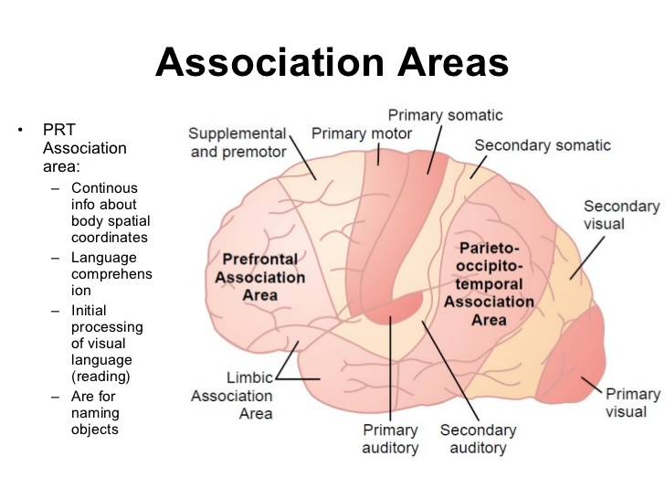

Slide 7
B- Prefrontal Association Area: It is no more the most important intellectual area in cerebral cortex. This area is used to plan complex patterns and sequences of motor movements. It receives input from the motor cortex and the P.O.T association area which gives its information about the spatial coordinates of the body that is necessary for the planning of effective movements. Main function: it is also capable of processing non motor function through carrying out prolonged thought processing in the mind and achieve non motor type of thinking It is therefore important in elaboration of thoughts i.e. increase in depth of different thought put together from multiple sources of information.

Slide 8
So Prefrontal Lobotomy leads to the followings:
Decreased aggressiveness and loss of an appropriate social response. this change may be related to limbic associated area.
Inability to carry out with sequential thoughts. These patients can easily be distracted from the central theme of thought.
Inability to recall information stored to be used in the elaboration of thoughts (working memory).

Slide 10
The Broca’s Area (speech area): lies in the inferior frontal gyrus and it is the site for plans and motor pattern for the expression of individual words.
Damage to it leads to Motor Aphasia or Expressive Aphasia in which there is intact comprehension but impaired expression and fluency of words (a person is capable to decide what he wants to say but can not make the vocal system omit words instead of noises).

Slide 11
C-Limbic Association Area: This area lies in the anterior pole of the temporal lobe, the ventral portion of the frontal lobe and the cingulate gyrus. This area is part of the Limbic System.
This area helps in behavior, emotions and motivations.

Slide 12
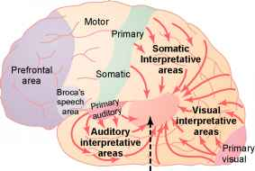

Slide 14
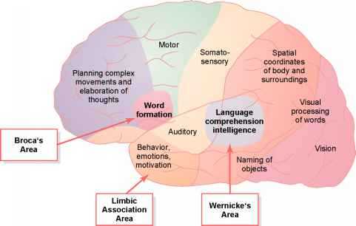

Slide 15
The Dominant Hemisphere (Dominance)
It is the hemisphere where Wernicke’s Area, Reading Area (Angular Gyrus), Broca’s Area and Motor Control Area are developed more than the other side or other hemisphere.
In 95% of the population → the left (hemisphere) side is dominant.
In the rest 5% → either both hemispheres or the right side (hemisphere) is dominant.
The dominant hemisphere receives information (both sensory and motor) from both hemispheres. This cross feeding organization prevents interference between the functions of the 2 sides of the brain. So the dominant hemisphere is important for language and verbal symbolism-related intellectual functions.
Damage to W. area of dominant hemisphere leads to :
Loss of intellectual functions associated with language .
Loss of ability to read.
Loss of aility to perform mathematical operations.
Loss of ability to think through logical problems.
Dominant hemisphere is therefore important for language and verbal symbolism- related intellectual functions, while non- dominant hemisphere is important for interpreting music, nonverbal visual experiences , spatial relations between person and surroundings , body language, intonations of peoples voices, somatic experiences related to the use of limbs and hands.

