Slide 1
DIAGNOSIS Of CARIES
Dr. Emad Farhan Alkhalidi
PhD conservative dentistry

Slide 2
INTRODUCTION
Diagnosis It is the determination of the nature of the disease, injury or other defect by examination, test and investigation.
As we know dental caries is an infectious disease, but there are many terms which describe the signs of the disease, for example, cavitation, white or brown spot, affected or infected dentin, etc

Slide 4
INTRODUCTION
In order to conserve tooth structure and perform minimally invasive dentistry, carious lesions must be detected (DIAGNOSED) at the earliest possible time.
By doing so, caries progress can be arrested, thus avoiding a more invasive operative intervention

Slide 5
INTRODUCTION
The accuracy of any diagnostic test or evaluation is typically measured according to its sensitivity and specificity.

Slide 6
Sensitivity Vs Specificity
Sensitivity: It is defined by the probability of the test giving a positive finding when disease is present
True Positive……False Positive
Specificity: It is the probability of a negative finding when disease is absent.
True Negative……False Negative
The application of multiple diagnostic tests to the individual patient increases the overall efficacy of caries diagnosis.
Notes:
The indications are that the use of the method of diagnosis gives sensitivities of the order of 60% and a specificity of 85%.

Slide 7
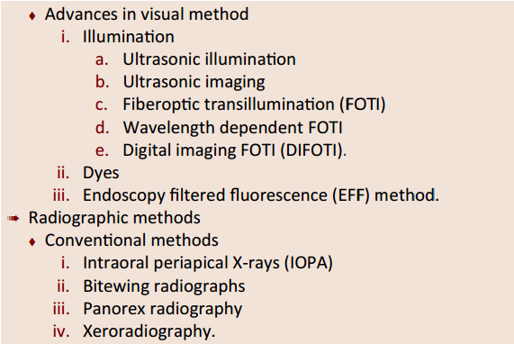

Slide 9
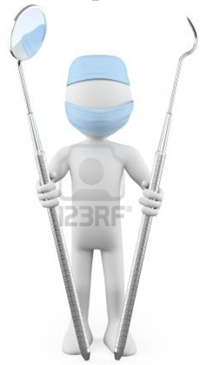
Visual-Tactile Method of Diagnosis
Mirror
Explorer
Light

Slide 10
Tactile examination
In this method explorer has been used for the tactile examination of the tooth for a long time.
The explorer is used to detect softened tooth structure.
Since demineralization is a process that does not always involve sufficient softening of the enamel to be detectable by an explorer.
When an explorer sticks, it’s usually a good indication that there is decay beneath; however, when it does not stick, it does not necessarily mean that decay is not present

Slide 11
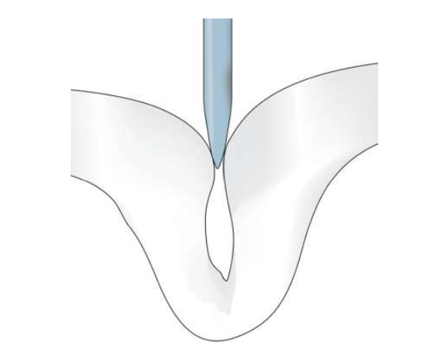
Sturdevant said cavitation at the base of a pit or fissure can be detected tactilely as softness, but mechanical binding of an explorer in the pits or fissures may be due to non carious causes, like shape of the fissure, sharpness of the explorer, or the force of application

Slide 13
Use of explorer is not advocated because;
Disadvantages
1- Sharp edge of explorer may fracture the demineralized enamel, if left alone, such lesion could have remineralized and reverted back to normal.

Slide 14
2- Interproximal caries account for more than 40 percent of caries in adults. The dental explorer is not an effective tool for interproximal caries detection.
3- For pit and fissure caries, the explorer is incapable of determining the presence of most occlusal caries

Slide 15
Visual examination
Use of visual examination only, is known as the European method, while use of sharp or blunt probe in visual tactile system is popularly known as the American system for diagnosis of dental caries.
Visual examination for diagnosing dental caries is a very popular method. It is based on the criteria such as:
Cavitation, surface roughness, opacification and discoloration of clean and dried teeth under adequate light source.

Slide 16
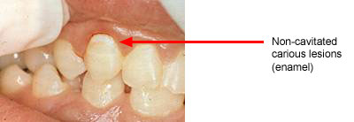
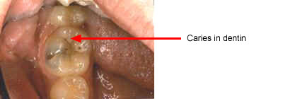
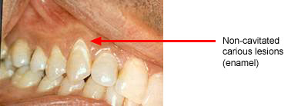
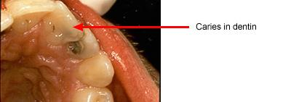
Non-cavitated carious lesion
ENAMEL
DENTIN

Slide 17
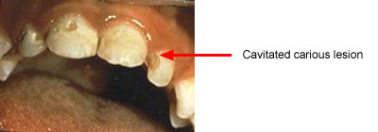
Cavitated Lesions
Where there is visual breakdown of a tooth surface, it is classified as cavitated carious lesion. An active cavity on a smooth surface has soft walls or floors as shown below:

Slide 18
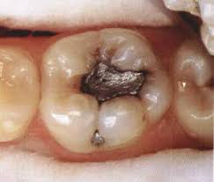
Secondary caries

Slide 19
Advantage: preferred over probing because of harmful effects of probing. Disadvantages: visual examination can not diagnose small lesion. Discoloration of pits and fissures which is found in normal teeth can be misdiagnose as carious lesion. difficult to assess the level of caries penetration.

Slide 20
Advanced visual-Dye penetration method
In carious dentin, two layers of decalcification can be identified:
One layer which is soft and cannot be remineralized
A second layer, which is hard with intermediate calcification and can be remineralized.
It is now clearly established that these dyes do not stain bacteria but instead stain the organic matrix of less mineralized dentin.
This make them less specific because dyes do not stain bacteria nor delineate (trace an outline) the bacterial front but stain collagen associated with less mineralized organic matrix.

Slide 21
Dye penetration method
Use of basic fuschin in propylene glycol for the diagnosis and treatment of carious dentin has been given by Fusayama, 1980. The dye was found to be carcinogenic.
To overcome this disadvantage, acid red or methylene blue were used, but methylene blue is slightly toxic.

Slide 23
Advanced visual-Fiberoptic transillumination (FOTI)
Transillumination takes advantage of the opacity of a demineralized tooth structure over more translucent healthy structures.
The decalcified area will not let light pass through as much as it does in a healthy area, generating a shadow corresponding to decay.

Slide 24
Illumination is delivered by means of fiberoptics from the light source to the tooth surface using a fiberoptic handpiece

Slide 26
Electrical Resistance Measurement
Sound tooth enamel is a good electrical insulator due to its high inorganic content.
Caries results increased porosity, Saliva fills the pores and forms conductive path-ways for electrical current.
The electrical conductivity is hence directly proportional to the amount of demineralization that has occurred. Electrical resistance refers to measuring the electrical conductivity through these pores.

Slide 27
Radiography
Carious lesions are detectable radiographically when there has been enough demineralization to allow it to be differentiate from normal
They are valuable in detecting proximal caries which may go undetected during clinical examination.
On average they have around 50% to 70% sensitivity in detecting carious lesions.
40% demineralization is required for definitive decision on caries

Slide 28
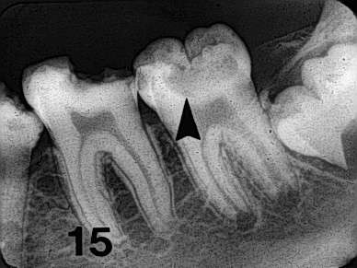
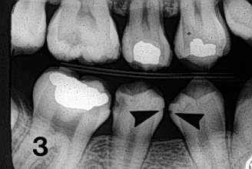
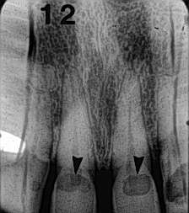

Slide 29
Advanced Radio.-Digital radiography
-Image recorded with non film receptor
The film replaced by flat electronic pad or sensor
-Images sent to computer displayed on monitor screen

Slide 31
Laser ﬂuorescence—DIAGNODent
Based on principle of fluorescence.
It uses a diode laser light source and a fiber optic cable that transmits light to a hand held probe. Light is absorbed induces infrared fluorescence by organic and inorganic materials. Emitted fluorescence is collected at probe tip, processed and presented on display as an integer between 0 and 99

Slide 32
Laser ﬂuorescence—DIAGNODent
The numeric readout on the device (00-99) indicates the amount of fluorescence.
Place the tip on the area to be evaluated. Use a rocking motion with the tip. Note and record the peak value.
Notes:
Technique: Before using the diagnodent, the unit must be
calibrated with the selected tip and a patient-specific baseline must be established. Switch on the diagnodent, set the diagnodent so that the readout confirms the correct position of the unit to the tip selected.

Slide 34
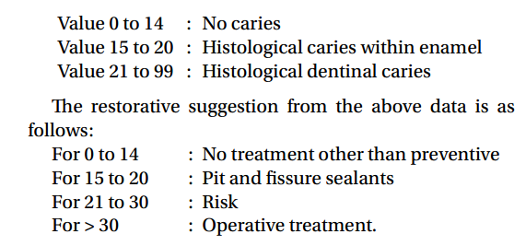
Laser ﬂuorescence—DIAGNODent
Based upon in vivo studies, the following correlations can be made.

Slide 35
THANK YOU....
THANK YOU....

