Slide 1
Class II cavity preparation
Karam Ahmed
MSc operative dentistry
Lec.6

Slide 2
Occlusal outline form (occlusal step)
  The occlusal outline form of a Class II tooth preparation for amalgam is similar to that for the Class I tooth preparation.

Slide 3
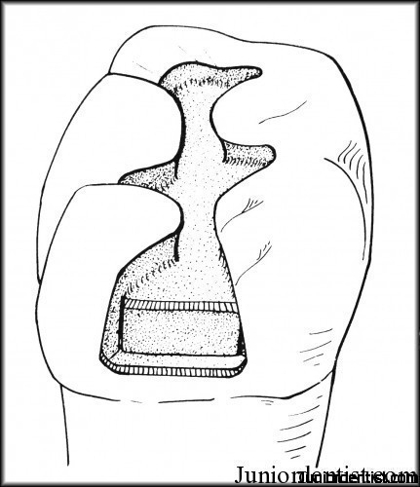

Slide 4
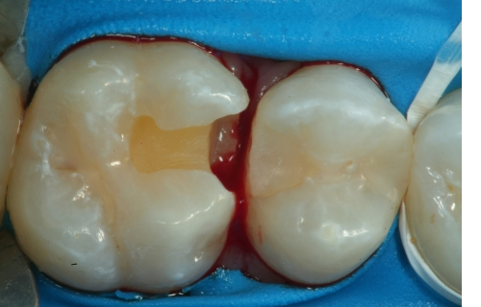

Slide 5
Proximal outline form (proximal box)
The objectives for extension of proximal margins are to:
Include all caries, faults, or existing restorative material.
Establish (ideally) not more than 0.5 mm clearance with the adjacent proximal surface facially, lingually, and gingivally

Slide 6
Occasionally, it is permissible not to extend the outline of the proximal box facially or lingually beyond the proximal contact to conserve tooth structure

Slide 7


Slide 8
Resistance form
(1) the pulpal and gingival walls being relatively flat and perpendicular to forces directed with the long axis of the tooth
(2) restricting extension of the walls to allow strong cusps and ridge areas to remain with sufficient dentin support

Slide 9
(3) restricting the occlusal outline form (where possible) to areas receiving minimal occlusal contact.
(4) the reverse curve optimizing the strength of both the amalgam and tooth structure at the junction of the occlusal step and proximal box

Slide 10
(5) slightly rounding the internal line angles to reduce stress concentration in tooth structure (automatically created by bur design).
(6) providing enough thickness of restorative material to prevent its fracture under mastication.

Slide 11
Retention form
Maintaining the bur parallel to the long axis of the tooth crown creates facial, lingual, and distal walls with a slight occlusal convergence During development of the distal pit area of the preparation, extension to include any distofacial and distolingual developmental fissures radiating from the pit may be indicated.

Slide 12
The distal pit area (in this example) provides dovetail retention form, which may prevent mesial displacement of the completed restoration.
The proximal ditch cut should be sufficiently deep into dentin (i.e., 0.5 to 0.6 mm) that retention locks, if deemed necessary, can be prepared into the axiolingual and axiofacial line angles without undermining the proximal enamel.

Slide 14
Secondary resistance and retention forms
Secondary resistance form in final tooth preparation involves both resistance of the remaining tooth structure against fracture from oblique forces and resistance of restorative material against fracture.

Slide 15
The occlusal convergence of the facial and lingual walls and the dovetail design (if needed) provide sufficient retention form to the occlusal portion of the tooth preparation.
To enhance retention form of the proximal portion, proximal locks may be indicated to counter proximal displacement

Slide 16
Finishing external walls
Use the mesial gingival margin trimmer to establish a slight cavosurface bevel at the gingival margin
When the gingival margin is positioned gingival to the cementoenamel junction (CEJ) on the tooth root, the bevel is not indicated.

Slide 18
Box-only preparation
When restoring a small, cavitated, proximal lesion in a tooth with neither occlusal fissures nor a previously inserted occlusal restoration, a proximal box preparation without an occlusal step has been recommended.

Slide 19
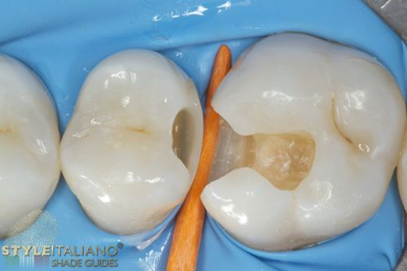

Slide 20
To maximize retention, preparations with facial and lingual walls that almost oppose each other are recommended.
As in the typical preparation, the facial and lingual proximal walls converge occlusally Retention locks are necessary in box-only preparations .

Slide 21
The End

