Slide 1
Festooning

Slide 2
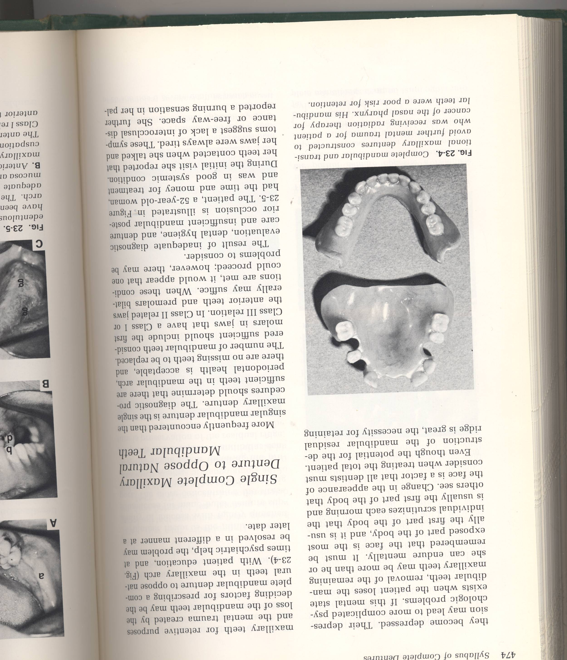
Surfaces of the denture
Occlusal surface.
Tissue surface.
Polished surface.

Slide 3
The polished surface is defined by :
The width of border of the denture according with the width of sulcus.
The buccolingual position of artificial teeth.
The fullness that given to the wax to obtain convexity and concavity in the facial and lingual aspects.

Slide 4
The polished surfaces, which are in contact with oral tissues ( lips, cheeks and tongue), must be smooth and have the natural details. This smoothing will be developed by waxing or festooning.
Q- why we do festooning?
The polished surface has an effect on:
- retention.
- esthetic.
- feeling of patient and phonetics (because there is a relation between the tongue and the palatal part of the teeth).

Slide 5
Festooning : is process of carving the denture base to simulate the contour of the natural tissues which are being replaced by the denture.
The form of the denture bases between the teeth and the border should be shaped in such a manner as to aid retention by the mechanical directional forces of the muscles and tissues.

Slide 6
requirements
They should duplicate the covered soft tissues as accurately as possible.
Labial and buccal fullness of the maxillary and mandibular dentures should be present.
Notches should be provided to accommodate the mucous membrane attachment both in size and direction.
The contour of the denture flanges should be compatible with the shape of the cheeks and lips.
The contour of the lingual flange of the mandibular dentures should have the least possible amount of the bulk, except the border.

Slide 7
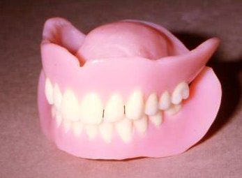
In general , we have two methods for festooning:
Press on method
Drop on method.

Slide 8
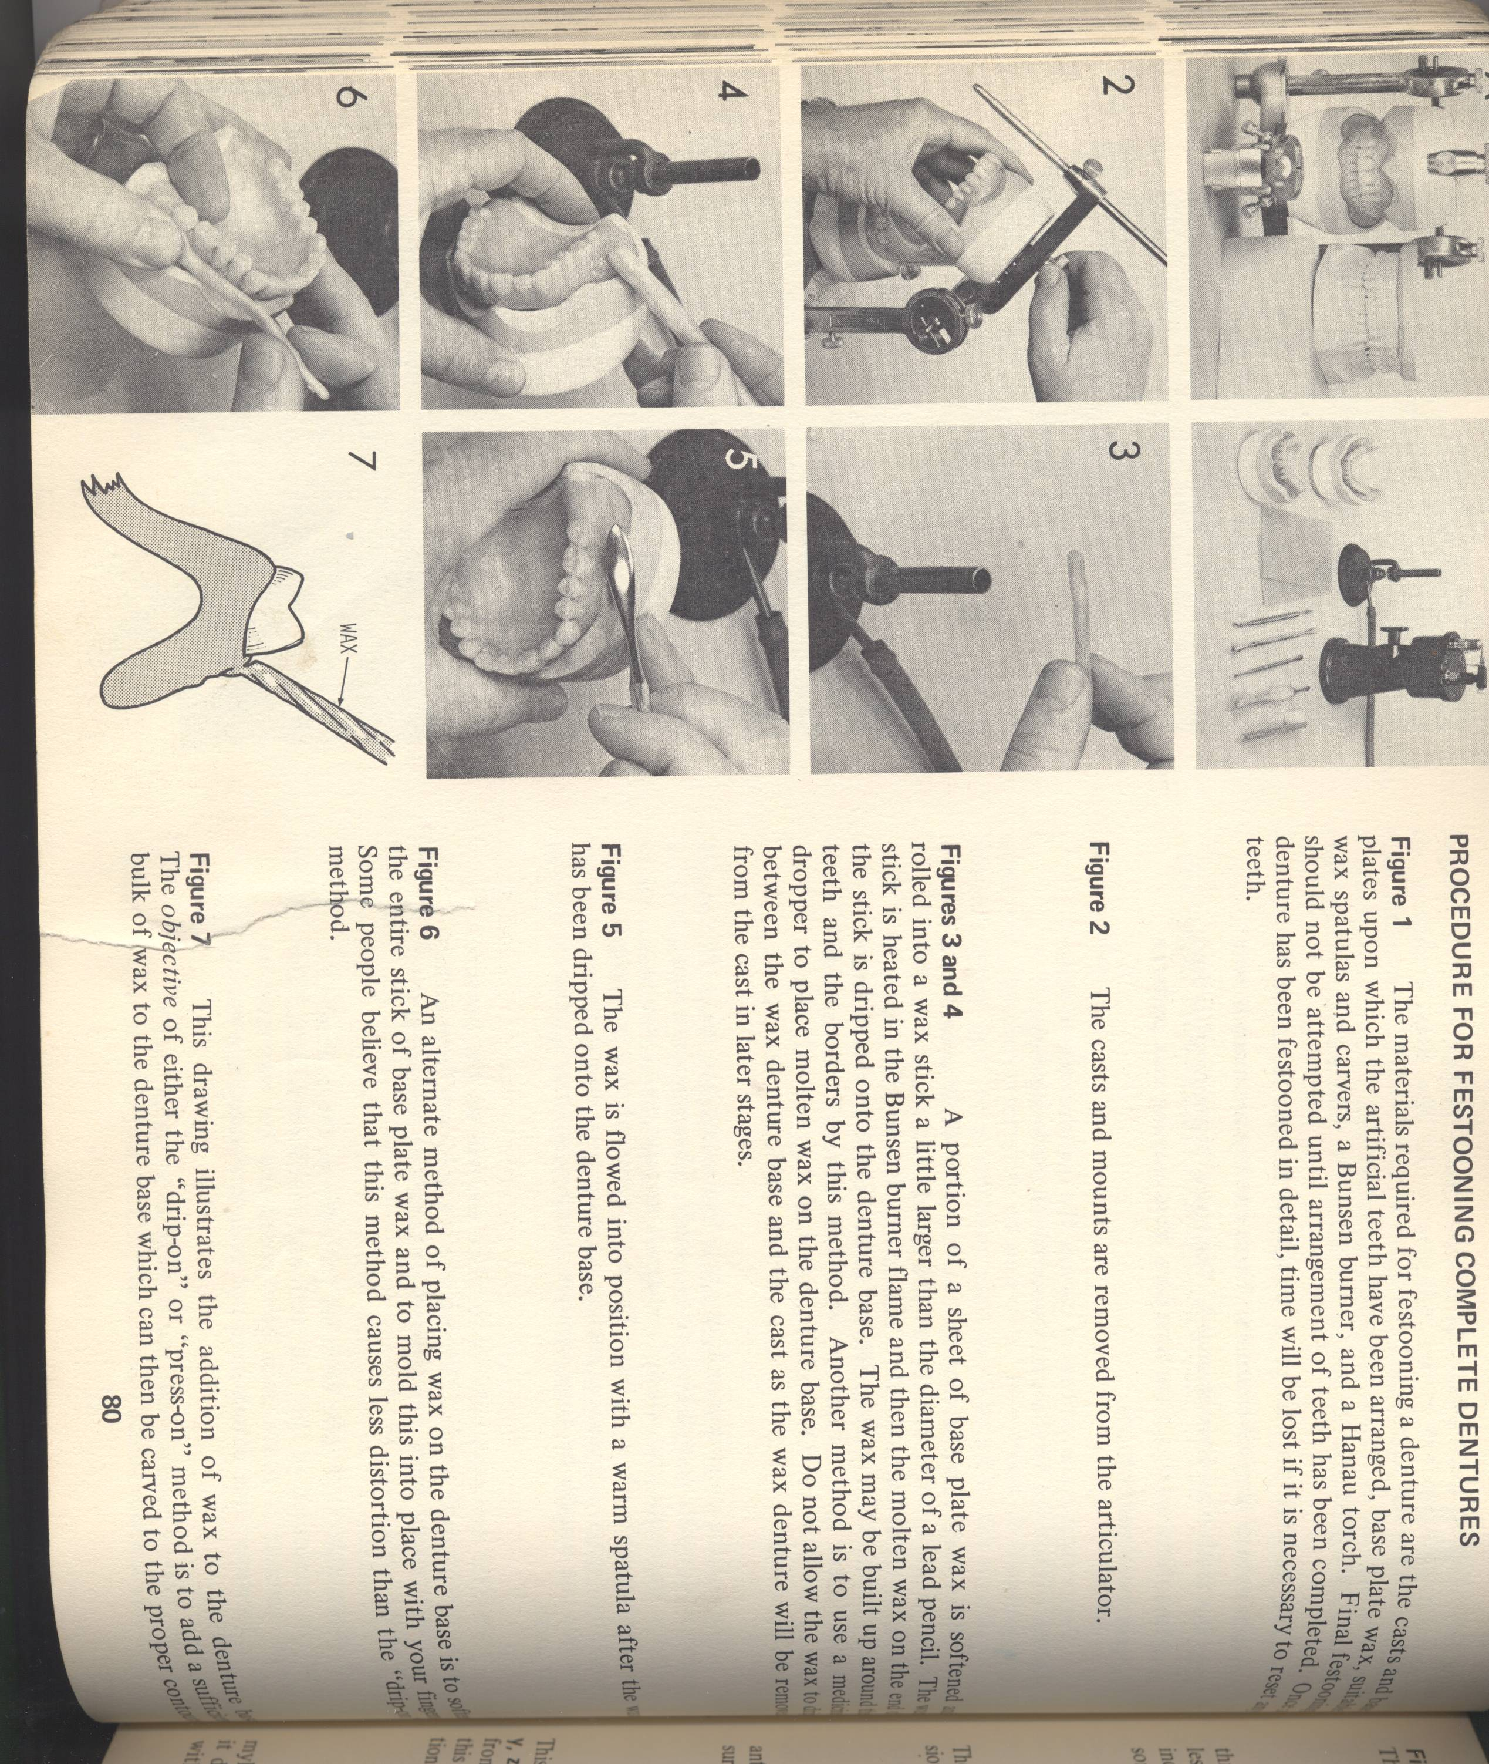
Press on method:
This method can be achieved by softening sheet of wax, then it will be adapted on the flanges of record base, and by using a hot spatula or wax knife we give the natural appearance of this outer surface as present in patient’s mouth, followed by using lacron carver to carve the forms of the roots and maintain the border of the denture. And finally we use a piece of cotton to smoothen this surface to be ready for flasking.

Slide 9
Drop on method:
In this method, we use stick of wax. The stick is heated on Bunsen burner flame and then the molten wax on the end of stick is dripped onto record base.
we give the shape and contour of the outer surface by drop of wax followed by another drop until we finished all outer surface and sealed the record base with cast, then we start the carving and smoothing as mentioned in press method.

Slide 10
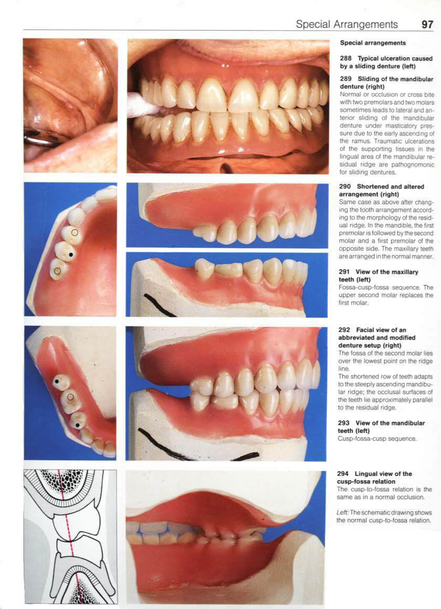
Gingival margins:
They have a scalloped appearance. The gingival margins are carved at an angle 45° to the tooth surface.
The level of the exposure depends on the age of the patient.
Older patients have more receded gums.
Interdental papilla
It is convex in shape both mesio-distally and occluso-gingivally.
It extends up to the contact point of the two adjacent.
Palatal surface
It is given a uniform thickness of 2.5 mm. excess bulk here can interfere with the tongue function and speech.

Slide 11
Stippling: it is a procedure of giving the outer surface of denture from premolar –to – premolar region the shape of orange shell.
Advantages of stippling:
Scattered of the light to maintain the natural esthetic of the denture.
Give natural appearance and enhance the comfort of the patient.
Improve the stability of the denture.
Disadvantages of stippling:
Is the accumulation of food. For this reason, stippling would made in the anterior region only.

Slide 12
The procedure of stippling:
It is done by warming the outer surface of record base on burner; from premolar-to-premolar region, and by using of toothbrush, apply rubber motion on the warmed outer surface.
If we forget make stippling during the step of festooning, then we can do it during the finishing of the denture by using small round bur to give irregularities (like orange shell) to the outer surface of record base.

Slide 13
 One of the most common error in festooning is to make the interdental papilla non existent, or too small. This provides a space between the teeth into which food tends to pack, and also makes the denture difficult to polish.

Slide 14

Polishing
Carving of the work is followed by polishing.
Prior to polishing, excess wax on the tooth surface should be removed. Wax is smoothened by gentle flaming using an alcohol followed by immediate cooling in chilled water.

Slide 15
Post dam:
butterfly depression carved in the cast to enhance posterior palatal seal(retention) of upper denture .
The posterior palatal seal is developed to maintain contact between the denture base and the movable soft palate during speech and swallowing.
Determination of posterior palatal seal created by locating the vibrating line.
Vibrating line:
its an imaginary line located at the junction of hard and soft palate.
It is determined in patient mouth when the patient said “AH” with a color transfer applicator.

Slide 16
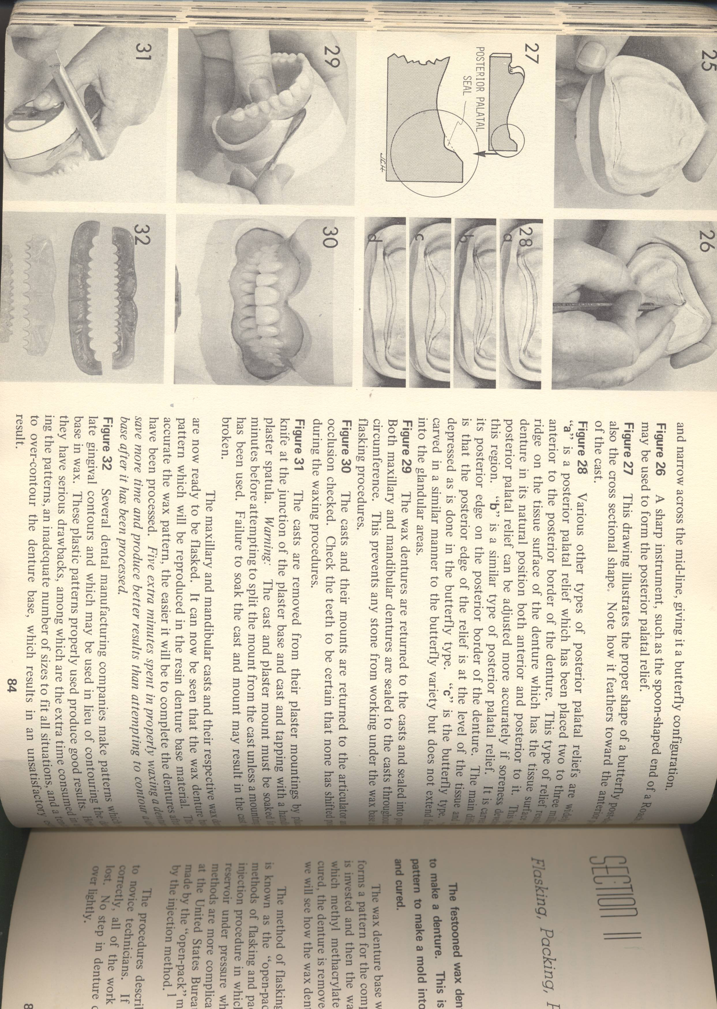
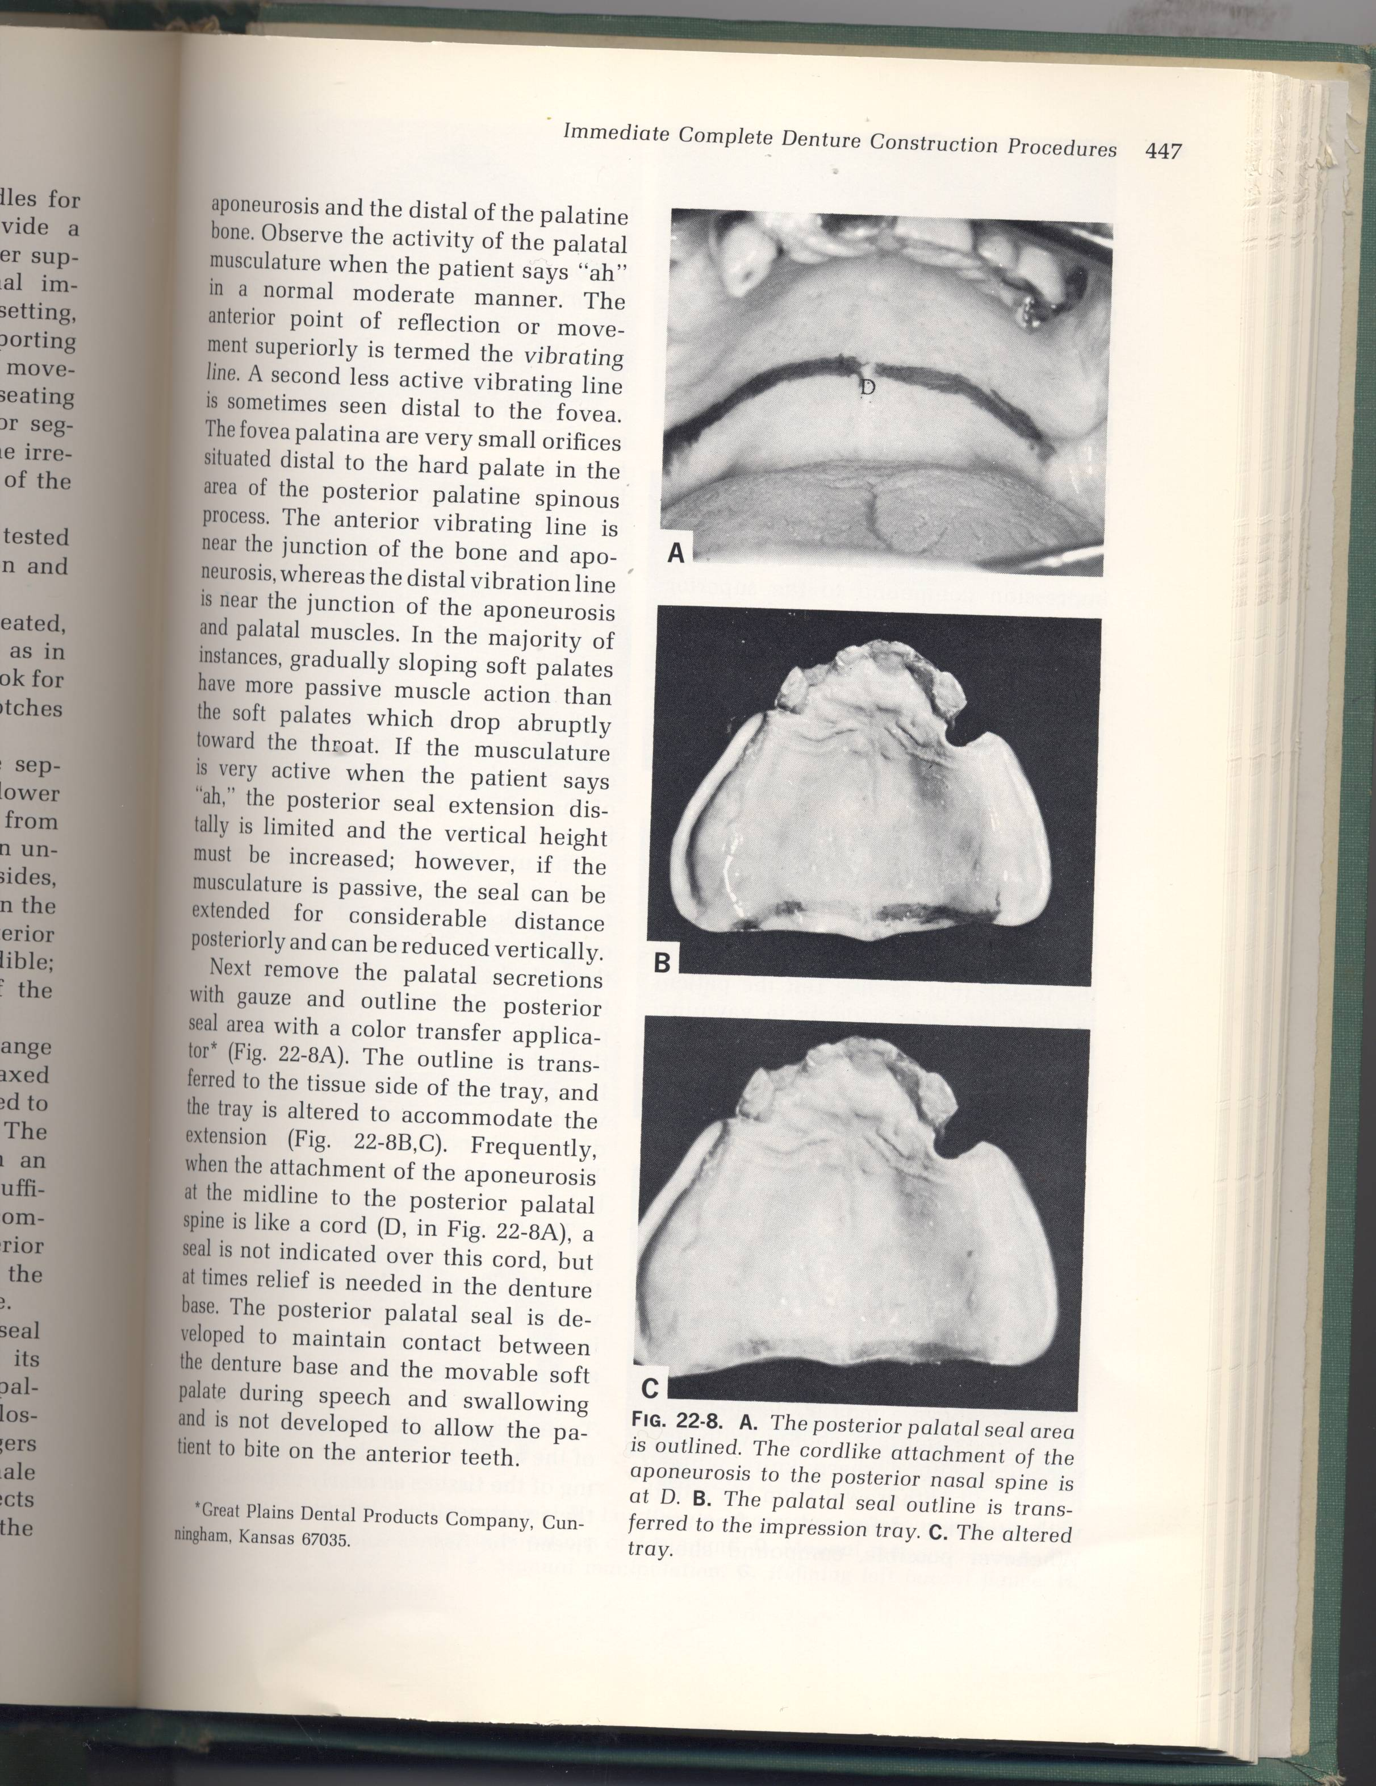

Slide 17
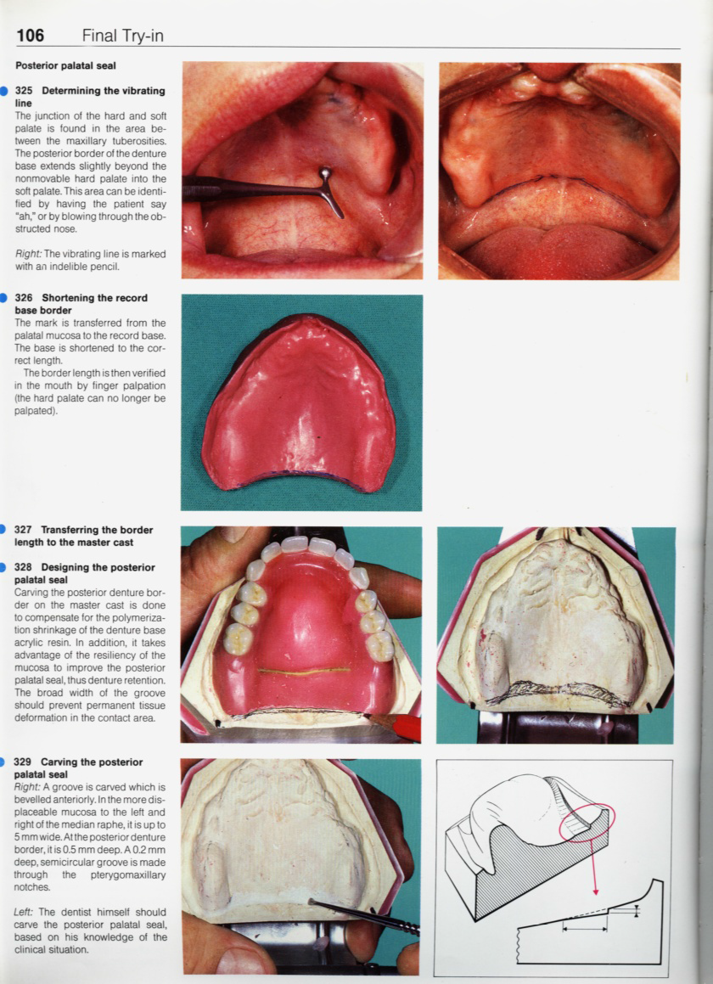

Slide 19
BORDER SEAL
After finish the festooning of all polished surfaces and carving of the cast in the post dam area. Now the next step is to do border seal. In this step, we firstly seat the record base correctly on the cast, then drop melted wax on the interface between border of record base and the cast, then smooth the wax. .

Slide 20
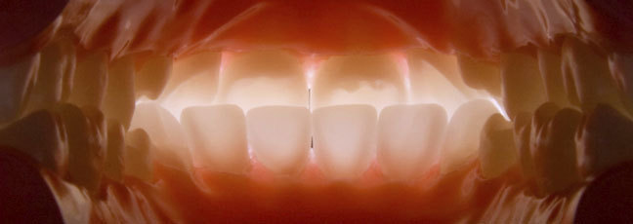
Care must be taken in that to ensure not to leave any space between base and cast. Like this mistake will failed the denture.

