Slide 1
Suture materials
Dr.Bassam Kh. Al-Abbasi Consultant pediatric surgeon
Nineveh medical college

Slide 2
History:-
-traumatic and surgical wounds were closed in 3000 BC by the Egyptians( Thorn & needles).
- Indian surgeons were using horsehair, cotton and leather sutures.
-in 19th century both silk &catgut became popular (can be steralised).
-recently natural materials replaced by polymeric synthetic materials that cause minimal inflammatory reaction.

Slide 3
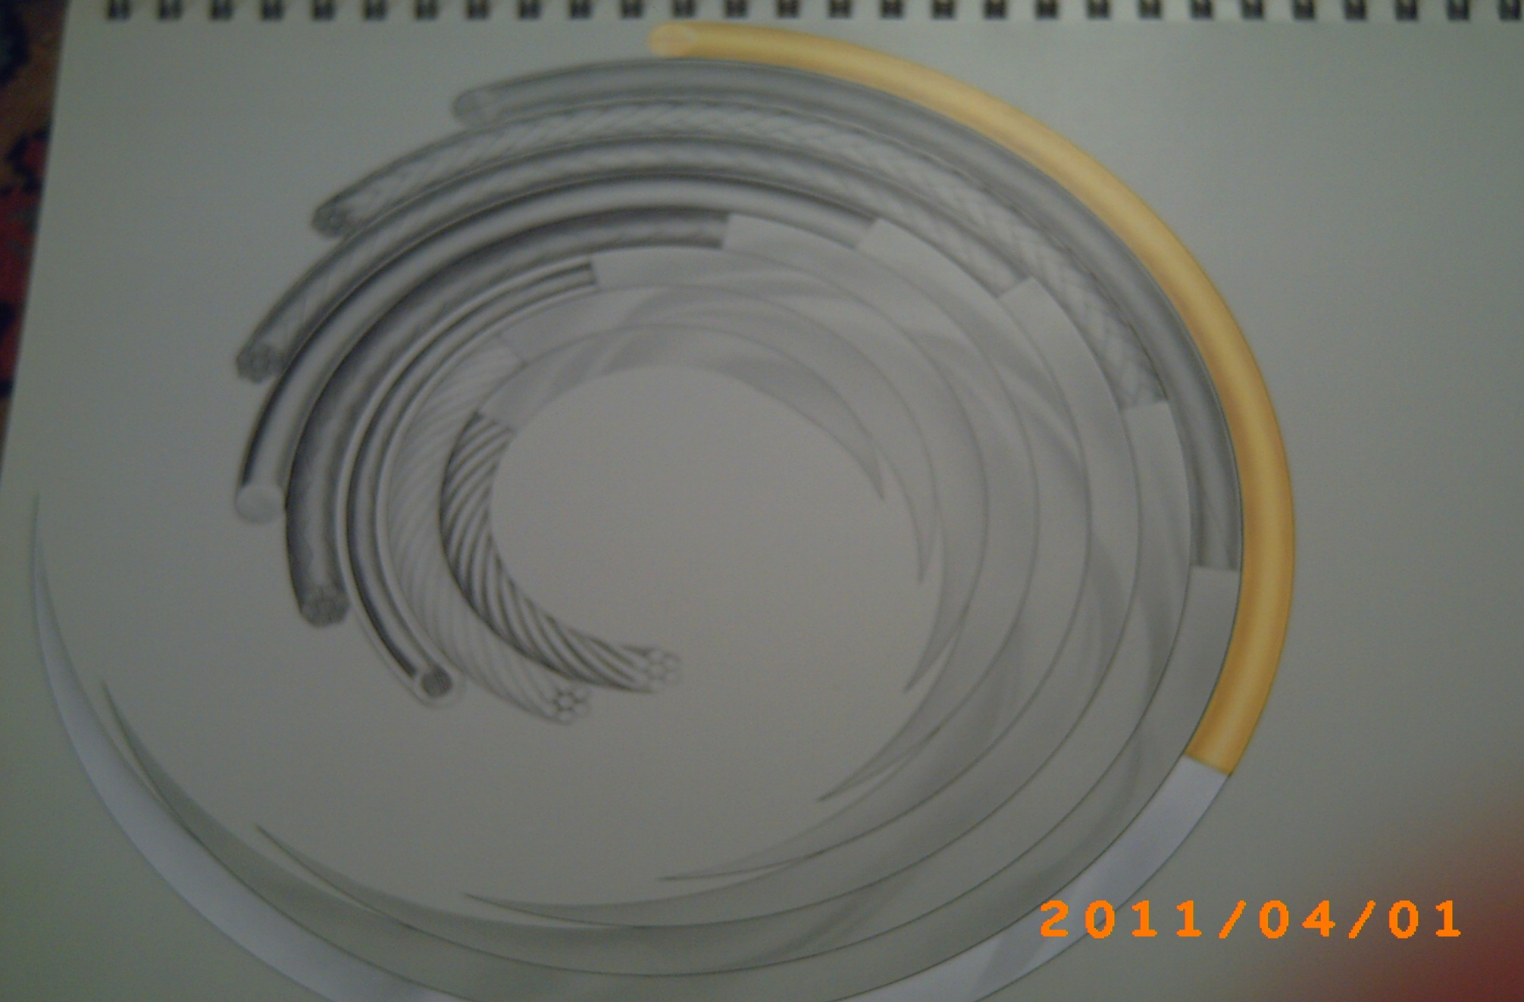
-They can be manufactured as monofilament or braided.
It can be coated with wax ,silicon or poly butyrate to run smoothly &to knot securely.
It can be impregnated with antiseptics to aid in prevention of postoperative infection (absorbable materials).
- Suture diameter varies from 0.02 to 0.8 mm.
The finest suture material that will hold the wound secure without it breaking or “cheese wiring "through the wound should be chosen.
The amount of suture material used should be kept to a minimum to reduced bacterial colonization.
-it can be anidus for infection &knots can be the focus for persistence &chronic inflammatory reaction(suture knot sinus)

Slide 4
Selection of suture materials
-the choice of suture materials should be based on the known physical &biological characteristics of the suture material and the healing properties of the sutured tissue.
Factors affect selection includes:-
1-Adequate tensile strength.
2- should hold the tissue together safely.
3- should be no stronger than sutured tissue.
4- secured knots to prevent slippage of suture material which can be affected by :
a-type of suture material.
b-length of the cut end.
5-easier to handle.
6- less tissue reaction.
7- condition of sutured tissue( dirty, contaminated or infected wound).

Slide 5
Classification
1-Non absorbable material:-
The integrity of some synthetic non absorbable materials in holding healed tissue can last indefinitely.
Many are monofilament and makes knots less likely to be a nidus for infection but require more skill in tying secure knots.
A-Natural:-
1-silk:
Types: braided or twisted multifilament, coated with wax or silicon o r uncoated, easy to handle with excellent knot.
Material: protein from silk worm.
Tensile strength:80-100%by 6 months
Absorption rate: slowly over 1-2 years.
Tissue reaction: moderate –high.

Slide 6
Contraindication: -vascular prosthesis.
-tissue require prolong approximation.
-risk of infection.
Uses: skin closure and ligation.
increasingly not recommended.
2-Linin:
Types: twisted.
Material: long staple flax fiber.
T.S.: stronger when wet .
loses 60% at 6 months&30%remain at 2 years.
Absorption: remain encapsulated in body tissue.
Tissue reaction: moderate.
Contra indication :vascular prosthesis.
Uses: ligation &GIT surgery (no longer use).

Slide 7
B-synthetics:-
1-stainless steel:
Types: mono or multifilament/poor handling.
Material: iron ,nickel ,chromium alloy.
T.s : infinite
Absorption: remain encapsulated in body tissue.
Tissue reaction: minimal
Contra indication: sensitivity to nickle.
when MRI going to be used.
Uses: bone surgery( sternotomy),ligament surgery.

Slide 8
2-Nylon:
Types: mono or multifilament
Material: polymer(strong and smooth).
Absorption: degrades &absorbed in 2 years.
Tissue reaction: low.
Contra indication: none.
Uses: cutaneous surgery (plastic surgery),
opthalmic surgery,
microsurgery,
hernia,
abdominal wall

Slide 9
3-p0lyester:
Types: mono or multifilament
Material: polyester(require 5 throw knot).
Absorption: remain encapsulated in body tissue.
Tissue reaction: low.
Contra indication: none.
Uses: cardiovascular surgery,
opthalmic surgery,
general surgery,
plastic surgery,
excellent for facial closure.

Slide 10
4-polypropylene:
Types: monofilament.
Material: polymer of propylene.
Absorption: remain encapsulated in body tissue.
Tissue reaction: low.
Contra indication: none.
Uses: cardiovascular surgery ,plastic & opthalmic surgery, general surgery,
subcuticular skin closure.

Slide 11
2-Absorbable suture material
It implies absorption &eventual disappearance of the Suture from tissue implantation site.
A-Natural:
1-catgut:-
It acts as active foreign body and may interfere with tissue healing ,with risk of prion transmission .
its avoid discomfort with suture removal (child)and have low incidence of stitch mark, and superior handling.
a-plain:
Material: collagen derived from healthy sheep or cattle.
T.s: lost withen 7-10 days(not recommended)
Absorbtion rate: phagocytosis and enzymatic degradation.
Tissue raction: high.
Contraindications: 1-slowly healed tissue.
2-tissue require prolong support.
Uses: 1-ligation of superficial vessels.
2-subcutaneous tissue, stoma .

Slide 12
b- chromic:
Material: collagen from sheep or cattle tanned with chromium salt.
T.S.: lost within 21-28 days .
Absorption: phagocytosis and degradation (90 days).
Tissue reaction: moderate.
Contra indication: as with plain.
Uses: as with plain.

Slide 13
B-synthetics
1-Poly glactin(vicryl):
Types: braided multi filament.
Material: copolymer of lactid coated with polyglactin.
T.S.: 60% remain at 2 weeks &30% at 3 weeks.
Absorption: 60-90 days complete absorption.
Tissue reaction: mild.
Contra indication: tissue require prolong approximation under tension.
Uses: ligation &GIT surgery ,ophthalmic surgery ,wound closure.

Slide 14
2-polyglyconate(maxon):
Types: monofilament.
Material: copolymer of glycolic acid.
T.S.: 70% remain at 2 weeks &55% at 3 weeks .
Absorption: at 180 days.
Tissue reaction: mild.
Contra indication: tissue require prolong approximation under stress.
Uses: alternative to vicryl & PDS

Slide 15
3- p0ly glycolic acid(dexon):
Types: braided multifilament.
Material: polymer of polyclycolic acid.
Absorption: complete absorption at 60-90 days.
Tissue reaction: minimal.
Contra indication: tissue require prolong approximation under stress.
Uses: as other non absorbable .

Slide 16
4-poly diaxanon(PDS):
Types: monofilament.
Material: polyester polymer.
Absorption: complete absorption in 180 days.
Tissue reaction: mild.
Contra indication: in heart valve.
Uses: as other absorbable.

Slide 17
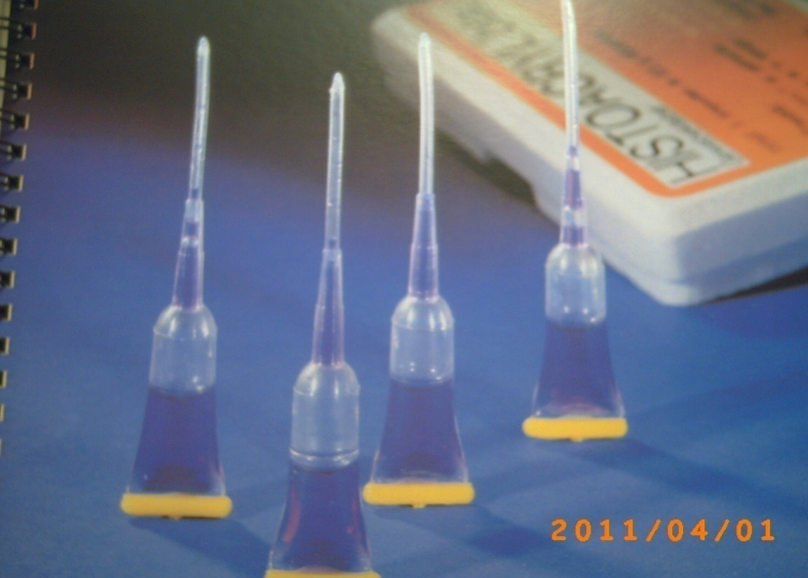
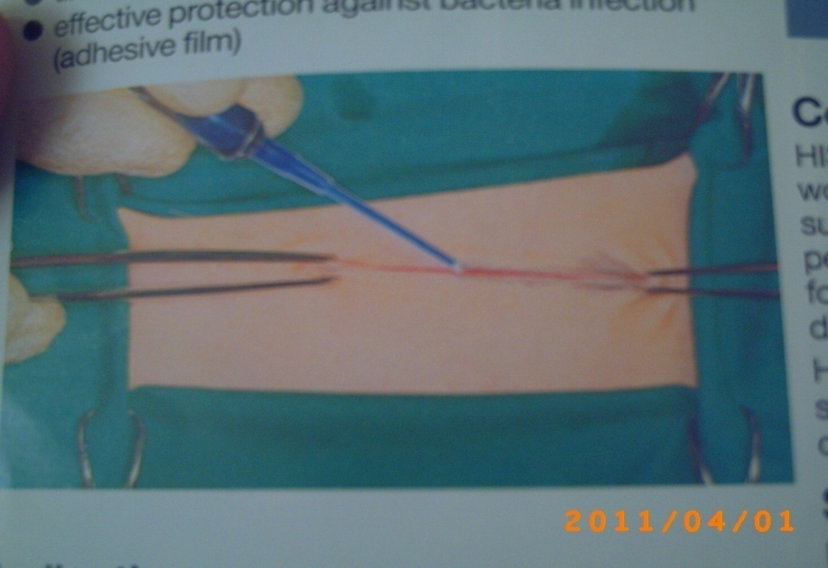
Metal clips:
-For skin.
advantages:
1- quick &accurate closure.
2-save time.
3-easy to remove.
4-low infection rate .
5- acceptable scar.
disadvantages:
- expensive.
- disposable.
-skin edge overlaps.
0thers:
-tissue glue
-steri strips

Slide 18
Any Questions

