Slide 1
Cestodes
Taenia solium & Taenia saginata

Slide 2
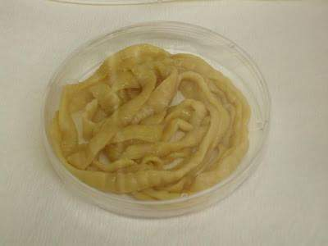
Taenia saginata Beef tapeworm
Taenia solium Pork tapeworm
Disease : Taeniasis

Slide 3
Morphology of adult
1. They are flat , hermaphroditic worms ,
live in small intestine of man.
2. Adult worms consist of a head , neck and
segmented body (proglottids) may reach
thousands.

Slide 4
3. The head (scolex) contain suckers (T. saginata), or suckers & hooks (T. solium).

Slide 5
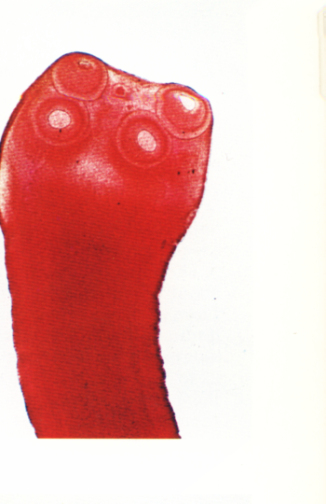
Scolex of T. saginata
Scolex of T. Solium

Slide 6
4. Mature segment contain both male & female sexual organs.
5. Gravid segment contain only uterus full with
eggs which usually passed with eggs out with
feces as diagnostic stages.

Slide 8
6. The length of adult worms is usually 4-10 m for T. saginata and 2-7 meter for T. solium.
7 . T. saginata usually have 1,000 to 2,000 segments,
while T. solium have an average of 1,000 segments.

Slide 9
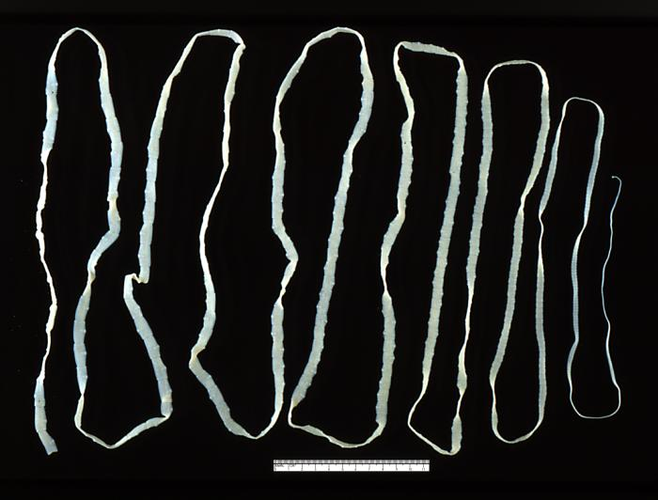
Adult worm of Taenia saginata

Slide 10
Adult worm of Taenia solium

Slide 11
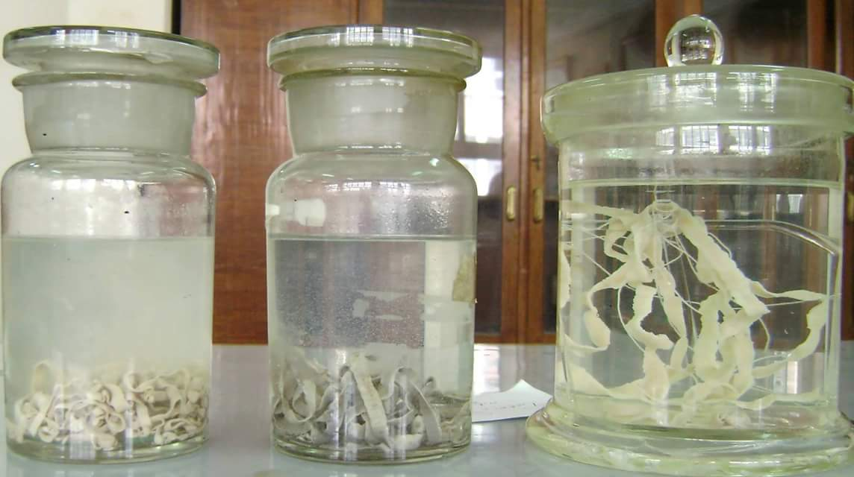

Slide 12
Gravid segment of T.Saginata
longer than wide consist of median uterus with 15-30 lateral uterine branches with unilateral genital pore .
Gravid segment of T.Solium
7 – 13 lateral uterine branches.

Slide 13
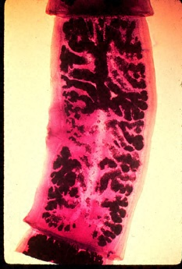
Gravid segment of T.Saginata
Gravid segment of T.Solium

Slide 14
Cysticercoids larva
It is bladder like cyst called bladder worm with invagenated or evagenated scolex .They are infective stages to human and they are two type :
C. Bovis: scolex without hooks in the muscles of cattles (T.saginata).
C.cellulosae : scolex with hooks in muscles of pigs (T.solium).

Slide 15
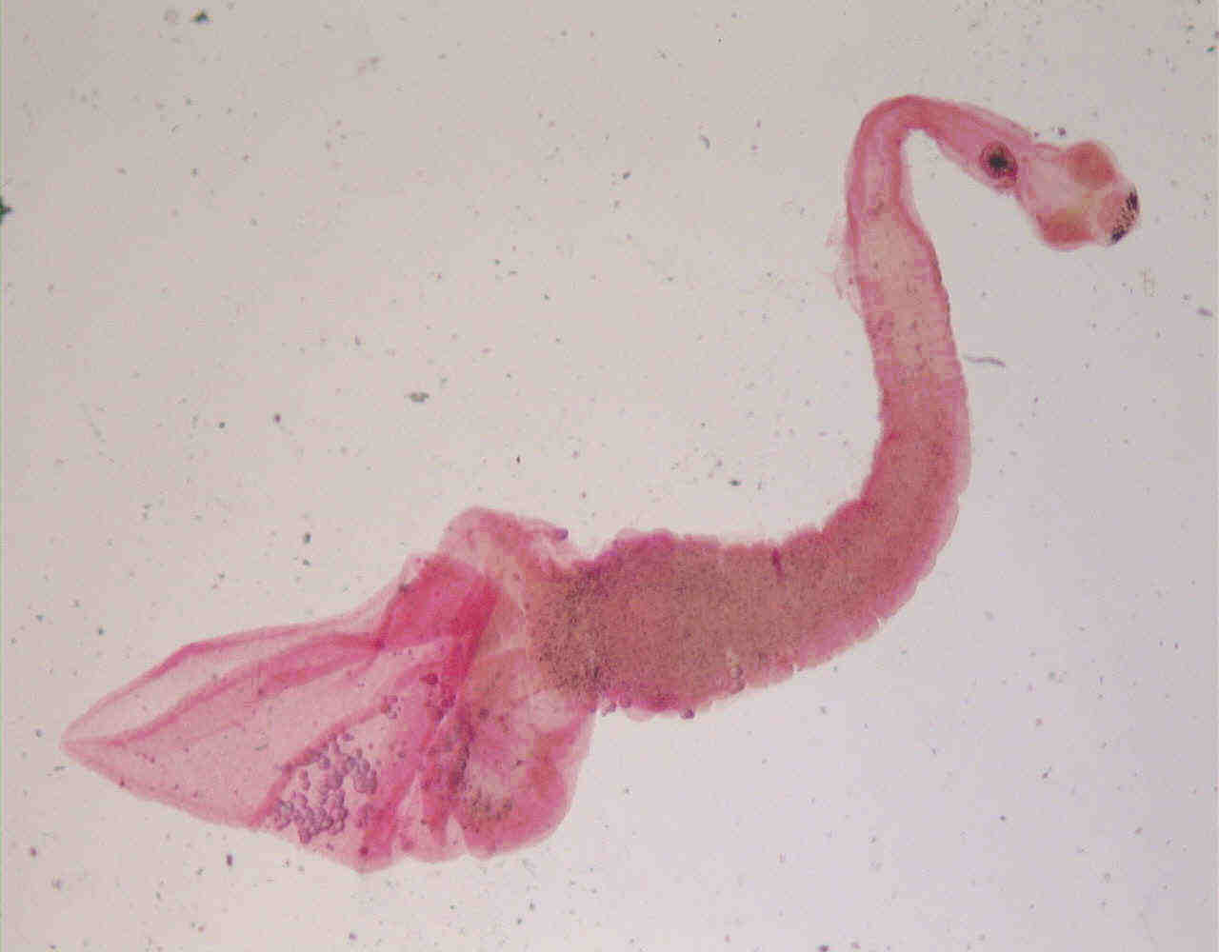
Cysticercus bovis
Cysticercus cellulosae

Slide 16
Life cycle of T. saginata and Taenia solium

Slide 17
Taenia spp
definitive hosts : Humans
intermediate host: Cattle for T. saginata and
pigs for T. solium.
infective stages: Cysticercus Larva
Diagnostic stages: egg , gravid segments in feces and scolex.

Slide 18
Laboratory Diagnosis
Microscopic identification of scolex and segments in feces are diagnostic for taeniasis.
The gravid segments can differtiate between T.saginata and T. solium but the eggs are morphologically identical, and indistinguishable between taenia species.

