Slide 1
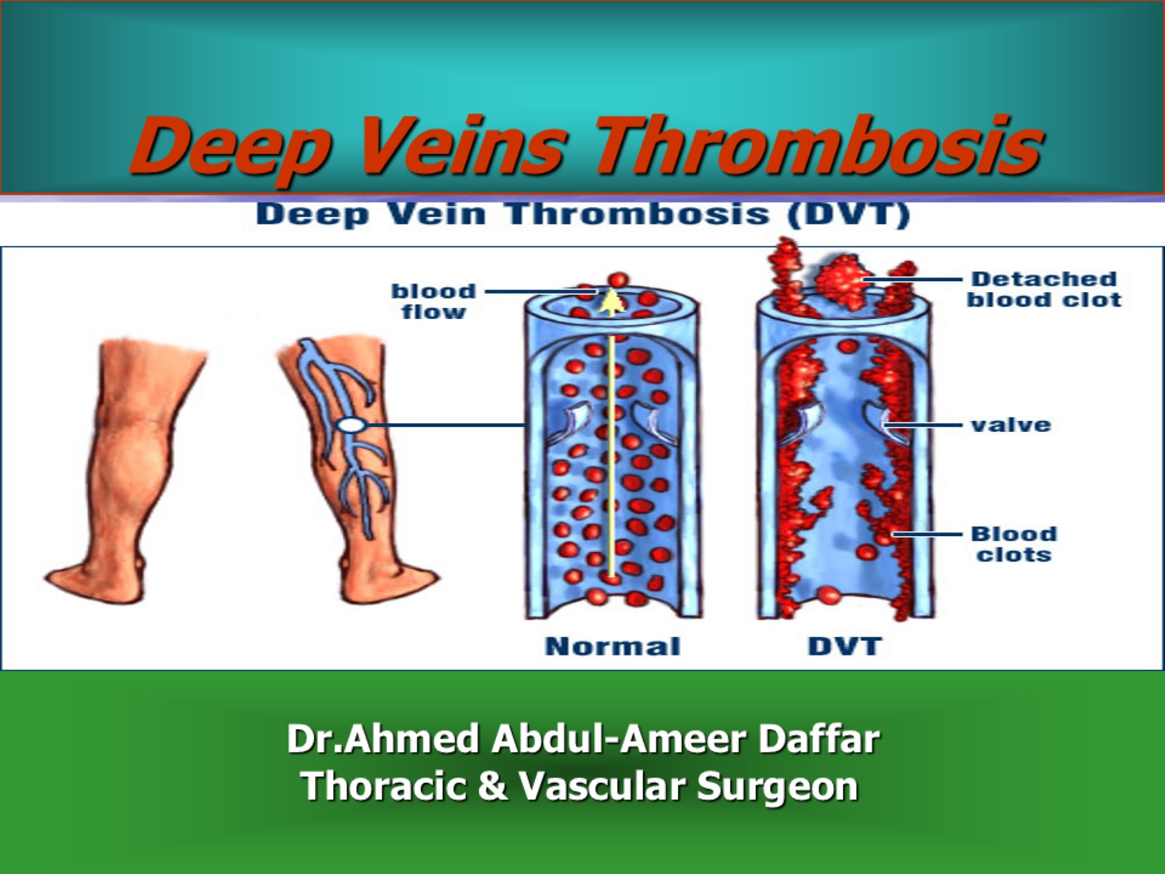
Deep Veins Thrombosis

Slide 2
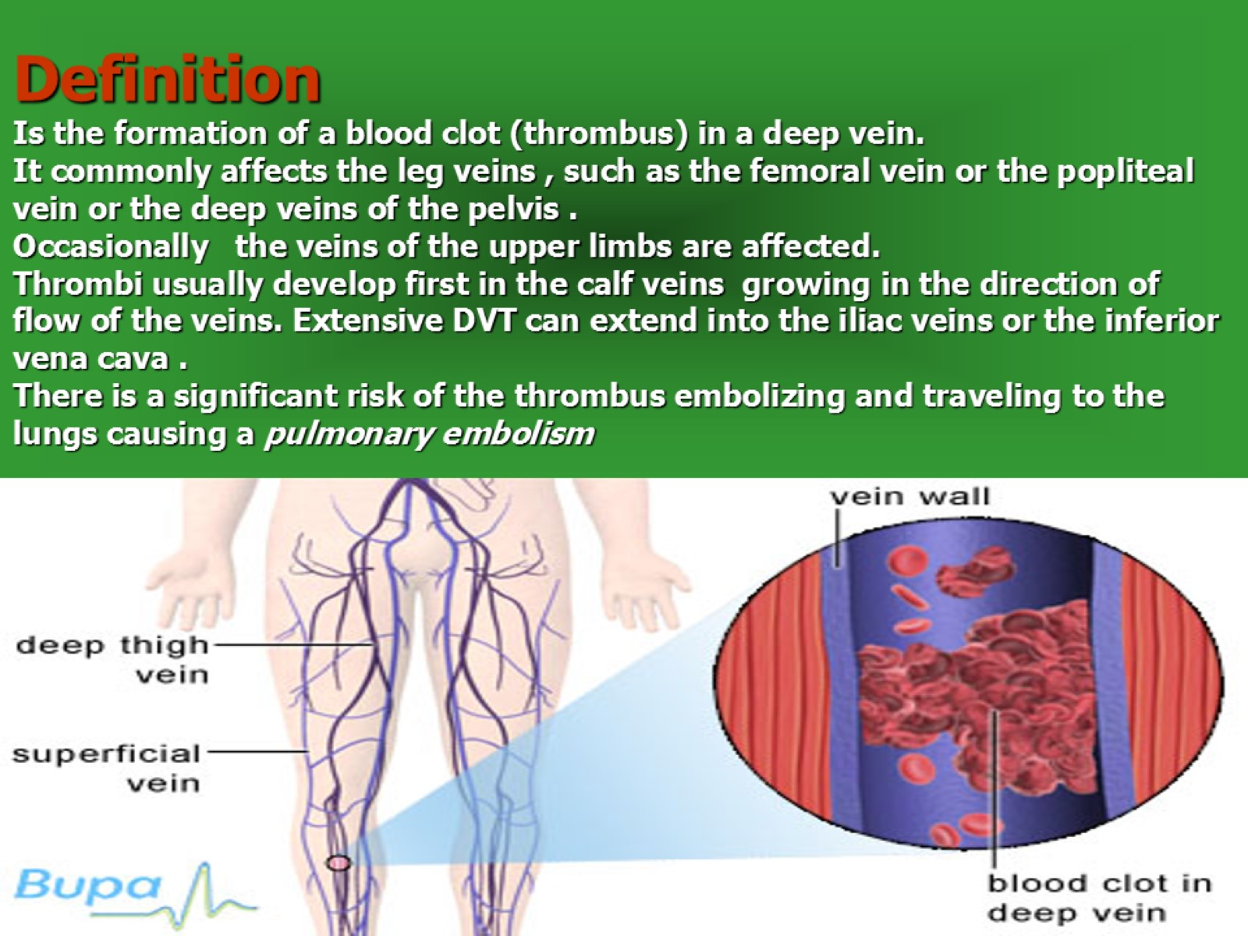
Definition
Is the formation of a blood clot (thrombus) in a deep vein.
It commonly affects the leg veins , such as the femoral vein or the popliteal vein or the deep veins of the pelvis .
Occasionally the veins of the upper limbs are affected.
Thrombi usually develop first in the calf veins growing in the direction of flow of the veins. Extensive DVT can extend into the iliac veins or the inferior vena cava .
There is a significant risk of the thrombus embolizing and traveling to the lungs causing a pulmonary embolism

Slide 3
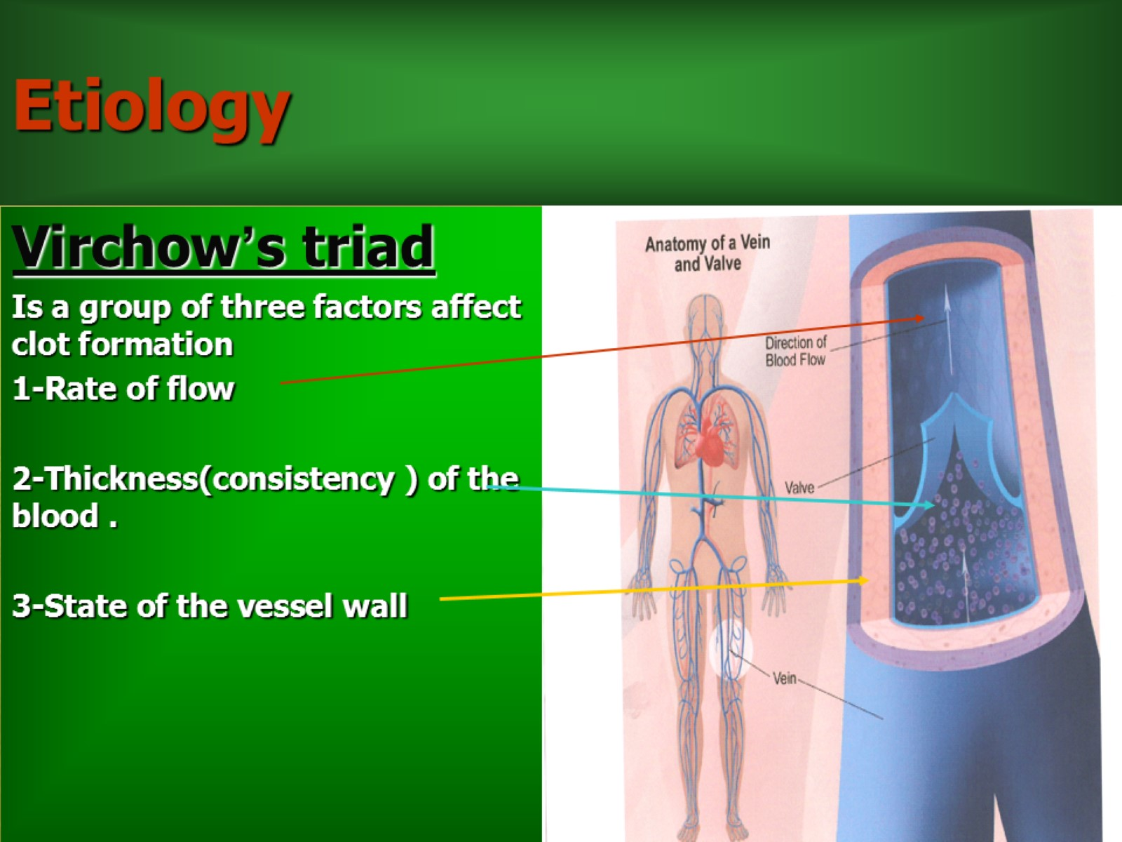
Etiology

Slide 4
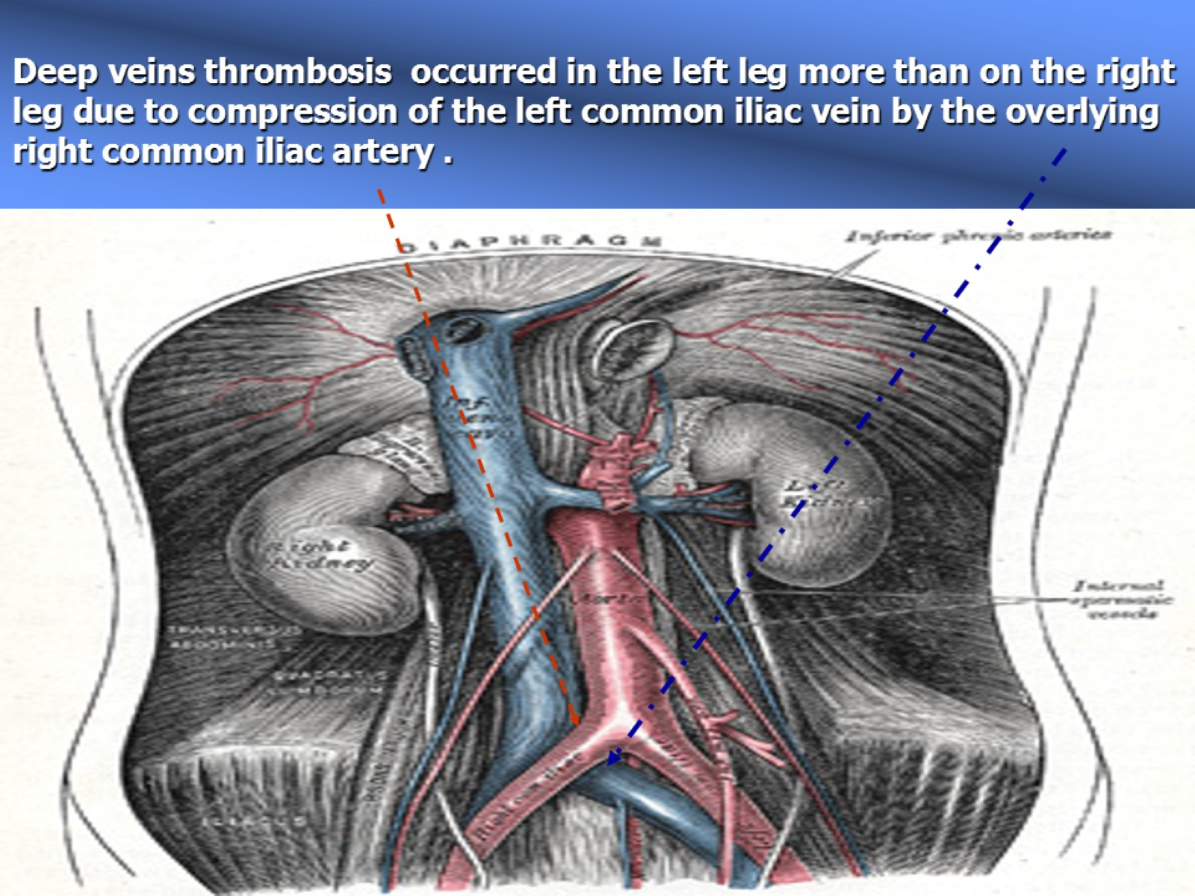
Deep veins thrombosis occurred in the left leg more than on the right leg due to compression of the left common iliac vein by the overlying right common iliac artery .

Slide 5
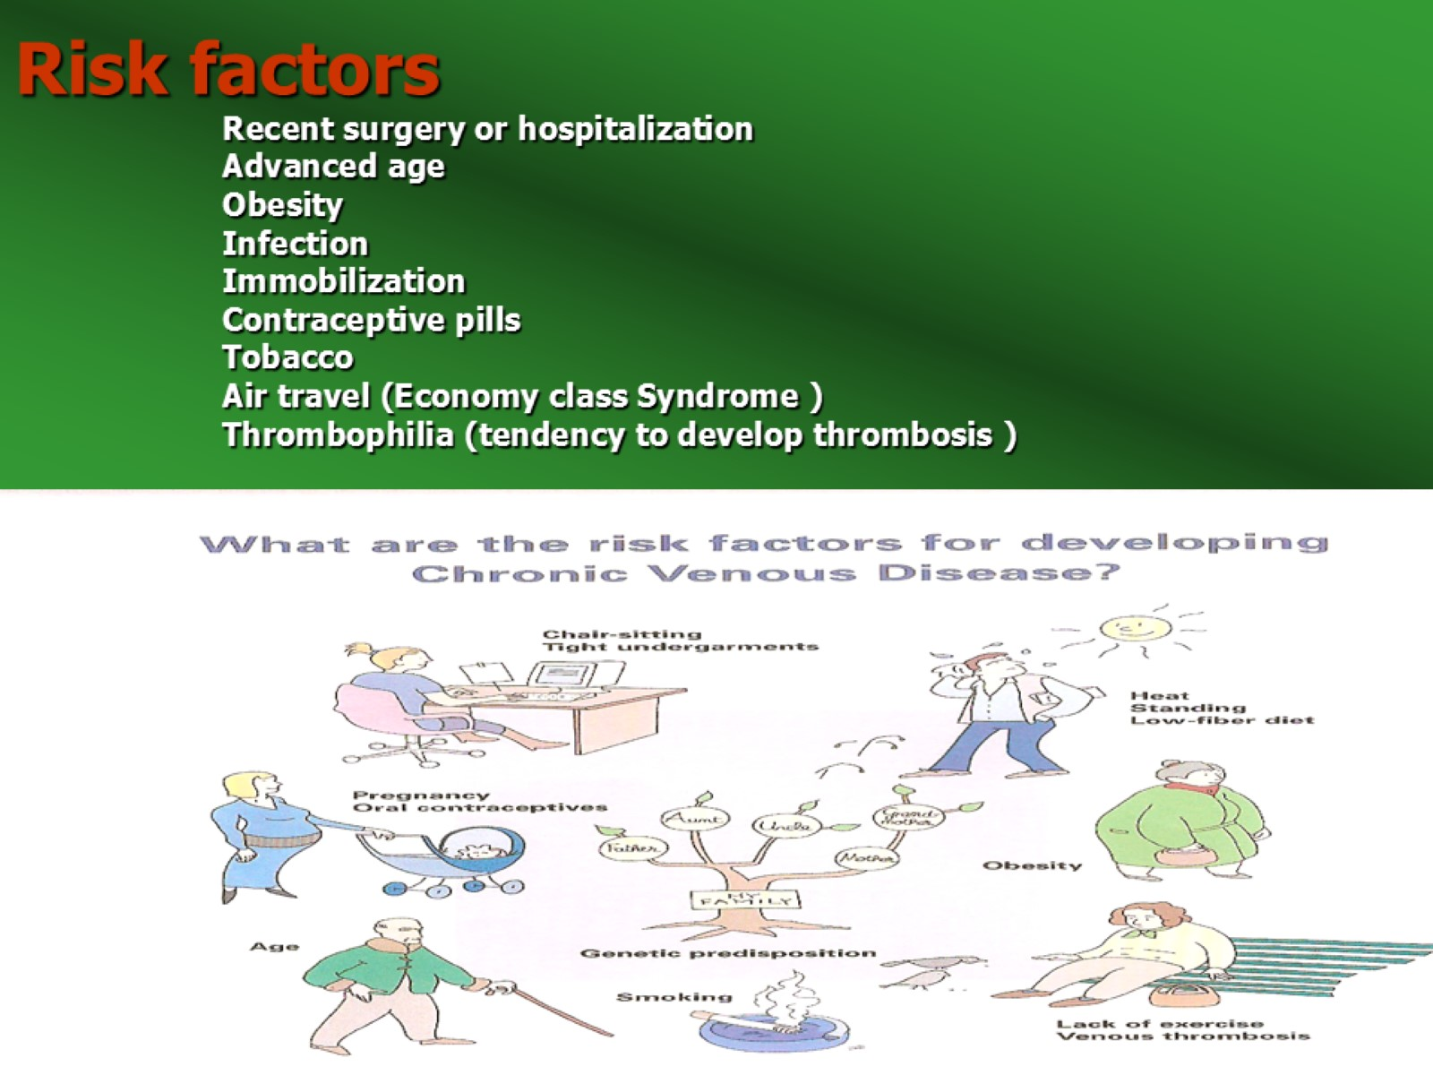
Risk factors
Recent surgery or hospitalization
Advanced age
Obesity
Infection
Immobilization
Contraceptive pills
Tobacco
Air travel (Economy class Syndrome )
Thrombophilia (tendency to develop thrombosis )

Slide 6
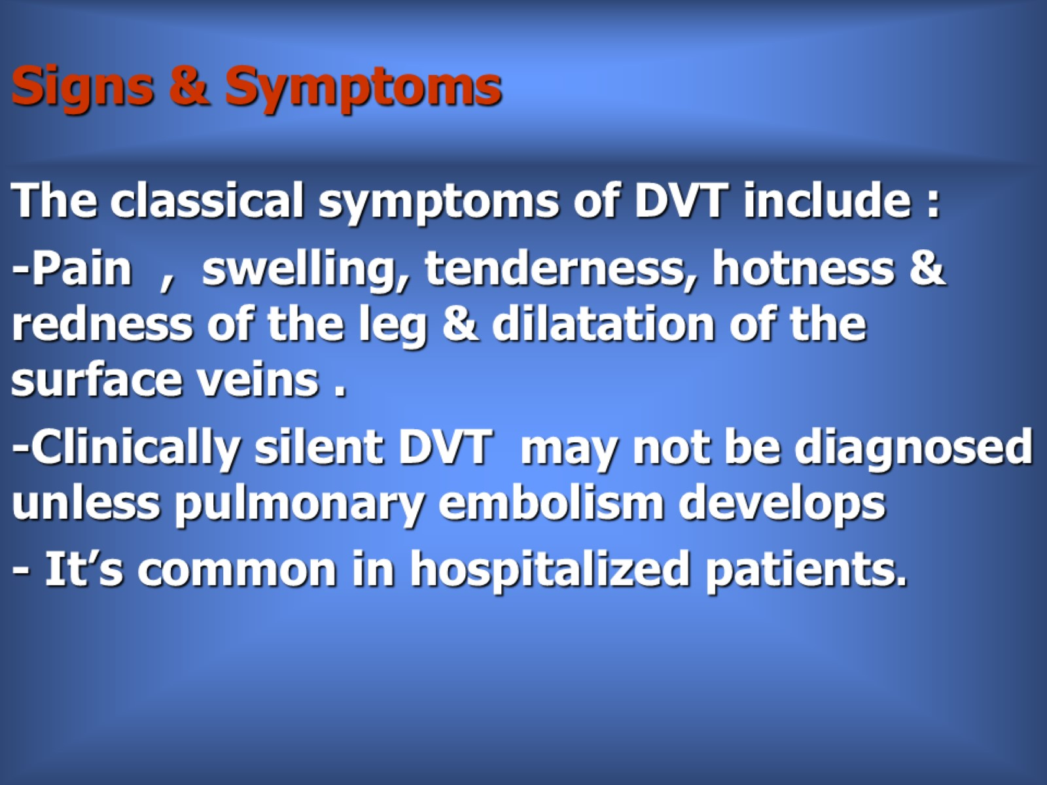
Signs & Symptoms

Slide 7
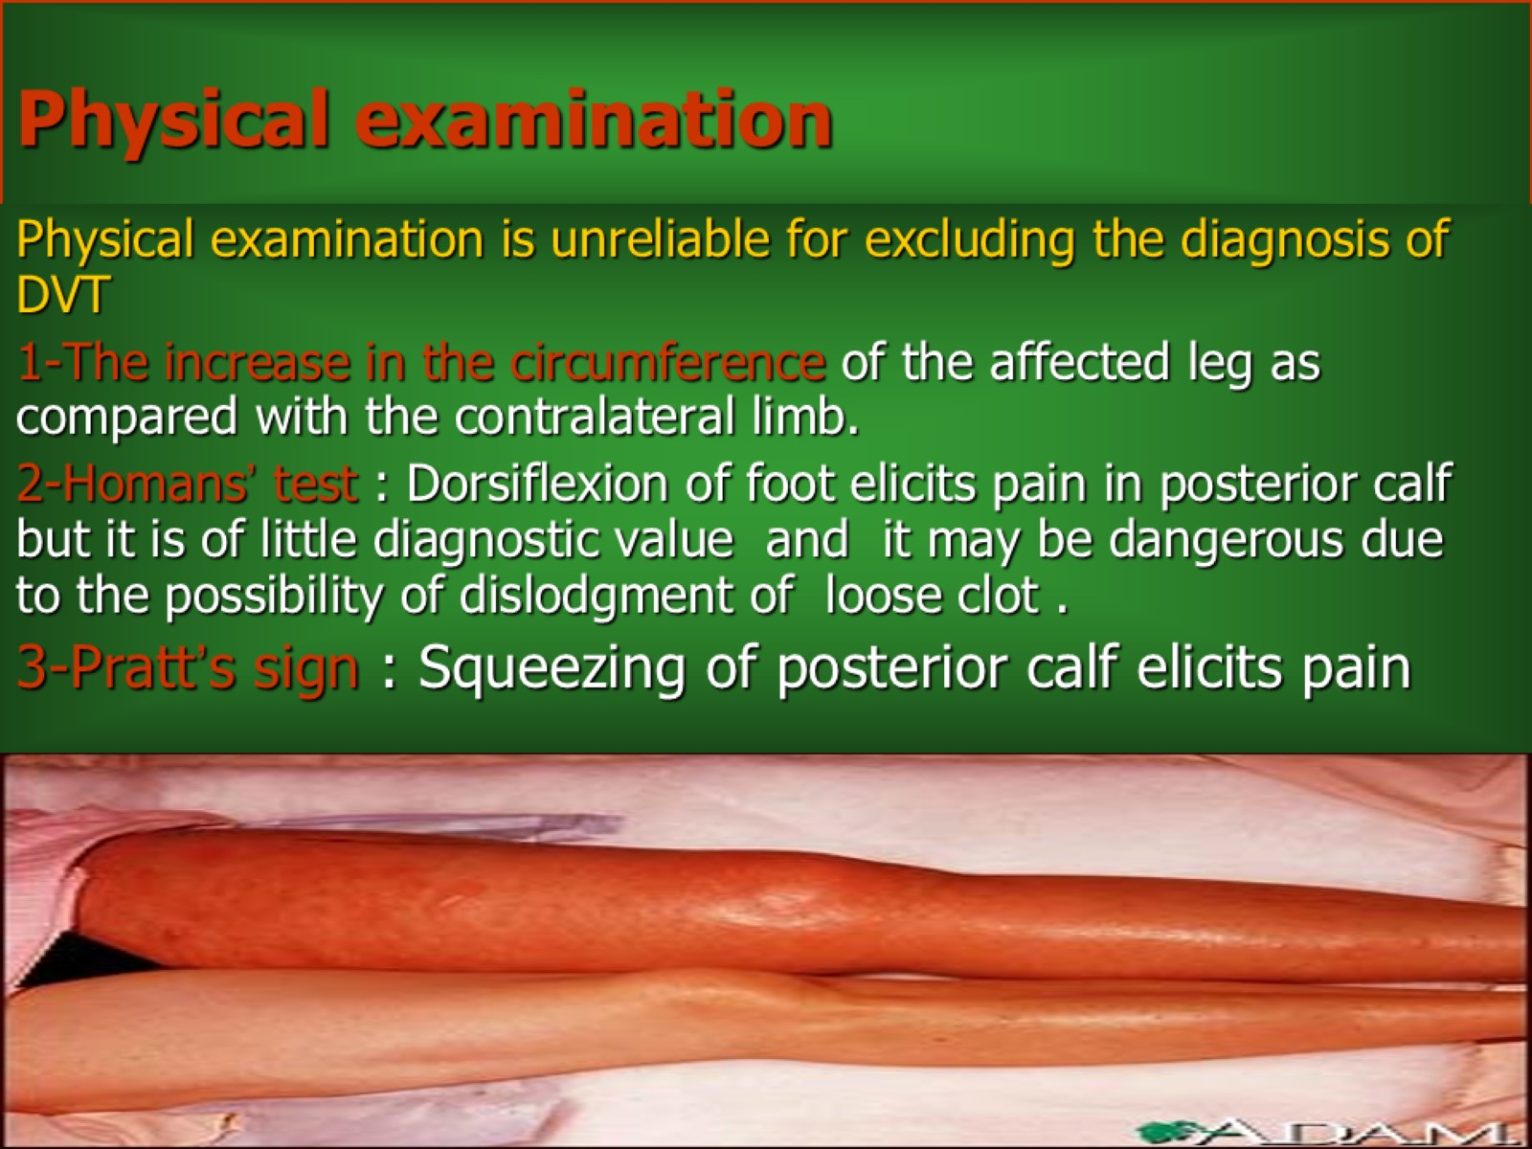
Physical examination

Slide 8
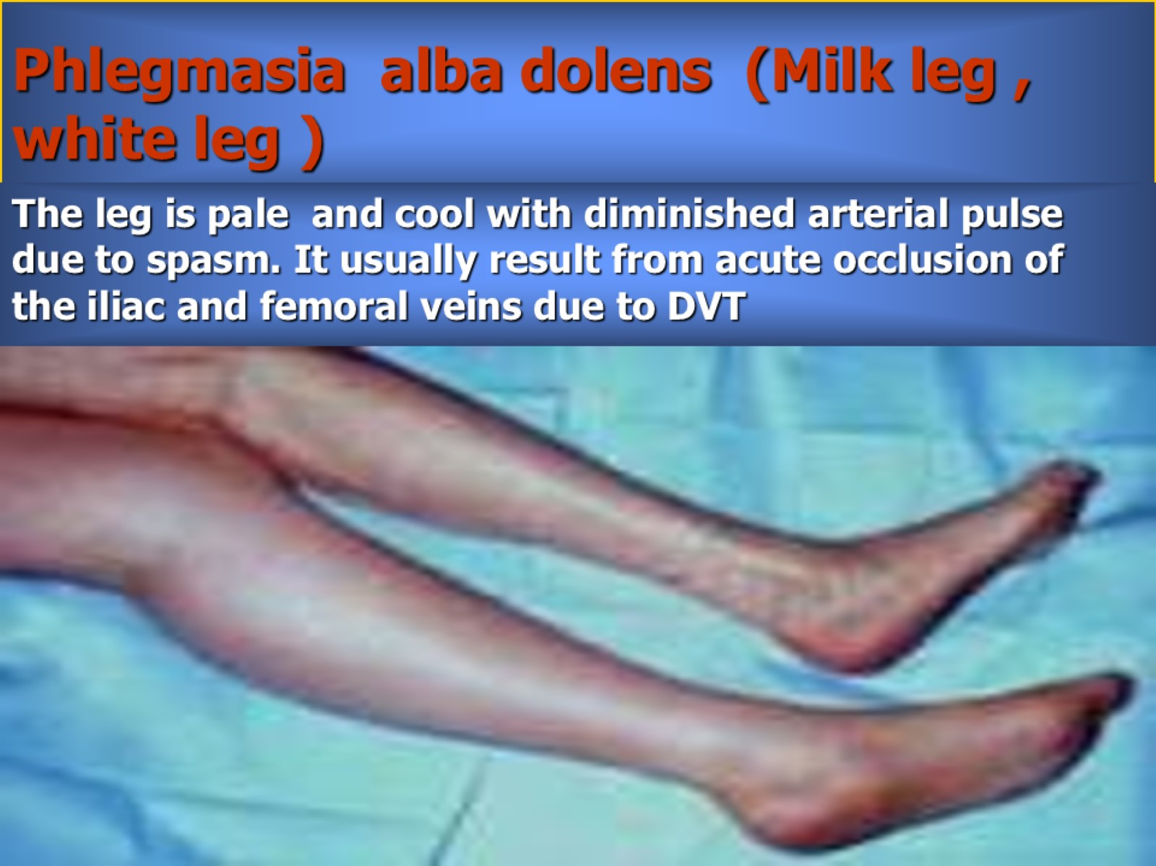
Phlegmasia alba dolens (Milk leg , white leg )

Slide 9
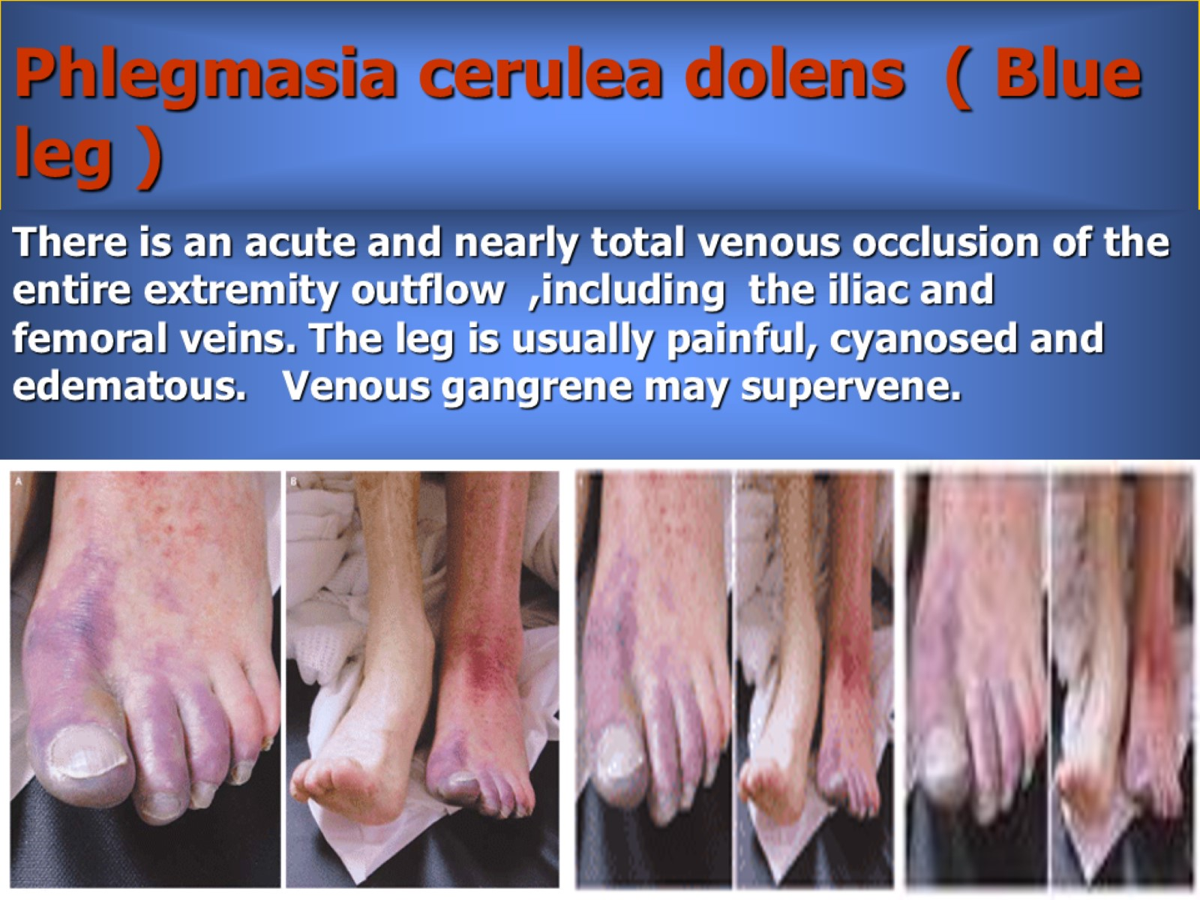
Phlegmasia cerulea dolens ( Blue leg )

Slide 10
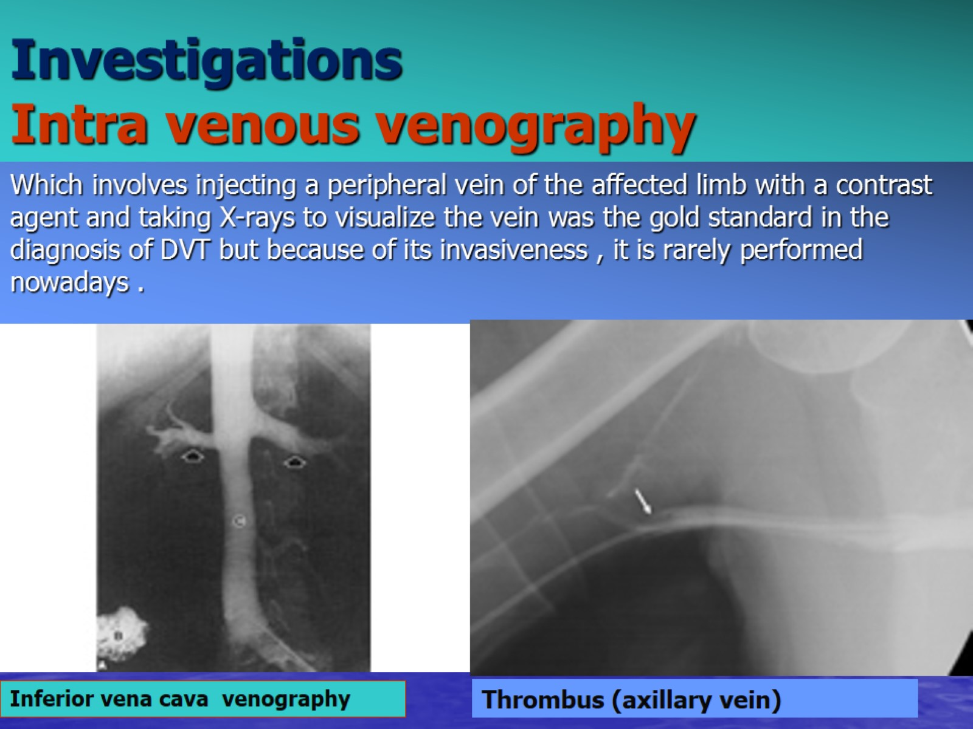
Investigations
Intra venous venography

Slide 11
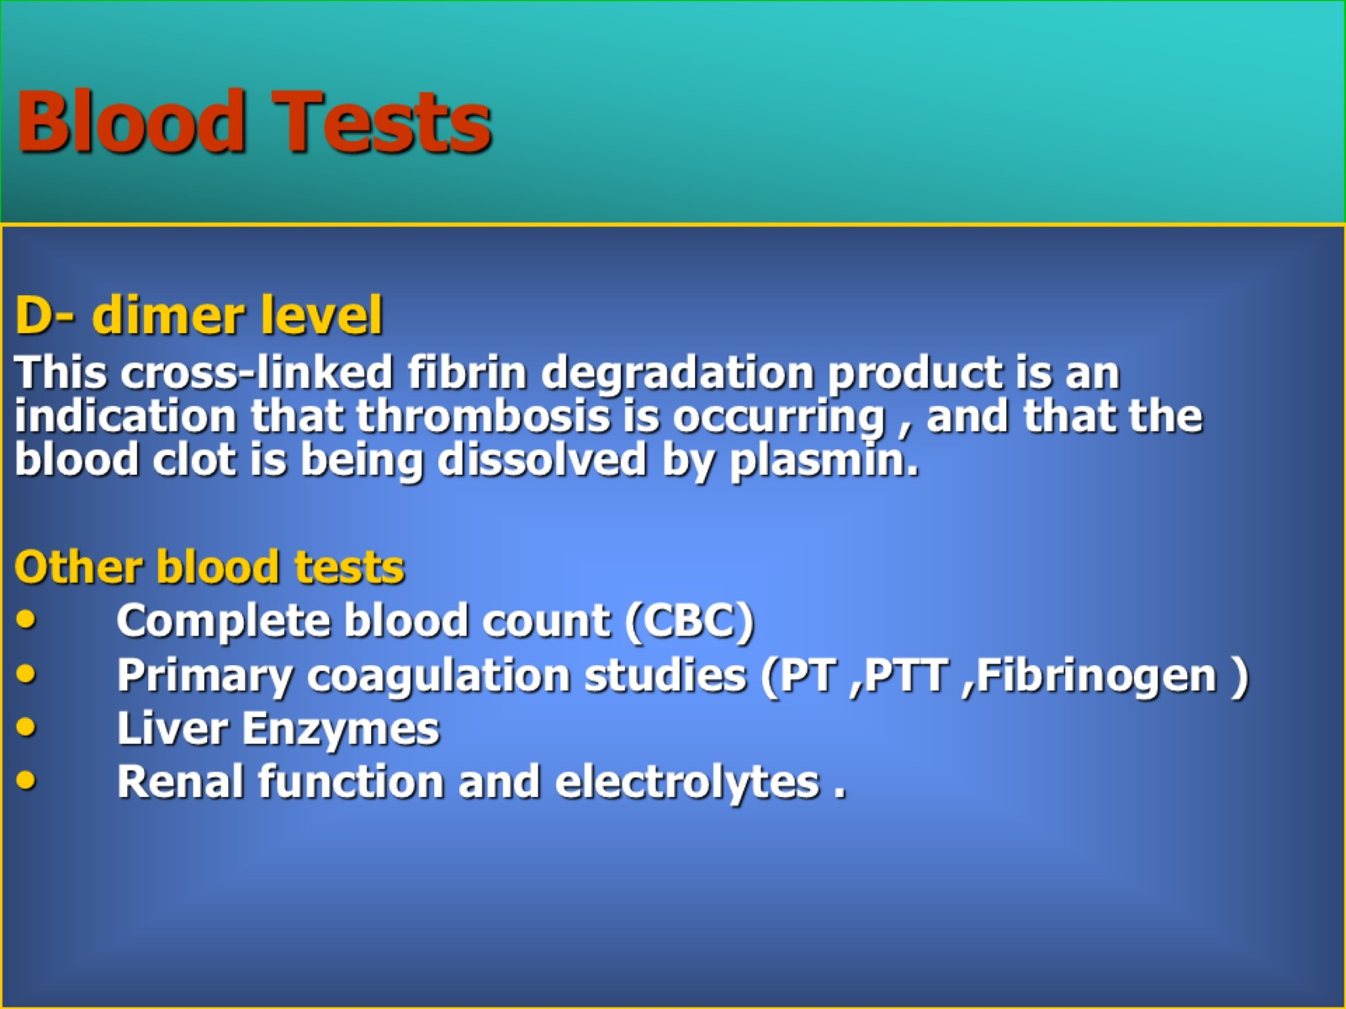
Blood Tests

Slide 12
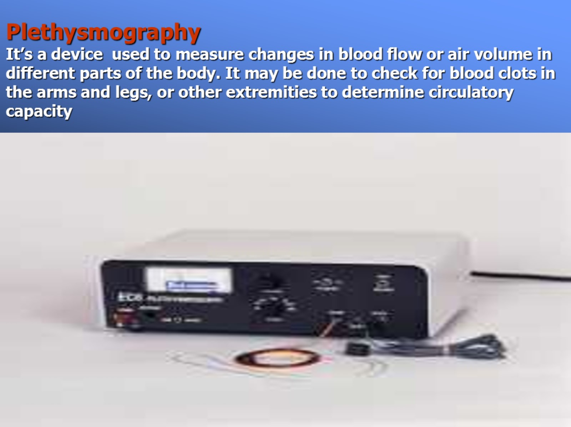
Plethysmography
It’s a device used to measure changes in blood flow or air volume in different parts of the body. It may be done to check for blood clots in the arms and legs, or other extremities to determine circulatory capacity

Slide 13
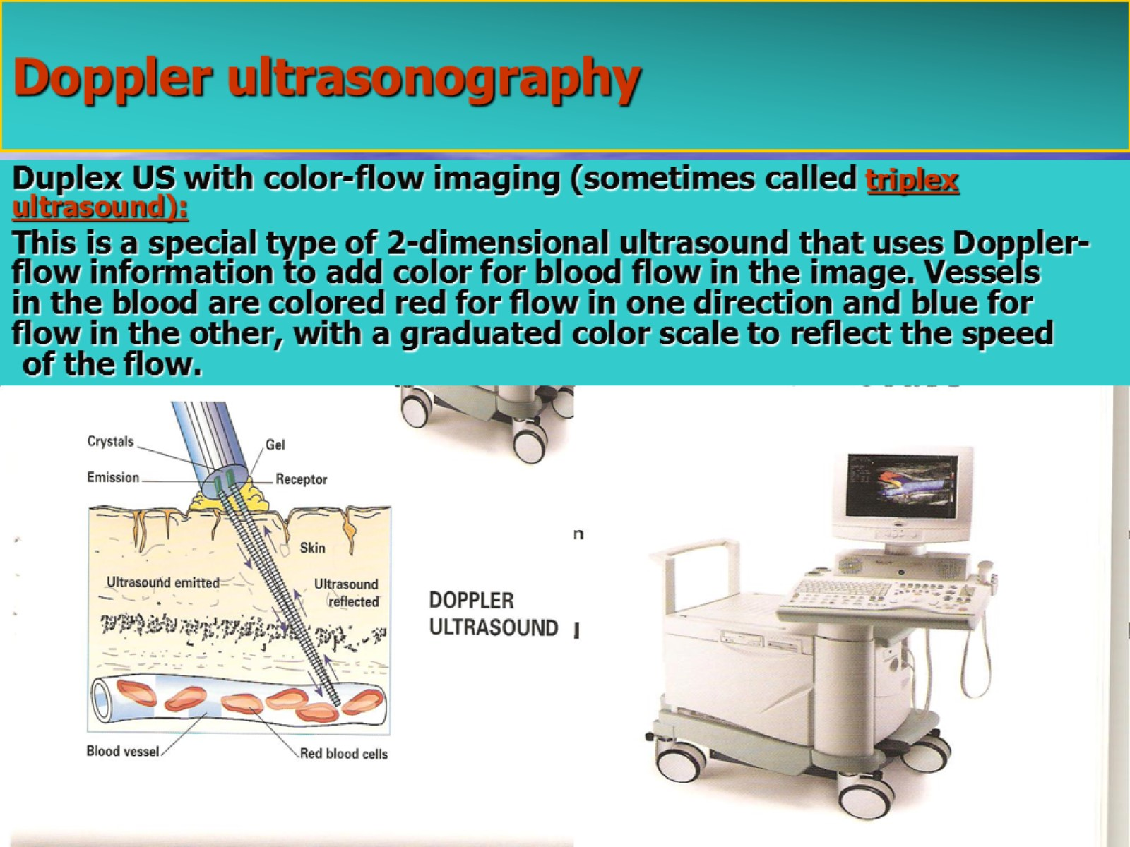
Doppler ultrasonography

Slide 14
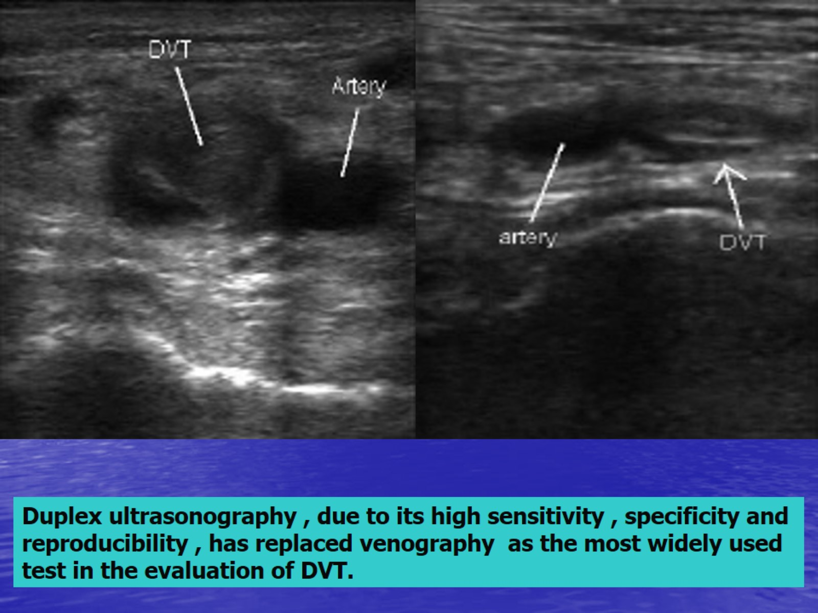

Slide 15
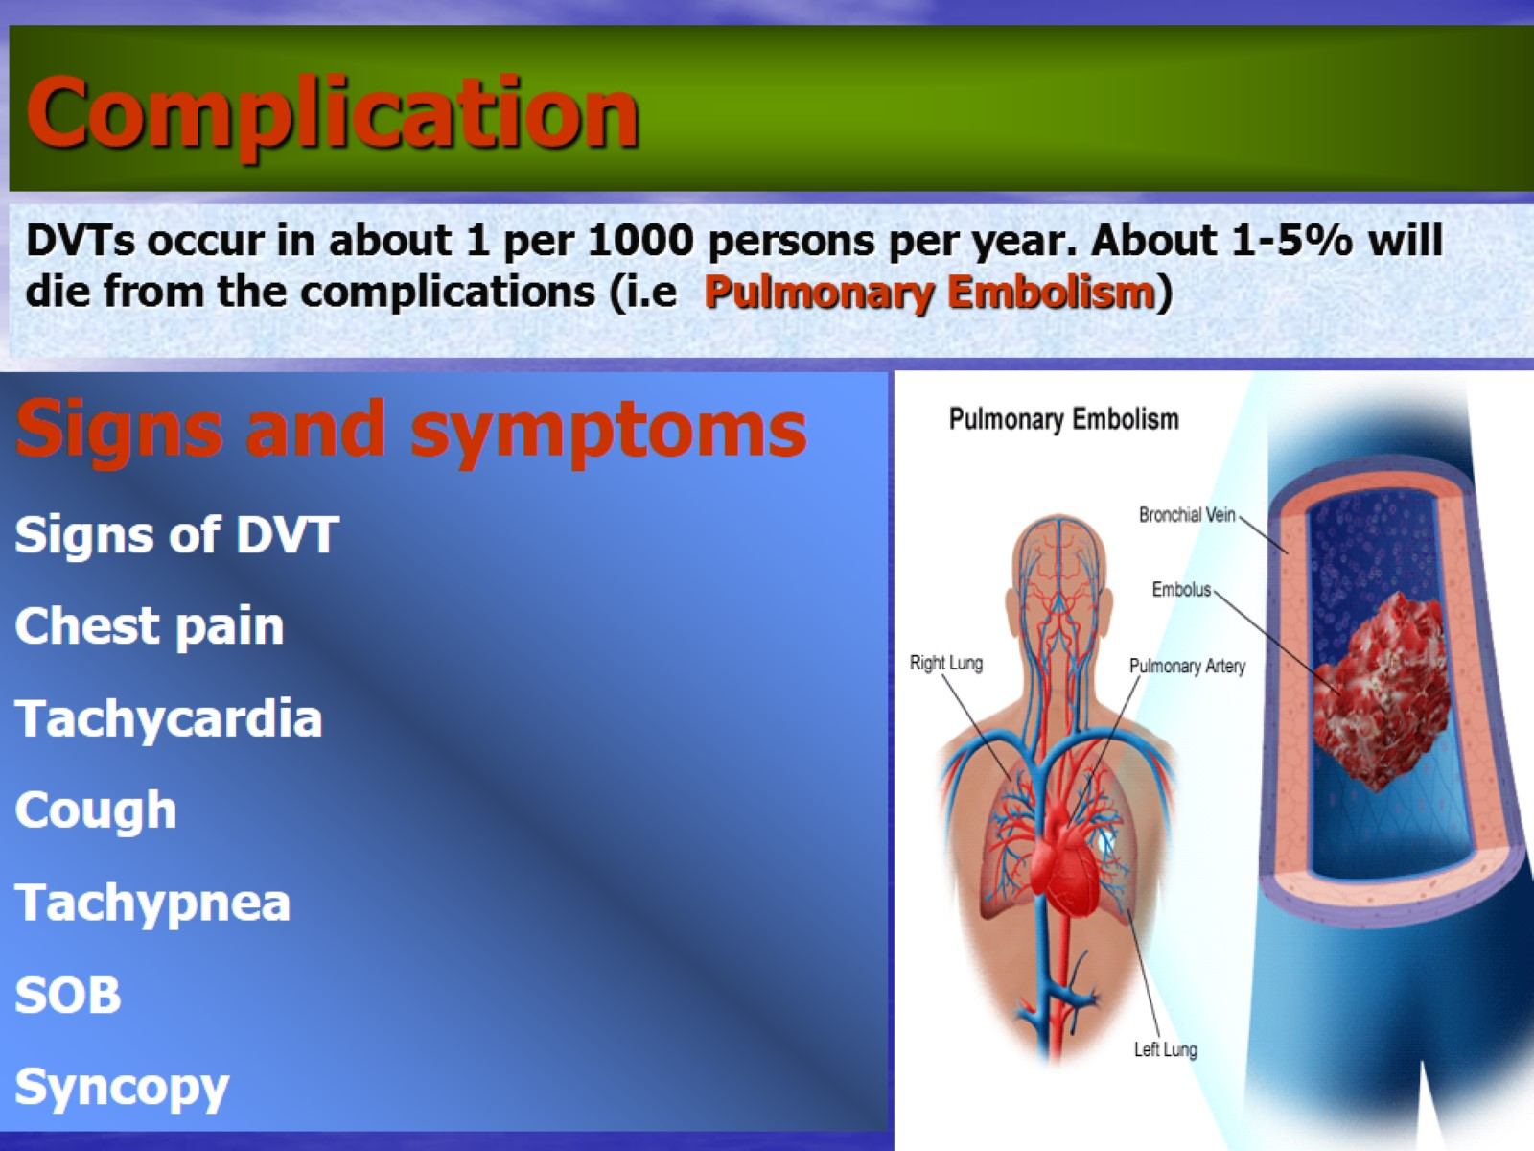
Complication

Slide 16
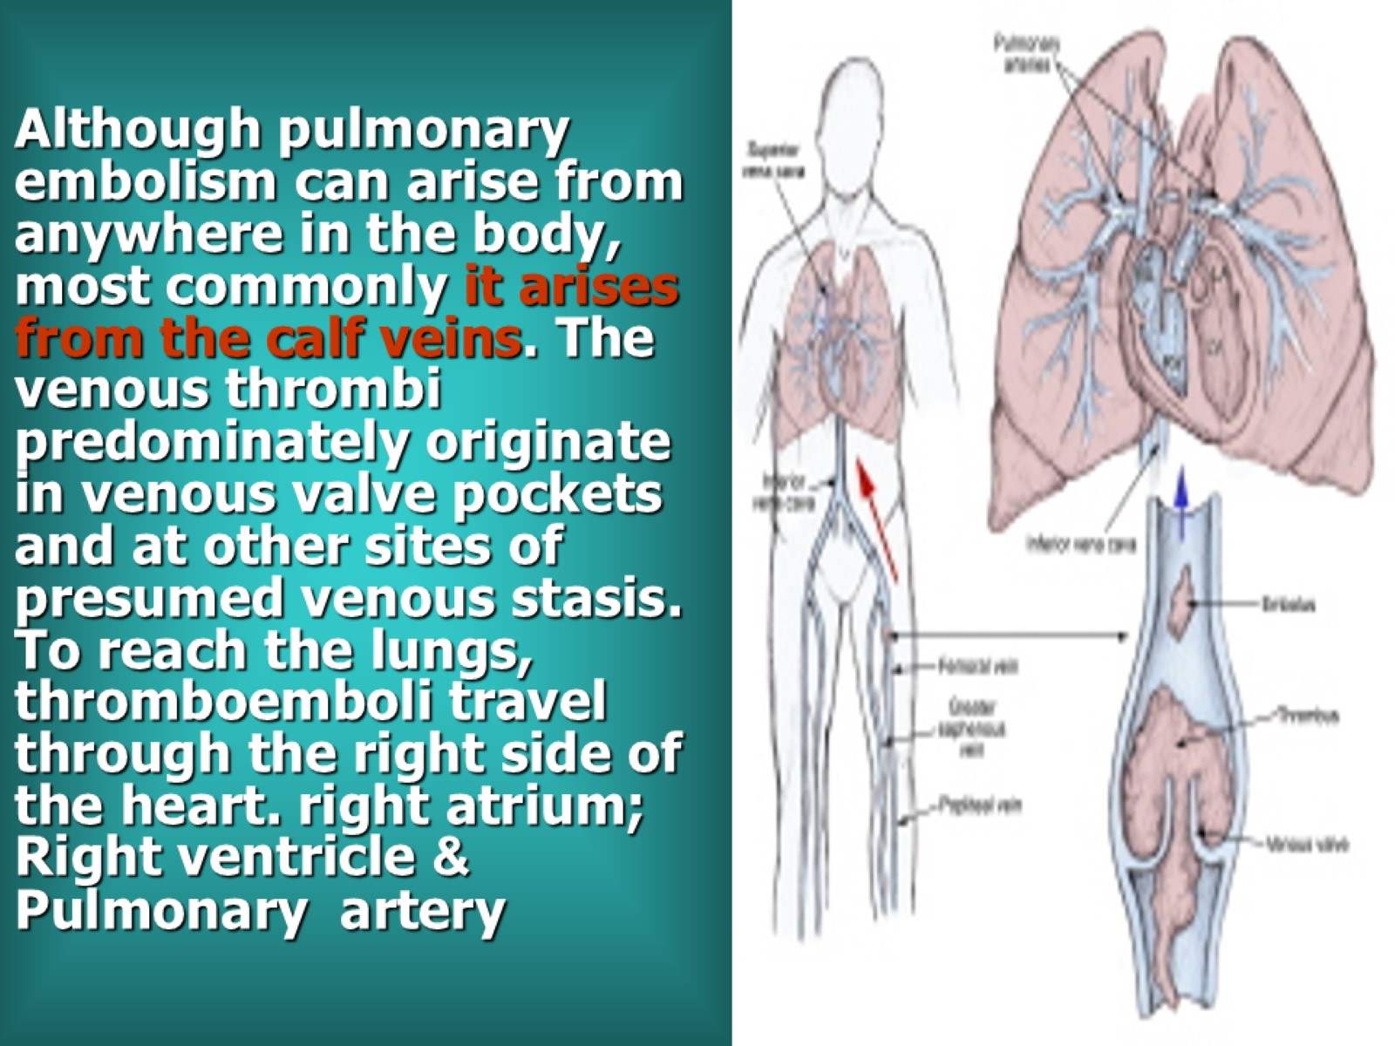
Although pulmonary embolism can arise from anywhere in the body, most commonly it arises from the calf veins. The venous thrombi predominately originate in venous valve pockets and at other sites of presumed venous stasis. To reach the lungs, thromboemboli travel through the right side of the heart. right atrium; &Right ventricle Pulmonary artery

Slide 17
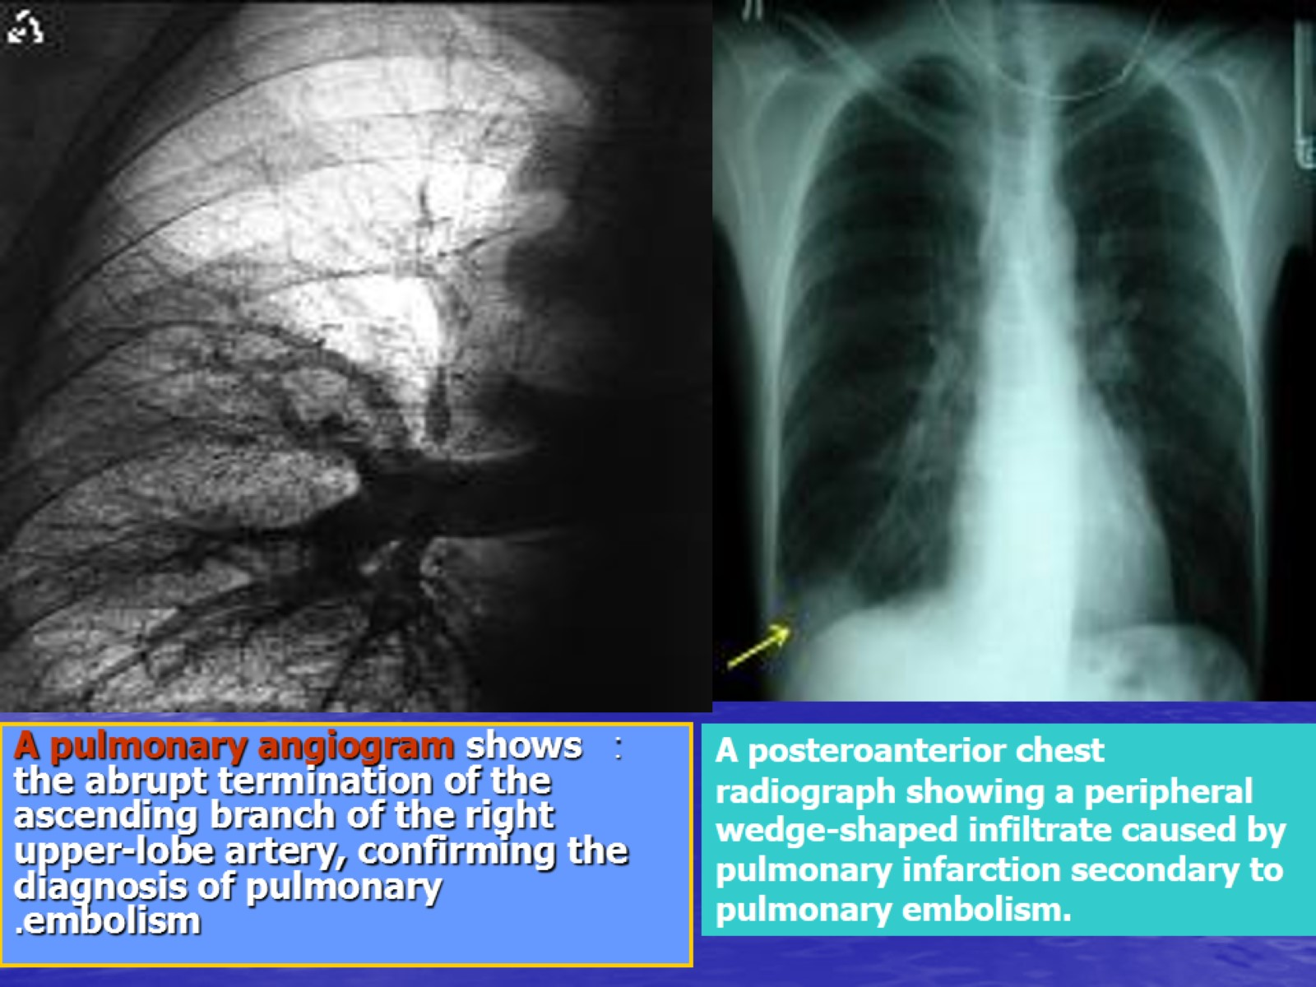

Slide 18
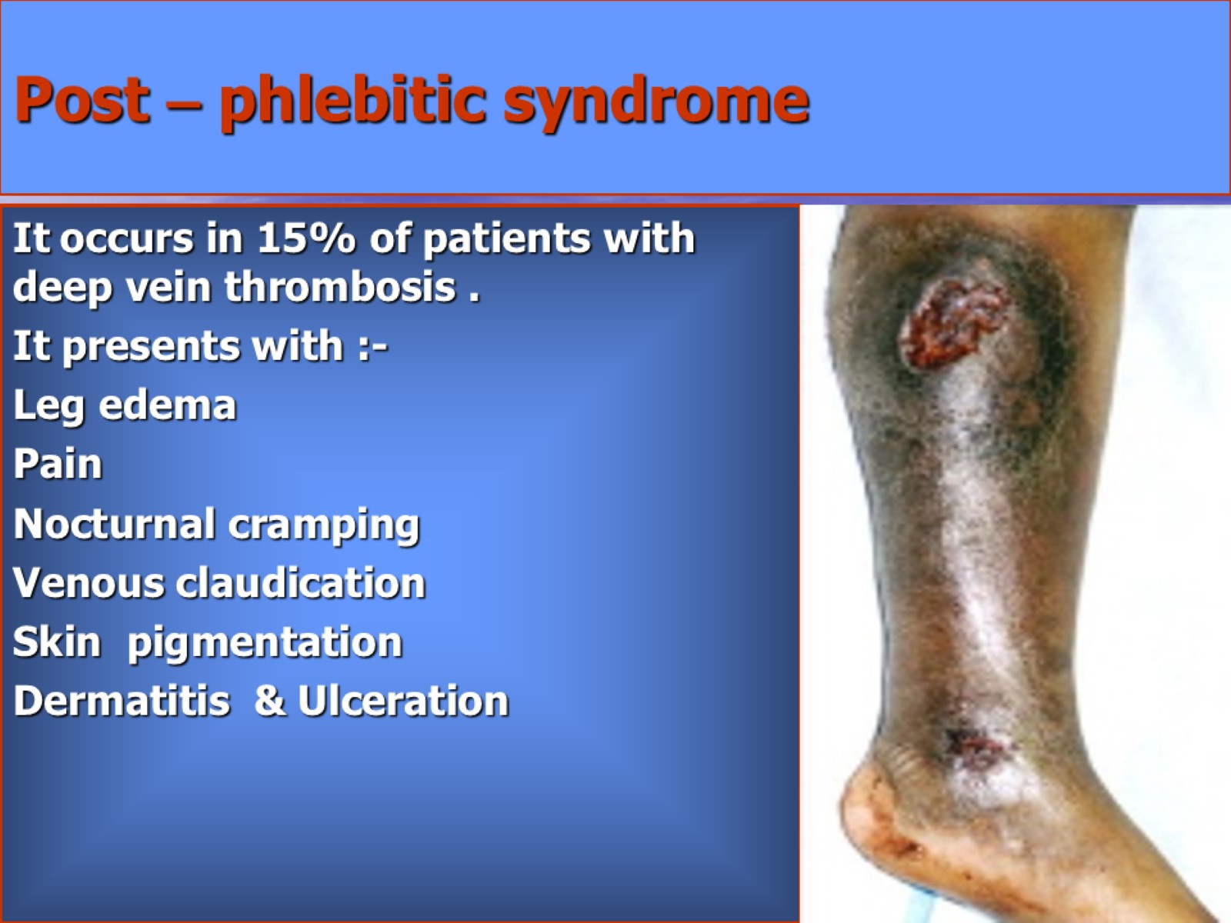
Post – phlebitic syndrome

Slide 19
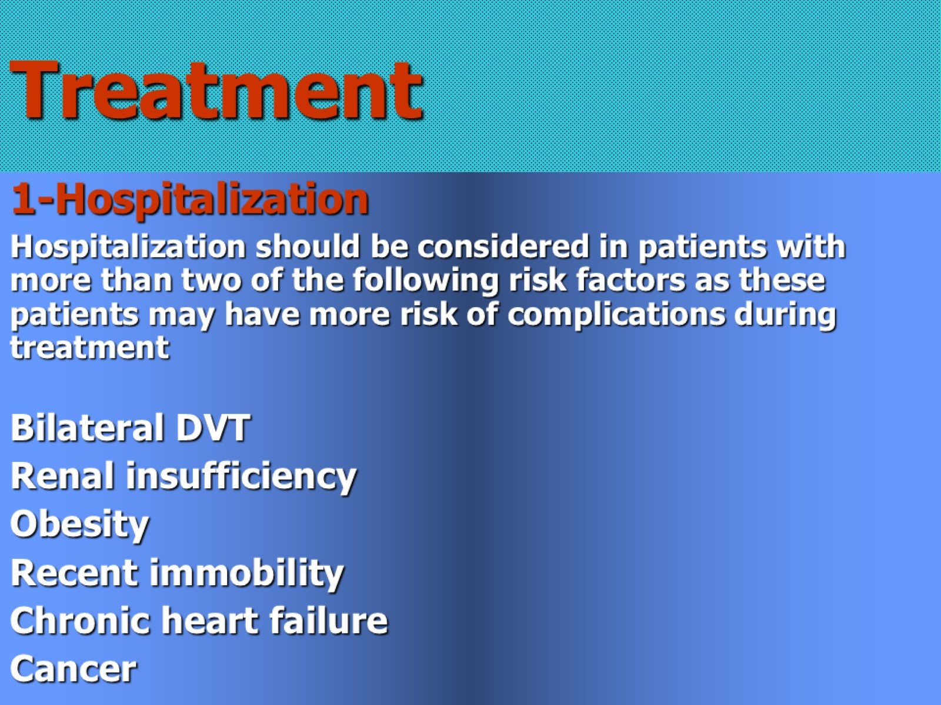
Treatment

Slide 20
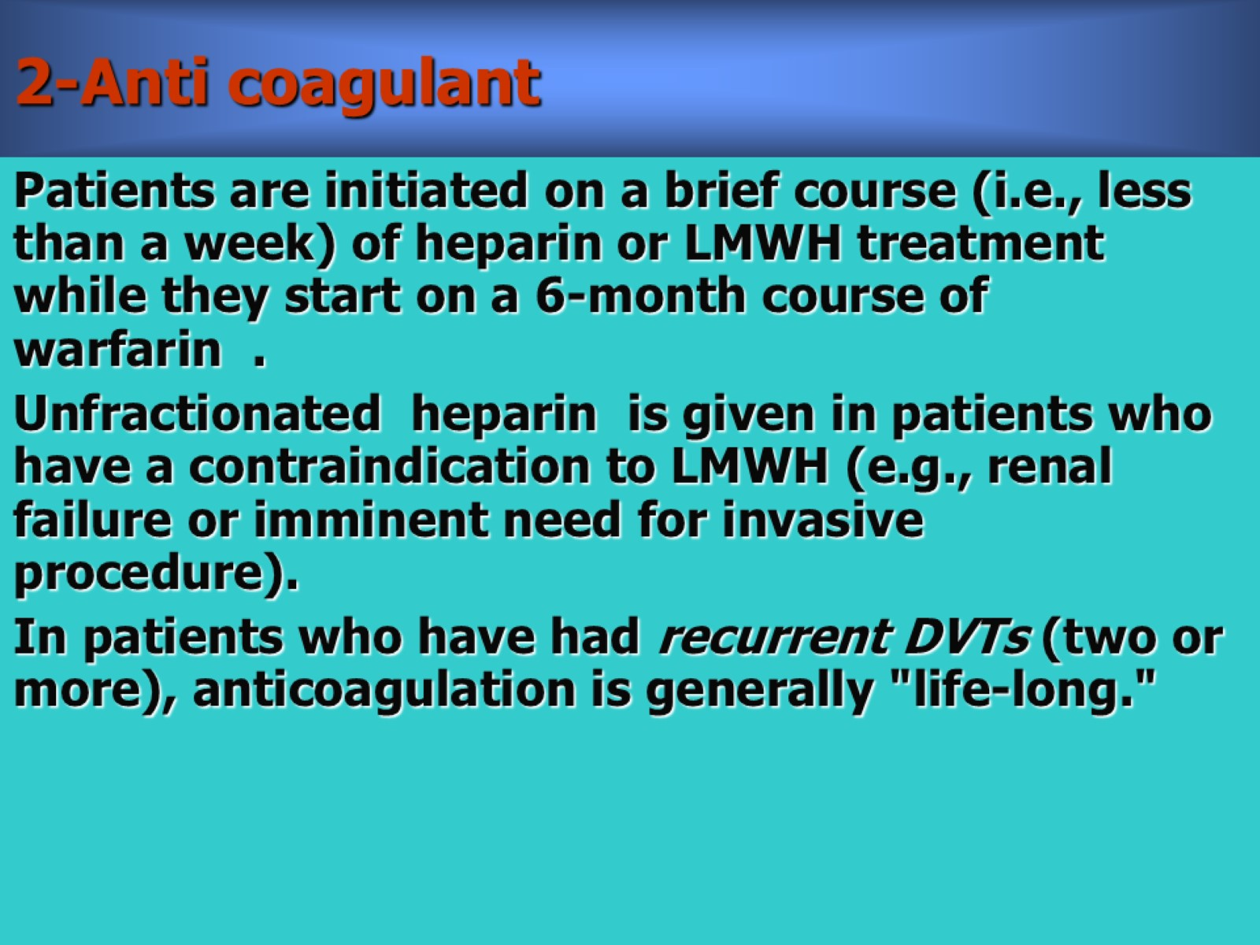
2-Anti coagulant

Slide 21
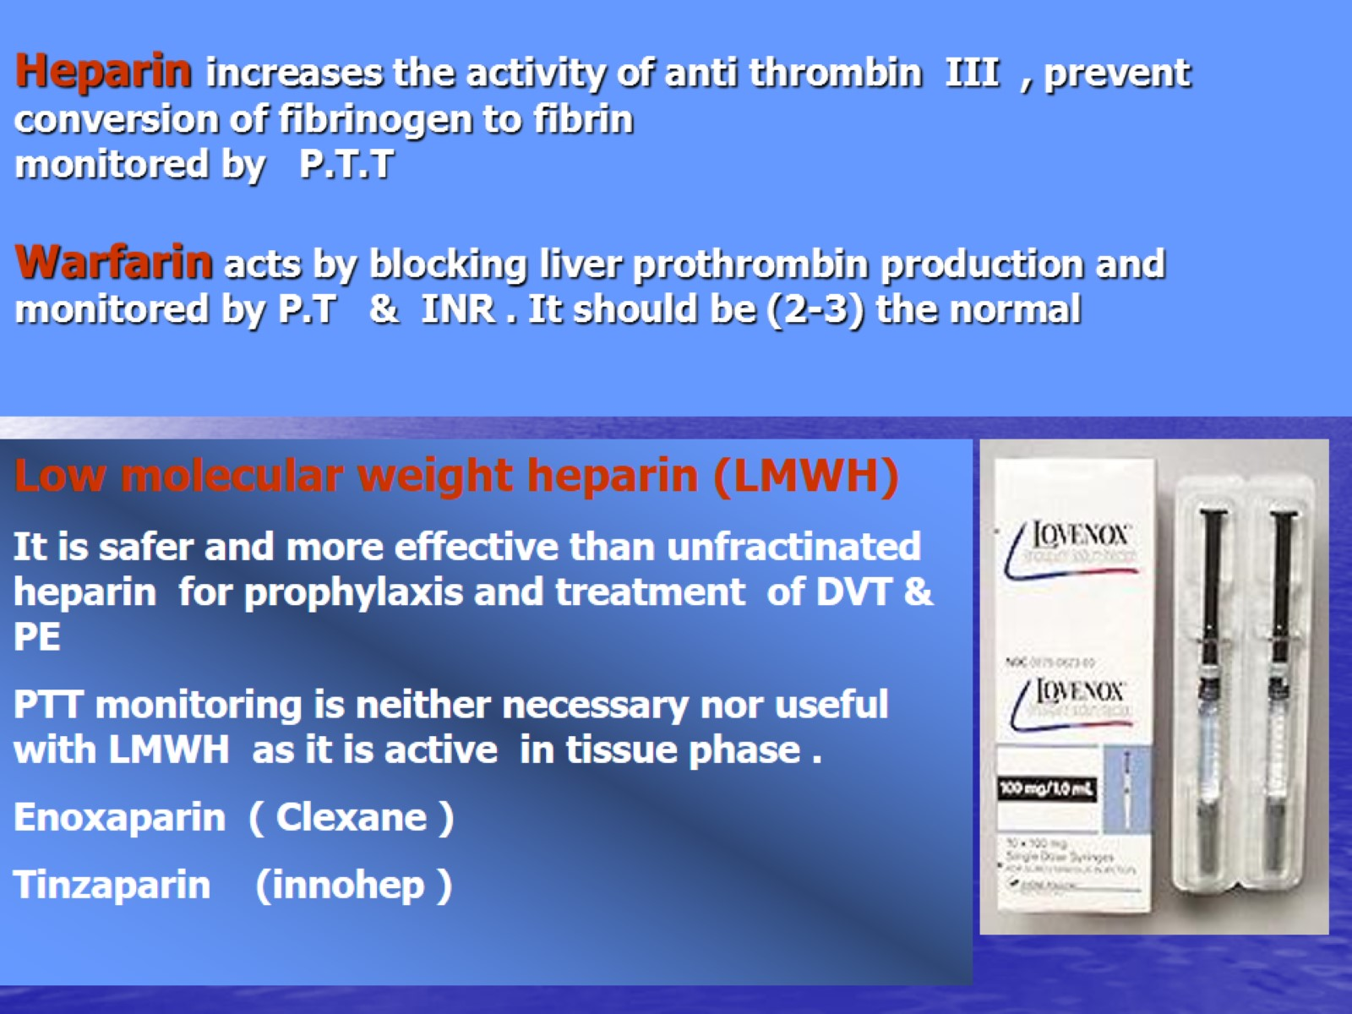
Heparin increases the activity of anti thrombin III , prevent conversion of fibrinogen to fibrin monitored by P.T.T

Slide 22
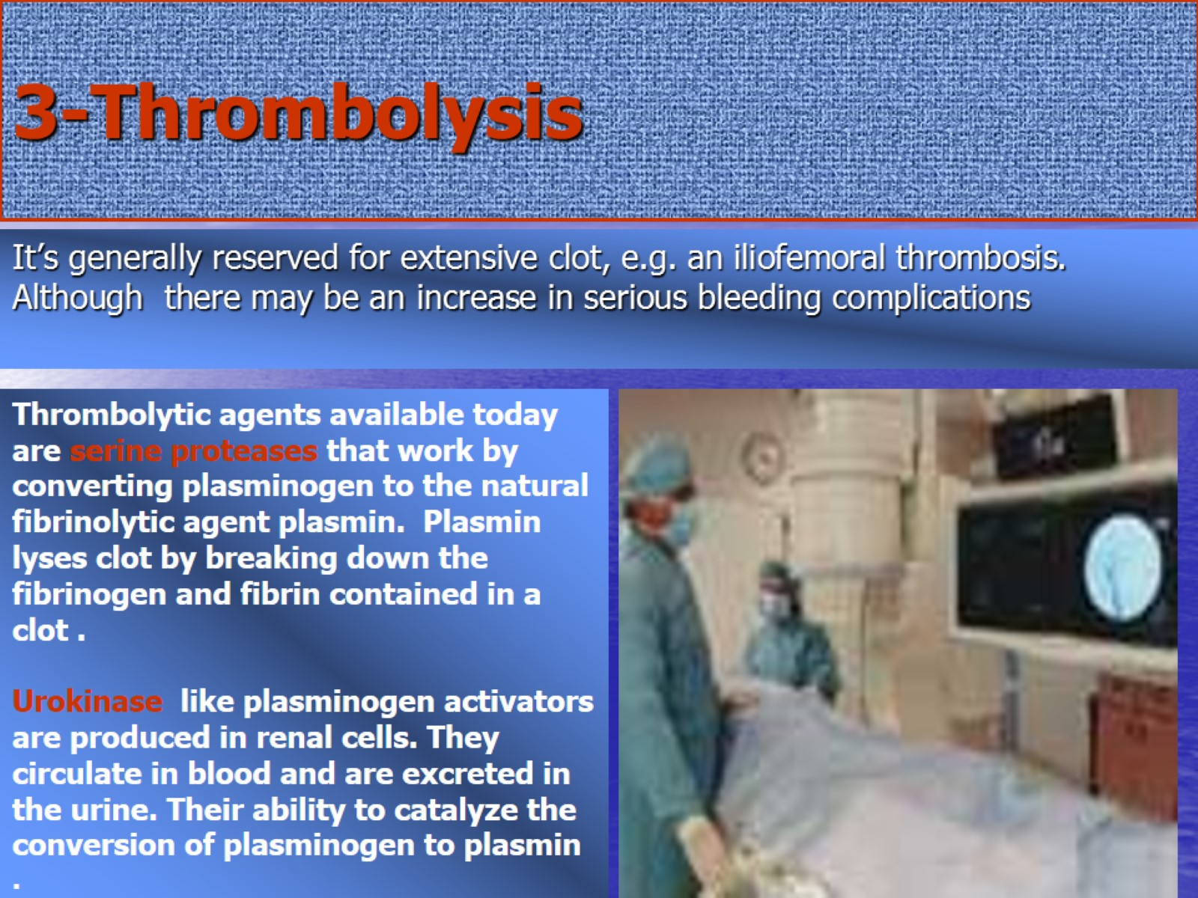
3-Thrombolysis

Slide 23
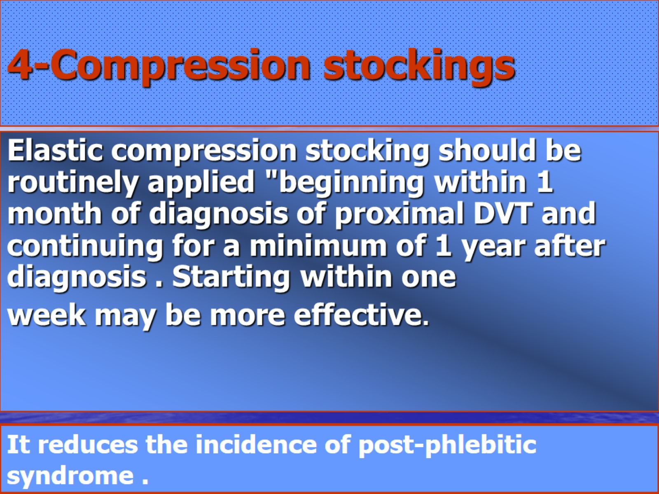
4-Compression stockings

Slide 24
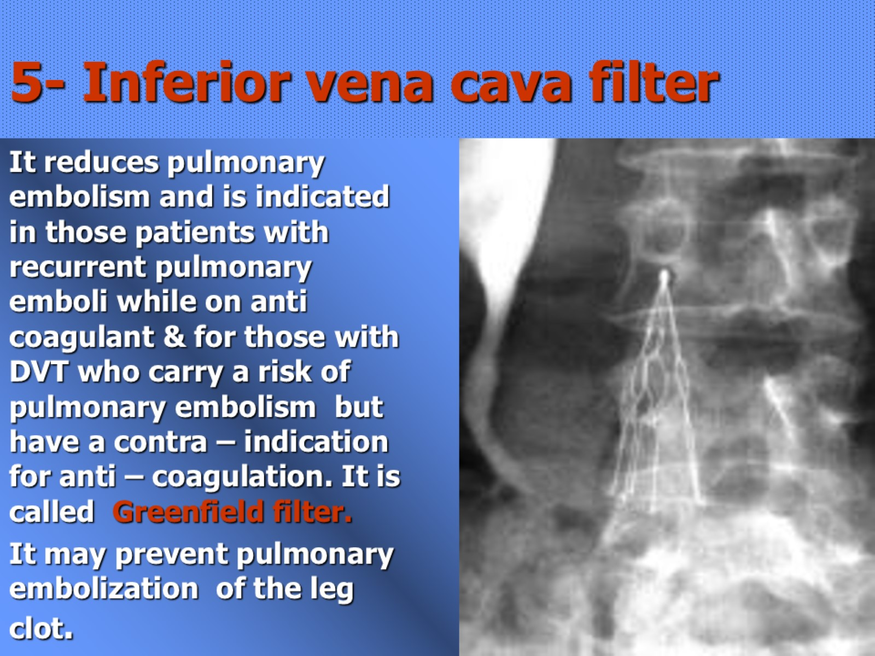
5- Inferior vena cava filter

Slide 25
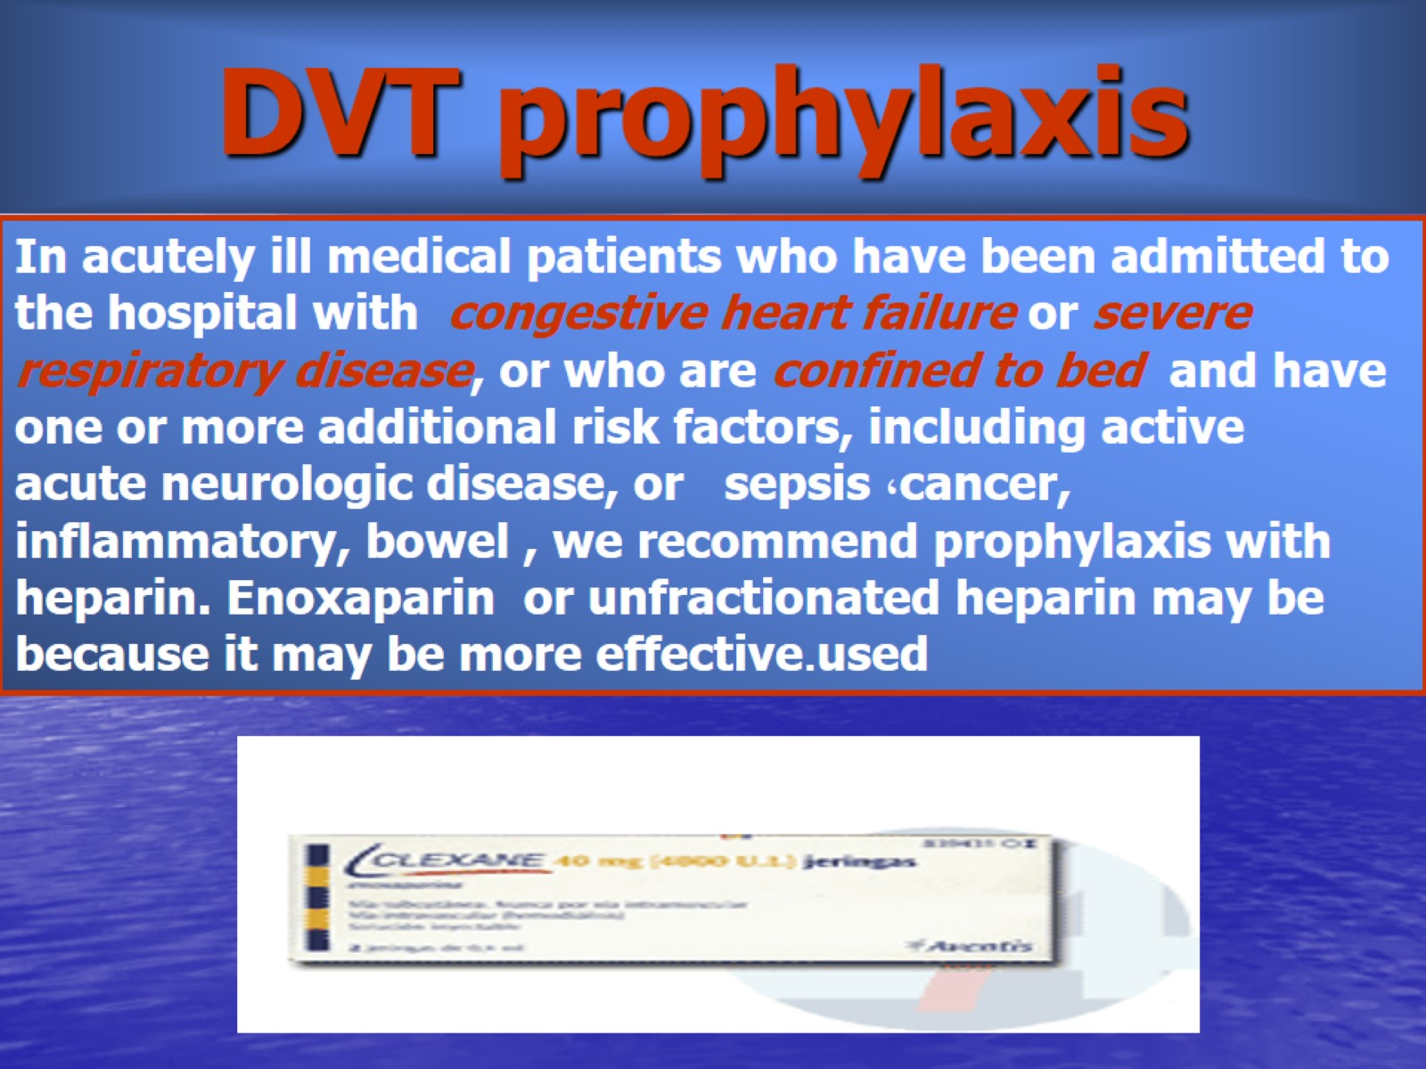
DVT prophylaxis

Slide 26
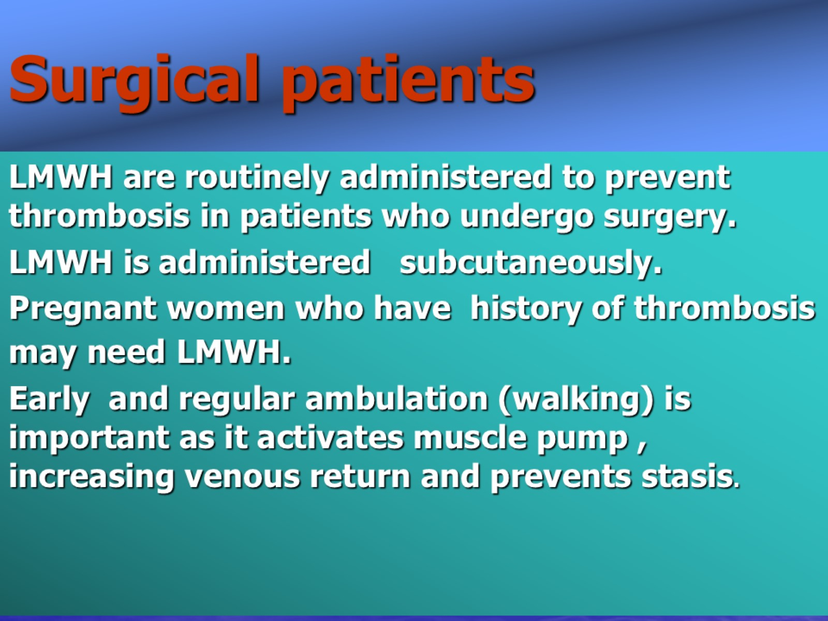
Surgical patients

Slide 27
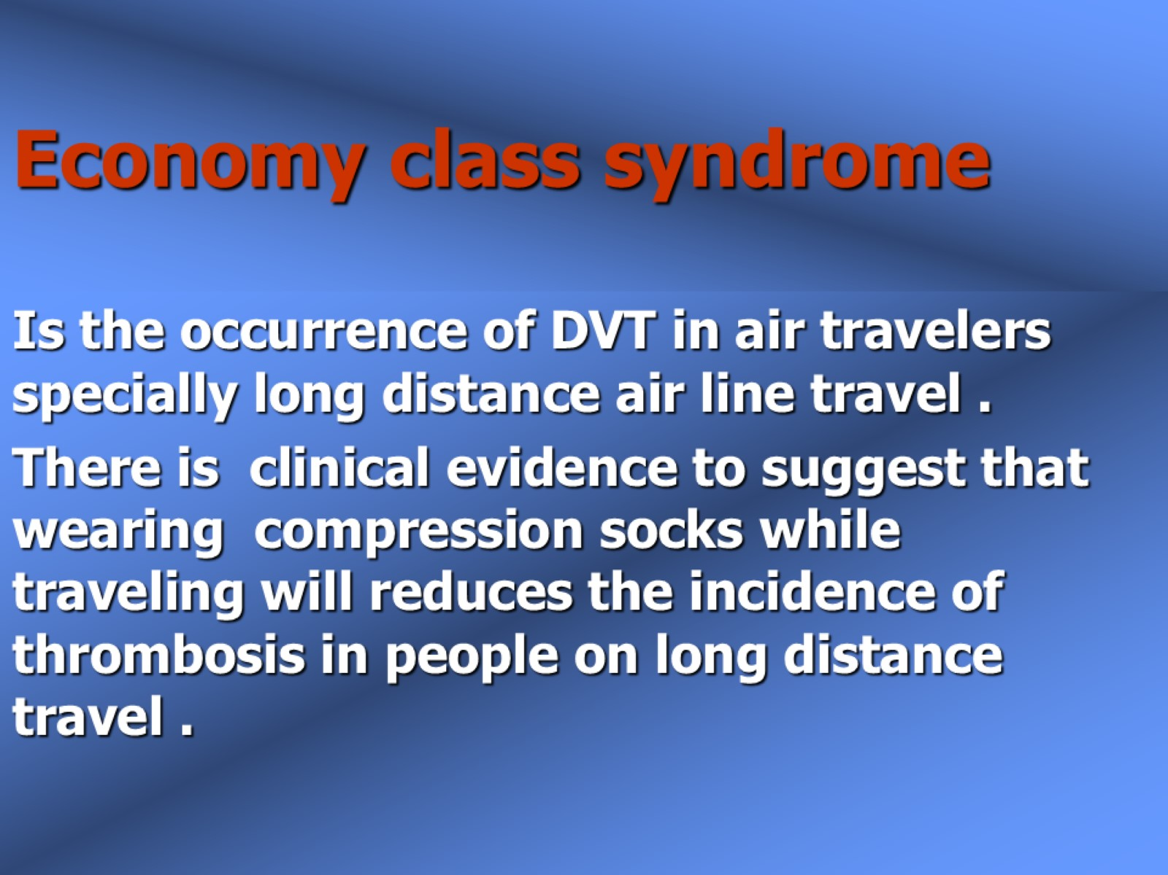
Economy class syndrome

Slide 28


