Slide 1
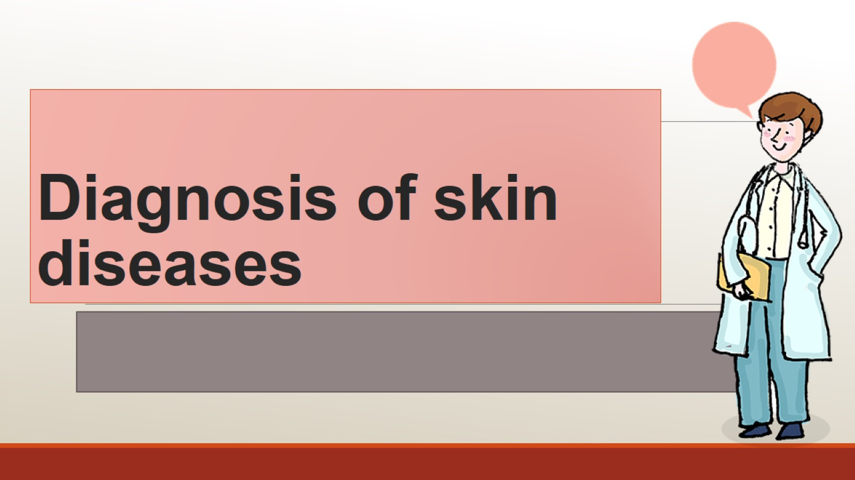
Diagnosis of skin diseases

Slide 2
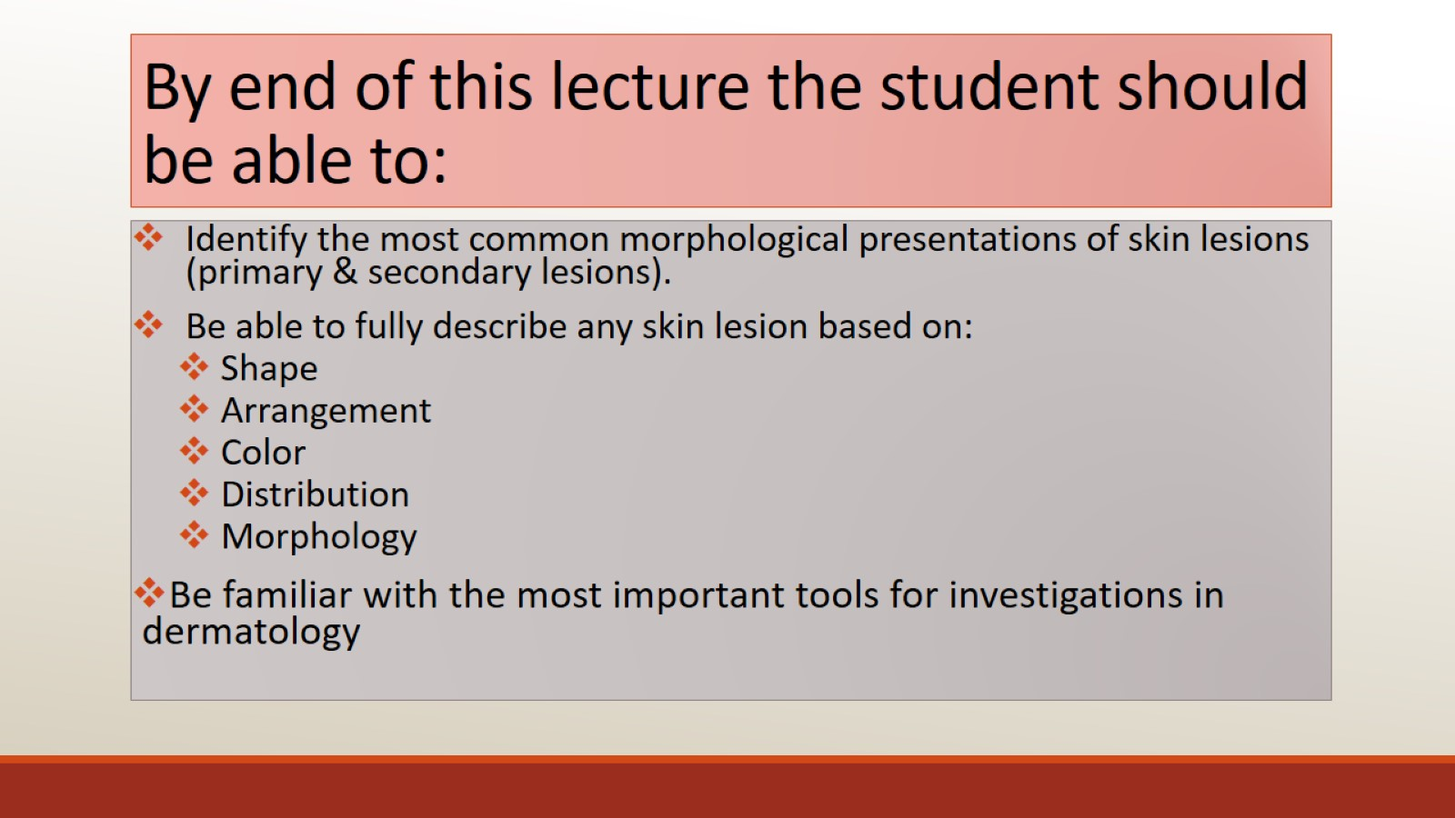
By end of this lecture the student should be able to:

Slide 3
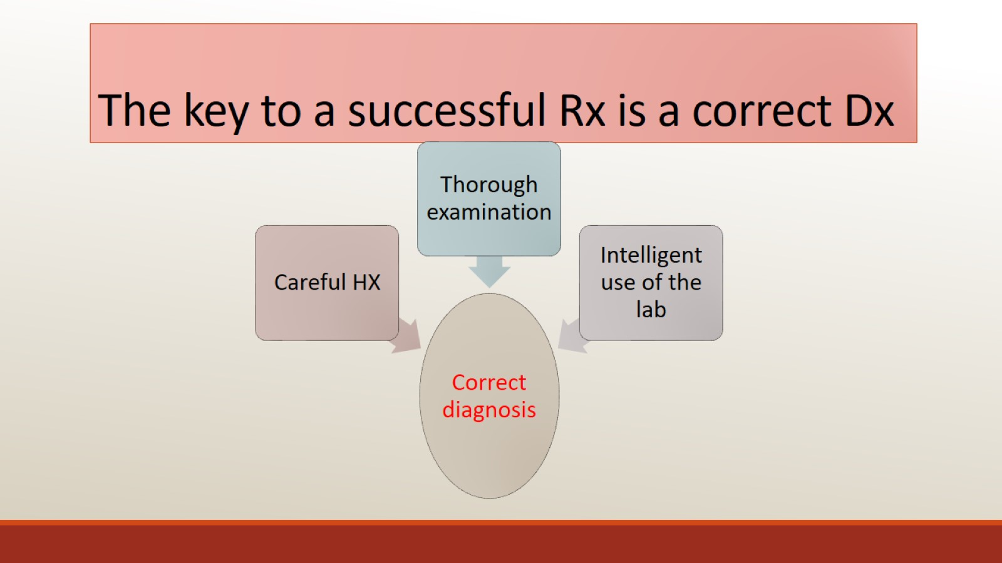
The key to a successful Rx is a correct Dx

Slide 4
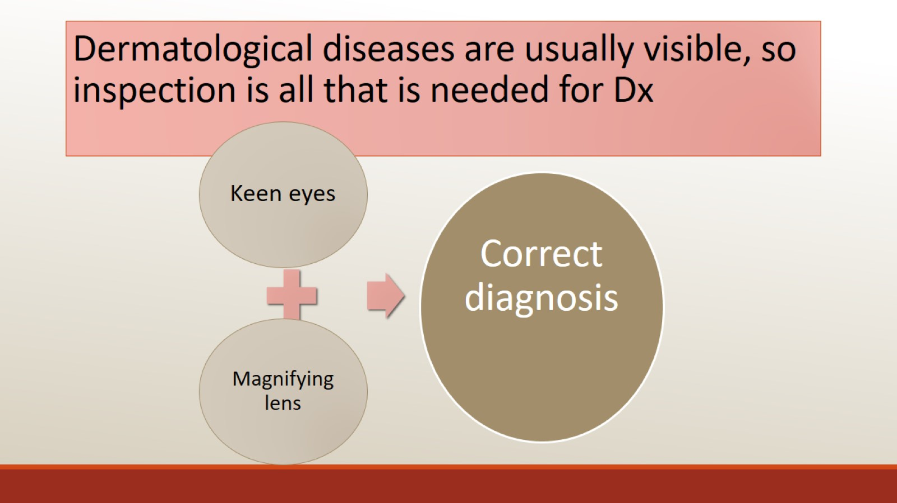
Dermatological diseases are usually visible, so inspection is all that is needed for Dx

Slide 5
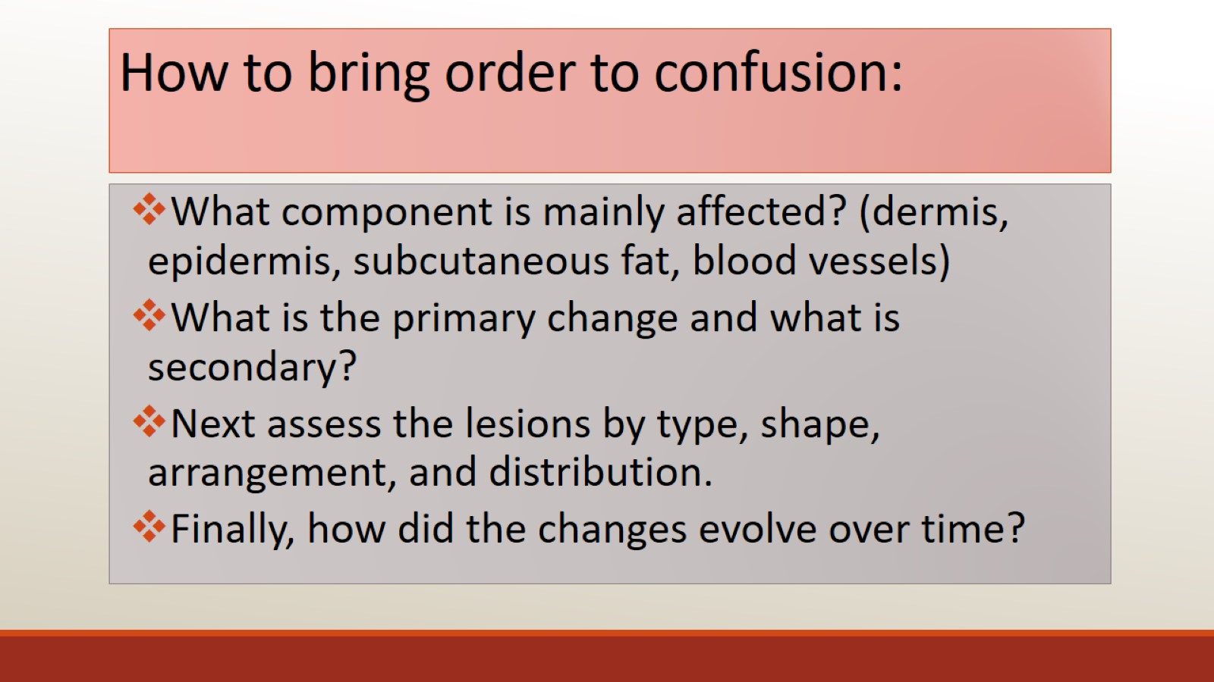
How to bring order to confusion:

Slide 6
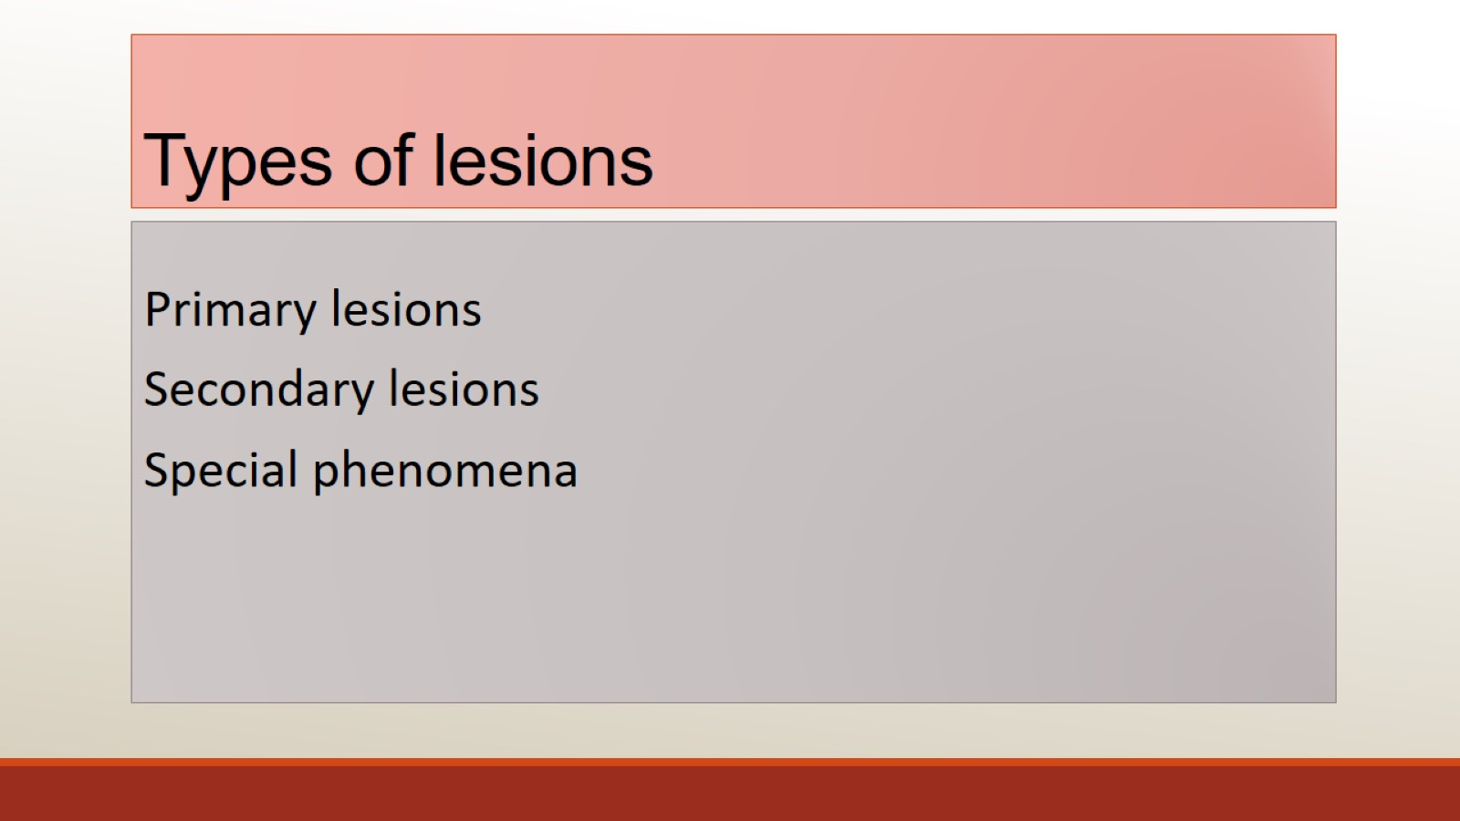
Types of lesions

Slide 7
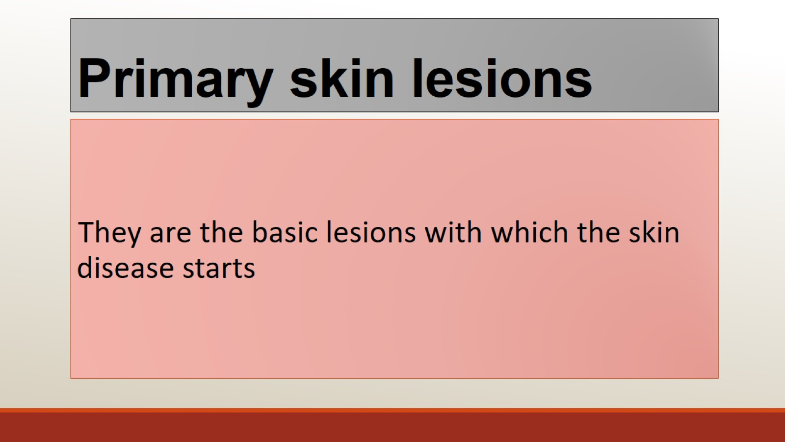
Primary skin lesions

Slide 8
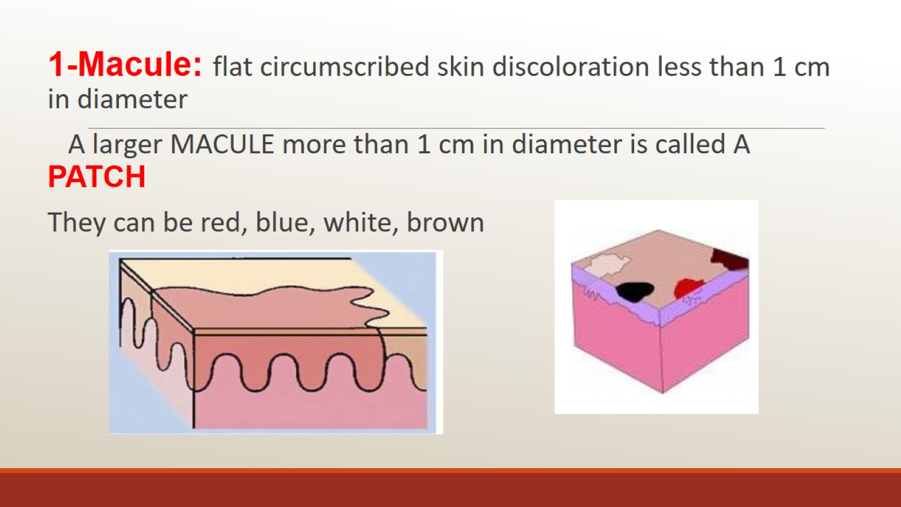

Slide 9
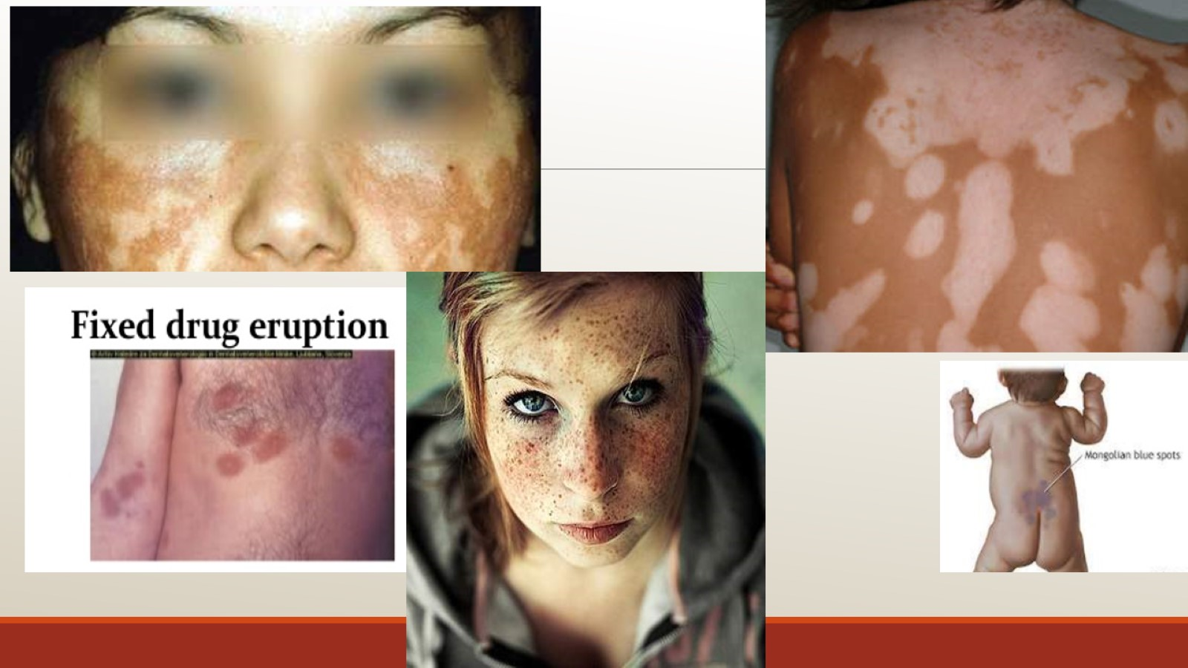

Slide 10
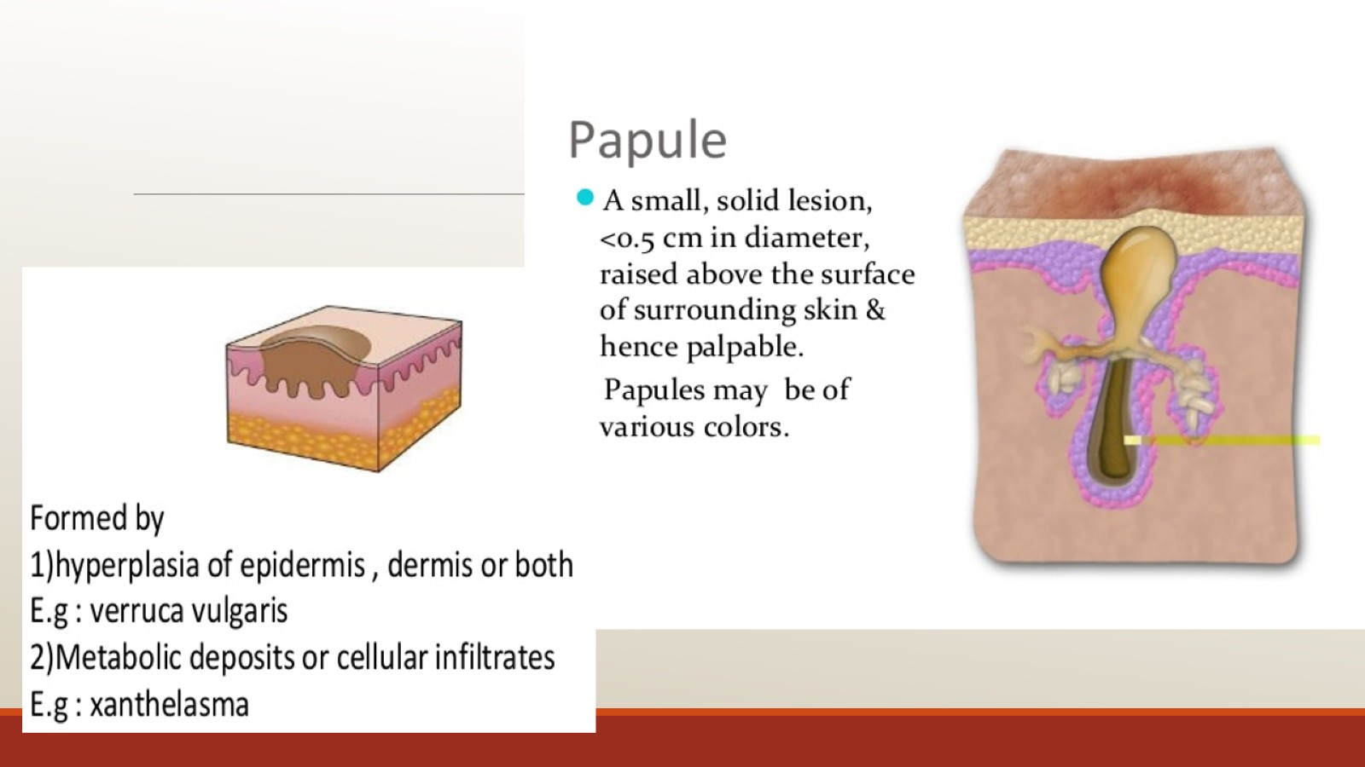
2---

Slide 11
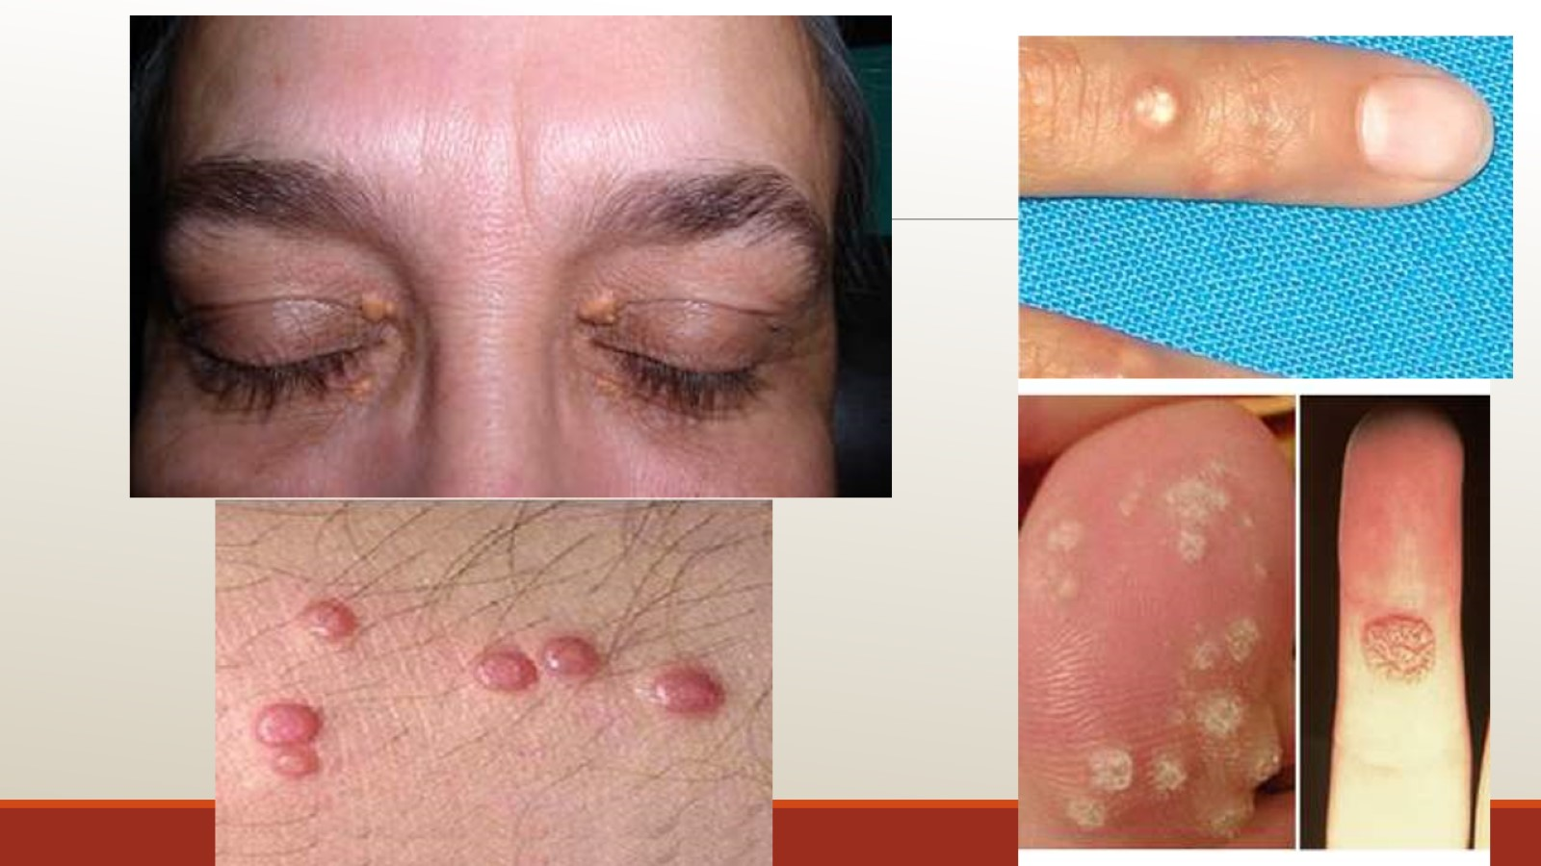

Slide 12
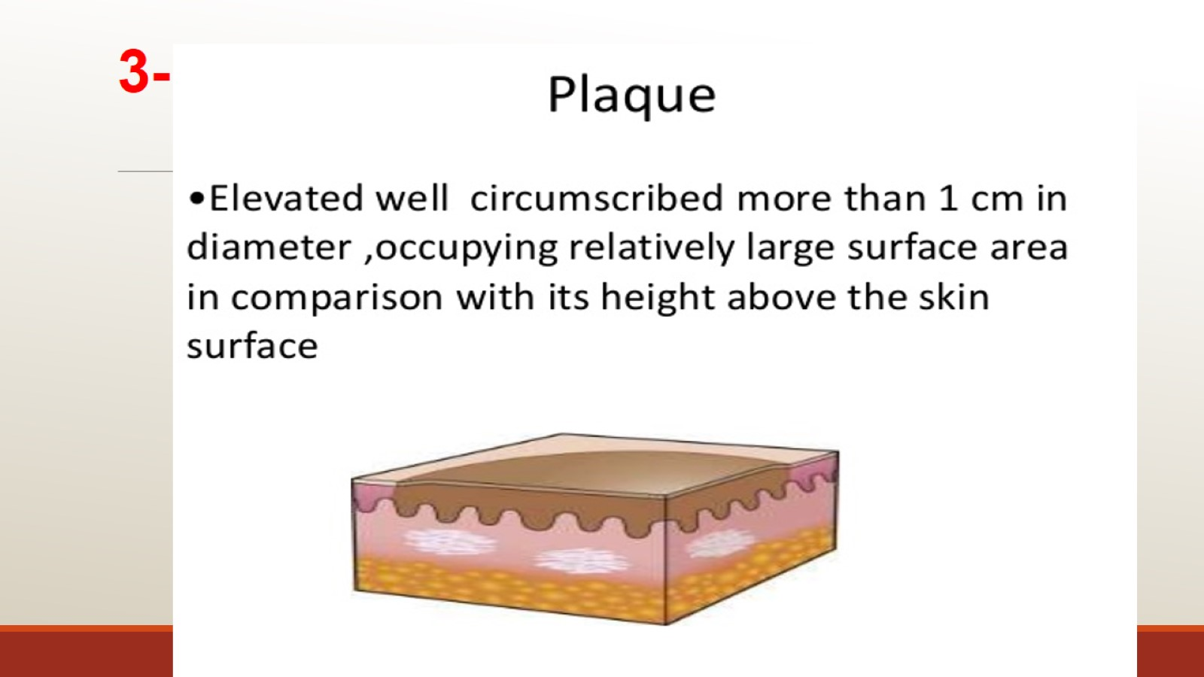
3-

Slide 13
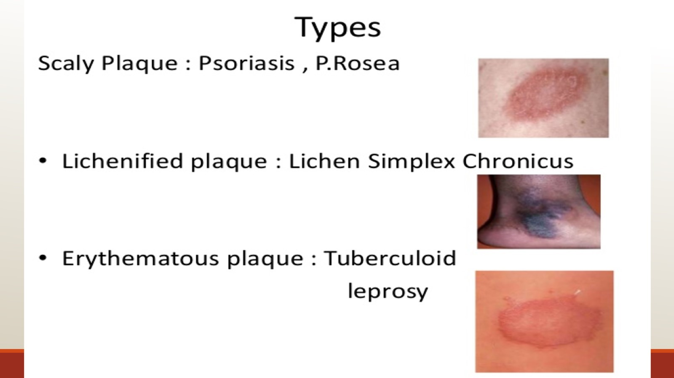

Slide 14
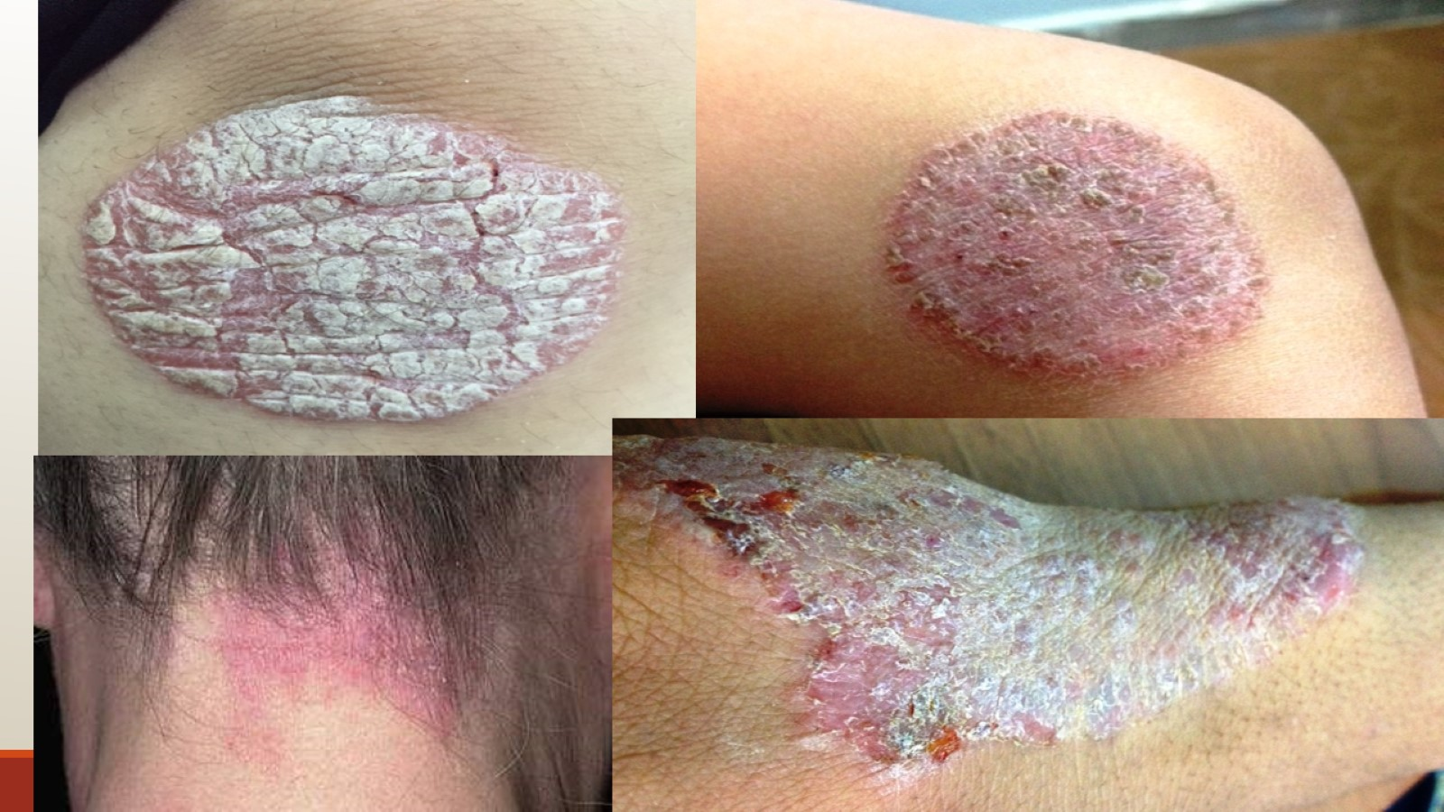

Slide 15
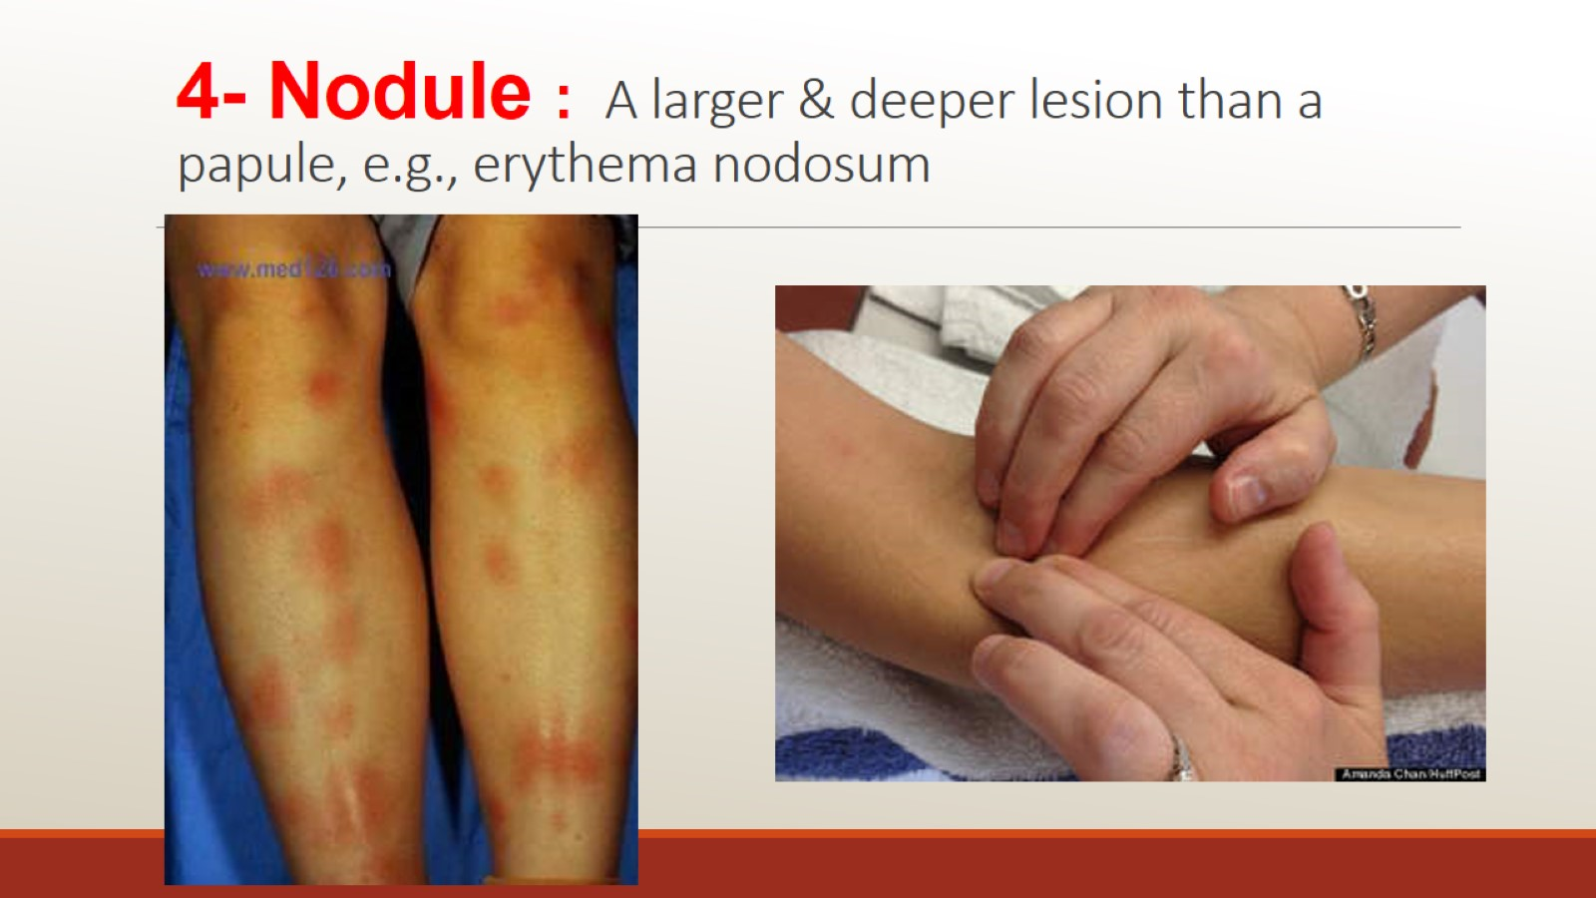
4- Nodule : A larger & deeper lesion than a papule, e.g., erythema nodosum

Slide 16
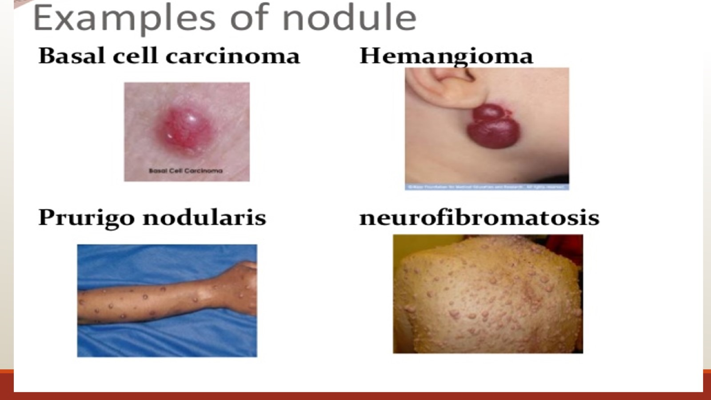

Slide 17
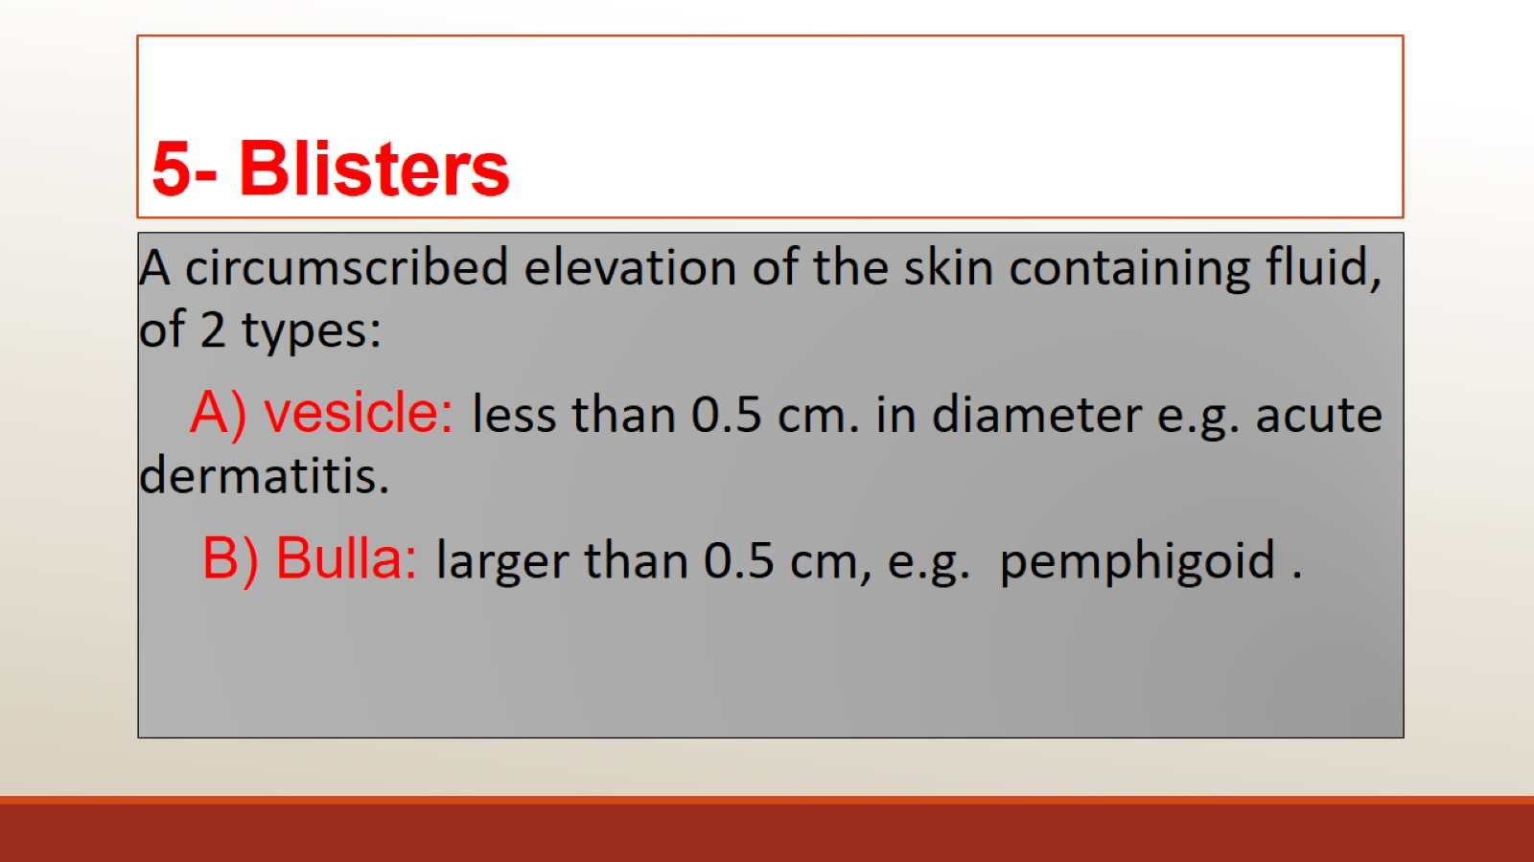
5- Blisters

Slide 18
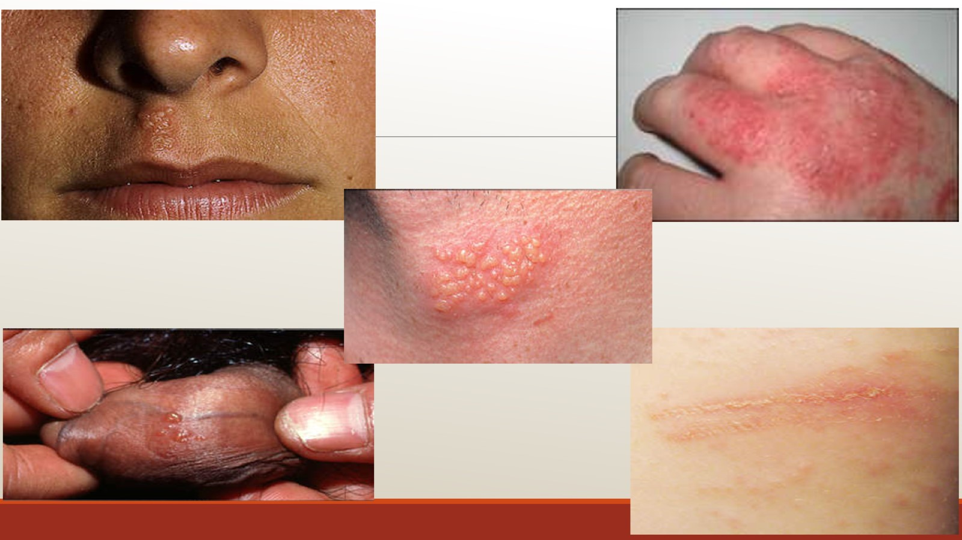
Eg of vesicles

Slide 19
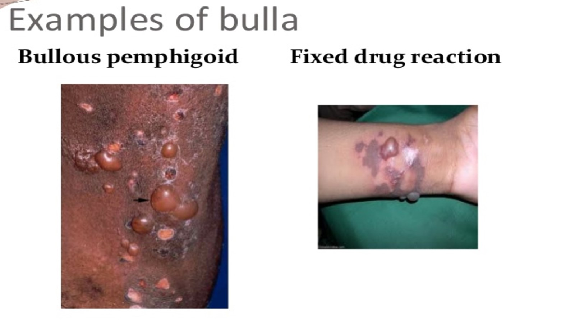

Slide 20
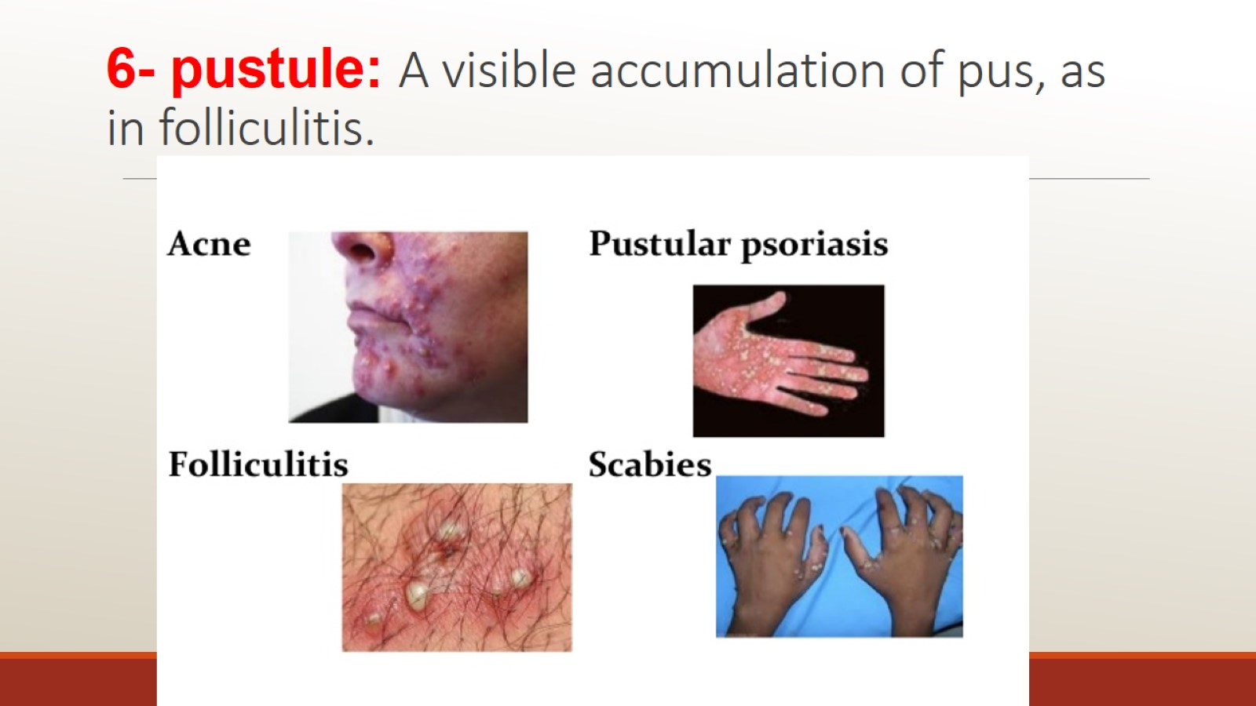
6- pustule: A visible accumulation of pus, as in folliculitis.

Slide 21
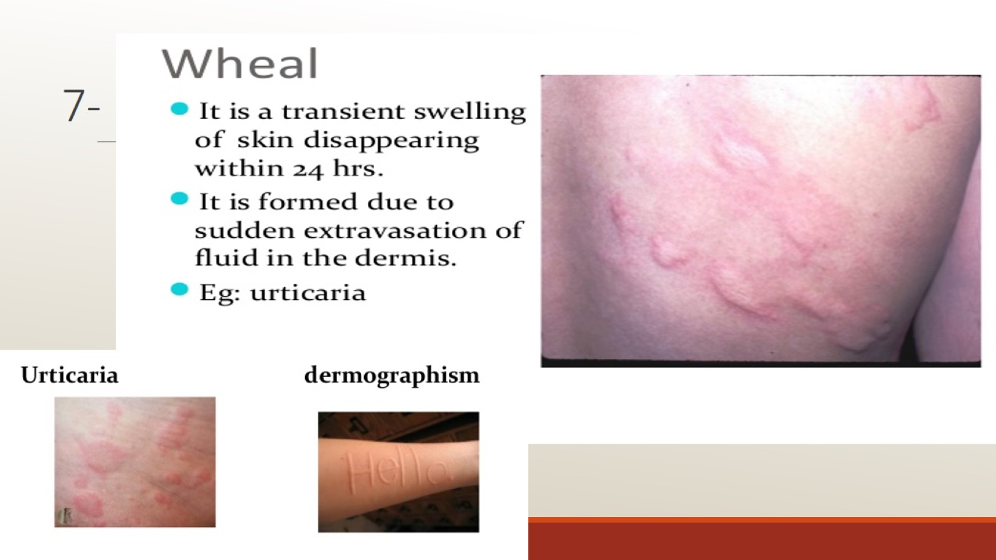
7-

Slide 22
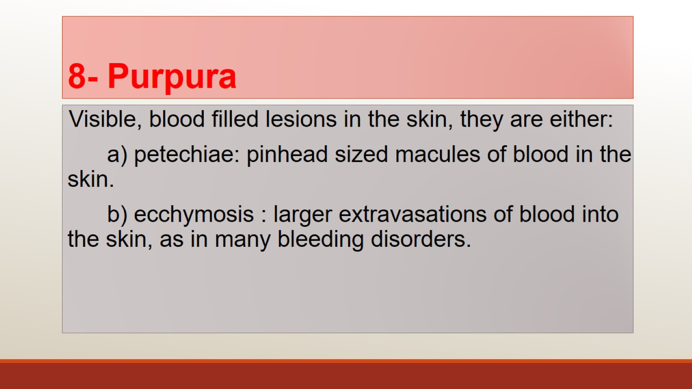
8- Purpura

Slide 23
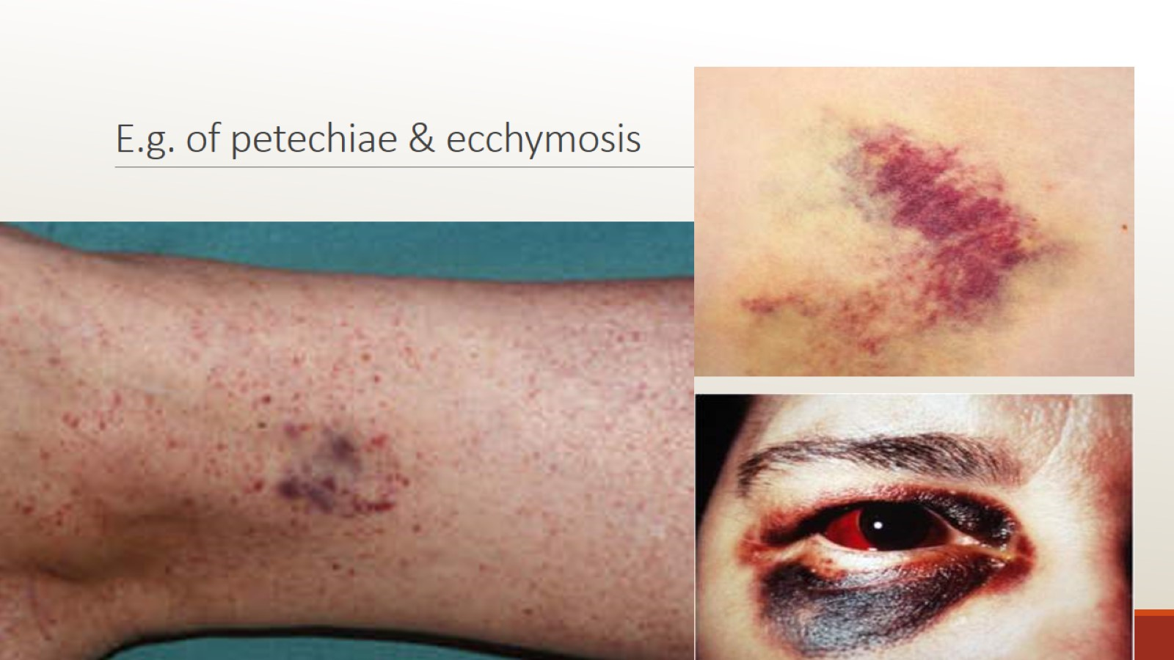
E.g. of petechiae & ecchymosis

Slide 24
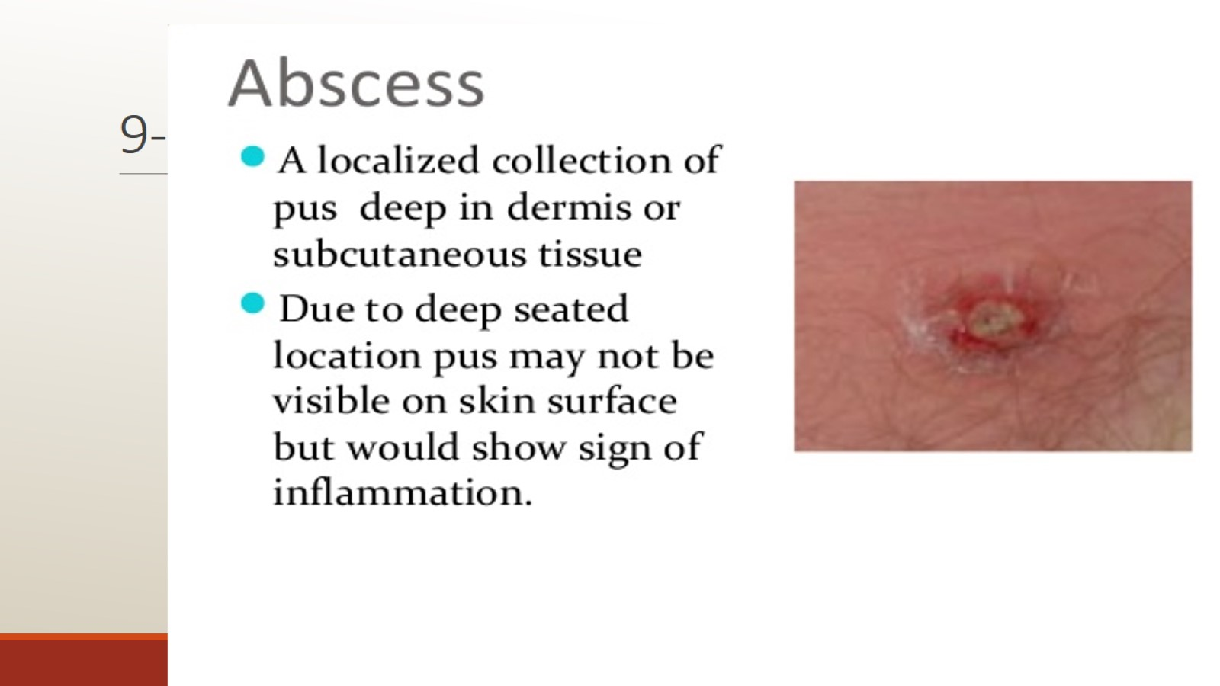
9-

Slide 25
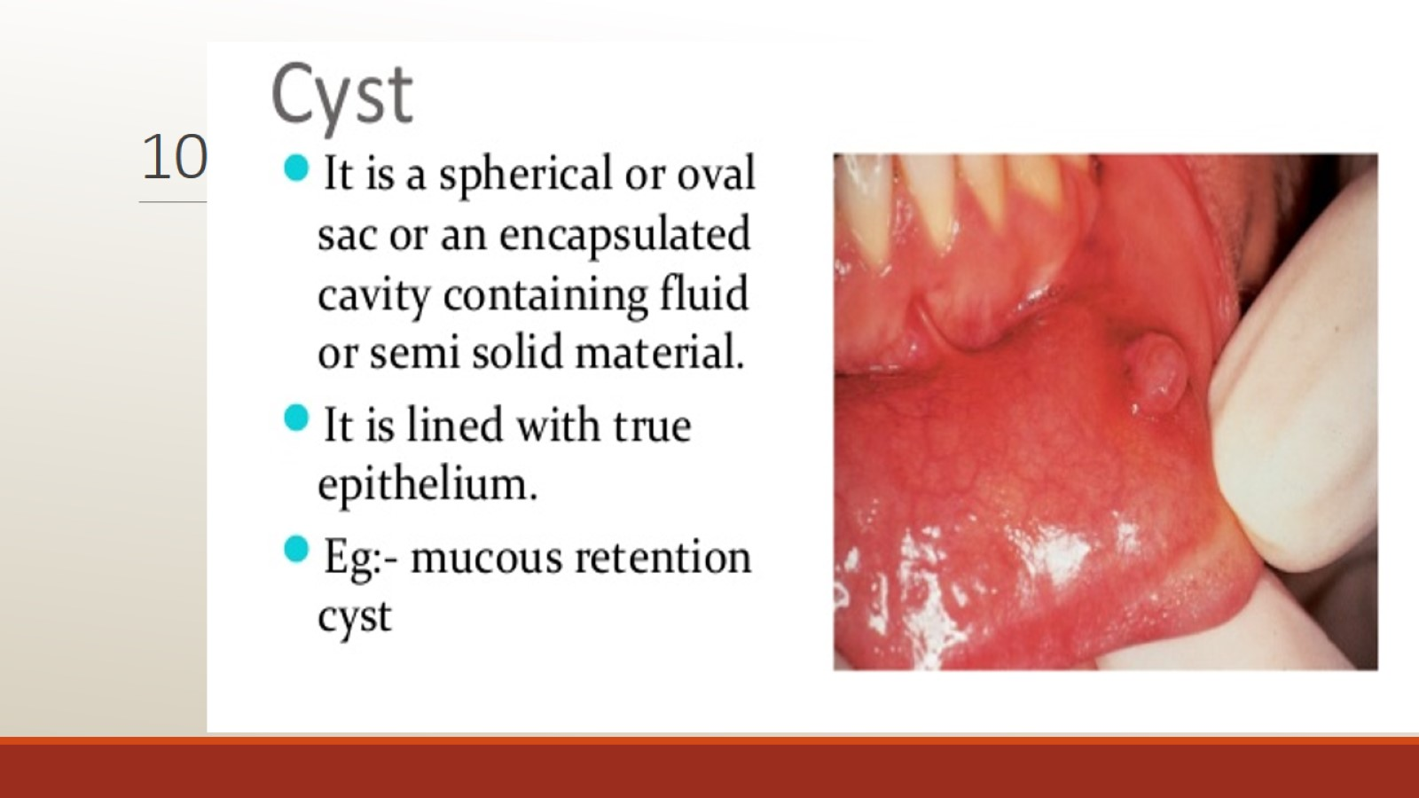
10-

Slide 26
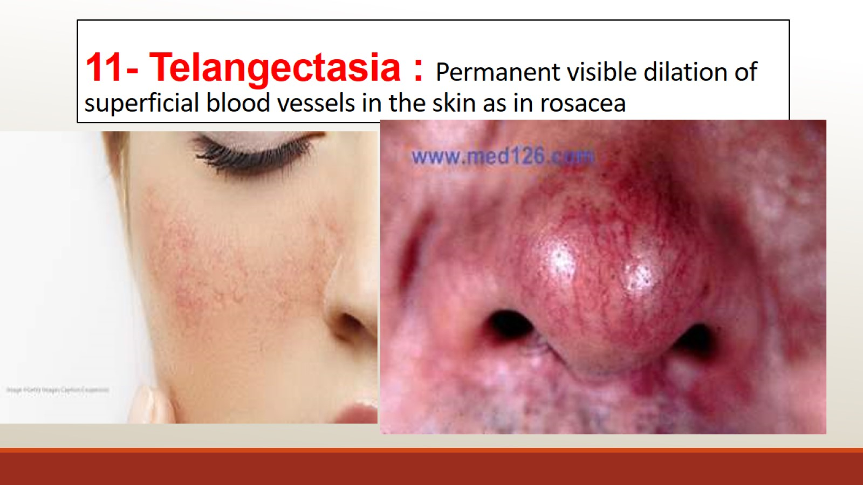
11- Telangectasia : Permanent visible dilation of superficial blood vessels in the skin as in rosacea

Slide 27
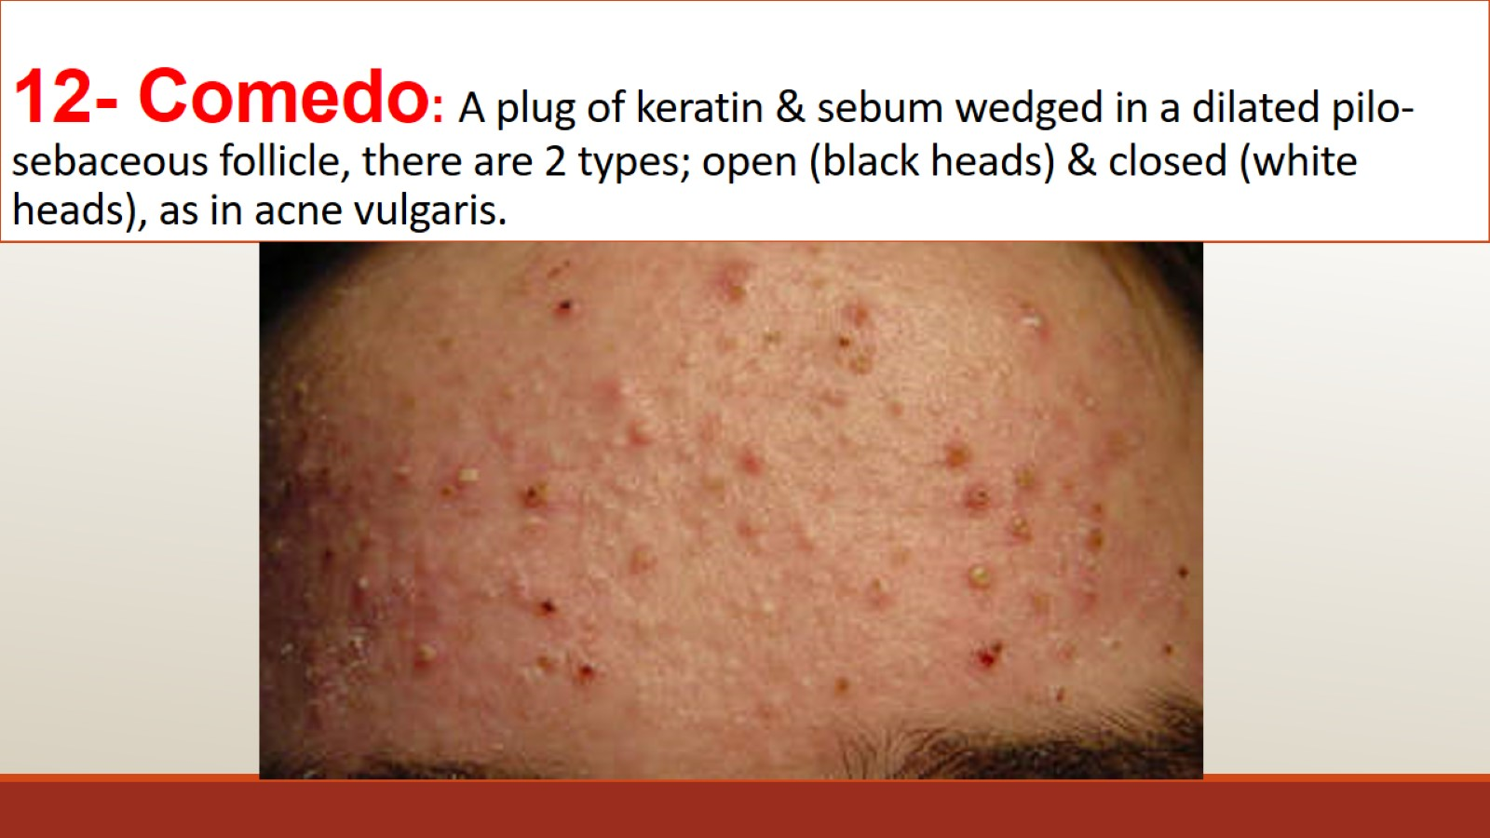
12- Comedo: A plug of keratin & sebum wedged in a dilated pilo-sebaceous follicle, there are 2 types; open (black heads) & closed (white heads), as in acne vulgaris.

Slide 28
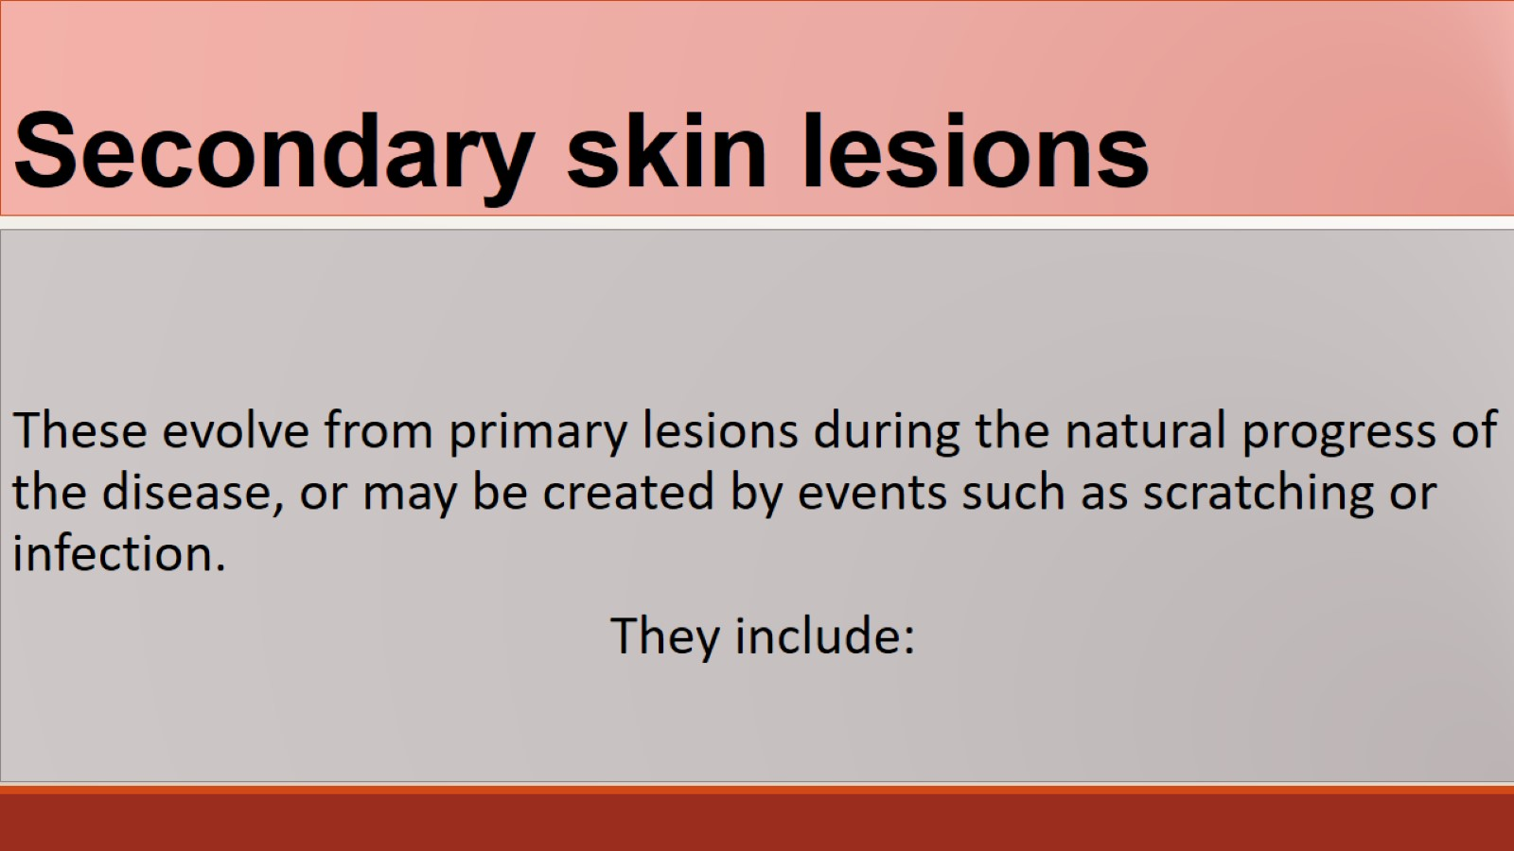
Secondary skin lesions

Slide 29
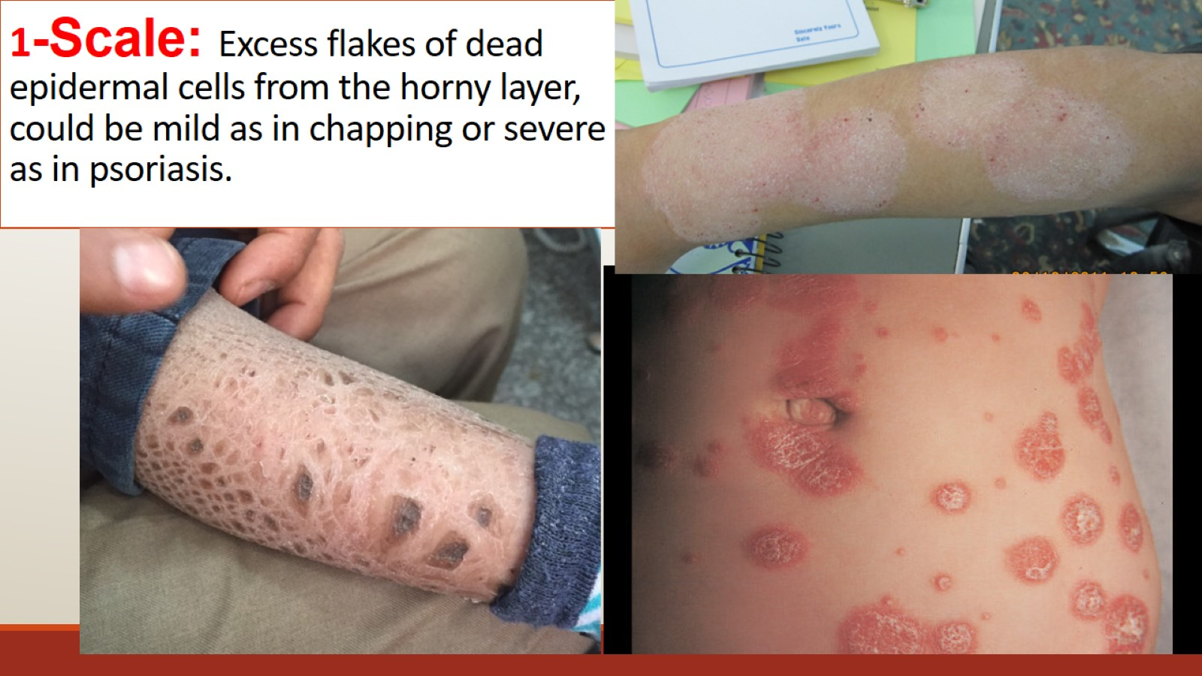
1-Scale: Excess flakes of dead epidermal cells from the horny layer, could be mild as in chapping or severe as in psoriasis.

Slide 30
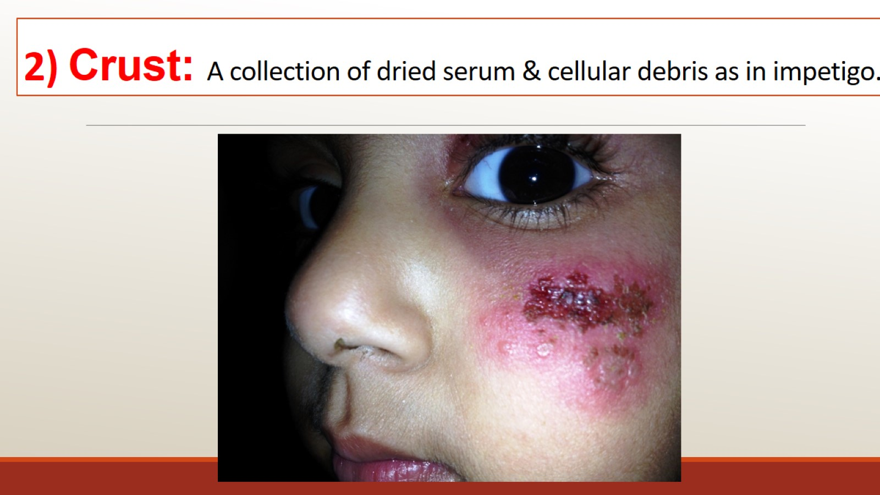
2) Crust: A collection of dried serum & cellular debris as in impetigo.

Slide 31
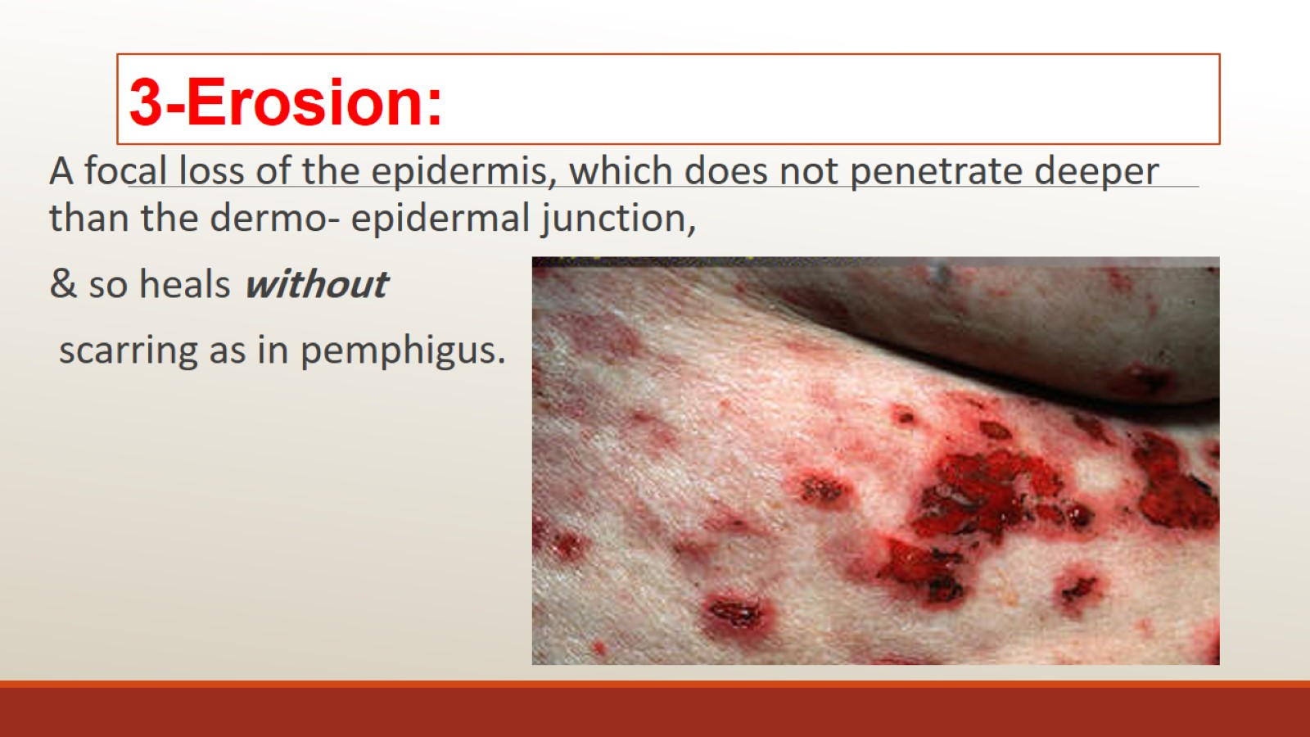
3-Erosion:

Slide 32
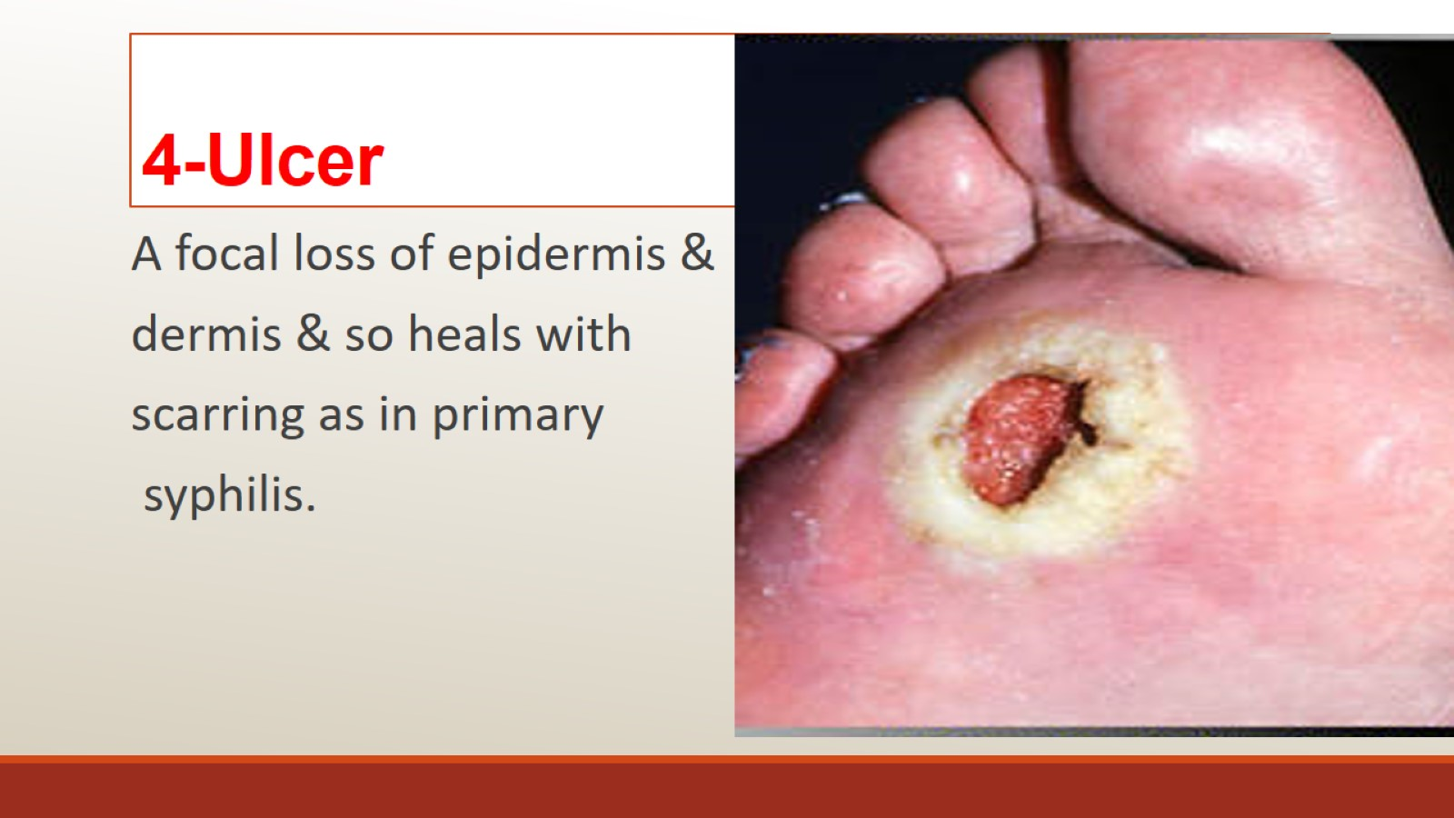
4-Ulcer

Slide 33
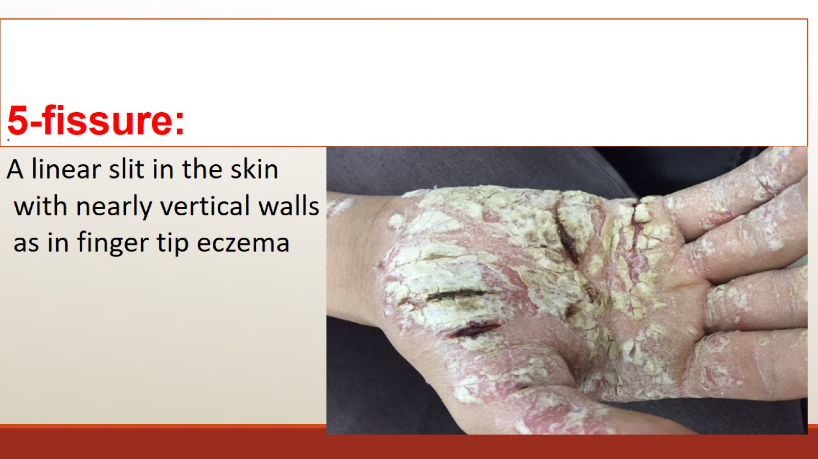
5-fissure:

Slide 34
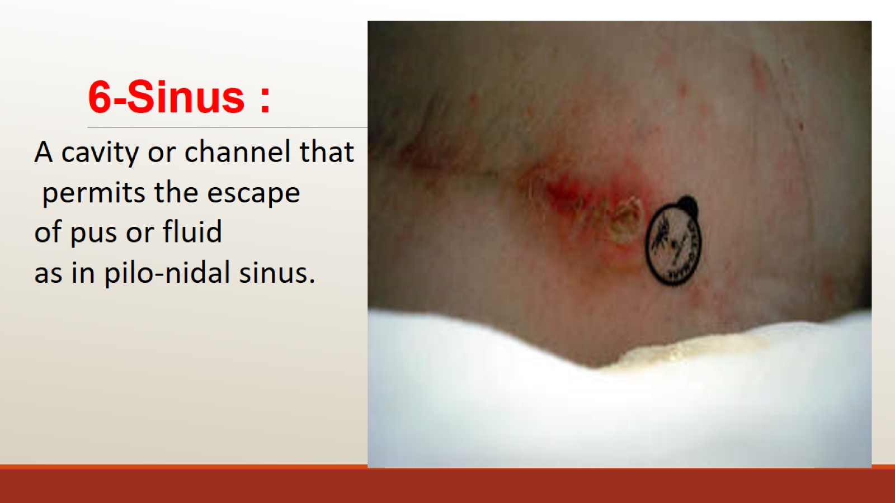
6-Sinus :

Slide 35
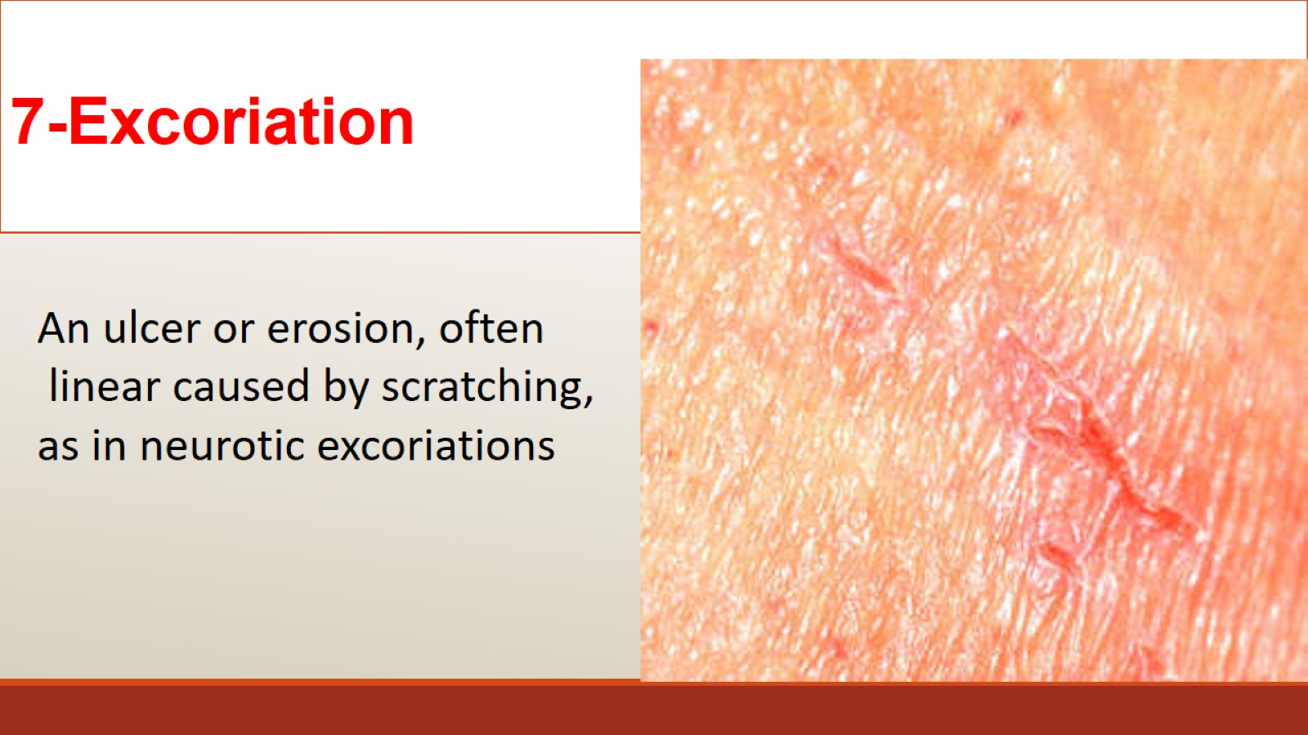
7-Excoriation

Slide 36
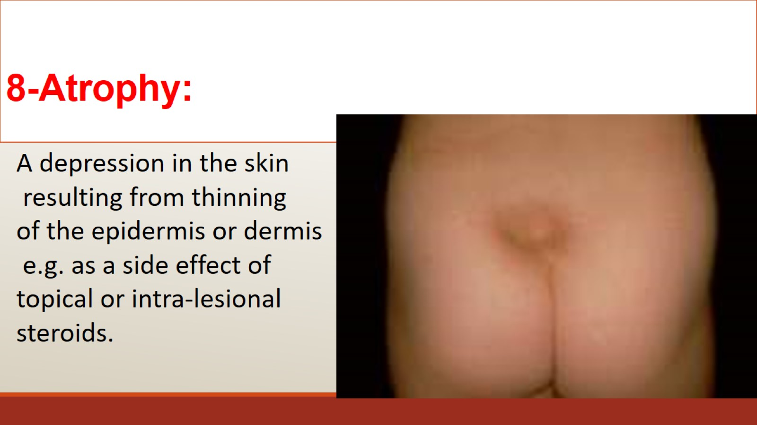
8-Atrophy:

Slide 37
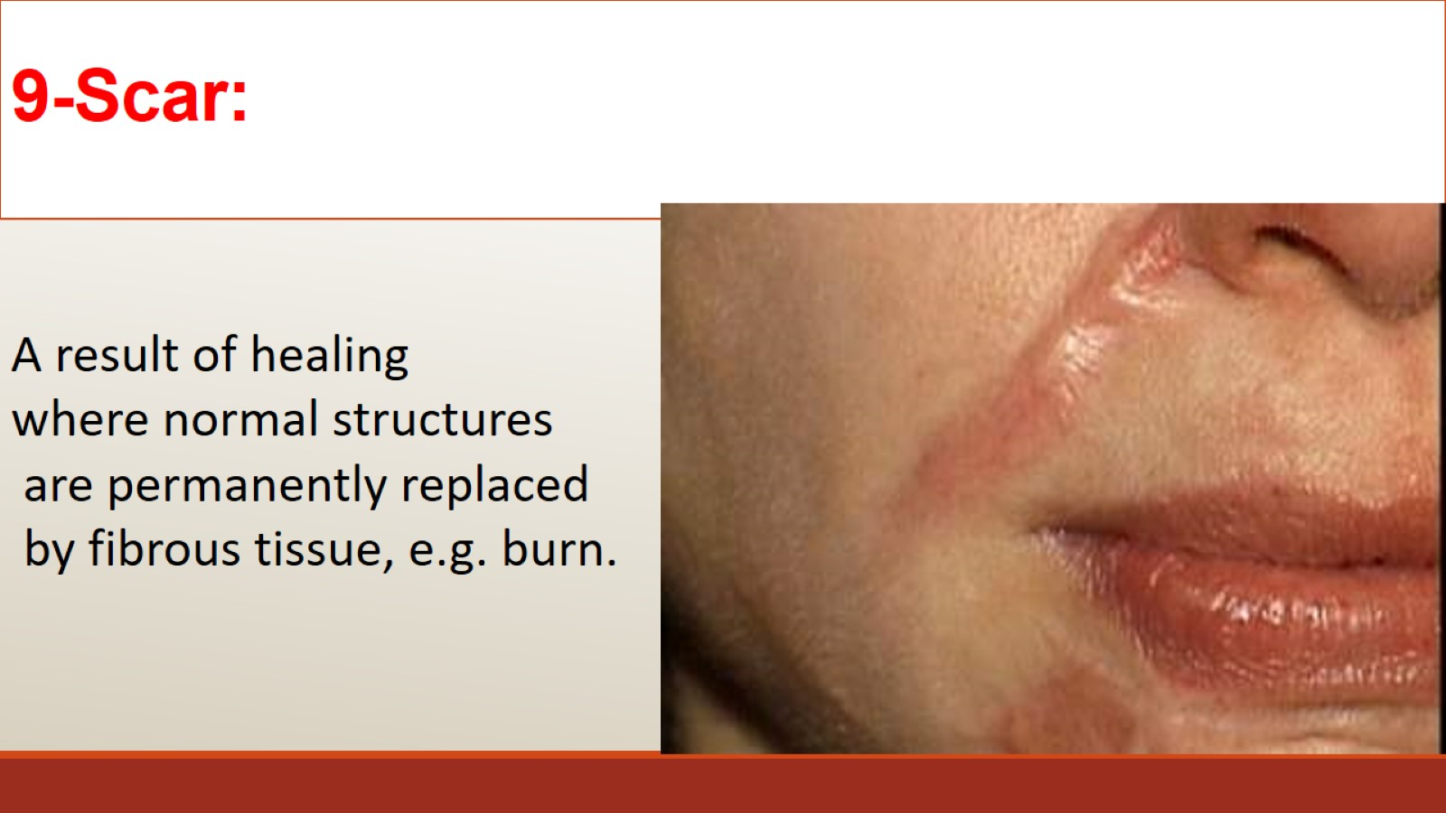
9-Scar:

Slide 38
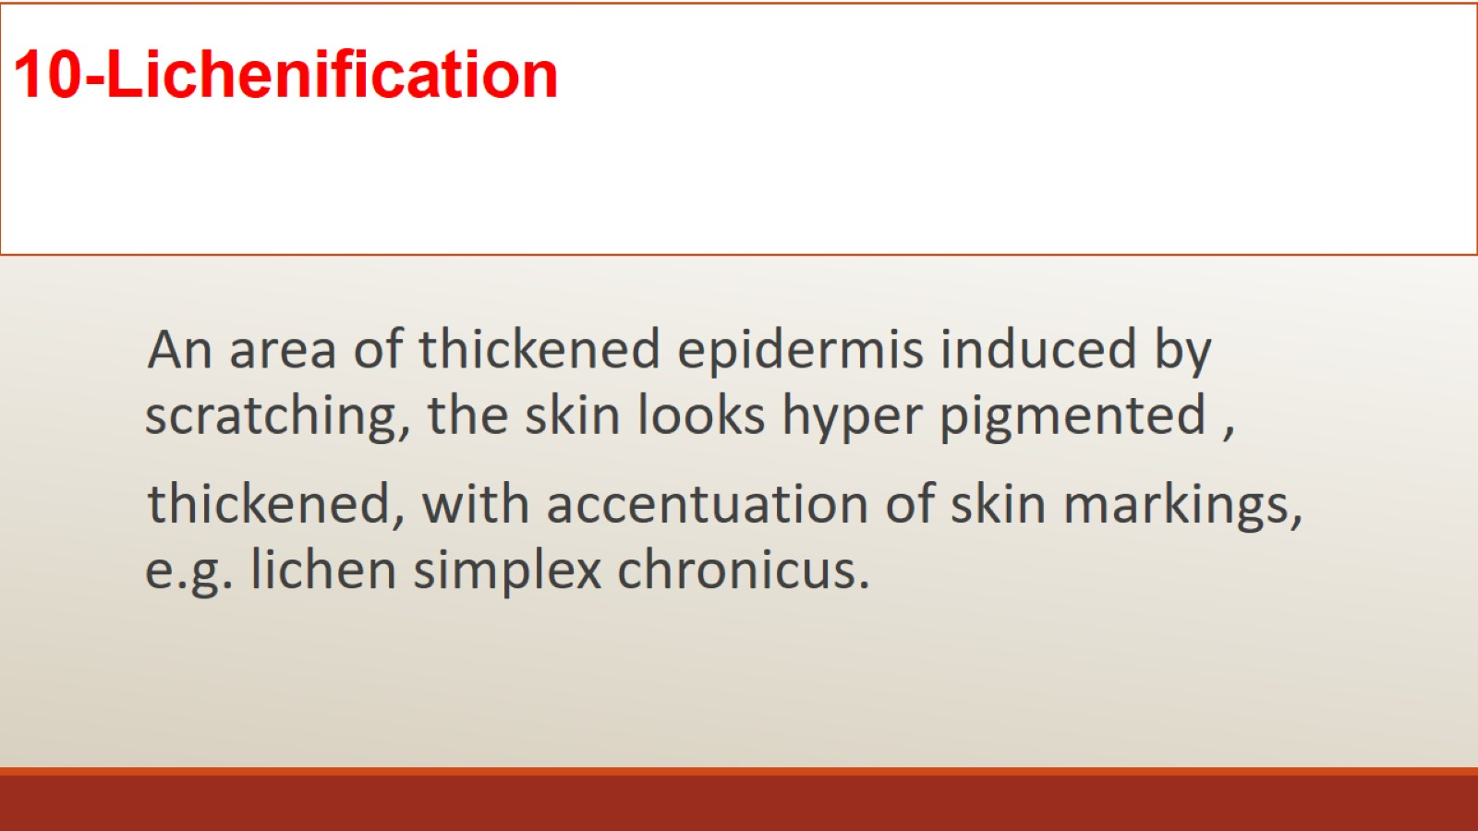
10-Lichenification

Slide 39
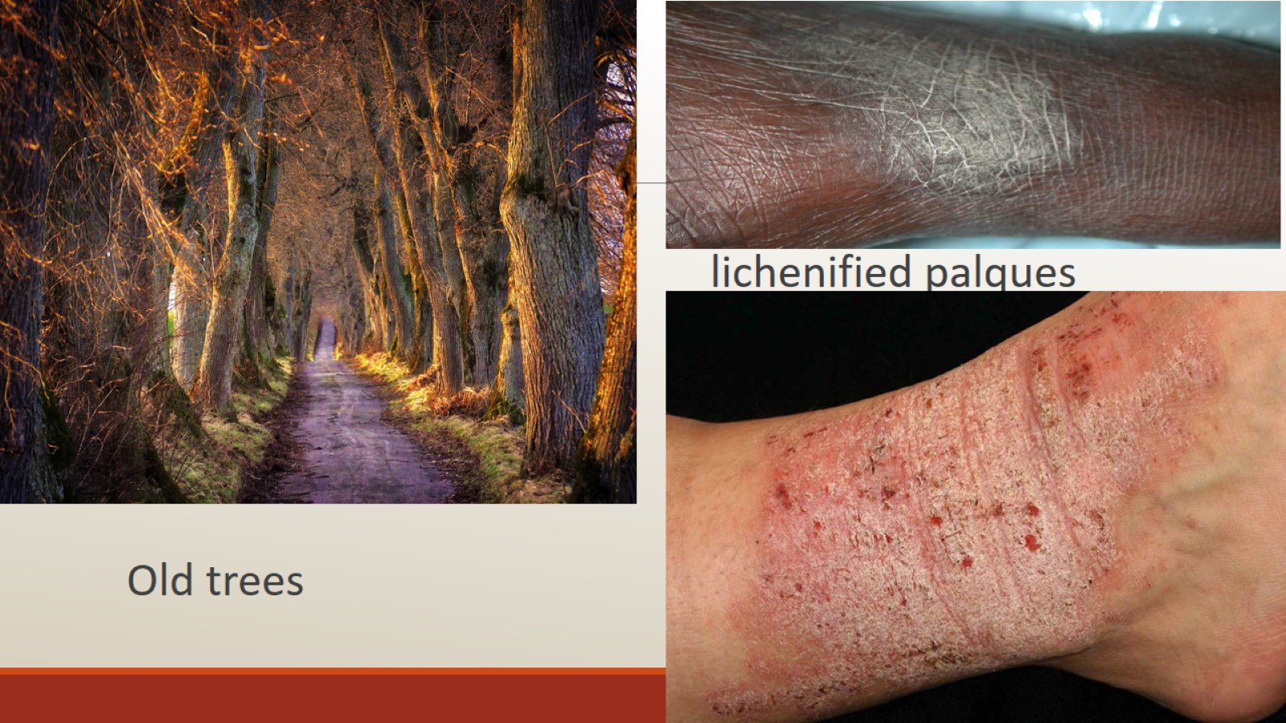

Slide 40
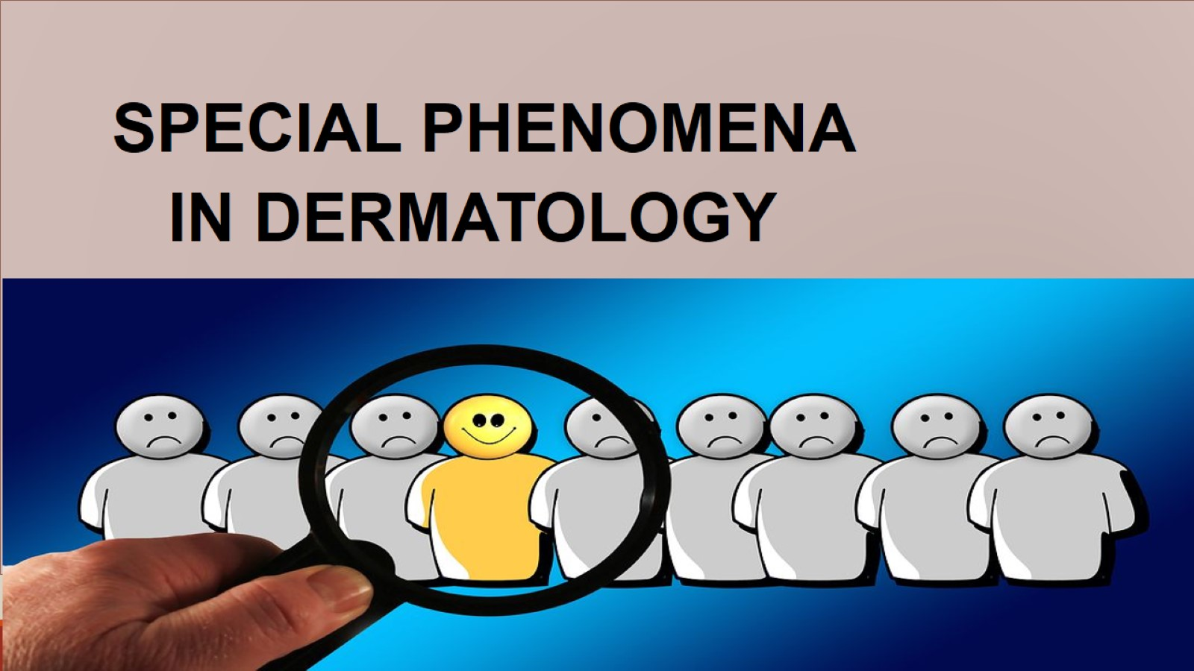

Slide 41
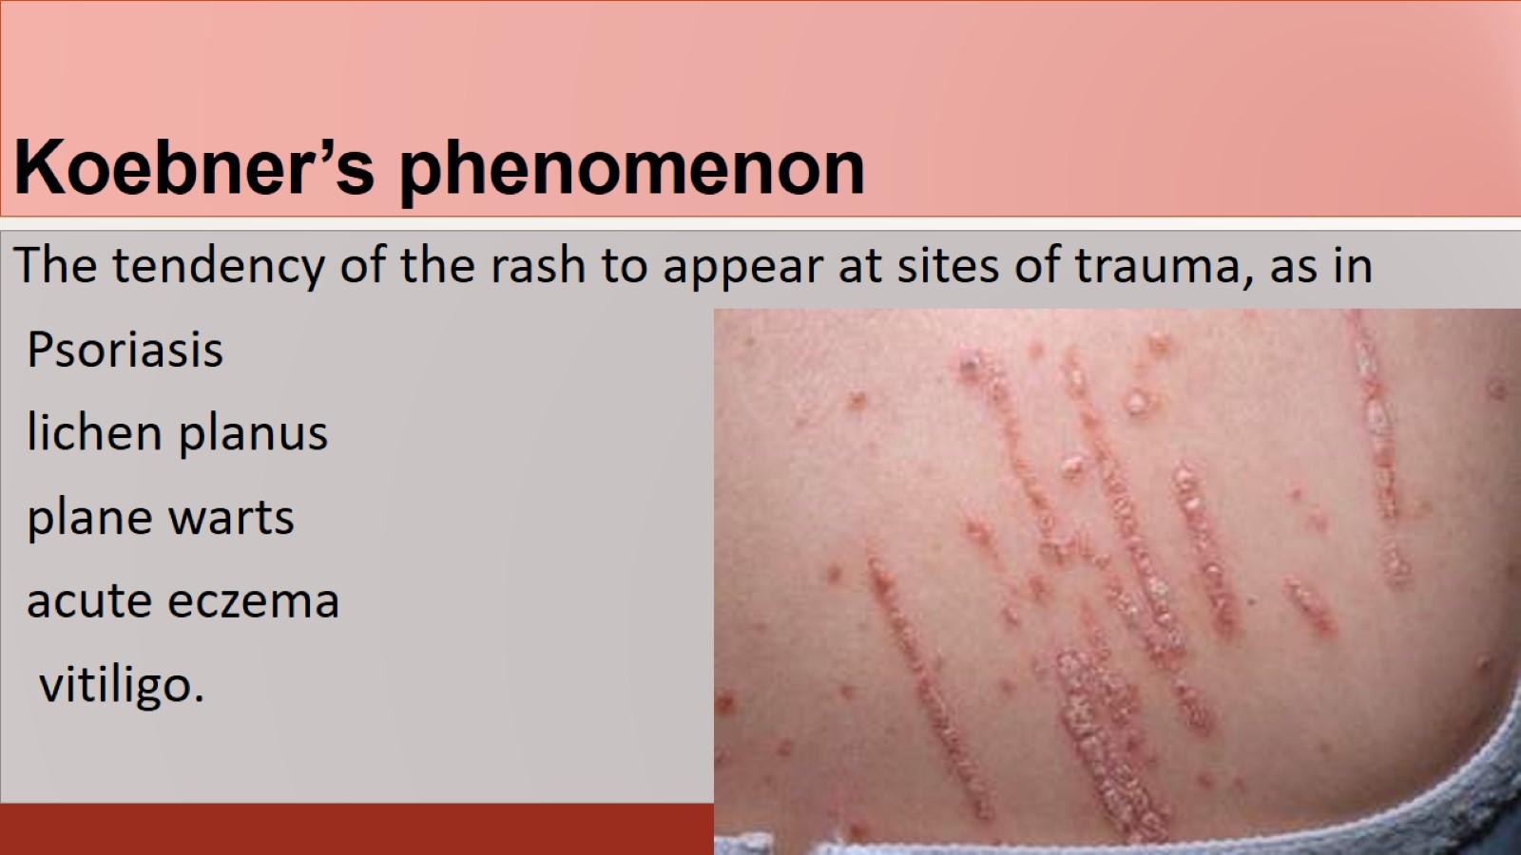
Koebner’s phenomenon

Slide 42
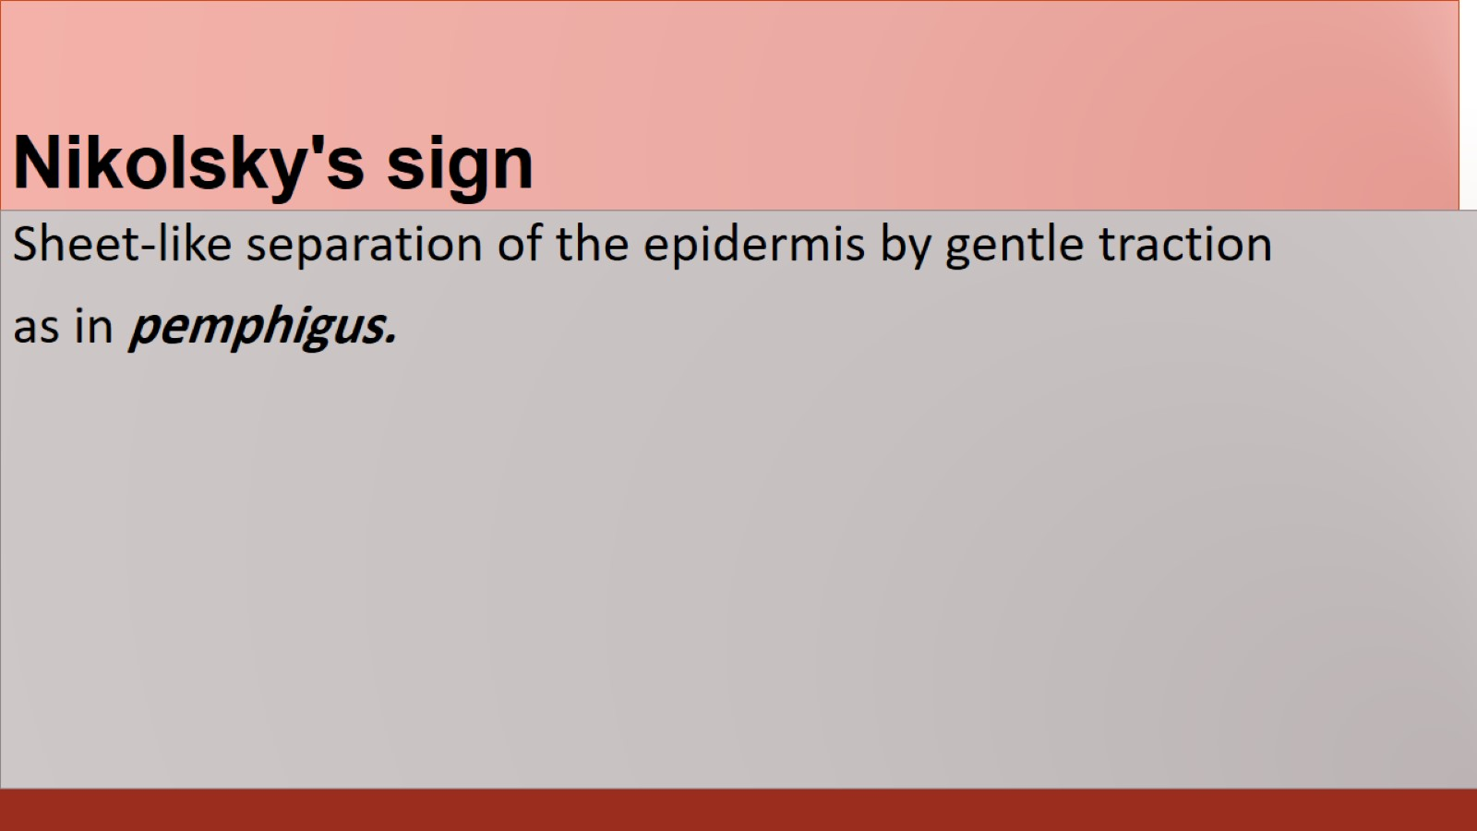
Nikolsky's sign

Slide 43
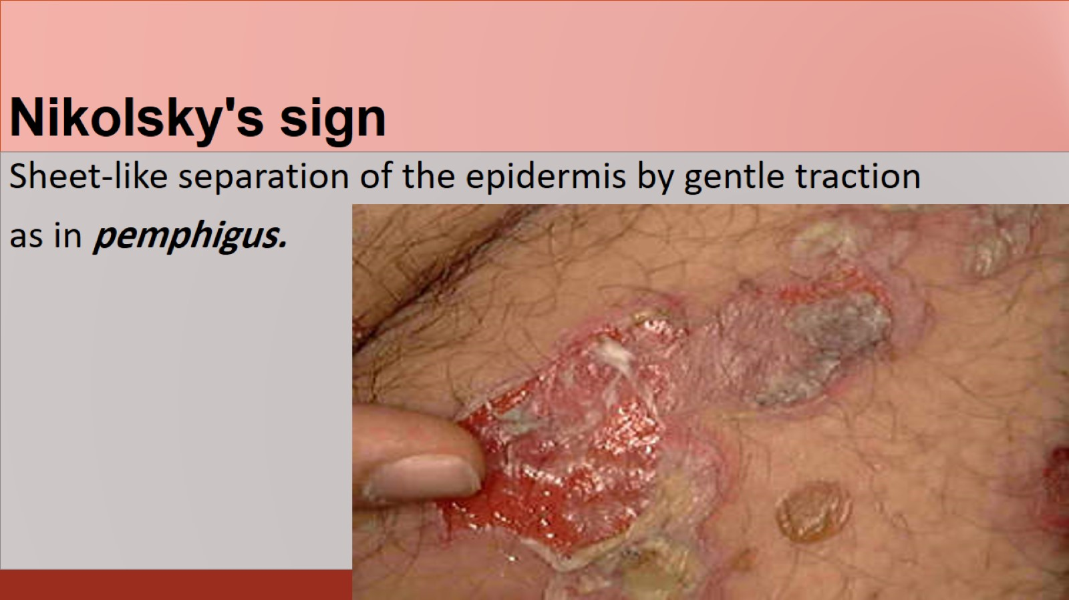
Nikolsky's sign

Slide 44
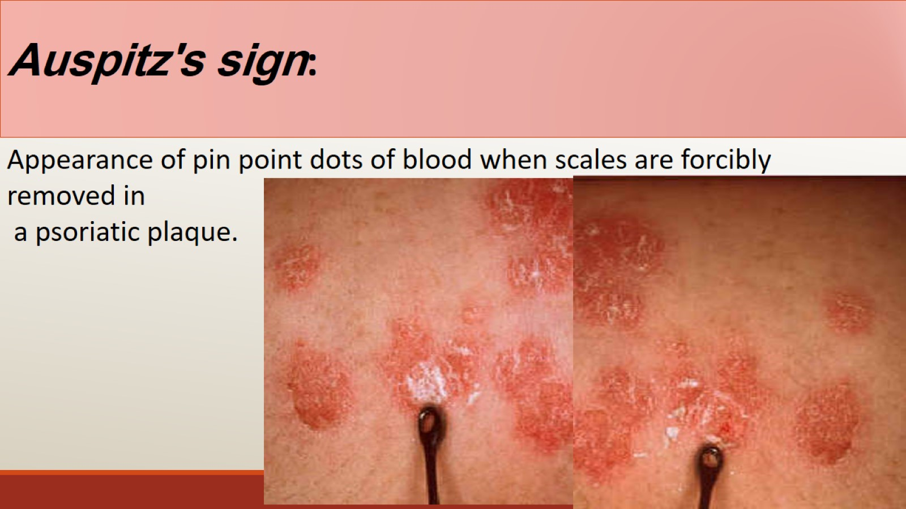
Auspitz's sign:

Slide 45
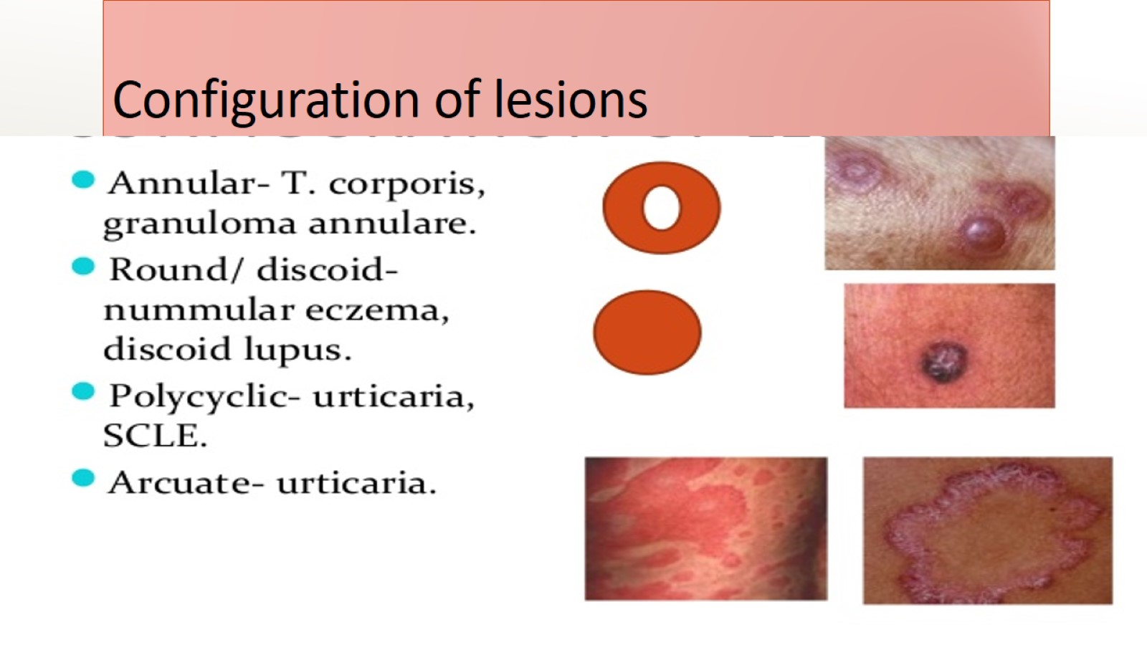
Configuration of lesions

Slide 46
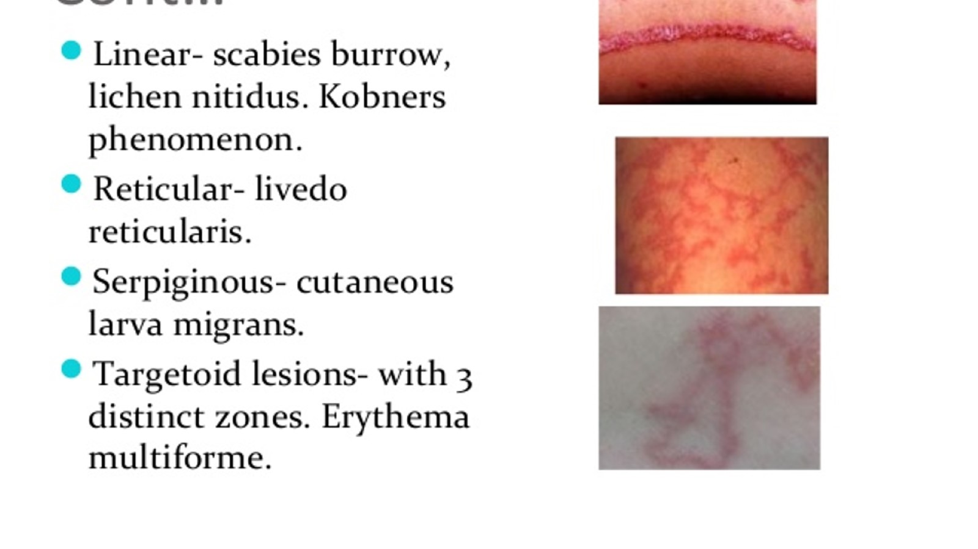

Slide 47
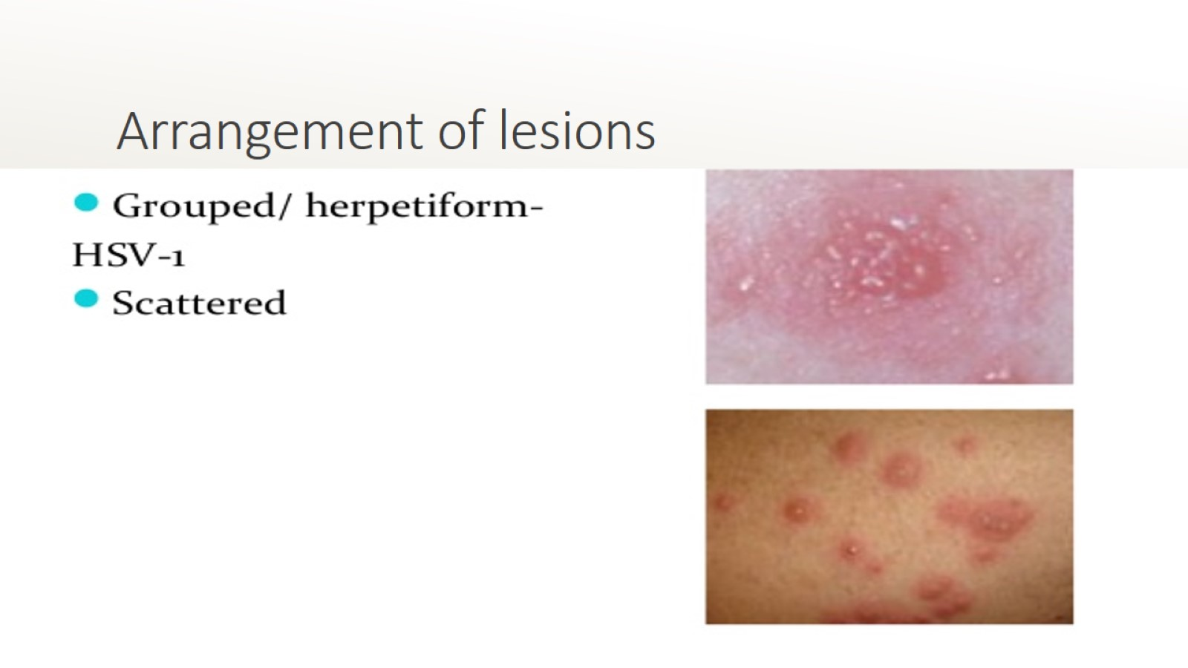
Arrangement of lesions

Slide 48
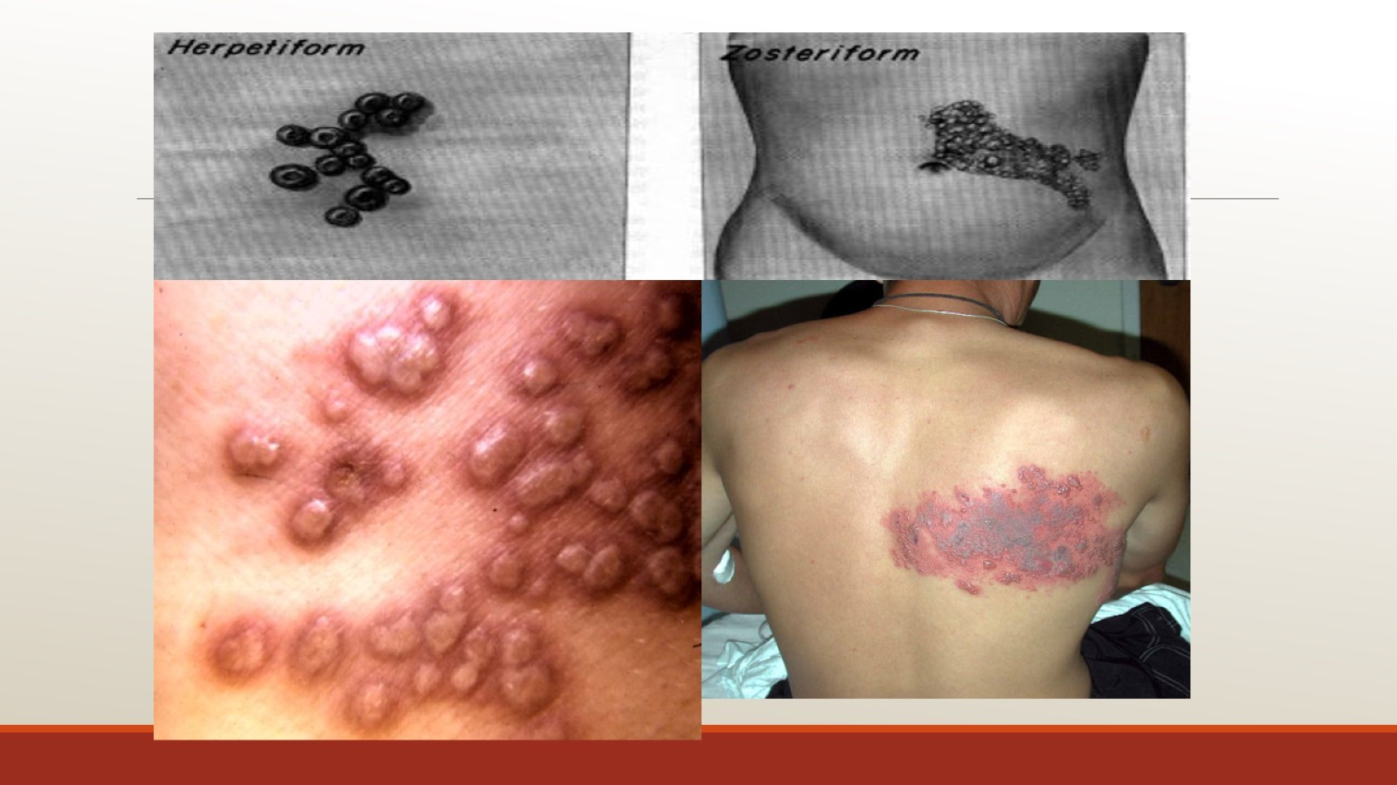

Slide 49
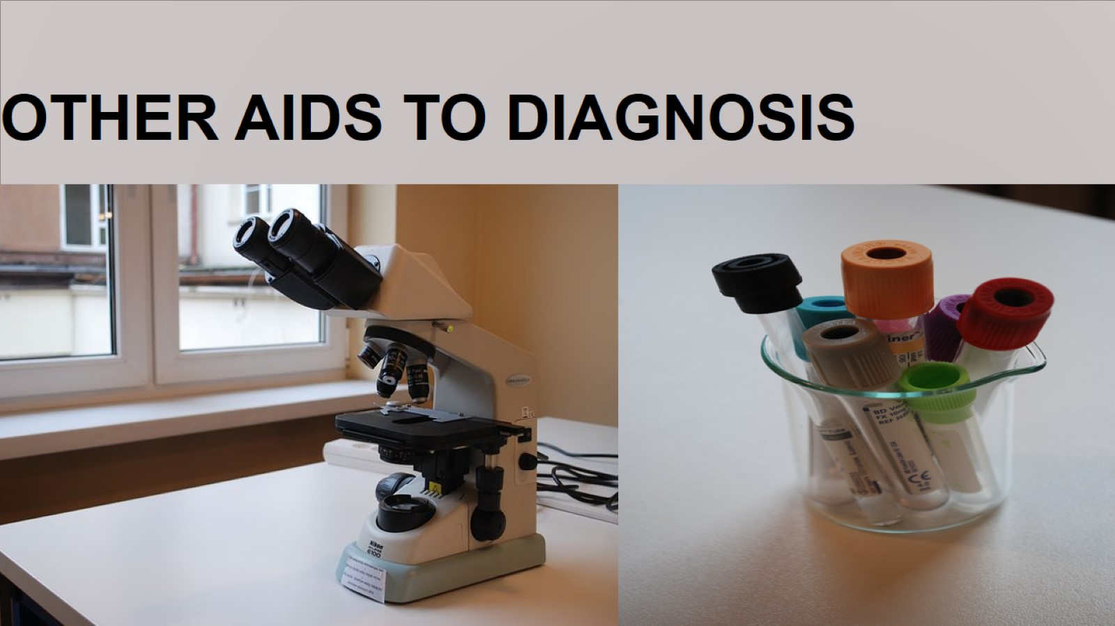

Slide 50
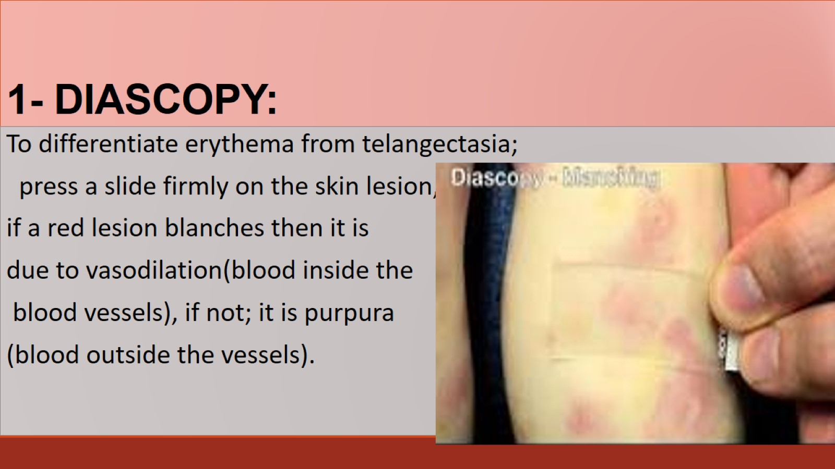
1- DIASCOPY:

Slide 51

In TB of the skin diascopy reveals an appearance called apple- jelly nodules.

Slide 52

2- Dermoscopy

Slide 53


Slide 54

Wood's lamp

Slide 55

Uses of WOOD’S lamp

Slide 56

4)MYCOLOGY SAMPLES

Slide 57

5)LAB. INVESTIGATIONS :

Slide 58

6) CYTOLOGY (Tzanck's smear):

Slide 59

7) PATCH TESTS:

Slide 60

8) PRICK TESTS:

Slide 61

9) HISTOLOGY & IMMUNOFLUORESCNCE:

Slide 62


Slide 63


