Slide 1
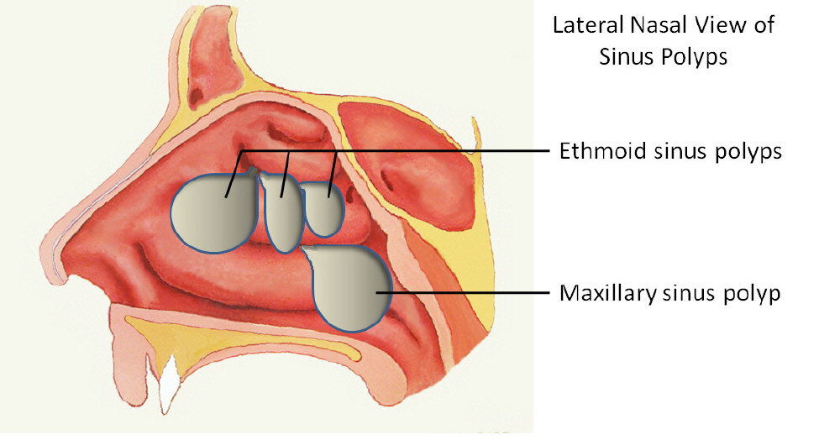
Nasal Polyps

Slide 2
Nasal polyps
A pedunculated portion of edematous mucosa of the nose or para-nasal sinuses.

Slide 3
Aetiology and pathology ‎Types: ‎1. Simple. oedematous submucosa, very loose fibrillary stroma, with intercellular serous (not mucinous) fluid. The surface is covered with ciliated columnar epithe­lium in the early stage: metaplasia to a transitional and then to a squamous type occurs in some cases.. ‎Allergic: usually multiple,eosinophils and plasma cells are found in large ‎numbers ‎Vasomotor: similar to allergic, but no allergen identifiable. Inflammatory: the role of infection is unclear They are not common but may be : ‎(a) 'Acute', an uncommon type, usually asso­ciated with influenza. The polypus is usually single, very soft, and slightly haemorrhagic. ‎(b) 'Chronic non-specific' often multiple. ‎(c) 'Chronic specific'. Rhinosporidiosis causes a friable bleeding polypus . ‎Mixed infective-allergic: Probably represents secondary infection in the allergic or vasomotor type. ‎Aspirin intolerance: the mechanism of development is not known but is not allergic. When associated with asthma the recurrence rate is particu­larly high. ‎2. Neoplastic ‎Benign: fjbroangioma, granuloma, neurofibromas, transitional-cell tumours. and fibromas ‎Malignant: carcinoma, melanoma , lymphoma

Slide 4
Sites of origin ‎1. Ethmoidal the commonest ‎2. Antral (maxillary). less , may be multiple or a single polypus may emerge from the sinus ostium and extend backwards to the posterior choana (antrochoanal polypus). 3. frontal or sphenoidal. ‎ Age incidence ‎ Simple ethmoidal polypi usually occur in adults but children with cystic fibrosis can have them. Antrochoanal polypi occur more commonly in children and young adults. ‎

Slide 5
Clinical features ‎Male/ Female; 3/1. Onset usually insidious, but may be sudden and rapid after an acute infection. ‎Nasal obstruction is the chief symptom. Other features : anosmia, epiphora, postnasal 'catarrh' (irritation and drip), headaches, snoring and change in speech tone. ‎ Antrochoanal polypus causes marked obstruction, ‎ Purulent rhinorrhoea ‎ Expansion of the nasal bones ('frog-face'). ‎ Diagnosis ‎ Biopsy is essential when the polypus is unilateral and haemorrhagic. Radiography CT scan is best

Slide 6
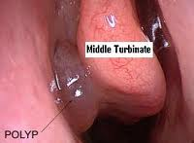

Slide 7
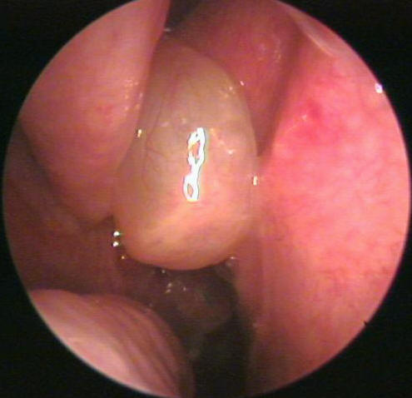

Slide 8
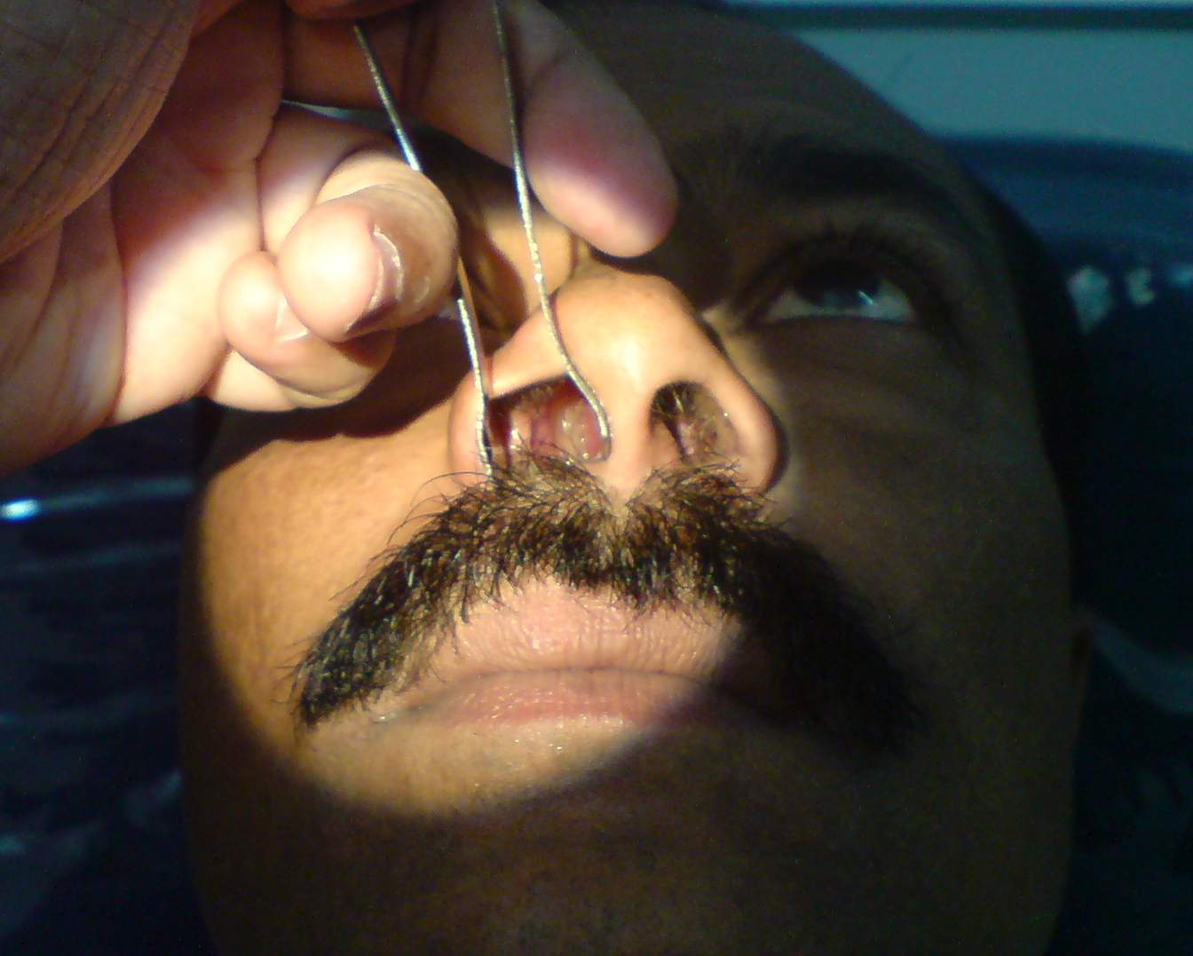

Slide 9
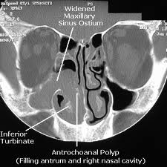

Slide 10
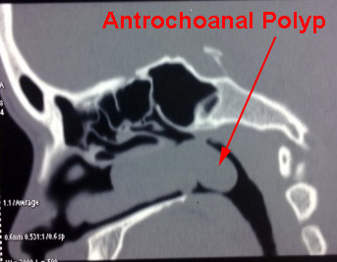

Slide 11
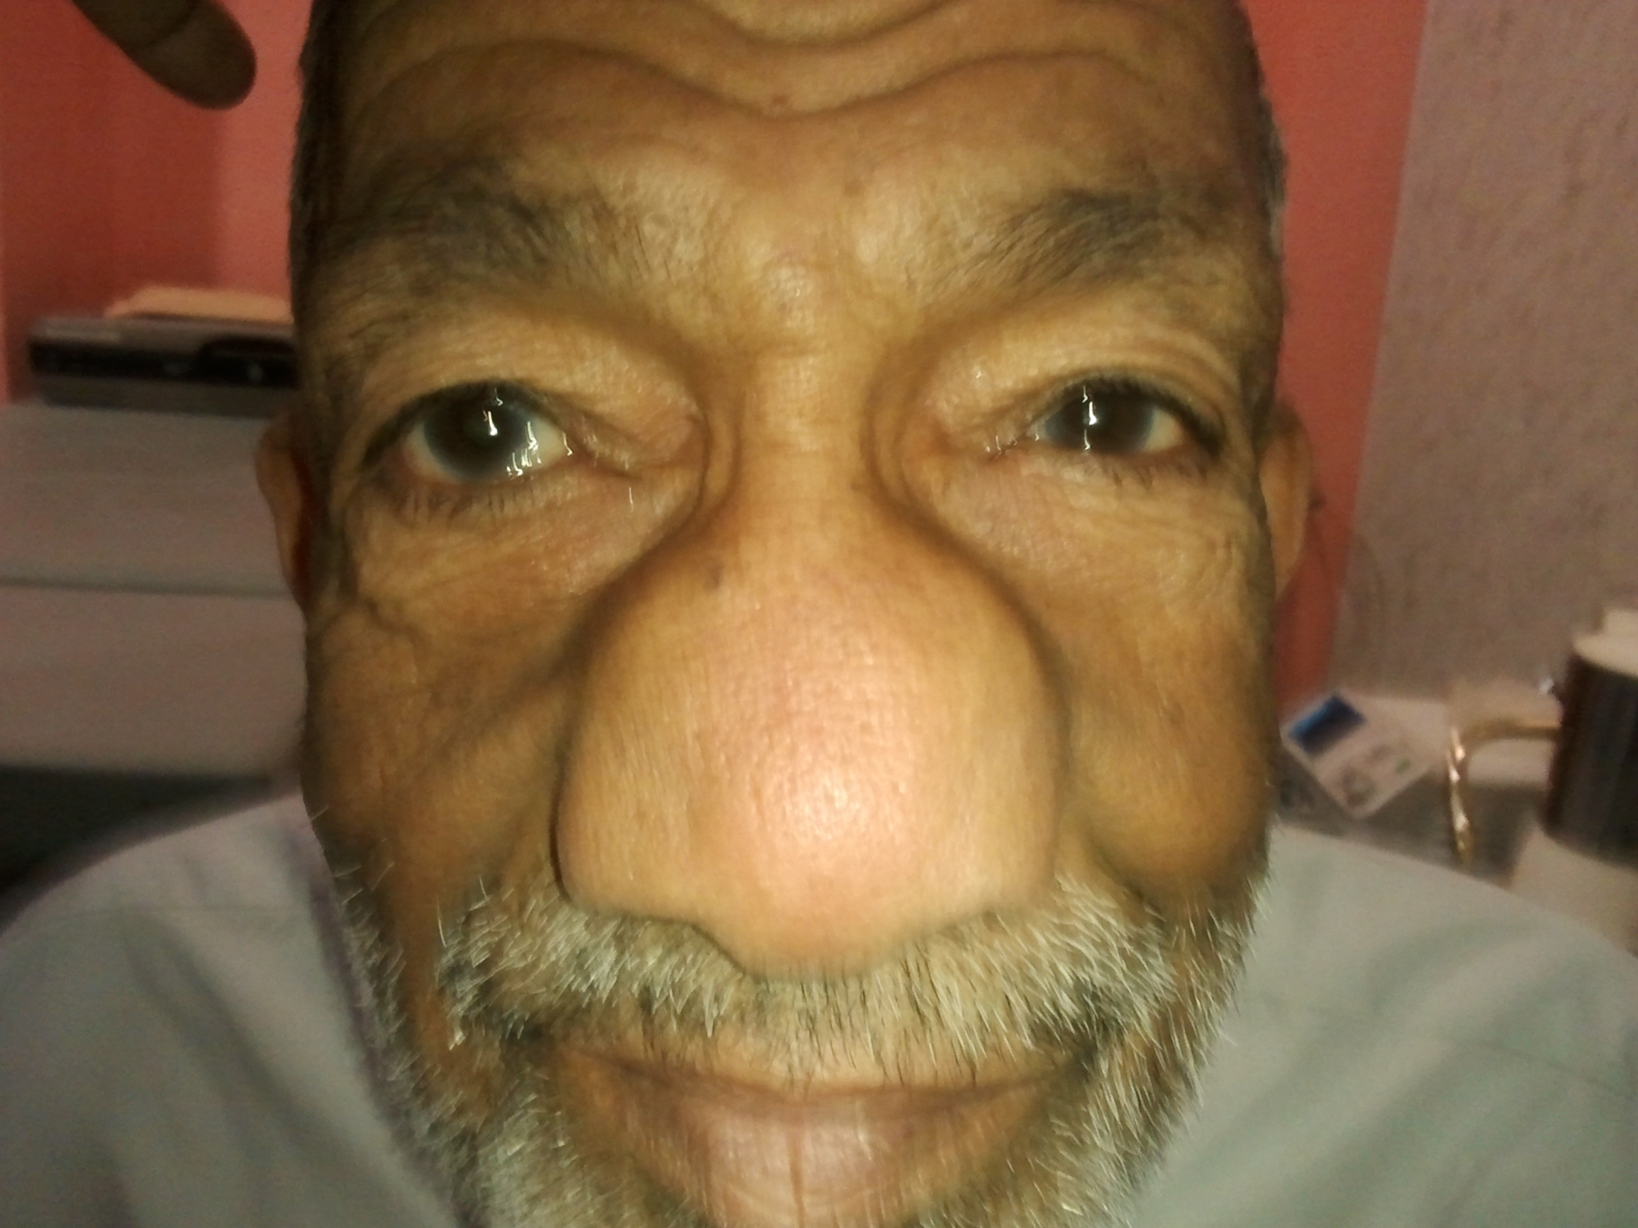

Slide 12
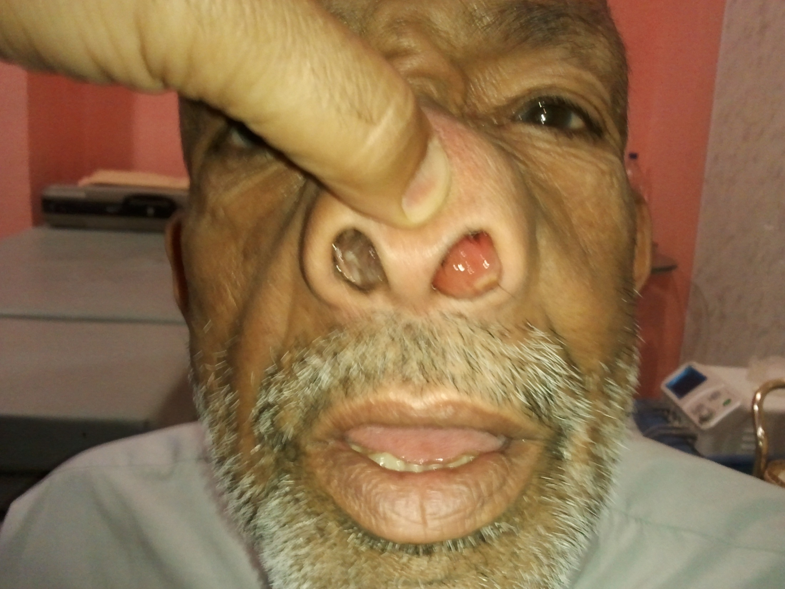

Slide 13
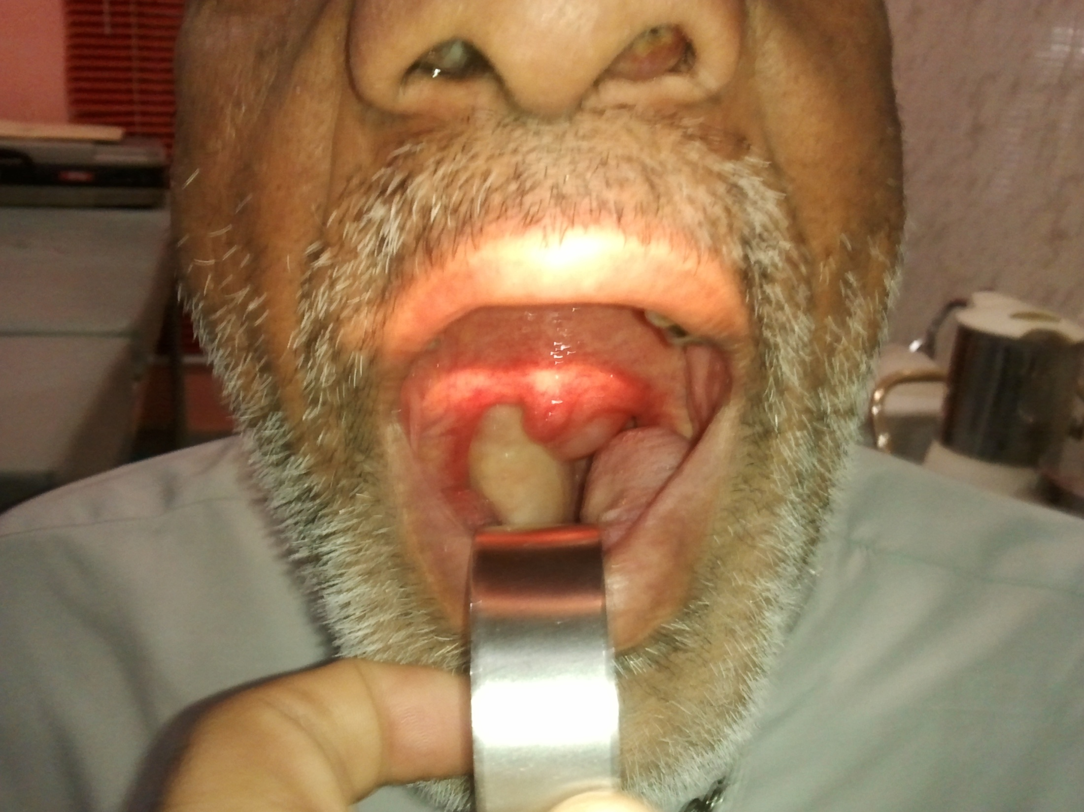

Slide 14
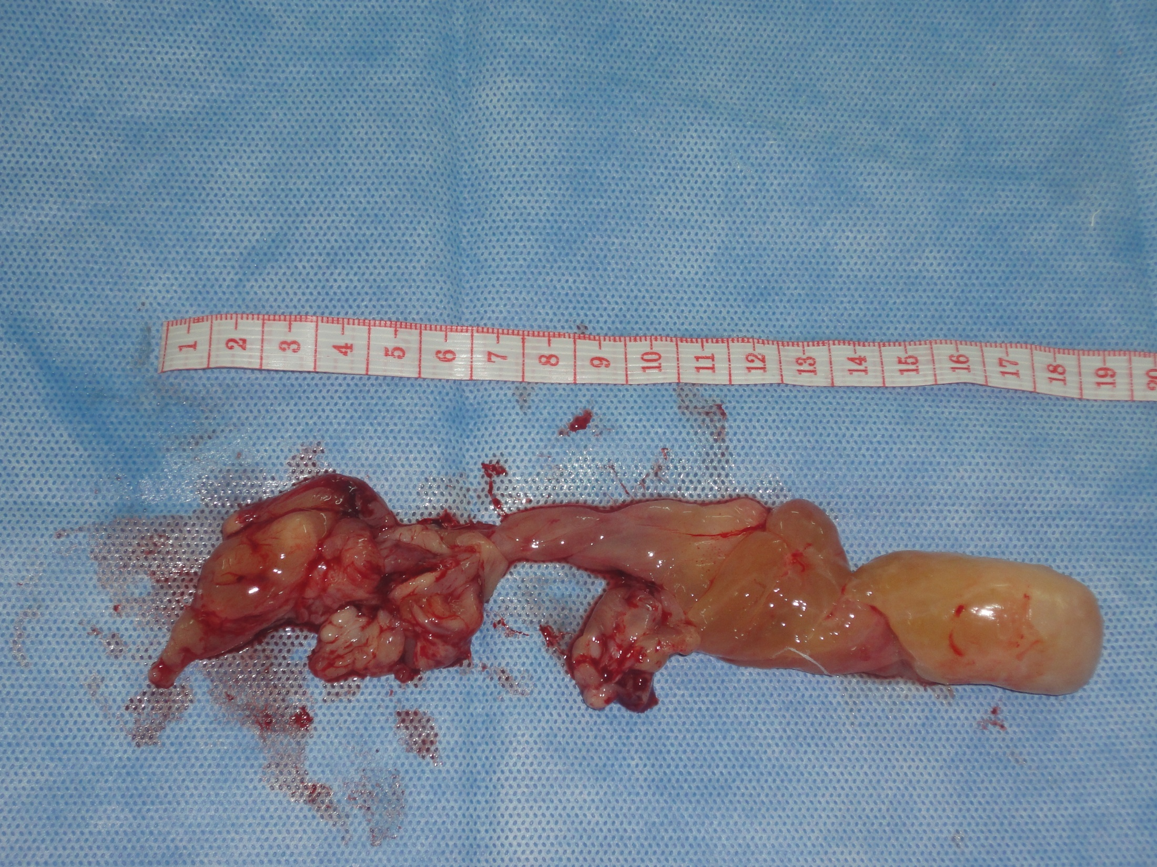

Slide 15
Treatment ‎ Conservative; in early cases 1.Antihistamine applied topically or systemic. 2. Topical steroid therapy. Beclomethasone aerosol spray often shrink existing polyps and prevent recurrence of those removed surgi­cally. 3.Combination therapy. a. Oral pred­nisolone on a reducing dose regimen is given for 15 days starting with 60 mg/day b. steroid nasal drops(ophtamethasone) are administered four times daily for a month. c. An antibiotic is given for a week if there is infection . d.Antihistamine as well

Slide 16
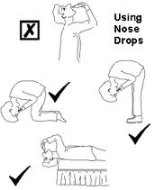

Slide 17
Surgical ‎Required when obstructive symptoms are established. ‎1. Minor procedures. Removal wilh the cold-wire snare ‎2. Major procedures are indicated for recurrent multiple polypi; for gross infection; or antrochoanal polypi. ‎polypectomy may be performed by : ‎(a) Intranasal ‎. Functional endoscopic surgery ‎(c) Exterrnal ‎Sublabial antrostomy is used for recurrent antrochoanal polypi. ‎. ‎

Slide 18
Long-term management ‎ ‎Removal of polypi is best followed by long-continued antihistamines by mouth, and regular courses of topical steroid aerosol or drops.

