Slide 1
General Pathology of Infectious Diseases
Dr.Zahraa Osama Yehya
Department of Pathology
Ninevah College of Medicine

Slide 2
Infectious Diseases
INTRODUCTION

Slide 3
Despite medical advances, only a handful of these diseases had actually been defeated, almost all victories are due to immunization programs (e.g. small pox, whooping cough, polio & measles), & thus, these diseases remain important cause of death around the globe, especially in developing countries due to the unsanitary living conditions & malnutrition

Slide 4
Although antibiotic usage has contributed indeed to the taming of some Infectious Diseases, indiscriminate use also has resulted in the development of increasingly virulent, multiple drug-resistant pathogens

Slide 5
The goal of these lectures is to highlight the general mechanisms by which infectious organelles cause pathology, i.e. to know the types, eatiology, pathogenesis, gross & microscopial appearance of these diseases so that we can understand the signs and symptoms, plan therapy, assess prognosis & plan prevention

Slide 6
Definition of infection

Slide 7
Infection is defined as the invasion of living tissue by m.o. or its products, followed by local reaction which may be associated with general reaction

Slide 8
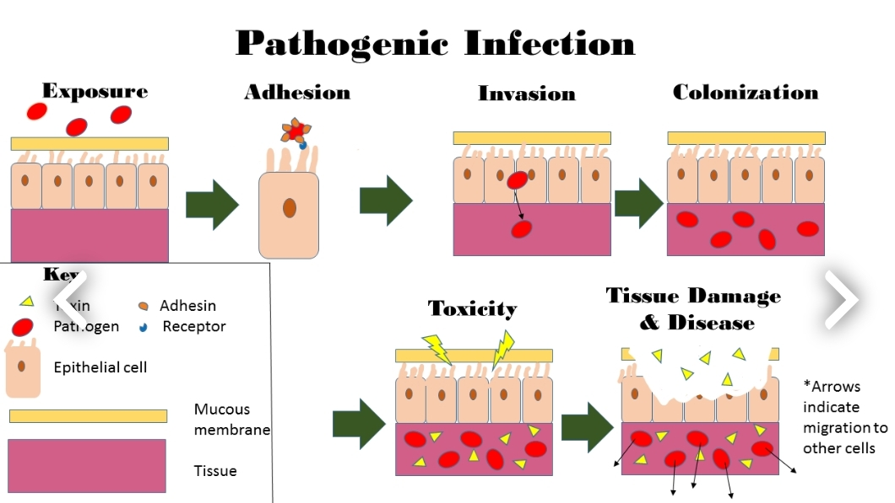

Slide 9
Following invasion, the m.o. may be :
eliminated without causing obvious disease (sub-clinical infection)
or causing clinical disease of any grade of severity

Slide 10
The outcome depends on the complex balance between:
the aggressive mechanisms of the m.o.
& the defense mechanisms of the host

Slide 11
Definitions

Slide 12
Commensals
are microorganisms that live on the expoure of the host WITHOUT causing harm. e.g. bacteria living on the skin, however, these harmless m.o. can cause diseases in case of immunodefeciency, these are called (Opportunistic infections)

Slide 13
Pathogen
m.o. that injure the host, this range from very small prion protein PPr which is 27 kD to 10 meters tape worm

Slide 14
Pathogenicity
the capacity of a particular m.o. to cause disease
Virulence
the degree of pathogenicity

Slide 15
Prions
are modified host protein that can cause human disease like spongiform enchephalopathies as in Creutzfeld-Jacob disease (CJD-mad cow disease).

Slide 16
Routes of Infection

Slide 17
Inhalation
Ingestion
Sexual routes
Parentral e.g. injection , bite etc
transplacental

Slide 18
Factors influencing the infection

Slide 19
1- Microorganism factors
Access: entry of m.o to the body cells
2. Dose & virulence
3. Invasiveness: ability of m.o to multiply & spread in the body through the use of endotoxin & exotoxin
4. Transmission: ability of m.o to pass to another suitable host.

Slide 20
2-Host Factors:
Mechanical barriers: clean dry Intact skin, keratin, mucous membrane of the conjuctiva, respiratory & GIT epithelium.
Chemical forces: acidity of sweat & gastric juice, lysosomal enz. secreted by mucous membrane of the lacrimal, salivary & nasal glands, secretory IgA antibodies in saliva, tears, intestinal contents, respiratory mucous, milk & urine.

Slide 21
Physical Forces: movement of respiratory cilia, mucus, continuous flow of urine & saliva, increase peristalsis causing diarrhea .
Phagocytosis: by macrophages & neutrophils.
Specific immune response: by cell-mediated & humeral immunity.

Slide 22
Local factors: e.g. ischemia & foreign body promote infection.
Systemic factors: e.g., malnutrition, diabetes mellitus, chronic alcoholism & malignancy.
Age: both very young & very old have increasing risk of infection.
Drugs: appropriate antimicrobial drugs eradicate many susceptible microorganism.

Slide 23
Results of infection

Slide 24
1. Eradication: most infections end by total eradication at the site of entry.
2. Persistence of infection: either in form of carrier state or mild chronic forms e.g. typhoid fever, hepatitis infection.

Slide 25
3. Spread: to other parts of the body .e.g. direct spread as in cellulitis, lymphatic spread as in lymphangitis & lymphadenitis , blood spread as in bactermia, septicemia & pyaemia.
4. Host death: in severe infection e.g. tetanus & diphtheria.

Slide 26
Routs of infection spread inside the body

Slide 27
1- Local spread: by the action of lytic enzymes. e.g Streptococci secrete hyaluronidase enzyme which degrades the extra cellular matrix between host cells.
2- Lymphatic spread: to the Lymph nodes.
3- Hematogenous spread: causing:
-Bacteremia: Presence of m.o in the blood.
-Septicemia: actively multiplying m.o in the blood.

Slide 28
4- Through body fluids: e.g., sexual transmitted disease (gonococcus).
5- Through excretions: e.g., from kidney to lower urinary tract.
6- Through nerves: e.g. rabies virus, varicella zoster virus.
7- Through placental- fetal route.

Slide 29
Tissue response ( microsopical responses) to infections

Slide 30
There are 5 major histological patterns of tissue reaction in infections:
1- Suppurative ( PMN ) inflammation characterized by production of pus .
2- Mononuclear & Granulomatous characterized by interstitial inflammation & formation of granuloma

Slide 31
3- Cytopathic- Cytoproliferative inflammation. These reactions are usually produced by viruses.
4- Necrotizing inflammation caused by powerful toxins e.g. Cl. Perfringens lead to gangrene .

Slide 32
5- Chronic inflammation & scarring, is the final common pathway of many infections, e.g. HBV lead to cirrhosis, Schistosomal eggs lead to fibrosis of U.B. wall

Slide 33
techniques for diagnosis of infectious diseases

Slide 34
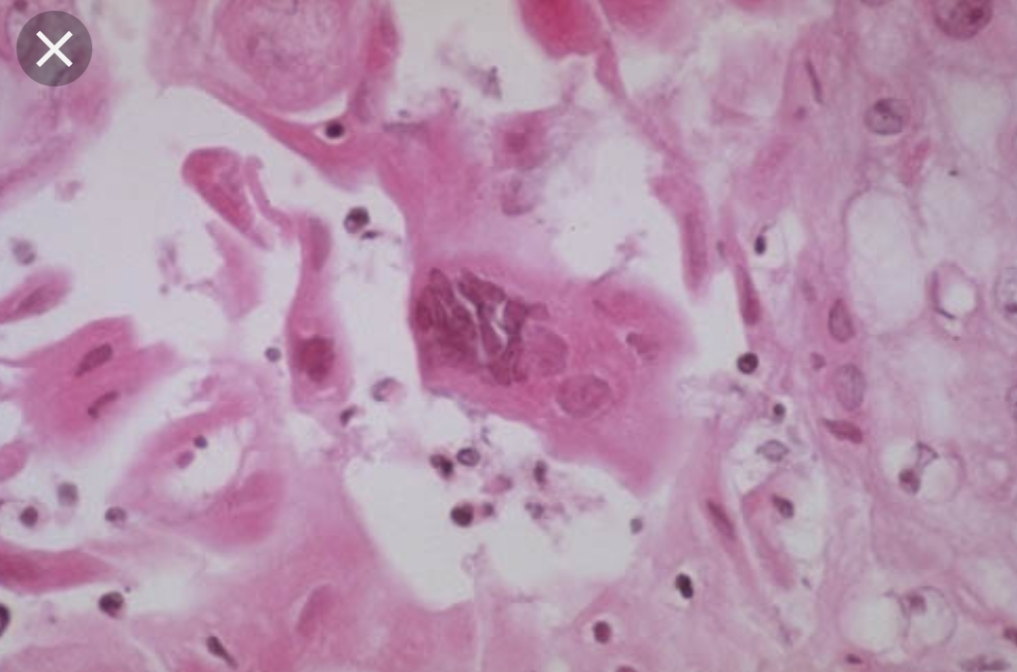
H&E stain: e.g. CMV & herpesviruse inclusion bodies, bacterial clumps, candida spp. All protozoa & helminths

Slide 35
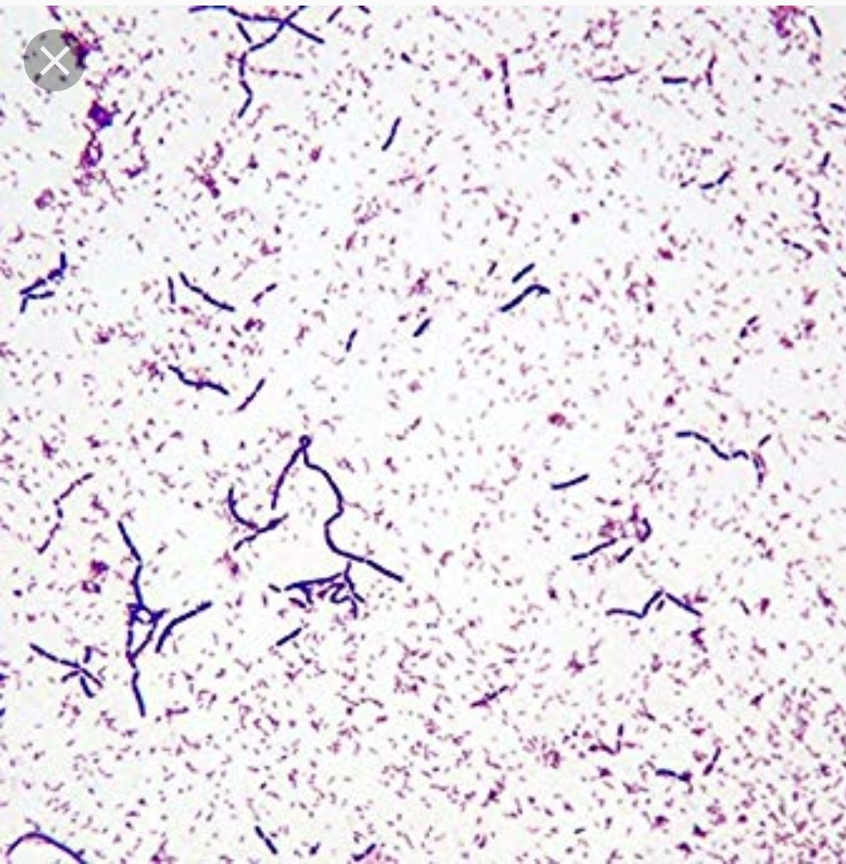
Gram stain: for most bacteria

Slide 36
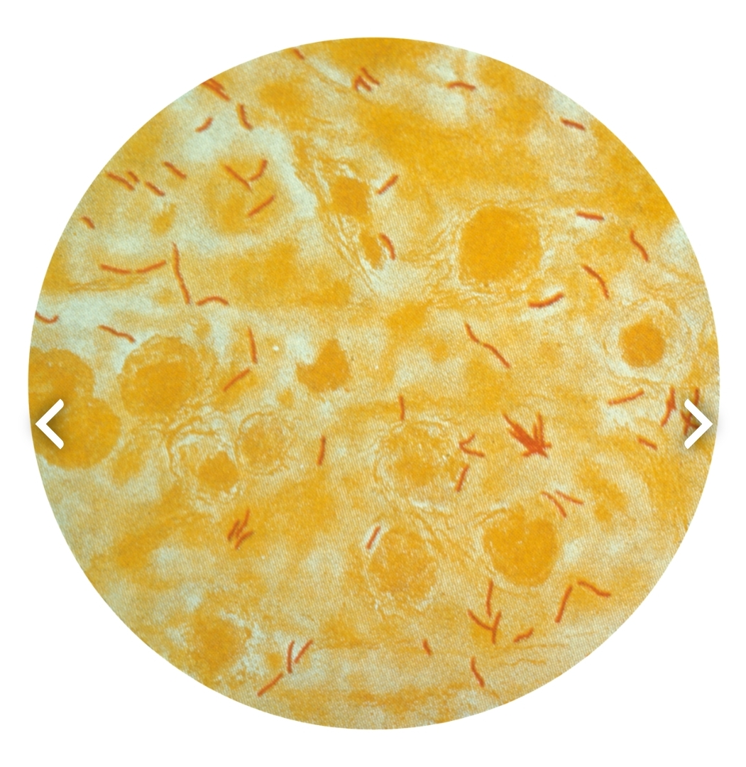
Acid fast stain: for Mycobacteria

Slide 37
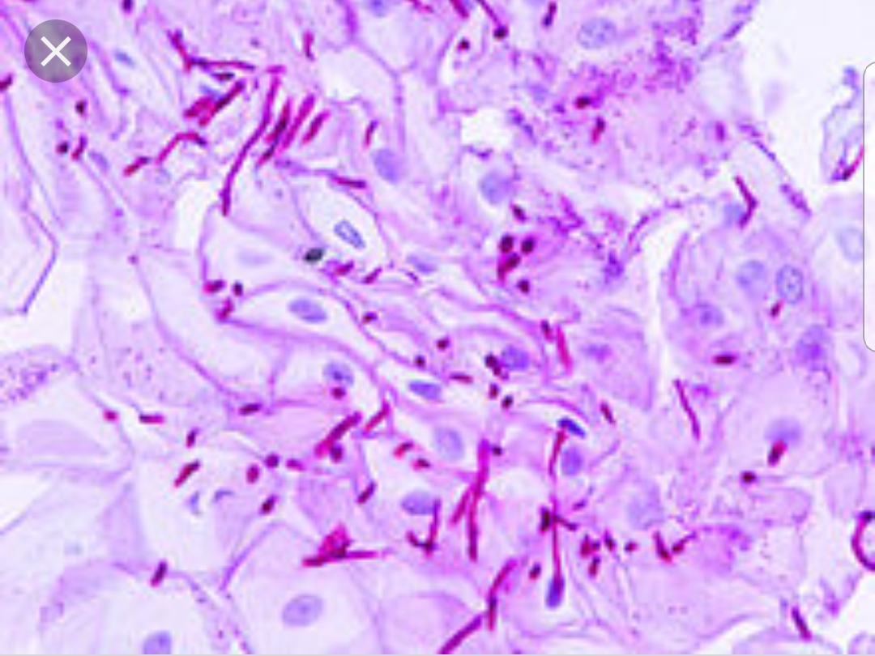
PAS (Periodic Acid Shiff): for fungi & ameobae, detect mucin & polysaccharides in m.o. cell wall

Slide 38
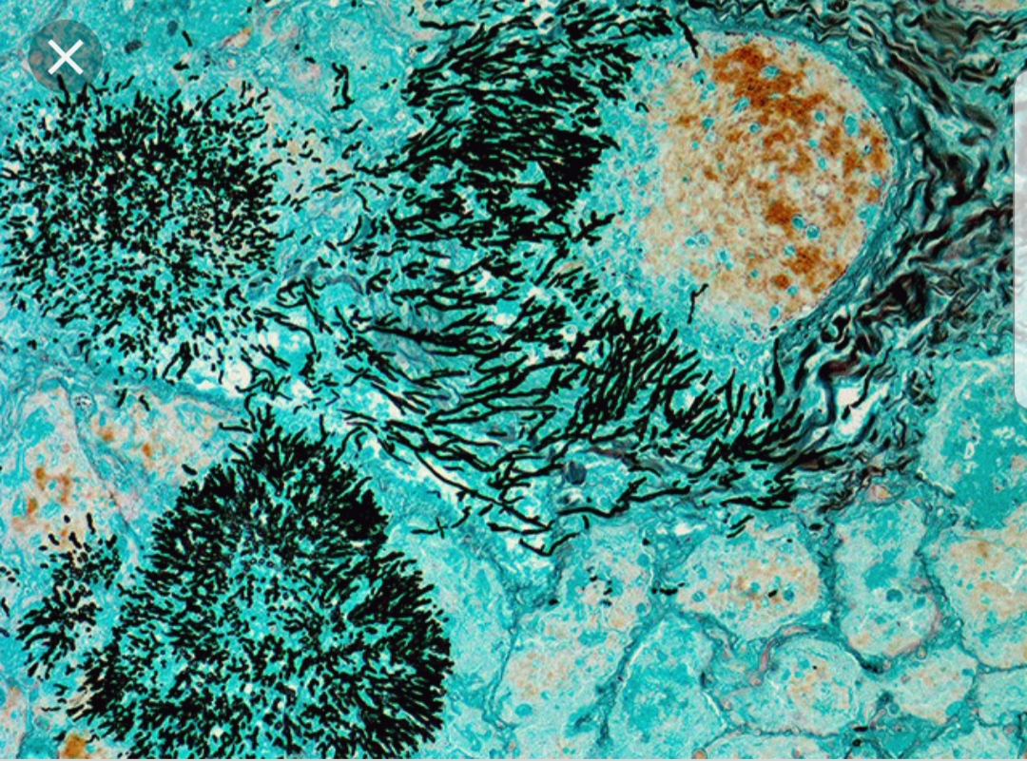
Silver stain: for fungi, pneumocystis

Slide 39
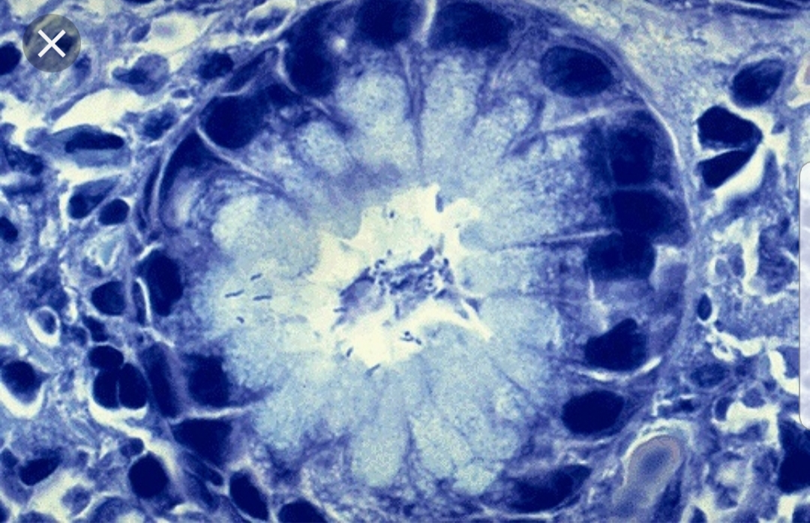
Giemsa stain: for Campylobacter, Leishmaniae, Malaria parasites

Slide 40
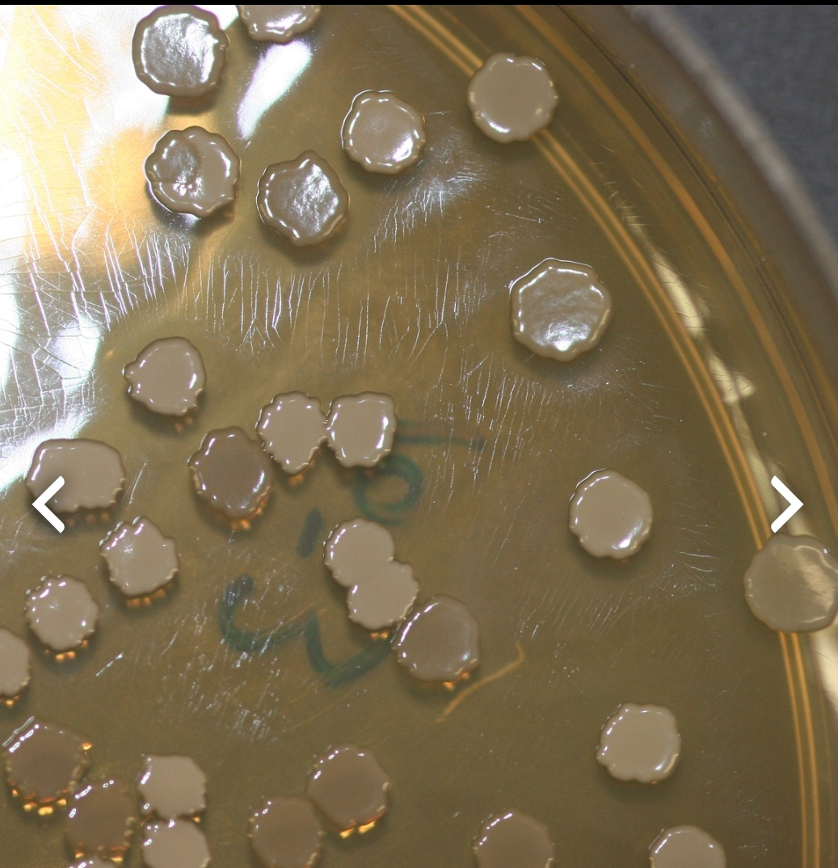
Culture: for all classes

Slide 41
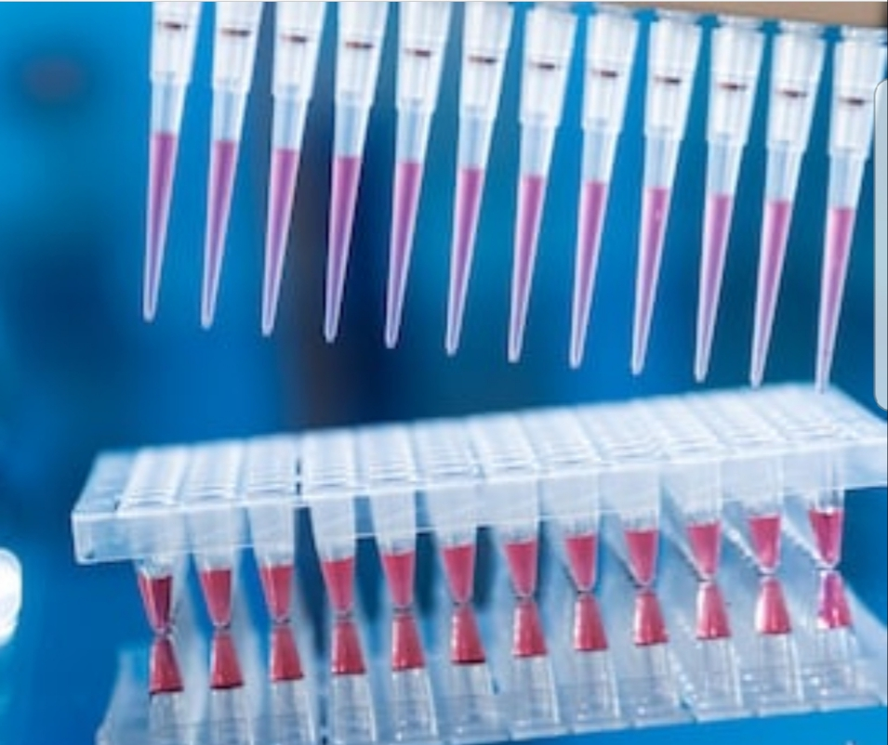
Molecular diagnostic tests e.g. PCR

Slide 42
Viral Infections

Slide 43
Viruses
are relatively simple, small, obligatory intracellular m.o. which replicates within cells by synthesis and assembly of separate components.
Viruses are classified by their nucleic acid genomes into:
DNA viruses
RNA viruses

Slide 44
Routes of infection

Slide 45
Airborne: m.o. carried by air, direct contact is not needed e.g. measles virus.
Inhalation of respiratory droplets: direct contact is needed ; e.g. influenza, chicken pox, measles, pertusis, RSV.
Ingestion : polio viruses
Parentral (s.c., i.v., i.m.) : e.g. AIDs in drug abuse & blood transfusion
Sexual route: e.g. HIV, HBV
Transplacental: e.g. HIV, HBV, HCV.

Slide 46
Following infection the virus is transmitted by blood cells, along nerves and become localized in certain tissue which it prefer (tropism) e.g. polio, rabies etc

Slide 47
Mechanisms of viral injury

Slide 48
1- Inhibits host cell DNA, RNA or protein synthesis e.g. Poliovirus.
2- Direct cell killing by damaging host cell membrane or DNA e.g. Rhinoviruses.
3. Virus replicate efficiently causing host cell lysis e.g. rhinovirus & influenza

Slide 49
4- Induce Immune reaction e.g type III & IV hypersensitivity reaction in respiratory cyncytial viruses, arbovirus encephalitis.
5- Damage host defence mechanism e.g. respiratory epithelium predisposes to the pneumonia by Staph. Pneumoniae & Haemophilus influenza. Immune system in AIDS.

Slide 50
6- Induce cell proliferation & transformation result in neoplasia e.g. HBV, EBV.
7- Virus killing cells of one type may cause damage to other cells that are dependent on the integrity of the virally damaged cells e.g. Poliovirus kills neurons leading to muscular atrophy.

Slide 51
Microscopical picture of viral infection

Slide 52
Mononuclear infiltration
Tissue necrosis
Giant cell formation
Inclusion body formation. (intranuclear or intracytoplasmic)

Slide 53
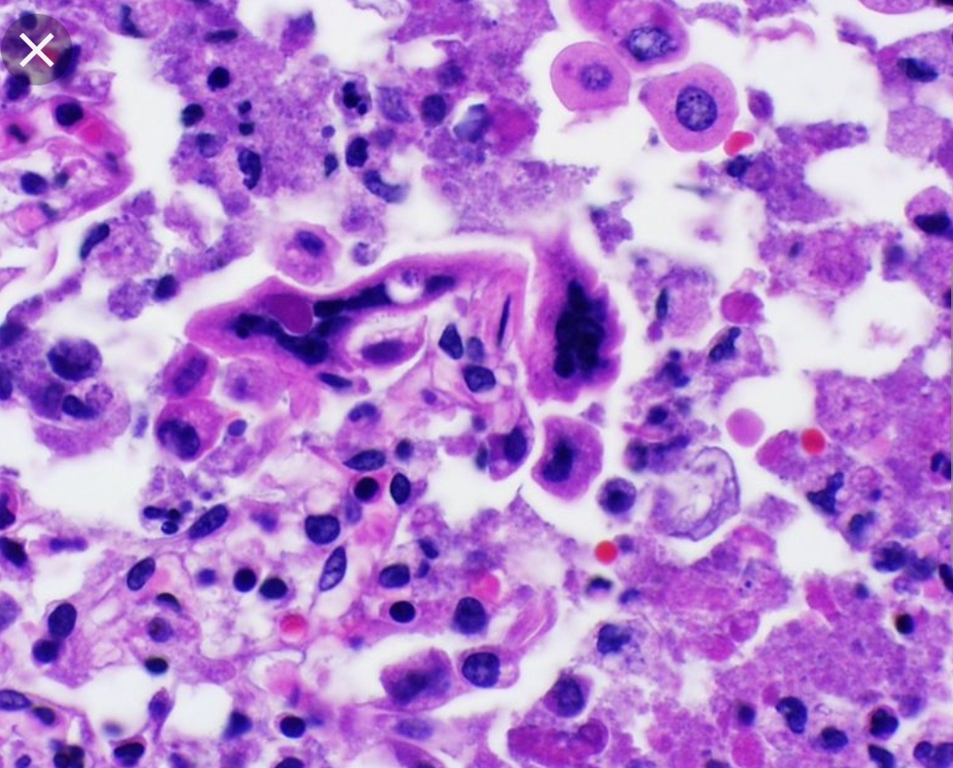
Giant cell pneumonia
Measles , RSV , para inlf. V.

Slide 54
Multinuc. Giant cells
HSV

Slide 55
Viral inclusion bodies
viral particles aggregate within the cells they infect & form characteristic ( Inclusion bodies).
Nuclear inclusions surrounded by a clear halo as in Herpes virus
Cytoplasmic inclusions as in small pox and rabies virus
Many viruses do NOT give rise to inclusions e.g. EBV.

Slide 56
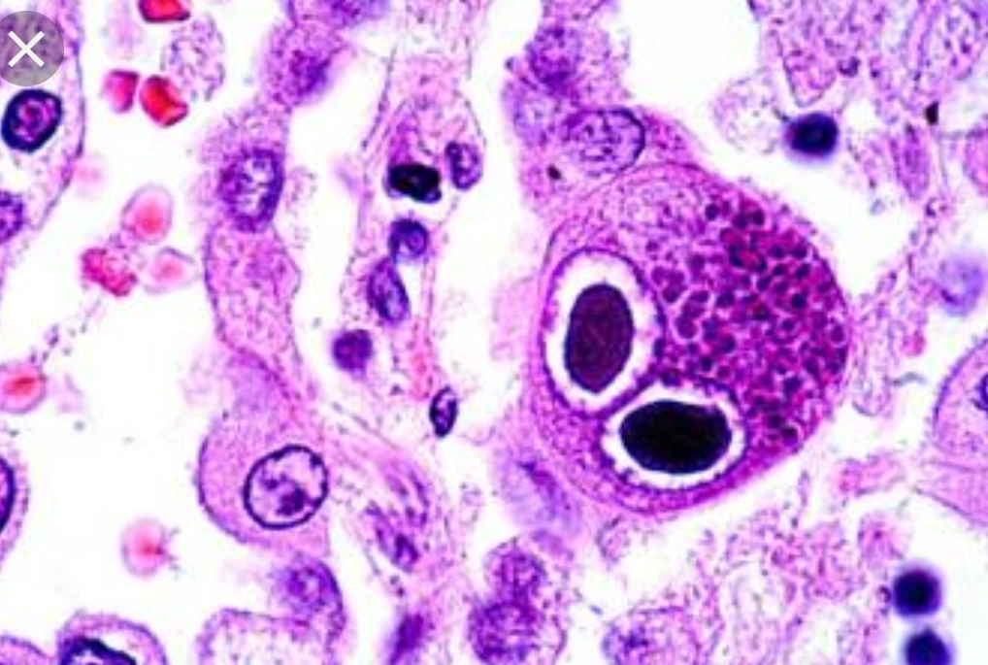
Perinuclear clearing & basophilic staining cytoplasmic inclusion bodies (owl’s eye appearance) CMV infection

Slide 57
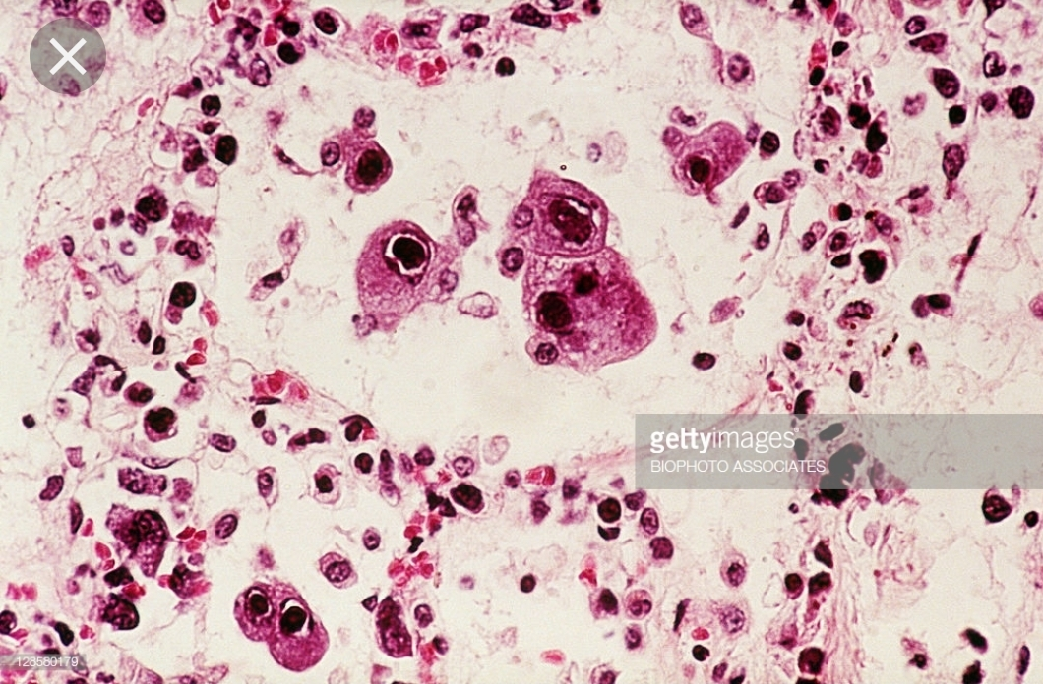

Slide 58
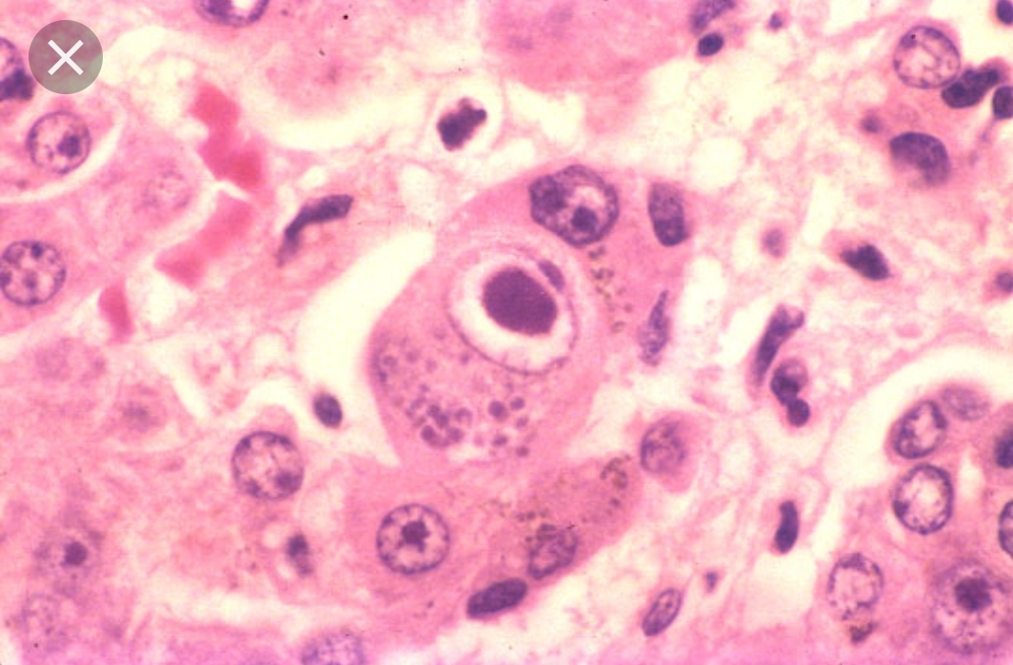

Slide 59
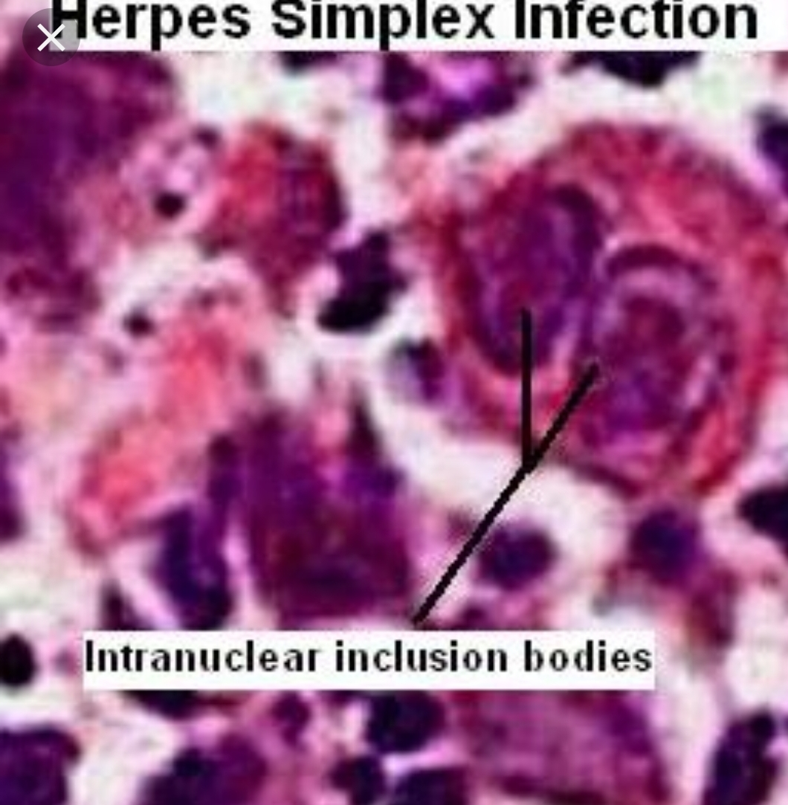

Slide 60
Body response to viral infection

Slide 61
Lymphocytosis
Production of interferons
Production of neutralizing a.b.s
Cell mediated immunity plays a role in controlling viral infection

Slide 62
Types of viral infection

Slide 63
Aborted.
Latent : Virus is synthesized continuously without altered cell e.g. HBV.
Persistent: Integrated in the cells, reactivated with depressed immunity.
Slow viral infection take very long incubation period as in HIV/AIDS.

Slide 64
Bacterial infections

Slide 65
Classification of Bacteria
Bacteria are classified on several criteria:

Slide 66
Gram stain
Bacteria are accorodingly, of two types:
Gram (+)
Gram (-)

Slide 68
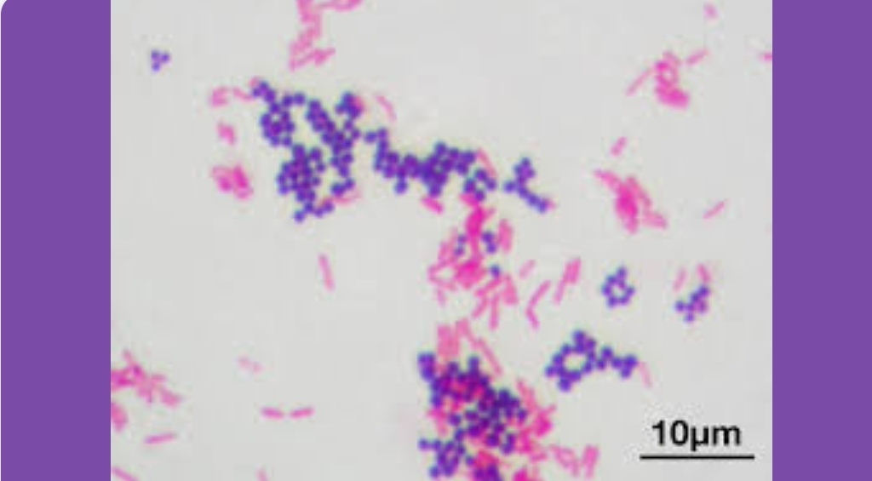

Slide 69
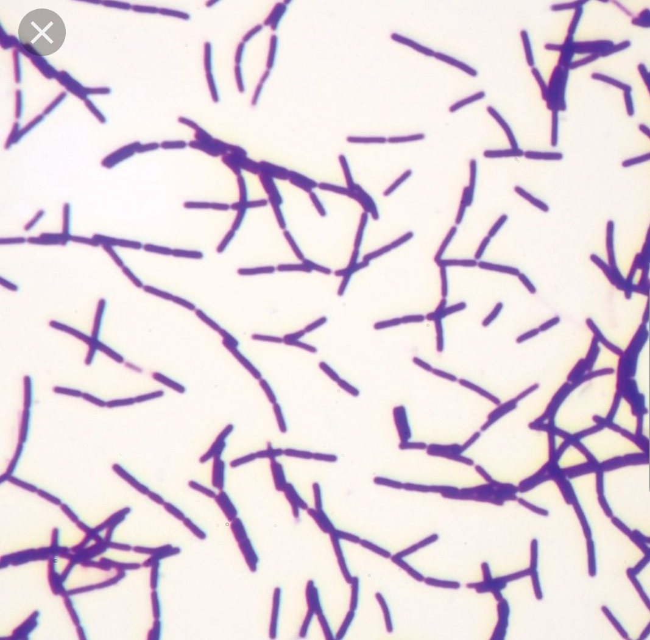
Gram(+): e.g. Staph, Strept, Mycoplasma, Clostridium, Corynebac

Slide 70
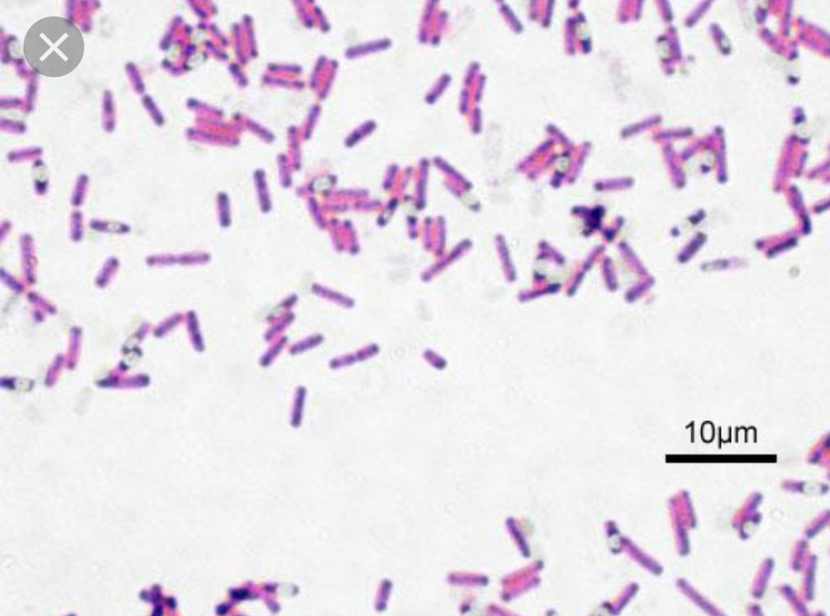
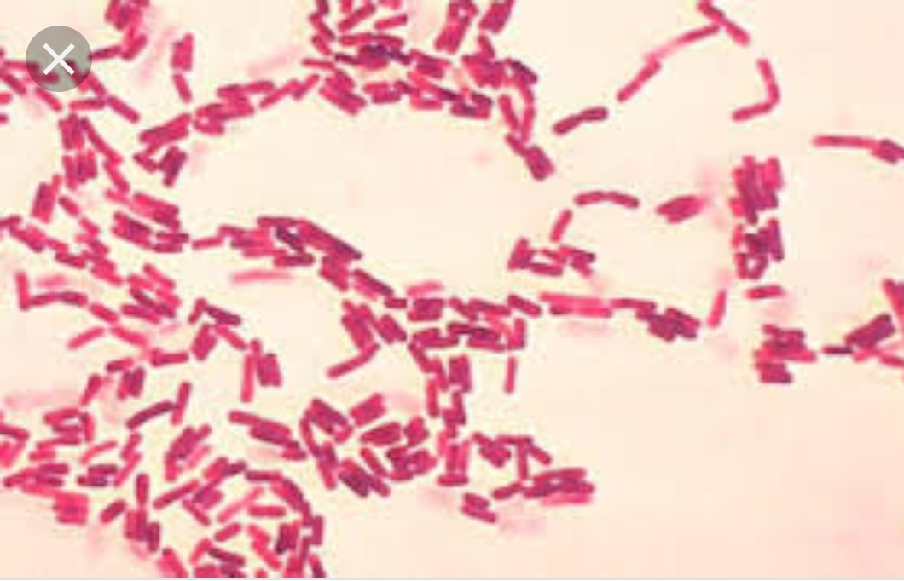
Gram (-) Salmonella, Shigella, Pseudomonas, Neisseria, Klebsiella, H.pylori, E.coli

Slide 71
Shape
Bacteria are classified as:
Cocci
Bacilli
Vibrios
Spirochates

Slide 72
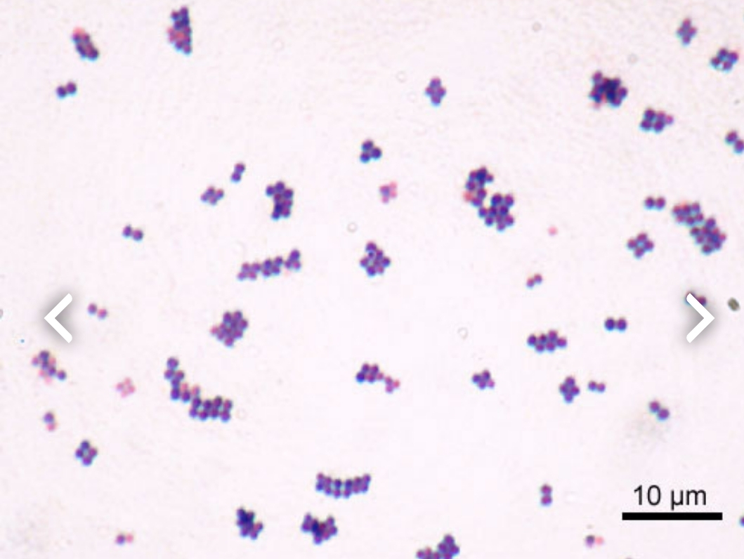
Cocci : e.g. Strept, Staph

Slide 73
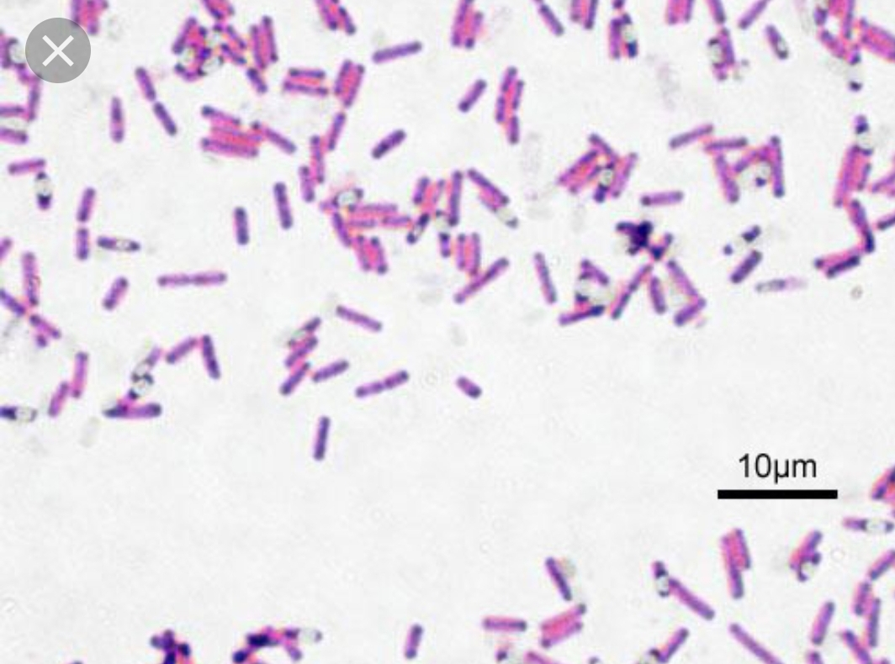
bacilli (rods) e.g.: Clostridium, Corynebac, Liisteria

Slide 74
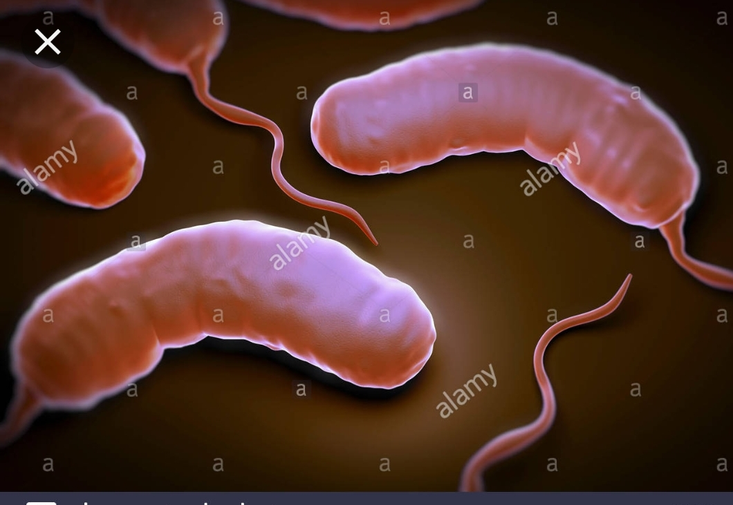
Vibrios e.g: V. cholerae

Slide 75
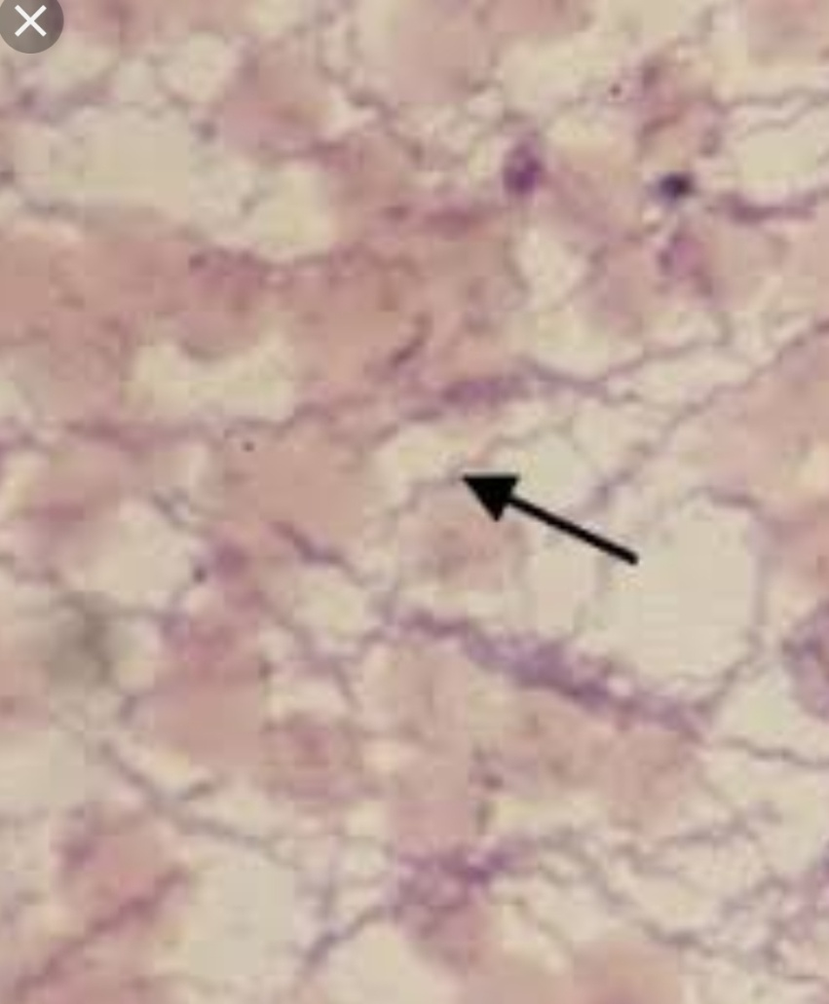
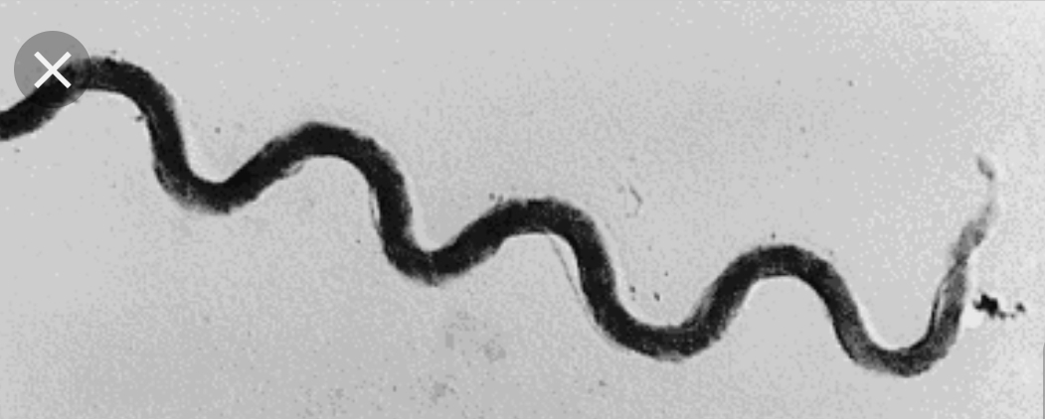
Spirochetes e.g. Treponema pallidum (Syphlis)

Slide 76
Growth requirements
bacteria are classified as:
Aerobic
Anaerobic

Slide 78
Mechanism of Bacterial injury (Pathogenesis)

Slide 79
1- Release toxins that kill cells. (exotoxin & endotoxin).
2- Release lytic enzymes, includes proteases, hyaluronidase, coagulase & fibrinolysins that destroy the tissue & facilitate the spread of bacteria .

Slide 80
3- Elicit an inflammatory reaction that may destroy not only the bacteria but also the infected tissue.
4-Elicit an immune reaction that may damage the tissues carrying the same antigen as the bacterium (“cross reactivity”).

