Slide 1
pharynx
Funnel shaped musculomembranous tube
extended from the skull base to the oesophagus opposite the sixth cervical vertebra

Slide 2
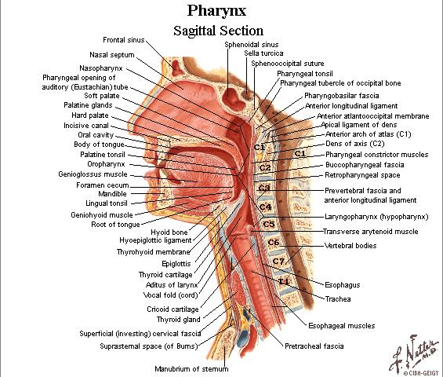
Pharynx
Nasopharynx
Oropharynx
Hypopharynx.

Slide 3
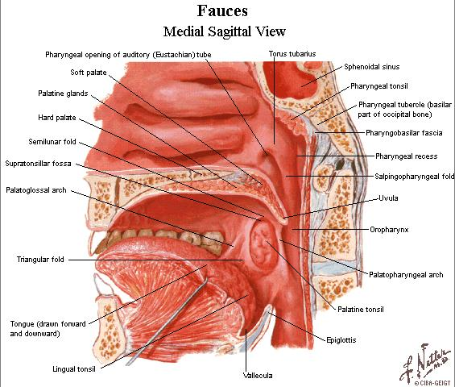
Nasopharynx
From base of skull to soft palate
Walls
structures
Pharyngeal opening of the eust.tube
Pharyngeal recess/ fossa of rosenmuller
Nasopharyngeal tonsil

Slide 4
oropharynx
From soft palate to the upper border of the epiglottis
Lat. Wall contains palatoglossal , palatopharyngeal arches & palatine tonsil in between

Slide 5
hypopharynx
From upper border of epiglottis to the lower border of the cricoid cartilage.
From 3rd to 6th cx. vert.
Supported by thyroid cartilage & thyrohyoid membrane

Slide 6
Nerve supply
Motor:
* cranial part of the XI nerve & vagus n (X)
** glossopharyngeal n (IX) to
stylopharyngeus muscle only
2. Sensory :
- maxillary n from the nasal part
- glossopharyngeal n.---oral part
- internal laryngeal n of the vagus from the
laryngeal part

Slide 7
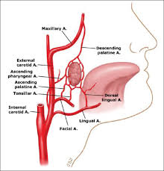
Blood supply
Ascending pharyngeal a.
Ascending palatine
Facial a.
Maxillary a
Lingual a

Slide 8
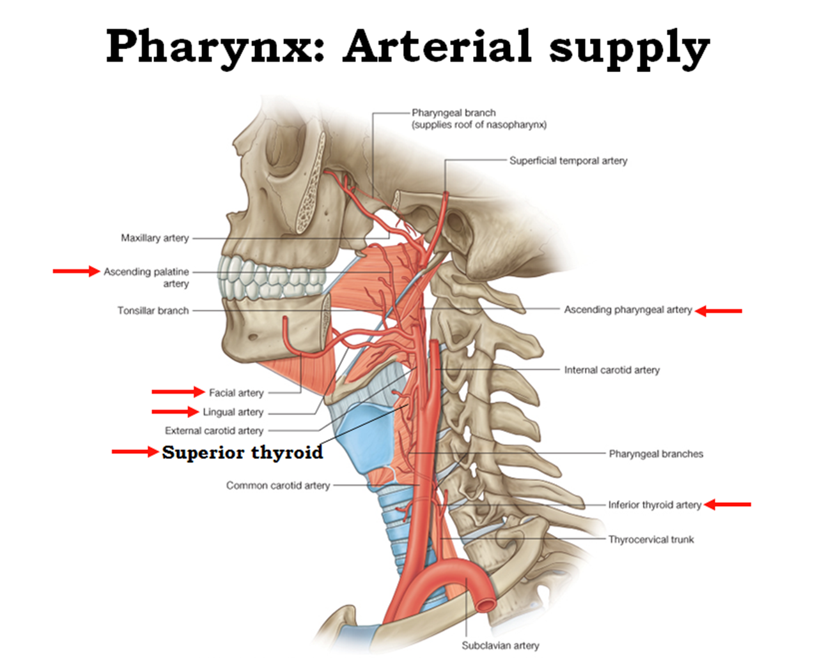

Slide 9
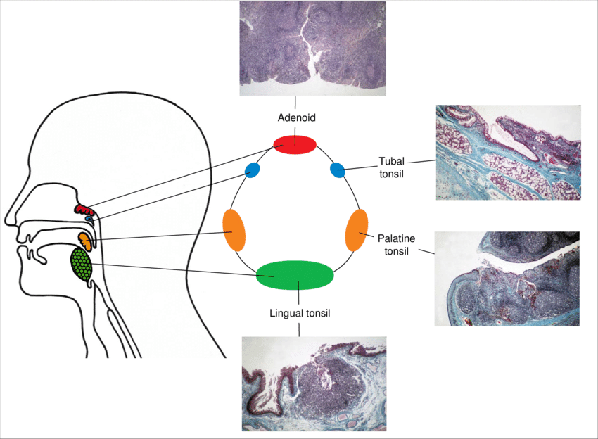
Veinous drainage : pharyngeal pluxes to int.jug.v.
Lymphatic drainage:
#- deep cx. Ln.
#- retropharyngeal
#- parapharyngeal Ln
- subepithelial lym. t. (Waldeyer`s ring):
1-palatine ts.
2-n/p ts ( adenoid)
3- lingual ts.
4- tubal ts.
5- lateral pharyngeal band.

Slide 10
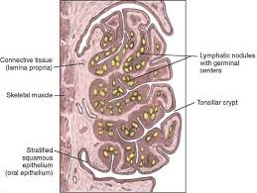
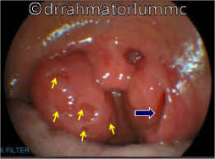
Palatine tonsil
Two masses of lymphoid tissue located in the lat. wall of the oropharynx between ant. & post. Faucial pillars
The free medial surface project into the cavity of pharynx and pitted by numerous small opening lead into crypts in which the mucous glands are secreting
Lat. Surface covered by fibrous tissue called capsule

Slide 11
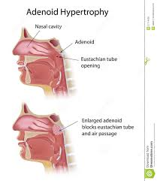
adenoid
Hypertrophy of the nasopharyngeal tonsil sufficient to produce symptoms .
- most commonly between 3 & 6 years.
- atrophy begins after 10 years / completes before 20 years.

Slide 12
Symptoms &signs
Due to hypertrophy :
1. nasal obstruction causing :
a- mouth breathing
b- difficulty in eating
c- noisy breathing & eating
d- drooling
e- snoring
f- toneless voice
Eustachian tube obstruction:
a- deafness
b- Secretory o. m.

Slide 13
B. Due to inflammation:
nasal discharge & post nasal drip
( egg- white plug of mucus seen behind uvula on gagging is almost diagnostic) .
O.M.
rhinosinusitis
Cx. Lymphadenitis.

Slide 14
C. Generalized disturbances:
mental dullness
Apathy
Nocturnal enuresis .

Slide 15
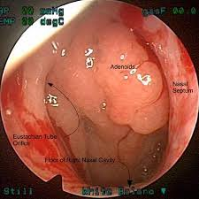
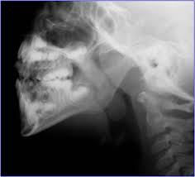
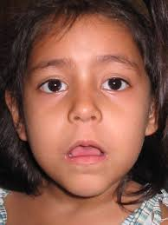

Slide 16
diagnosis
Symptoms, signs & examination by postnasal mirror in quite young children .
X-ray of post nasal space .
Endoscope.

Slide 17
DDX. :
Other causes of nasal obstruction
intrinsic rhinitis
F.B.
hypertrophy of posterior end of the inf. Turbinate.
Nasal septal deviation .
Congenital choanal atresia
Sinusitis
Antrochoanal polyp.

Slide 18
Orthodontoic abnormalities / high arch palate.
Thorn Waldt`s disease / cystic persistence of the median furrow of the n/ph tonsil.

Slide 19
treatment
A- conservative / no marked symptoms & signs
- decongestant nasal drop
- fresh air breathing & postural exercise
- nose blowing training
B- adenoidectomy

Slide 20
Indications of adenoidectomy
1- obstructive sleep apnea .
2- significant hearing loss.
3- repeated tonsillitis ,sinusitis or otitis media.

