Slide 1
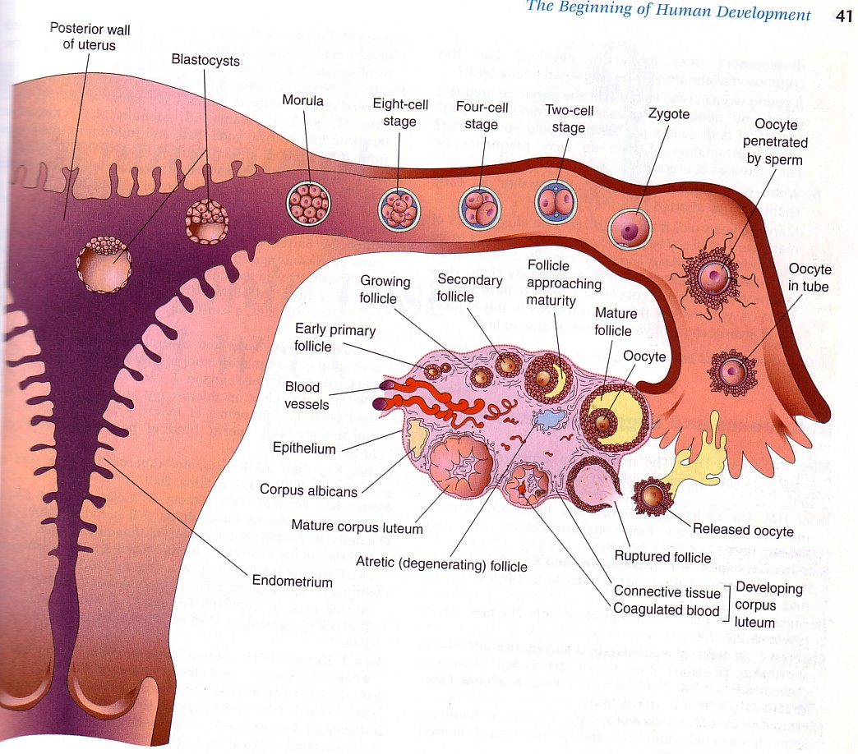
FERTILIZATION & IMPLANTATION
Dr.Sumeya

Slide 2
Obgectives
This lecture explain spermatogenesis and oogenesis then normal fertilization regarding time and site .
Also normal and abnormal implantation .

Slide 3
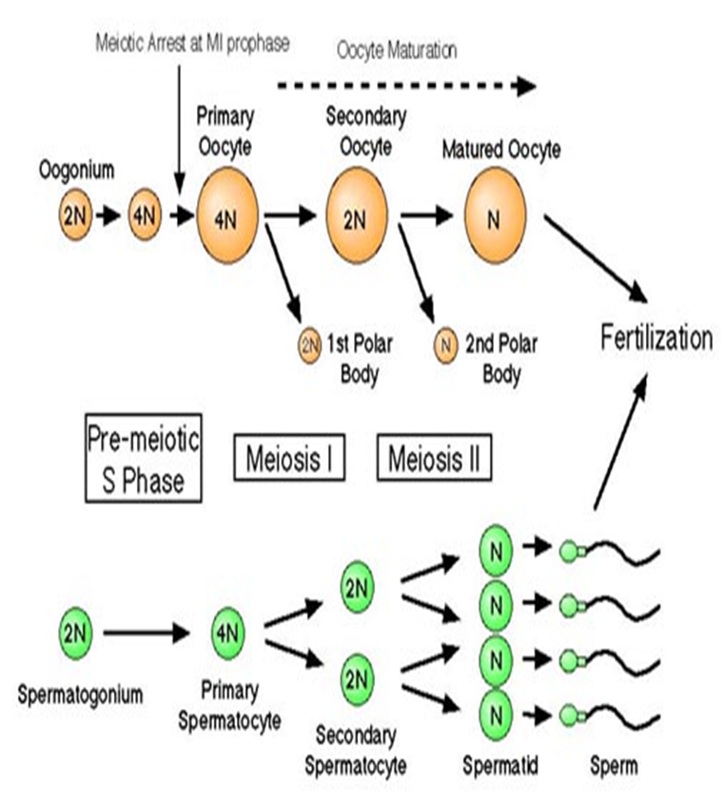
Gametogenesis
The creation of highly specialized sex cells

Slide 4
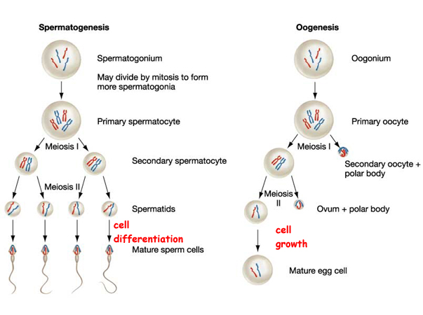

Slide 5
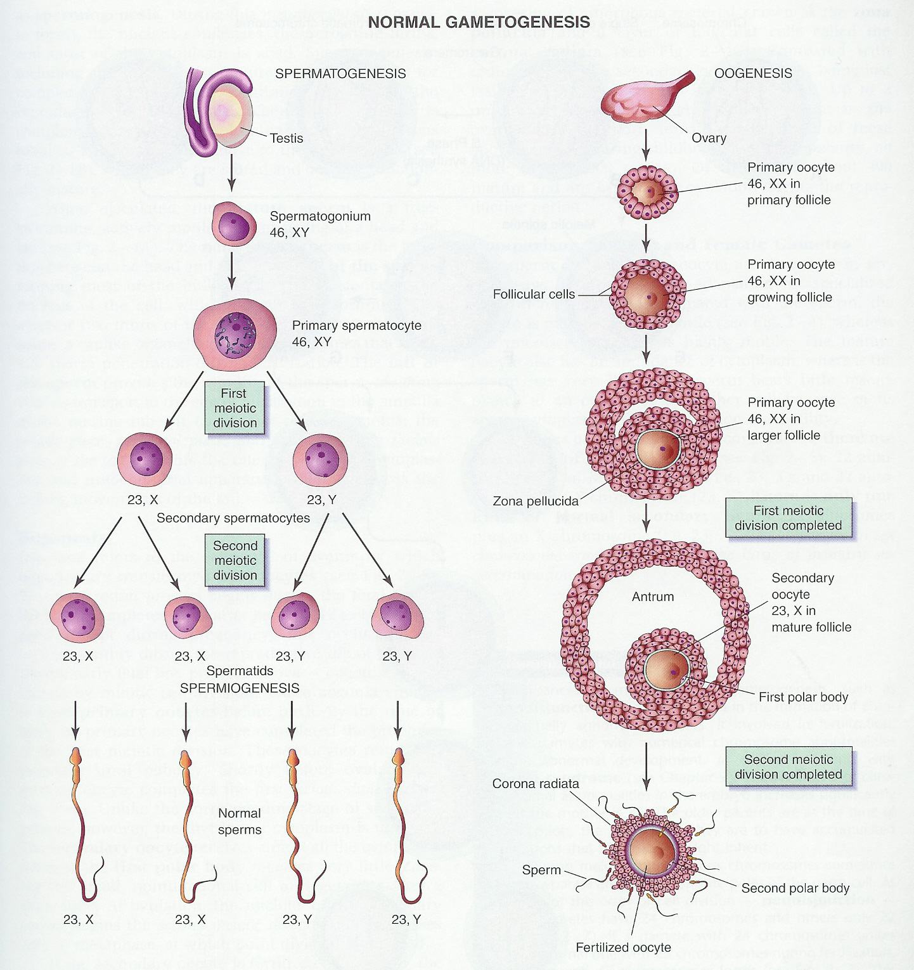

Slide 6
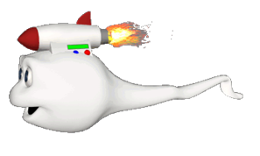
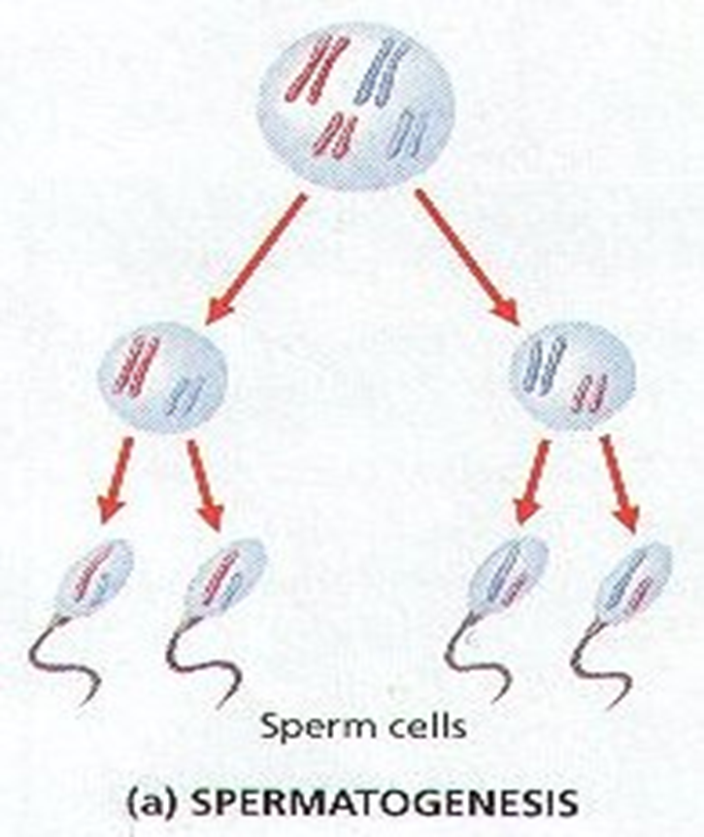
Spermatogenesis
The process of development of spermatids from the male primordial germ cells and their differentiation into spermatozoa.
Under stimulation anterior pituitary gonadotropic hormones.
PROCESS :
The Primordial germ cells develop into spermatogonia.

Slide 7
2.This occurs after puberty, and they remain in the wall of the Seminiferous Tubule .
3.Spermatogonia form primary spermatocytes.
4.They remain in the prophase of 1st meiotic division for 16 days.
5. Each contains 22 pairs of autosomes and one pair of sex chromosome XY.
6.Then divides into two secondary spermatocytes. (Meiotic div. completed).
7.Each secondary spermatocyte has equal cromosomes.(22+X) or (22+Y).
8.Each of these divides again(2nd meiotic div), thus forming 4 Spermatids.
9.Each containing equal cytoplasm and, HAPLOID chromosomes….
TWO with 23X & TWO with 23Y

Slide 8
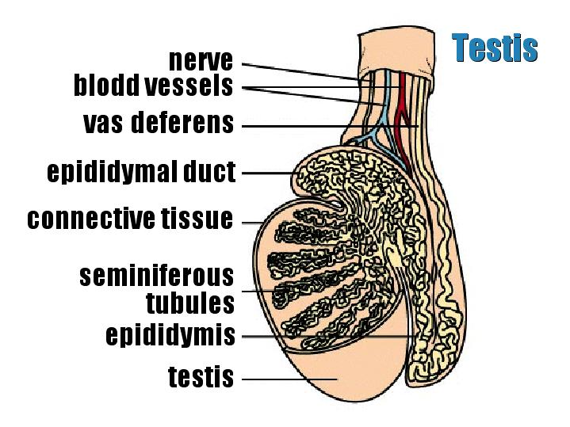

Slide 9
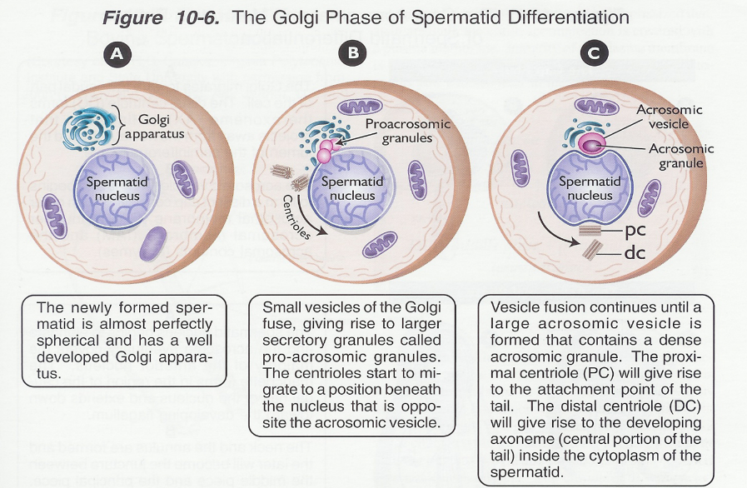
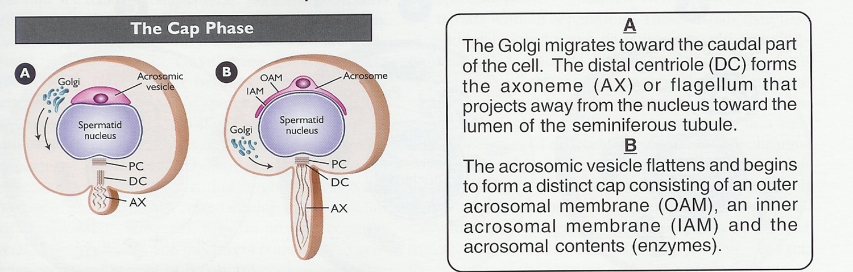
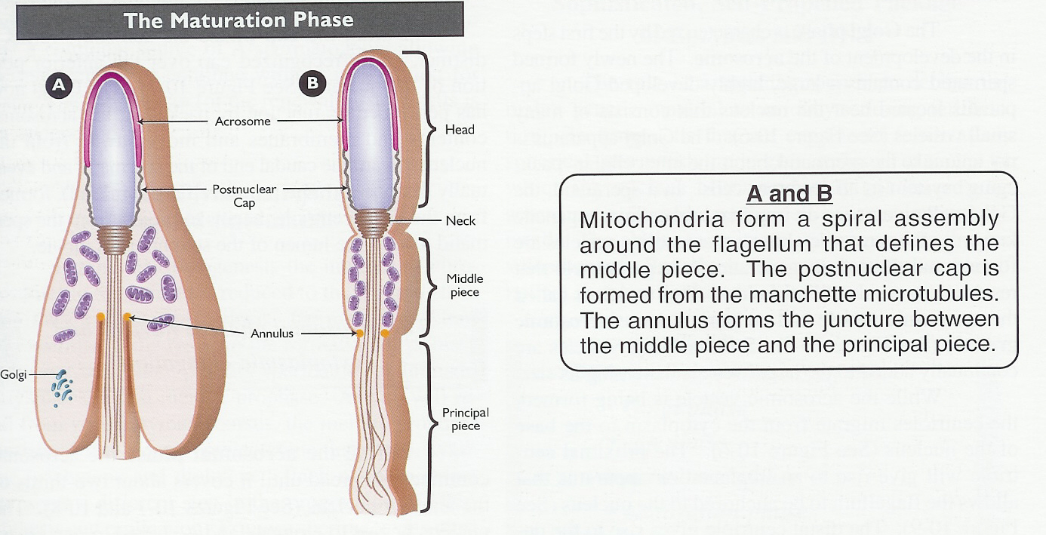
Spermiogenesis
Spermatids undergo morphological changes to form spermatozoa

Slide 10
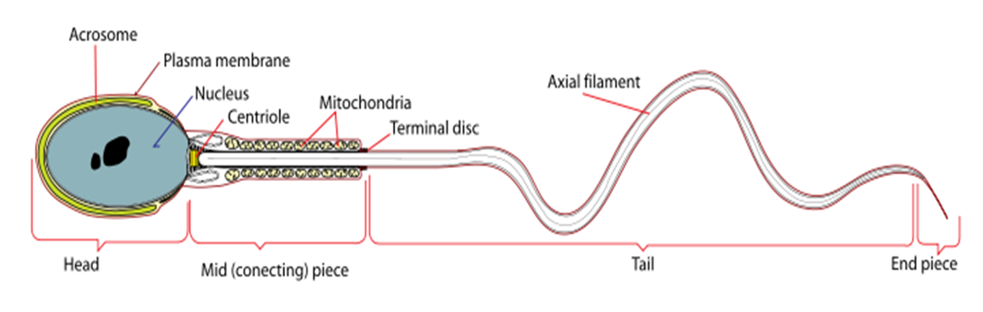

Slide 11
Structure Of The Sperm
The Head
has two important features.
The acrosome (derived from Golgi apparatus) contains hydrolytic enzymes which are released when the sperm reaches an ovum. These enzymes digest the outer membrane of the egg (proteins and complex sugars) , allowing penetration of the sperm.
The nucleus (haploid) contains a single set of chromosomes derived from the male. This will include either an 'X' or 'Y' chromosome, because of the way the XY separate during meiosis.

Slide 12
The Middle Piece
behind the head, contains numerous mitochondria. These respire sugars in the semen to generate ATP in order to provide the energy for movement of the tail.
The Tail
(Flagellum) contains microfilaments running the length of the tail (arranged in the usual 9 + 2 )Rhythmic contraction of the filaments causes the tail to wave and move against the fluid environment, providing forward motion.

Slide 13
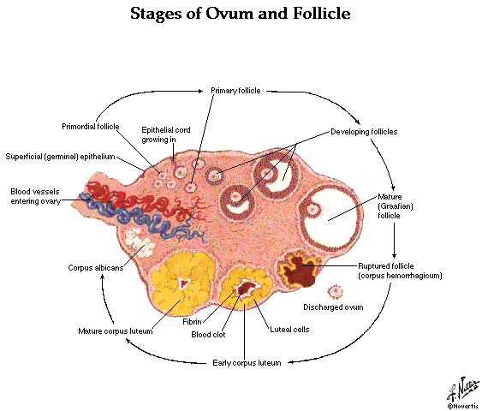
Female Genital System
The Ovary: female sex gland, produce ova.
The Uterus: in which the fetus develop.

Slide 14
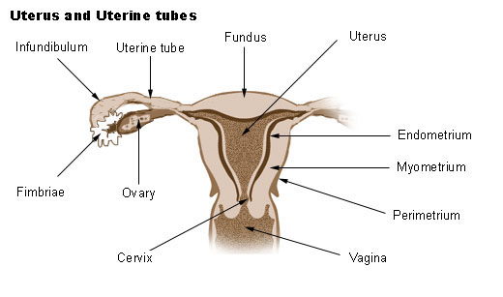

Slide 15
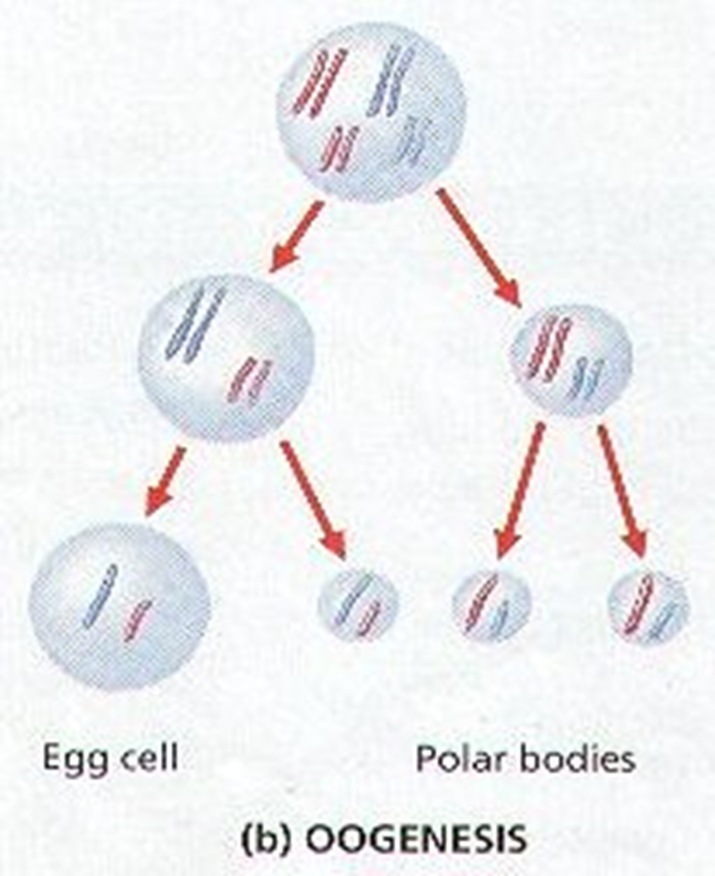
Oogenesis
Formation of female gametes, it means differentiation of female primordial germ cell (oogonium) into mature ovum.
Oogonia(2N) increased in the ovary through mitotic division.
Oogonia (2N) grow to primary oocytes (2N) intrauterine in primordial follicle.
primary oocytes (2N) enter meioses Ι but arrest until preovulation complete it to produce secondary oocytes (N) & first polar body (N).
Then, complete the second meioses to form mature ova (N) and second polar body at fertilization.

Slide 16
The total number of primary oocytes at birth is estimated to vary from 600,000 to 800,000.
During childhood, most oocytes become atretic; only approximately 40,000 are present by the beginning of puberty, and fewer than 500 will be ovulated. Some oocytes that reach maturity late in life have been dormant in the diplotene stage of the first meiotic division for 40 years or more before ovulation. Whether the diplotene stage is the most suitable phase to protect the oocyte against environmental influences is unknown.
The fact that the risk of having children with chromosomal abnormalities increases with maternal age indicates that primary oocytes are vulnerable to damage as they age.

Slide 17
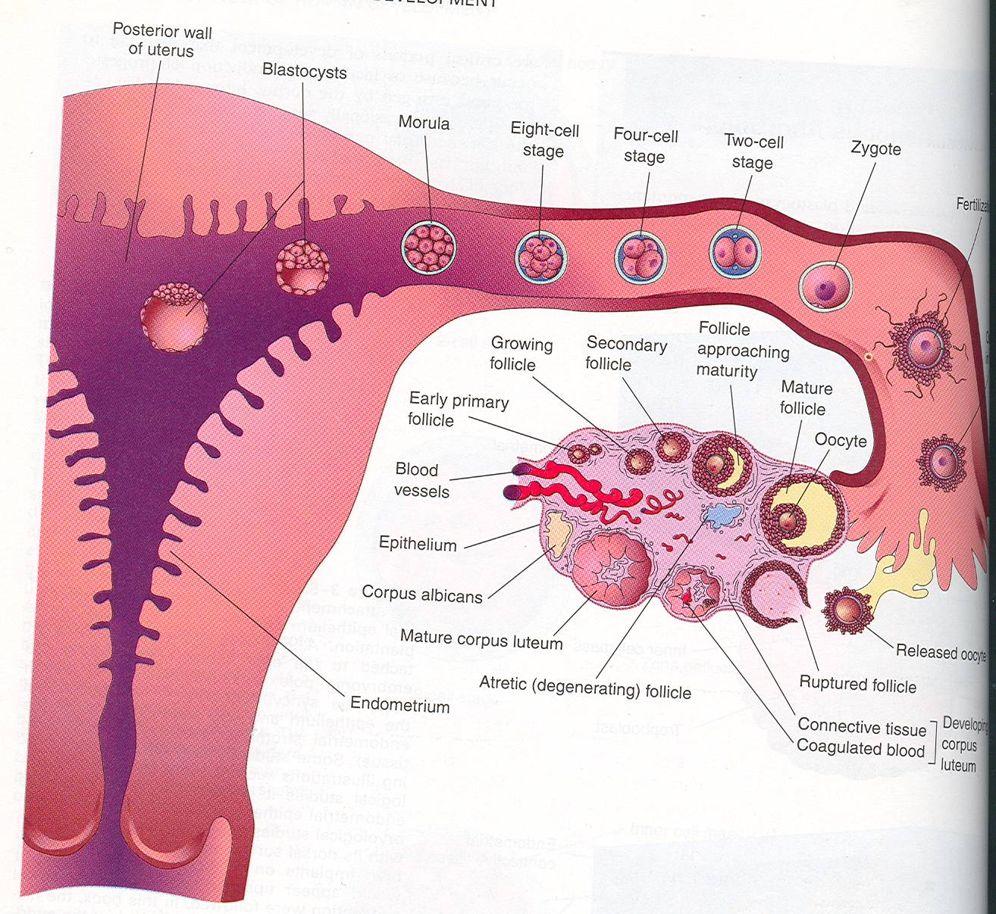
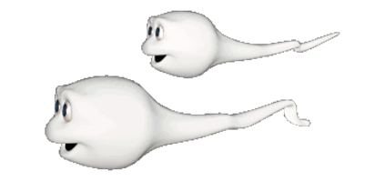
FERTILIZATION
It is the process during which a male gamete (sperm) unites with a female gamete (oocyte ) to form a single cell (ZYGOTE).

Slide 18
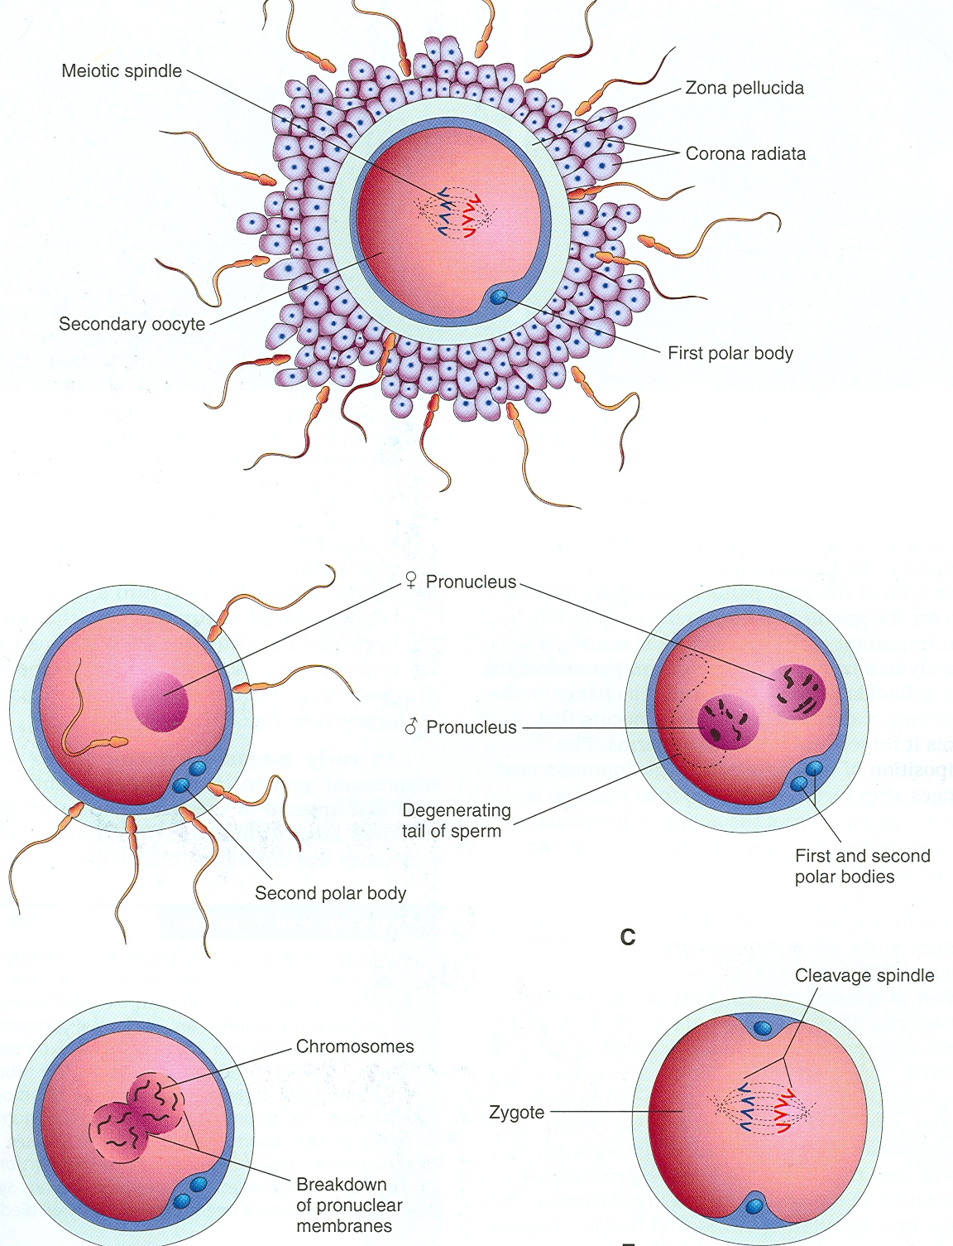
Fertilization
Begins with a contact between the sperm & the ovum.
Ends up with intermingling of the maternal and paternal chromosomes.

Slide 19
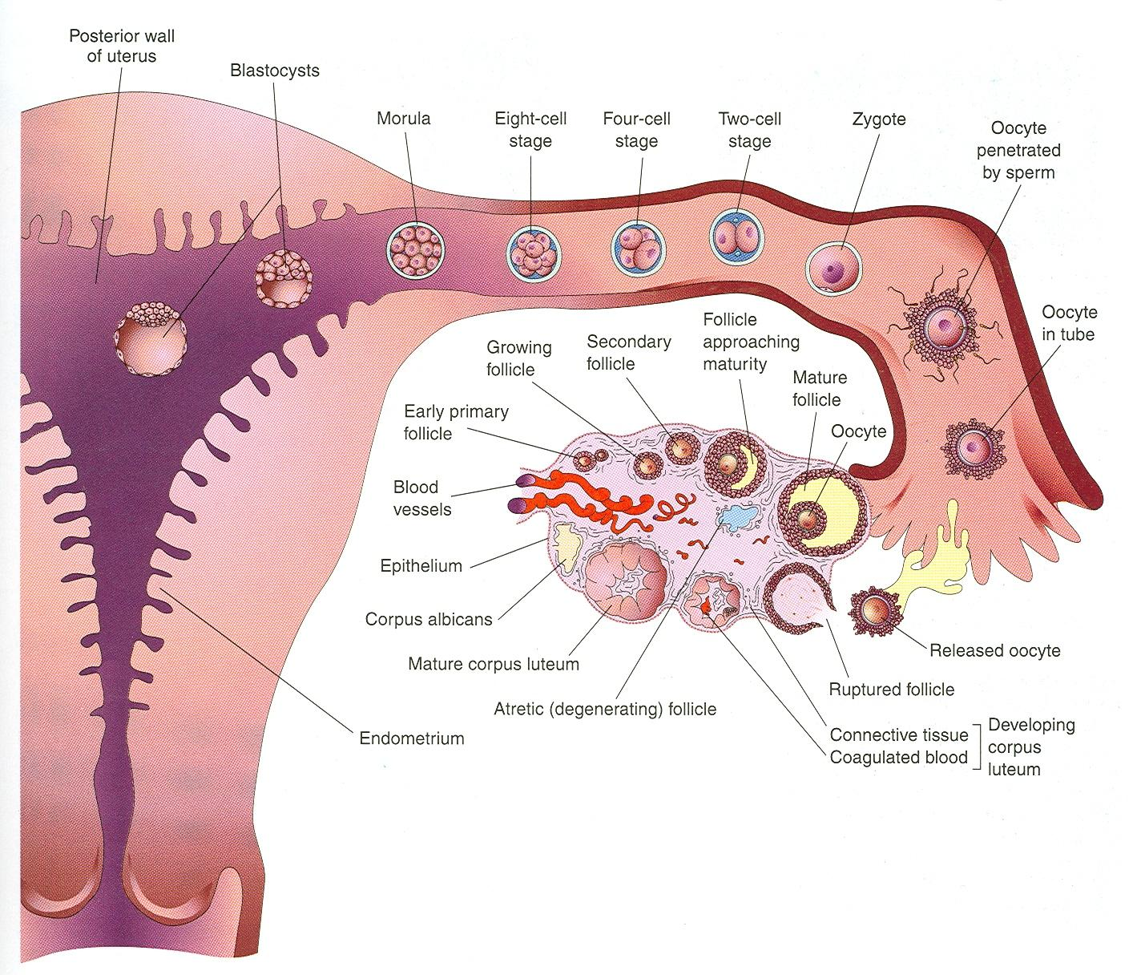
Site
Usually in the ampulla of the uterine tube.
Ampulla is the longest and widest part.
Fertilization may occur in other parts of tubes.
Does not occur in the uterine cavity.
Chemical signals from oocyte attract the sperms.

Slide 20
Spermatozoa
Spermatozoa are not able to fertilize the oocyte immediately upon arrival in the female genital tract but must undergo
(1) capacitation and (2) the acrosome reaction to acquire this capability.
Capacitation is a period of conditioning in the female reproductive tract that in the human lasts approximately 7 hours.

Slide 21

capacitation occurs in the uterine tube and involves epithelial interactions between the sperm and the mucosal surface of the tube. During this time, a glycoprotein coat and seminal plasma proteins are removed from the plasma membrane that overlies the acrosomal region of the spermatozoa.
Only capacitated sperm can pass through the corona cells and undergo the acrosome reaction.

Slide 22
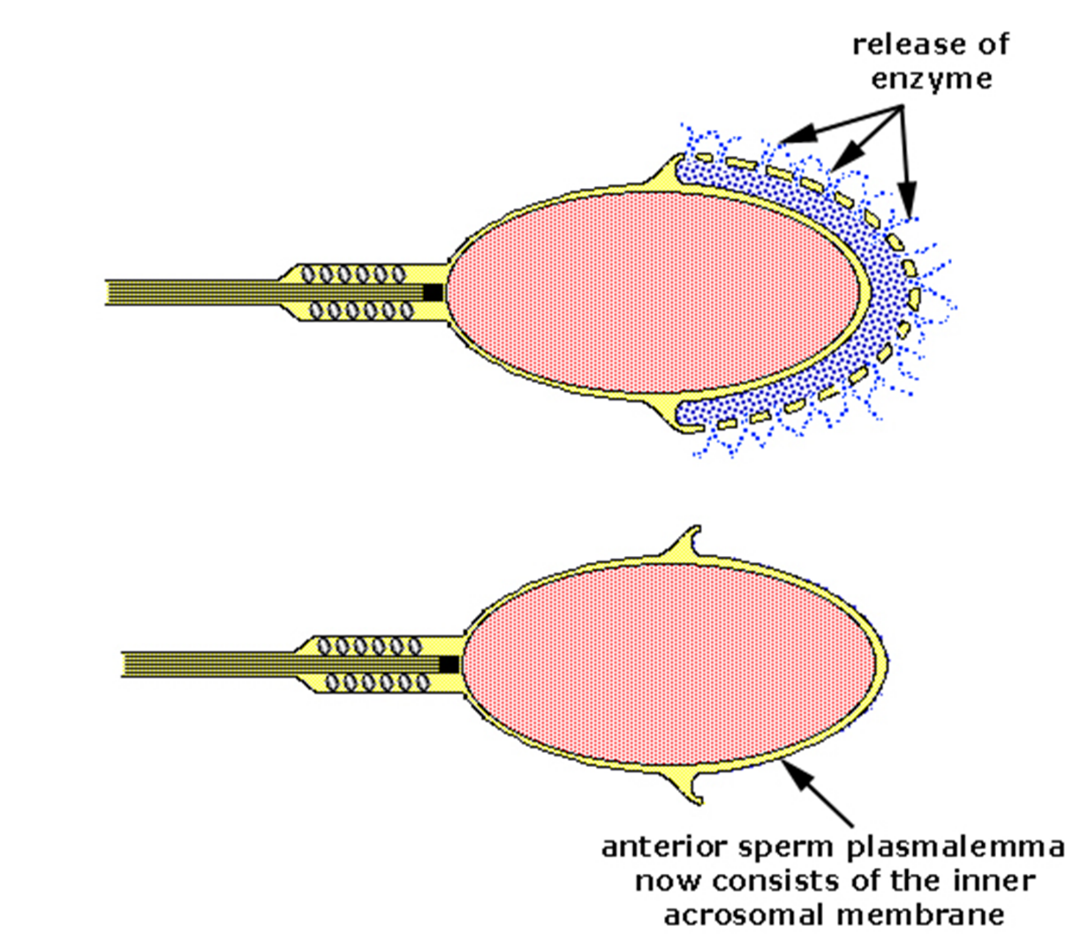
The acrosome reaction,
occurs after binding to the zona pellucida, is induced by zona proteins. This reaction culminates in the release of enzymes needed to penetrate the zona pellucida, including acrosin- and trypsin-like substances

Slide 23
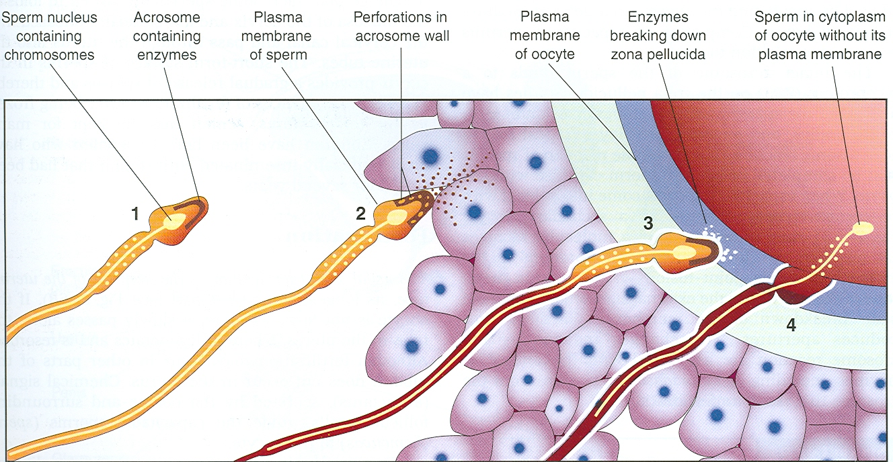
Phases of Fertilization
1- Passage of sperm through corona radiata, under the effect of : hyaluronidase enzyme from sperms, tubal E. and movement of tail of sperm.
2- Penetration of the zona pellucida by head of sperms through acrosine E. from acrosome of one sperm.
3- Fusion of the plasma membrane of the oocyte and that of the sperm. so sperm’s plasma membrane remains behind.

Slide 24
Phases of Fertilization
4- Completion of the second meiotic division & formation of the female pronucleus.
5- Formation of the male pronucleus :
It is a swollen nucleus of the sperm.
Its tail is detached and degenerated.
Zona reaction : it is a change in properties of zona pellucida that makes it impermeable to other sperms.
zygote

Slide 25
Chromosomes in zygote
Zygote is genetically unique.
Half of its chromosomes come from the father and the other half comes from the mother.
zygote contains 46 chromosomes (diploid).
New combination is formed which is different from either of the parents.

Slide 26
Sex of the Embryo
Embryo's chromosomal sex is determined at the time of fertilization.
Sex is determined by the type of sperm (X or Y) that fertilizes the oocyte.
So, it is the father whose gamete decides the sex.

Slide 27
Results of Fertilization
Stimulates the penetrated oocyte to complete its 2nd meiotic division.
Restores the normal diploid number of chromosomes in the zygote (46).
Determines the chromosomal sex of the embryo.
Initiates cleavage (cell division) of the zygote.

Slide 28
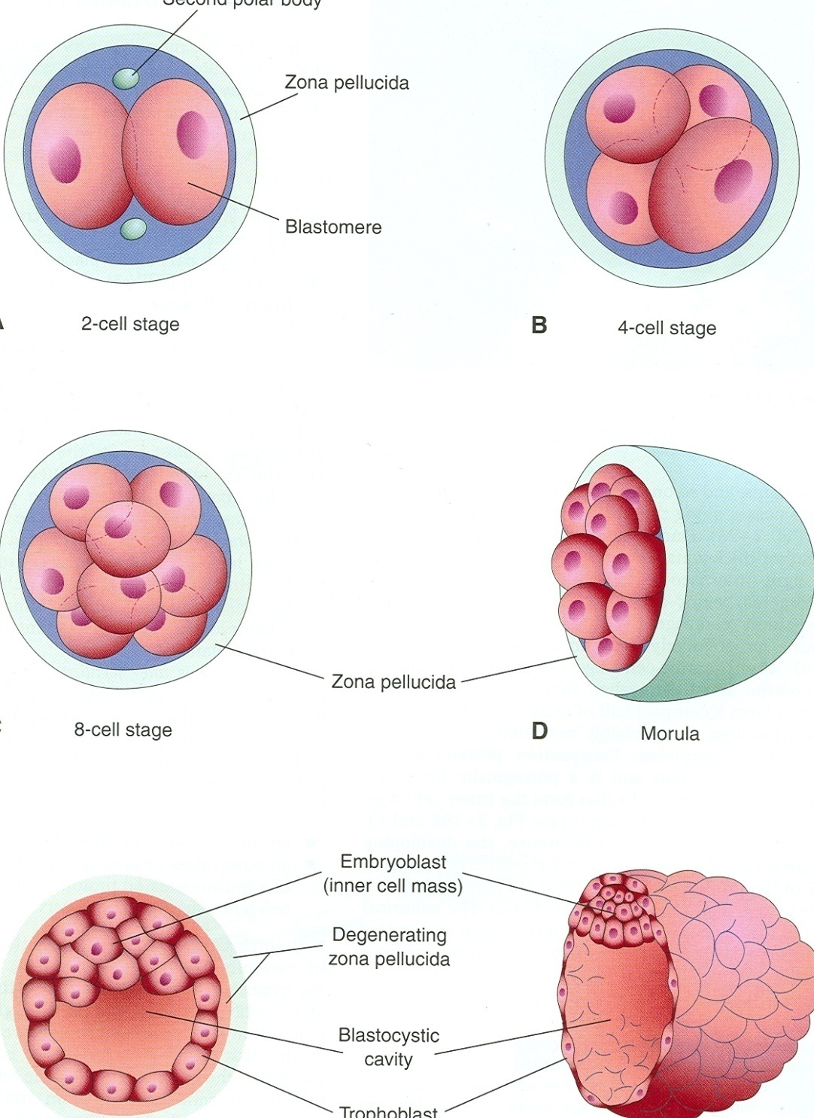
Cleavage of Zygote
Consists of repeated mitotic divisions of the zygote.
Rapid increase in the number of the cells.
These smaller embryonic cells are called Blastomeres.
Normally occurs in the uterine tube.

Slide 29
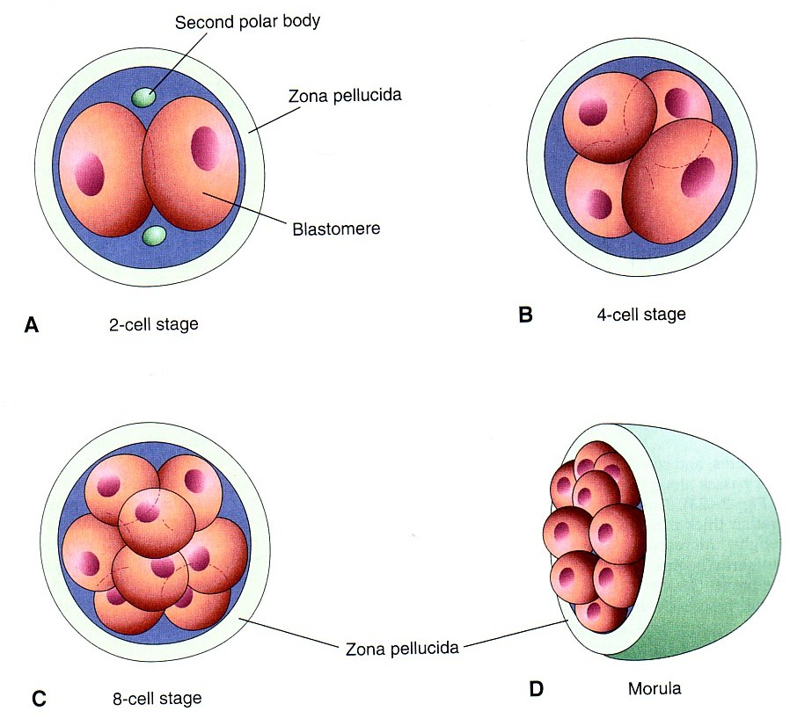
Cleavage of Zygote
It begins about 30 hours after fertilization.
Zygote divides into 2, then 4, then 8, then 16 cells.
Zygote lies within the thick zona pellucida during cleavage.
Zygote migrates in the uterine tube from its lateral end to its medial end.
Zona pellucida is translucent under light microscope.

Slide 30

Morula
When there are 16-32 blastomeres the developing human is called MORULA.
The Morula reaches the uterine cavity at this stage.
Spherical Morula is formed about 3 days after fertilization.

Slide 31
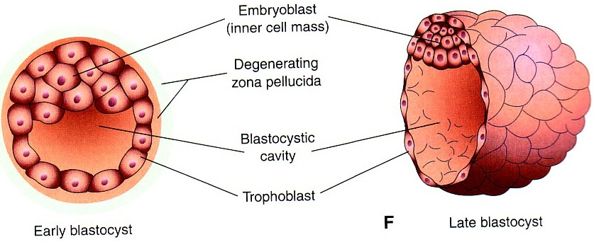
Formation of blastocyst :
The Morula reaches the uterine cavity by the 4th day after fertilization, & remains free for one or two days.
Fluid passes from uterine cavity to the Morula.
Now the Morula is called Blastocyst, its cavity is called blastocystic cavity, its cells divided into Embryoblast & Trophoblast.

Slide 32
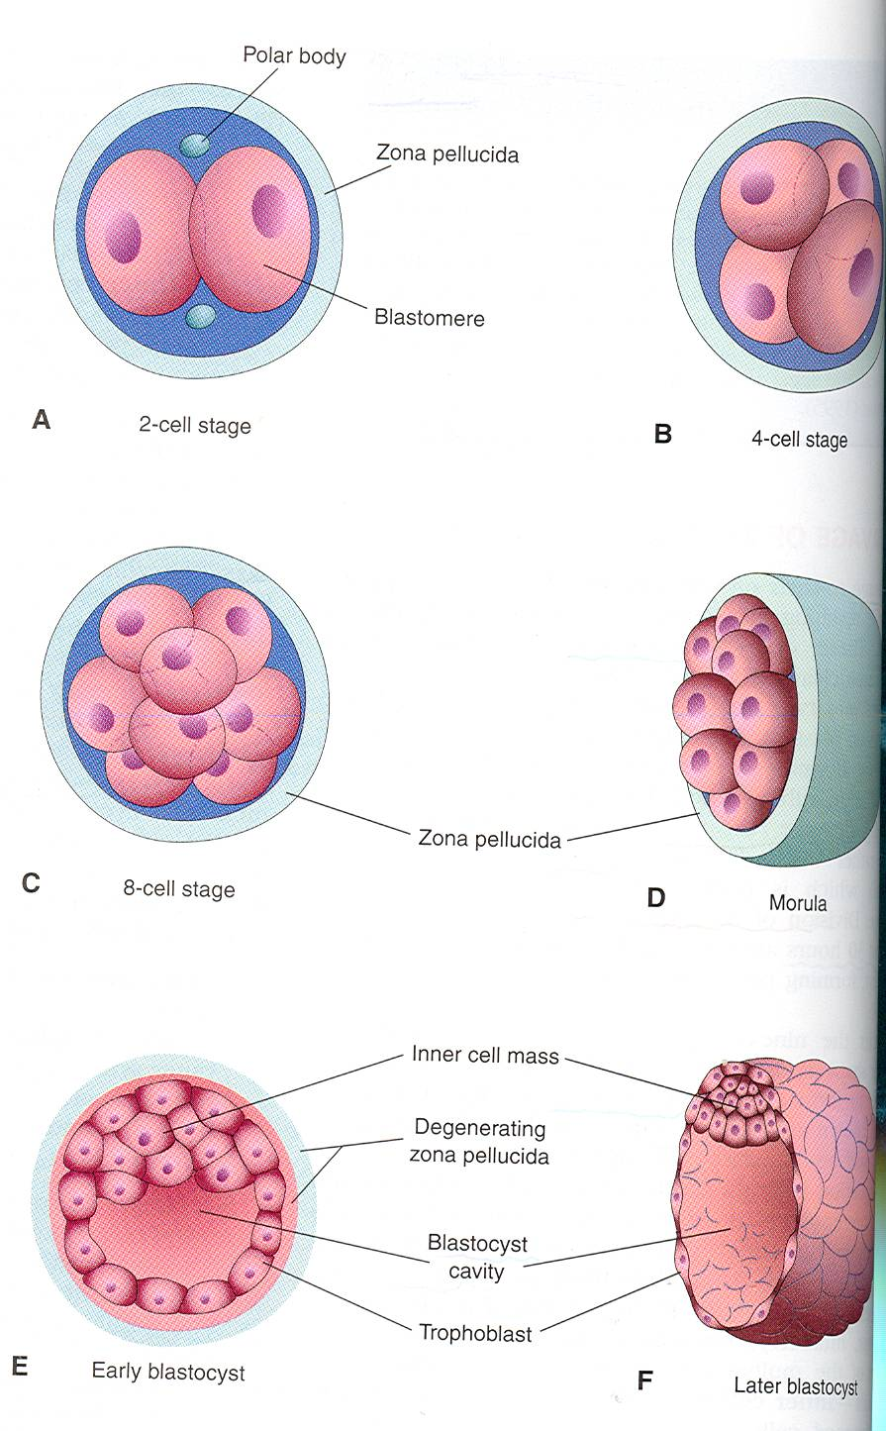
BLASTOCYST
It is formed of :
(1) Trophoblast .
(2) Inner cell mass.
(3) Blastocyst cavity.

Slide 33
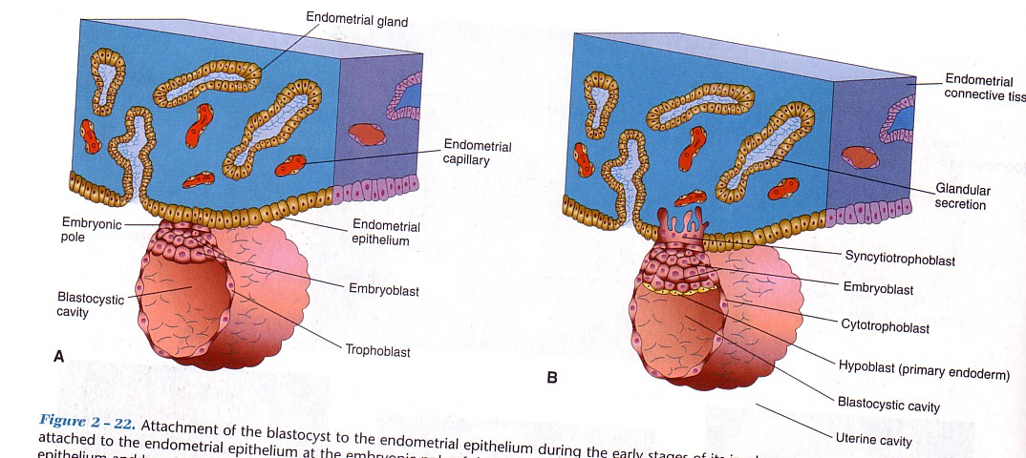
Definition :
It is the process by which the Blastocyst penetrates the superficial (Compact) layer of the endometrium of the uterus.
Site:
The normal site of implantation is the posterior wall of the uterus near the fundus.
Time:
It begins about the 6th day after fertilization.
It is completed by the 11th or 12th day.
IMPLANTATION
6th day

Slide 34
By the 5th day the Zona pellucida degenerates.
Blastocyst begins implantation by the 6th day.
Trophoblast cells penetrate the epithelium of the endometrium.
Penetration results from proteolytic enzymes (eg.COX-2) produced by the trophoblast.
6th day
7th day

Slide 35
By 7th day, Trophoblast differentiated into 2 layers:
Cytotrophblast, inner layer, mononucleated mitotically active cells.
Syncytiotrophoblast (outer multinucleated mass, with indistinct cell boundary.
By 8th day the blastocyst is superficially embedded in the compact layer of the endometrium (by the end of 1st week,the blastocyst is superficially implanted in endometrium).
7th day

Slide 36
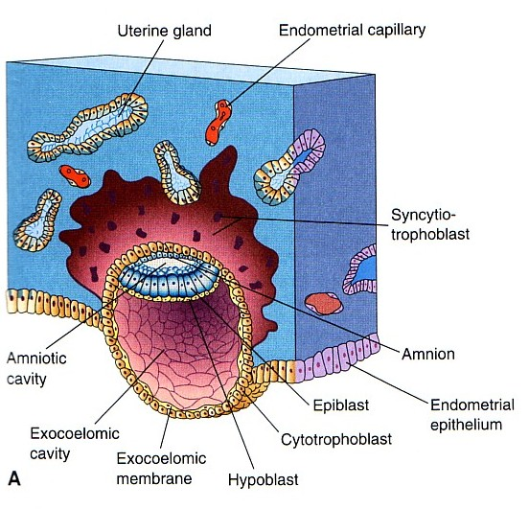
Blood-filled Lacunae appear in the Syncytiotrophoblast
which communicate forming a network by the 10th day or 11th day.
Syncytiotrophoblast
erodes the endothelial lining of the maternal capillaries which known as sinusoids.
Now blood of maternal capillaries reaches the lacunae so
Uteroplacental circulation
is established by 11th or 12th day.
8th day

Slide 37
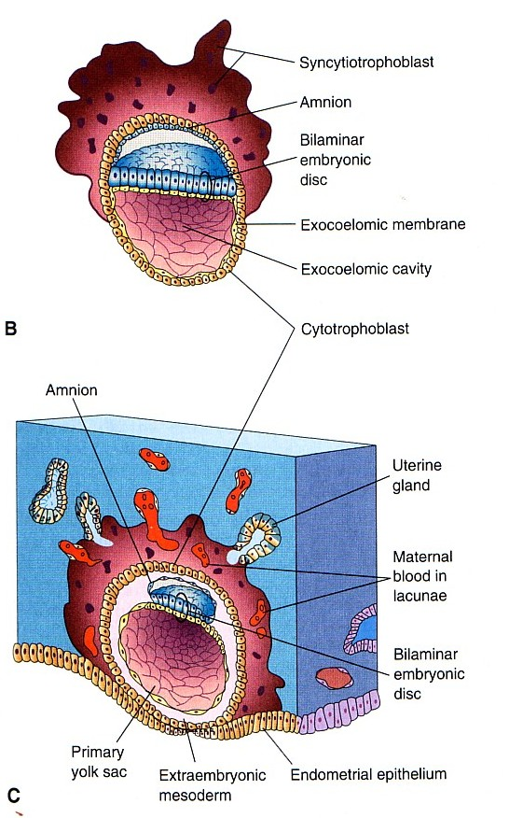
Endometrial cells undergo apoptosis (programmed cell death) to facilitates invasion of endometrium by the Syncytiotrophoblast.
Syncytiotrophoblast engulf these degenerated cells for nutrition of the embryo.
Implantation
can be detected by:
1- Ultrasonography.
2- hCG (human chorionic gonadotrophin which is secreted by the Syncytiotrophoblast) about the end of 2nd week

Slide 38
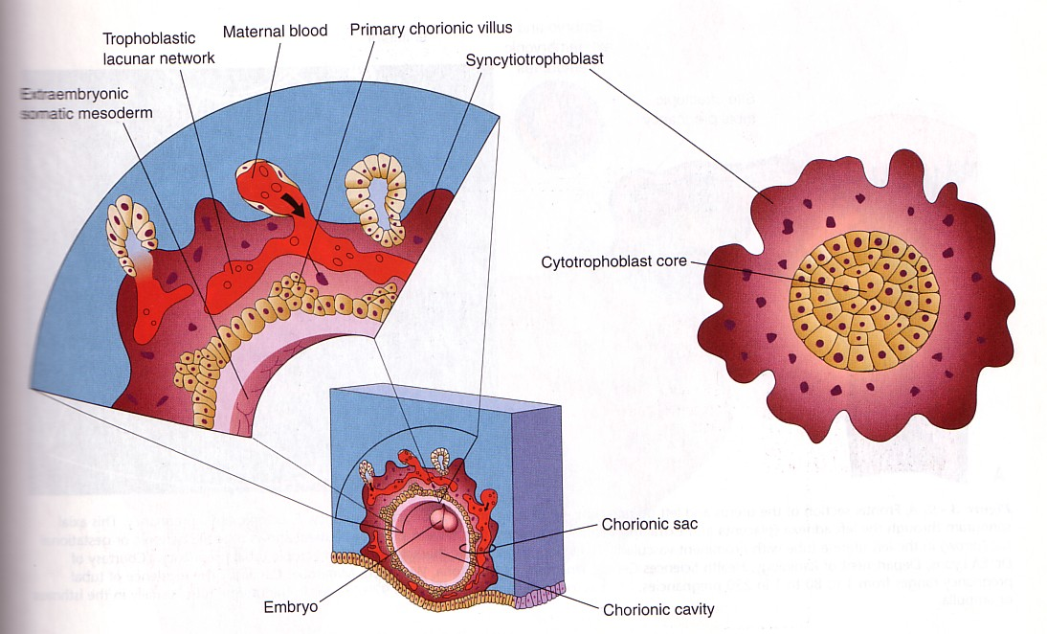
Formation of The Primary Chorionic villi
By the 13th day Proliferation of Cytotrophblast cells produce extension inside the Syncytiotropho-blast to form primary the chorionic villi.

Slide 39

THANK YOU

