Slide 1
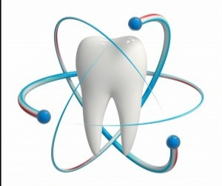
Restorative dentistry for children..
UNIVERSITY OF MOSUL
COLLEGE OF DENTISTRY
2020-2021
Department of
Orthodontics
By:
الأستاذ المساعد: عمر حسين اللويزي

Slide 2
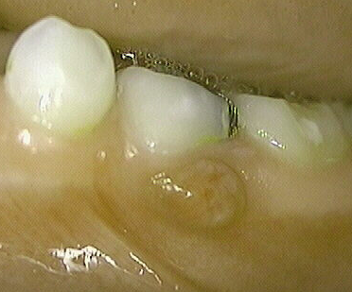
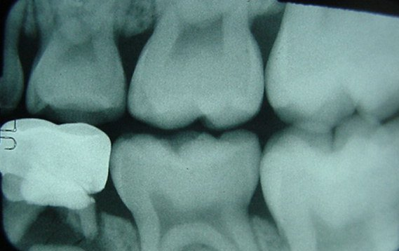
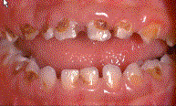
The basic principles in the selection of primary teeth for restoration
Child's age.
Amount of tooth structure remain
Exfoliation time.
General health of the child.
Present of draining
fistula or history of swelling.
Radiographic examination.
Degree of tooth mobility.
Child's oral condition
and degree of parent education
Restorable?

Slide 3
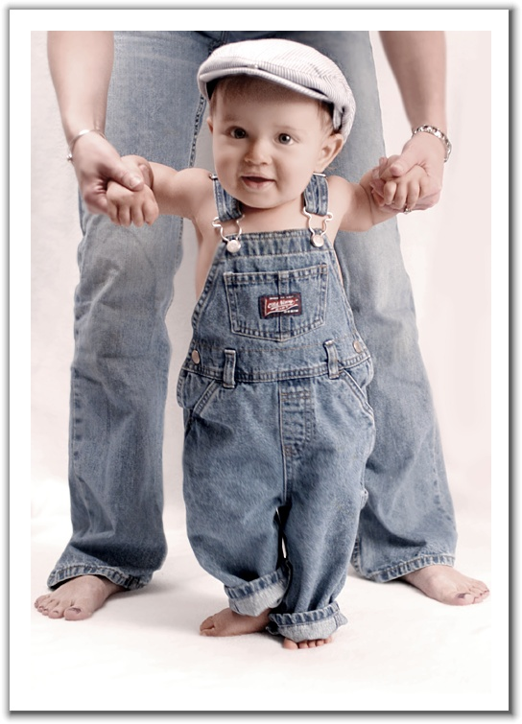
Conventional cavity preparation in primary teeth
Incipient Class I
child under 2 years of age
small cavity preparation made without
the aid of the rubber dam or local anesthetic
objective is to restore the tooth to arrest decay and to prevent further tooth destruction without a lengthily or involved dental appointment

Slide 4
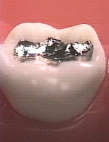
Basic principles in the preparation of cavities in the primary teeth :( Class I + Class II)
Pulpal Floor Depth
.5 - 1 mm into dentin
primary molars - 1.25 to 1.5mm
Intercuspal width - 1/3rd
Rounded internal line angles
B-L walls slightly undercut
M-D walls flare at marginal ridges

Slide 5
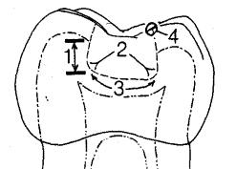
Internal Form of a Class I Prep
depth .5 - 1mm into dentin
angle of floor and walls is rounded
slightly rounded pulpal floor
Avoids pulp
sharp cavo-surface angle

Slide 6
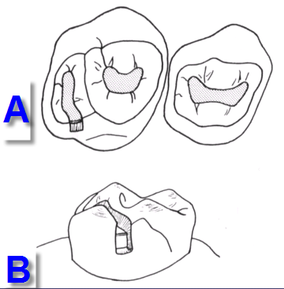
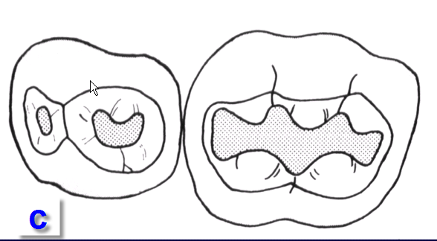
Class I Cavity Preparations
A Maxillary right first and second molars (occlusal view)
B Maxillary second primary
molar (lingual view)
C Mandibular right first and
second primary molars

Slide 7
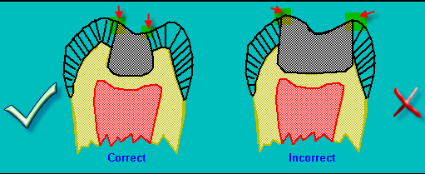
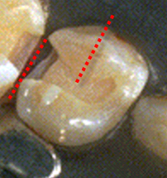
Class II Amalgam Preps
Accomplish occlusal outline form
Extend proximal box into
self cleaning area
leave 90 degree cavosurface margins
isthmus width 1/3
Proximal box in an occlusal gingival direction is parallel to the long axis of the tooth

Slide 8
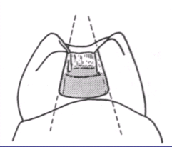
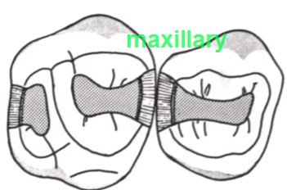
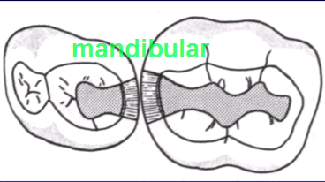
Class II Amalgam Preps
B-L walls of box should
converge occlusally
axiopulpal line angle should be slightly rounded or beveled
Gingival floor should be beneath
the contact, at, or just beneath the gingival tissue
Axial wall should follow
the contour of the tooth

Slide 9
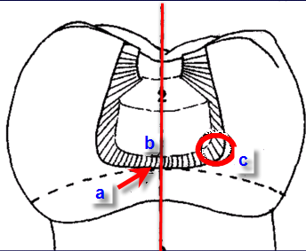
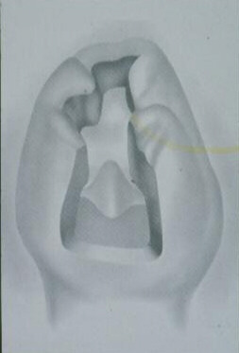
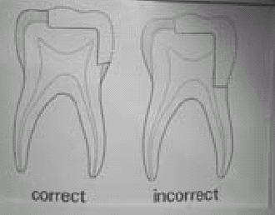
Class II Amalgam Preps
a) gingival floor position
b) box is perpendicular to long axis
c) rounded angles
d) Rounded axiopulpal line angle
e) wide Contact area
f) No bevel at gingival margins

Slide 10
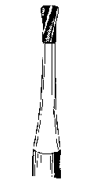
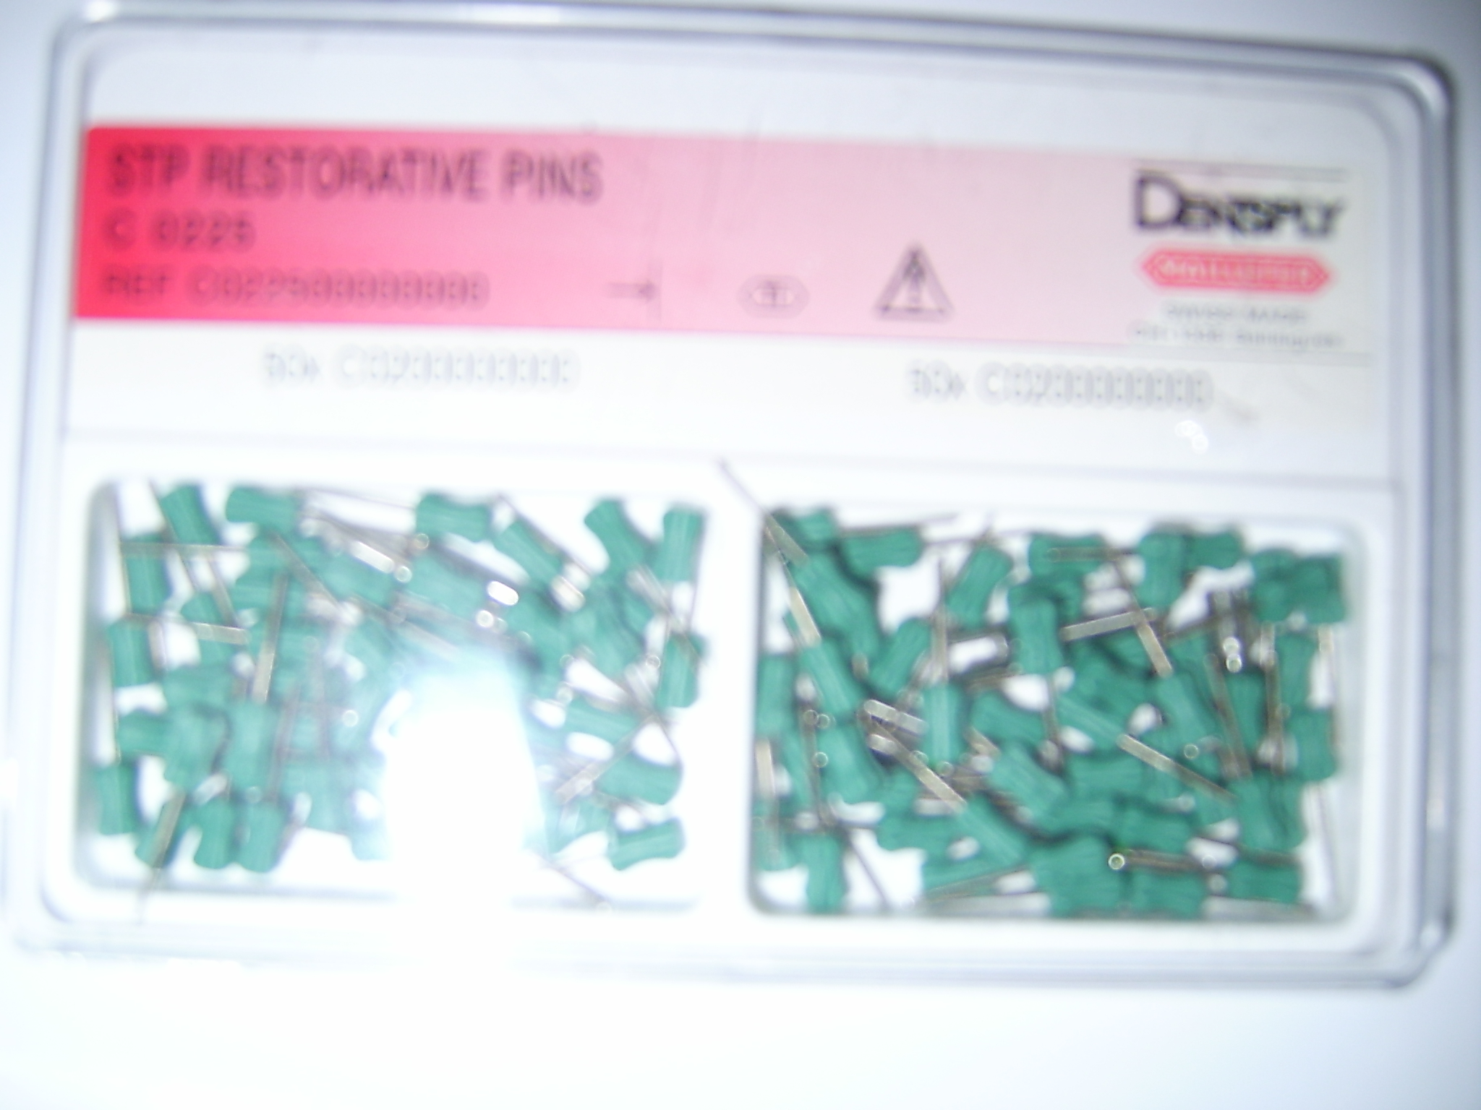
Questions
What will happen if we:
touch the adjacent tooth during prep of class II for the primary tooth
Use pins for the retention in primary teeth

Slide 11
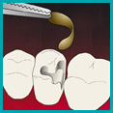
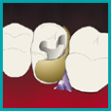
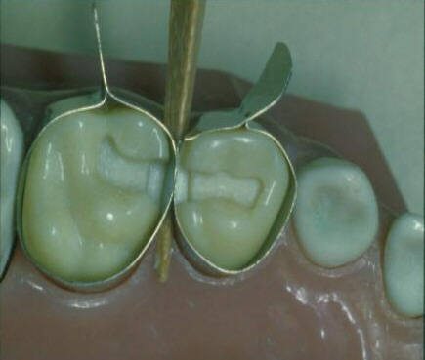
Types of matrix bands used in pediatric dentistry
T-band: allows for multiple matrices.
Sectional matrices:
allow for multiple matrix placements.
easy to use, not circumferential.
must be held in place by wedge.
Tofflemire matrix:
does not fit primary teeth contour well
difficult to place as multiple matrices.
Spot welded matrix:
allow for multiple matrix placements.
a spot welder is required at chair side.

Slide 12
T band

Slide 13
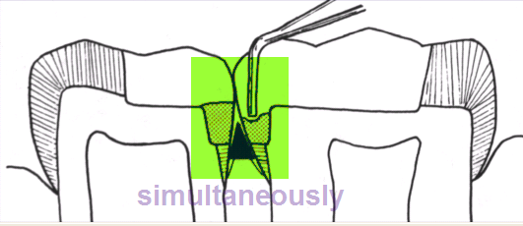
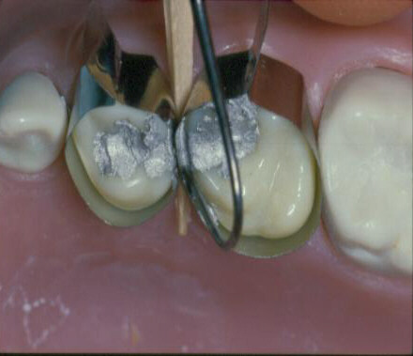
Back to back restoration technique of Class II’s
It is desirable to restore adjacent class II’s lesion simultaneously
Time
Patient management

Slide 14
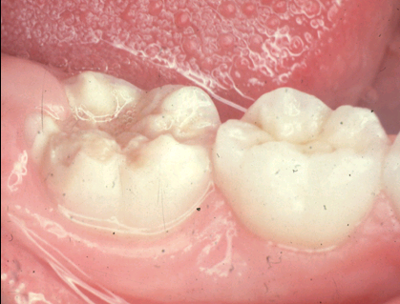
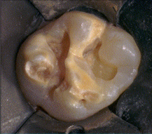
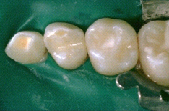
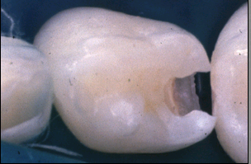
Esthetic composite resin or glass ionomer restoration for posterior teeth:
Can be used in:
lesions on distal of 2nd primary molars adjacent to permanent first molar
Hypoplastic tooth
Modification:
No undercut
The margins are beveled

Slide 15
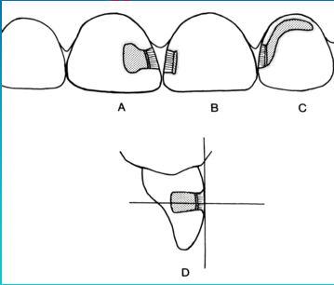
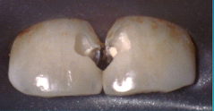
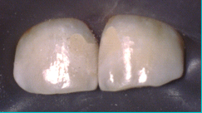
Class III Cavity - Incisors
Avoid weakening the incisal edge
The modification is not mandatory

Slide 16
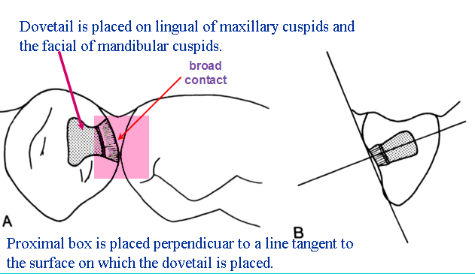
Class III Cavity (modified) Cuspids
Why the dove tail is mandatory here?
Do we have to
use wedge?
Can we use amalgam?

Slide 17
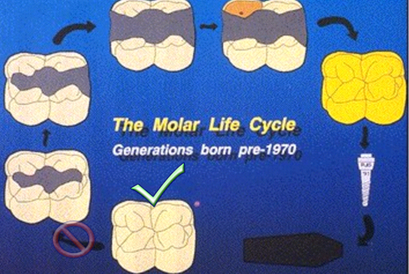
The goal
of restorative dentistry as we approach the 21st century should be to delay and prevent placement of initial restorations.

Slide 18
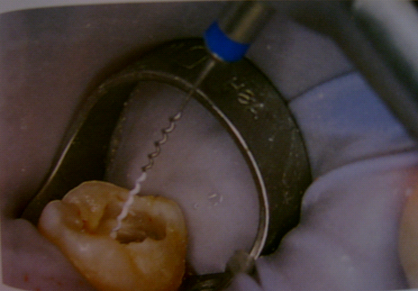
Rubber dam
Save time
Aids in management of the child patient
Control saliva
Provides protection
Rubber dam helps the dentist in educating parents

