Slide 1
Physiology of Neuron
Lecture one
Dr. Suroor Mohammed

Slide 2
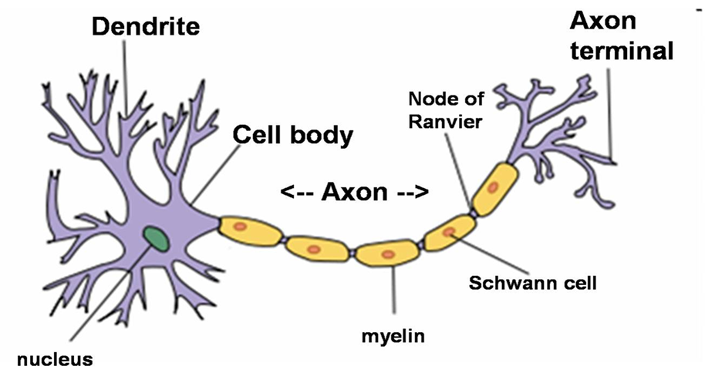
The Nervous System is formed of a number of cells, which are of 2 types:
1. Nerve cells = Neurons
2. Supporting cells = Glial cells
1. NEURONS
It is the basic structural unit of the NS.
It generates electrical impulses → transmitted from one part of the body to another.
In most neurons: electrical impulses → release of chemical messengers (= neurotransmitters) to communicate with each other.
Neurons are integrators: their output = the sum of the inputs they receive from thousands of other neurons that end on them.

Slide 3
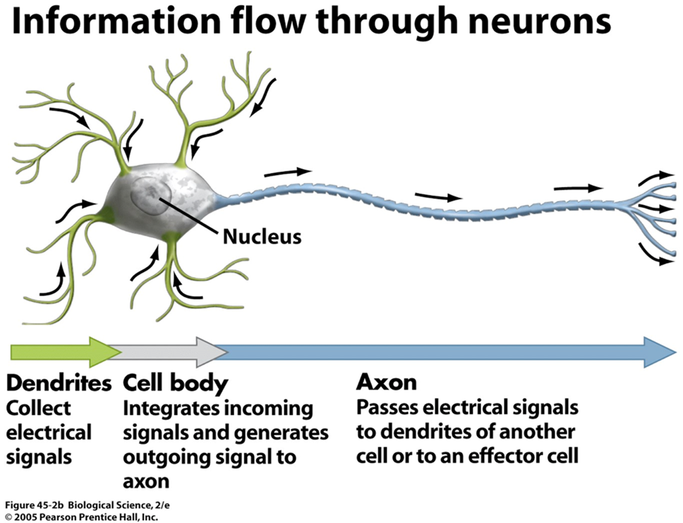
Neurons occur in a wide variety of shapes and sizes, but they share common features. They all possess 4 parts:
1. Cell Body ( Soma): It contains nucleus & organelles
→ provide energy & sustain metabolic activity of cells.
2. Dendrites:- Usually 5-7 process (or more) highly branched (up to
400,000) → to increased surface area.
receive most input & Transmit impulses toward cell body only.

Slide 4
3. Axon = Nerve Fiber:
- Usually single & long (few μm to 1m).
- Transmits impulses away from soma toward target cell.
- Axon hillock or initial segment (= beginning of axon + part of soma where axon joins it) is the trigger zone where electric signals are generated in most neurons. Signals are then propagated along axon.
- Near its end the axon undergoes branching.
4. Axon Terminal
- Each branch of the axon ends in an axon terminal.
- Responsible for the release of neurotransmitters (NT) from axon. NT diffuse out of the axon terminal to next neuron or to a target cell

Slide 5
2.Supporting cells:
There are sex categories of supporting cells:
1.Schwann cells , which form myelin sheaths around peripheral axons.
2. Satellite cells or ganglionic gliocytes , which support neuron cells bodies within the ganglia of the PNS.
3. Oligodendrocytes, which form myelin sheaths around axons of CNS. Unlike Schwann cells, they may branch to form myelin on up to 40 axons

Slide 6
4. Microglia, which migrat through the CNS and phagocytose foreign and degenerated material.
5. Astrocytes, which help to regulate the external environment of neurons in the CNS.
6. Ependymal cells, which line the cavities of the brain and the central canal of the spinal cord.
Axons of most (but not all) neurons are coated by a protective layer = myelin sheath termed as “myelinated neurons”.
Myelin sheath is formed by the following cells:
1. In peripheral NS (PNS): by Schwann cells
2. In central NS (CNS): by oligodendrocytes.

Slide 7
Schwann Cells
- They are glia-like cells.
- During embryonic development, these cells attach to growing axons & wrap around them → concentric layers of plasma membrane.
- Myelin sheath of an axon is formed of many Schwann cells that align themselves along length of axon.
- Nucleus is located in outermost layer. Each segment is separated from the next by a small un myelinated segment called node of Ranvier.
- Plasma membrane of Schwann cells is  80% lipid → myelin sheath is mostly lipid → appears glistening white to the naked eye.
Function of myelin sheath:
1. Myelin sheath helps to insulate axons & prevents cross-stimulation of adjacent axons.
2. Myelin sheath allows nerve impulses to travel with great speed down the axons, “jumping” from one node of Ranvier to the next.
***Some nerve fibers are “un myelinated”. Their axons are covered by a Schwann cell, but there are no multiple wrappings of membrane which
produces myelin. These axons conduct impulses at a much lower rate.

Slide 8
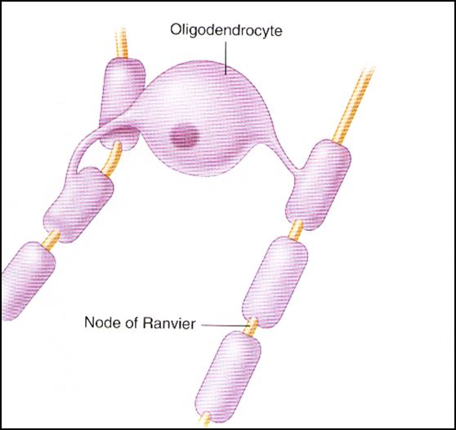
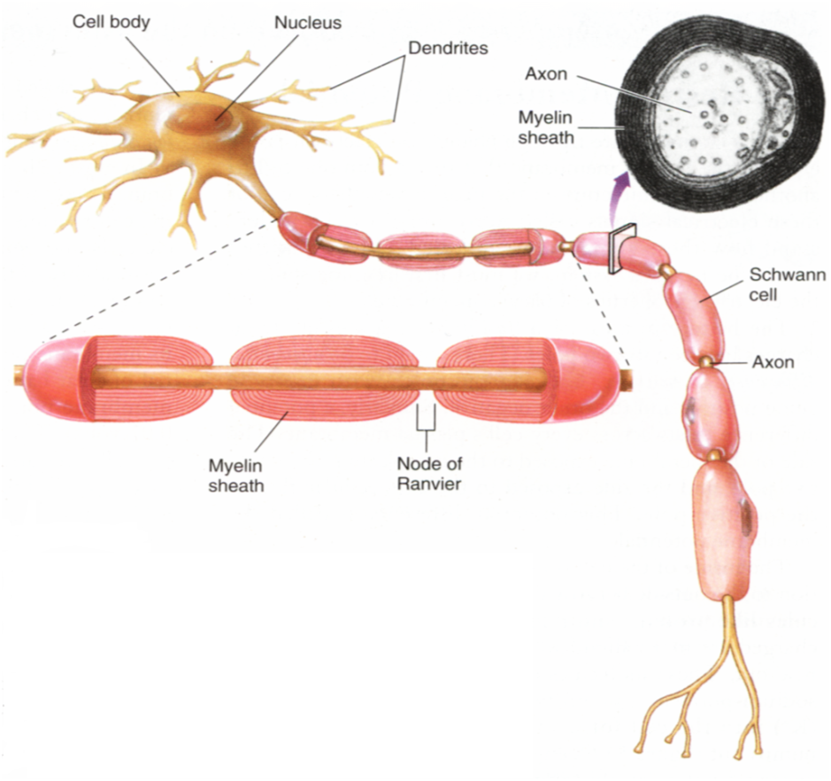

Slide 10
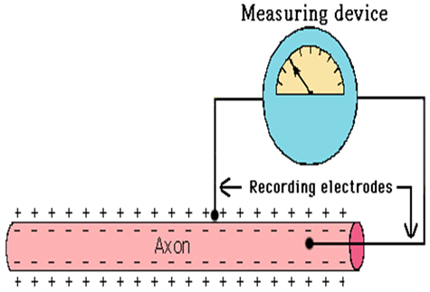
Nerve Impulse or Action Potential
Is the electrical current moving from the dendrites to cell body to axon.
It results from the movement of ions (charged particles) into and out a neuron through the plasma membrane
Resting Membrane Potential *RMP*
The resting membrane potential is the potential difference that exists across the membrane of excitable cells such as nerve and muscle in the period between action potentials (i.e., at rest).
Is the difference in electrical charge on the outside and inside of the plasma membrane in a resting neuron (not conducting a nerve impulse).
The outside has a positive charge and the inside has a negative charge.
We refer to this as a polarized membrane.
A resting neuron is at about -70mV

Slide 11
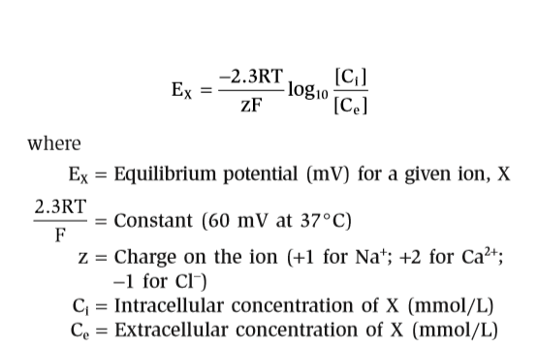
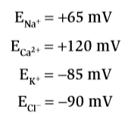
Nernst Equation The Nernst equation is used to calculate the equilibrium potential for an ion at a given concentration difference across a membrane, assuming that the membrane is permeable to that ion. By definition, the equilibrium potential is calculated for one ion at a time

Slide 12
At rest, The K+ conductance or permeability is high and K+ channels are almost fully open, allowing K+ ions to diffuse out of the cell down the existing concentration gradient. This diffusion creates a K+ diffusion potential, which drives the membrane potential toward the K+ equilibrium potential. At rest, the Na+ conductance is low, and, thus, the resting membrane potential is far from the Na+ equilibrium potential.
Because of the high ratio of potassium ions inside to outside, Therefore, if potassium ions were the only factor causing the resting potential, the resting potential inside the fiber would be equal to –94 mV.
The difference is due to :
1.There is 30 times more K+ inside the cell than outside and about 15 times more Na+ outside than inside.
2.There are also large negatively charged proteins trapped inside the cell. (This is why it is negative inside.)
3. The action of the Na+/K+ pumps , that pump out 3 Na ions for every 2 K ions that they transport into the cell.

Slide 13
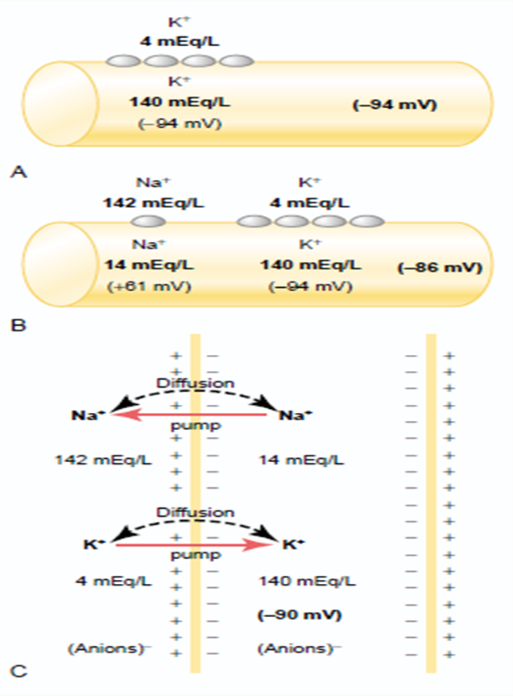

Slide 14
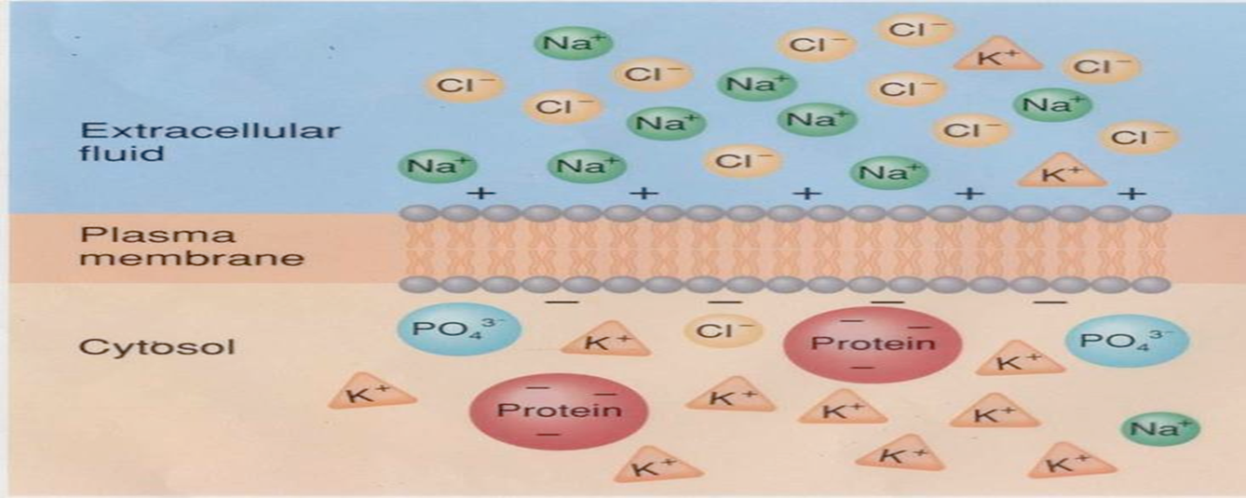
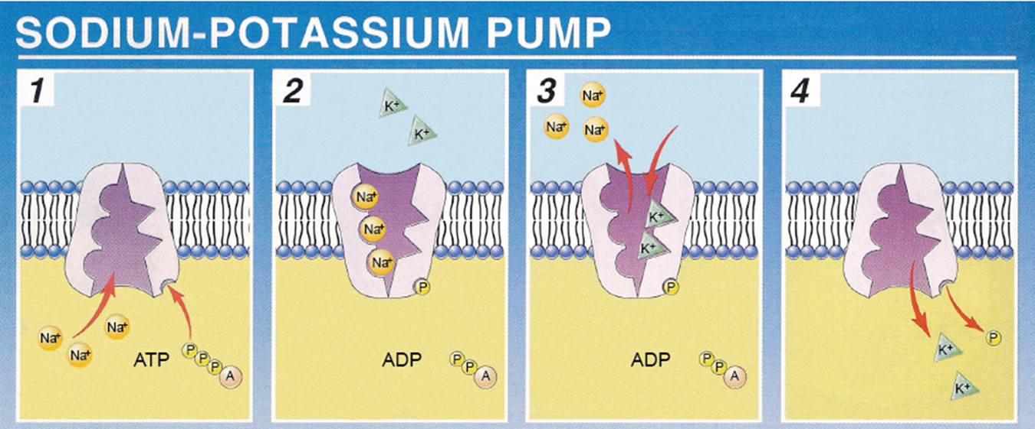

Slide 15
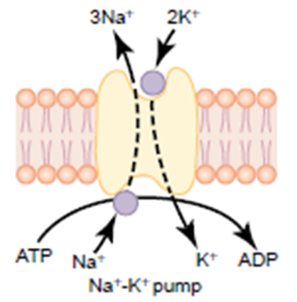
Why so much K+ inside
Special protein channels called sodium-potassium pumps moving 3 Na+ out and bringing 2 K+ back in, when the cell is at rest.
**In a resting cell there are no open channels for Na+ to easily move back into the cell. However, there are some K+ channels open at all time.
**Na+ causes the outside to be positive forcing more K+ into the cell. (Lots of potassium ions inside the resting cell.
There is continuous pumping of three sodium ions to the outside for each two potassium ions pumped to the inside of the membrane. The fact that more sodium ions are being pumped to the outside than potassium to the inside causes continual loss of positive charges from inside the membrane; this creates an additional degree of negativity Therefore, the net membrane potential of k+ with all these factors operative at the same time is about –90 mV .

Slide 16
Alterations in the membrane potential are achieved by varying the membrane permeability to specific ions in response to stimulations.
The physiology of neurons and muscle cells are their ability to produce and conduct these changes in membrane potential, such an ability is termed excitability or irritability.
If appropriate stimulation cause positive charges to flow into the cell. This change is called depolarization(hypo polarization).
A return to the RMP is known as repolarization.
If stimulation cause the inside of the cell to become more negative than the RMP this change is called hyper polarization which can be caused either by positive charges leaving the cell or by negative charges enter the cell.
Any potential not the RMP called membrane potential.
Any stimulus can cause action potential called threshold stimulus.
Electrotonic potential is a local potential and cannot be propagated and produced by sub threshold stimulus.

Slide 17
Action potential or ( nerve impulse)
The shape of action potential is the same in all the nerves but it's magnitude change from one nerve to another but it remain uniform shape.
When the axon membrane has been depolarized to a threshold level, the Na+gates open and the membrane becomes permeable to Na+, this permits Na+ to enter the axon by diffusion which further depolarized the membrane(make the inside less negative or more positive).
Since the gates for the Na+channels of the axon membrane are voltage regulated, this additional depolarization opens more Na+channels and makes the membrane even more permeable to Na+and more Na+ can enter the cell and induce a depolarization that opens even more voltage– regulated Na+gates
A positive feedback loop is thus created, the explosive increase in Na+permeability results in a rapid reversal of the membrane potential in that region from(– 70mv) to (+30mv). At that point in time, the channels of Na+ close (become inactivated).
At this time, voltage– gated K+ channels open and K+ diffuse rapidly out of the cell, and make the inside of the cell less positive or more negative. This process is called repolarization and represents the completion of a negative feed back loop.
Once an action potential has been completed, the Na+– K+ pump will extrude the extra Na+ that has entered the axon and recover the K+ that has diffused out of the axon.

Slide 18
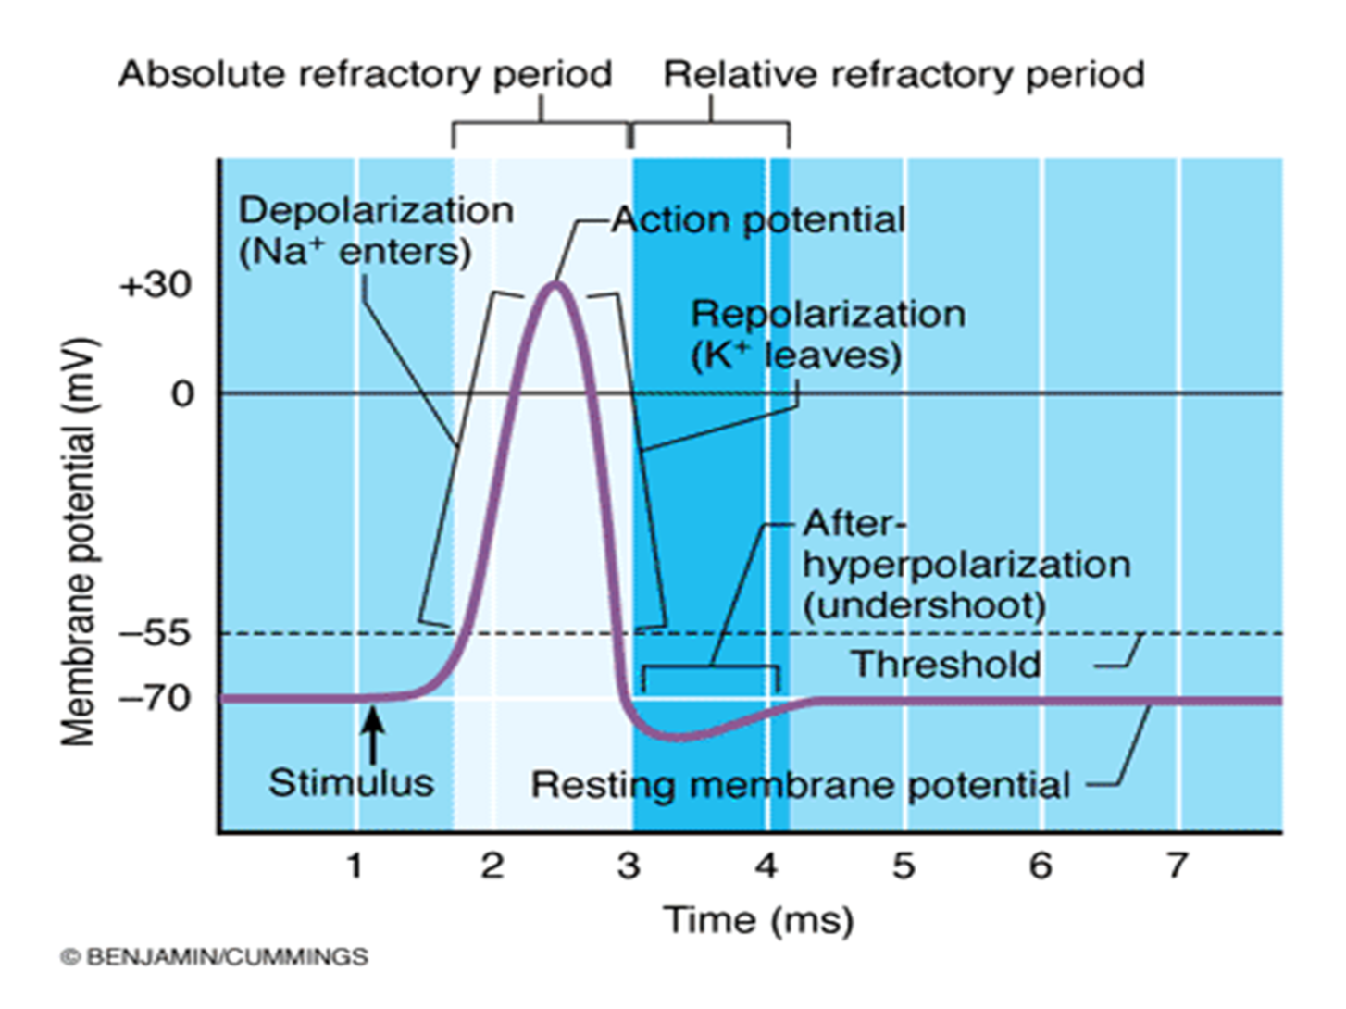

Slide 19
Phases of action potential
The first portion ,local response is due to slowly opening of voltage gated Na+channels.
At the firing level (–55mv), full complete opening of voltage gated Na+ channels, and Na+will rush very rapidly to cell and membrane potential will reach ( +35mv). So the depolarization is due to opening of the voltage gated Na+channels.
At ( +35mv) the Na+entarce will stop because:
1. The opening of voltage gated Na+ channels are time limited for short constant period and this limited time cause depolarization will reach only to (+35mv) and then stop.
2. At (+35mv) K+ channels are opened.
So depolarization from (–70mv to +35mv) is due to activation of Na+ channels. At (+35mv) opening of K+ voltage gated channels and K+ go outside according to concentration gradient by diffusion. The channels are opened completely from the first time and repolarization will start from (+35mv) to (–55mv), at this point there will be in activation ( closure) of K+ channels.
Na+ ions concentration inside will increase and this will cause stimulation to Na+–K+ pump to exclude Na+ and carry K+ inside, till it reach to (–70mv) again ( RMP), so that after potential ( after depolarization) phase due to Na+– K+ pump.

Slide 20
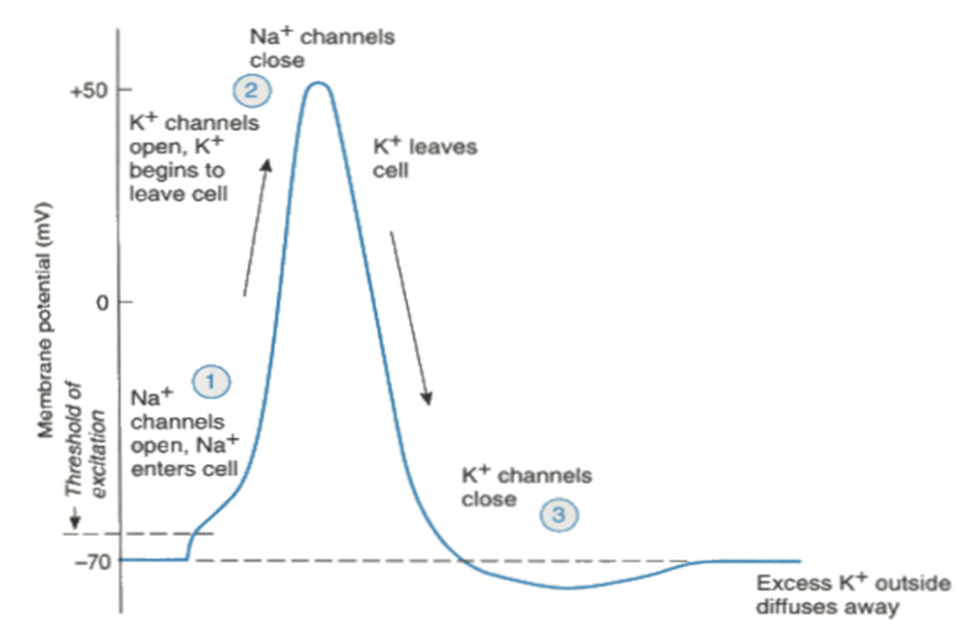
There will be loss of energy during action potential, so at after depolarization to put the membrane potential again equal to RMP by Na+–K+ pump is called {recharging of nerve}, so any stimulus at this phase the nerve will not response to it.
Why at( –55mv)Na+ channels will not open again ?
When Na+ channels inactivated, they need time more than 0.1msec. to return to their original conformation, and to open Na+ channels again at (–55 mv) must apply stimulus more than the first one

Slide 21
Repolarization of the action potential. The upstroke is terminated, and the membrane potential repolarizes to the resting level as a result of two events.
1.The inactivation gates on the Na+ channels respond to depolarization by closing, but their response is slower than the opening of the activation gates.
2. Depolarization opens K+ channels and increases K+ conductance to a value even higher than occurs at rest.
The combined effect of closing of the Na+ channels and greater opening of the K+ channels makes the K+ conductance much higher than the Na+ conductance. Thus, an outward K+ current results, and the membrane is repolarized.
Hyperpolarizing afterpotential (undershoot). For a brief period following repolarization, the K+ conductance is higher than at rest and the membrane potential is driven even closer to the K+ equilibrium potential . Eventually, the K+ conductance returns to the resting level, and the membrane potential depolarizes slightly, back to the resting membrane potential.

Slide 22
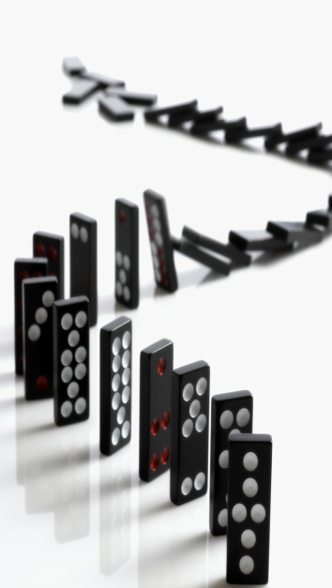
All or Non law of action potential
If we apply sub threshold stimulus for the nerve, we get no action potential because it is un able to bring RMP to firing level. But if we apply threshold stimulus, action potential will produced, and any increase in the stimulus, there is no change in the magnitude and shape or duration of action potential of the same nerve.
The shape, magnitude, duration and amplitude of action potential is the same always all the same all the time and not change regardless to the strength of stimulus to the same nerve
If a stimulus is strong enough to generate an action potential (reaches threshold), the impulse is conducted along the entire length of the neuron at the same strength

Slide 23
Refractory periods:
Means the nerve will not respond to stimulus during action potential and it is of two types:
Absolute RP. →located between the start of depolarization until one third of repolarization. The nerve never respond to any stimulus whatever it's strength, due to full, complete activation of Na+ channels and so no extra channels are opened, and then at (+35mv), there will be in activation of Na+ channels and it need time to return back to it's original condition.
Each nerve has got specific absolute RP, and this is important to limit the number of action potential generated by the neurons.
Relative RP.→ This period involve from third of repolarization to the end of repolarization. If we apply stimulus stronger than the original stimulus, the nerve will respond by new action potential, because the Na+ channels will open and can overcome the repolarization effects of the open K+ channels.

Slide 24
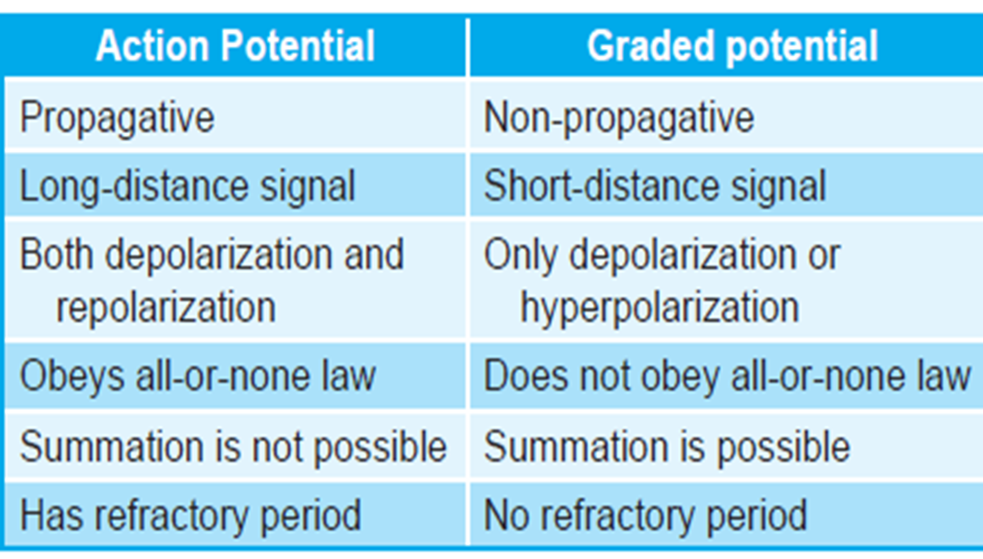

Slide 25
Factors effecting the conduction velocity of nerve impulses
1)_Diameter of the axon: which is directly proportional with the speed of conduction.
All peripheral nerves are mixed nerves ( the nerve contain many axons with different threshold levels and different diameter).
Maximal stimulus: is the stimulus when applied to nerve it will stimulate all axons in the nerve.
Compound action potential: Algebraic summation of all action potentials of all the axons in the mixed nerve.
2)_ Myelin sheath: myelinated nerve is faster than un myelinated nerve because, myelin sheath is an insulator material, so the depolarization and repolarization will occur between two nods of Ranveir, the action potential in myelinated nerve will jump and called Saltotary conduction, while in un myelinated nerve the action potential will walk.
3). Hypoxia ( low O2 to the tissue) , it depress the conduction.
4). Local anesthesia.
5). Temperature.

Slide 26
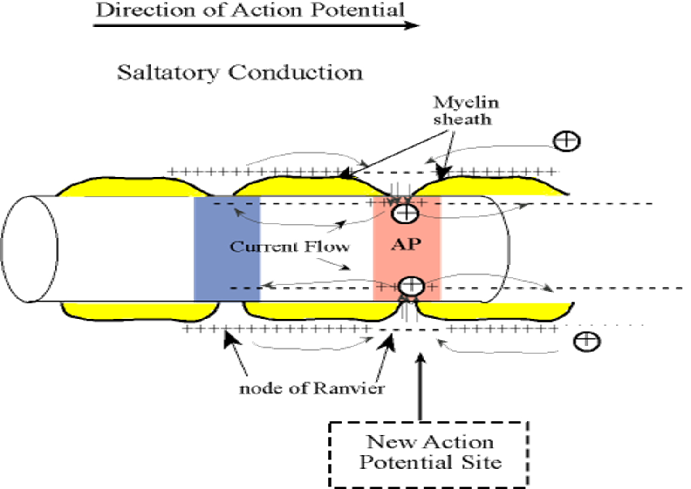
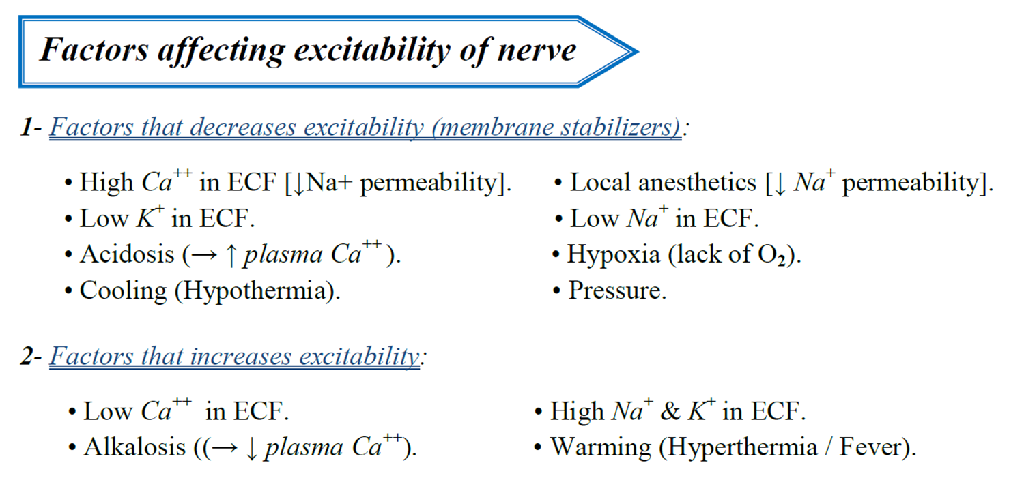

Slide 27


